Slide 1
Facade
Design Pattern
Chris Drew – 24th September 2014

Slide 2
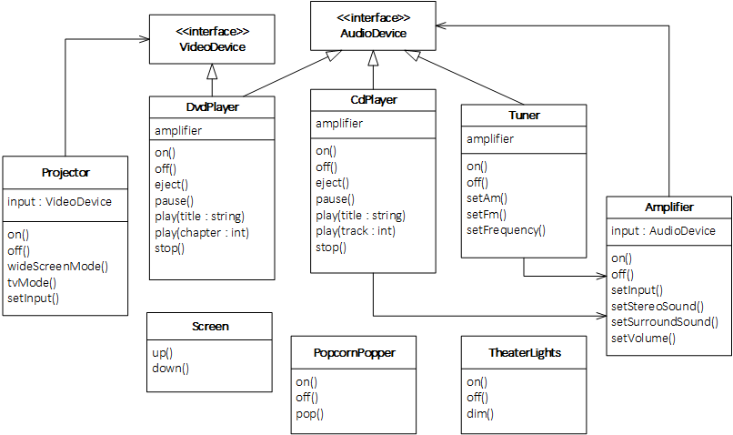
Problem: Home Theater

Slide 3
Watching a movie (the hard way)
popper.on(); // Turn on the popcorn popper...
popper.pop(); // and start popping...
lights.dim(10); // Dim the lights to 10%...
screen.down(); // Put the screen down...
projector.on(); // Turn on the projector...
projector.setInput(&dvd); // set it to DVD...
projector.wideScreenMode(); // and put it on wide screen mode for the movie...
amp.on(); // Turn on the amp...
amp.setInput(&dvd); // set it to DVD and...
amp.setSurroundSound(); // put it into surround sound mode...
amp.setVolume(11); // and set the volume to 11...
dvd.on(); // Turn on the DVD player...
dvd.play("Raiders of the lost ark"); // and FINALLY, play the movie!
Notes:
What about shutting everything down again?
How would you play a CD? etc…

Slide 4
Facade

