Slide 1
Facade
Design Pattern
Chris Drew – 24th September 2014

Slide 2
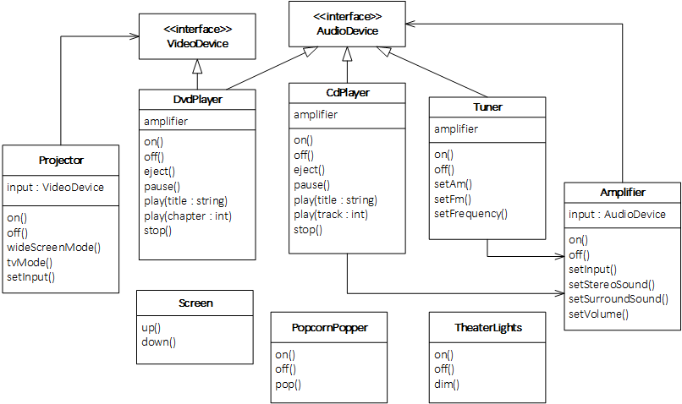
Problem: Home Theater

Slide 3
Watching a movie (the hard way)
popper.on(); // Turn on the popcorn popper...
popper.pop(); // and start popping...
lights.dim(10); // Dim the lights to 10%...
screen.down(); // Put the screen down...
projector.on(); // Turn on the projector...
projector.setInput(&dvd); // set it to DVD...
projector.wideScreenMode(); // and put it on wide screen mode for the movie...
amp.on(); // Turn on the amp...
amp.setInput(&dvd); // set it to DVD and...
amp.setSurroundSound(); // put it into surround sound mode...
amp.setVolume(11); // and set the volume to 11...
dvd.on(); // Turn on the DVD player...
dvd.play("Raiders of the lost ark"); // and FINALLY, play the movie!
Notes:
What about shutting everything down again?
How would you play a CD? etc…

Slide 4
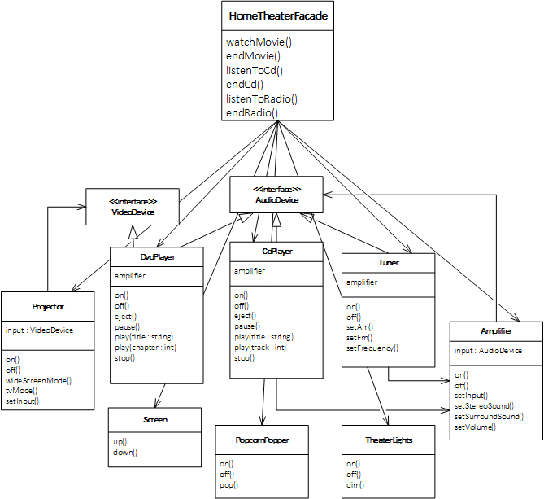
Facade

Slide 5
Watching a movie(the easy way)
HomeTheaterFacade theater(&amp, &tuner, &dvd, &cd, &projector,
&lights, &screen, &popper);
theater.watchMovie("Raiders of the Lost Ark");
theater.endMovie();

Slide 6
Code

Slide 7
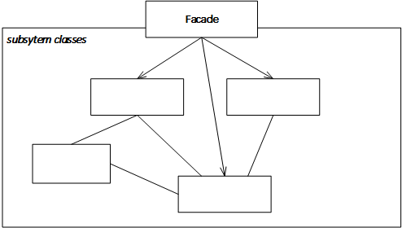
Facade definition
Provides a unified interface to a set of interfaces in a subsystem. Facade defines a higher-level interface that makes the subsystem easier to use.
Provide a simple interface.
Decouple subsystems from clients.
Clients still have access to subsystem classes if they wish.
Entry point to each subsystem layer in a layered system.

Slide 8
Notes for implementation
Facade does not “encapsulate” the subsystem classes and probably does not “own” them.
Subsystem classes should have no dependency on Facade.
Facade could be made an abstract class with concrete subclasses for implementations of the subsystem.
Choose which subsystem classes are private and which are public.

Slide 9
Facade vs Adapter
Difference is in intent
Adapter alters the interface of one or more classes into one interface that a client is expecting
Facade provides a simplified interface to a complex subsystem.
Perhaps more reasonable for Adapter to “own” the Adaptee?

Slide 10
End
https://github.com/crsdrw/patterns/tree/master/Patterns/PatternsLib/Facade

