Slide 1

PowerShell HashTables

Slide 2
What We Will Cover
What is an Array
What is a HashTable
Accessing data in a Hashtable
Iterating
Collection of Properties
Modifying Data in Hashtables
Creating a Hashtable from a log
Splatting
HashTables to Objects

Slide 3
What is an Array
A data Structure designed to store collections of items
To create an array:
$a = 1,2,3,4,5
$a -is [array]
True
To see each value you can use a foreach to see the items in the array
Foreach($i in $a)
{ write-output $i}
Or using the index number you can see each value:
$a[2]
PS /home/pi> $a[2]
3

Slide 4
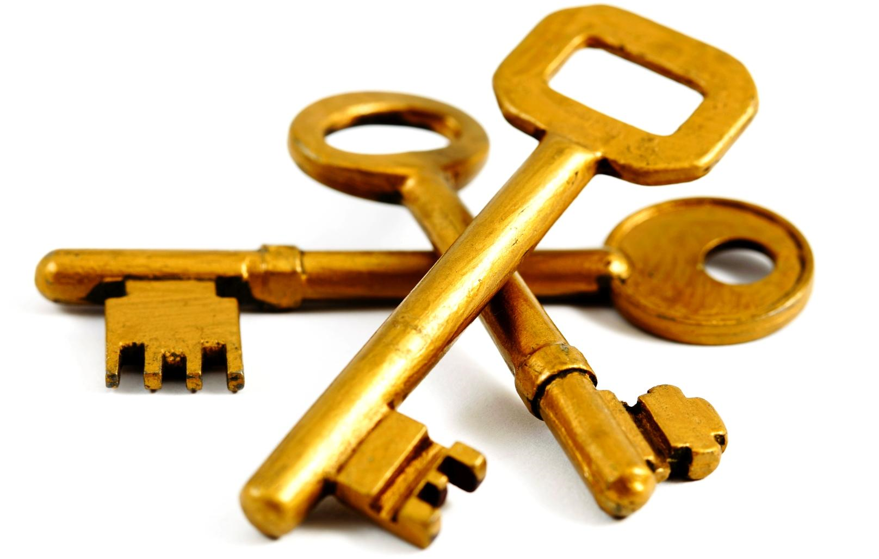
What is a Hash Table
A Hash table is an array in which you store each value with a key
$hash=@{}
$key = “AZ”
$value = “thom schumacher”
$hash.add($key, $value)
($hash).gettype()
$hash2=@{}
$key = ‘TX’
$value = ‘Ricc Babbitt’
$hash2.add($key, $value)
$key = “AZ”
$value = “thom schumacher”
$hash2.add($key, $value)
Notes:
https://kevinmarquette.github.io/2016-11-06-powershell-hashtable-everything-you-wanted-to-know-about/

Slide 5
Accessing data in a Hashtable
$hash2[‘AZ’]
Thom Schumacher
$hash2[‘TX’]
Ricc Babbitt
Populating hash table during creation
$Hash3= @{‘AZ’=‘Thom Schumacher’; ‘TX’ = ‘Ricc Babbitt’}
Can be used for a lookup table
$environments = @{
Prod = 'SrvProd05'
QA = 'SrvQA02'
Dev = 'SrvDev12’
}
$env = “QA”
$server = $environments[$env]
Multi - selection
$environments[@('QA','DEV’)]
$environments[('QA','DEV’)]
$environments['QA','DEV’]

Slide 6
Iterating
Treated as a Single object
($hash2 | measure-object).count
$hash2.count
If you need only the values
Use the .values property
$hash.values
If you only need the keys
Use the .keys propery
$hash.keys
For Each Object
$hash2.keys | foreach-object{ $msg = '{1} is the leader of the {0} User Group' -f $_, $hash2[$_] ; Write-output $msg}
Foreach(){..}loop
foreach($k in $hash2.keys)
{ $msg = '{1} is the leader of the {0} User Group' -f $k, $hash2[$k]
write-output $msg
}
Get Enumerator
$environments.getenumerator() | %{ $msg = '{1} is a server in the {0} environment' -f $_.key, $_.value; write-output $msg }

Slide 7
Iterating
Enumerating
Cannot modify the hash table During enumeration
$environments.Keys | ForEach-Object { $environments[$_] = 'SrvDev03’ }
An error occurred while enumerating through a collection: Collection was modified; enumeration operation may not execute. + CategoryInfo : InvalidOperation: tableEnumerator:HashtableEnumerator) [], RuntimeException + FullyQualifiedErrorId : BadEnumeration
foreach($key in $environments.keys) { $environments[$key] = 'SrvDev03’ }
Collection was modified; enumeration operation may not execute. + CategoryInfo : OperationStopped: (:) [], InvalidOperationException + FullyQualifiedErrorId : System.InvalidOperationException
The trick to this situation is to clone the keys before doing the enumeration.
$environments.Keys.Clone() | ForEach-Object {
$environments[$_] = 'SrvDev03'
}

Slide 8
Collection of Properties
PS /home/pi> $hash2 | get-member -MemberType Properties
TypeName: System.Collections.Hashtable
Name MemberType Definition
---- ---------- ----------
Count Property int Count {get;}
IsFixedSize Property bool IsFixedSize {get;}
IsReadOnly Property bool IsReadOnly {get;}
IsSynchronized Property bool IsSynchronized {get;}
Keys Property System.Collections.ICollection Keys {get;}
SyncRoot Property System.Object SyncRoot {get;}
Values Property System.Collections.ICollection Values {get;}

Slide 9
Data in Hashtables
Removing Data
$hash.email = 'crshnbrn66@gmail.com’
$hash.remove(‘email’)
Adding Hashtables
$hash += $hash2
Will add together if entries in $hash2 aren’t in $hash

Slide 10
Creating a Hastable from a log
$lines= get-content ~/Desktop/log.log
$lines | foreach{Convertfrom-stringdata $_}
Produces error
$hsh=$lines | foreach{Convertfrom-stringdata $_}
Produces a hastable inside a hashtable
$hsh[0][‘ClientID’]
$h=new-object hashtable;$lines | foreach{convertfrom-stringdata $_} | foreach{$h.add("$($_.keys)" , "$($_.values)")}
For each on the results and using add produces a single hash table object
Data from log:
ClientID = "GUID:DBEBB2C3-64D3-469E-A0AD-3022182F7010";
DateTime = "20181021230237.263000+000";
DownloadMethod = "BITS";
ProcessID = 2320;
ThreadID = 3840;

Slide 11
Splatting
First create a Hashtable with your values you want to splat
$hash4=@{“Path” = “/home/pi/Desktop/log.log” ; “NewName” = “/home/pi/Desktop/log.txt”}
Rename-item @hash4
$hash4=@{“Path” = “/home/pi/Desktop/log.txt” ; “NewName” = “/home/pi/Desktop/log.log”}
Rename-item @hash4

Slide 12
Hashtables to Objects
InLine in the creation of the hashtable
$environments = [pscustomobject]@{
Prod = 'SrvProd05'
QA = 'SrvQA02'
Dev = 'SrvDev12’
}
OR
$environments = @{
Prod = 'SrvProd05'
QA = 'SrvQA02'
Dev = 'SrvDev12’
}
After the hashtable has been created (casting)
[pscustomobject]$environments
Example 2
$hash=new-object hashtable;
get-process | foreach{$hash.add("$($_.name)$($_.id)","$($_.starttime)")}
$return = [pscustomobject]$hash

Slide 13
Group-Object –AsHashtable
One little known feature of Group-Object is that it can turn some datasets into a hashtable for you.
Import-CSV $Path | Group-Object -AsHashtable -Property email
See Kevin Marquettes everything you wanted to know about hashtables

