Slide 1

Hepatitis B Mortality prediction
1.Aagya Singh (20104076)
2. Aditya Waingade (20104099)
3. Devesh Zope (20104086)
Project Guide
Prof .Roshna Sangle
.

Slide 2
Contents
Introduction
Objectives
Scope
Literature Survey
Proposed System
Project Outcomes
Block Diagram
Use Case/DFD
Technology Stack

Slide 3
1.Introduction:
Problem Identified:
Predicting mortality risk in patients with hepatitis B a viral infection that can cause liver damage and cancer so it’s necessary to predict the future severity prior so that the healthcare professionals can determine appropriate treatment plans and improve patient outcome.
Solution proposed:
This model can potentially help clinicians identify high-risk patients early on and tailor treatment plans accordingly improving overall patient outcomes.
This model is trained using a dataset of clinical and demographic variables from patients with HepatitisB, including age , gender , liver function tests, etc

Slide 4
2.Objectives:
1. To identify patients who are at an increased risk of mortality or death from complications associated with the infection.
2. To find out the probability of death based on various clinical and demographic factors such age, sex, ascities, bilirubin content etc.
3. To improve patient care at an early stage by prior prediction.
4. To provide healthcare providers with information to guide their clinical-decision making to improve patient survival rate.

Slide 5
3. Scope
Identifying high-risk individuals who may benefit from closer monitoring, more frequent testing, and earlier intervention.
Estimates the burden of hepatitis B-related mortality and potential impact of the disease .
Early stage identification and management of individuals at risk of liver disease progression.
Reducing the overall burden of the disease’s mortality.

Slide 6
4. Literature Survey
Title | Author | Algorithm’s Used | Result
Development of a system for Predicting Mortality in Hepatitis B related liver failure | Xu et al. (2020) | Logistic Regression, Decision Tree | Identified Serum bilirubin, prothrombin time as the most important predictors of mortality.
Predicting the survival of Hepatitis B virus-related liver failure patients | Zhang et al. | Decision tree | Identified bilirubin content and age as the most important predictors of mortality.

Slide 7
5. Proposed System
Data Collection ,cleaning and preprocessing: Collecting data from multiple resources including electronic medical record, laboratory results, demographics, and clinical notes.
Feature selection: It is an important step in mortality prediction as it helps to identify the most relevant variables or features that can accurately predict the outcome.
Model Selection and model training: In our system we have used logistic regression, KNN, decision tree to build a model and compare the accuracies of each model.
Deployment: Model deployment has been carried out through streamlit and can be used by healthcare professionals to predict the mortality risk in Hepatitis B patients.

Slide 8
6. Algorithm used
Logistic Regression: It is a supervised learning technique. It is used for classification problems. It gives the probabilistic values which lie between 0 and 1.
KNN: It is a supervised learning technique. It assumes the similarity between the new case data and available cases and put the new case into the category that is most similar to the available categories.
Decision Tree: It is a tree-structured classifier, where internal nodes represent the features of a dataset, branches represent the decision rules and each leaf node represents the outcome.

Slide 9
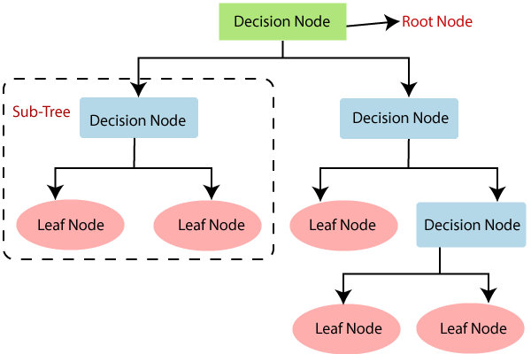
6.1 Decision Tree
It is a tree-structured classifier, where internal nodes represent the features of a dataset, branches represent the decision rules and each leaf node represents the outcome.

Slide 10
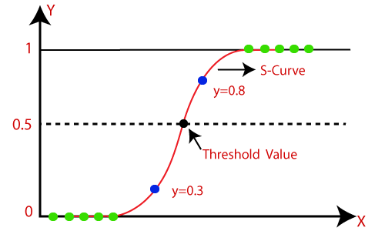
6.2 Logistic Regression
Logistic Regression is a supervised learning technique. It is used for classification problems. It gives the probabilistic values which lie between 0 and 1.

Slide 11
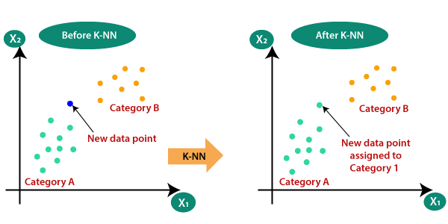
6.3 KNN
KNN: It is a supervised learning technique. It assumes the similarity between the new case data and available cases and put the new case into the category that is most similar to the available categories.

Slide 12
7. Project Outcomes
Users will have the ability to detect the disease at an early stage where treatment is more likely to be effective.
Reduce diagnostic errors that can occur due to human bias or errors in interpretation of medical data.
The project can lead to the development of a user-friendly platform or an application that can be integrated into existing healthcare and workflows.
Users or patients will be able to reduce health-care costs associated with the disease.

Slide 13
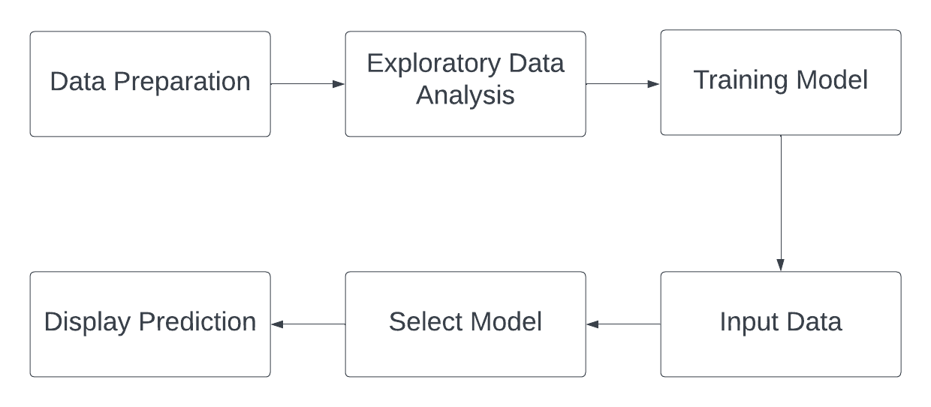
8. Block Diagram

Slide 14
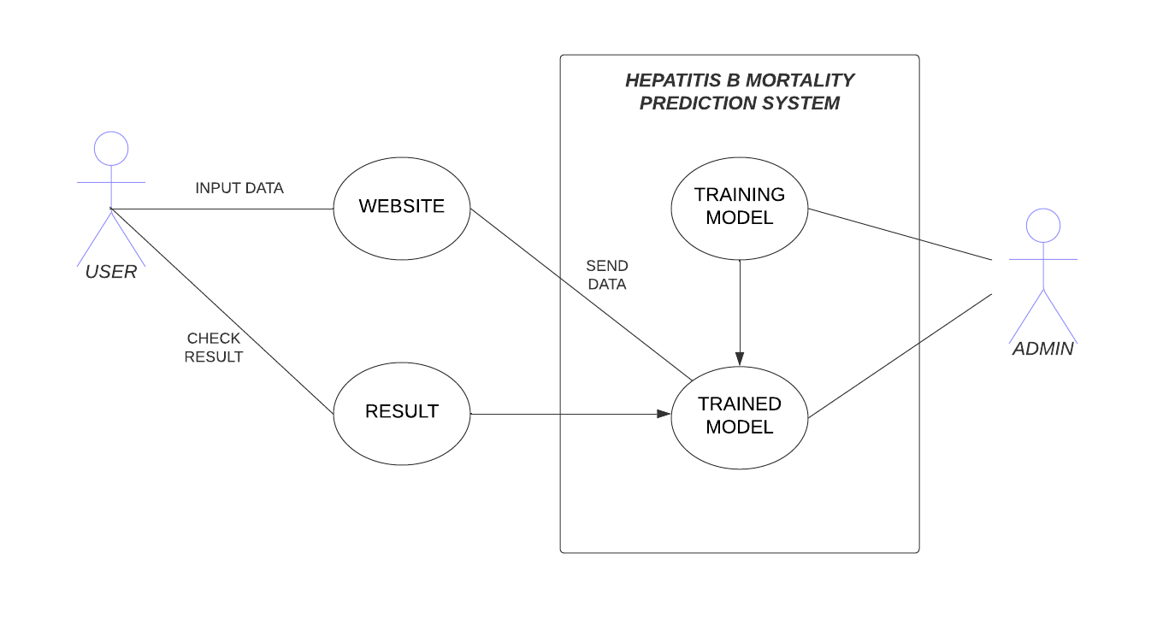
9. Use Case

Slide 15
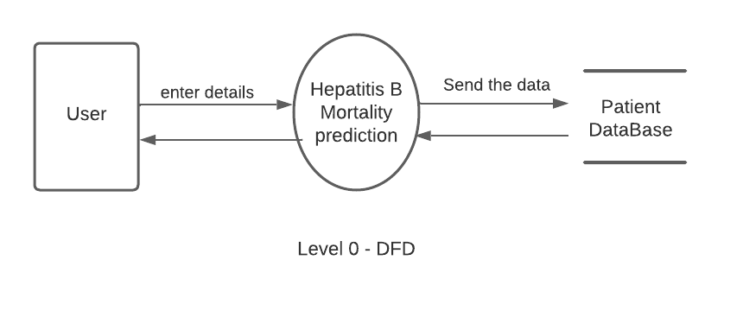
10. DFD

Slide 16
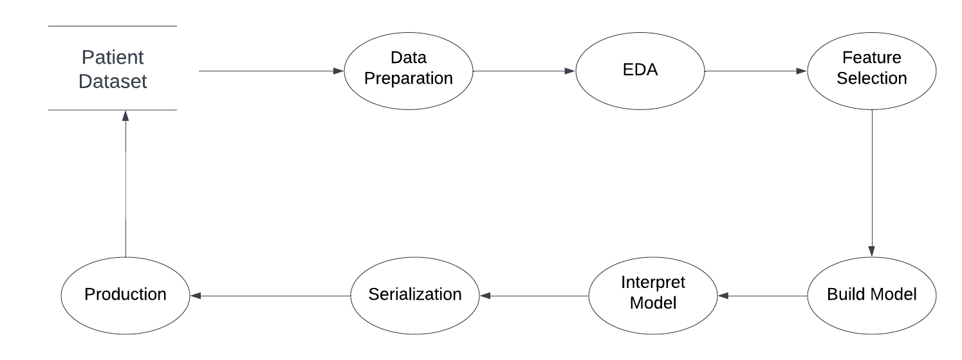
10.1 DFD

Slide 17
11. Technology Stack
Programming Language : Python
IDE : Visual Studio Code, Jupyter Notebook
Libraries: Numpy, MatplotLib, pandas, etc
Algorithm: Logistic regression, KNN, Decision Tree

Slide 18
12. Suggestions in review 1
Suggestion1: Improvement in GUI
Suggestion2: Add validations

Slide 19
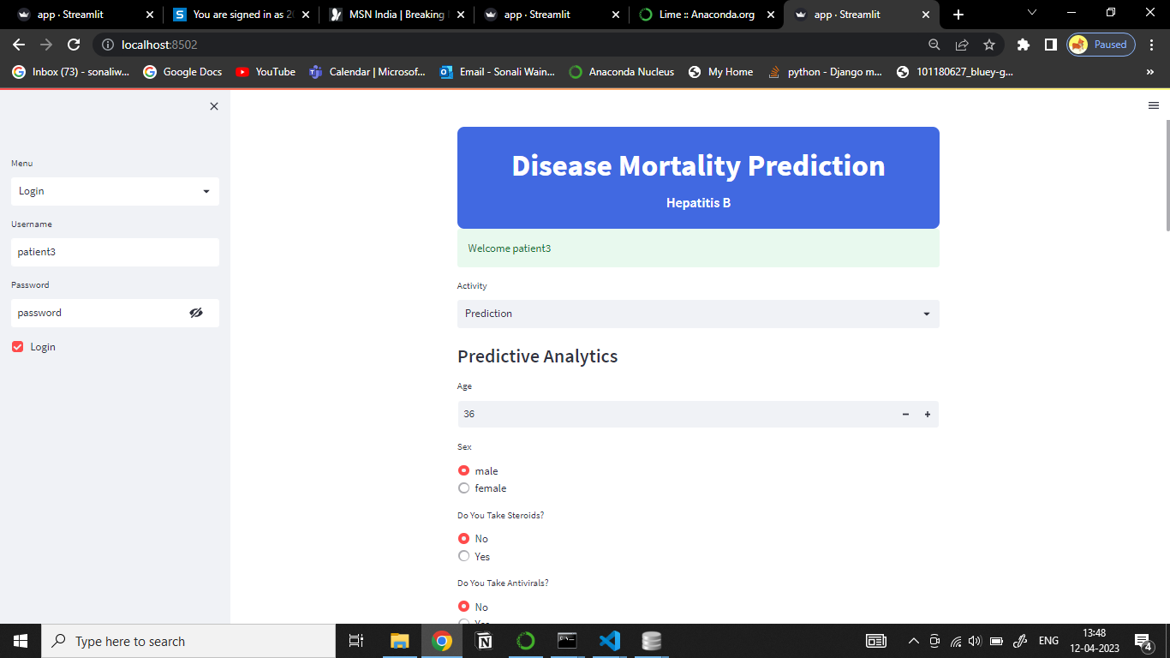
13. Result and Discussion

Slide 20
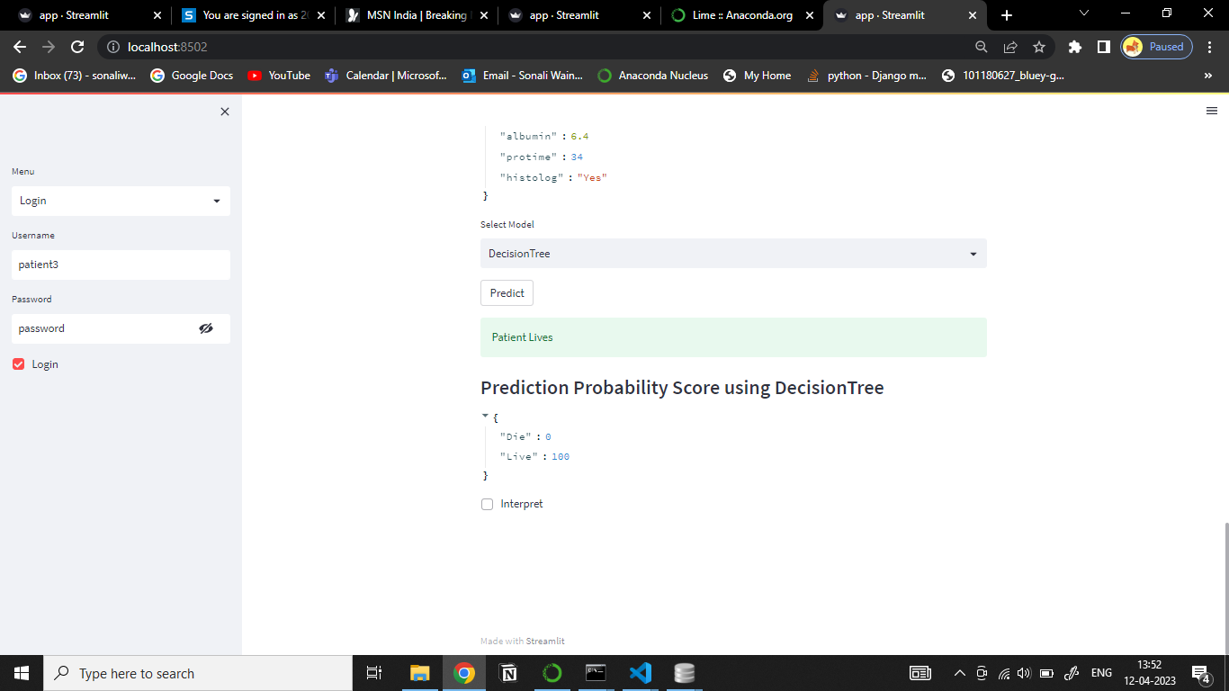

Slide 22
13. Conclusion and Future scope
Future Scope:
For future scope, the project can be improved by incorporating more advanced machine learning and data pre-processing techniques, such as data normalization.
Conclusion:
The Hepatitis B mortality prediction is a significant application of machine learning and predictive analysis in the business world. Through this project, we can predict the mortality of patient using certain significant patient features.

Slide 23
Thank You.

