Slide 1

Furniture Recommendation Website
Group members with Student Id
Tanishq Sahane (20104072)
Sakshi Thorbole (21204003)
Tejas Patil (20104123)
Project Guide
Prof. Ganesh Gourshete

Slide 2
Contents
Introduction
Objectives
Scope
Literature Survey
Proposed System
Project Outcomes
Block Diagram
Use Case/DFD
Technology Stack
Suggestions in Review-1
Result and Discussion
Conclusion and Future Scope
References

Slide 3
1. Introduction
Are you tired of endlessly scrolling through furniture websites or wandering aimlessly through furniture stores, unsure of what to buy? Our website is here to help. We use advanced algorithms and machine learning to recommend furniture pieces that fit your unique style and needs. Whether you're looking for a statement piece to elevate your living room or practical pieces to maximize your space, we've got you covered. Let us help you find the furniture pieces that will make your house feel like a home.

Slide 4
Problem Identified :
Furniture preferences are highly subjective and personal. It can be challenging to recommend the right furniture to each individual customer based on their unique tastes and requirements.
Furniture is often bulky and heavy, and shipping and delivery can be a challenge, especially if the website operates globally.
Solution Proposed :
The website could use data analysis and machine learning techniques to recommend furniture based on the customer's past purchases, browsing history, and personal preferences.
The website could partner with reliable shipping and logistics companies to provide fast and efficient delivery. The website could also offer flexible delivery options, such as same-day or next-day delivery, to meet the needs of customers.

Slide 5
2. Objectives
To provide personalized furniture recommendations to customers based on their individual preferences and requirements.
To efficiently manage and organize a large amount of product data, ensuring that it is accurate and up-to-date.
To differentiate itself from competitors by offering unique products or exceptional customer service.
To improve the relevance of search results and make it easier for customers to find the furniture they want.
To ensure that customers can always purchase the products they want by implementing effective inventory management systems.

Slide 6
3. Scope
Product catalog can be a comprehensive catalog of furniture products, including different styles, designs, materials, and sizes.
Furniture matching a tool that helps users find furniture products that match their existing decor and style.
Product comparison can be feature that allows users to compare different furniture products side-by-side, including price, features, and customer reviews.
Order tracking can be a feature that allows users to track the status of their orders and receive updates on delivery times and shipping information.

Slide 7
Literature Survey
Sr.no | Title | Author(s) | Year | Outcomes | Methodology | Result
1 | Furniture online consumer experience by Bio Resource | P.S. Gopalakrishnan, G. Raghavendra Rao, K. Prasad | 2022 | The proposed system improved customer satisfaction and sales revenue by providing personalized recommendations and accurate sales forecasting. | The system used a combination of machine learning algorithms, including natural language processing, sentiment analysis, and ARIMA model for time series forecasting. | A case study showed that the system increased sales revenue by 30%.
2 | Furniture shop management system | D. Sumathi, K. Saravanan | 2020 | The proposed system improved customer engagement and satisfaction by providing 24/7 support and accurate sales forecasting. | The system used a combination of machine learning algorithms, including natural language processing, sentiment analysis, and time-series analysis using ARIMA model. | A survey showed that 75% of the participants found the system helpful in addressing their queries.

Slide 8
5. Proposed System
Feature 1: Based on previous history, user will be recommended.
Feature 2: Search option is available to look for any specific furniture.
Feature 3: User can give feedback.
Feature 4: Website is customer friendly and easy to use.

Slide 9
6.Algorithm Used
Content Based Algorithm:
A content-based algorithm is a type of recommendation system that suggests items to users based on the characteristics and attributes of the items themselves. It analyzes the features of the items that a user has liked or interacted with in the past and recommends similar items with comparable characteristics. For example, let's say a user has watched several action movies in the past, and they rate them positively. A content-based algorithm would analyze the characteristics of those movies, such as the genre, actors, director, and plot elements, and recommend other action movies with similar features.

Slide 10
7. Outcome of Project
User can search for options available.
User can track the order.
User can buy the product.
User will be recommended based on his choice.
User can give feedback.

Slide 11
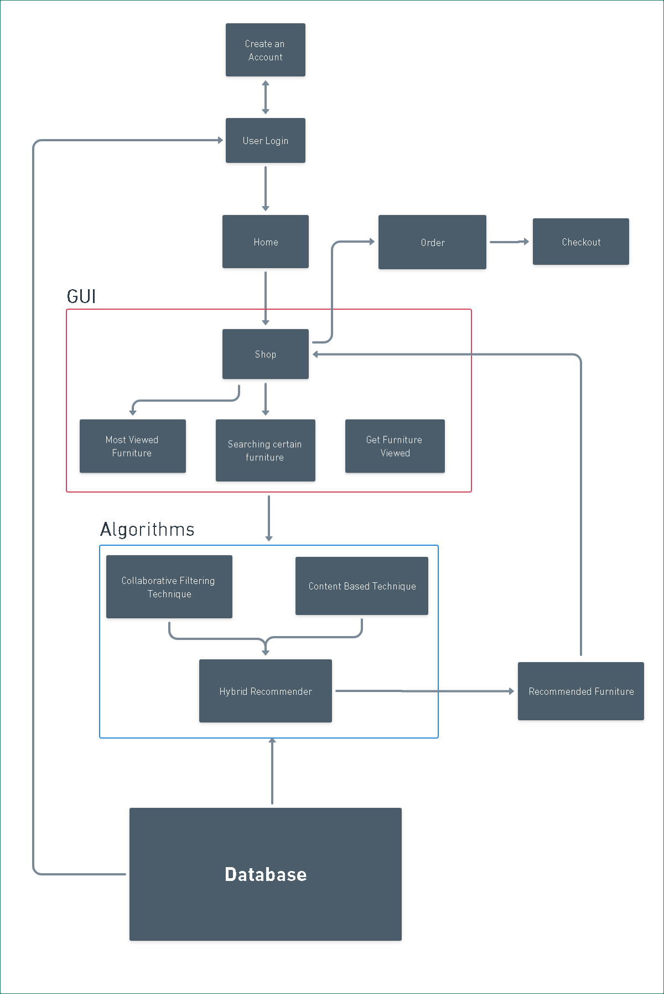
7. Block Diagram

Slide 12
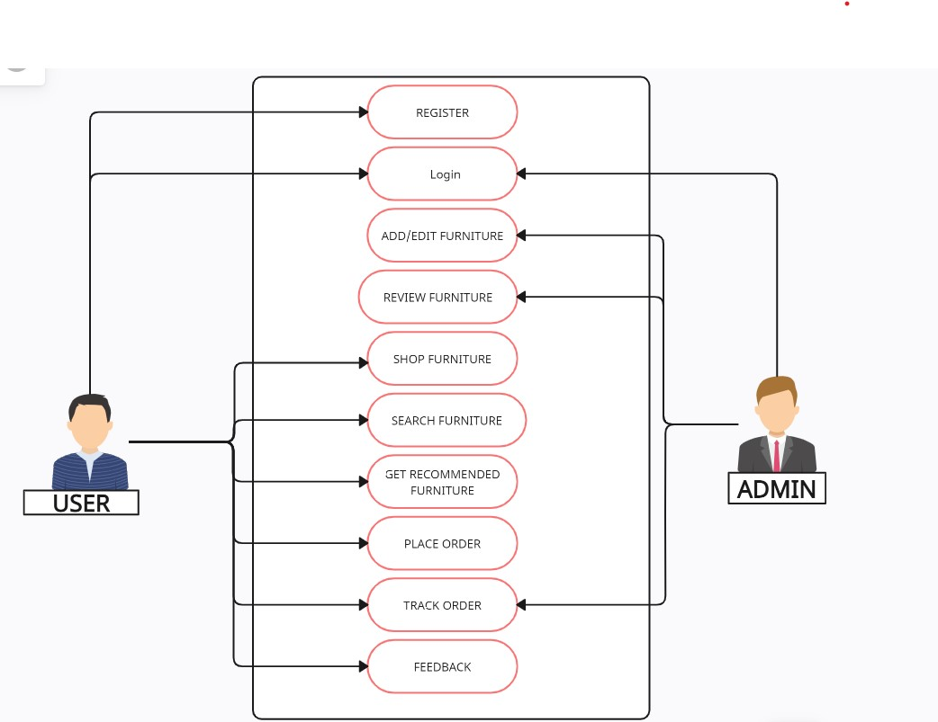
8. Use Case/Data Flow Diagram

Slide 13




9. Technology Stack
Frontend: HTML, CSS, JavaScript, PHP.
Backend: MySQL.
IDE: VsCode.

Slide 14
10. Suggestion in Review - 1
Add to cart
Filter
Changes in PPT

Slide 15
11. Result & Discussion
However, in general, a furniture recommendation website can provide a range of benefits to users, such as:
Personalized recommendations: By analyzing user preferences and past purchases, the website can offer personalized recommendations for furniture items that are likely to match the user's style and needs.
Convenience: Users can browse and purchase furniture items from the comfort of their own homes, without having to physically visit multiple stores or showrooms.
Variety: A furniture recommendation website can offer a wide range of products from different brands and designers, providing users with more options to choose from.

Slide 16
12. Conclusion & Future Scope
Based on my understanding of the topic, a furniture recommendation website can be a valuable tool for individuals who are looking to purchase furniture but are unsure of what to buy. However, the success of a furniture recommendation website depends on various factors such as the accuracy of its recommendations, the user interface, the quality of the products offered, and the level of customer service.

Slide 17
References
https://medium.com/web-mining-is688-spring-2021/wayfair-recommendation-system-for-furniture-buyers
https://www.researchgate.net/publication/348118609_Literature_Review_of_Recommendation_Systems
https://www.researchgate.net/publication/367615136_A_Systematic_Literature_Survey_on_Recommendation_System
https://www.researchgate.net/figure/The-framework-of-our-furniture-recommendation-system-based-on-
the-proposed-style_fig5_323125250

Slide 18
Thank You...!!

