Slide 1

Fitness Exercise App Using AIML
Sahil Shetty-20104122
Pranil Patil -20104121
Akash Patil-20104075
Project Guide
Prof. Manjusha Kashilkar

Slide 2
Contents
Introduction
Objectives
Scope
Literature Survey
Proposed System
Algorithm used
Project Outcomes
Block Diagram
Use Case/DFD
Technology Stack

Slide 3
1. Introduction
The fitness industry has been continuing to grow year after year with more individuals becoming health conscious. Today’s apps currently don’t have a simple all in one application in helping users progress in the gym. As a result, a website has been developed , to help users their gym life and the user will be able to track workouts for a particular day with the ability to add exercises.
Problem Identified :
    Users need a Program where they can check there accuracy of desired exercise.
    Solution Proposed :
    By using Fitness Accuracy System user will get and proper idea about his/her exercise Total reptation and accuracy.

Slide 4
2. Objectives
To empower people to create healthy training habits
To make sure user’s posture is accurate while exercising.
To check the reptation while performing exercises.
To check the accuracy of exercise performed.

Slide 5
3. Scope
Can be used to track workouts.
Can be used to count the reps of the exercise through rep counter.
Can be used to understand accurate exercise movement.
Can be used to make the user aware of the correct posture.
Can be used to avoid injuries.

Slide 6
4. Literature Survey
There are numerous other studies based on this, such as Jatin [3] use of OpenPose to identify posture. For it, V Gupta [2] employed a deep learning model. Another well-known study by Chen [5] utilised MediaPipe on a gadget for in-themoment hand monitoring. Robust articulated-ICP was utilised in A. Tagliasacchi's study [3] for real-time hand tracking. A.Toshev [4] completed a Deep Stance study in 2014 that utilised Deep Neural Networks to estimate human pose.
The above-mentioned researches were expensive, and a team of workers was needed to carry them out. Our study makes advantage of a device's webcam to record the numerous body coordinates needed to determine the angle and then provide the final count based on those values while being environment friendly.

Slide 7
5. Literature Survey
YEAR | AUTHOR | TITLE | ALGORITHMS | LIMITATIONS
2023 | 1]Ms. S. Harishma 2]Dr. R. K.Kavitha | Bicep Curl Tracker | K- nearest neighbour Algorithm | Only tracks webcam workout
2022 | 1]Yejin Kwon 2]Dongho Kim | Real-time Workout Posture Correction | Generative adversarial networks | Only detects the posture but not the reps i.e tracking is not feasible.
2021 | 1]Swapnil Dawange 2]Akash Chavan 3]Abhijit Dusane 4]H.P.Bhabad | Workout Analysis | Open Pose | The system is limited for workout purposes with single-person compatibility at a time.

Slide 8
6. Proposed System
Workout videos:
    User can refer to various workout plans to help them understand the exercises.
Similar exercise:
    User can see similar exercise to their current plan with the help of API
Reps Counter:
    User can perform the exercise by enabling the webcam and and can see counting of reps on the screen .

Slide 9
7. Algorithm used
1.K- nearest neighbour Algorithm
Classification
To locate the posture samples that are closest to a target one, the k-nearest neighbor (k-NN) approach for classifying poses requires a feature vector representation of each sample as well as a metric to determine the distance between any two such feature vectors.
When the user performs a downward movement,indicates that the "down" posture class has been put off and raises the counter as the probability falls below the cutoff.

Slide 10
8. Outcome of Project
User can get idea about accurate exercise .
User can track there movement is live feed.
User no need to count the repeatition instead can be seen directly in the screen.

Slide 11
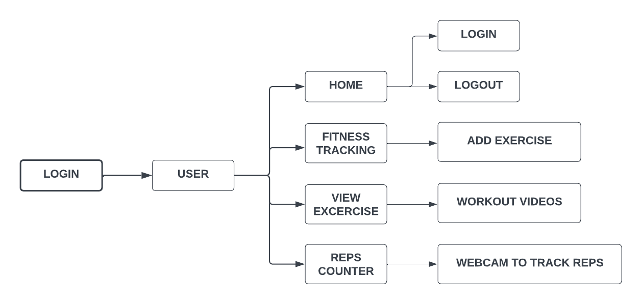
9. Block Diagram

Slide 12
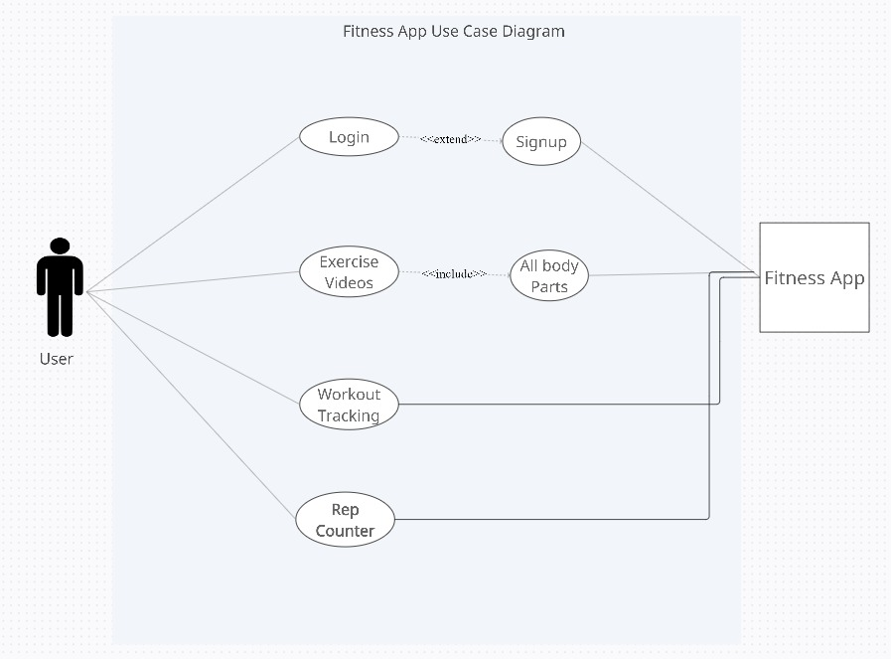
10. Use Case/Data Flow Diagram

Slide 13
11. Technology Stack
Frontend: Python, php, html
Backend: PhpMyAdmin
OS: Windows
IDE: Visual Studio Code

Slide 14
Thank You...!!

