Slide 1

Crops Guru:
Crop Recommendation System
Chirag Padyal_20104034 Vishal Bangar_20104084 Anuj Kundar_20104047
Project Guide
Ms. Rujata Chaudhari

Slide 2
Contents
Introduction
Objectives
Scope
Literature Survey
Proposed System
Project Outcomes
Block Diagram
Use Case/DFD
Technology Stack

Slide 3
1.Introdution
The Problem we Identified is,
Farmers struggle to select optimal crops due to various factors such as availability, soil quality, weather conditions, and market demand
The Solution we proposed is,
Providing a platform that recommends the best crop for farmers based on their farmland's characteristics, historical weather patterns, and market demand.

Slide 4
2. Objectives
To Develop a database of crops and their properties.
To Create a user-friendly interface for inputting location, soil type, and other info.
To Provide personalized crop recommendations based on user input and crop database.
To Improve crop yields and reduce wastage by recommending suitable crops.
To Increase efficiency of farming process by reducing research time and effort.
To Enable farmers to make informed decisions about crop selection.

Slide 5
3. Scope
Crops Guru provides agriculture domain-based crop recommendations to farmers.
Useful for small and large-scale farmers seeking to optimize crop yields and reduce risk of crop failure.
Can also be used by researchers and policymakers for crop selection analysis and informed decisions.

Slide 6
4. Literature Survey
Title | Year | Technology Stack | Advantage | Limitation | URL
"Crop recommendation system using machine learning algorithms" | 2018 | Data mining, machine learning algorithms, Random Forest | Improves crop yields, reduces risk of crop failure | No information provided about scalability of project | Link
"Agricultural crop prediction using machine learning" | 2020 | Data preprocessing, k-nearest neighbor, decision trees, neural networks | Accurately predicts crop yields, helps farmers make informed decisions | Require Heavy infrastructure for running model | Link

Slide 7
5. Proposed System
User inputs soil data and relevant information
Machine learning algorithms analyze historical weather data to predict weather patterns.
The weather prediction algorithm uses Random Forest to split the dataset and provide results.
Application recommends suitable crops based on farmland characteristics, weather patterns, and market demand
System provides real-time market demand data for crops

Slide 8
6. Algorithm Used
The Random Forest algorithm is used to predict the best crop for a particular area based on the available soil and climate data in a particular region based on a dataset of soil samples with known characteristics..
.

Slide 9
7. Outcome of Project
User Interface: A user-friendly interface that enables farmers to input their location, soil type, climate conditions, and other relevant data.
Crop Recommendation Report: A report that recommends a list of crops that are most suitable for a specific region based on the soil and climate analysis.

Slide 10
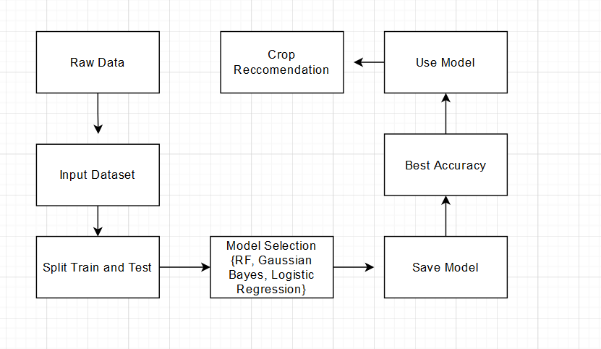
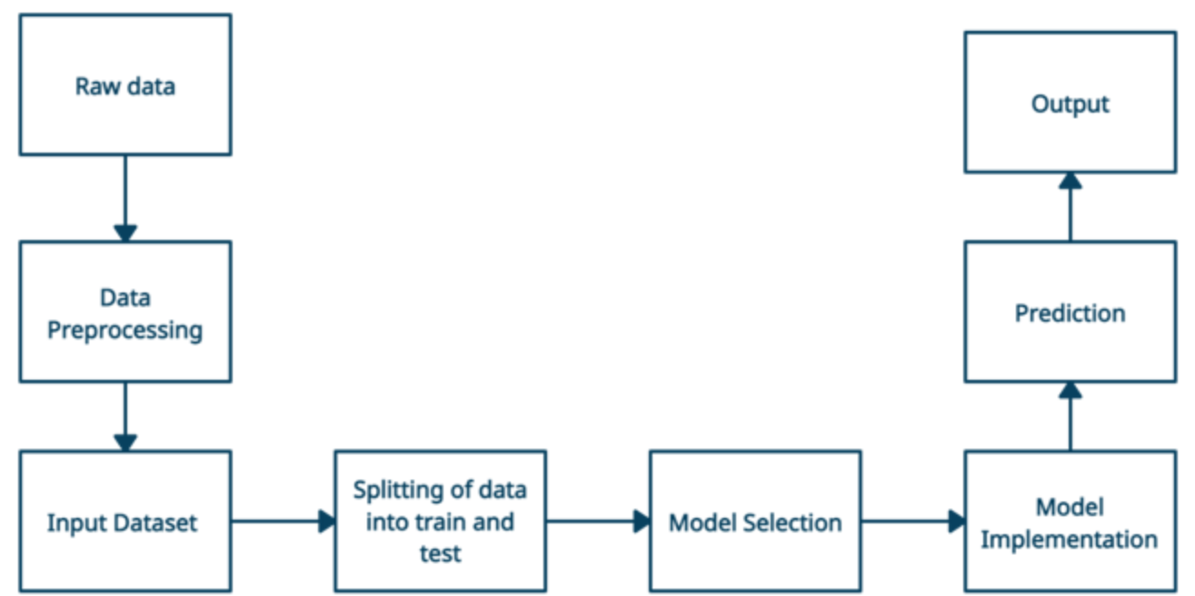
8. Block Diagram

Slide 11
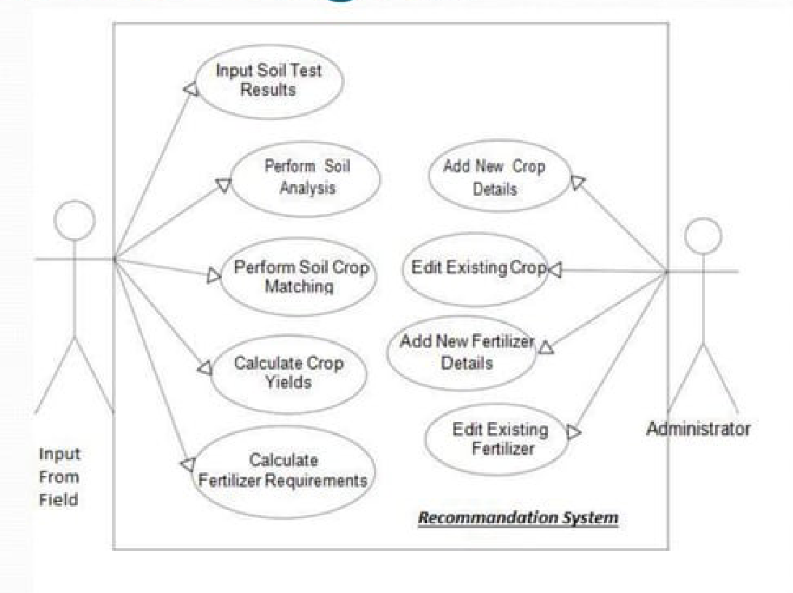
9. Use Case/Data Flow Diagram

Slide 12
10. Technology Stack
Front-end:-
Html
Css
Back-end:-
Framework:- Flask

Slide 13
Thank You...!!

