Slide 1

FAKE NEWS PREDICTION
Kritika Donde 20104102
Disha Panchal 20104126
Lakshit Patil 20104043
Project Guide
Prof. Mandar Ganjapurkar

Slide 2
Contents
Introduction
Objectives
Scope
Literature Survey
Proposed System
Algorithm Used
Project Outcomes
Flow diagram
Technology Stack
Suggestions in Review-1
Result and Discussion
Conclusion and Future Scope
References

Slide 3
1. Introduction
Problem Identified :
Fake news stories can spread quickly and have a significant impact on public opinion.
With the rise of social media, it has become easier to create and spread fake news.
Existing methods of detecting fake news, such as fact-checking, are time-consuming and may not be able to keep up with the speed of fake news creation and dissemination.
Solution Proposed :
Therefore, there is a need for more efficient and effective methods of fake news prediction to prevent the spread of misinformation and protect the public from its harmful effects.

Slide 4
2. Objectives
To identify and prevent the spread of fake news.
To improve media literacy and critical thinking among the general public to reduce the impact of fake news.
By educating people on how to identify and verify news stories.

Slide 5
3. Scope
Can have a wide range of consequences.
Can damage the credibility of legitimate news sources.
Can have a significant impact on political campaigns.
Can also impact public health, as misinformation about diseases and treatments can lead to dangerous decisions.

Slide 6
4. Literature Survey
Title | Author(s) | Year | Algorithm | Limitations | Result
Fake News Detection on Social Media: A Data Mining Perspective | M. Al-Qudah, and I. Alsmadi | 2021 | Combination of linguistic features and deep learning techniques | The dataset used is not diverse enough,consisting only of political news. The proposed model is not compared to other state-of-the-art models for fake news detection. | Achieved an accuracy of 92.7% on the dataset used in the study.
Identifying and Analyzing Political Fake News in Social Media | R. Fan, X. Li, and Y. Liang | 2019 | Multi-modal deep learning model using text and image features | -The dataset used is limited to political news.The model may not perform well with fake news that do not contain any images. | Achieved an F1-score of 0.845 for identifying political fake news.
Fake News Detection on Twitter using Hybrid CNN and RNN Models | V. Khandelwal and D. Batra | 2018 | Hybrid convolutional neural network and recurrent neural network model | The model is not compared to other state-of-the-art models for fake news detection.The dataset used is limited to fake news related to US presidential election 2016. | Achieved an accuracy of 91.14% in identifying fake news on the dataset

Slide 7
5. Proposed System
Features and Functionality:
Content analysis
Training data
Alerting Users
Investigative journalism
Predictive modeling

Slide 8
6. Algorithms Used
Passive Aggressive Classifier:
The PA algorithm can be used to classify news articles as either fake or genuine based on their features.
The algorithm is trained on a labeled dataset of news articles, where each article is labeled as either fake or genuine.
During training, the PA algorithm updates its weight vector in response to each example it sees, with the aim of minimizing the loss function. The loss function measures the difference between the predicted label and the true label.
Once the PA algorithm is trained, it can be used to predict the label of new, unseen news articles based on their features.
The algorithm calculates a score for each article, and if the score is above a certain threshold, the article is classified as fake, otherwise it is classified as genuine.
The threshold can be set based on the desired trade-off between precision and recall.

Slide 9
7. Outcome of Project
By flagging and removing fake news stories, a fake news prediction system can help improve the accuracy of the news that people consume.
By helping to ensure the accuracy of news stories, a fake news prediction system could help rebuild trust in media.
More informed decision-making: When people are provided with accurate information, they can make more informed decisions about important issues, such as politics, health, and business.
By helping journalists verify the accuracy of news stories and sources.

Slide 10
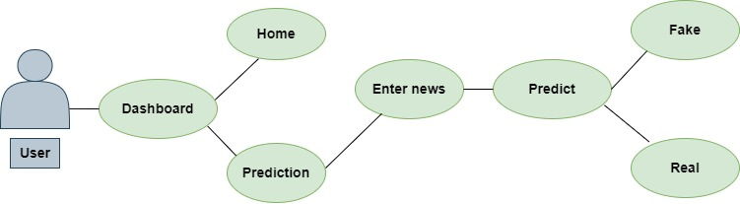
8. Use Case Diagram

Slide 11


9. Technology Stack
Language used : Python using ML Algorithm , HTML CSS.
IDE : Visual Studio code

Slide 12
10. Suggestions in Review-1
Write the literature survey in the tabular format.
Select the algorithm with the best accuracy.
Use realtime news.
Change the block diagram.

Slide 13

11. Result and Discussion

Slide 14
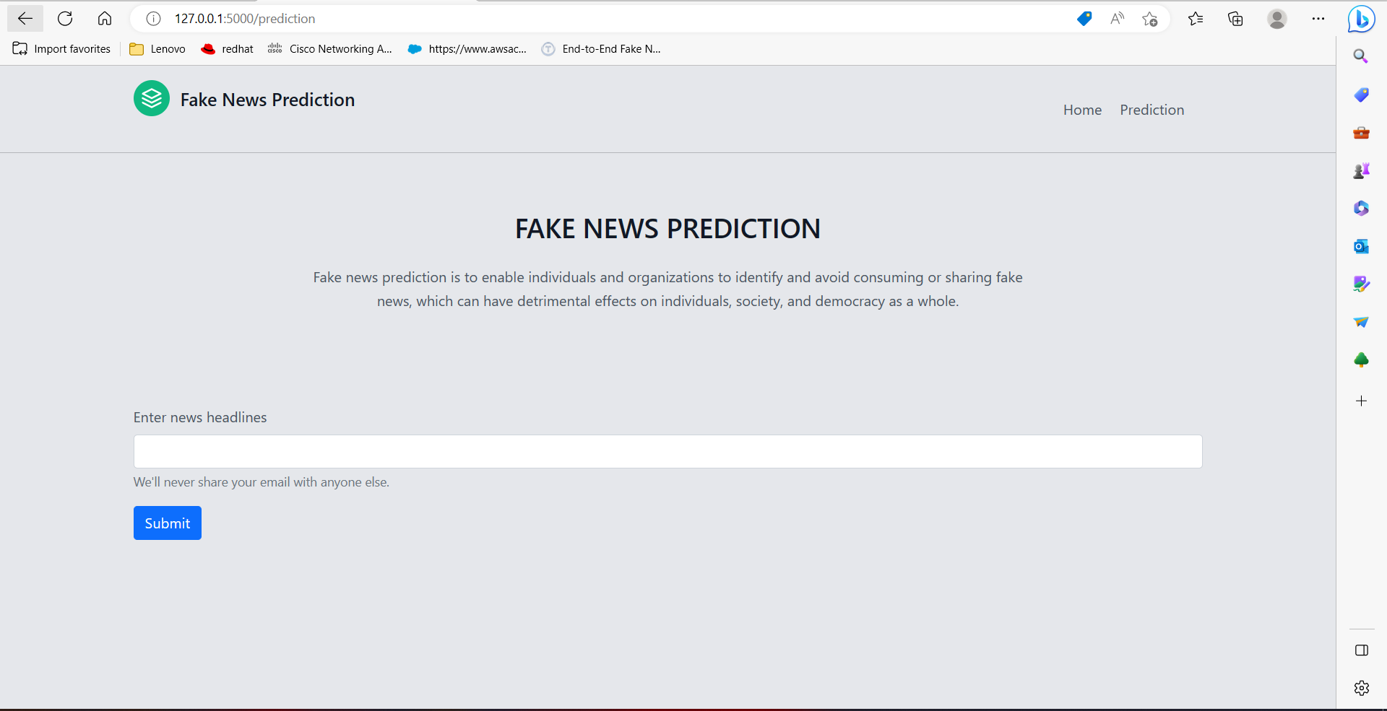

Slide 15
12. Conclusion and Future Scope
One key challenge in developing a fake news prediction system is the need to balance accuracy with speed. While it is important to identify fake news as quickly as possible, it is also crucial to ensure that the system is not mistakenly flagging legitimate sources as fake.
To improve the accuracy of a fake news prediction system, it may be helpful to incorporate a wide range of data sources and to use advanced machine learning algorithms to analyze patterns and trends in news content.
Additionally, it may be beneficial to incorporate human oversight into the system, to provide an additional layer of quality control and to help refine the algorithms over time.

Slide 16
13. References
"A Deep Learning Approach for Predicting Fake News" by Yuan Wu, et al. (https://ieeexplore.ieee.org/document/8258025)
"Fake News Detection on Social Media: A Data Mining Perspective" by Shivani Poddar, et al. (https://link.springer.com/article/10.1007/s40595-019-00070-4)
"Fake News Detection on Social Media: A Review" by Mehdi Khosrow-Pour, et al. (https://www.igi-global.com/article/fake-news-detection-on-social-media/237231)
"Fake News Detection: A Machine Learning Perspective" by Mohit Gupta, et al. (https://www.sciencedirect.com/science/article/pii/S1877050920313483)
"Fake News Detection Using Machine Learning Techniques: A Review" by Sarika Jain and Ankur Sharma (https://www.sciencedirect.com/science/article/pii/S2405452619306516)

Slide 17
Thank You...!!

