Slide 1

SyncServerII
Christopher G. Prince
Principal iOS Developer, roster
MIT open-source license
https://github.com/crspybits/SyncServerII
Notes:
I want to make this talk interactive. And I’m happy to reshape it depending on interest.
Tell them about the goals of the system.
Open source system to mobile apps to (a) store user data in users cloud storage (e.g., Google Drive), and (b) safely share that cloud data with other users (e.g., Facebook)
As I understand it, many of the people here are software developers.

Slide 2

Goals of this presentation
SyncServerII
Server
Client interface
iOS apps
Swift language
Notes:
https://www.intego.com/mac-security-blog

Slide 3
Overview
Project concept: Enable mobile apps to (a) store user data in users cloud storage (e.g., Google Drive), and (b) safely share that cloud data with other users (e.g., Facebook)
Unit of data storage: Files
Birth: Node.js and Mongo
But, Mongo isn’t well suited to transactions/rollbacks
And I ran into a design issue: Locks were held by client
Plus, when I bought a house, I lost steam on the project!
Rebirth: Swift and mySQL
Relaxed locking mechanism
Approx. back to development state as with Node.js and Mongo
Notes:
How much work is it to install on Redhat or other distros?
General orientation of SyncServer is file-based data storage.
Server: Swift for all components.

Slide 4
Current State of SyncServer
Generally: Beta
Support for single versioned files in cloud storage
Google sign-in + Google Drive for cloud storage
Facebook sign-in complete on client interface and server
Server
IBM Kitura multi-threaded ”embedded” http server
Perfect for mySQL bindings
Demo deployed to AWS EC2 using RDS/mySQL
Client interface for iOS
Supports online and offline client usage
iOS mobile apps
Example app with client side test cases
SharedImages app in TestFlight beta
Notes:
By beta, I mean: Not yet deployed in production
Single versioned files: Not yet dealing with versioning conflicts: i.e., one two devices making concurrent changes to the same file
No streaming yet; bottleneck/server limitation (Kitura limitation)
In process of adding Facebook sign-in support for sharing.
Stats:
Nearly all code in Swift
18,672 lines of code
280 automated test cases
Server: -------------------------------------------------------------------------------
Language files blank comment code
-------------------------------------------------------------------------------
Swift 58 1991 913 7312
Markdown 1 43 0 85
Bourne Shell 2 20 25 72
Ruby 1 14 15 26
SQL 1 0 0 4
-------------------------------------------------------------------------------
SUM: 63 2068 953 7499
-------------------------------------------------------------------------------
Shared library: -------------------------------------------------------------------------------
Language files blank comment code
-------------------------------------------------------------------------------
Swift 31 900 1080 1965
Markdown 1 197 0 394
Bourne Shell 1 8 1 90
C/C++ Header 2 6 0 26
Objective C 2 0 0 10
-------------------------------------------------------------------------------
SUM: 37 1111 1081 2485
-------------------------------------------------------------------------------
iOS Client
-------------------------------------------------------------------------------
Language files blank comment code
-------------------------------------------------------------------------------
Swift 66 2044 959 6361
JSON 1 0 0 48
Markdown 1 11 0 18
-------------------------------------------------------------------------------
SUM: 68 2055 959 6427
-------------------------------------------------------------------------------
Shared Images:
-------------------------------------------------------------------------------
Language files blank comment code
-------------------------------------------------------------------------------
Swift 18 420 232 1532
Objective C 2 97 38 482
JSON 7 0 0 209
C/C++ Header 3 18 27 38
-------------------------------------------------------------------------------
SUM: 30 535 297 2261
-------------------------------------------------------------------------------

Slide 5
Architecture
(in development)
Other social sign-ins?
Facebook
Mobile iOS app
Server
Google Drive
Client interface
Your app code here
Sign-ins
Google
Dropbox
(planned)
Facebook
mySQL
Dropbox
...
...
Notes:
A single app type requires its own server
mySQL only stores meta-info and not content
Requests to cloud storage go through the server for security purposes– so that a sharing user doesn’t have cloud storage creds going back to the mobile app.

Slide 6
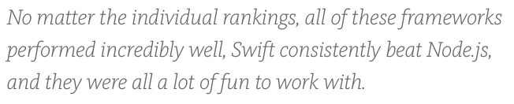
Swift Basics
Apple open-sourced their new language (Dec/2015)
See https://swift.org
Swift is pretty much in full-swing on Apple’s main hardware platforms
iOS, watchOS, tvOS; Apple promising stability soon.
Typical open source usage: HTTP server built using Swift
Run on MacOS or Linux
For Linux, Apple distributes builds for Ubuntu
Various projects are providing http & related libraries
E.g., Perfect, Vapor, Kitura (IBM), Zewo
Swift package manager
https://medium.com/@rymcol
Notes:
SyncServer: My project using server-side Swift and iOS/Swift client-side
https://medium.com/@rymcol/benchmarks-for-the-top-server-side-swift-frameworks-vs-node-js-24460cfe0beb
How much work is it to install Swift on Redhat or other distros?

Slide 7
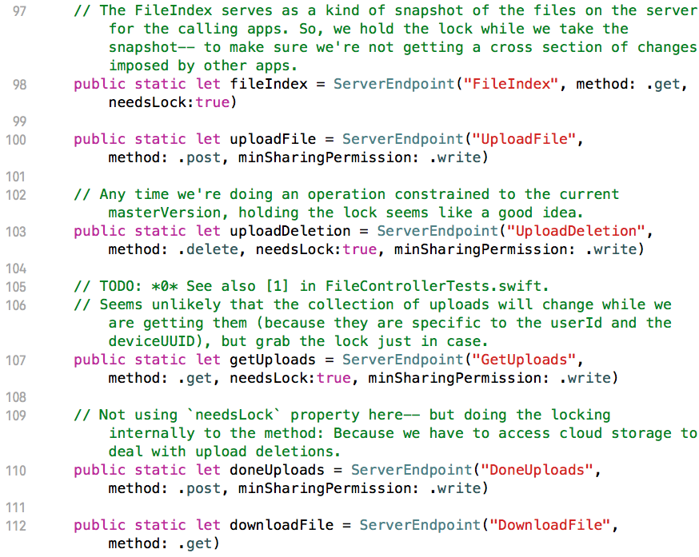
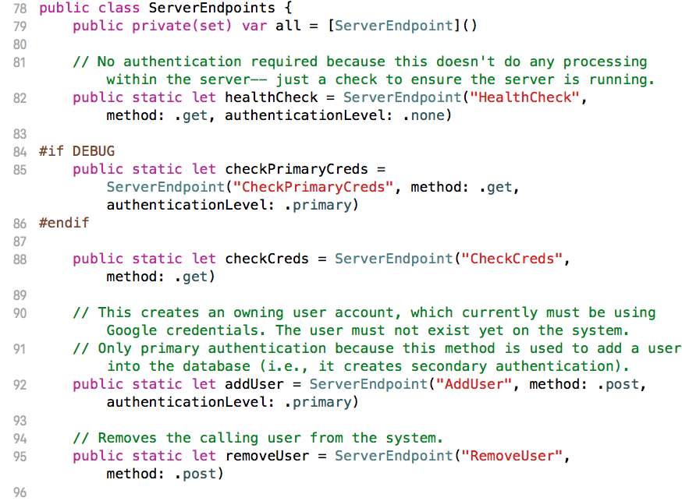
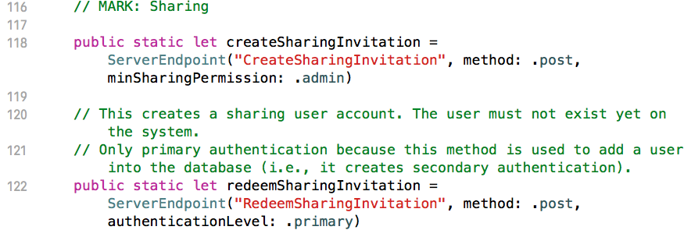
Server Endpoints
Notes:
FileIndex returns meta-data. There are two kinds of meta-data in the system: 1) General meta-data such as file creation time, file name, etc.
2) App specific meta-data, which is a string and can be used for any purpose by the client app.
UploadFile and UploadDeletion: Can operate concurrently, and just stage the operation. UploadFile actually uploads the file, but at the end of the operation, no other users can yet gain access to the file.
UploadDeletion: Doesn't actually remove entry from the file index-- just marks as deleted.
DoneUploads: Is the commit operation. Increments the master version.
GetUploads: Only use cases are for testing at this point.

Slide 8
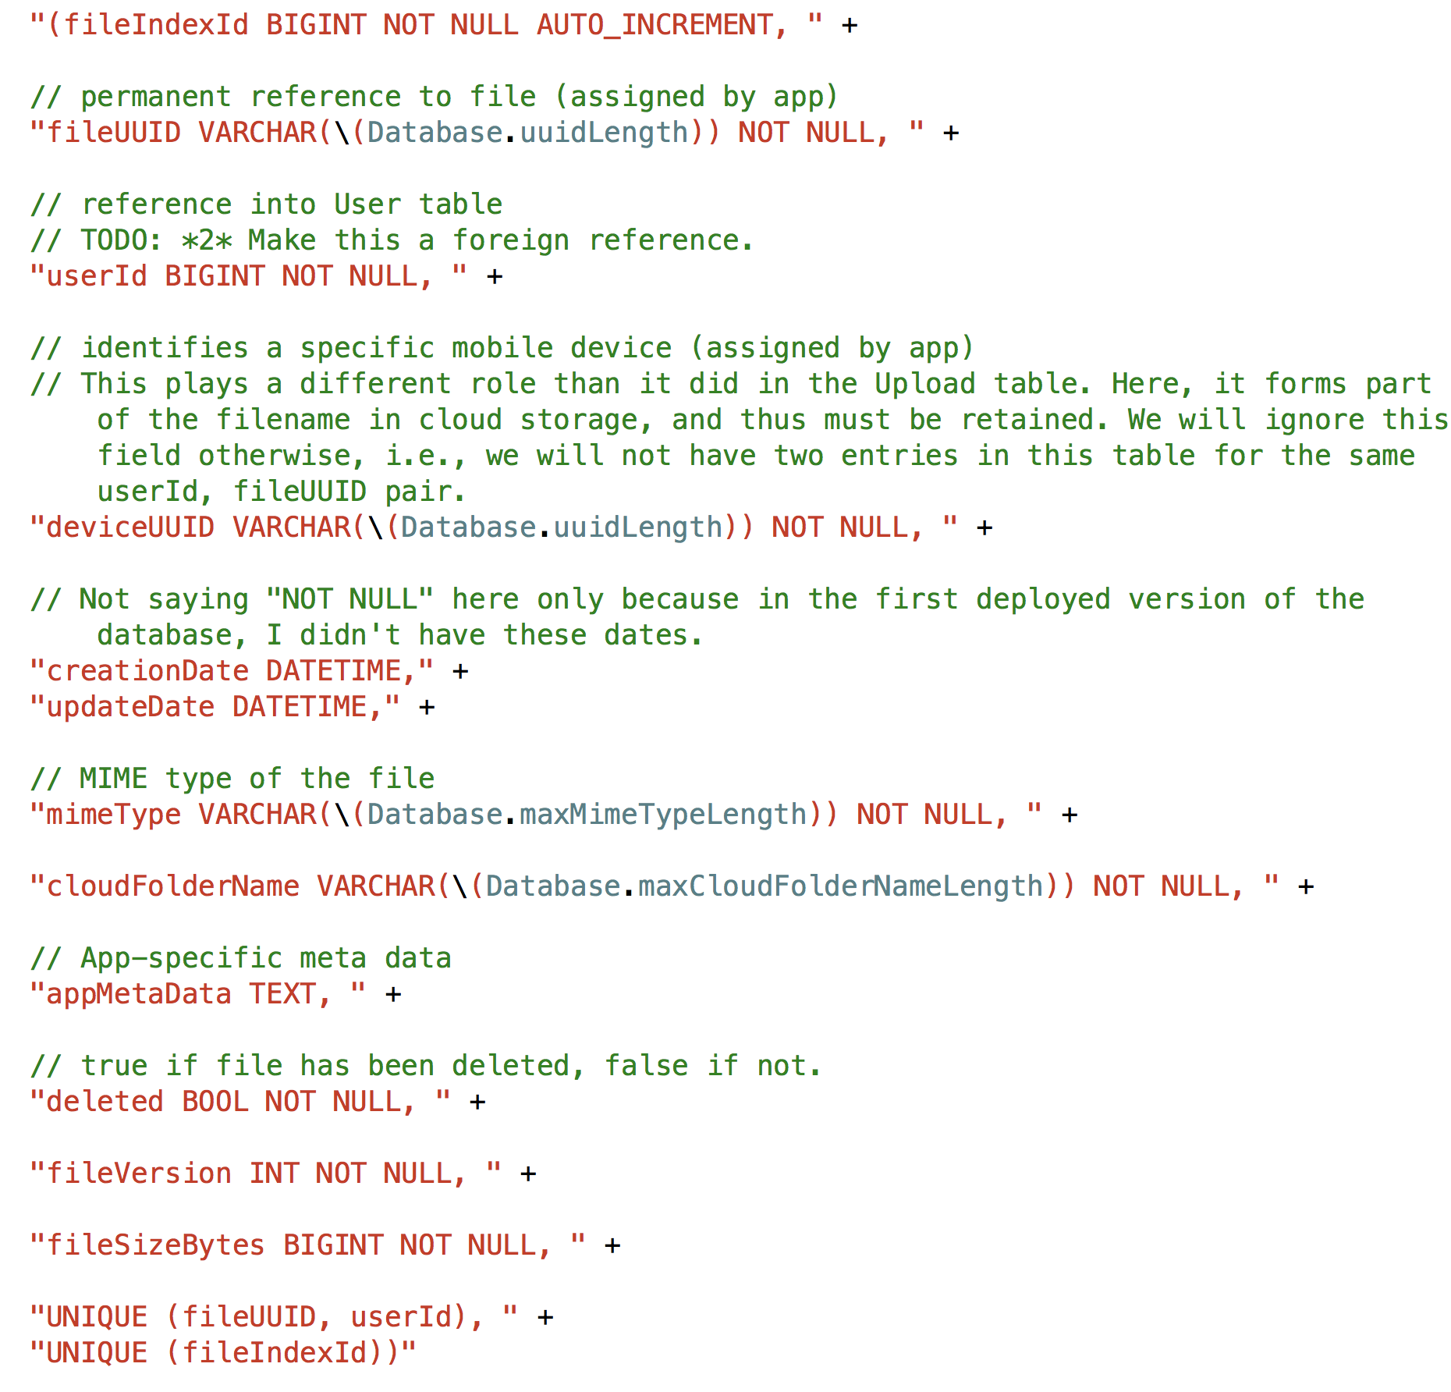
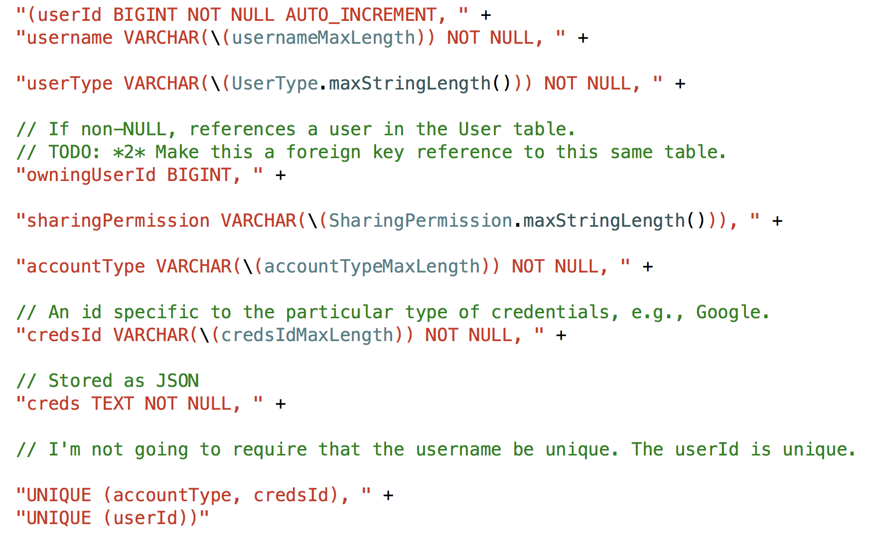
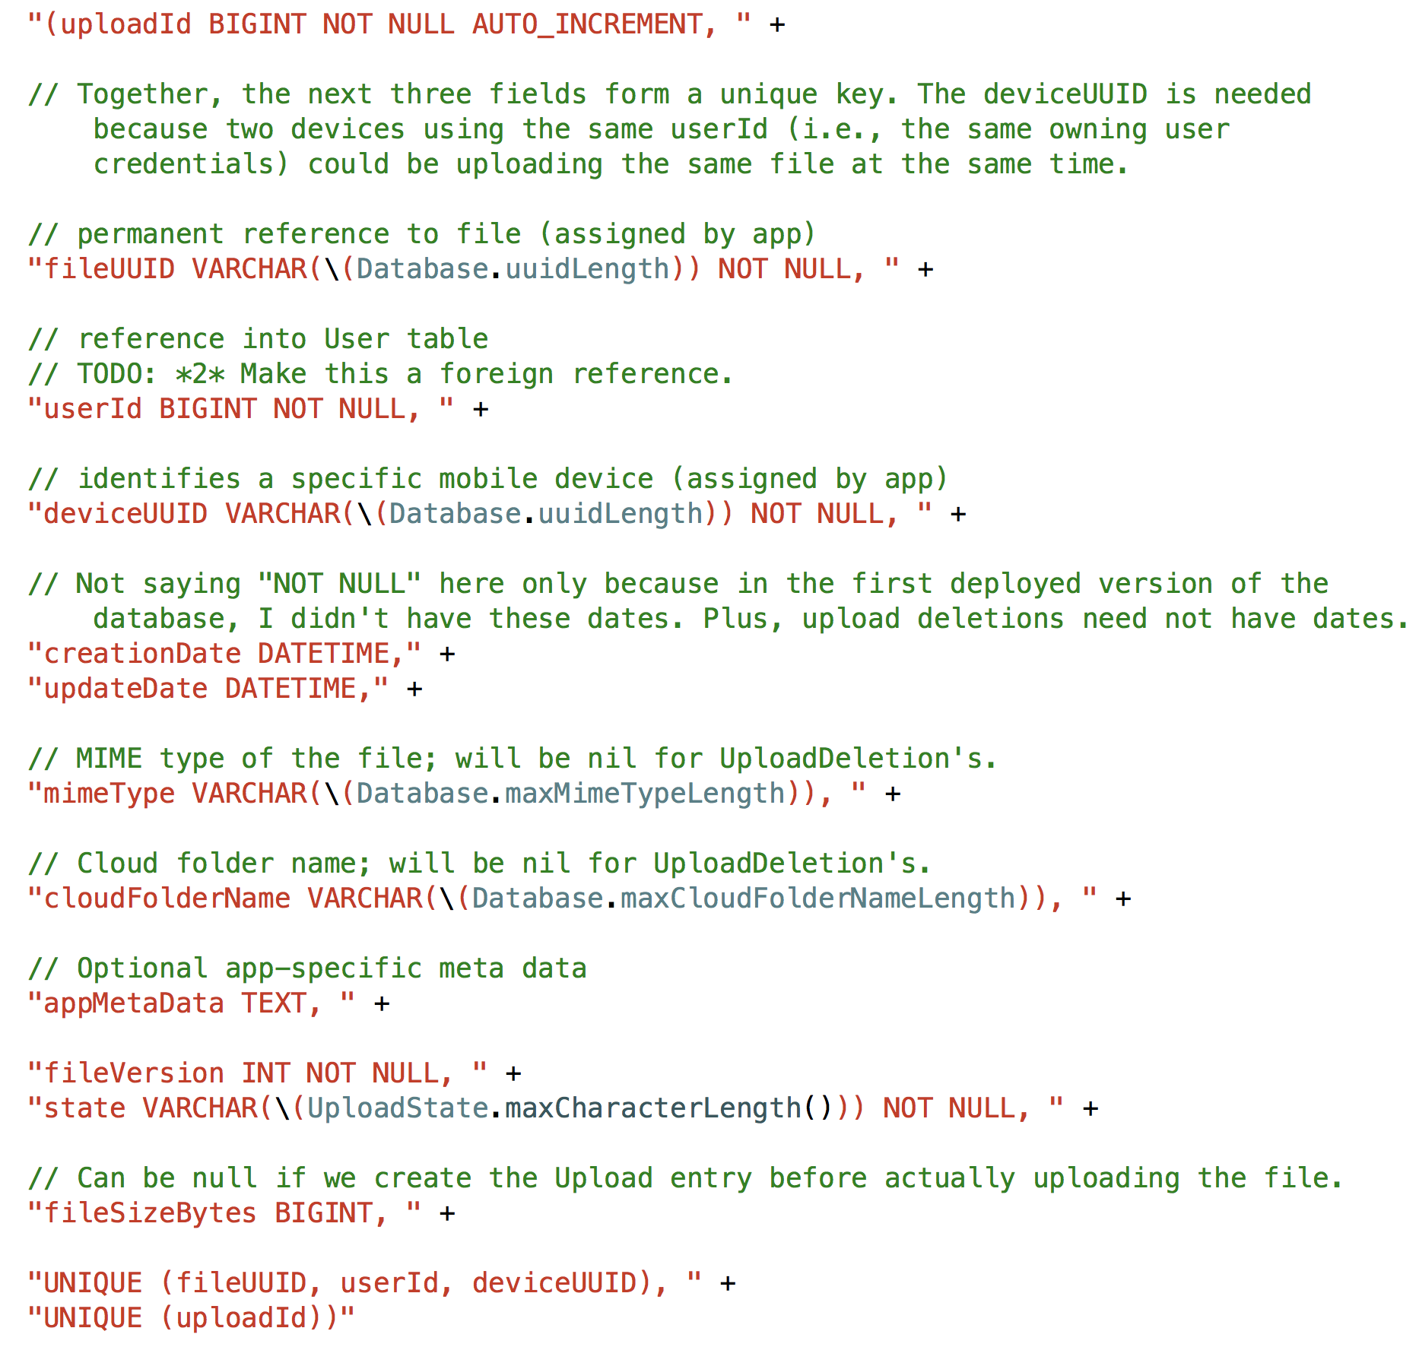
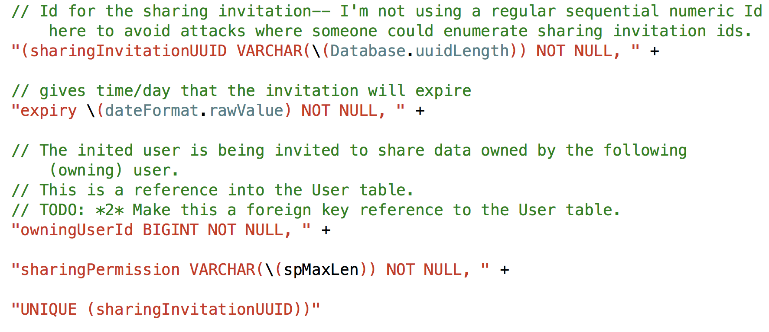
Server Database Tables
Sharing Invitations
Uploads
Files
Users
Notes:
enum UploadState : String {
case uploading
case uploaded
case toDeleteFromFileIndex
static func maxCharacterLength() -> Int { return 22 }
}
Files are identified by UUID’s
Owning user:
Someone with an cloud storage account who creates a new account
Sharing user:
An owning user or admin sharing user can create a sharing invitation
Permissions allowed: Read, Write, and Admin
Any other person with an sign-in known to the system (e.g., Google or Facebook) but without a specific account on the system can then accept the sharing invitation
The typical use case is that the invitation is sent to specific person, and they redeem the invitation

Slide 9
Optimistic “locking”
Locks held for brief periods, and then only server-initiated
Master Version
Integer value maintained by server
Reported to client with FileIndex
Each DoneUploads request increments master version for that owning user
Client passes last known master version to server when doing UploadFile, UploadDeletion, DoneUploads, or DownloadFile
Server fails operation if master version out of date
General assumption: A small number of users synchronizing data (for any single set of cloud data files)
Client detects master version change: recovery takes place
Notes:
TODO: Really need a diagram illustrating upload process, and then the download process.
ASSUMPTION: Only a small number of users are accessing the same data, and rarely will users ever be uploading at the same time
Server locks are partly done through fact of using InnoDB with mySQL with a REPEATABLE READ isolation level.
When the server fails the operation in these cases, it sends updated master version back to client– though client will likely want to do a FileIndex again to see what changed.

Slide 10
iOS Client
Provides interface from iOS app to SyncServer server
Implements another system goal
Client’s can operate with or without network access
Client database (Core Data) tracks pending uploads and downloads
No network connectivity: Operation can be carried out later
App crashes: Operation can be carried out later
Online/offline feature currently in testing

Slide 11
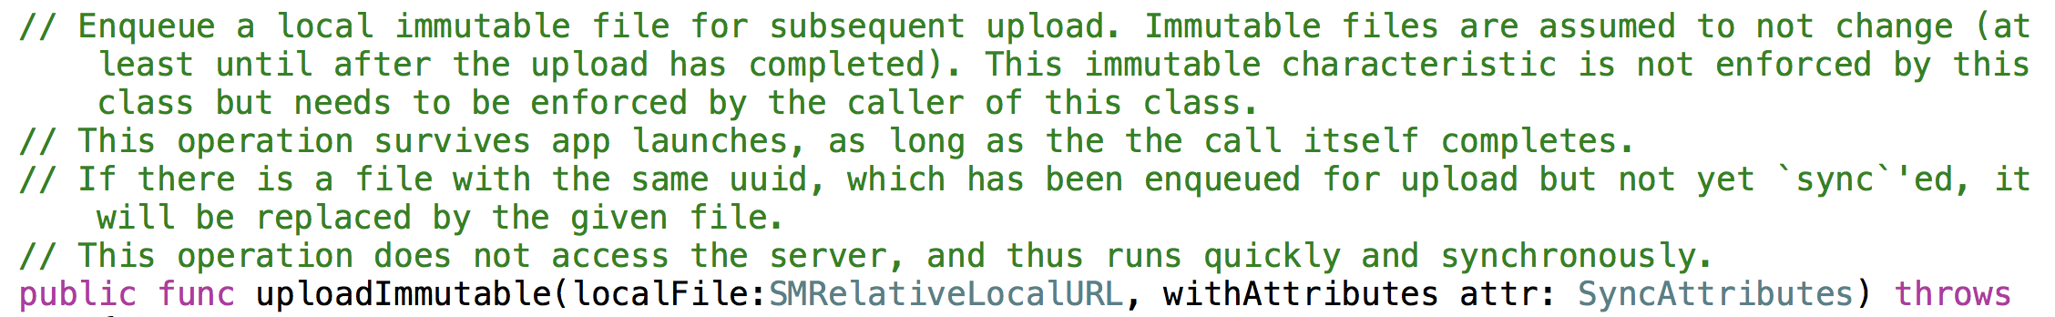
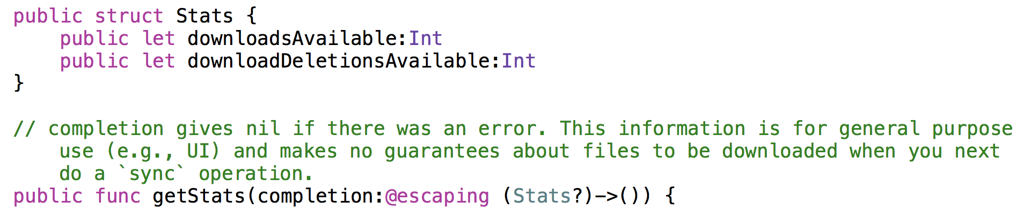
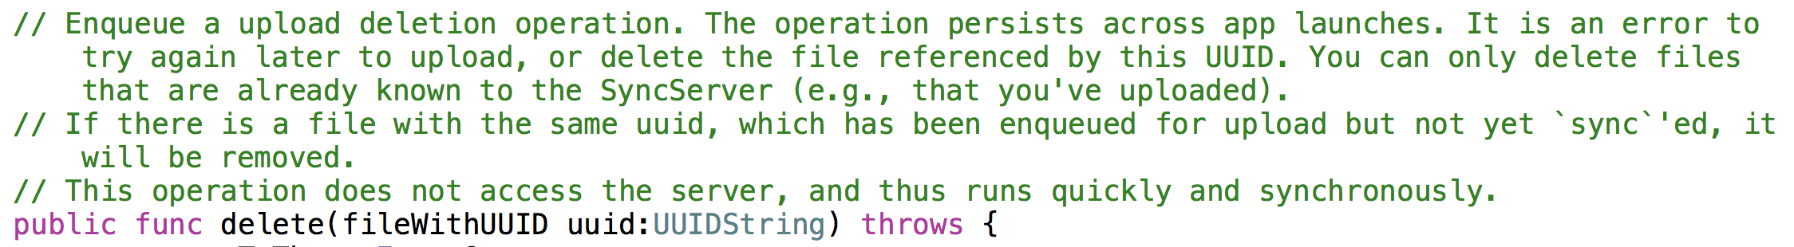
Client Interface: Methods
Notes:
sync: Downloads are always prioritized. The server and current cloud storage is taken to have the `truth`.
Note that there are no dowload operations available to a client directly. These operations occur asynchronously, at the initiation of the client interface itself.

Slide 12
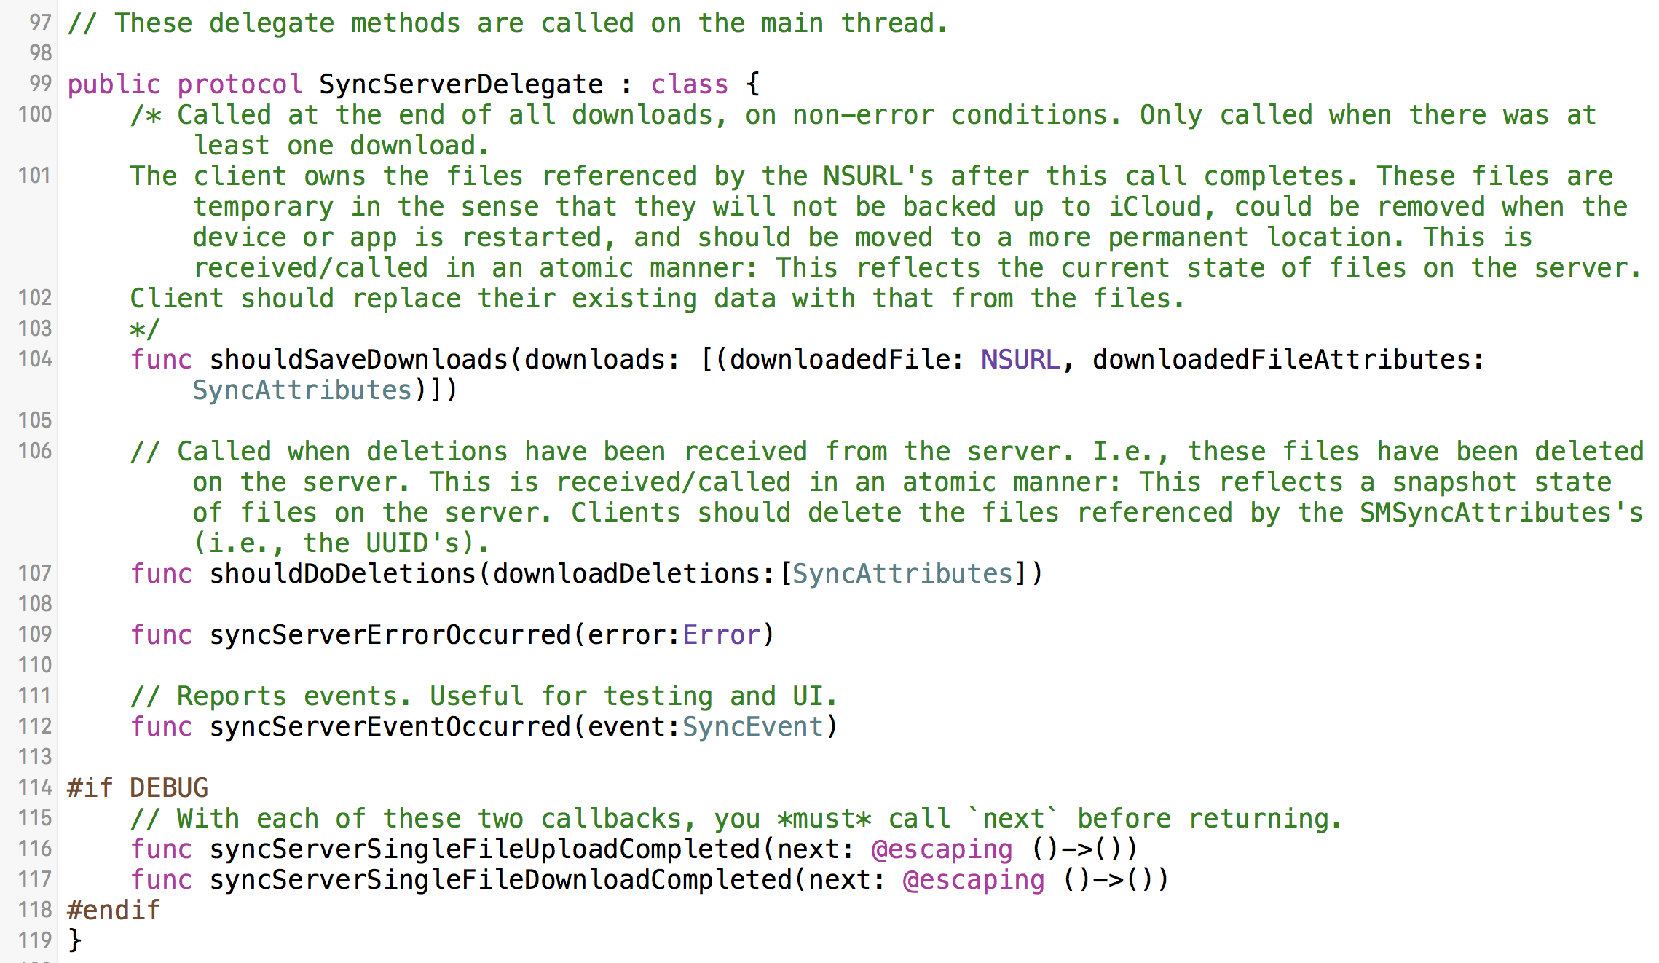
Client Interface: Delegate Methods

Slide 13
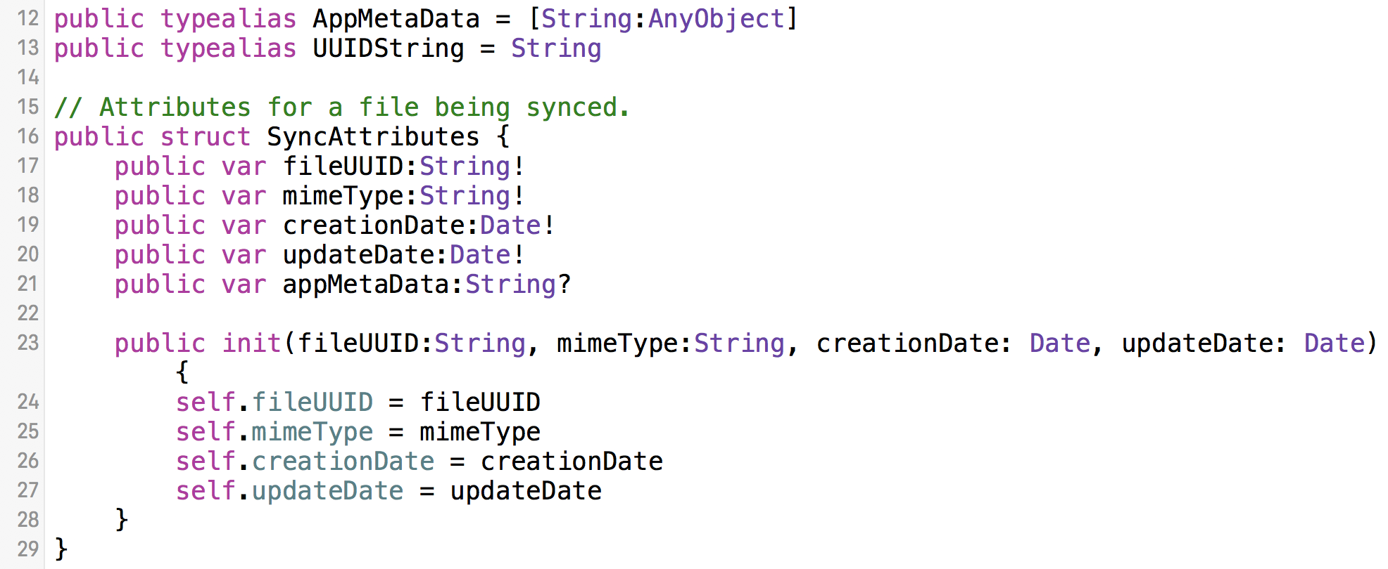
SyncAttributes

Slide 14
Demo Time!
SharedImages app
Server running on AWS
Google Drive folder with files stored for app
Notes:
DEMO! Connect into AWS and show the log from the running server. Also show the SharedImages app, running on my phone, from Quicktime.
I also want to show

Slide 15
SyncServer Next Steps
Plans
Wrap-up Facebook account support for sharing
Add support for multiple file versions
Add other cloud storage support (e.g., Dropbox and Onedrive)
Add other demo apps (e.g., WhatDidILike)
Dreams
Streaming support (when available in Kitura)
Android client interface
Android apps using that interface.

Slide 16
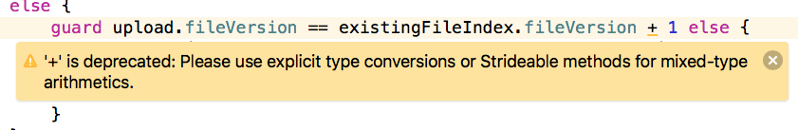

Favorite Swift & Xcode Errors
Unhandled DiagnosticKind in switch.
Notes:
﻿Unhandled DiagnosticKind in switch. Occurreed with Swift 3.1.1 on Linux. It was a compiler crash.

Slide 17
In Closing
https://github.com/crspybits/SyncServerII
https://crspybits.github.io/SyncServerII/
My “ask”:
Other people to
😇 Use SharedImages beta
😎 Develop & deploy demo apps
🙏🏻 Help on system development
chris@cprince.com

