Slide 1
CAPSTONE PROJECT 1
Simple Vehicle Property
Dashboard App in AAOS
Android Automotive OS · Kotlin · Jetpack Compose
Presented by: Cristi
Notes:
Hello, I'm Cristi. This is my Capstone Project 1 - a Simple Vehicle Property Dashboard app for Android Automotive OS, built in Kotlin with Jetpack Compose. It reads real-time signals from the car and shows them on the infotainment screen.

Slide 2
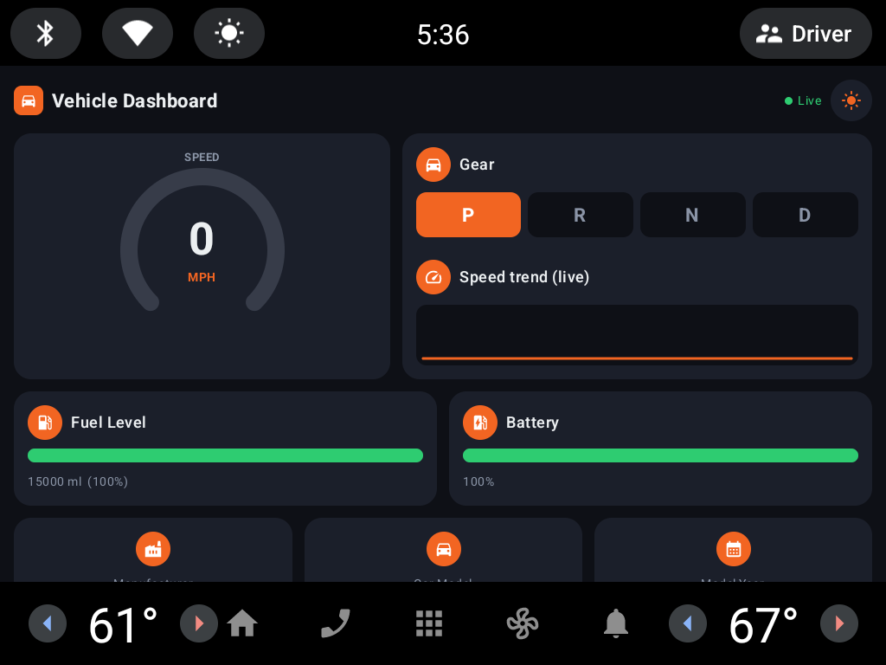
What the app does
1
Reads live vehicle signals
Connects to the vehicle through the AAOS Car API and reads real-time properties.
2
Rich dashboard of metrics
Speed, gear, fuel, battery, range, odometer, and vehicle make / model / year.
3
Updates automatically
Registered property callbacks refresh the UI the moment a signal changes (● Live).
4
Automotive-style UI
Circular speed gauge, live speed graph, gear selector and fuel / battery meter bars.
5
Alerts & theming
Low-fuel red alert and a day / night theme toggle (optional enhancements).
The dashboard running on the Android Automotive emulator (parked)
Notes:
The app connects to the vehicle through the AAOS Car API and reads real-time properties. It shows speed, gear, fuel, battery, range, odometer, and the vehicle make, model and year. Values update automatically the moment a signal changes - that's the registered property callbacks, shown by the 'Live' indicator. The UI follows automotive design: a circular speed gauge, a live speed graph, a gear selector, and fuel and battery meter bars. I also added a low-fuel red alert and a day/night theme.

Slide 3
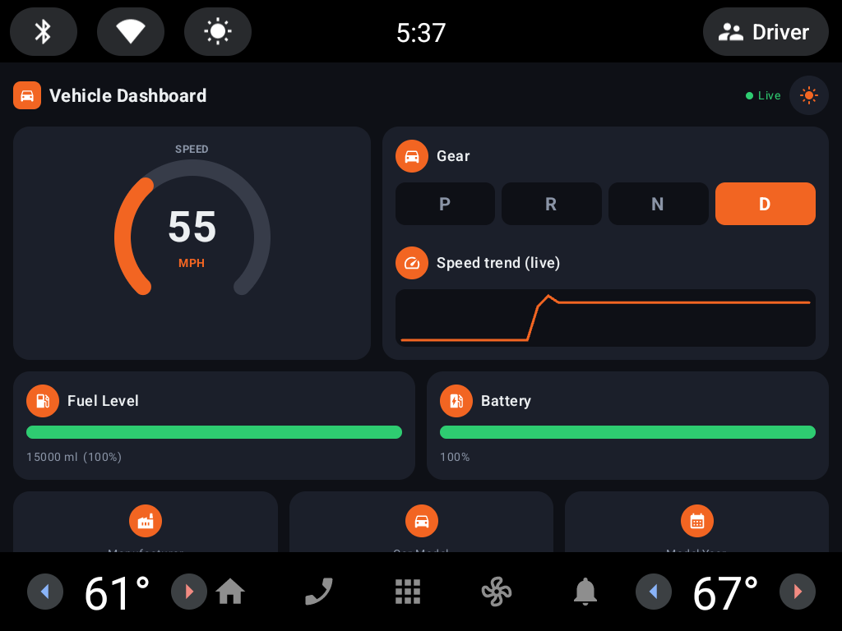
How it works (technical)
1
Platform: Android Automotive OS (AAOS), runs on the Automotive emulator.
2
Language / UI: Kotlin + Jetpack Compose (Material 3).
3
Car API: Car.createCar() → CarPropertyManager.
4
Properties: VehiclePropertyIds: PERF_VEHICLE_SPEED, GEAR_SELECTION, FUEL_LEVEL, EV_BATTERY_LEVEL, RANGE_REMAINING, PERF_ODOMETER, INFO_*.
5
Real-time: registerCallback(...) with SENSOR_RATE_ONCHANGE updates the UI on change.
6
Permissions: CAR_SPEED, CAR_POWERTRAIN, CAR_ENERGY, CAR_MILEAGE, CAR_INFO.
Live update: 55 MPH in Drive, with the speed-trend graph
Notes:
Technically, it runs on Android Automotive OS in the emulator, written in Kotlin with Jetpack Compose. It connects using Car.createCar and CarPropertyManager, and reads VehiclePropertyIds such as PERF_VEHICLE_SPEED, GEAR_SELECTION, FUEL_LEVEL, EV_BATTERY_LEVEL, RANGE_REMAINING and PERF_ODOMETER. Real-time updates come from registerCallback with SENSOR_RATE_ONCHANGE. It requests the required car permissions: CAR_SPEED, CAR_POWERTRAIN, CAR_ENERGY, CAR_MILEAGE and CAR_INFO. On the right, the app is updating live to 55 MPH in Drive, with the speed-trend graph rising.

Slide 4
Thank You
Simple Vehicle Property Dashboard App in AAOS · Capstone Project 1
Notes:
That's the Simple Vehicle Property Dashboard - a working AAOS app reading live vehicle data through the Car API and showing it on an automotive dashboard. Thank you - I'm happy to answer any questions.

