Slide 1

T1
The Relationship Between
Job Listings and Stock Price
Boyuan Xia
Nadley Aisuan
Yuchen Zhou
Notes:
亮亮图文旗舰店
https://liangliangtuwen.tmall.com

Slide 2
CONTENT
Background
1
2
Data Descriptions
3
Models and Results
4
Further Exploration
5
Suggestion

Slide 3
Project Backgrounds

Slide 4







Project Backgrounds
Thinknum is the leading web data vendor for investment firms and corporations. The database includes job-related data from over 500,000 public and private companies around the world.
headcount
employee sentiment
store locations
job listings
social media traction
product pricing

Slide 5
Project Backgrounds
Background
Aims
Banks, media, and tech companies have shed tens of thousands of jobs over the past few months, in what some commentators are calling a “white collar recession”.
The American labor market remains tight, with around 1.5 jobs available per unemployed worker, but fears remain of mass layoffs across other industries as financial conditions continue to tighten.
In this project you will place yourselves in the shoes of a portfolio manager trying to leverage job listings data to make better investment decisions. In particular, you will focus on what impact, if any, hiring freezes have on companies’ stock prices.
1
2

Slide 6
Literature Review
Human Capital Data and Financial Outcomes
Thinknum Alt Data Quantamental Investing
Job listing impacts on the labor market data
Nowcasting deck
Labor Trends
2020 GSAM ESG Amplified
Case Study: Healthcare Purchasing Data
Human Capital Data
Job listing
Influence

Slide 7
Data Descriptions

Slide 8
Data Sources
Financial
Data
Bloomberg Terminal
Job Listings
Data
Thinknum Database
Data
Other
Variables
Other Platforms

Slide 9




Data Processing
Thinknum Data Platform
API
1
2
Firstly, we tried to download data through Thinknum Data Platform.
In order to obtain data more efficiently, we chose using API with Python.
Data Cleaning
3
We reorganized the format of our data and dropped some missing data and outliers.
And we also rescaled all variables with MinMaxScaler.
Merge
4
We merged the data from different sources.

Slide 10
Catrgories
Management
Manager Lead
Header Operation
Consulting
Consultant Advisor
Analyst
Science/Research
Scientist Specialist
Engineering
Marketing
Engineer Scientist
Developer Architect
Software Hardware
Marketing Sale
Customer Product

Slide 11
Statistic Description
Time Range: 2019-01-01 ~ 2023-10-15
Sample: 61 companies ( Information Technology Sector of S&P 500 Index)
 | Stock Price | Market cap | Job Listing
count | 11961 | 11961 | 11961
mean | 172.84 | 1.36018E+11 | 6763.36
std | 143.20 | 3.82541E+11 | 11066.19
min | 8.63 | 3552M | 100
25% | 65.52 | 16093M | 1283
50% | 133.66 | 29826M | 2857
75% | 230.33 | 95492M | 6771
max | 899.79 | 3.08015E+12 | 92379

Slide 12
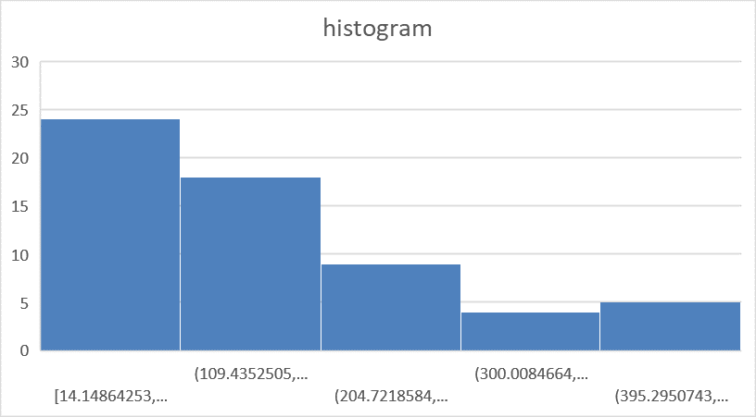
Visualization: Stock Price

Slide 13
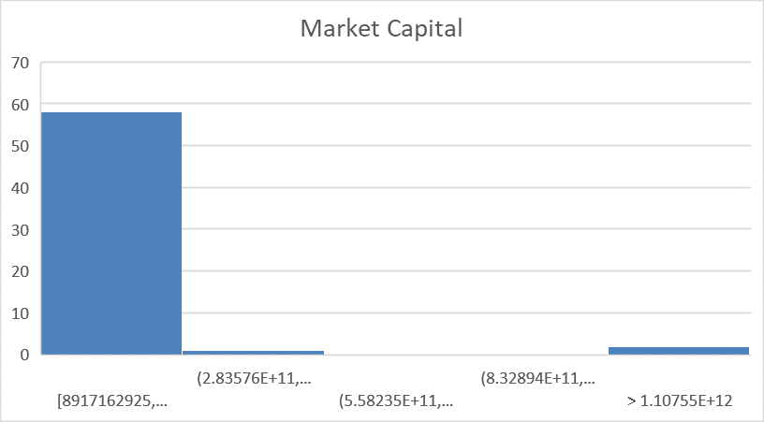
Visualization: Market Cap

Slide 14
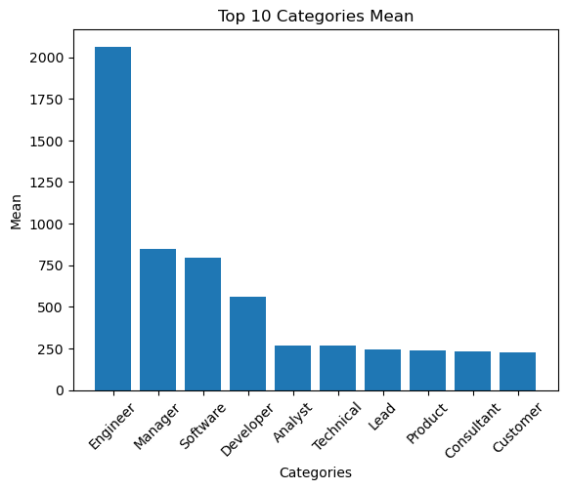
Job Categories
The top 10 occupational categories with the highest average recruitment numbers in the sector

Slide 15
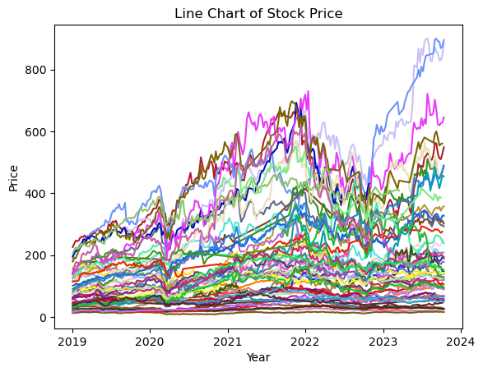
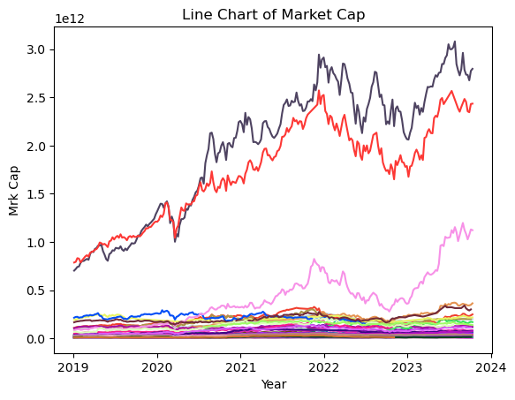
Visualization: Stock Price and Market Capital

Slide 16
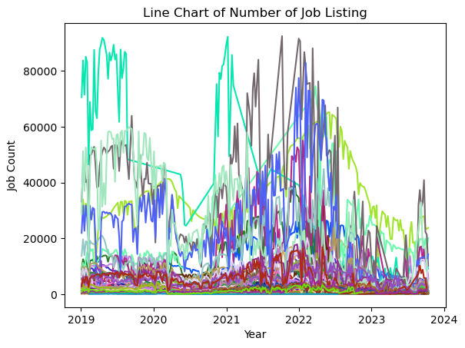
Visualization: Job Listing

Slide 17
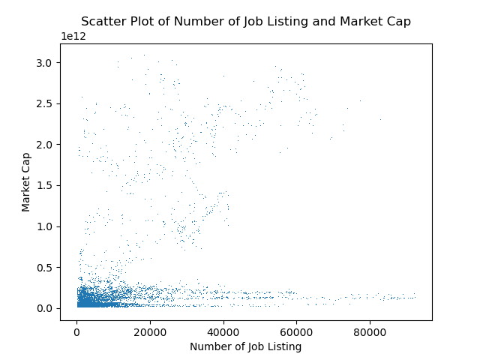
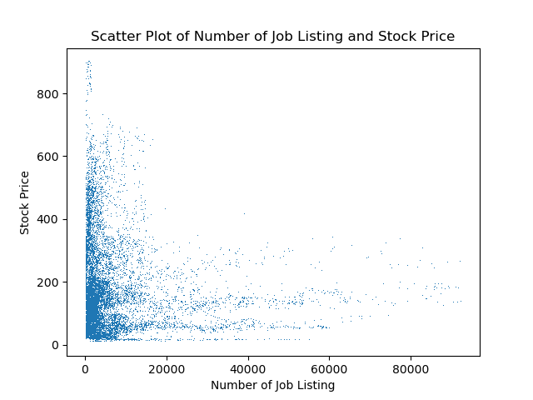
Visualization: Relation Between SP/MC and Number of Job Listing

Slide 18
Correlation
 | Job Count | Engineer | Manager | Software | Developer | Analyst | Technical | Lead | Product | Consultant | Customer
price | -0.1026 | -0.0811 | -0.0409 | -0.0245 | -0.073 | -0.1137 | -0.0787 | -0.0654 | -0.028 | -0.0299 | -0.0209
sp_1q | -0.0943 | -0.0761 | -0.0333 | -0.0197 | -0.0666 | -0.1083 | -0.0751 | -0.0608 | -0.0252 | -0.0292 | -0.0163
sp_2q | -0.0781 | -0.0637 | -0.0189 | -0.0062 | -0.0556 | -0.0974 | -0.0629 | -0.0507 | -0.0092 | -0.0238 | -0.0049
sp_3q | -0.0631 | -0.0482 | -0.0066 | 0.0064 | -0.0436 | -0.0871 | -0.0502 | -0.038 | 0.0072 | -0.0201 | 0.0084
sp_4q | -0.0491 | -0.0374 | 0.0083 | 0.0195 | -0.0328 | -0.0803 | -0.0361 | -0.0277 | 0.0186 | -0.017 | 0.0216
mrk_cap | 0.4741 | 0.7168 | 0.6568 | 0.6592 | 0.1276 | 0.1425 | 0.2718 | 0.4392 | 0.5677 | 0.0363 | 0.2327
mc_1q | 0.4692 | 0.7017 | 0.6591 | 0.655 | 0.1258 | 0.1418 | 0.2677 | 0.442 | 0.5551 | 0.0372 | 0.2347
mc_2q | 0.4738 | 0.6959 | 0.6711 | 0.6615 | 0.1289 | 0.1457 | 0.2757 | 0.4509 | 0.556 | 0.0416 | 0.241
mc_3q | 0.4828 | 0.6986 | 0.6888 | 0.6719 | 0.1347 | 0.1517 | 0.2904 | 0.4626 | 0.5666 | 0.0462 | 0.2513
mc_4q | 0.4863 | 0.6953 | 0.7003 | 0.6819 | 0.1369 | 0.1515 | 0.3048 | 0.4726 | 0.5609 | 0.0493 | 0.2617

Slide 19
Models and Results

Slide 20
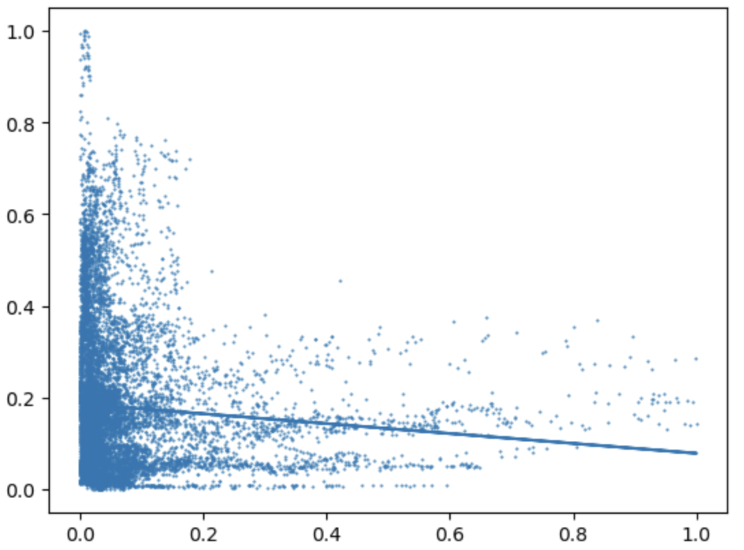
Approaches
We split the data into train sets (80%) and test sets (20%).
Applied ML models to explore the relationship between the number of job listings and companies’ performance.
However, the prediction results of all the following algorithms are poor.
Linear Regression (Ordinary Least Squares)
SVM
Random Forest
Decision Tree

Slide 21

New Approaches
ADD CATEGORIES
NORMALIZATION
LAGGED
NEW MODELS
In order to get more features, we add several types of jobs.We also change the dependent variable from stock price to market capitalization
As the impact of job listings may only appear months later
Performed normalization on our data
We tried more complex models to fit our data

Slide 22
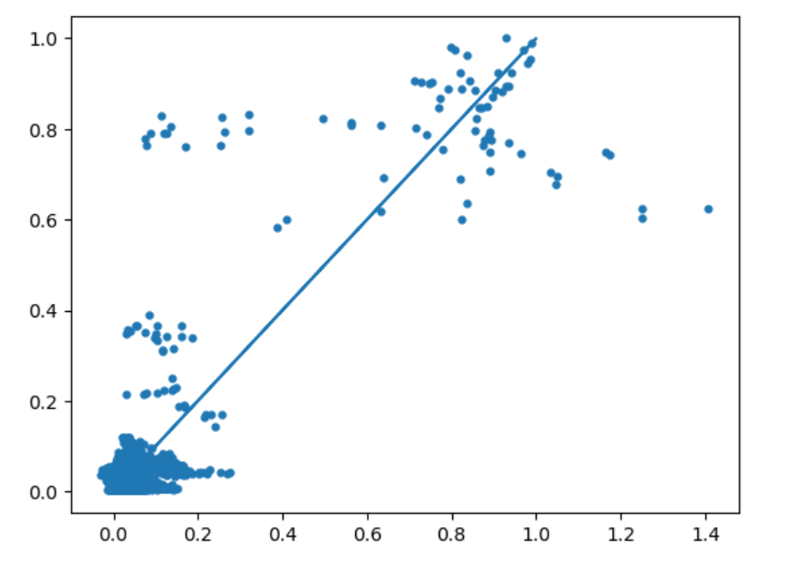
Linear Regression
Y = ∂x + з
Results:
Mean squared error: 0.01
Variance score: 0.74
Mean absolute error: 0.04
R2 = 0.744004

Slide 23
Linear Regression
Variables | Coefficient
Analyst | 0.00551
Lead | 0.00700
Intern | -0.0174***
Customer | 0.0272***
Consultant | 0.0335***
Technical | -0.0408***
Product | 0.0438***
Sale | -0.0504***
Job_count | -0.0510***
Specialist | 0.0549***
Operation | -0.0554***
Engineer | -0.0652***
Scientist | -0.0654***
Support | 0.0828***
Developer | -0.0831***
Information | 0.0900***
Business | 0.0941***
Marketing | -0.103***
Manager | -0.121***
Hardware | 0.185***
Advisor | -0.205***
Software | 0.218***

Slide 24
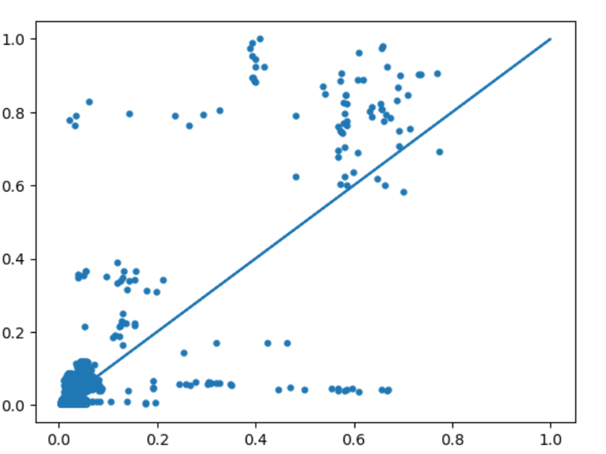
Random Forest
n_estimators = 200
random_state = 0
max_features="log2"
max_depth=30
Results:
Mean squared error: 0.01
Variance score: 0.77
Mean absolute error: 0.03
R2 = 0.77273

Slide 25
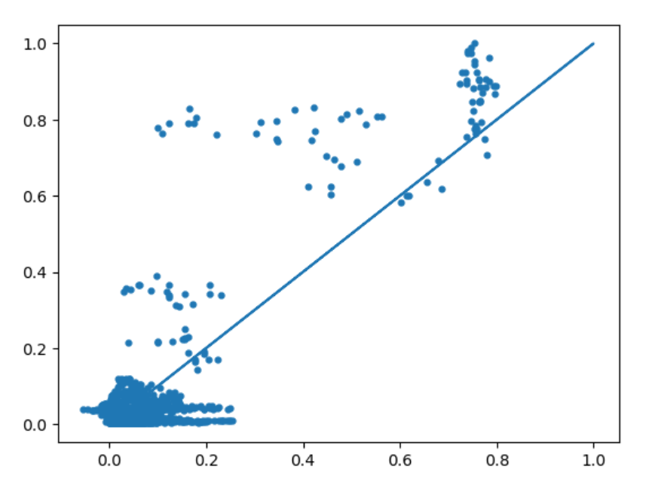
Neural Network
activation = 'tanh'
solver='adam'
alpha=1e-5
hidden_layer_sizes = (20,5)
random_state=1
Results:
Mean squared error: 0.01
Variance score: 0.75
Mean absolute error: 0.04
R2 = 0.750259

Slide 26
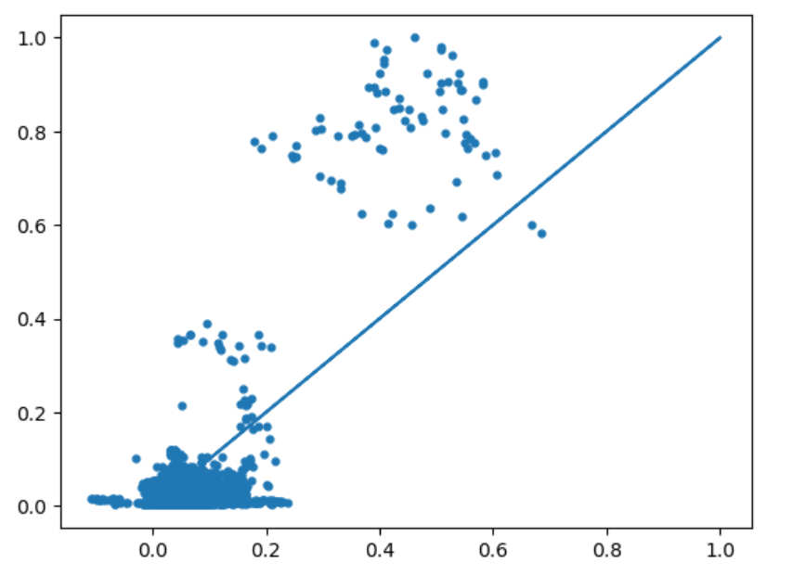
Support Vector Machine
Kernel: Linear
Results:
Mean squared error: 0.01
Variance score: 0.59
Mean absolute error: 0.06
R2 = 0.593907

Slide 27
Conclusion
According to the accuracy, the performance of the Neural Network model is the best after 4 quarters, which is about 0.827804. That means our data is complex and has a lot of non-linear characteristics, which suits non-linear models more.
And the performance of our models come best when lagged for 4 quarters, which may imply that the influences of hiring certain jobs on company performance appear quarters later.

Slide 28
Further Exploration
Are happy employees good for corporate performance?
Do different roles, seniority levels, or locations have a different impact on corporate performance?
Does higher employee satisfaction lead to better equity returns?
How do a company's hiring decisions impact employee sentiment?

Slide 29
Suggestions for the project
Categorizing data is crucial for improving the model's fitting performance. It is recommended to incorporate categorical data.
When scraping data, it is advisable to start as early as possible, as you may encounter some challenges and limitations along the way.
When downloading data from the Bloomberg Terminal at school, it is possible to encounter download limitations, and it is important to be aware of them.

Slide 30
Thank You for Listening

