Slide 1
Windows Powershell Basics
For IT Professionals

Slide 2
Agenda
Brainstorming
What’s Powershell
Get Started with Powershell
Powershell basics
Getting help
Working with Scripts
Creating Powershell scripts
Running scripts
Automating Administrative Tasks

Slide 3
Preview Questions
1) [Match](39+79-51)*497/28 = ?
2) [Date] How many days to the next Christmas Day?
3) [Capacity] 3GB > 3145726 ?
4) [File] Total length of execution file in a certain folder?
5) [Registry] Get the value of key “PortNumber” in HKEY_LOCAL_MACHINE\SYSTEM\CurrentControlSet\Control\Terminal Server\WinStations
6) [Service] Service Windows Firewall is Running?
7) [Process] How many Firefox process currently running?
Notes:
1. (39+79-51)*497/28
2. [datetime]("2017-12-25") - (Get-Date)
3. 3GB –gt 2145726KB
4. Get-ChildItem -Path D:\snailgame\server1\release\*.exe | Measure-Object -Sum length
5. (Get-ItemProperty -Path 'HKLM:\SYSTEM\CurrentControlSet\Control\Terminal Server\WinStations\RDP-Tcp').portnumber
6. Get-Servcie –name Mpssvc
7. (Get-Process –name firefox).count

Slide 4




What Is PowerShell?
Windows PowerShell™ includes an interactive prompt and a scripting environment
Commands are object-based
Large set of built-in commands
All shell commands use the same parser
Windows PowerShell is installed by default on Windows OS from Windows Server® 2008 R2 and Windows® 7

Slide 5





Environment & Background
1.0
2.0
3.0
4.0
5.0
标题数字等都可以通过点击和重新输入进行更改，顶部“开始”面板中可以对字体、字号、颜色、行距等进行修改。标题数字等都可以通过点击和重新输入进行更改，顶部“开始”面板中可以对字体、字号、颜色、行距等进行修改。
2006, release for XP,2K3,Vista,
2k8
2009,integrated with Win7,2008 R2
2012,integrated with Win8, 2012 and available for Win7, 2008 SP1, 2008 R2
2013,integrated with Win8.1 and Win2012 R2. Also available for Win7 SP1,2008 R2
2016,integrated with Win10 and Window Server 2016

Slide 6
Why Is Powershell Powerful?
What’s Powershell?
Task automation, configuration management framework
Consisting of a command-line shell and associated scripting language built on the .NET Framework
Full access to COM and WMI
Can be invoked on both local and remote
Provides a hosting API with which Powershell runtime can be embedded inside other applications
Reasons:
Convenient
Object-oriented
Binding .NET
Backward Compatibility
Extensibility

Slide 7
Why Use Windows Powershell?
PowerShell is a great way to manipulate server and/or workstation components
It’s geared toward system administrators by creating a more simplified syntax base
PowerShell is more secure than running vbscripts
Quick analysis of various computer specs

Slide 8
What’s Windows Powershell for?
Administrator
 | before | Now
GUI | MMC | GUIs built on top of Powershell
Interactive Shell | CMD | Powershell
Scripting | BAT in CMD | Powershell
COM | WMI(VBScript and JScript) | Powershell

Slide 9
Familiar Commands
You can use commands that you are familiar with such as CD, PING, IPCONFIG or DIR
There are also some Unix commands that can be used such as LS or MAN (these commands are aliases to the actual PowerShell commands)
Get-Alias will list the preloaded Alias’s and will show you what Cmdlet they are mapped to
Can tab complete
One of the time savers in PowerShell is giving the user the ability to pipe commands together

Slide 10
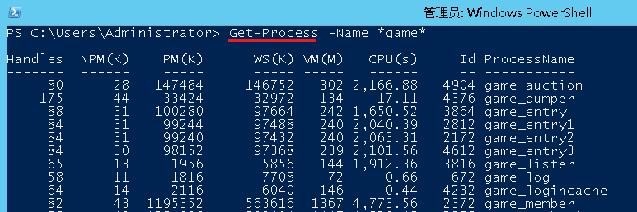
Cmdlets
Verb + Noun = Cmdlet
Get-Help
Get-Command
Get-Member
Verb | Action | Comments
Add | Adds a resource to a container, or attaches an item to another item | For this action, do not use verbs such as Append,Attach,or Insert
Get | Specifies an action that retrieves a resource | For this action, do not use verbs such as Read,Open,Cat,Dir,Find or Search
Set | Replaces data on an existing resource or creates a resource that contains some data. | For this action, do not use verbs such as Write, Reset, Assign, or Configure.
New | Creates a resource. | For this action, do not use verbs such as Create, Generate, Build, Make, or Allocate.
Remove | Deletes a resource from a container. | For this action, do not use verbs such as Clear, Cut, Dispose, Discard, or Erase.

Slide 11
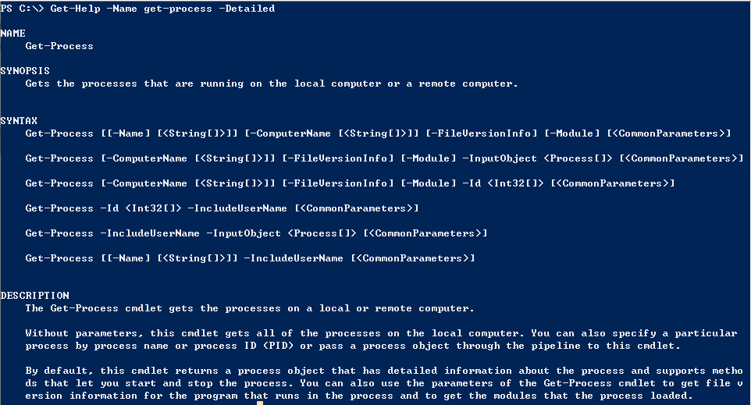
Get-Help
Help about PowerShell commands and topics

Slide 12
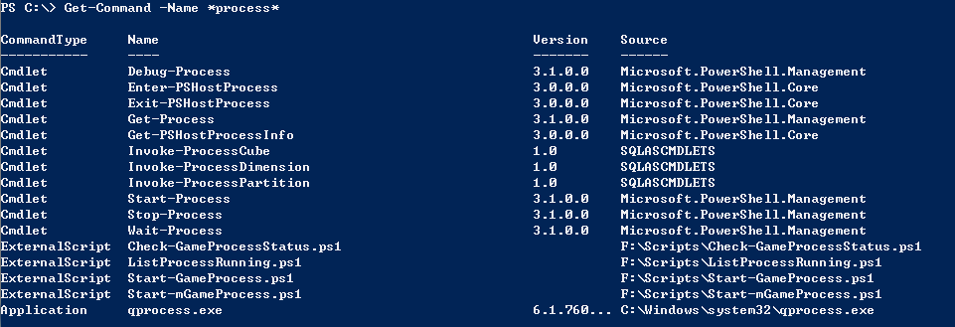
Get-Command
Get information about anything that can be invoked

Slide 13
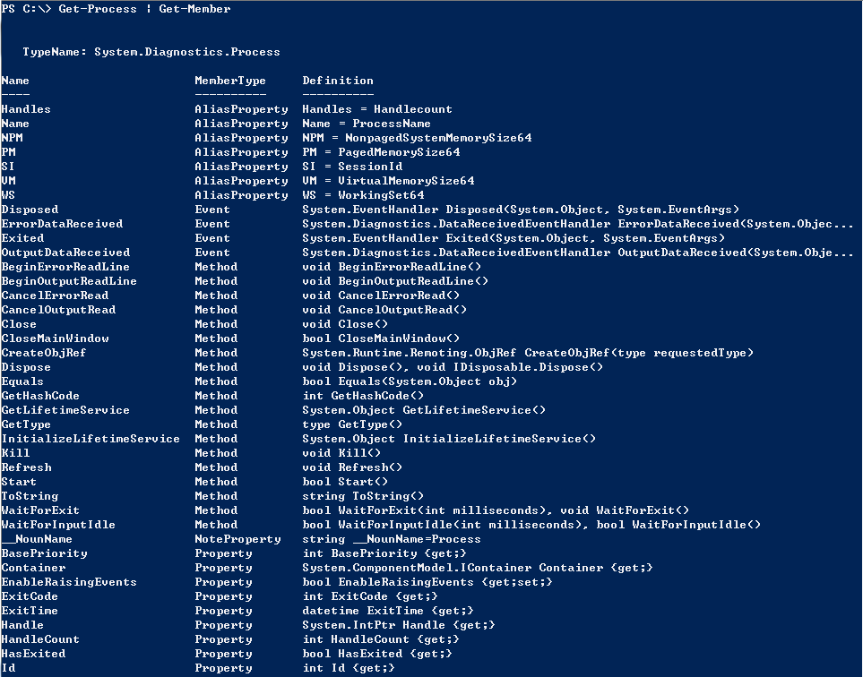
Get-Member
Show what can be done with an object

Slide 14










PowerShell Syntax
Argument
String
Name
Verb Noun
PS> Get-Process
–computername “test1”
Parameter
Command
Property Names
Handles | WS(K) | Id | ProcessName
---- | ---- | ------ | ------------
1315 | 869700 | 3384 | firefox
1816 | 85448 | 4332 | OUTLOOK
Property Values

Slide 15






Piping and the Pipeline
Scenario 1
Get-Service | Where-Object { $_.Status –eq “Running” } | Sort-Object Name
Cmdlet
Filter
Sort
Scenario 2
Get-item –path HKLM:\Software\MyCompany | new-Itemproperty –name
NoOfEmployees –value 8124

Slide 16
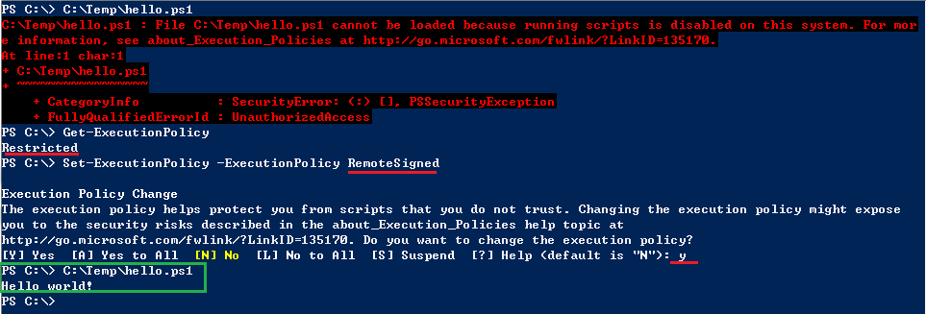
Script Security Settings
Restricted – No scripts can be run. Windows PowerShell can be used only in interactive mode.
AllSigned – Only scripts signed by a trusted publisher can be run.
RemoteSigned – Downloaded scripts must be signed by a trusted publisher before they can be run.
Unrestricted – No restrictions; all Windows PowerShell scripts can be run.

Slide 17
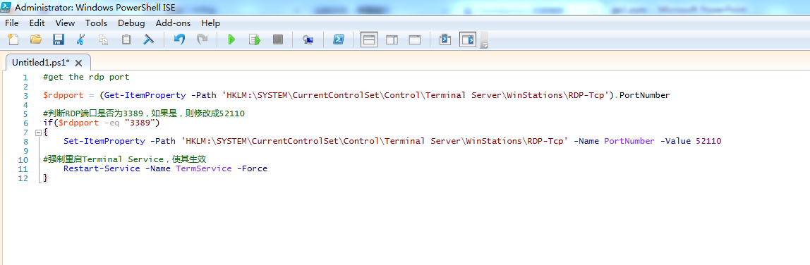
Creating Powershell scripts

Slide 18
Running Scripts
PowerShell scripts differ from most scripts
PowerShell scripts end in .ps1 and have to be run inside a PowerShell window
Double clicking a PowerShell script will open the script in notepad
Scripts must also be run in these format
PS C:\> . C:\Temp\hello.ps1
PS C:\> & C:\Temp\hello.ps1
PS C:\> C:\Temp\hello.ps1
PS C:\Temp> .\hello.ps1

Slide 19
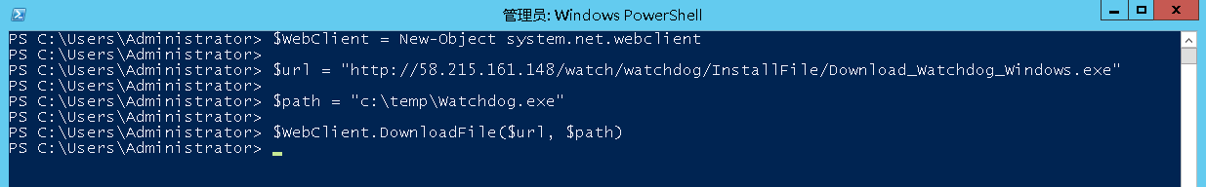
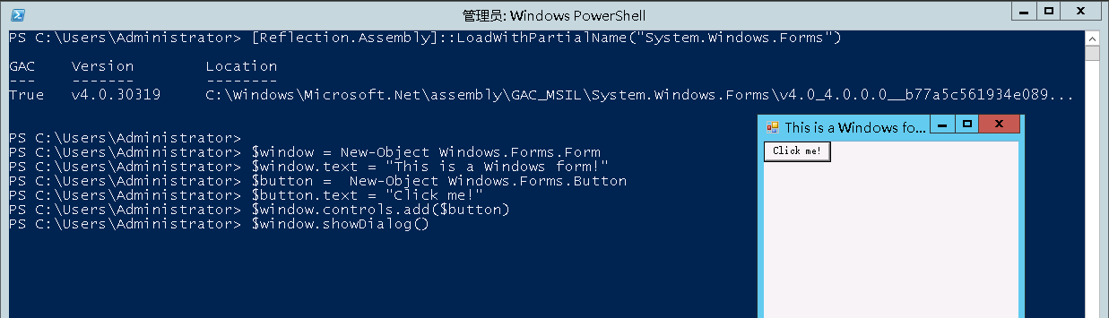
Engaged with .NET

Slide 20
Automating Administrative Tasks
Windows服务器初始化
加载磁盘，创建磁盘分区并格式化
显示文件后缀名
更改RDP端口
系统优化（禁用不常用的服务，禁止自动更新）
日常工作
更新配置文件中的某一个值（如game_lister中的ClientVersion）
批量生成配置文件
更新服务端资源文件
开服，检查游戏进程状态
和计划任务配合，定时开关服

Slide 21

THANK YOU

