Slide 1
The Missing Benchmark Metric: Memory
2nd February 2019
Java Dev Room, FOSDEM, Brussels
Jens Wilke
@cruftex
cruftex.net
TODO: add copyright!
Notes:
Good evening everybody!
Thanks, Diana from reply for inviting me today!
Thanks for check24 and Jenny and Silvia for josting this meetup
I am doing this talk in English, for many reasons, although I am actually born in Munich, so I am able to understand German as well
I am a Java programmer since 20 years, but this is actually my first talk about a Java topic in my hometown!
Pealse be gentle. I pushed myself to do this talk, but I am not a regular talker

Slide 2
About Me
Performance Fan(atic)
Author of cache2k
70+ answered questions on StackOverflow about Caching
JCache / JSR107 Contributor
General manager of a boutique software engineering shop in Munich
@cruftex / cruftex.net
https://cache2k.org
Notes:
Questions:
Who has a computer?
Who is a Java programmer?
Who is doing applications that do process lots of data in batch?
Who is doing applications that are interactive, like eCommerce shops?

Slide 3
Content
Why?
How to gather memory metrics?
How (not) to gather memory metrics from a running JMH benchmark?
Real benchmark results … to get a feeling whether this is worthwhile
Happyness?!
Please ask questions right away!

Slide 4
Motivation
Compare different caching libraries in identical scenario (access sequence, cache size, CPU and JDK) with JMH
Primary result: Throughput in ops/s
WT-beep?! Compare caching libraries and ignore memory consumption?!
Space vs. Time trade off
But:
no mechanism in JMH to extract memory usage metrics (yet…)

Slide 5
Metric: Object Graph Traversing
EHCache sizeof
Java Agent for Memory Measurements
Pro:
  No actual usage long running benchmark needed, just fill up the data scructures
  No complex setup (dedicated hardware)
Con:
  How to choose the root object / traverse the whole heap?
  Static value of heap objects only

Slide 6
Metric: Heap Dump /
Heap Historgram
e.g. use jmap to get a heap dump or histogram
Pro:
  Same as before, we don‘t need a real benchmark run
  Accurate value of used heap space
  Additional information in the histogram or dump
Con:
  Costly
  Static value of heap objects only

Slide 7
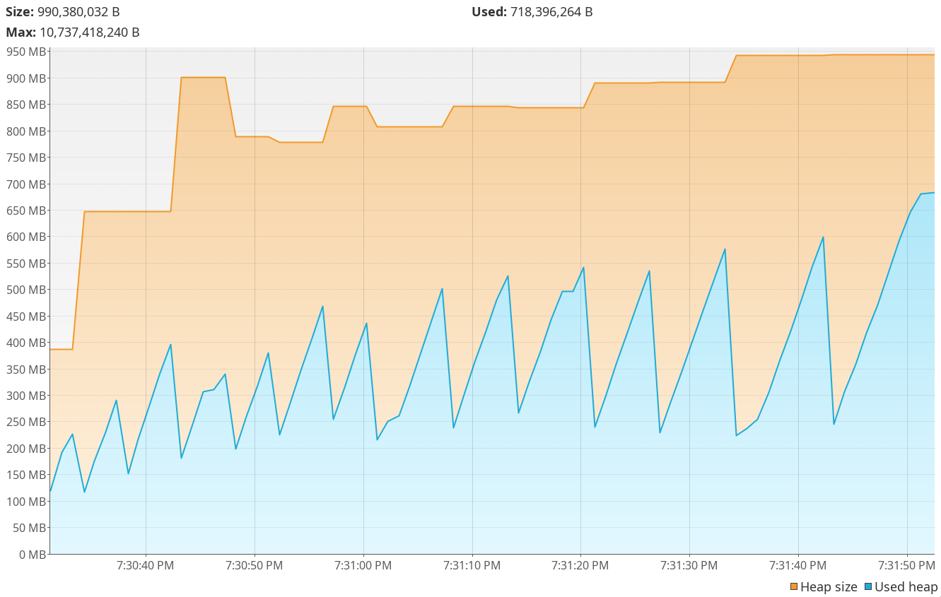
Let it Run!

Slide 8
How to Extract a (single) Metric?
Warmup Iteration 1
Warmup Iteration 2
Iteration 1
Iteration 2
Iteration 3

Slide 9
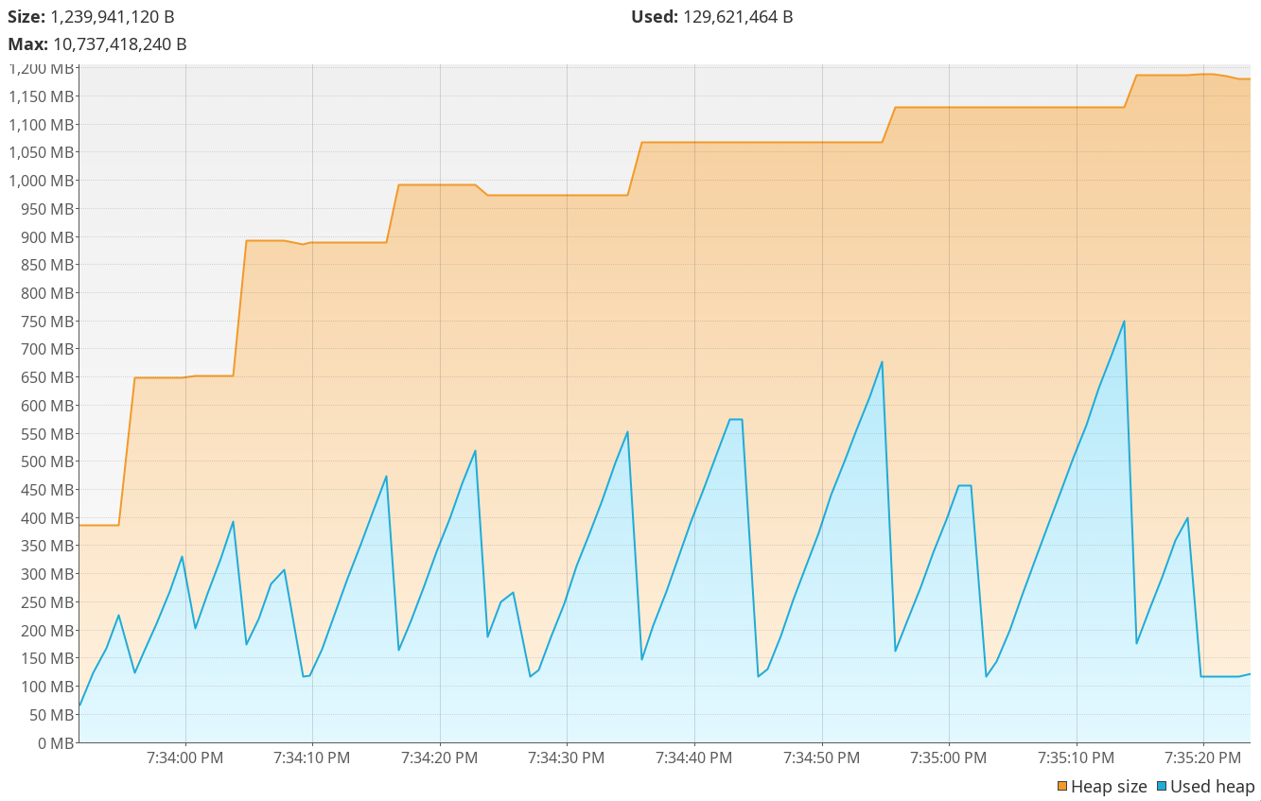
Warmup Iteration 1
Warmup Iteration 2
Iteration 1
Iteration 2
Iteration 3
Force GC!

Slide 10
Side to Side Comparison
^ no forced GC
forced GC >

Slide 11
Wait a minute….
Warmup Iteration 1
Warmup Iteration 2
Iteration 1
Iteration 2
Iteration 3

Slide 12
Sidenote:
GC and Micro Benchmarks
Micro-Microbenchmark: GC might happen during an iteration
  Single GC occurence causes skewed result
  Use JMH parameter -gc true or Zero GC
=> Get garbage collector out of the equation
NotSo-Microbenchmark: GC happens always during an iteration
  Make sure a lot of GCs happen, JMH parameter: -prof gc
  Increase warmup and iteration time
  „Know your GC“ ↔ „Get to know your GC“
=> You cannot avoid the GC. Make it go steady.

Slide 13
A Metric? Some Metrics!

Slide 14
Linux OS Metrics:
VmRSS, VmHWM
Iteration 1
Iteration 2
Iteration 3
VmHWM
VmRSS
Linux:
/proc/self/status

Slide 15
GC Notifications
Notification after GC run (via GarbageCollectionNotificationInfo)
Contains memory usage before and after GC
(examples only shows notification in iteration 2)
Iteration 1
Iteration 2
Iteration 3
max(committedAfterGc)
max(usedAfterGc)

Slide 16
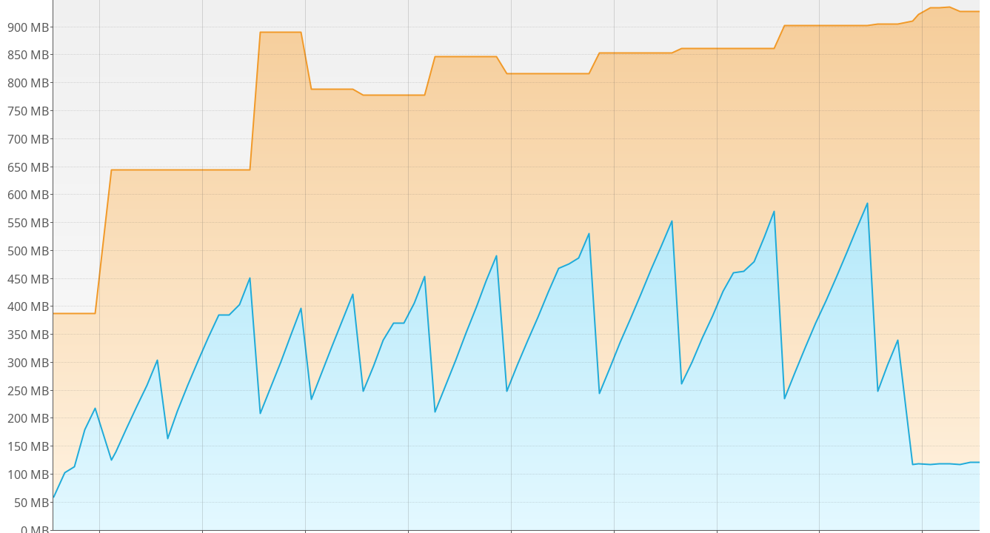
Allocation Rate
Iteration 1
Iteration 2
Iteration 3
allocRate(b/s)
allocRate(b/op)

Slide 17
Minimal Memory at the End
JMH can run multiple VMs after another (forks)
at end of each fork the invasive collectors could happen (force GC, heap histogram)
Iteration 1
Iteration 2
Iteration 3
VmRSS.fin
Force GC!
heapUsedHisto.fin
heapUsedMx.fin

Slide 18
Example JMH Running Scheme
JMH can run multiple VMs after another (forks)
9 iterations to collect results
3 forks, at end of each fork the invasive collectors happen (force GC, heap histogram)
Parameters: -f 3 -wi 3 -i 3
JMH Control Process
Fork 1
WU
WU
I
I
I
Fork 2
WU
WU
I
I
I
Fork 3
WU
WU
I
I
I
Time

Slide 19
Results
Notes:
Do we really need a fast cache?
Problably not much gain when EhCache is replaced
lots of caches in the JVM, locales, XML parsing, etc.
Use with hibernate
More caching opportunities with a light weight and fast cache

Slide 20
TODO: Benchmark Seutp
Notes:
Do we really need a fast cache?
Problably not much gain when EhCache is replaced
lots of caches in the JVM, locales, XML parsing, etc.
Use with hibernate
More caching opportunities with a light weight and fast cache

Slide 23
Conclusion
The JVM provides different ways to ask for used memory (Runtime, MXBean, jmap / Historgram, GC Notifications)
If GC is happening, also record memory usage in your JMH results
JMH can also be used to construct benchmarks to evaluate (peak) memory consumptions
Be aware of the different GC implementations

Slide 24
Thanks & Enjoy Live!
JMH extensions available at: github.com/cache2k/cache2k-benchmark
  ForcedGcMemoryProfiler
  LinuxVmProfiler
Plan/idea: discuss this more and add it into the JMH code base
Please like:
github.com/cache2k/cache2k

Slide 25
Notes
How to start visualvm with bigger font size to make screenshots:
visualvm -J-Dsun.java2d.uiScale=1.0 --fontsize 18
First VisualVm heap graph from:
java-11 -jar jmh-suite/target/benchmarks.jar \\.ZipfianSequenceLoadingBenchmark -jvmArgs -server\ -Xmx10G\ -XX:BiasedLockingStartupDelay=0\ -verbose:gc\ -XX:+UseParallelGC -f 1 -wi -w 15s -i 3 -r 15s -prof comp -prof gc -prof hs_rt -prof hs_gc -prof org.cache2k.benchmark.jmh.LinuxVmProfiler -prof org.cache2k.benchmark.jmh.MiscResultRecorderProfiler -prof org.cache2k.benchmark.jmh.GcProfiler -t 4 -p factor=5 -p entryCount=1000000 -p cacheFactory=org.cache2k.benchmark.Cache2kFactory -rf json -rff /run/shm/jmh-result/result-Cache2kFactory-ZipfianSequenceLoadingBenchmark-4.json
Second VisualVm heap graph, additional parameters:
-prof org.cache2k.benchmark.jmh.ForcedGcMemoryProfiler -gc true

