Slide 1
Java In-Process Caching – Performance, Progress and Pitfalls
17th October 2018
Lightweight Java User Group Munich
Jens Wilke
@cruftex
cruftex.net
Notes:
Good evening everybody!
Thanks, Diana from reply for inviting me today!
Thanks for check24 and Jenny and Silvia for josting this meetup
I am doing this talk in English, for many reasons, although I am actually born in Munich, so I am able to understand German as well
I am a Java programmer since 20 years, but this is actually my first talk about a Java topic in my hometown!
Pealse be gentle. I pushed myself to do this talk, but I am not a regular talker

Slide 2
About Me
Performance Fan(atic)
Author of cache2k
70+ answered questions on StackOverflow about Caching
JCache / JSR107 Contributor
General manager of a boutique software engineering shop in Munich
@cruftex / cruftex.net
https://cache2k.org
Notes:
Questions:
Who has a computer?
Who is a Java programmer?
Who is doing applications that do process lots of data in batch?
Who is doing applications that are interactive, like eCommerce shops?

Slide 3
Content
In-Process Cache Fundamentals
  What is an in-process cache doing
  Why you maybe should not write another one
  Performance comparison
  Technical Overview
Next talk or discussion:
Features
APIs

Slide 4
Cache by Wikipedia
In computing, a cache /kæʃ/ kash,[1] is a hardware or software component that stores data so that future requests for that data can be served faster
Notes:
Boring!
So more questions:
Who is using caching?
Who is not using caching?
Who is afraid of caching?

Slide 5
Web Application
Every line of code I see I can usually put on the this axis:
0
1
> 1
number of executions per web request

Slide 6
Web Application
With a cache we need less executions
0
1
> 1
number of executions per web request
Notes:
With a cache we can achieve that expensive operations are executed less often

Slide 7
Java In-Process Caching
A tool to tackle the space time tradeoff problem
Improve UX and lower latency:
Have hot data as „close to the CPU as possible“ (on the heap and as object reference)
Notes:
I see a in-process cache as a tool to tackle the space-time tradeoff problem. By wireing in a cache I can trade in memory for saving expensive operations.
An Java in-process cache keeps objects on the heap and as „close to the CPU as possible“
Sometimes people read about application architecture and that it is good to use a cache, specifically memcache. Memcache is useful for languages that don‘t keep memory content between requests. In Java we can keep information on the heap without to query other processes or external systems

Slide 8
Whats needed?
The interface of a cache is similar (sometimes identical) to a Java Map:
  cache.put(key, value);
  value = cache.get(key);
We need two things for a cache:
  A hash table
  An eviction strategy
    to limit the used memory
    but keep data that is „hot“

Slide 9
A Simple Cache with LinkedHashMap
public class LinkedHashMapCache<K,V>
extends LinkedHashMap<K,V> {
private final int cacheSize;
public LinkedHashMapCache(int cacheSize) {
super(16, 0.75F, true);
this.cacheSize = cacheSize;
}
protected boolean removeEldestEntry(Map.Entry<K, V> eldest) {
return size() >= cacheSize;
}
}
Notes:
LinkedHashMap is from the JDK and connects all entries in a double linked list
We can build a simple LRU cache with that!
Question:
Who has done a Java cache implementation himself?
Who has used the LinkedHashMap?
Next: Rant on LinkedHashMap!!

Slide 10
Side note….
We need a cache and all we get from the JDK is the LinkedHashMap?!
Digging into the JDKs Java code internals we will find a lot of cache implementations for a lot of different things…..

Slide 11
A Simple Cache with LinkedHashMap
What is missing?!
public class LinkedHashMapCache<K,V>
extends LinkedHashMap<K,V> {
private final int cacheSize;
public LinkedHashMapCache(int cacheSize) {
super(16, 0.75F, true);
this.cacheSize = cacheSize;
}
protected boolean removeEldestEntry(Map.Entry<K, V> eldest) {
return size() >= cacheSize;
}
}

Slide 12
Ooops, Thread Safety!
public class SynchronizedLinkedHashMapCache<K,V> {
final private LinkedHashMapCache<K,V> backingMap;
public void put(K key, V value) {
synchronized (backingMap) {
backingMap.put(key, value);
}
}
public V get(K key) {
synchronized (backingMap) {
return backingMap.get(key);
}
}
}
Notes:
We want to have concurrent access!
Let‘s take the LinkedHashMapCache from before and wrap the put and get into a synchronized statement
Now we have a cache! Let‘s see how it performs...

Slide 13
A ReadOnly Benchmark (JMH)
BenchmarkCache<Integer, Integer> cache;
Integer[] ints;
entryCount = 10_000;
@Setup
public void setup(){
cache = getFactory().createUnspecialized(entryCount * 10);
ints = new Integer[PATTERN_COUNT];
RandomGenerator generator = new XorShift1024StarRandomGenerator(1802);
for (int i = 0; i < PATTERN_COUNT; i++) {
ints[i] = generator.nextInt(entryCount);
}
for (int i = 0; i < entryCount; i++) {
cache.put(i, i);
}
}
@Benchmark @BenchmarkMode(Mode.Throughput)
public long read(ThreadState threadState) {
int idx = (int) (threadState.index++ % PATTERN_COUNT);
return cache.get(ints[idx]);
}
Notes:
…. so let‘s do an JMH benchmark!
JMH details would be a complete other talk….
For benchmarking I am using a cache that contains just integer objects as key and value
BenchmarkCache is the cache abstraction for benchmarking which delegates to the cache implementations
Next slide is setup….

Slide 14
A ReadOnly Benchmark (JMH)
BenchmarkCache<Integer, Integer> cache;
Integer[] ints;
entryCount = 10_000;
@Setup
public void setup(){
cache = getFactory().createUnspecialized(entryCount * 10);
ints = new Integer[PATTERN_COUNT];
RandomGenerator generator = new XorShift1024StarRandomGenerator(1802);
for (int i = 0; i < PATTERN_COUNT; i++) {
ints[i] = generator.nextInt(entryCount);
}
for (int i = 0; i < entryCount; i++) {
cache.put(i, i);
}
}
@Benchmark @BenchmarkMode(Mode.Throughput)
public long read(ThreadState threadState) {
int idx = (int) (threadState.index++ % PATTERN_COUNT);
return cache.get(ints[idx]);
}
Notes:
A random number sequence between 0 and 10.000 is generated
The sequence is stored as an array of integer objects. That‘s because I don‘t want to benchmark the JVM object creation or GC, but isolate the operation of the cache access

Slide 15
A ReadOnly Benchmark (JMH)
BenchmarkCache<Integer, Integer> cache;
Integer[] ints;
entryCount = 10_000;
@Setup
public void setup(){
cache = getFactory().createUnspecialized(entryCount * 10);
ints = new Integer[PATTERN_COUNT];
RandomGenerator generator = new XorShift1024StarRandomGenerator(1802);
for (int i = 0; i < PATTERN_COUNT; i++) {
ints[i] = generator.nextInt(entryCount);
}
for (int i = 0; i < entryCount; i++) {
cache.put(i, i);
}
}
@Benchmark @BenchmarkMode(Mode.Throughput)
public long read(ThreadState threadState) {
int idx = (int) (threadState.index++ % PATTERN_COUNT);
return cache.get(ints[idx]);
}
Notes:
The cache is intialized with entries from 0 to 10.000

Slide 16
A ReadOnly Benchmark (JMH)
BenchmarkCache<Integer, Integer> cache;
Integer[] ints;
entryCount = 10_000;
@Setup
public void setup(){
cache = getFactory().createUnspecialized(entryCount * 10);
ints = new Integer[PATTERN_COUNT];
RandomGenerator generator = new XorShift1024StarRandomGenerator(1802);
for (int i = 0; i < PATTERN_COUNT; i++) {
ints[i] = generator.nextInt(entryCount);
}
for (int i = 0; i < entryCount; i++) {
cache.put(i, i);
}
}
@Benchmark @BenchmarkMode(Mode.Throughput)
public long read(ThreadState threadState) {
int idx = (int) (threadState.index++ % PATTERN_COUNT);
return cache.get(ints[idx]);
}
Notes:
The read operation is one cache access and executed by JMH as often as possible within a specific time span (throughput)
Why only read only? Because I‘d like to compare with the Javas‘ ConcurrentHaspMap

Slide 17
Benchmark Specs
Environment:
  CPU: Intel(R) Xeon(R) CPU E3-1240 v5 @ 3.50GHz, 4 physical cores
    Benchmarks are done with different number of cores by Linux CPU hotplugging
  Oracle JVM 1.8.0-131, JMH 1.18
  Ubuntu 14.04, 4.4.0-137-generic
Library Versions:
  Google Guava Cache, Version 26
  Caffeine, Version 2.6.2
  cache2k, Version 1.2.0.Final
  EHCache, Version 3.6.1
Code is at:
  https://github.com/cache2k/cache2k-benchmark
Notes:
For completeness I have summarized the versions and evironment data here
Important to know is that the target system has 4 physical cores
JMH benchmarks are run with 1, 2, 3 and 4 threads AND cores are limited to 1, 2, 3 and 4 as well

Slide 18
JMH Parameters
JMH Parameters:
  2 forks, 2 warmup iterations, 3 measurement iterations, 15 second iterations times
=> 6 measurement iterations
Graphs show the confidence interval
Confidence interval is at 99.9% confidence level!

Slide 19
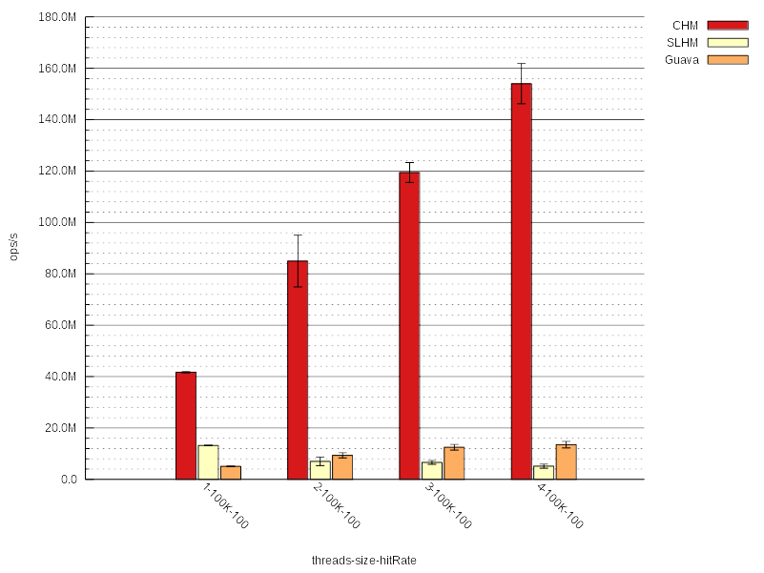
Read Only Benchmark Results
Notes:
The Y-axis is the throughput in operations per second
The X-axis is the number of used CPU cores and benchmark threads
I‘ll do the benchmark also with different cache sizes and hit rations, but here it is always 100K entries and 100% hits
First bar, in red is the ConcurrentHashMap, then our own implementation SynchronizedLinkedHashMap

Slide 20
Read Only Benchmark Results
Red: CuncurrentHashMap
Yellow: SynchronizedLinkedHashMapCache
Orange: Google Guava Cache
Notes:
Let‘s look closer….
Our own cache is getting worse for more threads and Guava is doing better
Lock contention!

Slide 21
More Concurrency:
Partitioning
public class PartitionedLinkedHashMapCache<K,V> {
final private int PARTS = 4;
final private int MASK = 3;
final private LinkedHashMapCache<K, V>[] backingMaps = new LinkedHashMapCache[PARTS];
@Override
public void put(K key, V value) {
LinkedHashMapCache<K, V> backingMap = backingMaps[key.hashCode() & MASK];
synchronized (backingMap) {
backingMap.put(key, value);
}
}
@Override
public V get(K key) {
LinkedHashMapCache<K, V> backingMap = backingMaps[key.hashCode() & MASK];
synchronized (backingMap) {
return backingMap.get(key);
}
}
}

Slide 22
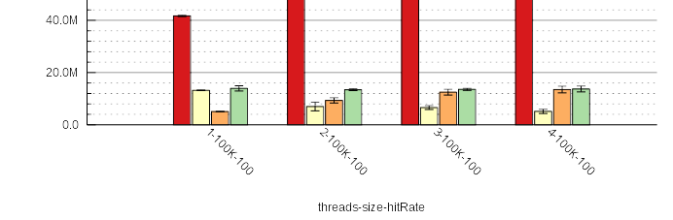
Read Only Benchmark Results II
Red: CuncurrentHashMap
Yellow: SynchronizedLinkedHashMapCache
Orange: Google Guava Cache
Green: PartionionedLinkedHashMap
Notes:
Faster than Guava!
But not leveraging more cores!

Slide 23
LRU – Least Recently Used
head / front
tail
1. put(1, x)
1
insert new head
2. put(2, x)
2
1
insert new head
3. get(1)
1
2
move to front
move to front
4. put(3, x)
3
1
2
insert new head
5. put(4, x)
4
3
1
2 >
Insert new head
remove tail

Slide 24
LRU Properties
Simple and smart algorithm for eviction (or replacement)
Everybody knows it from CS, „eviction = LRU“
But:
List operations need synchronization
A cache read means rewriting references in 4 objects, most likely touching 4 different CPU cache lines
A read operation (happens often!) is more expensive than an eviction (happens not so often!)
LRU is not scan resistent; scans wipe out the working set in the cache
Non frequently accessed objects need a long time until evicted

Slide 25
LRU Alternatives?
We are looking for:
  Reduce CPU cycles for the read operation and do more costly things for eviction later
  Also take frequency into account, keeping more frequently accessed objects longer in the cache
Yes, there are some, see:
Wikipedia:Page_replacement_algorithm
Lots of scientific papers!

Slide 26
Clock
Read: Set the reference bit
Eviction: Scan at clock hand:
  Referenced? Clear reference and move to the next
  Not-Referenced? Evict!
R=1
R=0
R=0
R=1

Slide 27
Clock Pro + (cache2k)
0 hits
5 hits
1 hit
4 hits
handCold
0 hits
1 hits
0 hits
handHot
0 hits
2 hits
1 hit
2 hits
0 hits
access history

Slide 28
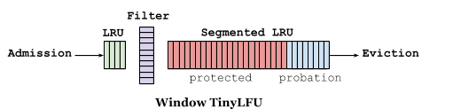
Queue +W-Tiny-LFU (Caffeine)
Remember cache access in a queue
Update data structures for eviction alogrithm in a separete thread

Slide 29
Will It Blend?

Slide 30
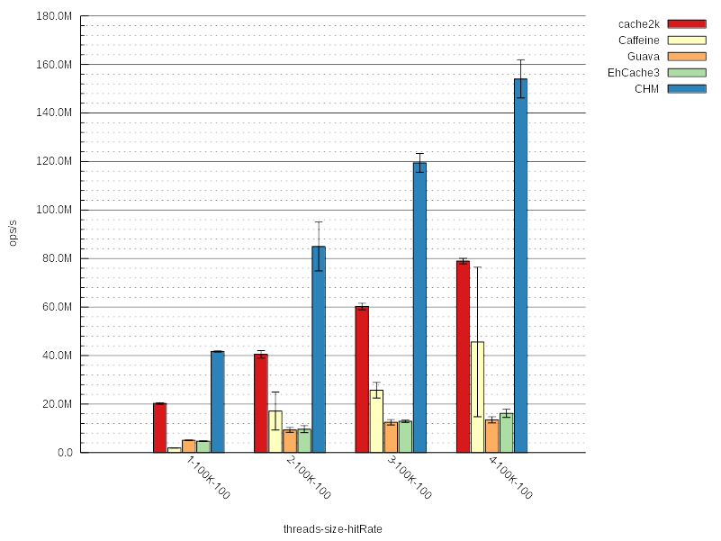
Read Only Benchmark Results III
Bigger….

Slide 32
Pretty fast!
But what about eviction efficiency?

Slide 33
Benchmarking Eviction Quality
Collect access sequences (traces)
Replay the access sequence on a cache and count hits and misses
  More information about the traces in the blog article:
  https://cruftex.net/2016/05/09/Java-Caching-Benchmarks-2016-Part-2.html

Slide 34
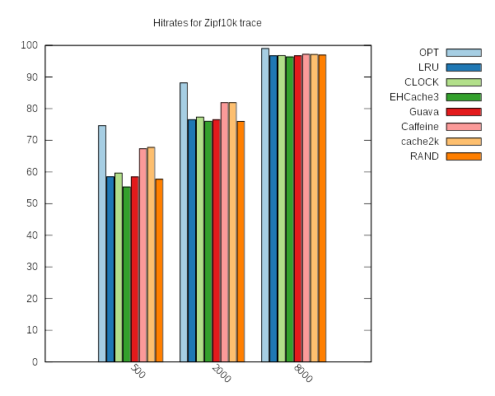

Slide 35
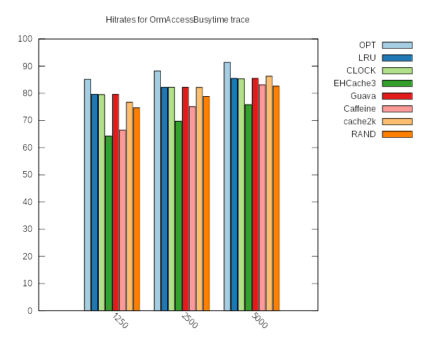

Slide 36
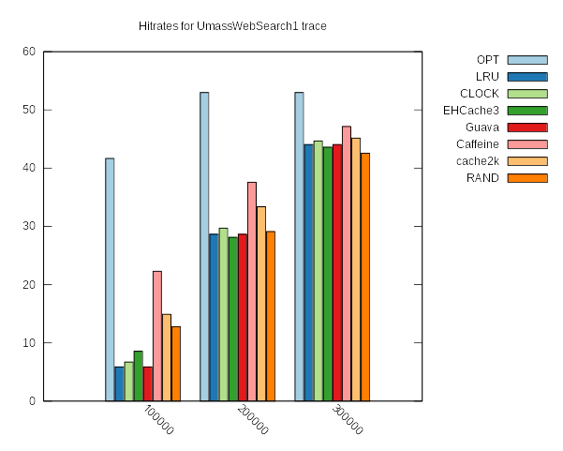

Slide 37
Eviction Result
New algorithms from
Caffeine and cache2k look good :)

Slide 38
Great?! No! Accademic Objection:
Clock is O(n)!
R=1
R=0
R=0
R=1

Slide 39
Cache2k and Clock-Pro +
Improved and battle tested Clock-Pro algorithm
  Uses counter instead of reference bit
  Heuristics to reduce intensive scanning, if not much is gained
E.g. test with a random sequence at 80% hitrate, results in the following average entry scan counts:
  100K entries: 6.00398
  1M entries: 6.00463
  10M entries: 6.00482
  => Little increase, but practically irrelevant.

Slide 40
Hint / Confession
The shown performance benchmark only reads and only covers the „hit“ case
Yes, when eviction is needed, or with read/write the performance benefit of cache2k becomes less
More benchmark results at: https://cruftex.net
All benchmarks are in:
https://github.com/cache2k/cache2k-benchmark

Slide 41
Summary
LRU is simple but there are better options
Caching != LRU
Caffeine and cache2k use modern eviction algorithms and have better eviction efficiency than LRU
Unfortunately not in every studies scenario, but mostly
Caffeine likes to have cores
EHCache3 likes to have memory
cache2k optimizes on a fast/fastest access path for a „cache hit“ while having reasonable eviction efficiency

Slide 42
Technical Overview I
 | Guava | Caffeine | EHCache3 | cache2k
Latest Version | 26 | 2.6.2 | 3.6.1 | 1.2.0.Final
JDK compatibility | 8+ | 8+ | 8+ | 6+
sun.misc.Unsafe | - | X | X | -
Hash implementation | own | JVM CHM | old CHM | own
Single object per entry | - | - | - | X
Treeifications of collisions | - | X | - | -
Metrics for hash collisions | - | - | - | X
Key mutation detection | - | - | - | X

Slide 43
Technical Overview II
 | Guava | Caffeine | EHCache3 | cache2k
Eviction Algorithm | Q + LRU | Q + W-TinyLFU | Scan8 | Clock-Pro+
Lock Free Cache Hit | Lock free | Lock + Wait free | Lock free | Lock + Wait free
Limit by count | X | X | X | X
Limit by memory size | - | - | X | -
Weigher | X | X | - | DEV
JCache / JSR107 | - | X | X | X
Separete API jar | - | - | - | X

Slide 44
How „usable“ is cache2k?
Guava, Caffeine, EhCache, cache2k have a comparable set of basic features (e.g. listeners, read through / CacheLoader, expiryAfterWrite / time to live)
cache2k is tested and integrated with:
  Hibernate (via JCache)
  datanucleus (via JCache)
  Spring Framework
Extras in cache2k:
  Sophisticated epxiry + refresh ahead
  Resilience / exception handling
Missing in cache2k:
  Eviction listener, weigher, async cache loader (next version)
  expireAfterAccess / time to idle (available via JCache, but slow)

Slide 45
Project Links
Benchmarks:
https://github.com/cache2k/cache2k-benchmark
Cache implementations:
  https://github.com/google/guava/wiki/CachesExplained
  https://github.com/ben-manes/caffeine
  http://www.ehcache.org/
  https://cache2k.org

Slide 46
Questions?
Notes:
Do we really need a fast cache?
Problably not much gain when EhCache is replaced
lots of caches in the JVM, locales, XML parsing, etc.
Use with hibernate
More caching opportunities with a light weight and fast cache

Slide 47
Thanks &
Enjoy Live!

