Slide 2
Links
talk slides and diagram source data
https://github.com/cruftex/talk-java-in-process-caching-performance-progress-pitfalls
used benchmarks
https://github.com/cache2k/cache2k-benchmark
disclaimer
No guarantees at all. Do not sue me for any mistake, instead, send a pull request and correct it!

Slide 3
About Me
Performance Fan(atic)
Java Hacker since 1998
Author of cache2k
70+ answered questions on StackOverflow about Caching
JCache / JSR107 Contributor
Jens Wilke
@cruftex
cruftex.net

Slide 4
About Me
In computing, a cache /kæʃ/ kash,[1] is a hardware or software component that stores data so that future requests for that data can be served faster
Jens Wilke
@cruftex
cruftex.net

Slide 5
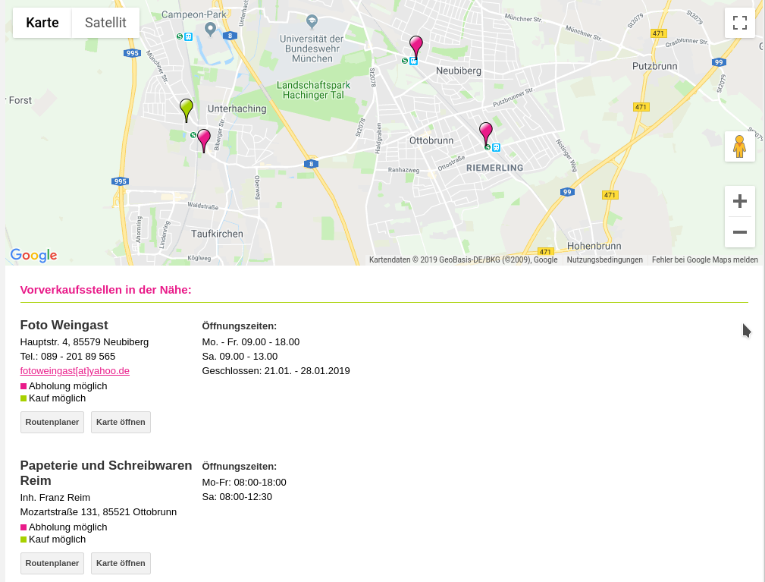
Example 1: Geolocation Lookup

Slide 6

Example 2: Date Formatting

Slide 7

Expensive Operations per Web Request
How often is an operation executed per web request or user interaction?
Less than once:
e.g. initialization on startup
Exactly once:
e.g. detch data and resolve geolocation
More than once:
e.g. render a date
X
X
X
0
1x
10x

Slide 8
Reduce Expensive Operations
Cache:
Less executions per web request or user interaction
X
X
X
0
1
10x

Slide 9
(Java) Caching
technical
benefits
temporary data storage to serve requests faster
reduce expensive operations at the cost of storage
A tool to tackle the space time tradeoff problem
Lower latency and improve UX
If not because of great UX, let‘s save computing costs!

Slide 10
Java In Process Caching
technical
benefits
temporary data storage to serve requests faster
reduce expensive operations at the cost of heap memory
keep data as close to the CPU as possible
A tool to tackle the space time tradeoff problem
Lower latency much more and improve UX
If not because of great UX, let‘s save more computing costs!

Slide 11
Constructing an Java In Process Cache
interface
implementation
The interface of a cache is similar (sometimes identical) to a Java Map:
cache.put(key, value);
value = cache.get(key);
A hash table
An eviction strategy
  to limit the used memory
  but keep data that is „hot“

Slide 12
Up Next
Benchmark a Simple Cache

Slide 13
Read Only JMH Benchmark
@Param({"100000"})
public int entryCount = 100 * 1000;
BenchmarkCache<Integer, Integer> cache;
Integer[] ints;
@Setup
public void setup() throws Exception {
cache = getFactory().create(entryCount);
ints = new Integer[PATTERN_COUNT];
RandomGenerator generator =
new XorShift1024StarRandomGenerator(1802);
for (int i = 0; i < PATTERN_COUNT; i++) {
ints[i] = generator.nextInt(entryCount);
}
for (int i = 0; i < entryCount; i++) {
cache.put(i, i);
}
}
@Benchmark @BenchmarkMode(Mode.Throughput)
public long read(ThreadState threadState) {
int idx = (int) (threadState.index++ % PATTERN_COUNT);
return cache.get(ints[idx]);
}
Benchmark that does only read a cache that is filled with data intially.
No eviction takes place, so we can compare the read throughput with a (concurrent) hash table.
1
2
create a cache, via a wrapper to adapt to different implementations
create an array with random integer objects. Value range does not exceed entry count
fill cache once, not part of the benchmark
benchmark operation does one cache read with random key
3
4

Slide 14
Benchmark Specifications
hardware
cache versions
CPU: Intel(R) Xeon(R) CPU E3-1240 v5 @ 3.50GHz
4 physical cores
Benchmarks are done with different number of cores by Linux CPU hotplugging
Oracle JVM 1.8.0-131, JMH 1.18
Ubuntu 14.04, 4.4.0-137-generic
Google Guava Cache, Version 26
Caffeine, Version 2.6.2
cache2k, Version 1.2.0.Final
EHCache, Version 3.6.1
JMH parameters
2 forks, 2 warmup iterations, 3 measurement iterations, 15 second iterations times
=> 6 measurement iterations

Slide 15
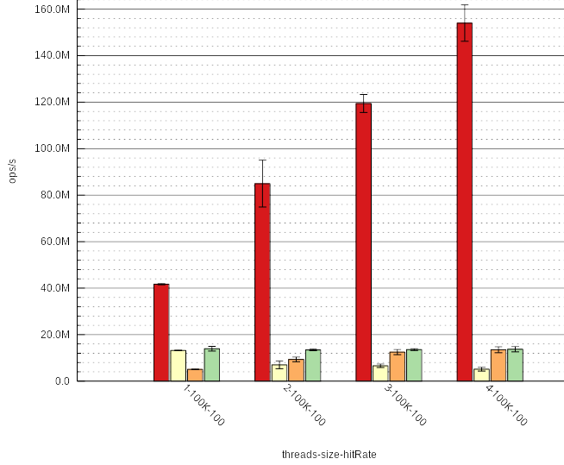
Results
 ConcurrentHashMap
 Simple Java Implementation with LRU via LinkedHashMap
 Google Guava Cache
 Simple Java Implementation with LRU via LinkedHashMap and Segmentation
Y axis: operations/s
X axis: Number of threads
Especially when multi-threaded the ConcurrentHashMap is much faster then a cache.

Slide 16
Up Next
LRU = Least Recently Used

Slide 17
LRU List Operations
double linked list with three entries
head
tail
cache operation
list operation
1. put (1, x)
1
insert new head
2. put (2, x)
2
1
insert new head
3. get (1)
1
2
move to front
4. put (3, x)
3
2
1
insert new head
5. put (4,x)
2 > insert new head
remove tail

Slide 18
LRU Properties
cool...
...but:
Simple and smart algorithm for eviction (or replacement)
Everybody knows it from CS, „eviction = LRU“
List operations need synchronization
A cache read means rewriting references in 4 objects, most likely touching 4 different CPU cache lines
A read operation (happens often!) is more expensive than an eviction (happens not so often!)
LRU is not scan resistent; scans wipe out the working set in the cache
Non frequently accessed objects need a long time until evicted

Slide 19
LRU Alternatives?
We are looking for:
Reduce CPU cycles for the read operation and do more costly things for eviction later
Also take frequency into account, keeping more frequently accessed objects longer
Yes, there are some, see:
Wikipedia:Page_replacement_algorithm
Lots of scientific papers!

Slide 20
Technical Overview I
 | Guava | Caffeine | EHCache3 | cache2k
Latest Version | 26 | 2.6.2 | 3.6.1 | 1.2.0.Final
JDK compatibility | 8+ | 8+ | 8+ | 6+
sun.misc.Unsafe | - | X | X | -
Hash implementation | own | JVM CHM | old CHM | own
Single object per entry | - | - | - | X
Treeifications of collisions | - | X | - | -
Metrics for hash collisions | - | - | - | X
Key mutation detection | - | - | - | X

Slide 21
Technical Overview II
 | Guava | Caffeine | EHCache3 | cache2k
Eviction Algorithm | Q + LRU | Q + W-TinyLFU | „Scan8“ | Clock-Pro+
Lock Free Cache Hit | Lock free | Lock + Wait free | Lock free | Lock + Wait free
Limit by count | X | X | X | X
Limit by memory size | - | - | X | -
Weigher | X | X | - | X
JCache / JSR107 | - | X | X | X
Separete API jar | - | - | - | X

Slide 22
Simple Cache – Part I
public class LinkedHashMapCache<K,V>
extends LinkedHashMap<K,V> {
private final int cacheSize;
public LinkedHashMapCache(int cacheSize) {
super(16, 0.75F, true);
this.cacheSize = cacheSize;
}
protected boolean removeEldestEntry(Map.Entry<K, V> eldest) {
return size() >= cacheSize;
}
}

Slide 23
Simple Cache – Part II (thread-safe)
public class SynchronizedLinkedHashMapCache<K,V> {
final private LinkedHashMapCache<K,V> backingMap;
public void put(K key, V value) {
synchronized (backingMap) {
backingMap.put(key, value);
}
}
public V get(K key) {
synchronized (backingMap) {
return backingMap.get(key);
}
}
}

Slide 24
Simple Cache – Part II – Thread Safety
public class SynchronizedLinkedHashMapCache<K,V> {
final private LinkedHashMapCache<K,V> backingMap;
public void put(K key, V value) {
synchronized (backingMap) {
backingMap.put(key, value);
}
}
public V get(K key) {
synchronized (backingMap) {
return backingMap.get(key);
}
}
}

Slide 25
Simple Cache – Part III – Partitioning/Segmentation
public class PartitionedLinkedHashMapCache<K,V> {
final private int PARTS = 4;
final private int MASK = 3;
final private LinkedHashMapCache<K, V>[] backingMaps =
new LinkedHashMapCache[PARTS];
public void put(K key, V value) {
LinkedHashMapCache<K, V> backingMap = backingMaps[key.hashCode() & MASK];
synchronized (backingMap) {
backingMap.put(key, value);
}
}
public V get(K key) {
LinkedHashMapCache<K, V> backingMap = backingMaps[key.hashCode() & MASK];
synchronized (backingMap) {
return backingMap.get(key);
}
}
}

