Slide 1
SQL vs. NoSQL
Things to consider for your next database choice
Jens Wilke 2018-03-17 / CC BY-SA 3.0

Slide 2


Jens Wilke
@cruftex
https://cruftex.net
https://cache2k.org

Slide 3
My DB Background
“NoSql” Java Database engine for setop box in 2000
Two ORM Mappers / persistence layers
Database related bachelor thesis with Prof. Bayer (inventor of the B-Tree)

Slide 4
Why this presentation?

Slide 5
Why NoSQL?


(Web) Scale
Special Purpose
and….

Slide 6
SQL … S***!
http://blog.schauderhaft.de/2010/02/15/why-sql-sucks/
Comments on the blog post:
“SQL is fun to learn and use, just get the basics down of Set Theory / Domain Relational Algebra, normalization and start with ANSI 92 SQL statements”
“I hate SQL. [ … ] I can write HTML5, CSS3, JavaScript, jQuery, PHP, & MD5 encryption all day, but SQL...it's like someone decided to give a genetically-engineered gorilla the opportunity to write code.”
and….

Slide 7
Impedance Mismatch
SQL Relational Data Model
(tables, primary keys, foreign keys, data types)
vs.
Objects
JSON
XML
Graph/RDF

Slide 8
I say: SQL is Cool!
Declarative style vs. imperative style:
I tell what I want, the database finds out how to get it
Well, I know, there is some legacy in its syntax, so there is in Unix dd

Slide 9
No SQL, Really?
New Databases speak SQL, too! Examples:
CockroachDB
Apache Hive
Apache Spark
Specialized Query Languages look a lot like SQL:
CouchDB N1QL

Slide 10
Fault Tolerance, Scaling
→ Distributed Systems

Slide 11
The CAP Theorem
Consistency: All clients have always the same view of the data
Consistency
Availability: Each client can always read and write
CA
CP
Partition
Tolerance
Partition Tolerance: The total system works despite network partitions
Availability
AP
Notes:
Update and Discussion:
https://codahale.com/you-cant-sacrifice-partition-tolerance

Slide 12
The CAP Theorem
Consistency
Pick Two!
CA
CP
Partition
Tolerance
Availability
AP

Slide 13
The CAP Theorem
CA:
MySQL, PostgreSQL, Oracle, …
Consistency
CP:
Cassandra, CouchDB, Riak, ...
CA
CP
AP:
HBase, MongoDB (2010!),
Redis, ...
Partition
Tolerance
Availability
AP
As of 2010 from this blog post:
http://blog.nahurst.com/visual-guide-to-nosql-systems

Slide 14
Details more Details and Limitations
Smart Algorithms and Theories
CAP
Consistent Hashing
Paxos
Raft
Vector Clocks
Calvin
...
Eventual Consistency
Casual Consistency
Read-your-write Consistency
Session Consistency
Monotonic Read Consistency
Monotonic Write Consistency
ACM 2008 / 1466448 Werner Vogels (CTO Amazon)

Slide 15
Consistent?!
→Jepsen Reports
https://jepsen.io/

Slide 16
MongoDB 3.4.0-rc3 Feb2017
The Jepsen Report says:
“[ … ] In this Jepsen analysis, we develop new tests which show the MongoDB v0 replication protocol is intrinsically unsafe, allowing the loss of majority-committed documents. [...]”
Good! Improvements:
→ Defined consistency guarantees (Casual Consistency) and rigorous tests

Slide 17
Jepsen Reports Wrap Up
You will find scary things about any modern and distributed database
If you don’t find anything it’s even more scary

Slide 18
Rumble in NoSQL Paradise
…. oops, we gotta earn money!

Slide 19
Riak
Distributed Key/Value store
Major driver: Basho Technologies
August 2009: Initial release
Mid 2017: Basho runs out of money
April 2018: First community release
License: Apache

Slide 20
MongoDB
Distributed Key/Value store
Major driver: MongoDB Inc
Feb 2009: Initial release
Oct 2017: MongoDB IPO
2018: Total Funding: $309,8M, Revenue $154.5M, Negative cash flow: $47.0M
Oct 2018: License Change:
Server Side Public License (SSPL)
MongoDB drops out of Debian, Red Hat, Ubuntu dirstros, since not Open Source (OSI approved) any more
Notes:
https://lwn.net/Articles/776182/

Slide 21
My Take on the Licensing
No matter whether OSI compliant or not: More restrictive licensing, kills the contributor community around the (core) product
Less adoption
Less thinkers, less innovation
There is a chance that the product will disappear, since a fork or community take over cannot and/or will not happen

Slide 22
What about the Old Guys?

Slide 23
PostgreSQL
1996: Initial Release
Diverse Community
JSON Support
XML Support
Solutions for: High Availability, Scaling
But:
Fragmentation, Many Add-Ons,
No relevant Jepsen Test
But No But: Diversity → Fragmentation

Slide 24
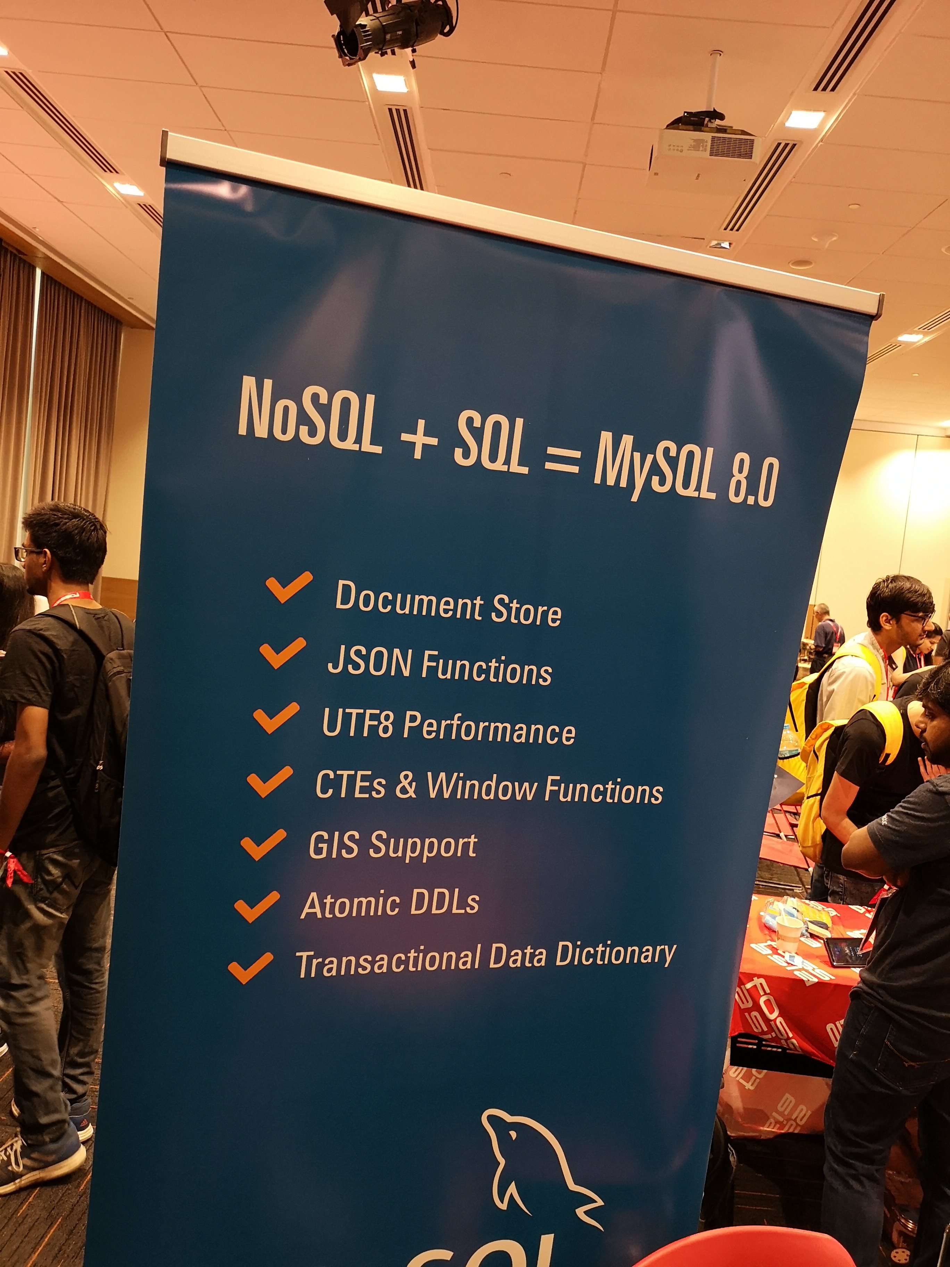
MySQL

Slide 25
Wrap Up

Slide 26
Directions of DBs
Universal / Relational / Traditional / SQL (PostgreSQL, MySQL)
or specialized:
Wide Column Stores (Hbase, Cassandra)
Document Stores (CouchDB. MongoDB)
Key/Value Stores (Redis, memcache)
In Memory Data Grids (hazelcast, SAP Hana)
Time Series (OpenTSDB, influxDB)
Graph / Triplet Stores (neo4j, OrientDB, ArangoDB)
Search Engines (Apache SOLR, elasticsearch)
Stream (RethinkDB)
….

Slide 27
There is no Single Reason….
Managed Offerings / Cloud
Speed
Operating Cost
Developer Productivity
SQL
Jepsen
Graph
Map/Reduce
...
Community
Maturity
Support
License
Robustness
Scalability of Processing
Scalability of Data
High Availability
….

Slide 28
Take Away
Know SQL and have at least one traditional/universal/relational database in your toolbox
If needed you can tune this database to a large extend to specific scenario (analytics, cluster/scaling, high availability, ….)
Databases exist that can serve specific requirements better, but know there limitations and consistency model (suggestion: read and understand the latest Jepsen report on it)

