Slide 1
Shrink: Distance preserving graph compression
Sadri, Amin, Flora D. Salim, Yongli Ren, Masoomeh Zameni, Jeffrey Chan, and Timos Sellis

Slide 2

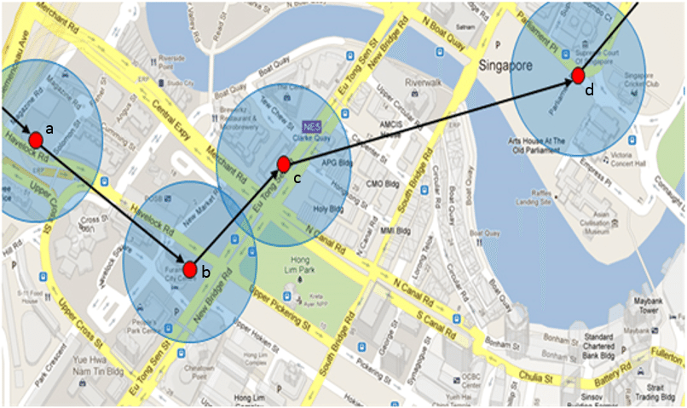
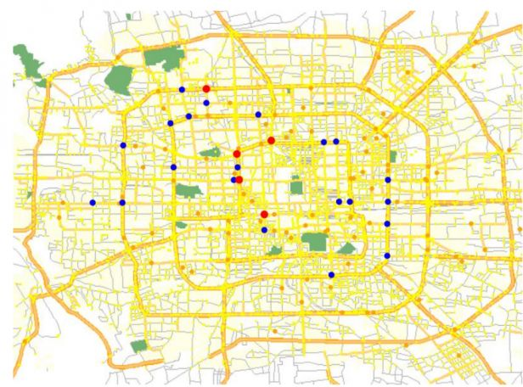
Summarizing the Movement Graph (Spatial aspects)
Trajectories and movements => graph
Nodes: stay points, significant location (e.g. Home, Office)
Edges: distance, trip duration
The graph is large and complex.

Slide 3
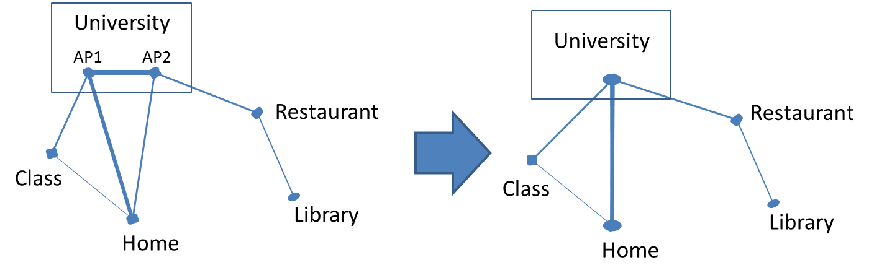
RQ2: Distance Preserving Graph Compression (Shrink)
We use Shrink to reduce the complexity of the movement graph.
The simplified movement graph is ready for analysis
running queries more efficiently
comparison with the movement graph from other users
address the data sparsity
Simplified graph

Slide 4
RQ2: Literature Review Graph compression
General methods:
Depend on the graph type
Need decompression before querying the graph
Web-graphs social networks {Raghavan 2003} {Boldi 2011} {Chierichetti 2009}
Query friendly: Target specific classes of queries:
Neighbourhood {Maserrat 2010} {Navlakha 2008}
Reachability {Feder 1995} {Moyles 1969} {Van 2011}
Pattern queries \cite{Fan 2012},
Distance-based queries
{Ruan 2011}: Lossless, Not for all nodes
{Toivonen 2011}: CWG

Slide 5
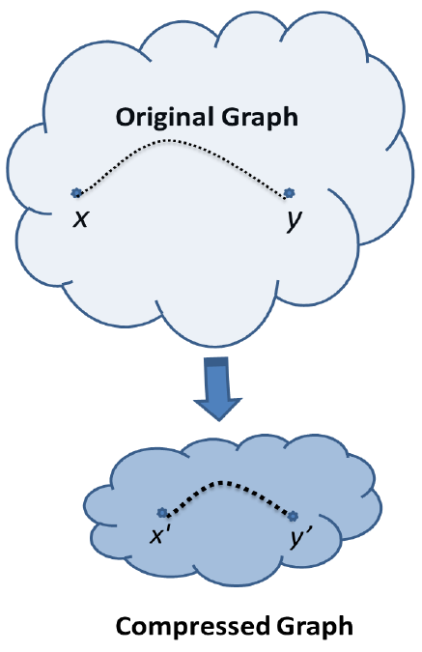
RQ2: Shrink Overview
Shrink reduces the graph size while preserving the distances between the nodes.
Instead of querying on the original graph, it is possible to run the queries on the compressed graph.
Outcome of compression:
1. The graph can be stored in the lower space
2. The queries run faster on the compressed graph

Slide 6
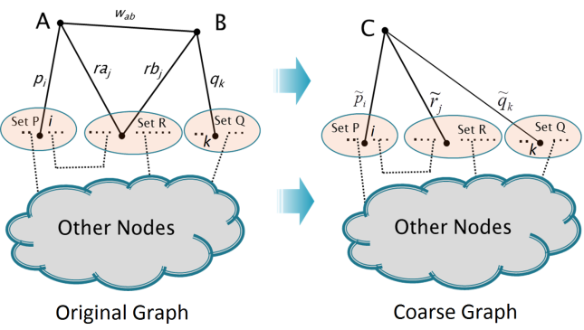
RQ2: Methodology (Shrink)
Based on merging nodes iteratively
Main challenge: Finding new weights with the least effect on the distances between the nodes

Slide 7
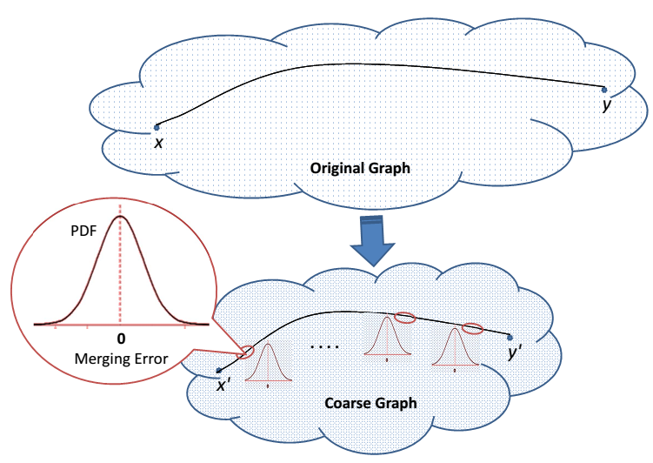
RQ2: Methodology- Cont.
Each merging causes error
It increases the distances between some pairs and decreases the distances between the other pairs.
We can consider a PDF of error for each merging

Slide 8


RQ2: Methodology- Cont.
p
p
Error
Error
Main idea: PDF with zero mean
Based on Law of Large numbers, if they are independent, for long paths, the total errors is zero (the distances are preserved).
Overall, the change is negligible because the increases and decreases compensate for each other.
We prove that RMSE is minimum when error mean is zero.

Slide 9
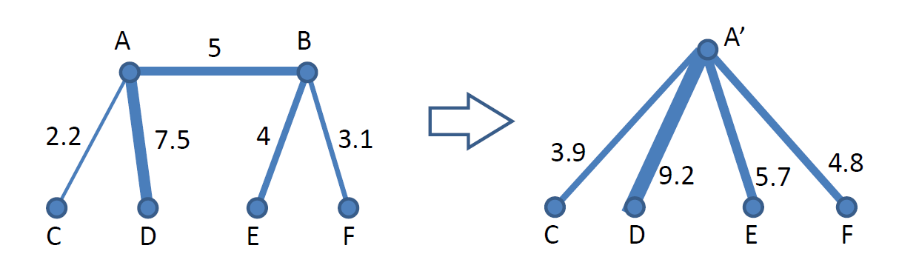
RQ2: Methodology- Cont.
We define a system of linear equations to find the new weights.
All the weights are defined in a way that the mean of error is equal to zero.
The equations are not general and can be solved with the linear complexity.

Slide 10
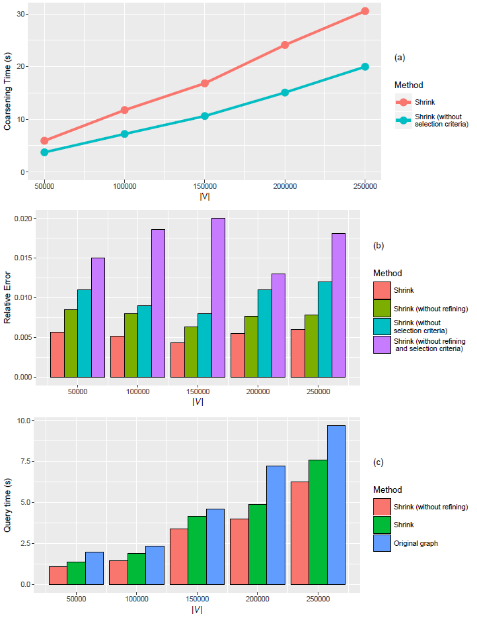
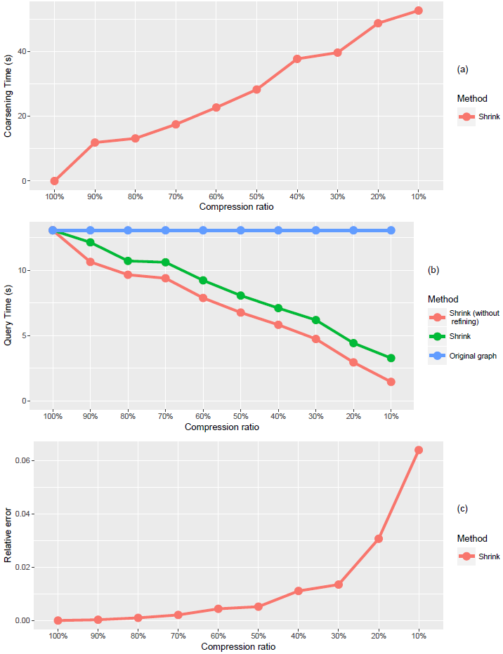
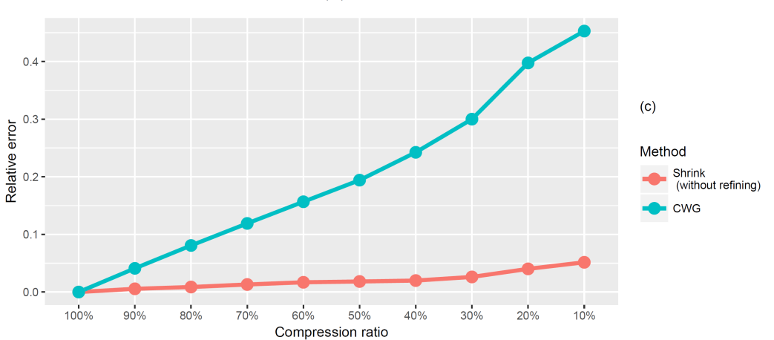
RQ2: Results

Slide 11
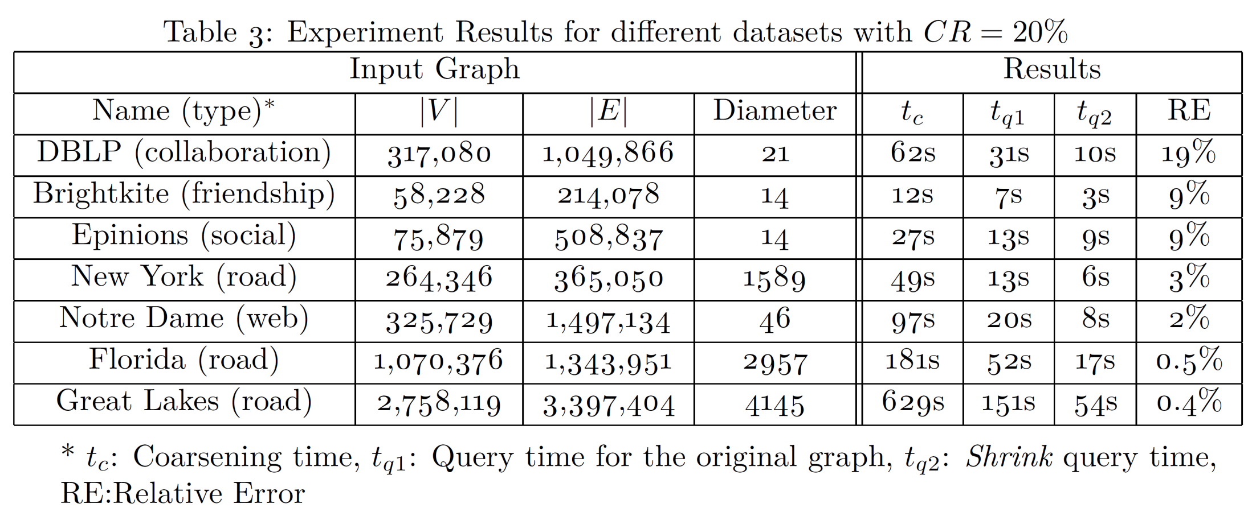
RQ2: A Generic Method

