Slide 1
Steganography Hiding information in plain sight
Christopher Robin
Craig Russell

Slide 2
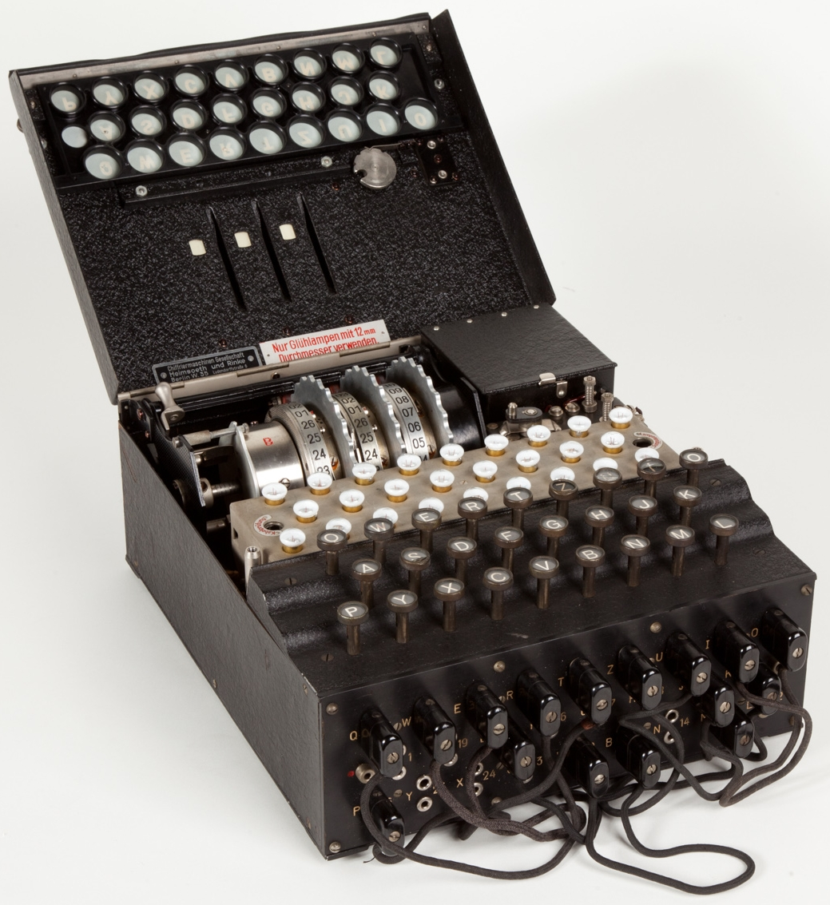

Steganography
Steganos – covered/secret
Hides the location of information
Locational key
Invisible ink
Cryptography
Krytpos – secret/hidden
Hides the translation of information
Mathematical key
German Enigma Machine

Slide 3
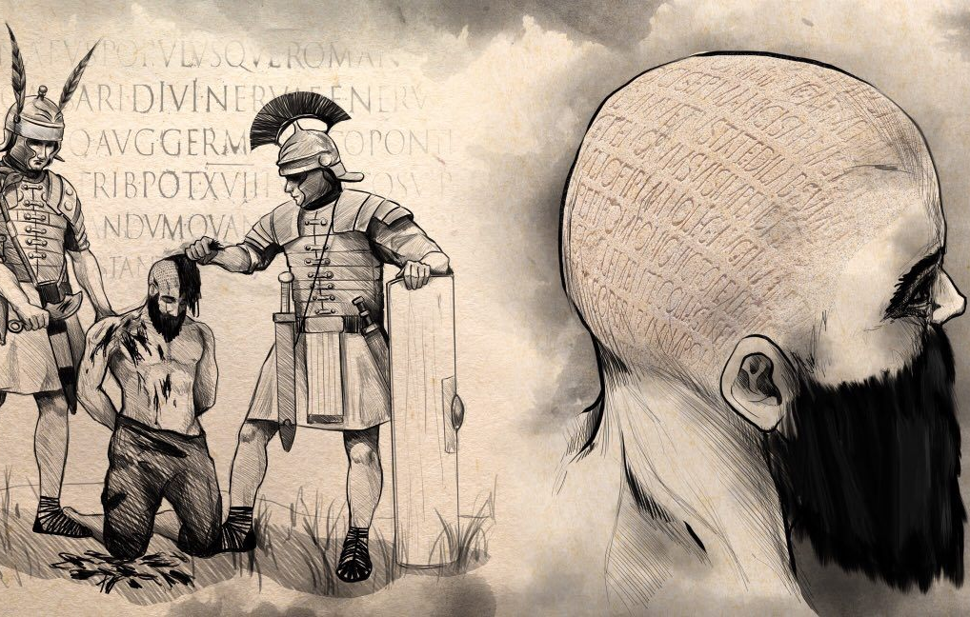
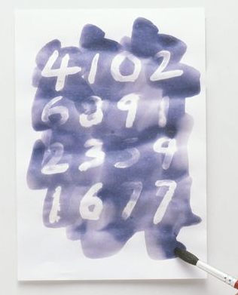
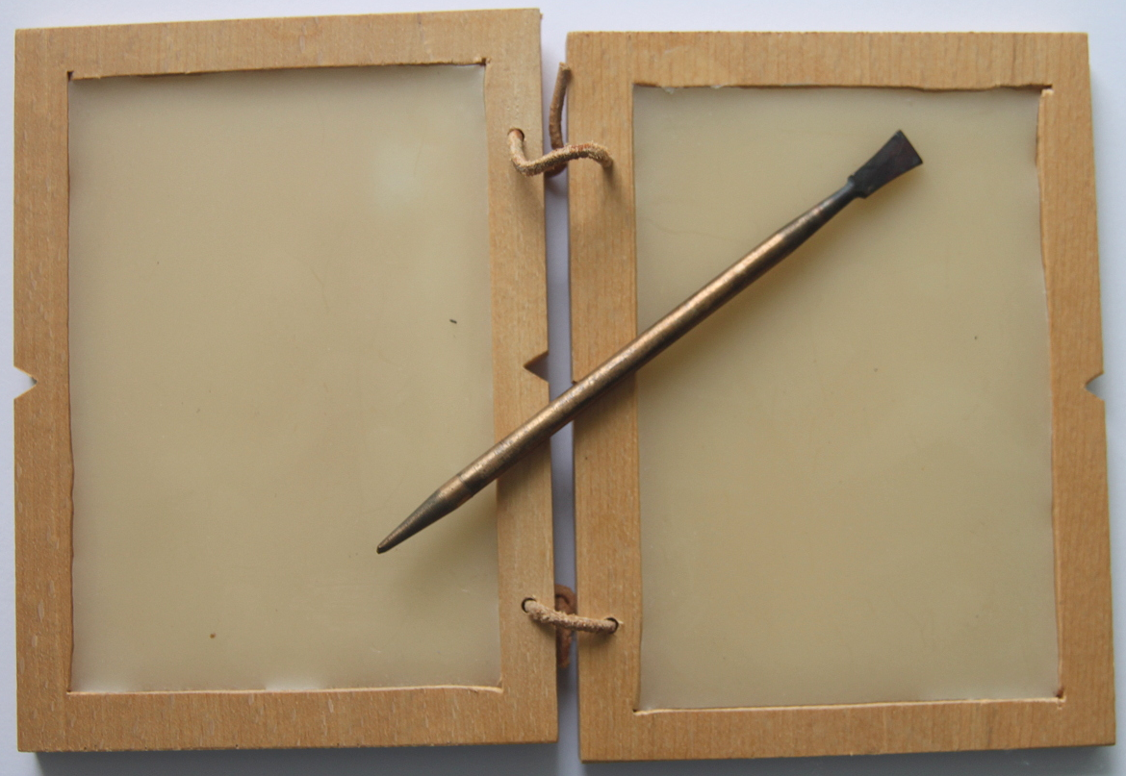
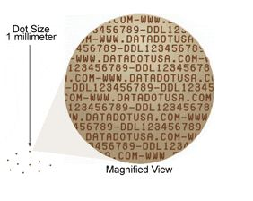
Historical context
440 BC – Greeks tattooed onto shaved head
480 BC – Spartans wax tablets
1776 – Revolutionary war invisible ink
1940s – WWII Microdots

Slide 4
Steganography Intro Activity
Steganography hides information using a variety of methods. UnlikE encryption, who’s only goAl is to obscure data, hidden data is able to carry large amountS of information without detection. Methods for redirecting one’s attention can be used to further hide information. EarlY uses include changing typefaces and fonts in a block of text and tattooing a message onto the head of a slave.
Some messages are harder to find than others…

Slide 5
Steganographic Techniques
Using noise – noise in an image can be replaced with meaningful data
Spreading out information – using set intervals between pixels to hide data
Adopting a statistical profile – reformulating data to avoid typical patterns like letter frequency
Replacing randomness with information – some applications use random numbers to add realistic features, purposely setting these values could hold information
Changing orders of lists
Splitting information – creating several packages with portions of the data that create the initial message only when enough are combined
Hiding the source – broadcasting information anonymously

Slide 6
Digital Image Steganography
Information can be stored inside media files
Making small changes that will be indiscernible from the original
Common approach is to use LSB

Slide 7
Significance
Hypothetical app that takes pictures w/ cloud service, could encrypt credit card/other personal data, and steals data
Digital watermarking

Slide 8
Terms/notation
Steganograms – steganographic messages
Steganalysis – searching for steganograms
Lossy and lossless

Slide 9
Lossless Bitmap
Each pixel has a color value stored for r, g, b

Slide 10
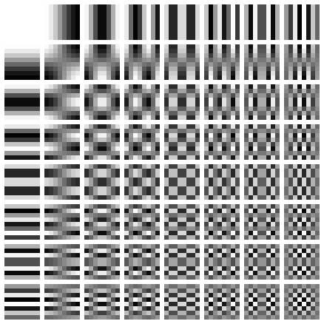
Discrete cosine transform
Represents 8x8 block of pixels as
weights of this chart
For example, a black “A” on white
background

Slide 11
The X² attack
Histogram of DCT coefficients

Slide 12
Example

Slide 13
Questions?

