Slide 1
CPA RIDEA Portfolio
November 2026

Slide 2
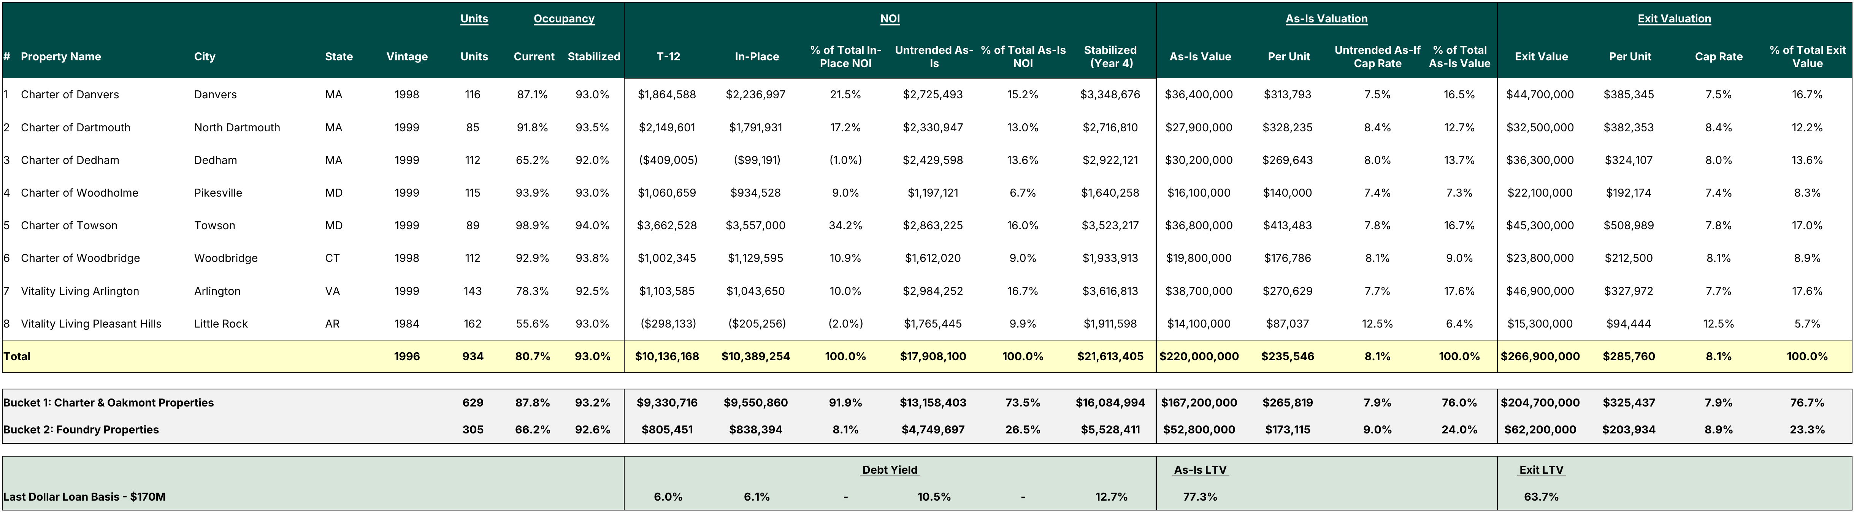
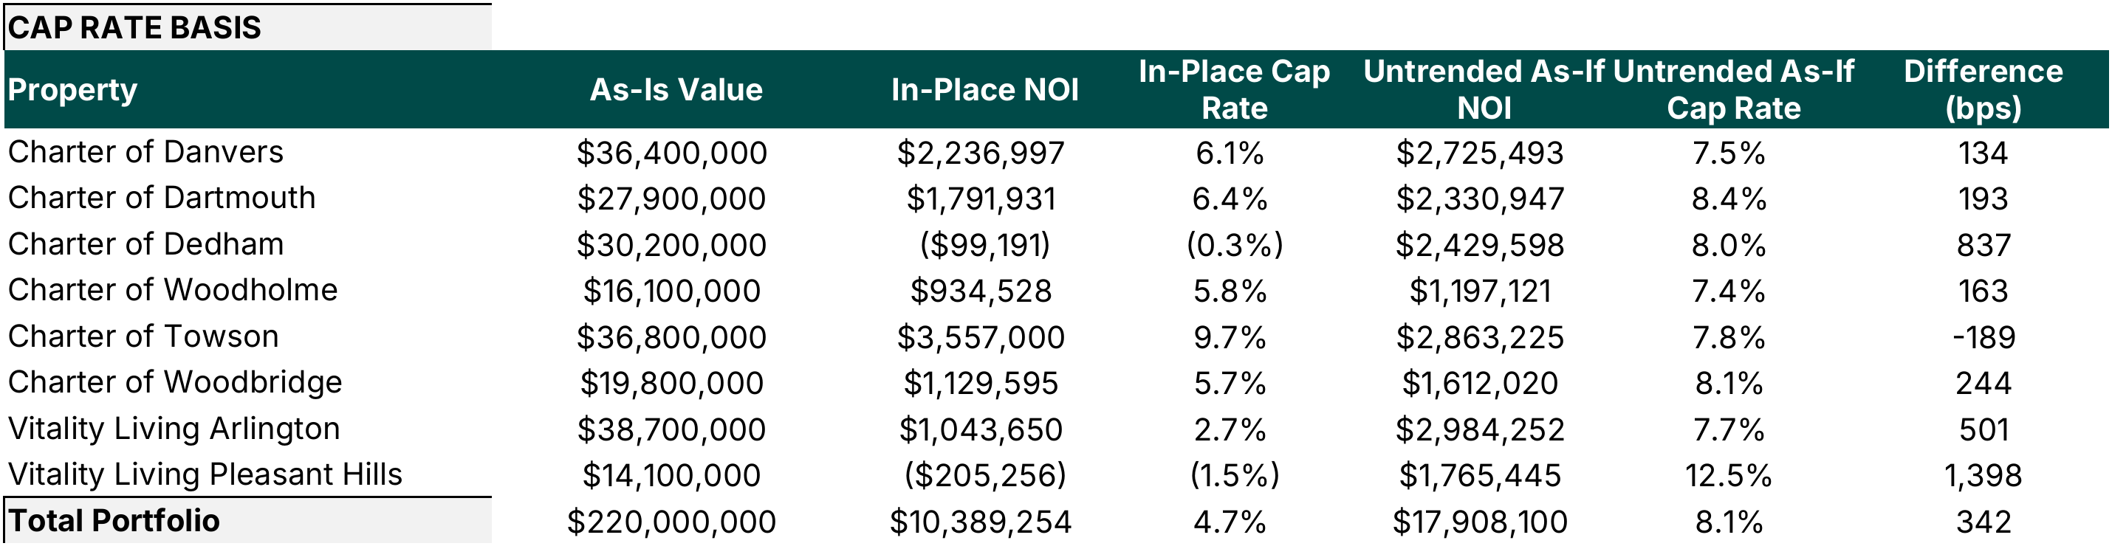
Portfolio Overview
Notes:
(1) Cap Rate in the As-Is Valuation block is Untrended As-If NOI divided by As-Is Value. It is not an In-Place cap rate. On In-Place NOI the portfolio cap rate is 4.7% versus 8.1% on the Untrended As-If basis (table at left).
(2) Vitality Living Pleasant Hills was destroyed by a tornado and rebuilt, and the new building only recently opened. The 55.6% current occupancy is measured against all 162 units including newly delivered units that are still leasing up. On the units that were occupiable, the property was effectively 100% leased. See the August 2026 IC memo footnotes for unit counts.
(3) T-12 NOI reflects a management fee of 5.0% of EGI. In-Place NOI reflects T-12 expenses, except payroll, food service and utilities, which are set at the higher of T-12 or T-3 annualized.

Slide 3
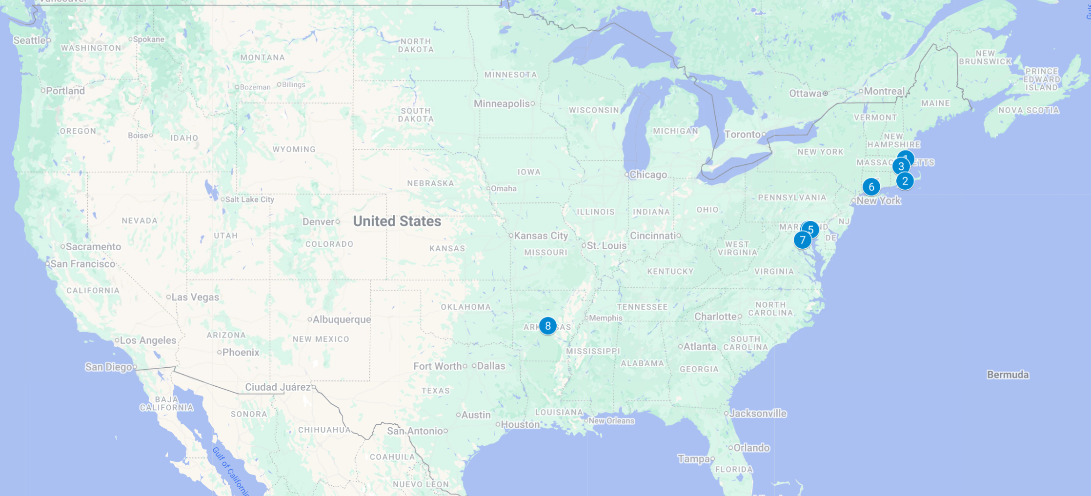
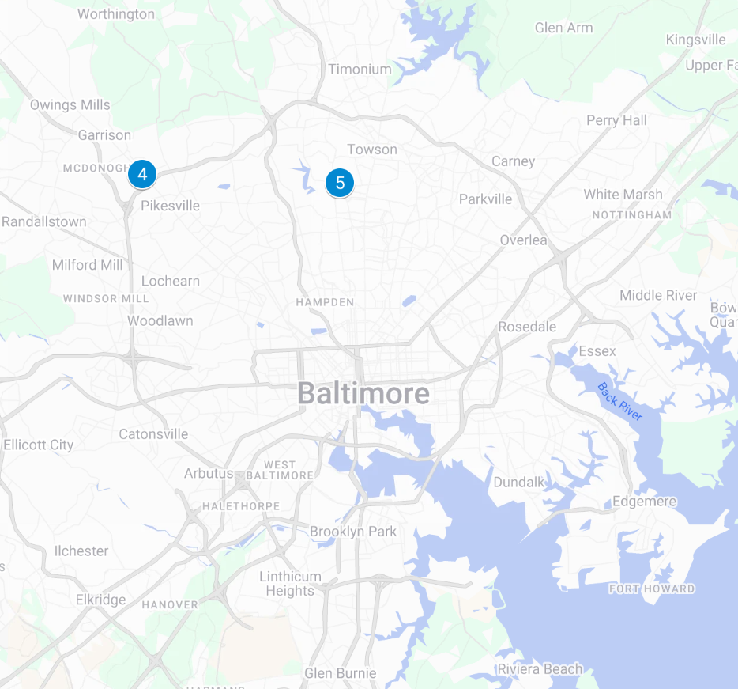
Portfolio Location Overview
1
3
6
2
4-5
7
4
5
8

Slide 4
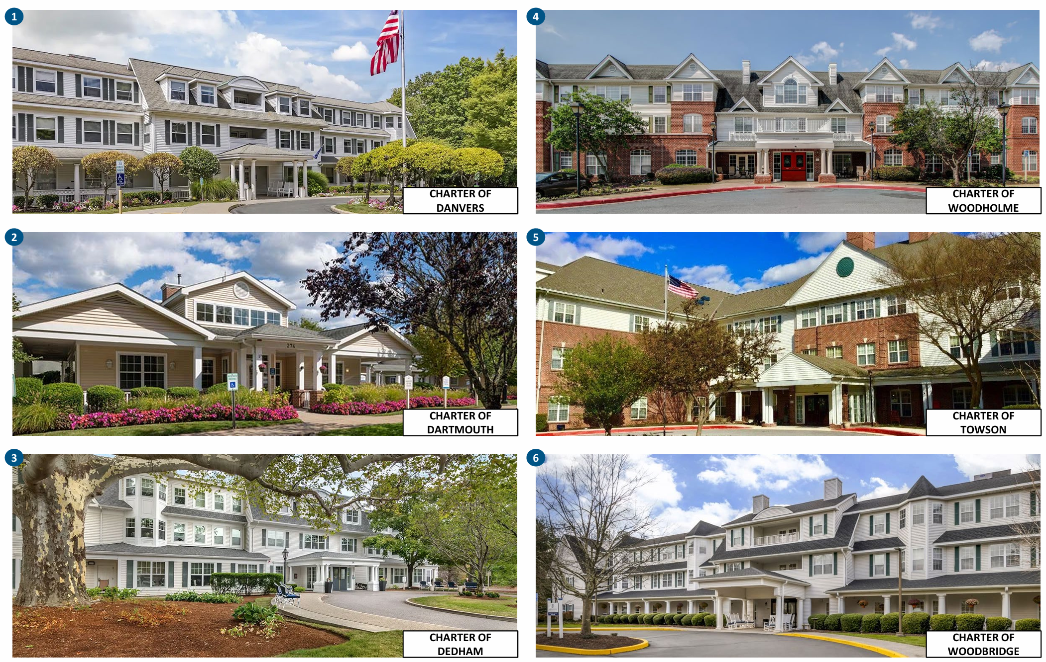
Exterior Property Photos (1 of 2)
1
3
2
4

Slide 5
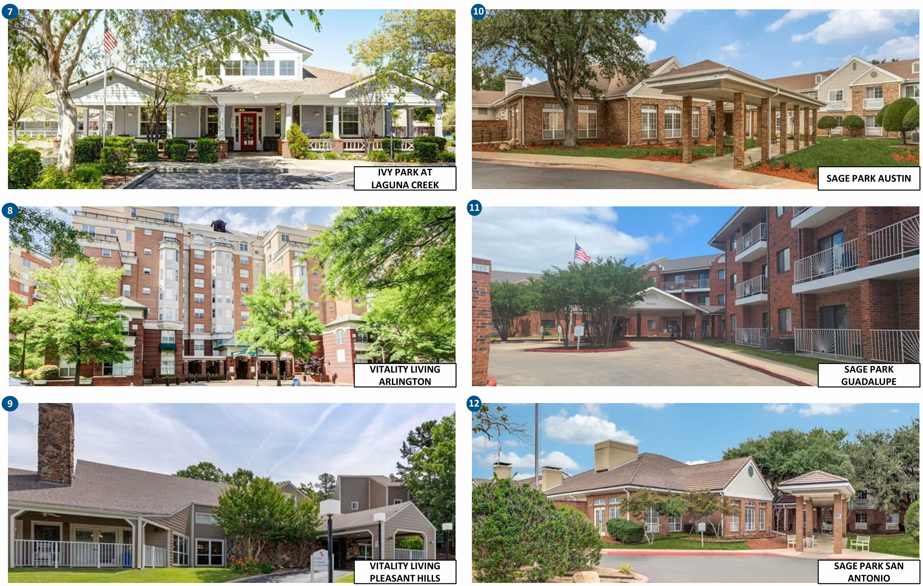
Exterior Property Photos (2 of 2)
5
7
6
8

Slide 6
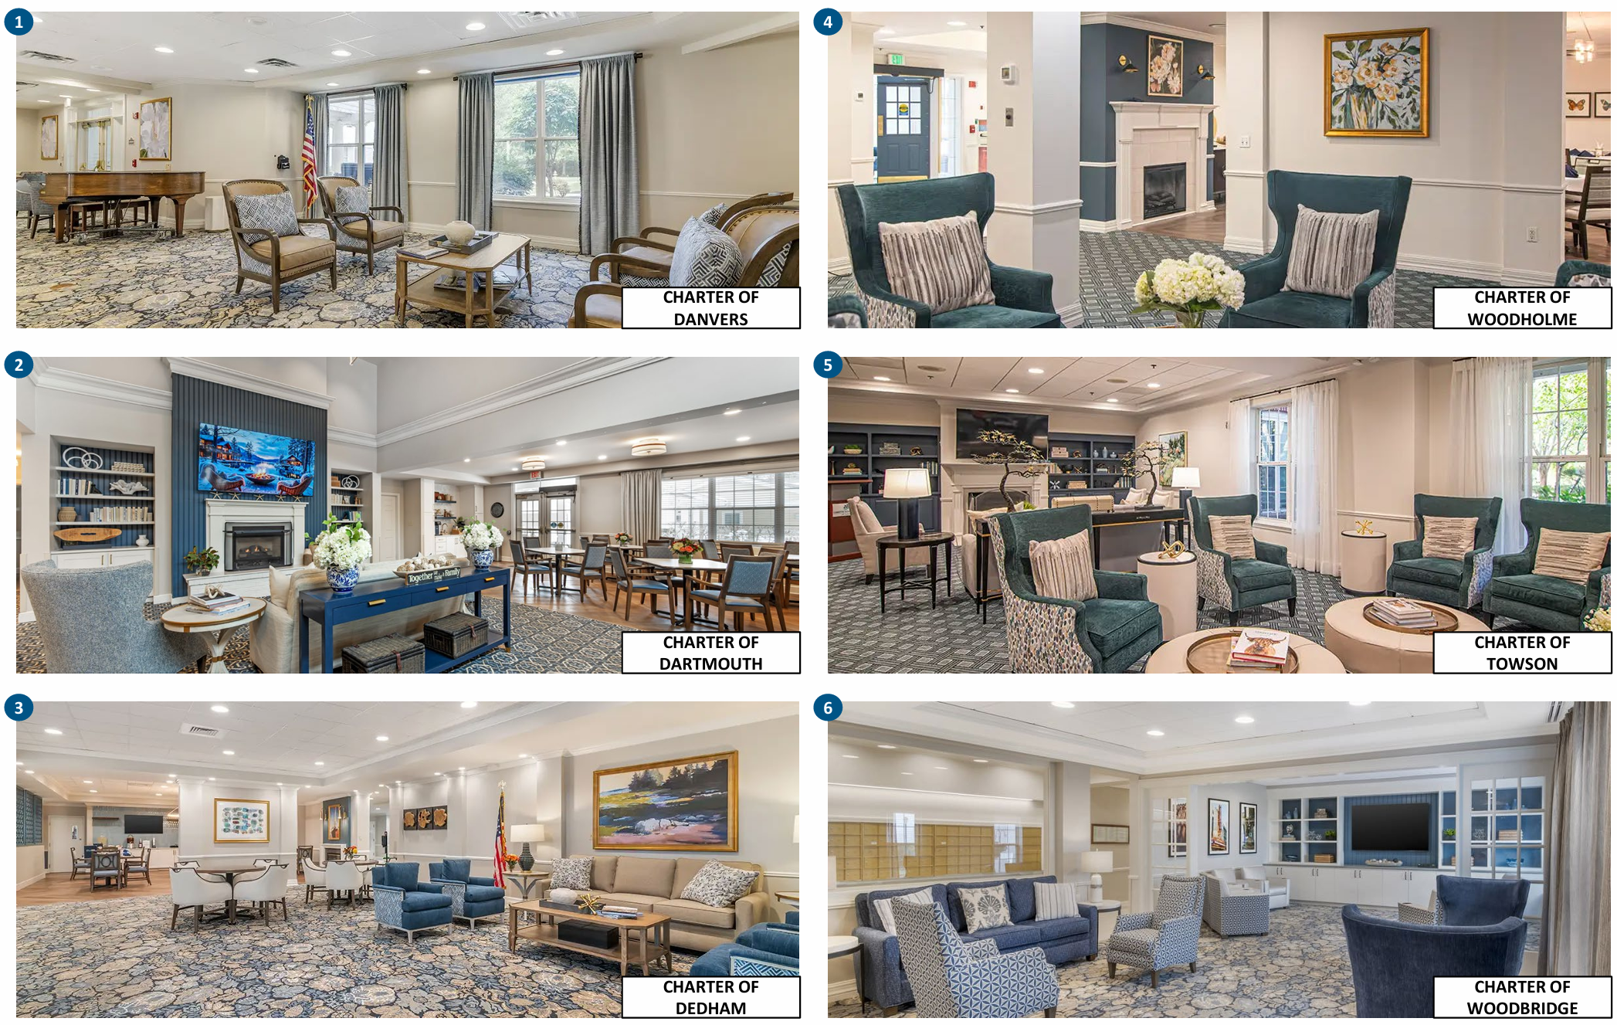
Interior Property Photos (1 of 2)
1
3
2
4

Slide 7
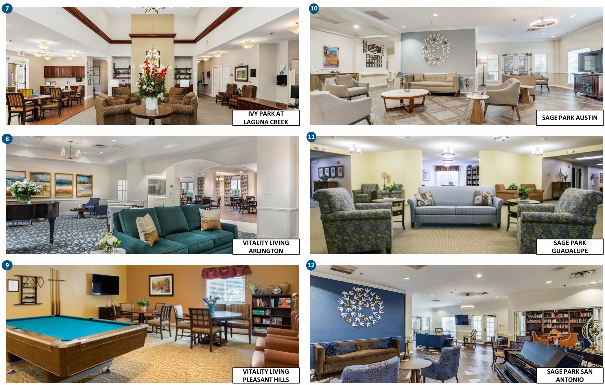
Interior Property Photos (2 of 2)
5
7
6
8

Slide 8
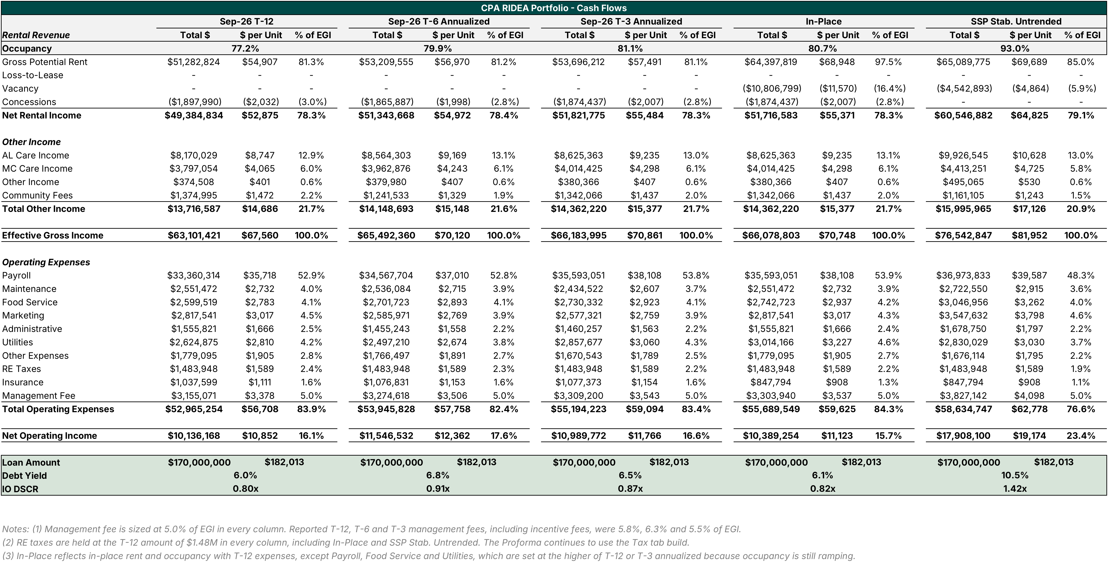
Portfolio Historical Financials & In-Place

Slide 9
Portfolio Proforma Cash Flows

Slide 10
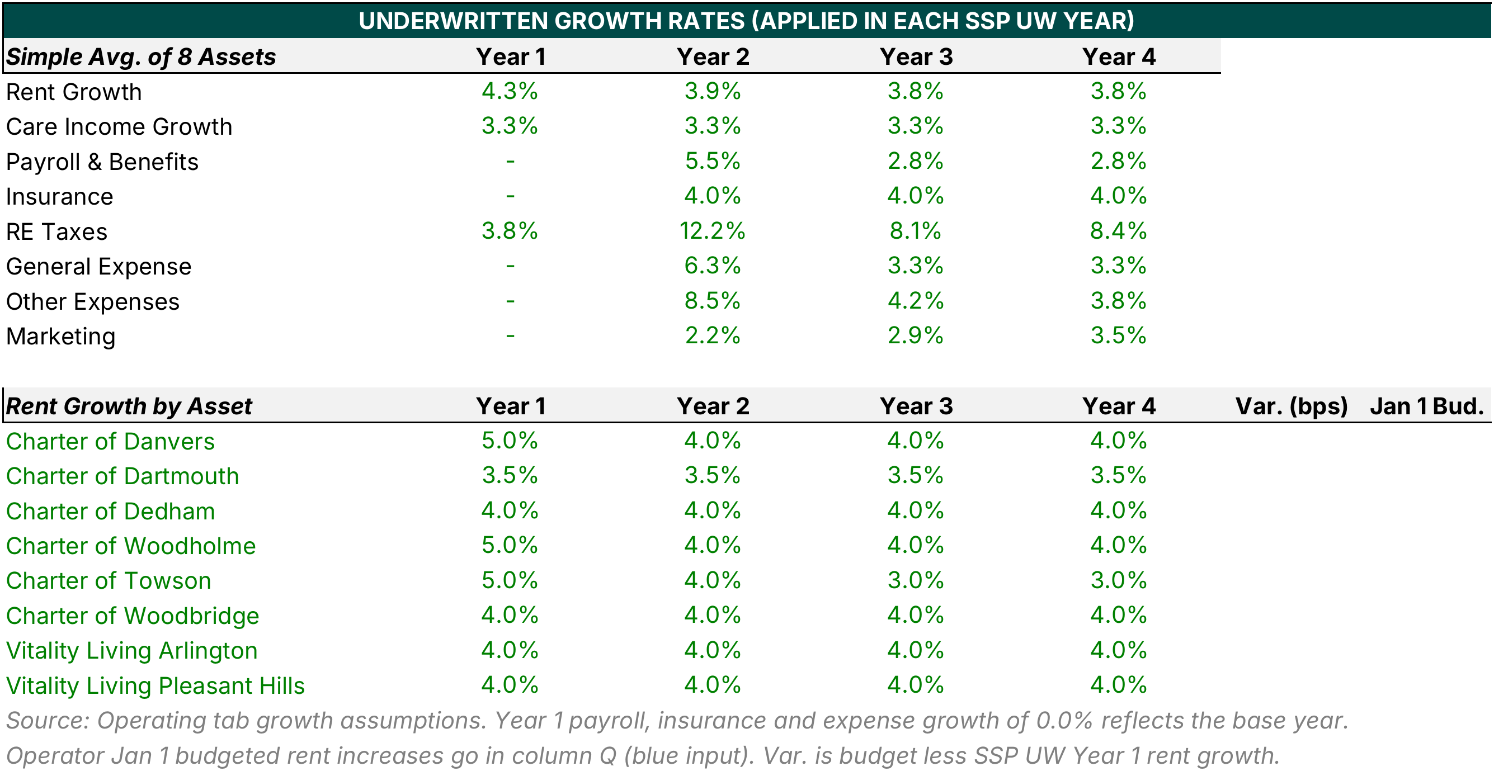
Proforma Growth Assumptions
Rent growth: SSP UW averages 4.3% in Year 1 and 3.8% in Years 3 and 4, ranging from 3.0% (Towson, Years 3 and 4) to 5.0% (Danvers, Woodholme and Towson, Year 1).
Expense growth: payroll, insurance and other expense lines carry 0.0% in Year 1 and grow 2.2% to 8.5% in Year 2, normalizing to 2.8% to 4.2% in Years 3 and 4. RE taxes grow 12.2% in Year 2 and 8.1% to 8.4% thereafter on the Tax tab reassessment build.
Operator Jan 1 budget: budgeted rent increases by property are not yet in the model. They are to be entered in the Proforma tab (column Q) so the variance to SSP UW Year 1 rent growth calculates. Deal team voiceover to cover the operator budgets.

Slide 11
NOI Walk – September T12 to Stabilized Untrended
Portfolio NOI rises from $10.4M In-Place to $17.9M SSP Stabilized Untrended (+$7.5M, or +72%), and debt yield on the $170M whole loan moves from 6.1% to 10.5%. Occupancy lease up from 80.7% to 93.0% and concession burn off add $8.4M, while rent growth adds only $0.7M.
Occupancy rolldown is now shown as its own bar. Towson (98.9% to 94.0%) and Woodholme (93.9% to 93.0%) give back $0.3M as occupancy normalizes to stabilized levels. Pleasant Hills (55.6% to 93.0%), Dedham (65.2% to 92.0%) and Arlington (78.3% to 92.5%) contribute $6.9M of the $8.4M lease up, which is the main business plan risk. The asset level bridge is on the next page.
Expenses scale with census: payroll ($1.4M), other opex ($1.0M) and management fee ($0.5M) offset care and other income of +$1.6M. RE taxes are held at T-12 in both columns, so the taxes step is zero. In-Place payroll, food service and utilities are set at the higher of T-12 or T-3 annualized.

Slide 12
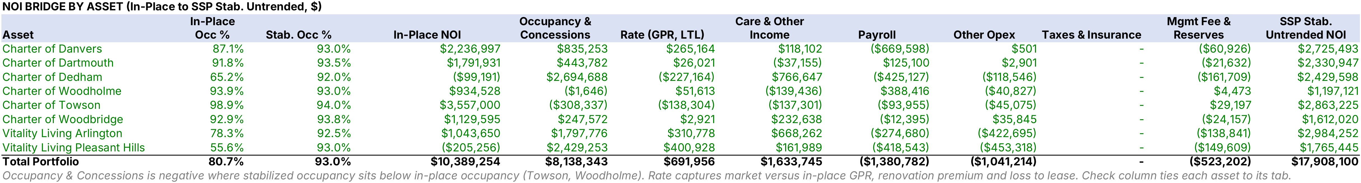
NOI Bridge by Asset: In-Place to SSP Stabilized Untrended
Towson steps down $0.7M, from $3.6M In-Place to $2.9M Stabilized Untrended. Occupancy rolldown (98.9% to 94.0%) is $308K of the decline. The balance is $138K of lower stabilized rate (market GPR below In-Place), $137K of lower care and other income, $94K of payroll and $45K of other opex, partly offset by $29K of lower management fee.
Woodholme (93.9% to 93.0%) is the only other asset that rolls down on occupancy, at ($2K) net of concession burn off. Portfolio occupancy rolldown totals ($310K) and is shown as its own bar on the NOI Walk.
Lease up assets drive the walk. Pleasant Hills ($2.4M), Dedham ($2.7M) and Arlington ($1.8M) contribute $6.9M of the $8.4M occupancy and concession lift.
Setting In-Place payroll at T-3 annualized removes most of the Towson payroll step up that appeared when In-Place used T-12 ($309K before, $94K now).

Slide 13
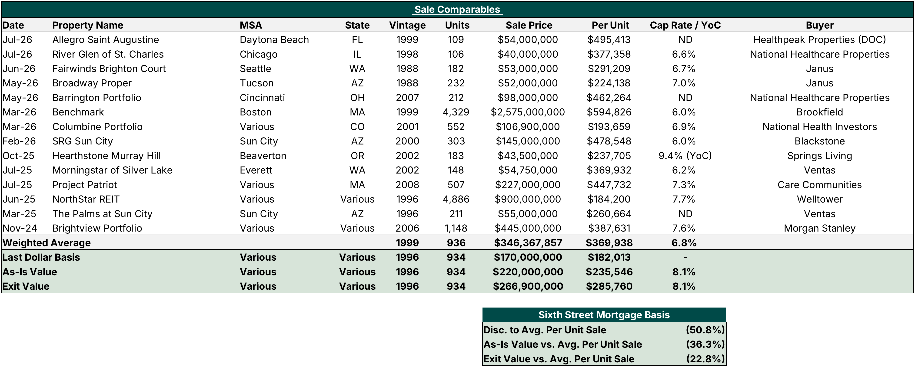
Portfolio Sales Comparables

Slide 14
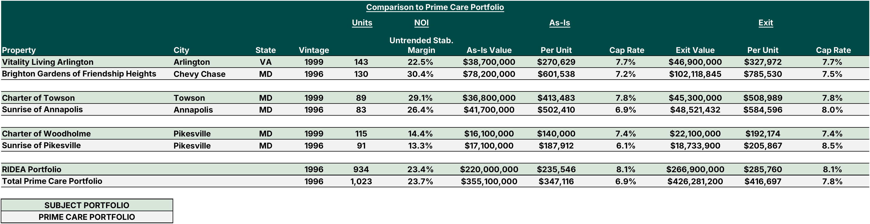
Comparison to Prime Care Portfolio

Slide 15
TBU
Adverse Selection Analysis
The $170M whole loan is allocated across the eight assets on a 50/50 blend of as-is value and in-place NOI, so ALA is more so skewed towards the cash-flowing assets. Each asset releases at the greater of 120% of its ALA and 100% of net sale proceeds. The sponsor must also pay down whatever is needed to keep post-release DY at or above the 7.5% closing level.
Every single asset sale leaves the remaining pool stronger than at close. LTV ranges from 65.2% to 75.9% versus 77.3% at closing, and DY holds at or above 7.5%. The lower yielding and lease-up assets release at 100% of net sale proceeds, which lifts our DY to as high as 8.7%.
Releasing the most accretive assets is expensive for the sponsor. Selling Towson alone requires a $50.5M paydown, or 141.5% of net sale proceeds, which means a $14.8M sponsor check. Selling the best two assets requires $19.4M of new equity, and LTV falls to 59.4% with DY held at 7.5%.
If the sponsor sells the best four assets, the loan pays down to $38.1M at 37.1% LTV and 7.5% DY, with $18.2M of sponsor equity required. Selling the best six repays the loan in full at par.

Slide 16
SSP Returns Sensitivity – Senior Advance Rate & Pricing

