Slide 1
CPA RIDEA Portfolio
November 2026

Slide 2
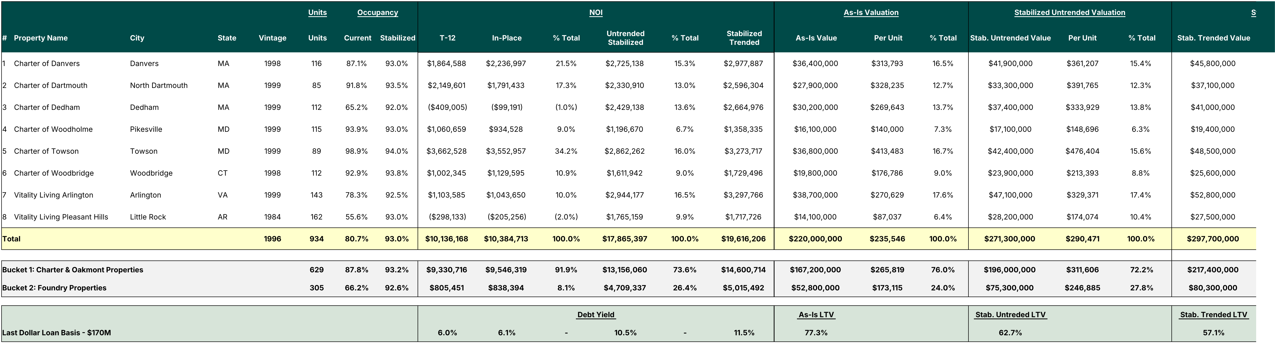
Portfolio Overview
Notes:
(1) Cap Rate in the As-Is Valuation block is Stab. Untrended NOI divided by As-Is Value. It is not an In-Place cap rate. On In-Place NOI of $10.4M the portfolio cap rate is 4.7% versus 8.1% on the Stab. Untrended basis.
(2) Vitality Living Pleasant Hills was destroyed by a tornado and rebuilt, and the new building only recently opened. The 55.6% current occupancy is measured against all 162 units, including newly delivered units that are still leasing up. On the units that were occupiable, the property was effectively 100% leased. See the August 2026 IC memo footnotes for unit counts.
(3) T-12 NOI reflects a management fee of 5.0% of EGI. In-Place NOI reflects T-12 expenses, except payroll, food service and utilities, which are set by asset at the higher of T-12, T-6 or T-3 annualized.

Slide 3
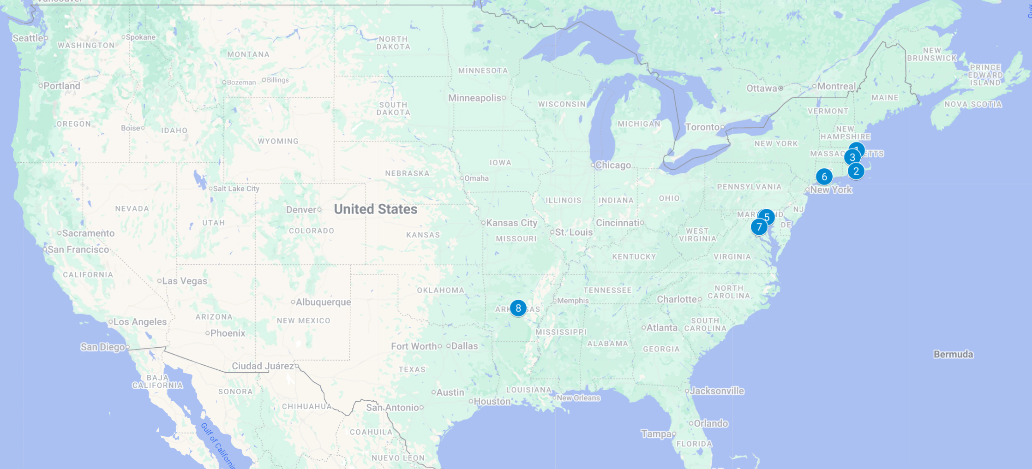
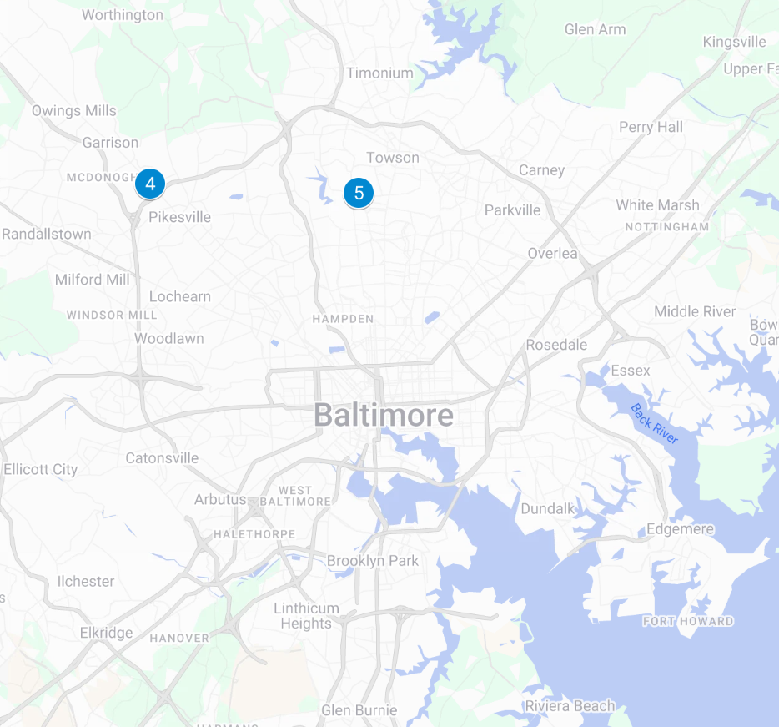
Portfolio Location Overview
1
3
6
2
4-5
7
4
5
8

Slide 4
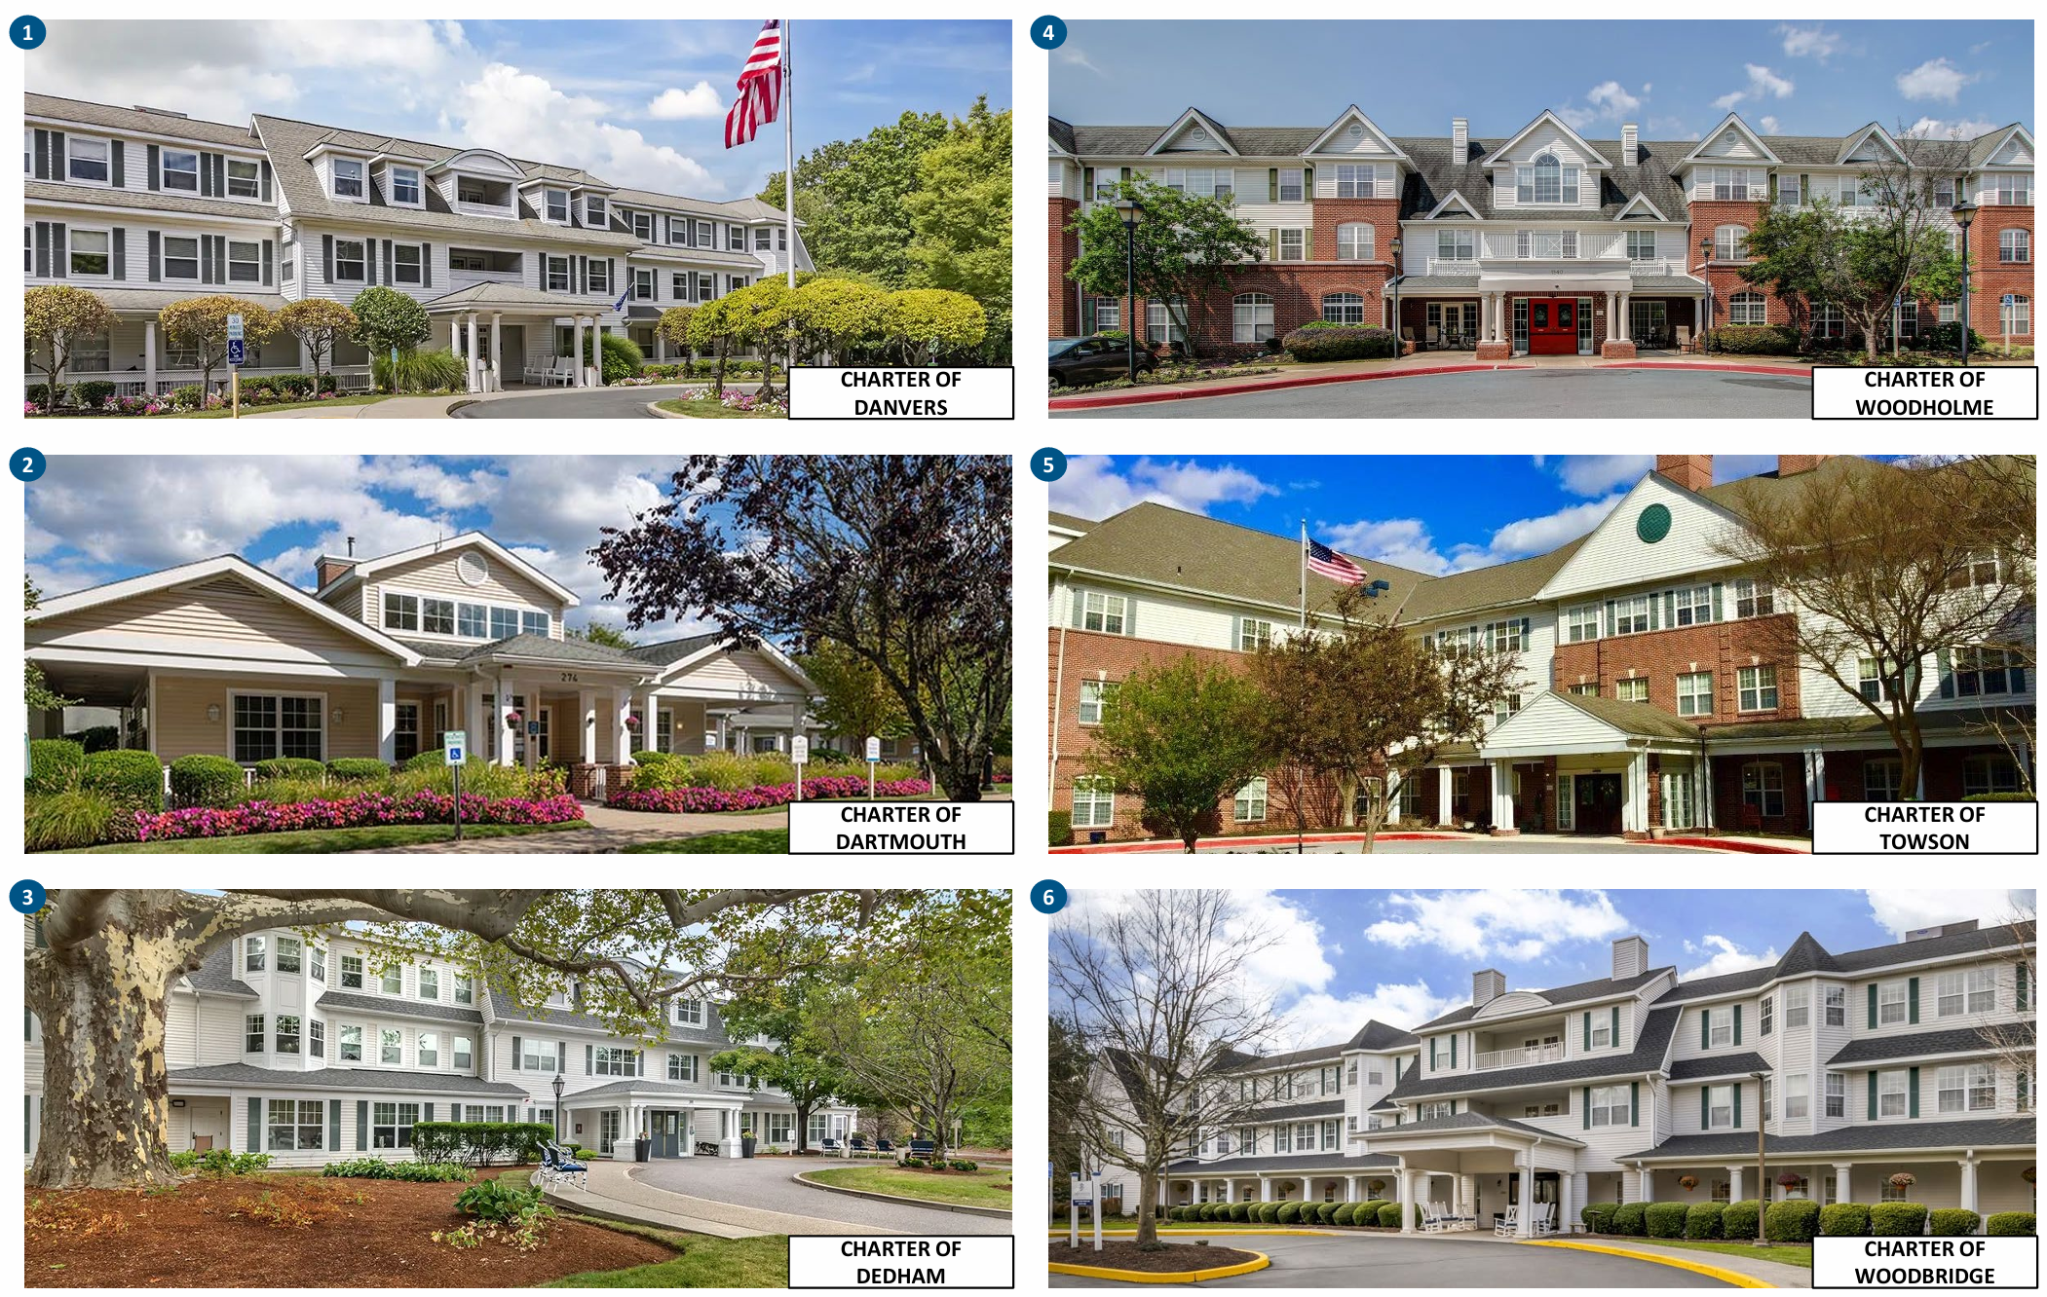
Exterior Property Photos (1 of 2)
1
3
2
4

Slide 5
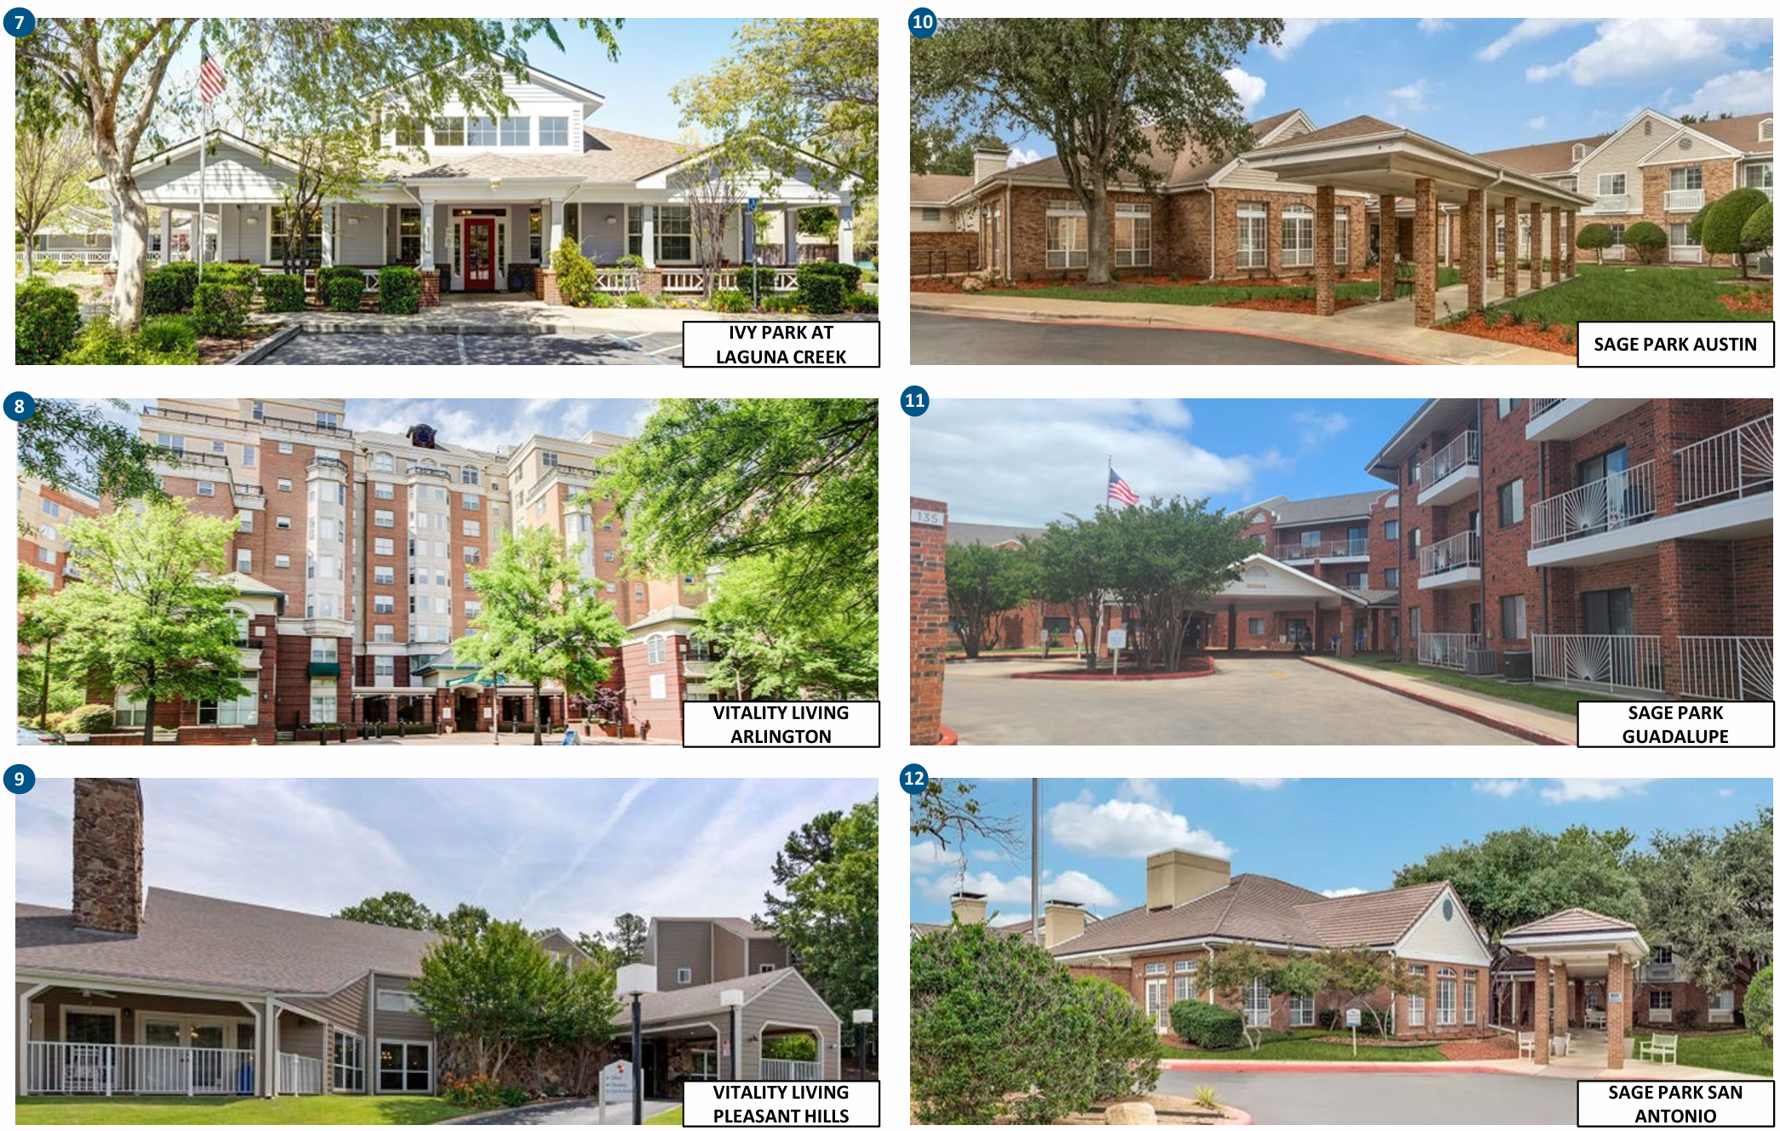
Exterior Property Photos (2 of 2)
5
7
6
8

Slide 6
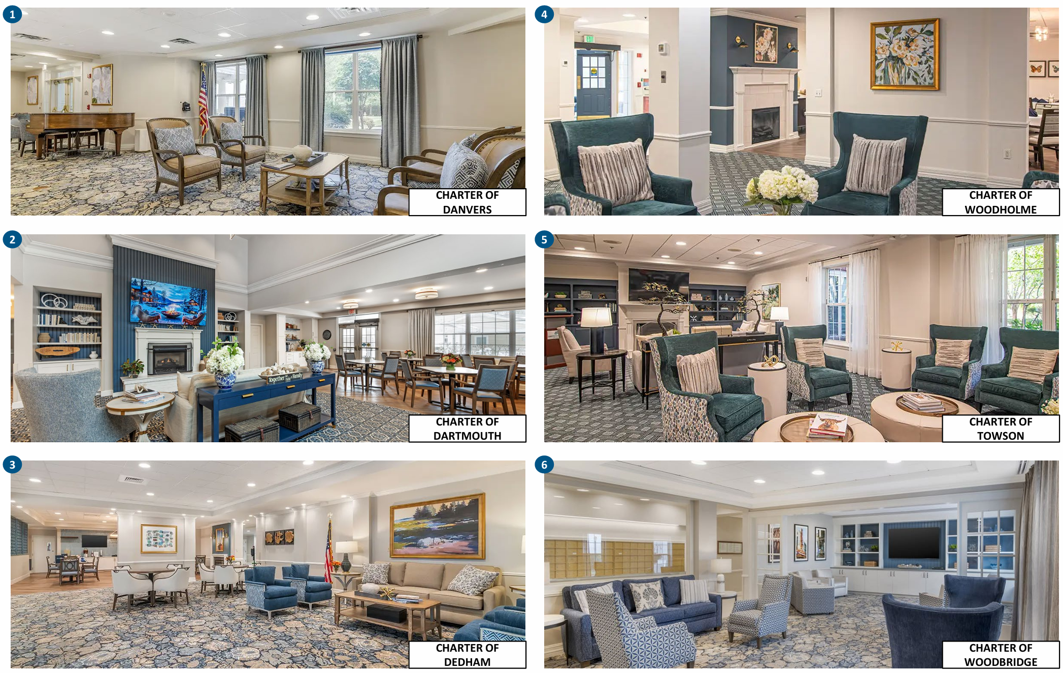
Interior Property Photos (1 of 2)
1
3
2
4

Slide 7
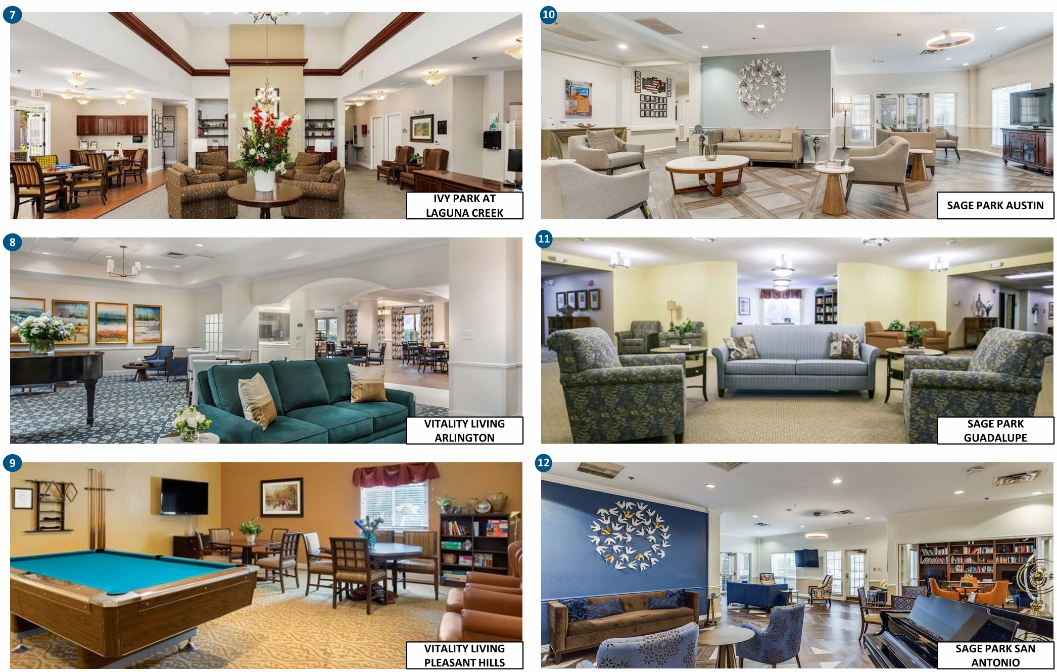
Interior Property Photos (2 of 2)
5
7
6
8

Slide 8
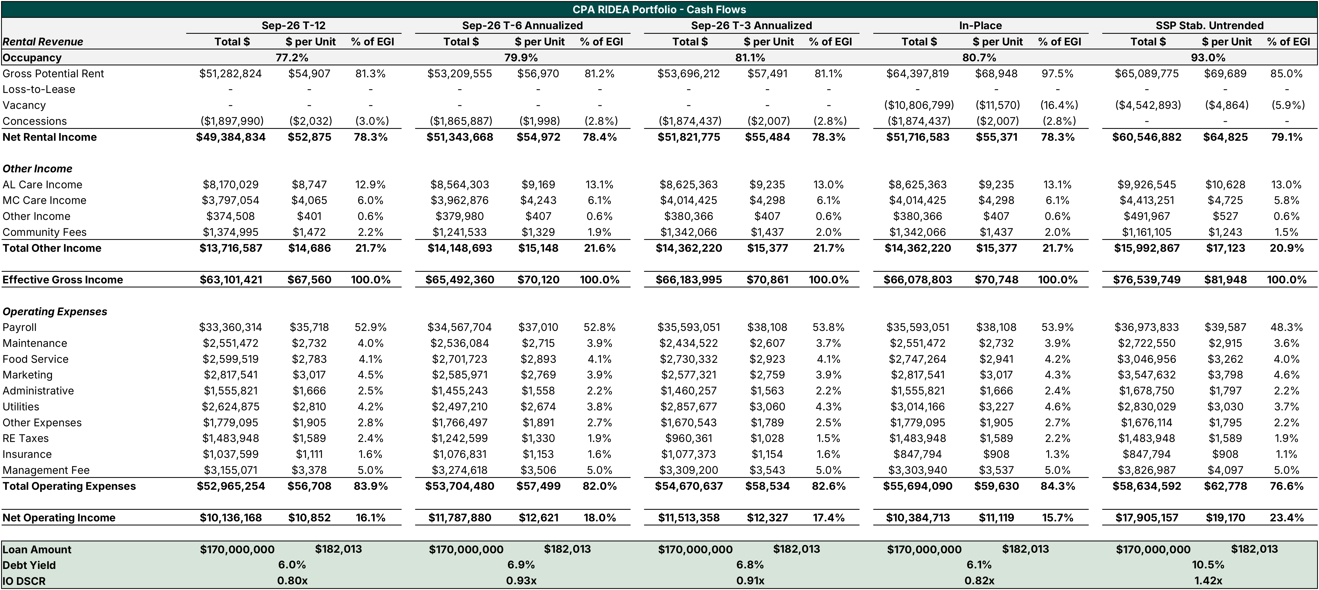
Portfolio Historical Financials & In-Place
Notes: (1) Management fee is sized at 5.0% of EGI in every column. Reported T-12, T-6 and T-3 management fees, including incentive fees, were 5.8%, 6.3% and 5.5% of EGI.
(2) RE taxes are held at the T-12 amount of $1.48M in every column, including In-Place and SSP Stab. Untrended. The Proforma uses the Tax tab build.
(3) In-Place reflects in-place rent and occupancy with T-12 expenses, except payroll, food service and utilities, which are set by asset at the higher of T-12, T-6 or T-3 annualized because occupancy is still ramping.

Slide 9
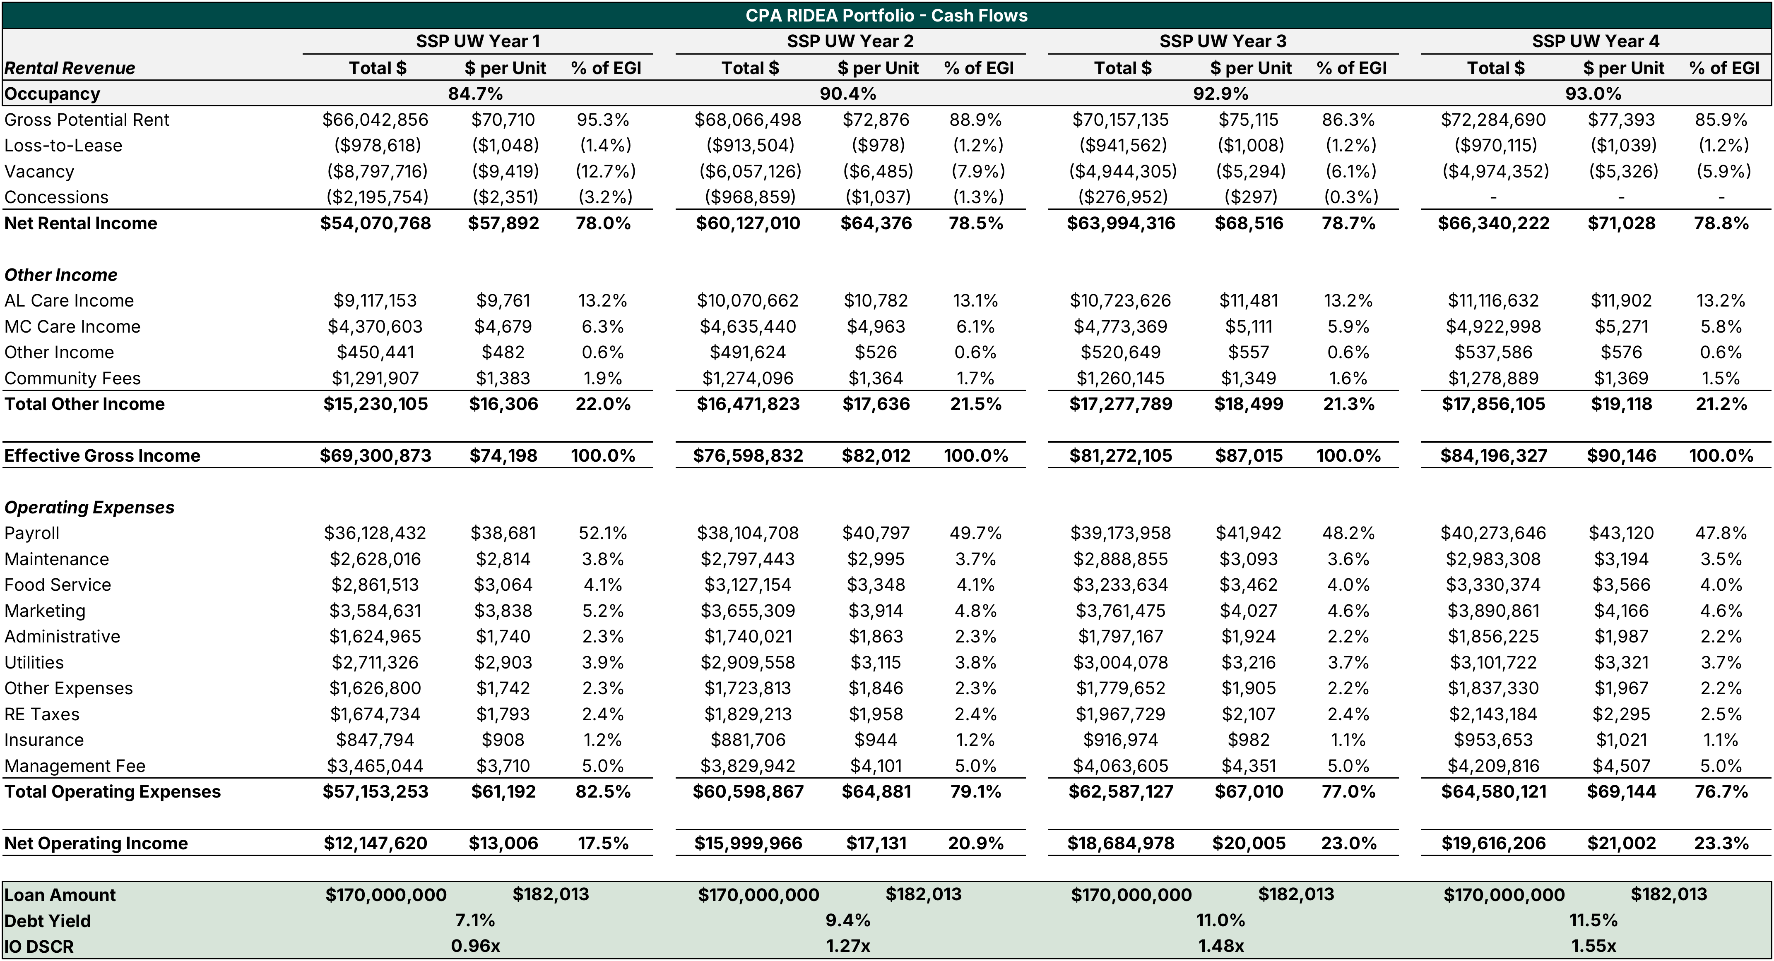
Portfolio Proforma Cash Flows

Slide 10
NOI Walk – September T12 to Stabilized Untrended
The bridge from in-place NOI to our stabilized untrended is primarily attributable to occupancy and concessions, not rent growth. Portfolio NOI rises from $10.4M In-Place to $17.9M SSP Stabilized Untrended (+$7.5M, or +72%), and debt yield on the $170M whole loan goes from 6.1% to 10.5%. Occupancy rises from 80.7% to 93.0% and concessions burn off completely, which together add $8.1M of revenue.
Expenses are underwritten to rise with occupancy, which offsets much of the revenue gain. We add $1.4M of payroll, $1.0M of other operating expenses and $0.5M of management fees to staff and run the higher census. This leaves a net uplift of $7.5M from $10.5M of revenue gains. In-Place payroll, food service and utilities are already set at the higher of T-12, T-6 or T-3 annualized, and RE taxes are held at T-12.
The NOI uplift is concentrated in three lease up assets, which are the main business plan risk. Pleasant Hills (55.6% to 93.0%), Dedham (65.2% to 92.0%) and Arlington (78.3% to 92.5%) together add about $6.4M of NOI. Assets above stabilized occupancy roll down inside the same occupancy bar: Towson (98.9% to 94.0%) is ($308K) and Woodholme (93.9% to 93.0%) is ($2K), so the lease up gain is $8.4M gross and $8.1M net.
Occupancy lift is nearly entirely due to lease-up at Dedham, Arlington, and Pleasant Hills assets

Slide 11
Rent Growth Projections

Slide 12
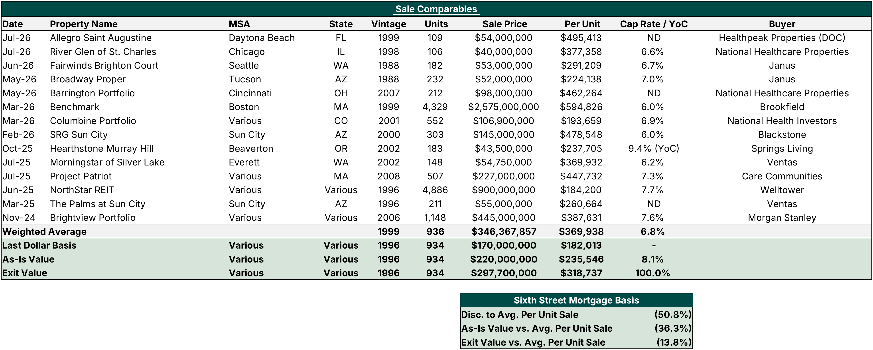
Portfolio Sales Comparables

Slide 13
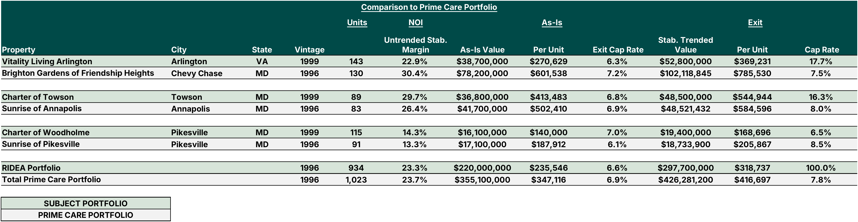
Comparison to Prime Care Portfolio

Slide 14
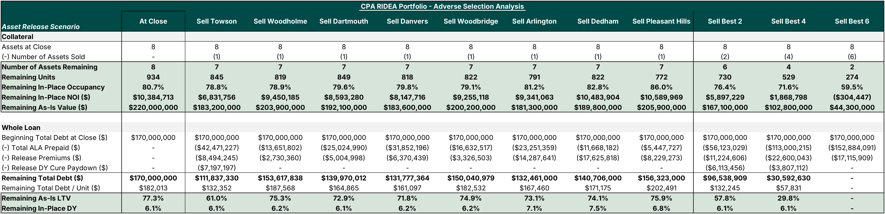
TBU
Adverse Selection Analysis
The $170M whole loan is allocated across the eight assets on a 50/50 blend of as-is value and in-place NOI, so ALA is more so skewed towards the cash-flowing assets. Each asset releases at the greater of 120% of its ALA and 100% of net sale proceeds. The sponsor must also pay down whatever is needed to keep post-release DY at or above the 6.1% closing level.
Every single asset sale leaves the remaining pool stronger than at close. LTV ranges from 61.0% to 75.9% versus 77.3% at closing, and DY holds at or above 6.1%. The lower yielding and lease up assets release at 100% of net sale proceeds, which lifts our DY to as high as 7.5%.
Releasing the most accretive assets is expensive for the sponsor. Selling Towson alone requires a $58.2M paydown, or 162.9% of net sale proceeds, which means a $22.5M sponsor check. Selling the best two assets requires $22.1M of new equity, and LTV falls to 57.8% with DY held at 6.1%.
If the sponsor sells the best four assets, the loan pays down to $30.6M at 29.8% LTV and 6.1% DY, with $25.7M of sponsor equity required. Selling the best six repays the loan in full at par.

Slide 15
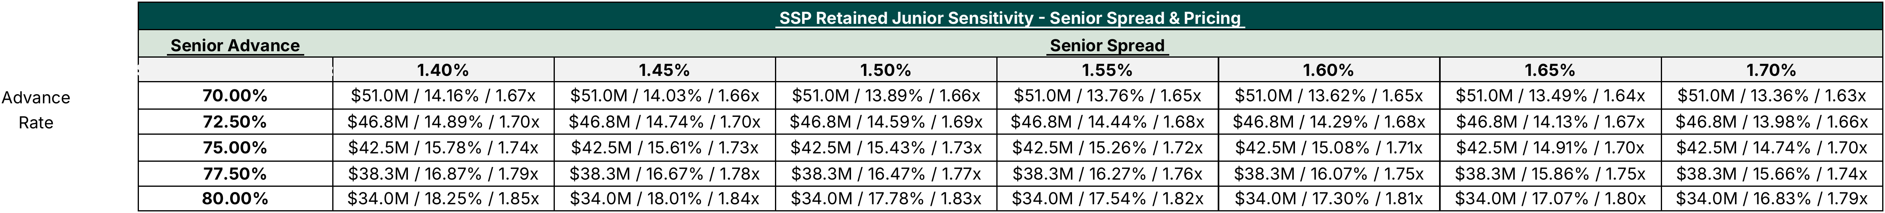
SSP Returns Sensitivity – Senior Advance Rate & Pricing

