Slide 1
Join Patterns for Visual Basic
Claudio Russo
Programming Principles and Tools
Microsoft Research, Cambridge
(crusso@microsoft.com)
OOPSLA 2008, Nashville, TN

Slide 2
Concurrent Basic (CB)
Aim: simplify concurrent programming in VB
How: extend VB with concurrency constructs!
Based on asynchronous message passing, so good for both distributed and local concurrency.
Derived from Gonthier and Fournet’s foundational join calculus.
Builds on earlier MSRC projects: Polyphonic C# (‘02), Cω (‘04), Joins Concurrency Library (‘06)... (cf. JoCaml, Funnel, JoinJava).
CB’s novel contributions:
familiar syntax, generic abstractions, flexible inheritance, extensibility.

Slide 3
VB Events
VB ≈ C# + declarative event handling
Class Document
Public Event Saved( sender As Object, args As EventArgs)
Private Sub CaseSaveOrSubmit(sender As Object,args As EventArgs)_
Handles SaveButton.Click, SubmitButton.Click
' Save this document to disk
RaiseEvent Saved(Me, Nothing)
End Sub
End Class
A type publishes a named event using an Event declaration (as in C#).
Unlike C#, a method subscribes to one or more events using a Handles statement.
RaiseEvent runs the event’s current handlers with the supplied arguments.
VB already supports sequential, event -based programming (GUIs, web servers...)!

Slide 4
CB in One Slide
Types can declare synchronous and asynchronous channels.
Threads synchronize & communicate by sending on channels.
a synchronous send waits until the channel returns some result.
an asynchronous send returns immediately, but posts a message.
A type defines a collection of join patterns.
A join pattern is a method that runs when some set of channels are non-empty.
Each send may enable...
some pattern, causing a request to complete or a new thread to run.
no pattern, causing the request to block or the message to queue.

Slide 5
Syntax of CB
A channel is declared like an “Event” using a method signature:
(Only a Synchronous channel may have a return type.)
A join pattern is declared like an “event handler”, by qualifying a method using When and a set of local channel names (the pattern) :
(The continuation’s parameters must match the sequence of channel parameters. Its return type must agree with the first channel – the only channel that may be synchronous.)
Asynchronous Put(t As T)
Synchronous Take() As T
Function CaseTakeAndPut(t As T) As T When Take, Put
Return t
End Function

Slide 6
A Simple Buffer in CB (for use by producer/consumer threads)
Class Buffer(Of T)
Asynchronous Put(t As T)
Synchronous Take() As T
Function CaseTakeAndPut(t As T) As T When Take, Put
Return t
End Function
End Class
Put(t) returns immediately but posts its T argument to a queue.
Take()returns a T but has no arguments.
CaseTakeAndPut(t) may run when both Take() and Put(t) have been called. Its body consumes both calls; returns to the caller waiting on Take.
Just one pattern, so calls to Take() must wait until or unless there’s a Put(t).
Buffer(Of T) is generic – couldn’t write this is Cω or Polyphonic C#!

Slide 7
The Buffer in Action
Class Buffer
Asynchronous Put(t As String)
Synchronous Take() As String
Function CaseTakeAndPut(t As String) As String _
When Take, Put
Return t
End Function
End Class
Producer Thread
B As Buffer
Consumer Thread
B.Take()
Take()
B.Put(“a”)
Take()
Put(“a”),Take()
Function CaseTakeAndPut(“a”) As String
When Take, Put
Return “a”
End Function
B.Put(“b”)
Time
B.Put(“c”)
Put(“b”)
Put(“b”),Put(“c”)
B.Take()
Put(“b”),Put(“c)
Put(“c”)
Function CaseTakeAndPut(“b”) As String
When Take, Put
Return “b”
End Function

Slide 8
Alternative Patterns
Class Choice
Asynchronous Left(l As String)
Asynchronous Right(r As String)
Synchronous Wait() As String
Function CaseWaitLeft(l As String) As String _
When Wait, Left
Return “left: ” + l
End Function
Function CaseWaitRight(r As String) As String _
When Wait, Right
Return “right: ” + r
End Function
End Class
Wait() has two continuations.
Wait() blocks until/unless a call to Left(l) OR Right(r) occurs.
Wait() executes a different body in each case, consuming l or r.

Slide 9
Patterns with Several Messages
Class Join
Asynchronous Left(l As String)
Asynchronous Right(r As String)
Synchronous Wait() As String
Function CaseWaitLeftRight(l As String,r As String) _
As String _
When Wait, Left, Right
Return l + r
End Function
End Class
Wait() blocks until/unless calls to both Left(l) AND Right(r) occur.
Wait() executes CaseWaitLeftRight(l,r)’s body, receiving and consuming l and r.

Slide 10
Asynchronous Patterns
Delegate Sub Callback(S As String)
Class AsyncBuffer
Asynchronous Put(S As String)
Asynchronous BeginTake(C As Callback)
Sub CaseBeginTakePut(C As Callback, S As String) _
When BeginTake,Put
C(S)
End Sub
End Class
BeginTake(c) is asynchronous but queues a callback, c.
c(s) is run on a new thread when both a BeginTake(c) and Put(s) have arrived (in either order).

Slide 11
The AsyncBuffer In Action
Consumer Thread
Producer Thread
B As AsyncBuffer
B.BeginTake(C)
BeginTake(C)
B.Put(“a”)
BeginTake(C)
Time
C(“a”)
B.Put(“b”)
B.Put(“c”)
Put(“b”)
Put(“b”),Put(“c”)
Class AsyncBuffer
Asynchronous Put(S As String)
Asynchronous BeginTake(C As Callback)
Sub CaseBeginTakeAndPut _
(C As Callback,S As String) _
When BeginTake, Put
C(S)
End Sub
End Class
B.BeginTake(D)
Put(“b”),Put(“c)
Put(“c”)
D(“b”)

Slide 12
Generic Futures
Class Future(Of T)
Delegate Function Computation() As T
Synchronous Wait() As T
Private Asynchronous Execute(comp As Computation)
Private Asynchronous Done(t As T)
Private Sub CaseExecute(Comp As Computation) When Execute
Done(Comp())
End Sub
Private Function CaseWaitAndDone(t As T) As T When Wait, Done
Done(t) : Return t
End Function
Public Sub New(Comp As Computation)
Execute(Comp)
End Sub
End Class
A future represents the value of a concurrent computation. An old idea…
Creating a future spawns a worker thread to do some expensive computation.
When the future’s value is needed the current thread blocks on Wait() until/unless the worker is Done(t).
Meanwhile, the current thread can do useful work.

Slide 13
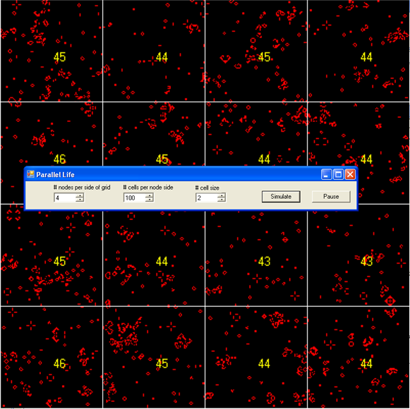
Parallel Life
Game of Life divided amongst p² nodes.
Each node updates an n² region of cells using a dedicated thread.
Nodes maintain private arrays of cells, overlapping one edge with each neighbour node.
To remain in sync, a node repeatedly:
sends its edges to its neighbours;
receives 4 edges from its neighbours;
updates cells in parallel with other nodes.
Since no arrays are shared, this algorithm easily distributes across machines.

Slide 14
Life (extract)
Class Node
Private Asynchronous StartWorker()
Private Sub CaseStartWorker() When StartWorker
While True
Send()
Receive()
Relax() ‘ Relax() computes the next subgrid
End While
End Sub
End Class

Slide 15
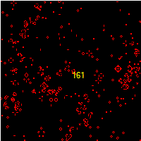
Life (extract)
Class Node
...
Public up, right, down, left As Node
Public Asynchronous TopRow(Row As State())
Public Asynchronous RightColumn(Column As State())
Public Asynchronous BottomRow(Row As State())
Public Asynchronous LeftColumn(Column As State())
Private Sub Send()
up.BottomRow(MyTopRow) : right.LeftColumn(MyRightColumn)
down.TopRow(MyBottomRow) : left.RightColumn(MyLeftColumn)
End Sub
Private Synchronous Receive()
Private Sub CaseReceiveAndRows(TopRow As State(),RightColumn As State(),
BottomRow As State(), LeftColumn As State()) _
When Receive, TopRow, RightColumn, BottomRow, LeftColumn
MyTopRow = TopRow : MyRightColumn = RightColumn
MyBottomRow = BottomRow : MyLeftColumn = LeftColumn
End Sub
End Class

Slide 16
Adding a “pause” toggle
Class Node
...
Public Asynchronous Toggle()
Private Sub CaseReceiveAndToggle() When Receive, Toggle
Await()
End Sub
Private Synchronous Await()
Private Sub CaseAwaitAndToggle() When Await, Toggle
Receive()
End Sub
End Class
TopRow & RightColumn & BottomRow & LeftColumn
Toggle
Receive?
Await?
Toggle

Slide 17
Generic Automata
Class GenericPCA(Of State)
Class Node
...
Public Asynchronous TopRow(Row As State())
Public Asynchronous RightColumn(Column As State())
Public Asynchronous BottomRow(Row As State())
Public Asynchronous LeftColumn(Column As State())
Private Synchronous Receive()
Private Sub CaseReceiveAndRows(TopRow As State(),RightColumn As State(),
BottomRow As State(), LeftColumn As State()) _
When Receive, TopRow, RightColumn, BottomRow, LeftColumn
...
End Sub
End Class
End Class
The type State is actually a type parameter of an enclosing class, abstracting various cellular automata – this is generic parallel algorithm!

Slide 18
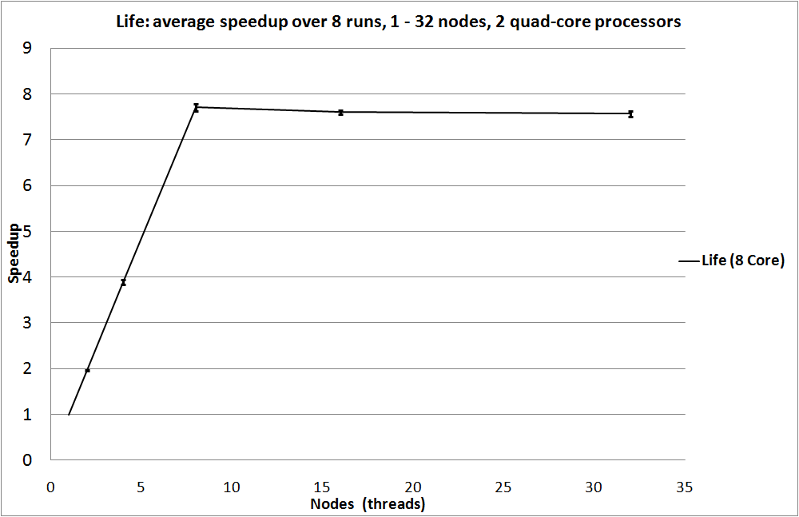
Speedup

Slide 19
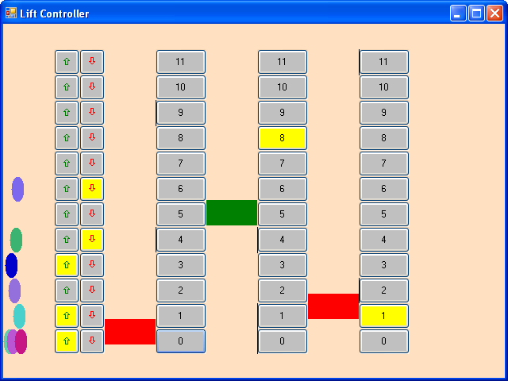
Animated Lift Controller
call buttons (on 11th floor)
floor buttons in Lift 3
person
lift 3 of 3
demonstrates Erlang-style ActiveObject pattern
each agent runs a private “message” loop.

Slide 20
Inheritance
Start() spawns a loop that issues ProcessMessage requests.
Messages join with ProcessMessage and are queued until ProcessMessage is re-issued.
Patterns are thus serialized: no need to lock private state.
Class ActiveObject
Private Done As Boolean
Protected Synchronous ProcessMessage()
Public Asynchronous Start()
Private Sub CaseStart() When Start
While Not Done
ProcessMessage()
End While
End Sub
Public Asynchronous Halt()
Private Sub CaseHalt() When ProcessMessage, Halt
Done = True
End Sub
End Class
Class Person
Inherits ActiveObject
Public Asynchronous GotoFloor(f As Floor)
Private Sub CaseGotoFloor(f As Floor)
When ProcessMessage, GotoFloor
‘ Call a lift
End Sub
...
End Class
Sub-class Person declares an additional pattern on the inherited ProcessMessage channel!
Cω forced duplication of inherited patterns, breaking encapsulation! This is much better...

Slide 21
Quiz: what’s wrong with this code?
Public Class Form
Private Asynchronous Start()
Private Synchronous Done(Result As String)
Private Sub Button_Click() Handles Button.Click
Button.Enabled = False
Start()
End Sub
Private Sub CaseStart () When Start
‘ Compute (expensive) Result on a separate thread
Done(Result)
End Sub
Private Sub CaseDone(Result As String) When Done
Label.Text = Result
Button.Enabled = True
End Sub
End Class
CaseStart() always runs in a new thread (a performance issue).
CaseDone() modifies Label from a non-UI thread (a real bug).

Slide 22
Modifying Dispatch with Attributes
Public Class Form
...
<ThreadPool()> _
Private Sub CaseStart () When Start
‘ Compute (expensive) Result on a separate thread
Done(Result)
End Sub
<UI()> _
Private Sub CaseDone(Result As String) When Done
Label.Text = Result
Button.Enabled = True
End Sub
End Class
run me asynchronously in the ThreadPool!
run me synchronously on the UI event loop!
Users employ custom attributes to control how a continuation is run. The attributes are user-extensible; thus future proof. (Got your own Thread Pool? Just roll your own MyThreadPoolAttribute.)

Slide 23
Continuation Attributes
The CB runtime exposes an abstract attribute class with two virtual methods:
Public Delegate Sub Continuation()
Public MustInherit Class ContinuationAttribute
Inherits Attribute
Public MustOverride Sub BeginInvoke(task As Continuation)
Public MustOverride Sub Invoke(task As Continuation)
End Class
BeginInvoke(task) runs task() asynchronously (somehow)
Invoke(task) runs task() synchronously (somehow)
NB: we are using attributes to extend behaviour (not just metadata).

Slide 24
ThreadPool() Attribute
To avoid creating new threads, the user may prefer to run asynchronous patterns in the CLR ThreadPool:
Class ThreadPoolAttribute
Inherits ContinuationAttribute
Public Overrides Sub BeginInvoke(task As Continuation)
ThreadPool.QueueUserWorkItem(Function(state As Object) task(), _
Nothing)
End Sub
Public Overrides Sub Invoke(task As Continuation)
task()
End Sub
End Class
BeginInvoke(task) runs task() asynchronously on some ThreadPool thread.
Invoke(task) runs task() synchronously on current thread (us usual).

Slide 25
UI() Attribute
To force that a continuation is executed on a Windows UI thread one defines:
Class UIAttribute
Inherits ContinuationAttribute
Private SC As SynchronizationContext = SynchronizationContext.Current()
Public Overrides Sub BeginInvoke(task As Continuation)
SC.Post(Function(state As Object) task(), Nothing)
End Sub
Public Overrides Sub Invoke(task As Continuation)
SC.Send(Function(state As Object) task(), Nothing)
End Sub
End Class
BeginInvoke(task) runs task() asynchronously on the UI thread.
Invoke(task) runs task() synchronously on the UI thread – blocking the current thread until done.
(SychronizationContext is provided by the CLR. The attribute instance caches the current context when allocated.)

Slide 26
Events vs. Channels
Event A(x As T, y As U)
Event B(x As T, y As U)
Sub P(x As T,y As U) Handles A, B
End Sub
Sub Q(x As T,y As U) Handles A, B
End Sub
Asynchronous A(x As T)
Asynchronous B(y As U)
Sub P(x As T,y As U) When A, B
End Sub
Sub Q(x As T,y As U) When A, B
End Sub
Handlers P(x,y) AND Q(x,y) execute whenever A(x,y) OR B(x,y) are raised.
vs.
Pattern P(x,y) OR Q(x,y) executes whenever A(x) AND B(y) are received.
Similar syntax, “dual” semantics!

Slide 27
Compilation
Public Class ActiveObject
Private Done As Boolean
Protected ReadOnly ProcessMessageChannel As [Synchronous].Channel
<SynchronousChannel()> _
Protected Sub ProcessMessage()
ProcessMessageChannel()
End Sub
Protected ReadOnly StartChannel As [Asynchronous].Channel
<AsynchronousChannel()> _
Public Sub Start()
StartChannel()
End Sub
Protected ReadOnly HaltChannel As [Asynchronous].Channel
<AsynchronousChannel()> _
Public Sub Halt()
HaltChannel()
End Sub
Private Sub CaseStartContinuation()
CaseStart()
End Sub
Private Sub CaseStart()
While Not Done : ProcessMessage() : End While
End Sub
Private Sub CaseHaltContinuation()
CaseHalt()
End Sub
Private Sub CaseHalt()
Done = True
End Sub
Protected Overridable Function JoinSize() As Integer
Return 3
End Function
Protected ReadOnly Join As Join = Join.Create(JoinSize(), True)
Private Sub JoinInitialize(
ByRef ProcessMessageChannel As [Synchronous].Channel, _
ByRef StartChannel As [Asynchronous].Channel, _
ByRef HaltChannel As [Asynchronous].Channel)
Join.Initialize(ProcessMessageChannel)
Join.Initialize(StartChannel)
Join.Initialize(HaltChannel)
Join.When(StartChannel).Do(AddressOf CaseStartContinuation)
Join.When(ProcessMessageChannel).And(HaltChannel).Do(AddressOf CaseHaltContinuation)
End Sub
Sub New()
JoinInitialize(ProcessMessageChannel, StartChannel, HaltChannel)
End Sub
End Class
Class ActiveObject
Private Done As Boolean
Protected Synchronous ProcessMessage()
Public Asynchronous Start()
Private Sub CaseStart() When Start
While Not Done
ProcessMessage()
End While
End Sub
Public Asynchronous Halt()
Private Sub CaseHalt() When ProcessMessage, Halt
Done = True
End Sub
End Class
Translates to
CB is implemented in the production VB compiler.
Currently use Joins Library as a runtime.
After type-checking, mostly a source 2 source translation.

Slide 28
Summary
CB frees programmers from dirty thoughts of locks, monitors etc.
The model is simple, yet expressive, especially with Generics and inheritance.
Asynchronous, so good for both local and distributed concurrency.
The syntax is approachable, similar to VB Event handling.
Integrates with existing thread model, yet provides simple, pragmatic hooks for integrating with Parallel FX, ThreadPool, event-loops…
Full implementation in production code (suitable for tech transfer).
Possible to compile even more efficiently and optimize.
(See me for a demo)

Slide 29
Links
Joins Library with samples, tutorial & doc:
http://research.microsoft.com/downloads/
PADL paper on Joins Library :
http://research.microsoft.com/~crusso/papers/padl07.pdf
On Cω and Polyphonic C#:
http://research.microsoft.com/comega/

Slide 30
Credits
Nick Benton, Cedric Fournet, Luca Cardelli
Georges Gonthier
Erik Meijer, Harish Kantamneni
Timothy Ng, Danny van Velzen
Gavin Bierman, Andrew Kennedy
Lucian Wischik

Slide 31
Special Edition Bonus Material!

Slide 32
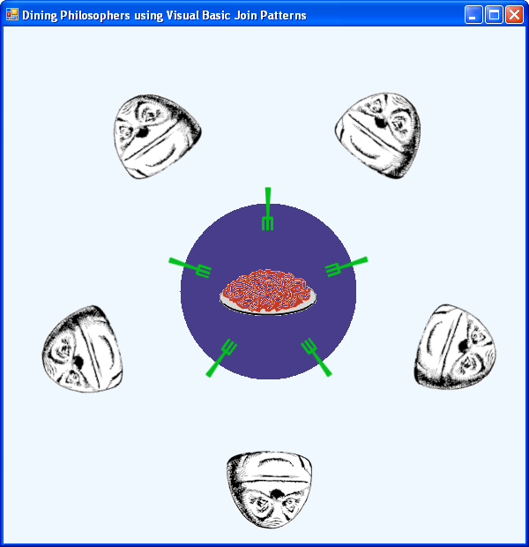
Classic Example: Dining Philosophers
Five philosophers each repeatedly think, feel hungry, eat and then go back to thinking.
The philosphers eat spaghetti at a circular table with five forks on.
A philosopher must have picked up the fork on his left and his right before starting to eat.
Once he has eaten, he returns both forks to the table.
Two pitfalls:
starvation : a hungry philosopher never gets to eat.
deadlock: e.g. all philosophers pick up the fork on their left and wait forever for the second fork.

Slide 33
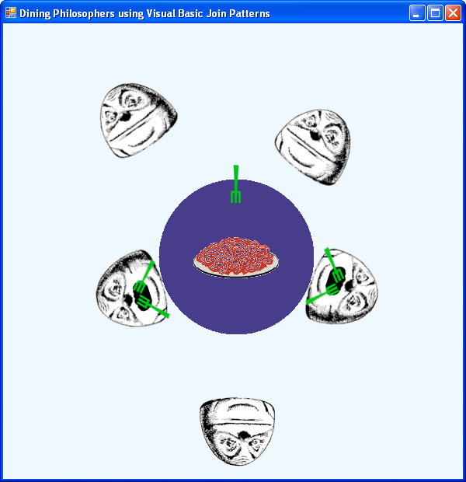
Classic Example: Dining Philosophers
One Solution (there are others): only allow a maximum of four philosophers to be sitting at the table at any one time.
How?
Introduce a fictional Room with capacity n = 4.
Each philosopher must enter the room, maybe waiting if full, eat then leave the room.
>4

Slide 34
Dining Philosophers (extract)
Class Room
Synchronous Enter()
Synchronous Leave()
Private Asynchronous HasSpaces(count As Integer)
Private Asynchronous IsFull()
Public Sub New(size As Integer)
HasSpaces(size)
End Sub
Private Sub CaseEnterAndHasSpaces(n As Integer) When Enter, HasSpaces
If (n > 1) Then HasSpaces(n - 1) Else IsFull()
End Sub
Private Sub CaseLeaveAndHasSpaces(n As Integer) When Leave, HasSpaces
HasSpaces(n + 1)
End Sub
Private Sub CaseLeaveAndIsFull() When Leave, IsFull
HasSpaces(1)
End Sub
End Class

Slide 35
Reader/Writer Lock in CB
Class ReaderWriter
Synchronous AcquireExclusive()
Synchronous ReleaseExclusive()
Synchronous AcquireShared()
Synchronous ReleaseShared()
Private Asynchronous Sharing(n As Integer)
Private Asynchronous Idle()
Sub CaseAcquireExclusiveAndIdle() When AcquireExclusive, Idle
End Sub
Sub CaseReleaseExclusive() When ReleaseExclusive
Idle()
End Sub
Sub CaseAcquireSharedAndIdle() When AcquireShared, Idle
Sharing(1)
End Sub
Sub CaseAcquireSharedAndSharing(n As Integer) When AcquireShared, Sharing
Sharing(n + 1)
End Sub
Sub CaseReleaseSharedAndSharing(n As Integer) When ReleaseShared, Sharing
If n = 1 Then Idle() Else Sharing(n - 1)
End Sub
Public Sub New()
Idle()
End Sub
End Class
A single private message represents the state:
none ↔ Idle() ↔ Sharing(1) ↔ Sharing(2) ↔ …

