Slide 1
The Joins Concurrency Library
“Cω in a Box”
Claudio Russo
Microsoft Research, Cambridge
crusso@microsoft.com

Slide 2

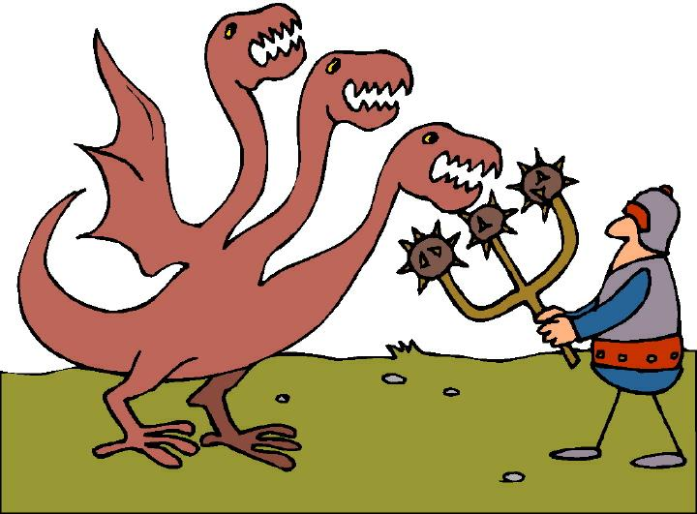
Introduction
Concurrency is going mainstream: rise of multi-core and asynchronous web applications.
Most languages only provide “traditional” concurrency primitives: locks, monitors, CAS. Too low-level & error-prone, non-compositional.
Cω extended C# 1.0 with high-level, asynchronous concurrency abstractions -join patterns - based on the join calculus.
(variant of Polyphonic C#, related to JoCaml).
“Great! Pity they’re tied to an outdated research compiler…”
With Generics, we can be provide join patterns as a .NET library – called “Joins”.
Joins, written in C# 2.0, is usable from VB, F# etc…

Slide 3
Cω Concurrency in One Slide
Classes can have both synchronous and asynchronous methods.
Values are passed (between threads) by ordinary method calls:
  If the method is synchronous, the caller blocks until the method returns some result (as usual).
  If the method is asynchronous, the call immediately returns void.
A class defines a collection of join patterns. Each pattern guards a body that runs when a set of methods have been invoked. One method may appear in several patterns.
  When pending method calls match some pattern, the pattern’s body runs.
  If there is no match, the calls are queued up.
  If a pattern joins only asynchronous methods, its body runs in a new thread.

Slide 4
A Simple Buffer in Cω
class Buffer {
async put(string s);
string get() & put(string s) {
return s;
}
}
For use by producer/consumer threads:
Producers call b.put(s) to post a string.
Consumers call b.get() to receive a string.

Slide 5
A Simple Buffer in Cω
class Buffer {
async put(string s);
string get() & put(string s) {
return s;
}
}
An asynchronous method (hence returning no result), with a string argument

Slide 6
A Simple Buffer in Cω
class Buffer {
async put(string s);
string get() & put(string s) {
return s;
}
}
An asynchronous method (hence returning no result), with a string argument
An ordinary (synchronous) method with no arguments, returning a string

Slide 7
A Simple Buffer in Cω
class Buffer {
async put(string s);
string get() & put(string s) {
return s;
}
}
An asynchronous method (hence returning no result), with a string argument
An ordinary (synchronous) method with no arguments, returning a string
Combined in a join pattern

Slide 8
A Simple Buffer in Cω
class Buffer {
async put(string s);
string get() & put(string s) {
return s;
}
}
Calls to put(s) return immediately, but are internally queued if there’s no waiting get()
Calls to get() block until/unless there’s a matching put(s)
When there’s a match the body runs, returning the
argument of put(s) to the caller of get()
How pairs of calls match up is unspecified

Slide 9
A Simple Buffer in Cω
class Buffer {
async put(string s);
string get() & put(string s) {
return s;
}
}
Does this example involve spawning any threads?
  No, but calls will typically be from different, existing threads.
Is it thread-safe?
  Yes. The compiled code uses locks.
Which method gets the returned result?
  The synchronous one; there is at most one of these in a pattern.

Slide 10
The Buffer Over Time
Producer
Thread
Buffer b
Consumer
Thread
b.get();
get()
b.put(“a”);
get()
put(“a”),get()
Time
b.get() & put(“a”){
return “a”;
}
b.put(“b”);
b.put(“c”);
put(“b”)
put(“b”),put(“c”)
b.get();
put(“b”),put(“c)
put(“c”)
b.get() & put(“b”){
return “b”;
}

Slide 11
The Joins Library
Joins is an imperative combinator library for join patterns.
Joins provides typed channels instead of Cω’s joined methods.
A channel is a value of a special delegate* type:
  sending/receiving on a channel is just delegate invocation.
A Join object contains the scheduling logic declared in a Cω class.
The join object owns :
  the set of channels it has initialized.
  a set of user-defined join patterns.
Each join pattern is constructed by:
  conjoining a subset of the join’s channels (the pattern);
  supplying a continuation delegate.
To emulate a Cω class, a user declares fields to expose the channels of a privately constructed join object…
*Delegates are C#’s first-class methods. Like first-class functions in FP but with nominal typing.

Slide 12
C# Buffer using the Joins Library
class Buffer {
async put(string s);
string get() & put(string s) {
return s;
}
}
using Microsoft.Reseach.Joins;
class Buffer {
Asynchronous.Channel<string> put;
Synchronous<string>.Channel get;
Buffer() {
Join j = Join.Create();
j.Initialize(out put);
j.Initialize(out get);
j.When(get).And(put).Do(delegate(string s){
return s;
});
}
}
… b.put(“hello”); ...; string s = b.get() …

Slide 13
C# Buffer using the Joins Library
class Buffer {
async put(string s);
string get() & put(string s) {
return s;
}
}
using Microsoft.Reseach.Joins;
class Buffer {
Asynchronous.Channel<string> put;
Synchronous<string>.Channel get;
Buffer() {
Join j = Join.Create();
j.Initialize(out put);
j.Initialize(out get);
j.When(get).And(put).Do(delegate(string s){
return s;
});
}
}
… b.put(“hello”); ...; string s = b.get() …
reference the library
declare channels using delegate types
create a Join object
initialize channels
client code appears the same
declare the join pattern(s)

Slide 14
Using the Joins Library
Declare your flavoured channels:
Asynchronous.Channel<string> put;
Synchronous<string>.Channel get;
Create a Join Object:
Join join = Join.Create();
Initialize your channels:
join.Initialize(out put);
join.Initialize(out get);
Construct your pattern(s):
join.When(get).And(put).Do(delegate(string s) {
return s;
});
An easy pattern with a small vocabulary: Asynchronous, Synchronous, Channel, Join, Create, Initialize, When, And, Do.
Boilerplate Code -tedious,
but always the same.

Slide 15
Reader/Writer Lock in Five Patterns
public class ReaderWriter {
public Synchronous.Channel Exclusive, ReleaseExclusive;
public Synchronous.Channel Shared, ReleaseShared;
private Asynchronous.Channel Idle;
private Asynchronous.Channel<int> Sharing;
public ReaderWriter() {
Join j = Join.Create(); … // Boilerplate omitted
j.When(Exclusive).And(Idle).Do(delegate {});
j.When(ReleaseExclusive).Do(delegate{ Idle();});
j.When(Shared).And(Idle).Do(delegate{ Sharing(1);});
j.When(Shared).And(Sharing).Do(delegate(int n){ Sharing(n+1);});
j.When(ReleaseShared).And(Sharing).Do(delegate(int n){
if (n==1) Idle(); else Sharing(n-1);});
Idle();
}
}
A single private message represents the state:
none ↔ Idle() ↔ Sharing(1) ↔ Sharing(2) ↔ Sharing(3) …

Slide 16
Beyond Cω: Dynamic Joins
A Cω class is limited to declaring a static set of methods and patterns.
With Joins, you can construct channels and patterns on-the-fly, eg. n-way Joins:
public class JoinMany<R> {
public Asynchronous.Channel<R>[] Responses;
public Synchronous<R[]>.Channel Wait;
public JoinMany(int n) {
Join j = Join.Create(n + 1);
j.Initialize(out Responses, n);
j.Initialize(out Wait);
j.When(Wait).And(Responses).Do(delegate(R[] results){
return results;
});
}
}
an array of channels
Join dynamically sized for n+1 channels
dynamic initialization of n channels
continuation sees an array of n values
Object new JoinMany<R>(n) waits for n async responses of type R.
The constructor initializes and joins an array of asynchronous channels.
The pattern receives and returns an array of correlated Rs, one per producer.
( The Cω solution is less direct and requires explicit multiplexing)

Slide 17
Join Implementation
Join<IntSet>
Size | int | 32
Count | int | 5
State | IntSet | 01…00
Actions | List<Action>
11…00 | c.WaitQ.WakeUp()
001…00 | joinPattern.Spawn()
Each Join object contains:
  its (immutable) declared Size.
  a current Count of owned channels (< Size).
    Count provides an ID for the next channel.
    so each join pattern can be identified with a set of channel IDs.
  a mutable State encoding“the current set of non-empty channels”
    just a set of channel IDs (with elements in [0…Size)).
    represented as an IntSet, a bit vector with efficient set operations.
  a set-indexed map of pattern match Actions (wakeup or spawn thread).
  a lock (the object lock) to protect its own and its channels’ state.
IntSet is a type parameter; its instantiation (and bit-length) varies with Size.

Slide 18
Asynchronous Channels
Asynchronous.Channel[<A>]
Target Object
Target Method | Invoke
Join<IntSet>.AsynchronousTarget[<A>]
Owner | Join<IntSet>
ID | Int | 0
SetID | IntSet | 10…00
Q | Queue | Queue<A> | 5 |
a1
a2
an
The target object of an asynchronous channel contains:
  a reference to its Owner, a Join instance.
  an integer ID and pre-computed singleton SetID = { ID}.
  a queue, Q, of pending calls:
    Channel<A> holds a proper queue of A arguments (cyclic list)
    Channel (no arg) just holds a count of calls (much cheaper)
The target method acquires the Owner’s lock and scans for patterns that match the Owner’s new state and either:
  enqueues its argument or bumps the counter (no matching pattern)
  wakes up a blocked thread (matching synchronous pattern)
  spawns a new thread (matching asynchronous pattern)

Slide 19
Synchronous Channels
Synchronous<R>.Channel<A>
Target Object
Target Method | Invoke
Join<IntSet>.SynchronousTarget<R,A>
Owner | Join<IntSet>
ID | Int | 1
SetID | IntSet | 01…00
WaitQ | ThreadQueue
Patterns | List<JoinPattern<R>>
Thread1,Thread2,…
11…00 | jp1
… | …
010…00 | Spawn
010…00 | Spawn
The target object of a synchronous(<R>) channel contains:
  its Owner, ID and SetID (like an asynchronous channel)
  WaitQ, a notional queue of waiting threads; implemented using a lock
  Patterns, a set-indexed map of (R-returning) join patterns involving ID
The target method acquires its Owner’s lock, then scans its patterns for matches with Owner’s new state and either:
  enqueues its thread and blocks (no matching pattern)
  dequeues other channels, calls continuation (some matching pattern)
When awoken, a blocked thread retries to find a match and may block again.

Slide 20
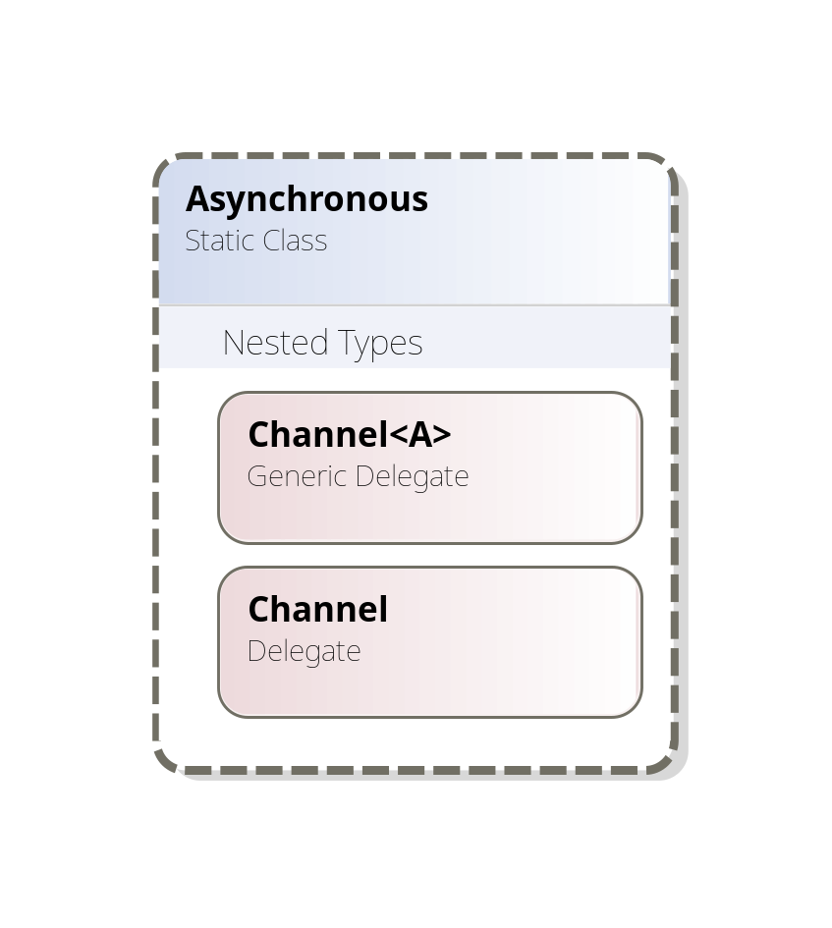
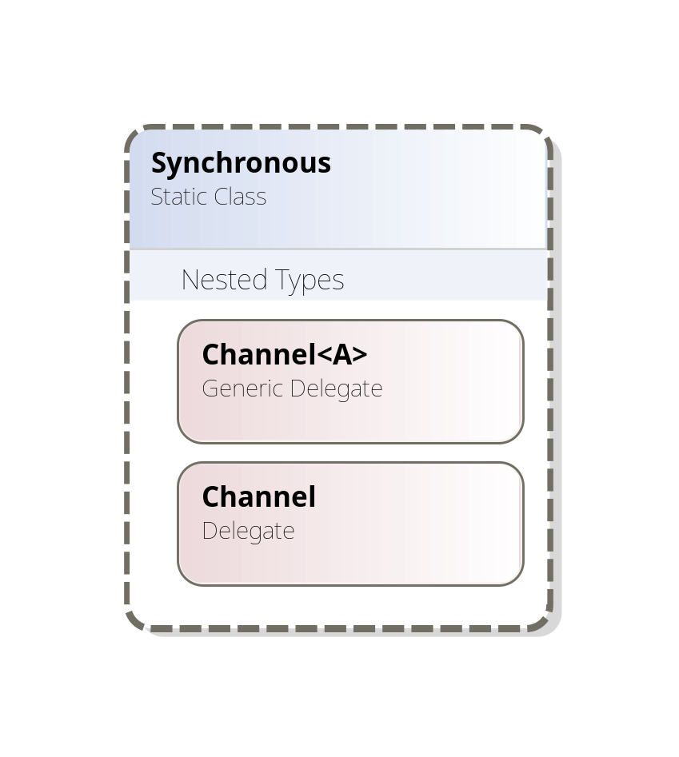
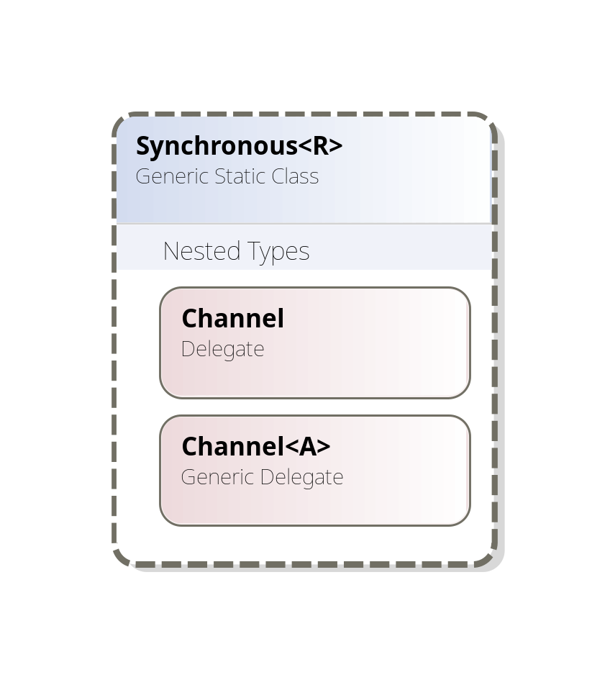
Channel Flavours
(Asynchronous | Synchronous[<R>]).Channel[<A>]
blocking behaviour
optional return type
optional argument type
void Channel<A>(A a)
void Channel<A>(A a)
R Channel()
void Channel()
void Channel()
R Channel<A>(A a)

Slide 21
Channel Flavours
(Asynchronous | Synchronous[<R>]).Channel[<A>]
blocking behaviour
optional return type
optional argument type
class Asynchronous {
delegate void Channel();
delegate void Channel<A>(A a); }
class Synchronous {
delegate void Channel();
delegate void Channel<A>(A a); }
class R Synchronous<R> {
delegate R Channel();
delegate R Channel<A>(A a); }

Slide 22
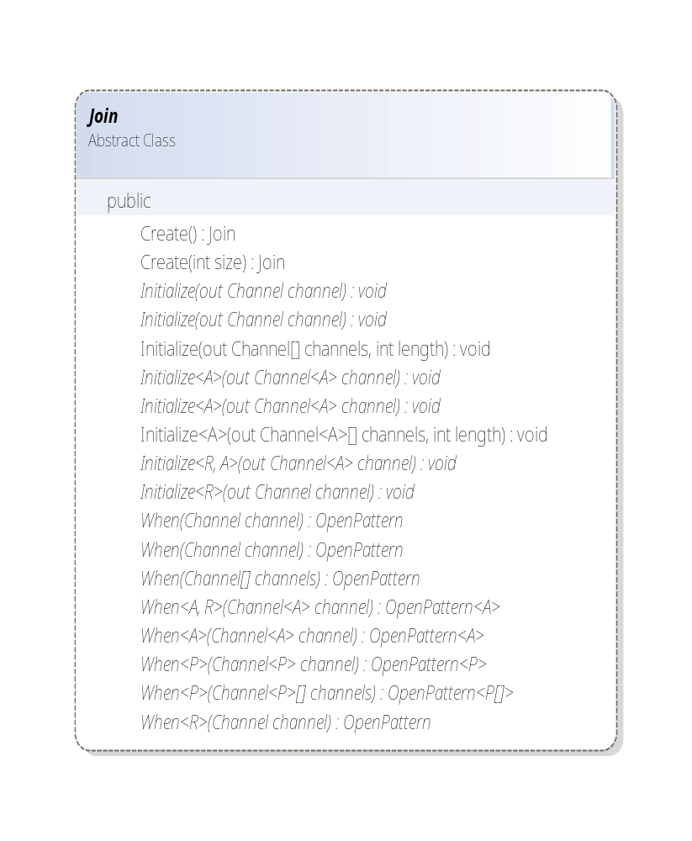
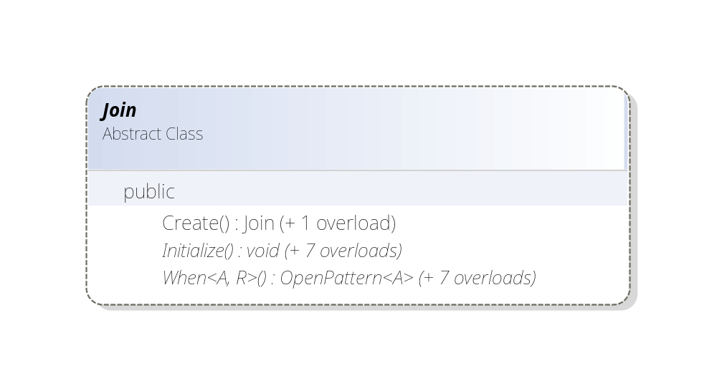
The Joins Interface
Create([size]) is a static factory method.
Initialize(out channel)
Initialize(out channels, length)
allocate new channel(s).
out parameter simulates overloading on return type.
When(channel(s))starts a new pattern.
Overloading makes changing channel flavour easy, without editing calls to Initialize/When.

Slide 23
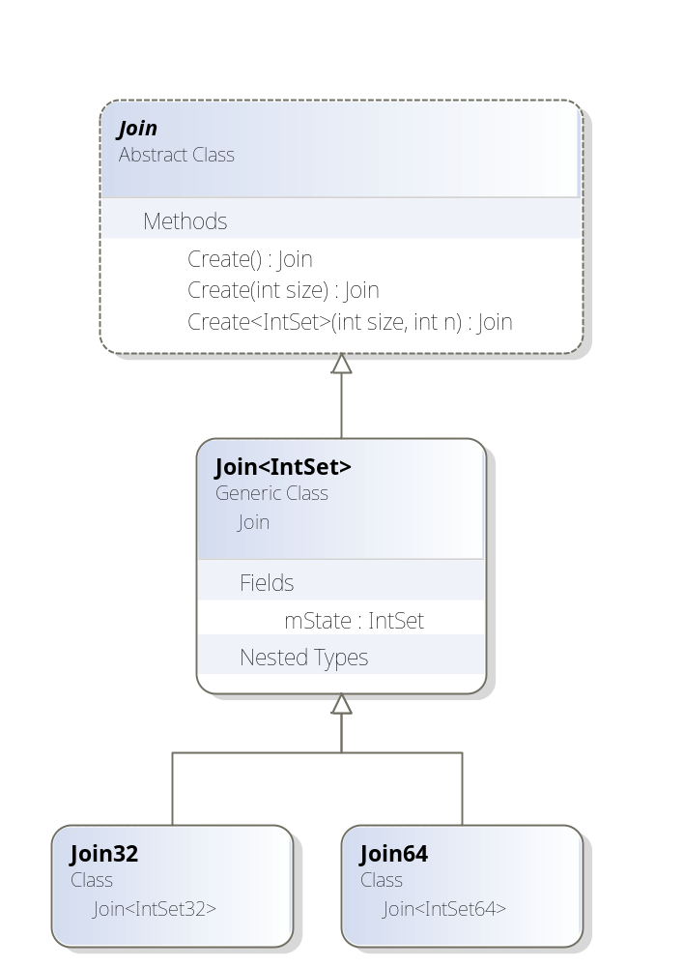
Creating a Join Object
The Join class is abstract (new Join() illegal).
Factory method Join.Create(size) returns some instantiation of subclass Join<IntSet>.
Actual argument for IntSet is a set ADT accommodating integers < size, represented as an inline bit vector of arbitrary length.
Create<IntSet>(size,n) uses generic recursion to
construct an IntSet struct of the right size.
static Join Create(int size) {
…
return Create<IntSet64>(size, (size / 64));
}
static Join Create<IntSet>(int size,int n)
where IntSet struct, IIntSet<IntSet> {
if (n == 0) return new Join<IntSet>(size);
else return Create<PairSet<IntSet>>(size,n>>1);
}

Slide 24
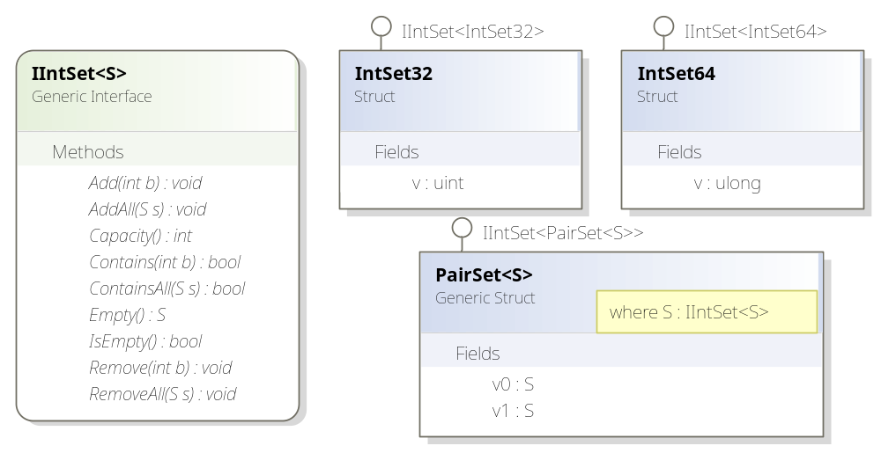
Variable Sized IntSets
Interface IIntSet<S> specifies set operations on S.
Every IntSet is a struct with interface IIntSet<IntSet>.
IntSet32(64) implement 32(64)-element sets using machine words.
PairSet<S> constructs a double capacity set from two S-sets.
Use of F-bounded constraints: PairSet<S> where S:IIntSet<S>.

Slide 25
Join Pattern Syntax
(simplified, no array patterns)
join.When(a₁).And(a₂). … .And(a_{n}).Do(continuation)
join.When(a₁).And(a₂). … .And(a_{n}).Do (
delegate (P₁ p₁, … ,P_{m} p_{m}) { body }
);
a₁ may be a synchronous or asynchronous channel.
a_{i} (i > 1) must be an asynchronous channel.
continuation must return an R if a₁ is Synchronous<R>; otherwise void.
The type and number of continuation’s arguments depends on the types of channel(s) a₁ … a_{n} . From left to right:
  a_{i} of type Channel adds no argument.
  a_{i} of type Channel<A> adds one argument of type P_{j}=A.
A dynamic check ensures linearity (no repeated channels)

Slide 26
Patterns & Their Continuations
Synchronous<R>.Channel<A> s;
j.When(s).Do(
delegate(A a) { return result; }
);

Slide 27
Patterns & Their Continuations
Synchronous<R>.Channel<A> s;
Asynchronous.Channel<X> ax;
j.When(s).And(ax).Do(
delegate(A a, X x) { return result; }
);

Slide 28
Patterns & Their Continuations
Synchronous<R>.Channel<A> s;
Asynchronous.Channel<X> ax;
Asynchronous.Channel<Y> ay;
j.When(s).And(ax).And(ay).Do(
delegate(A a, X x, Y y) { return result; }
);

Slide 29
Patterns & Their Continuations
Synchronous<R>.Channel<A> s;
Asynchronous.Channel<X> ax;
Asynchronous.Channel<Y> ay;
Asynchronous.Channel a;
j.When(s).And(ax).And(ay).And(a).Do(
delegate(A a, X x, Y y) { return result; }
);

Slide 30
Patterns & Their Continuations
Synchronous<R>.Channel<A> s;
Asynchronous.Channel<X> ax;
Asynchronous.Channel<Y> ay;
Asynchronous.Channel a;
Asynchronous.Channel<Z>[] czs;
j.When(s).And(ax).And(ay).And(a).And(czs).Do(
delegate(A a, X x, Y y, Z[] zs) { return result; }
);

Slide 31
Patterns & Their Continuations
Synchronous<R>.Channel<A> s;
Asynchronous.Channel<X> ax;
Asynchronous.Channel<Y> ay;
Asynchronous.Channel a;
Asynchronous.Channel<Z>[] czs;
Asynchronous.Channel[] cs;
j.When(s).And(ax).And(ay).And(a).And(czs).And(cs).Do(
delegate(A a, X x, Y y, Z[] zs) { return result; }
);

Slide 32
Why not just curry - or tuple?
Consider this 3-argument continuation:
delegate(int i,bool b,float f) {
Console.WriteLine("{0},{1},{2}",i,b,f);};
Its curried version is too ugly in C# 2.0 and awkward in VB (no lambdas):
delegate(int i){
return delegate(bool b){
return delegate(float f){
Console.WriteLine("{0},{1},{2}",i,b,f);};};}
The tupled version requires ugly nested projections (C# lacks pattern matching):
delegate(Pair<Pair<int, bool>,float> p){
Console.WriteLine("{0},{1},{2}",p.Fst.Fst,p.Fst.Snd,p.Snd);}

Slide 33
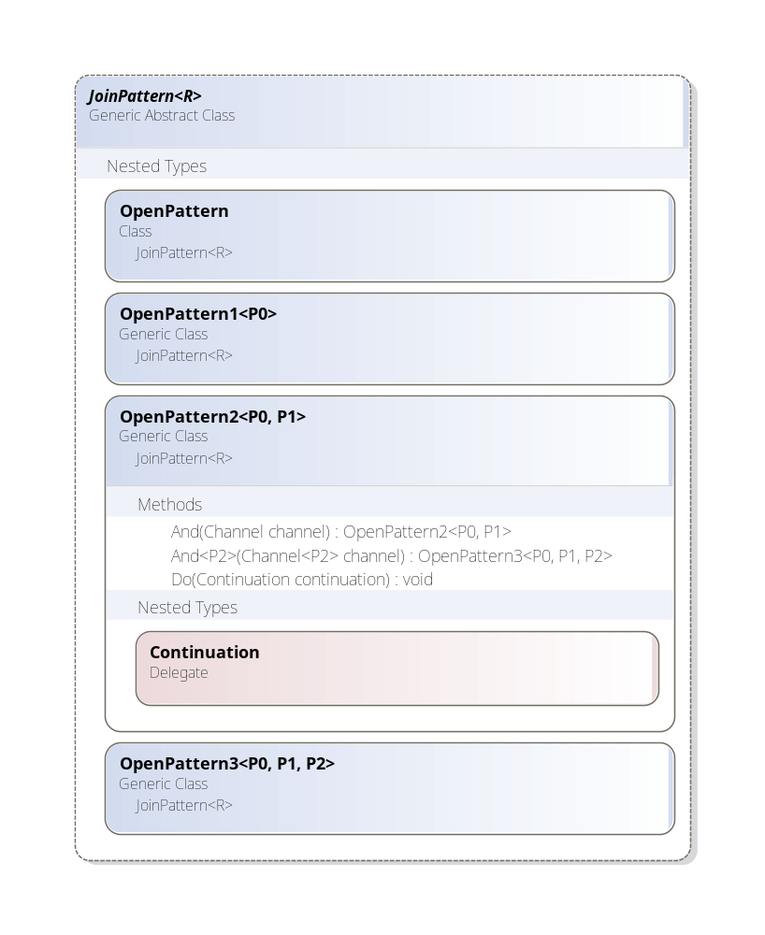
Typing Patterns
j.When(s) | OpenPattern<A>
.And(ax) | OpenPattern<A,X>
.And(ay) | OpenPattern<A,X,Y>
.And(a) | OpenPattern<A,X,Y>
.Do(cont) | void
Here cont has nested type:
JoinPattern<R>.
OpenPattern<A,X,Y>.
Continuation
which is just:
delegate R Continuation(
A p0, X p1, Y p2
)
delegate R Continuation(P0 p0,P1 p1)

Slide 34
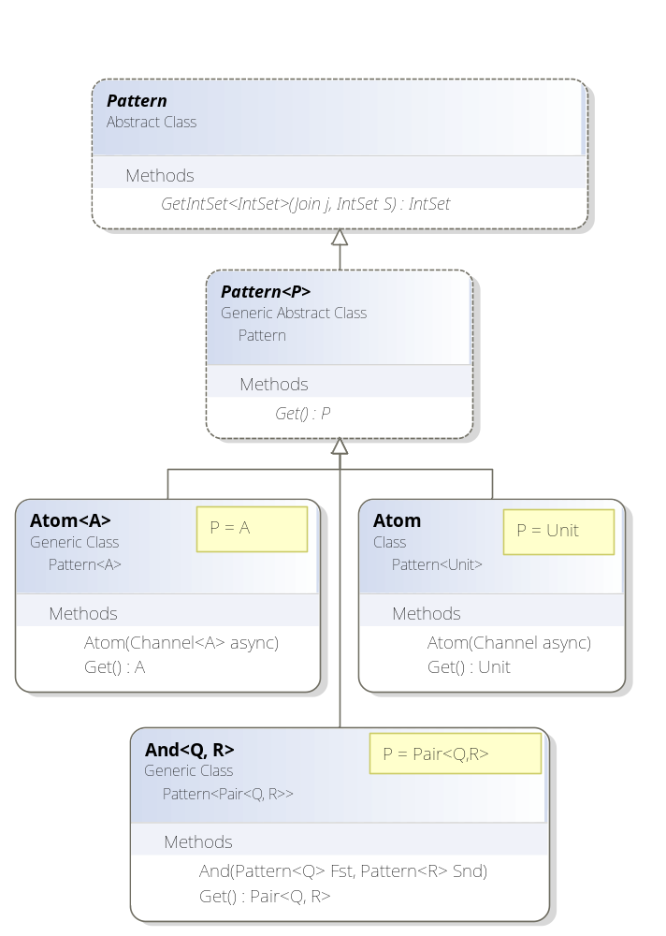
Patterns as GADTs
Each JoinPattern contains a Pattern.
A Pattern is a conjunction of atomic channels.
GetIntSet() returns an IntSet for scheduling.
Subclass Pattern<P> hides an existential type P.
Method Get()dequeues all the pattern’s channels as a single value of type P.
Get()’s return type varies in each subclass:
Atom.Get() returns Unit;
Atom<A>.Get() returns A;
And<Q,R>.Get() returns Pair<Q,R>.
Patterns are an OO example of a Generalized Algebraic Datatype.
This GADT provides efficient dequeing of multiple queues without boxing or casts.

Slide 35
Dynamic Checks
Join patterns must be well-formed, individually and collectively.
Constructing a join pattern will throw JoinException if:
the pattern repeats an asynchronous channel (i.e. is non-linear),
a channel is null or foreign to the pattern's Join instance,
the pattern is redundant, or
the pattern is empty
A channel is foreign to Join instance j if it was not initialized by j.
A pattern is redundant when its set of channels sub- or supersets the channels of a sibling pattern.
A pattern is empty when its set of channels is empty.
Cω has the advantage that it can ensure or check these conditions statically.

Slide 36
Generic Gymnastics
Joins (ab)uses almost every feature of C# & CLR Generics (see paper):
Generic classes, delegates and (unboxed) structs.
Overloading on generic arity and nesting of generic types to provide a uniform API (cosmetic, but appearances do matter)
Polymorphic recursion and F-Bounded Constraints to construct IntSet representations as unboxed bit vectors of fixed, but arbitrary, size.
Dynamically constructed existential types (Join<IntSet> : Join)
Generalized Algebraic Datatypes: conjunctions of channels are represented internally as type-indexed trees (Pattern<P>), to support efficient dequeuing of multiple channels w/o boxing or casts.
The implementation is (essentially) cast-free and does not rely on runtime type passing.

Slide 37

Performance
Pitting a Joins OnePlaceBuffer (4 channels, 2 patterns) against a hand-coded Cω translation yields:
allocating 1000 objects is 60x slower .
sequential send/receive (1000 Put & Gets) is 2x slower.
For 1000 concurrent Put/Gets, performance is comparable.
WHY?
Cω statically knows the set of patterns in a class.
Pattern matching compiles to a cascading test against constant bit vectors.
This code is shared between all instances of the same class.
With Joins, each instance of a class has to re-construct and traverse a private, heap-allocated list of actions.
Cω benefits from static checking; Joins must detect some errors dynamically (eg. spotting non-linear patterns).
In practice, any perf difference is masked by the cost of context switching.

Slide 38
Summary
Cω extended C# with high-level asynchronous concurrency constructs:
  good for both local and distributed settings
  efficiently compiled to counters, queues and automata.
The Joins library provides the same constructs with:
  similar performance, more flexibility, fewer guarantees.
The implementation exercises most features of C# Generics.
Joins Download: http://research.microsoft.com/downloads/
(see the tutorial for encodings of futures, Actors, etc.)
Comega: http://research.microsoft.com/comega/

Slide 39
Join Pattern Syntax
join.When(a₁).And(a₂). … .And(a_{n}).Do(continuation)
join.When(a₁).And(a₂). … .And(a_{n}).Do (
delegate (P₁ p₁, … ,P_{m} p_{m}) { body }
);
a₁ must be a channel or array of asynchronous channels.
a_{i} (i > 1) must be an asynchronous channel or channel array.
continuation must return an R if a₁ is Synchronous<R>; otherwise void.
The type and number of continuation’s arguments depends on the types of channel(s) a₁ … a_{n} . From left to right:
  a_{i} of type Channel<A> adds one argument of type P_{j}=A.
  a_{i} of type Channel<A>[] adds one argument of type P_{j}=A[].
  a_{i} of type Channel or Channel[] adds no argument.
At most one channel - a₁ - may be synchronous.
Limitation: a continuation may only bind m < 8 arguments.

Slide 40
Join VB
Now adding join patterns to VB, piggybacking on the Joins library.
Benefits: n-ary channels, more static checking, no boilerplate, no limit on # of continuation arguments, no wrappers for remoting.
Public Class Buffer(Of T)
Public Asynchronous Channel Put(ByVal t As T,…)
Public Synchronous Channel Take(…) As T
Case Take(…) As T, Put(ByVal t As T,…)
Return t
End Case
End Class
class Buffer {
async put(string s);
string get() & put(string s) {
return s;
}
}
Channels are similar to events but can be invoked externally (events can only be “raise”d by their owning class.)
Join patterns are like declarative VB event handlers but wait for multiple (not alternative) events & may return values.

Slide 41
Distribution and .NET Remoting
class Buffer: MarshalByRefObject{
async Put(string s);
string Get() & Put(string s) {
return s;
}
}
class Buffer: MarshallByRefObject{
Asynchronous.Channel<string> put;
Synchronous<string>.Channel get;
[OneWay]
void Put(string s) { put(s);}
string Get() { return get();}
Buffer() { … }
}
Channels are remotable: the target object is an instance of MarshalByRefObject - an imported channel always contains a proxy.
Asynchronous channels are non-blocking: target methods are marked [OneWay].
In Cω, a remote send is just a remote method invocation.
However, with Joins, calling b.Put(s) hides a synchronous read:
b.Put(s) ≈ Asychronous.Channel<string> c = b.Put; c(s);
Naively invoking a remote channel first reads the channel, adding a roundtrip!
Solution: explicitly wrap channels using forwarding (OneWay) methods…

Slide 42
Generic Joins
Cω didn’t (and couldn’t easily) support Generics.
Now defining a generic Buffer<T> is easy and much more useful …
content type T
class Buffer<T> {
Asynchronous.Channel<T> put;
Synchronous<T>.Channel get;
Buffer() {
Join j = Join.Create();
j.Initialize(out put);
j.Initialize(out get);
j.When(get).And(put).Do(delegate(T t){
return t;
});
}
}
…
Buffer<string> b = new Buffer<string>();
… b.put(“hello”); ...; string s = b.get() …
class Buffer<T> {
async put(T t);
T get() & put(T t){
return t;
}
}

Slide 43
Or in Visual Basic…
Public Class Buffer(Of T)
Public Put As Asynchronous.Channel(Of T)
Public Take As Synchronous(Of T).Channel
Public Function TakeAndPut(ByVal t As T) As String
Return t
End Function
Public Sub New()
Dim j As Join = Join.Create()
j.Initialize(Put)
j.Initialize(Take)
j.When(Take).And(Put).Do(AddressOf TakeAndPut)
End Sub
End Class
VB doesn’t have anonymous delegates, use a named method instead.

Slide 44
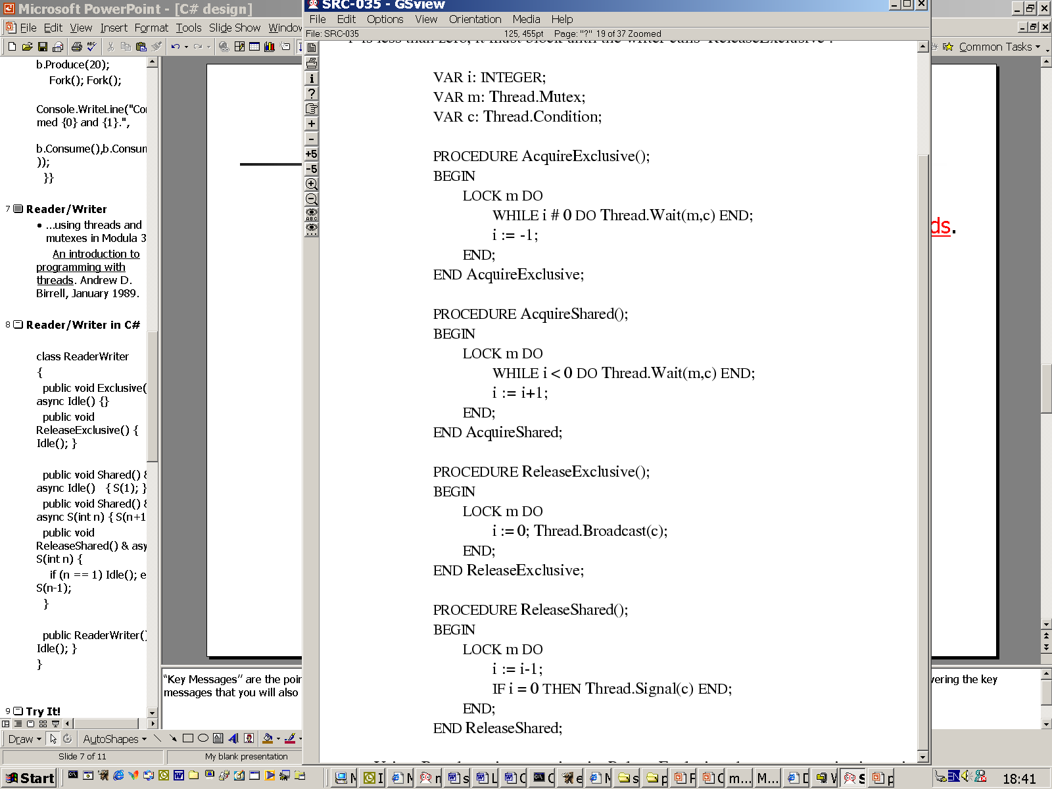
Reader/Writer
…using threads and mutexes in Modula 3
An introduction to programming with threads
Andrew D. Birrell, January 1989

Slide 45
Futures
public class Future<T> {
public delegate T Computation();
public Synchronous<T>.Channel Get;
Asynchronous.Channel Execute, Done;
T Value;
public Future(Computation comp) {
Join j = Join.Create();… // boilerplate omitted
j.When(Execute).Do(delegate {
Value = comp(); comp = null;// to avoid leak
Done(); // signal Done
});
j.When(Get).And(Done).Do(delegate {
Done(); // reissue Done to allow many Gets
return Value;
});
Execute(); // spawn the worker
}
}
A future represents the value of a concurrent computation. An old idea…
Creating a future spawns a worker thread to do some expensive computation.
When the future’s value is needed the current thread waits on Get() until/unless the worker is Done().
Meanwhile,the current thread can do useful work.
// finding the maximum of an array a with two threads…
Future<int> topMax =
new Future<int>(delegate { return Max(a,a.Length/2, a.Length); });
int bottomMax = Max(a, 0, a.Length / 2);
int concurrentMax = (bottomMax <= topMax.Get()) ? topMax.Get() : bottomMax;

Slide 46
Active Objects for a Lift Controller
An ActiveObject uses its own thread to serialize asynchronous requests and avoid locking private state.
class ActiveObject {
protected Join join = Join.Create();
protected Synchronous.Channel ProcessMessage;
Asynchronous.Channel Start;
public ActiveObject() {
join.Initialize(out ProcessMessage);
join.Initialize(out Start);
join.When(Start).Do(delegate {
while (true) ProcessMessage();
});
Start();
}
}
class Person : ActiveObject {
Floor floor;
public Asynchronous.Channel<Floor> GotoFloor;
public Person() {
join.Initialize(out GotoFloor);
join.When(ProcessMessage).And(GotoFloor).Do(delegate(Floor f) {
this.floor = f;
});
}
}
In the Lift demo, each sprite is an ActiveObject which Starts its own thread that loops calling synchronous ProcessMessage.
Subclass Person inherits a protected Join, adds the message GotoFloor and a pattern on ProcessMessage and GotoFloor.

Slide 47
Beyond Cω: Dynamic Joins
public class JoinMany<R> {
public Asynchronous.Channel<R>[] Responses;
public Synchronous<R[]>.Channel Wait;
public JoinMany(int n) {
Join j = Join.Create(n + 1);
j.Initialize(out Responses, n);
j.Initialize(out Wait);
j.When(Wait).And(Responses).Do(delegate(R[] results){
return results;
});
}
}
an array of channels
Join dynamically sized for n+1 channels
dynamic initialization of n channels
continuation sees an array of n values
Object o = new JoinMany<R>(n) waits for n async responses of type R.
Producer i post result r on o.Responses[i](r); Consumer call o.Wait().
The constructor initializes and joins an array of asynchronous channels.
The pattern receives and returns an array of Rs, one per joined channel.
No direct expression in Cω: a Cω class declares a static set of async. methods.

Slide 48
Join Implementation
Join<IntSet>
Size | int | 32
Count | int | 5
State | IntSet | 01…00
Actions | List<Action>
11…00 | c.WaitQ.WakeUp()
001…00 | joinPattern.Spawn()
The Join object contains:
  Its (immutable) declared Size.
  A current Count of owned channels (< Size) = ID of next channel.
  A mutable State - a generic IntSet with elements in [0…Size) :
    State = “the current set of non-empty channels”
    represented as a bit vector with efficient set operations.
    State[ID] is the current status of channel ID (0:empty, 1:non-empty).
  A set-indexed map of pattern match Actions (wakeup or spawn thread).
  The Join’s lock protects its own and its channels’ state.
Constructing a pattern pre-computes its IntSet to faster matching.and early error detection (eg. rejecting overlapping or non-linear patterns)
Joins uses an efficient, targeted wakeup of waiting threads (no PulseAll).

Slide 49
Why the Fuss?
Q: Why use n-ary continuations instead of uniform currying or tupling?
A: Currying is ugly in C#2.0 (ok in C# 3.0); awkward in VB.
Tupling is tedious without pattern matching: needs nested projections…
delegate(int i,bool b,float f) {
Console.WriteLine("{0},{1},{2}",i,b,f);}
delegate(int i){
return delegate(bool b){
return delegate(float f){
Console.WriteLine("{0},{1},{2}", i, b, f);
return new Unit();};};}
delegate(Pair<Pair<int, bool>,float> p){
Console.WriteLine("{0},{1},{2}",
p.Fst.Fst, p.Fst.Snd, p.Snd); }

Slide 50
Summary
Cω extended C# with high-level asynchronous concurrency constructs:
  good for both local and distributed settings
  efficiently compiled to counters, queues and automata.
The Joins library provides the same constructs.
Similar performance, more flexibility, fewer static guarantees.
Applies most features of CLR Generics.

Slide 51
For More Information
Getting the Joins Library with samples, tutorial & doc:
http://research.microsoft.com/downloads/
On Cω:
http://research.microsoft.com/comega/
On Polyphonic C# (Cω predecessor) :
http://research.microsoft.com/~nick/
contact: crusso@microsoft.com

Slide 52
Reader/Writer in Cω
public class ReaderWriter {
private async idle();
private async s(int n);
public void Exclusive() & idle() {}
public void ReleaseExclusive() { idle(); }
public void Shared() & idle() { s(1);}
& s(int n) { s(n+1);}
public void ReleaseShared() & s(int n) {
if (n == 1) idle(); else s(n-1);
}
public ReaderWriter() {idle();}
}
A single private message represents the state:
none ↔ idle() ↔ s(1) ↔ s(2) ↔ s(3) …

Slide 53
Predictable Example:
Dining Philosophers
eating
waiting
to eat
waiting
to eat
thinking
eating

Slide 54
Cω Code Extract
class Room {
private async hasspaces(int n);
private async isfull();
public void enter() & hasspaces(int n) {
if (n > 1) hasspaces(n-1); else isfull();
}
public void leave()
& hasspaces(int n) {
hasspaces(n+1);
}
& isfull() {
hasspaces(1);
}
public Room (int size) { hasspaces(size); }
}
eating
waiting
to eat
waiting
to eat
thinking
eating

Slide 55
Joins Library Extract (C#)
class Room {
private Asynchronous.Channel<int> HasSpaces;
private Asynchronous.Channel IsFull;
public Synchronous.Channel Enter, Leave;
public Room (int size) {
Join j = Join.Create(); … j.Initialize(out Leave);
j.When(Enter).And(HasSpaces).Do(delegate (int n) {
if (n > 1) HasSpaces(n-1); else IsFull();
});
j.When(Leave).And(HasSpaces).Do(delegate (int n) {
HasSpaces(n+1);
});
j.When(Leave).And(IsFull).Do(delegate {
HasSpaces(1);
});
HasSpaces(size);
}
}

Slide 56
Demos
Animated Lift Controller using fine grained local concurrency.
  demonstrates Active Objects pattern: each agent (3 lifts, 5 people, 12 floors) runs a single thread processing asynchronous messages.
Dining Philosophers
TerraServer web application
  (how to hide network latency using asynchronous web service requests).

