Slide 1

Neural Network Based Face Detection
Based on H. A. Rowley, S. Baluja and T. Kanade, "Neural network-based face detection," in IEEE Transactions on Pattern Analysis and Machine Intelligence, vol. 20, no. 1, pp. 23-38, Jan. 1998, doi: 10.1109/34.655647.
By Karthik Danda

Slide 2
FACE VS NON-FACE CLASSIFICATION

Slide 3
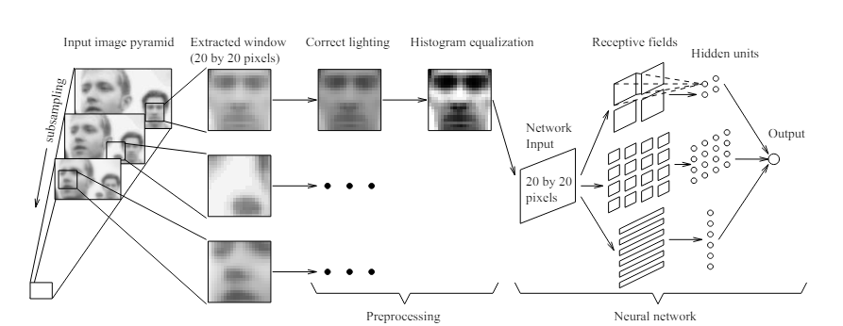

Slide 4
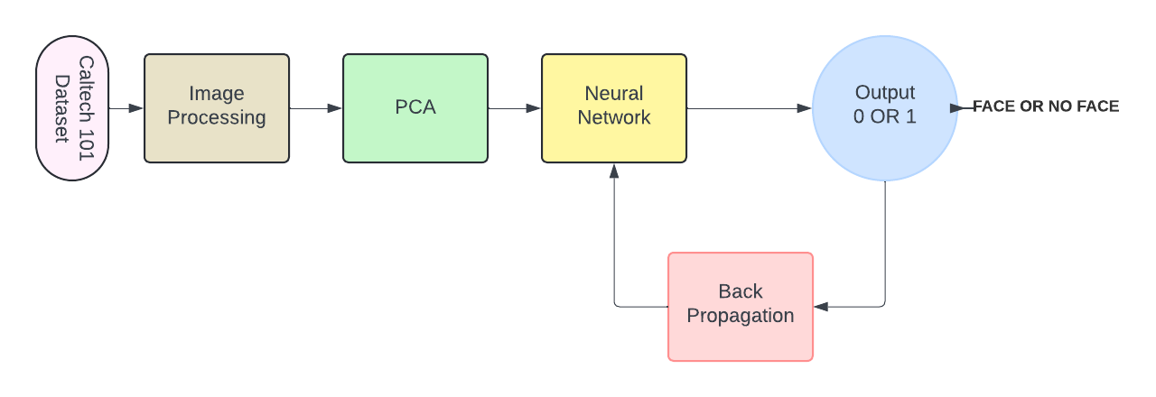
ALGORITHM

Slide 5
Dataset - CALTECH 101
The Caltech 101 dataset is a popular choice for tasks involving image classification.
It has a wide range of objects.
The size of the data is 9,144 images, with about 40 to 800(Categories with faces) images per category.
The faces in Caltech 101 have varying backgrounds and different poses with variations in orientation, lighting, and background clutter.
To avoid model bias I have ensured that there are equal amounts of FACE and NON face images.
For face detection, this means if there are more non-face images than face images, the model might tend to predict non-face more often, potentially missing actual face instances.

Slide 6
IMAGE PRE-PROCESSING
Grey Scale conversion for simplicity.
Standardizing the images with a size of 255x255
Histogram equalization to correct any errors due to the lighting conditions.
Flattening the image, Which leads to 65,025 Values.
Principle Component analysis.

Slide 7
Principle Component Analysis
Principal component analysis (PCA) is a linear dimensionality reduction technique with applications in exploratory data analysis, visualization, and data preprocessing. From Wikipedia.
The data is linearly transformed onto a new coordinate system such that the directions (principal components) capturing the largest variation in the data can be easily identified. From Wikipedia.
Can be done using two ways Eigen Value decomposition or with Singular Value decomposition.
I have used Singular Value decomposition(SVD).
Reduced the data from 65025 to 330.

Slide 8

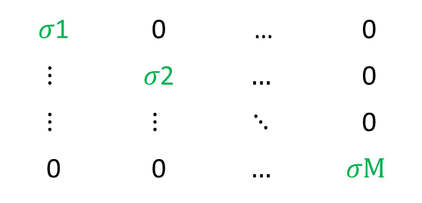
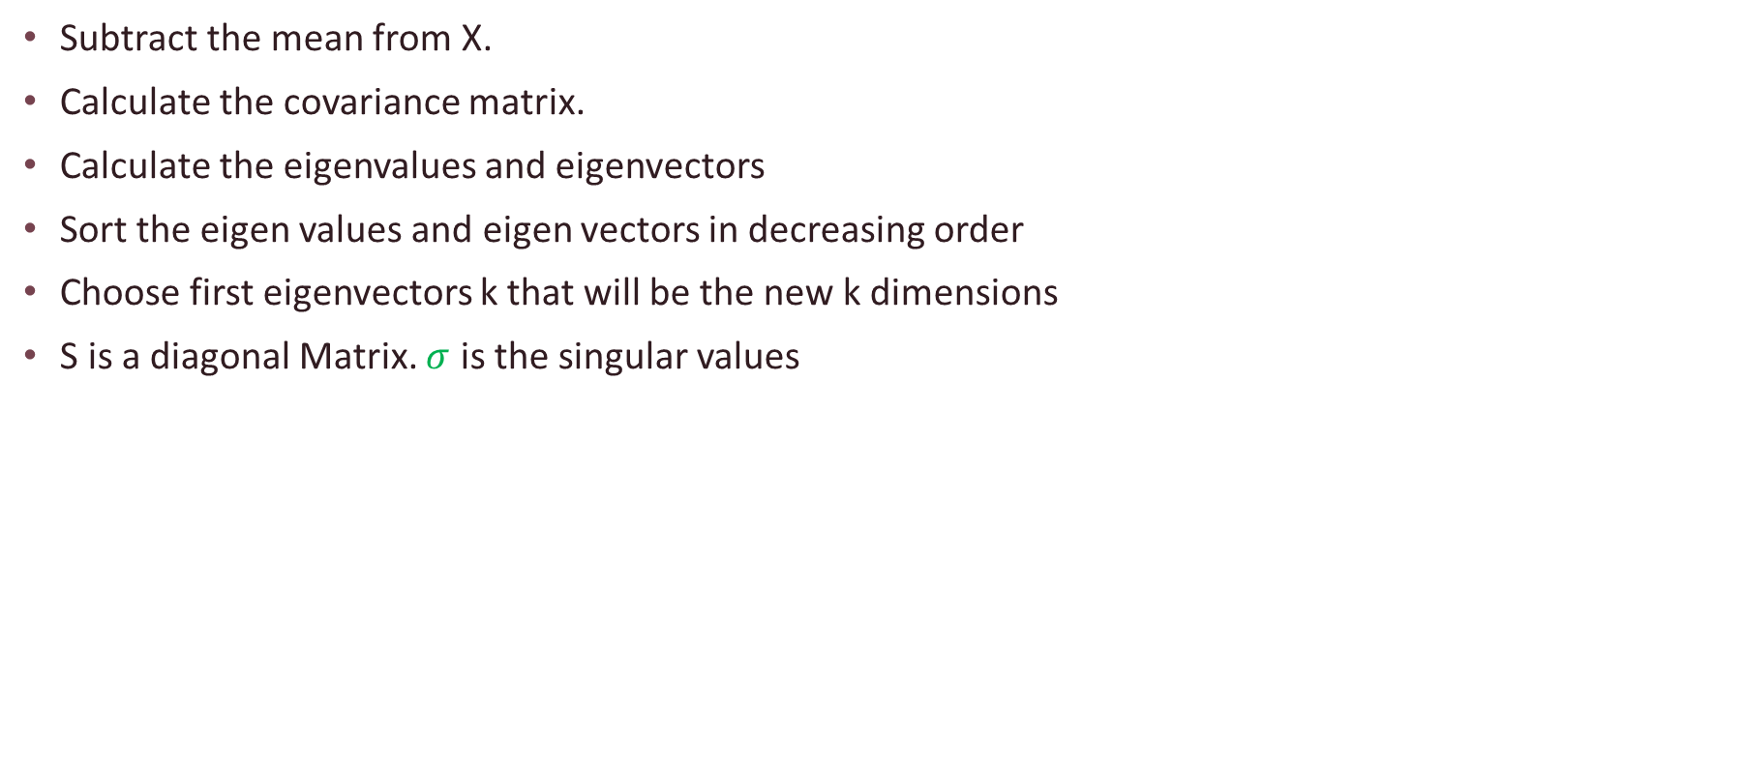
Principle Component Analysis
Subtract the mean from X.
Calculate the covariance matrix.
Calculate the eigenvalues and eigenvectors
Sort the eigen values and eigen vectors in decreasing order
Choose first eigenvectors k that will be the new k dimensions
S is a diagonal Matrix. $σ$ is the singular values
𝜎1 | 0 | … | 0
$$⋮$$ | 𝜎2 | $$…$$ | 0
$$⋮$$ | $$⋮$$ | $$⋱$$ | 0
0 | 0 | $$…$$ | $$σM$$

Slide 9
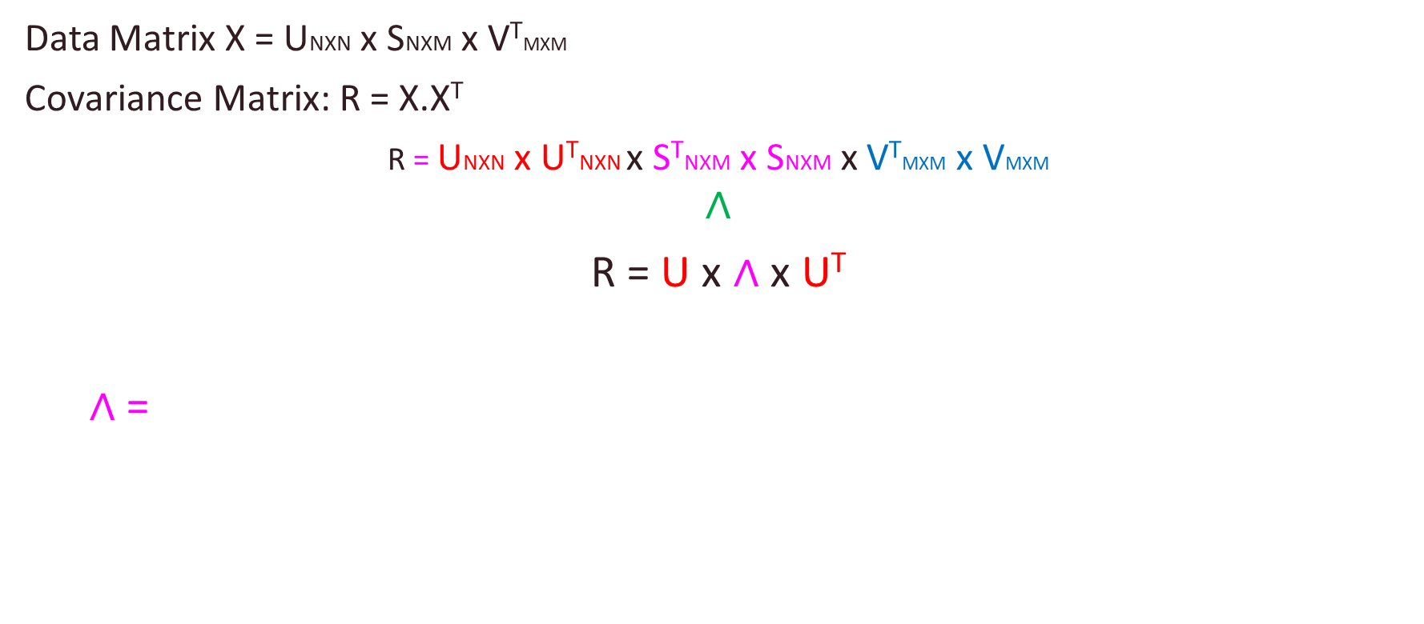
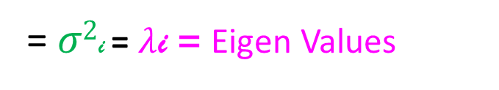
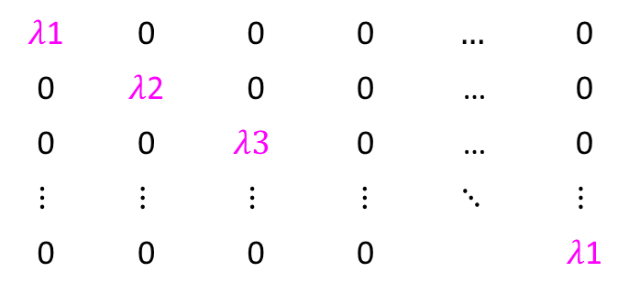
Principle Component Analysis
Data Matrix X = UNXN x SNXM x V^{T}MXM
Covariance Matrix: R = X.X^{T}
R = UNXN x U^{T}NXN x S^{T}NXM x SNXM x V^{T}MXM x VMXM
$$∧$$
R = U x ∧ x U^{T}
∧ =
I
= $σ2$i = $λ$i = Eigen Values
$λ$1 | 0 | 0 | 0 | $$…$$ | 0
0 | $λ$2 | 0 | 0 | … | 0
0 | 0 | $$λ3$$ | 0 | … | 0
$$⋮$$ | $$⋮$$ | $$⋮$$ | ⋮ | $$⋱$$ | $$⋮$$
0 | 0 | 0 | 0 |  | $λ$1
UNXN = [e1 e2 e3 …. ….. ….. ….. ….ek …..en]^{T}
Eigenvectors`

Slide 10
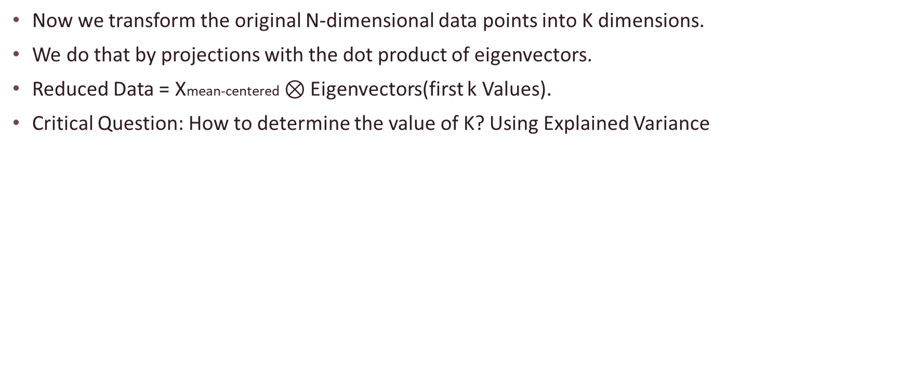
Principle Component Analysis
Now we transform the original N-dimensional data points into K dimensions.
We do that by projections with the dot product of eigenvectors.
Reduced Data = Xmean-centered $⊗$ Eigenvectors(first k Values).
Critical Question: How to determine the value of K? Using Explained Variance
[U, S, V] = svd(X_centered, 'econ');
singularValues = diag(S);
totalVariance = sum(singularValues.^2);
explainedVariance = singularValues.^2 / totalVariance;
cumulativeVariance = cumsum(explainedVariance);
% Find the smallest k that explains at least 95% of the variance
k = find(cumulativeVariance >= 0.95, 1);
fprintf('Number of components to retain: %d\n', k);

Slide 11
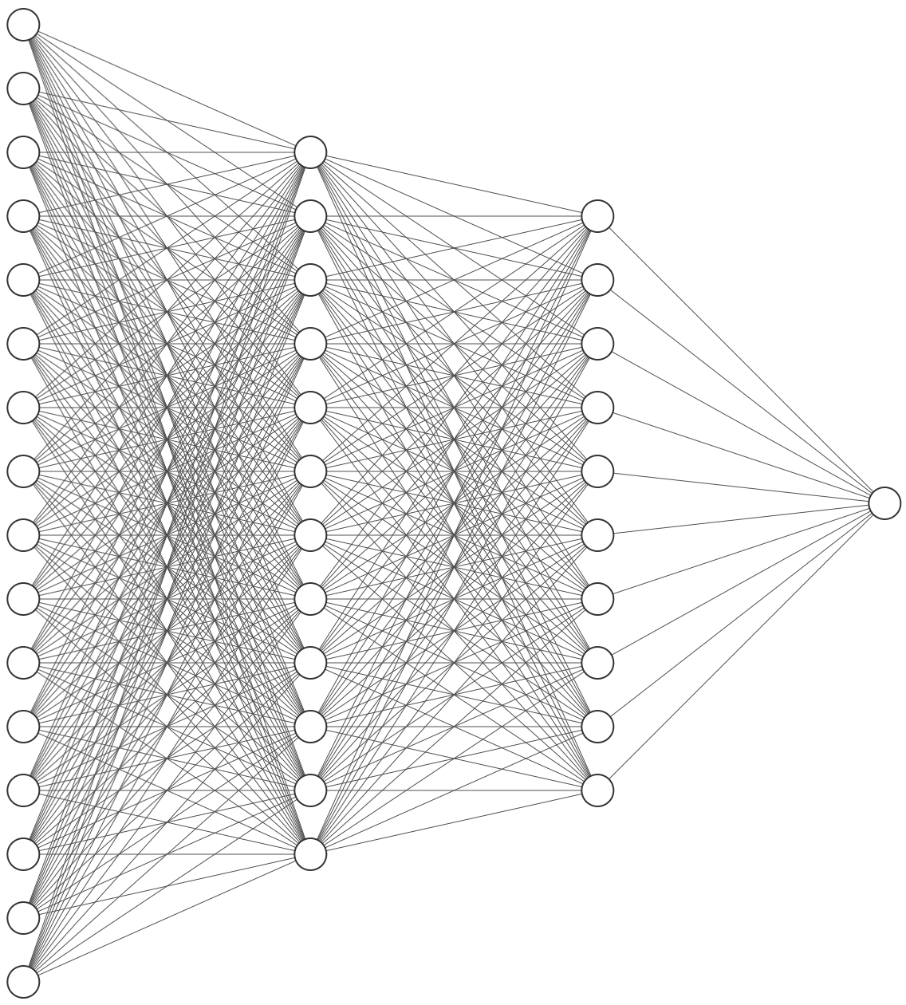
Neural Network
Input Size 330
Hidden layers 2
Hidden Size 10
Output 1(Binary)
Activation Sigmoid
Training Using Back Propagation and mini batch Gradient Descent

Slide 12
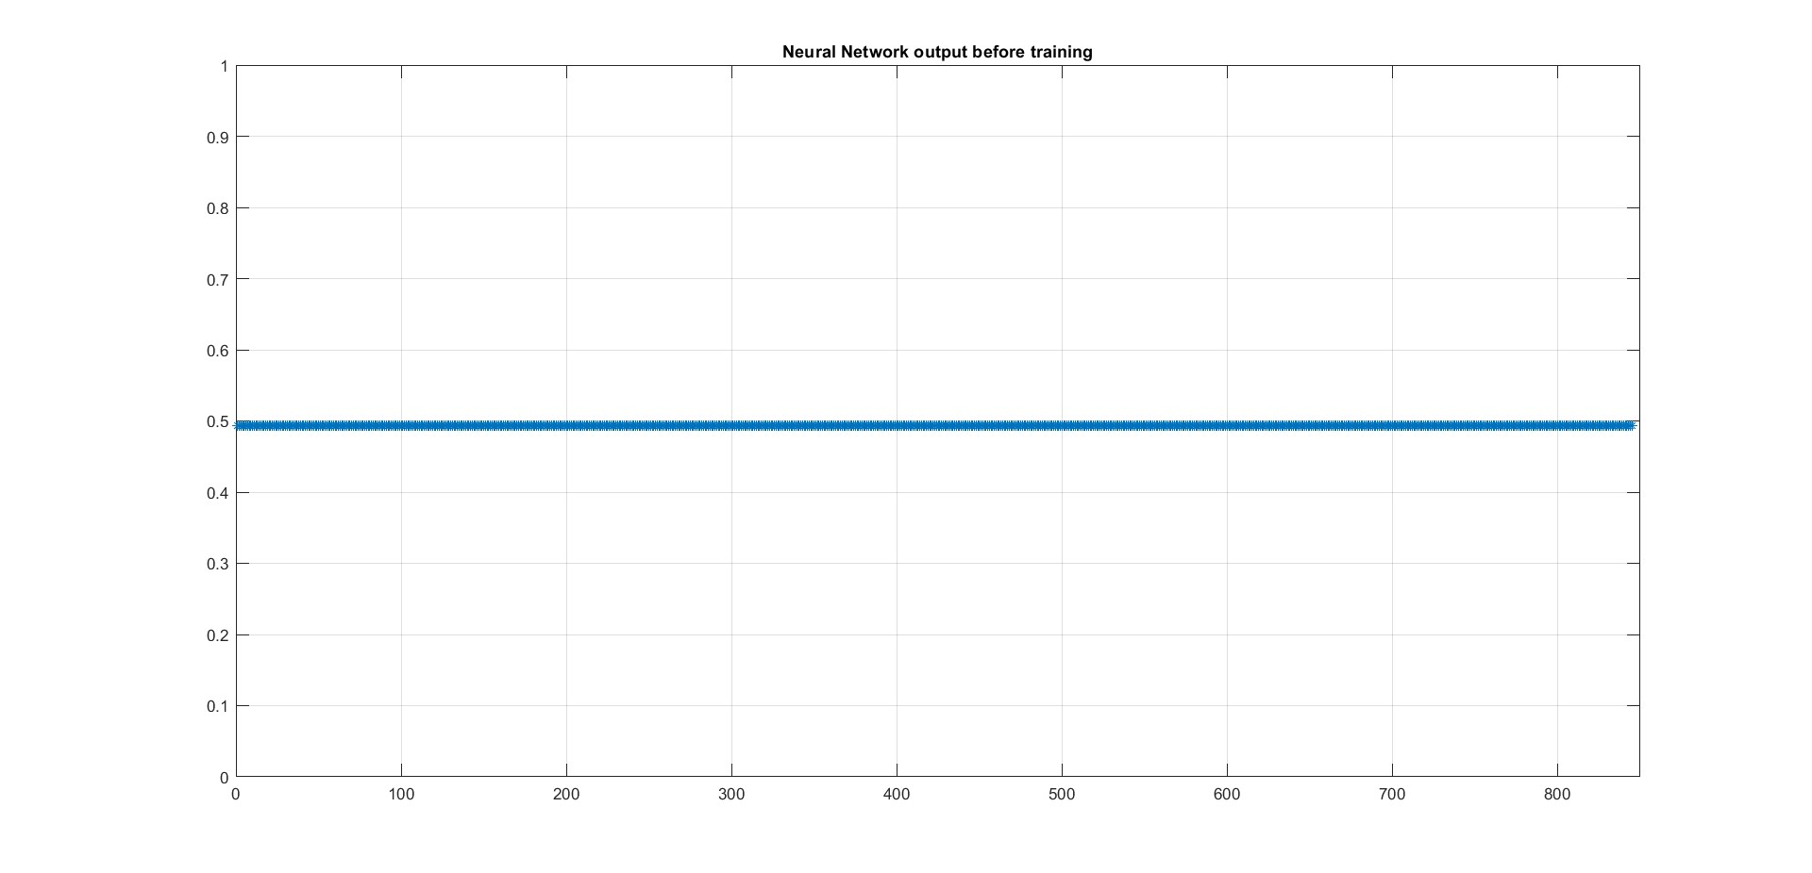
WEIGHTS and ACTIVATION
Initiate the weights by randomizing.
Initially the weights are very small multiple of 0.01
Sigmoid Activation is used since it is ideal for the binary classification.
Because of the weights being near zero the output of the neural network is around 0.5 for every input.
Update the weights and bias using the Backpropagation.

Slide 13




Training Using the Back Propagation
Cost Function:
Mini Batch Gradient Descent with a batch size of P = 30:

Slide 14
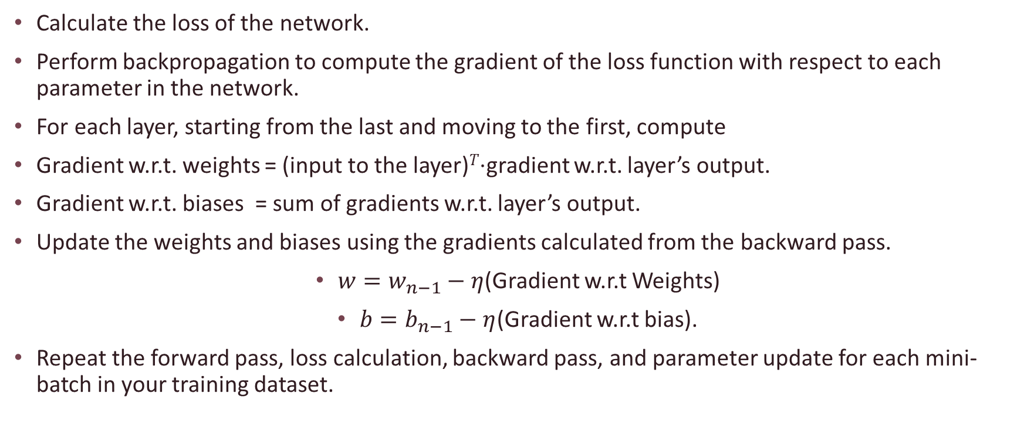
Backpropagation
Calculate the loss of the network.
Perform backpropagation to compute the gradient of the loss function with respect to each parameter in the network.
For each layer, starting from the last and moving to the first, compute
Gradient w.r.t. weights = (input to the layer)^{𝑇}⋅gradient w.r.t. layer’s output.
Gradient w.r.t. biases = sum of gradients w.r.t. layer’s output.
Update the weights and biases using the gradients calculated from the backward pass.
$w=w_{n−1}−η$(Gradient w.r.t Weights)
$b=b_{n−1}−η$(Gradient w.r.t bias).
Repeat the forward pass, loss calculation, backward pass, and parameter update for each mini-batch in your training dataset.

Slide 15
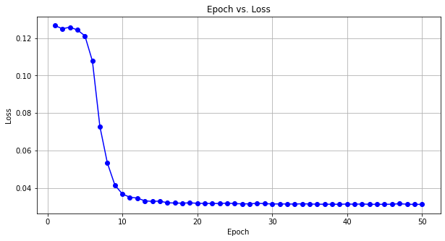
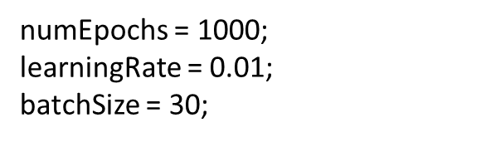
Results of the Neural Network

Slide 16
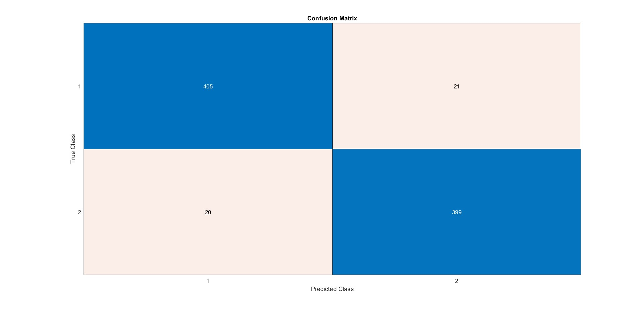
Results of the Neural Network
Test Accuracy: 94.32%

Slide 17
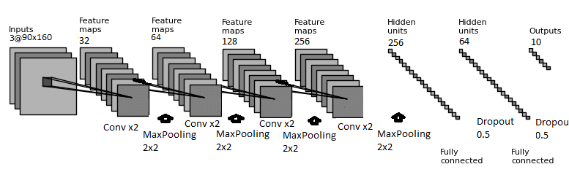
Face detection in the image using CNN

Slide 18
Base Algorithm
Step :1 Image Preprocessing:
The images are first normalized in terms of lighting and grayscale intensity to reduce variability that isn't relevant to face detection.
Step 2: Sliding Window Technique:
The algorithm employs a window that slides across the image at multiple scales (sizes of the window). For each position of the window, the region within is extracted for further analysis.
This means the same image is repeatedly rescaled, and the detection window slides over these scaled versions to detect faces of various sizes.
Step 3:Feature Extraction:
Each window is then resized to a standard size (typically 20x20 pixels), suitable for the neural network.
Features might be extracted using simple pixel values or more complex image processing techniques (like histogram normalization) to prepare them for input into the neural network.

Slide 19
Step 4: Neural Network:
The extracted features from each window are fed into a neural network.
The neural network consists of several layers (including convolutional layers in some variants) designed to determine whether the window contains a face.
The output of the network is a binary classification indicating the presence or absence of a face.
Step 5: Merging and Refining Results:
Overlapping regions that are detected as faces are merged to reduce duplicates and refine the detection bounding boxes.

Slide 20
Better Papers
"Rapid Object Detection using a Boosted Cascade of Simple Features" by Paul Viola and Michael Jones (2001). Fast and accurate
Joint Face Detection and Alignment Using Multitask Cascaded Convolutional Networks" by Kaipeng Zhang, Zhanpeng Zhang, Zhifeng Li, and Yu Qiao (2016)
J. Redmon, S. Divvala, R. Girshick and A. Farhadi, "You Only Look Once: Unified, Real-Time Object Detection," (2016)

