Slide 1
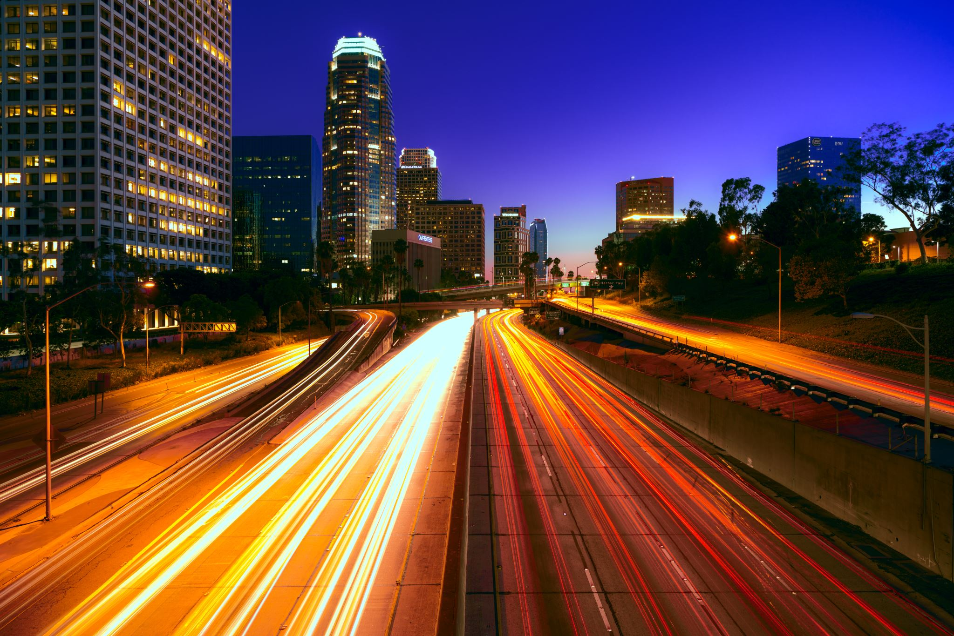
Analysis of Traffic Collisions in LA County
Armine Grigoryan
Lucine Mkrtchyan
Nicole nguyen

Slide 2
Data
2010-2019
Traffic collisions across LA County
Limitations:
Transcribed from actuals reports
Some fields missing
Kaggle:
https://www.kaggle.com/cityofLA/los-angeles-traffic-collision-data
Origin website
https://data.lacity.org/A-Safe-City/Traffic-Collision-Data-from-2010-to-Present/d5tf-ez2w
Notes:
Our project analyzed multiple factors attributing to motor vehicle accidents. We examined the relationships between the number of accidents against various circumstances and influences.
We found our data from Kaggle, but it originates from data.lacity.org
The goal of the website is to increase transparency for the public in hopes to drive innovation and problem solving for the city
This particular data set we found spans across the past 10 years
It contains data on reported traffic collisions all around LA county
<insert>
Limitations:
- Since this data was transcribed from actuals reports, there may be some inaccuracies do due human error.
Some data may have not been recorded; therefore, resulting in blank items in our data
<insert>

Slide 3
Challenges
Formatting
Broken links
Mapping data codes
Speed bumps along the way…
Notes:
Before starting our analysis, each of us had to overcome some challenges with formatting:
Formatting the date columns
Inconsistent formatting of address column(some street types were written in full, some abbreviated, others had extra spacing or smashed together)
Difficulties with dataset:
Some columns related to links that didn’t work
Example: what is an MO Code?
We had to search the data to map it and create a race dictionary from the alphabetical letter codes

Slide 4
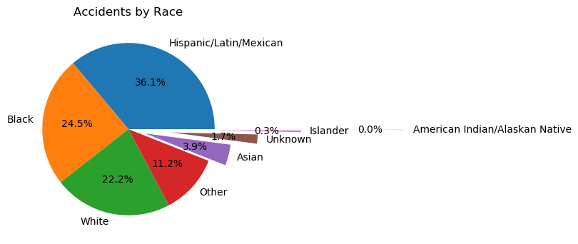
Notes:
I hope you guys are hella hungry! Because we’re about to feed you a lot of bars and pies!
Cliché assumption: Asians are bad drivers
Question: Are Asians bad drivers?
Analysis: In this sample population from LA County, Hispanic/Latin/Mexican had the highest percentage of accidents occurring in the 10 year dataset. The race demographic in Southern regions of California is primarily Hispanic, whereas the Bay Area is primarily asian. If the sample was taken from a population whose density was evenly spread, then the sample could be more conclusive.
The percentage for some of the race demographics were so low that displaying them caused an overlap in text. The pie chart was exploded in a way to make each part readable. Although a bar chart would have been better for this data, the pie chart looked unique in the way it was exploded

Slide 5
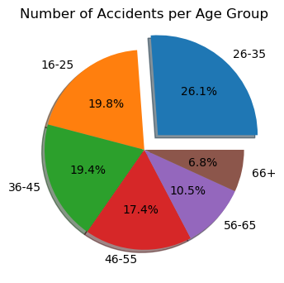
Notes:
Question: Are younger drivers more at risk of causing accidents?
Analysis: The ages were binned into ranges to make the dataset more manageable and then analyzed. The assumption was the younger age range would have a higher count of accidents. It was found that those within the age range of 26-35 had the highest number of accidents amongst the other age groups, although the fair amount of . Other factors that could contribute to this is the population density of 26-35 year-olds.

Slide 6
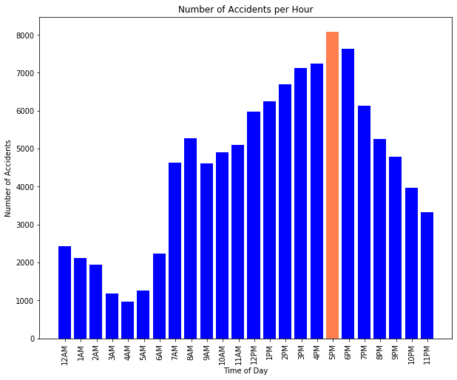
Notes:
Question: Are accidents most frequent around rush hour?
Analysis: We compared every hour of the day to see which hour held the most reported collisions. Analysis shows that 5pm is the time in which most accidents occurred with other high number of accidents between 3-6pm. Rush hour occurs between 3-7pm. 5pm would be the peak of rush hour.

Slide 7
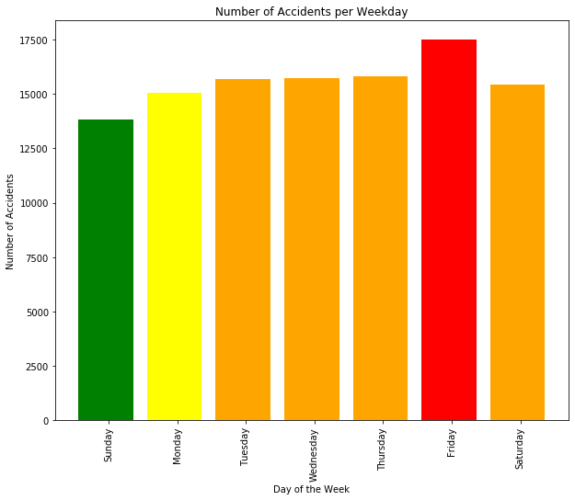
Notes:
Question: Which day of the week is more prone to accidents?
Analysis: Our assumption was that a week day would have the highest rates of reported collisions because of work schedules. Analysis shows that Friday was the day where most accidents occurred.

Slide 8
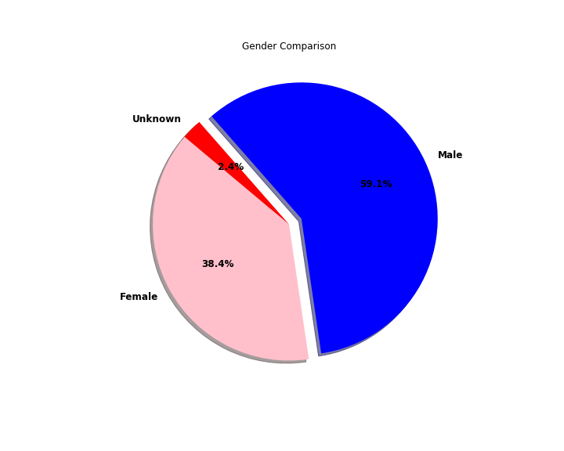
Notes:
Question: Do male or female drivers cause the most accidents?
Analysis: The data from the last 10 years shows that men are more likely to be involved in an accident than women.

Slide 9
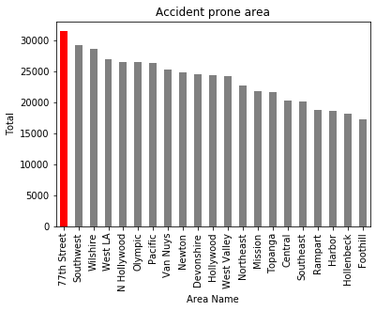
Notes:
Question: Which area in Los Angeles has the most traffic collisions?
Analysis: The date was changed to year and we were able to do a groupby the date to year and compare the area with the most amount of collisions in the last 10 years is 77th street.

Slide 10
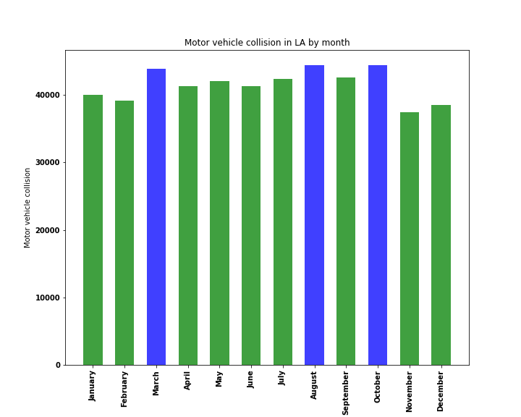
Notes:
Question: Is the frequency of accidents greater in some months than others?
Analysis: Our assumption was that the bad weather would cause more accidents, therefore we would have more accidents during rainy season. Results do not fully support our assumption,
as the number of accidents is the greatest in March, August and October, but heavy rain is more common from December through early April.

Slide 11
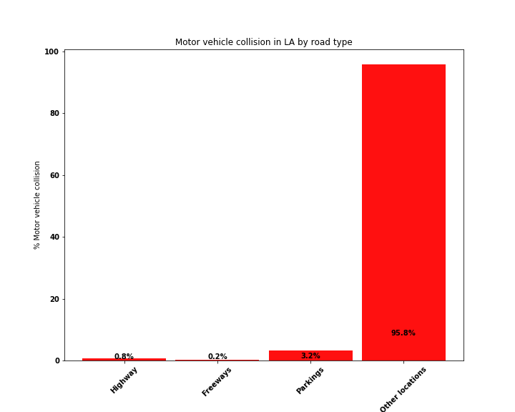
Notes:
Question: Which road types is more prone to accidents?
Analysis: The road types where grouped into 4 types: highways , freeways, parking and other location. “Other location” category, includes city streets, residential areas, alley, boulevard, etc.
As the speed limit is greater on freeways and highways, the assumption was that the majority of accidents would happen on these roads. It was found that the percentage of accidents is not significant for highways, freeways and parking compared to streets, residential areas, alley, etc.

Slide 12
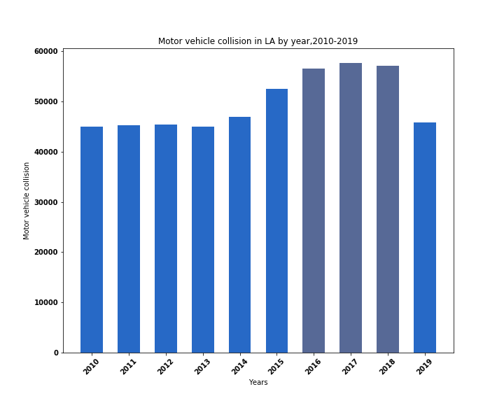
Notes:
Question: Does the number of accidents increase or decrease over the years?
Analysis: Our assumption was that the number of accidents would increase over the years as the number of drivers increase. The results almost support our assumption. The analysis shows that the number of accidents has upward tendency and the peak value(57723) was in 2017. It is slightly less in 2018. As for 2019, since the year isn’t over and we don’t have complete data it is too early to have conclusion for 2019.

Slide 13
Conclusion
The highest number of accidents was among the age group of 26-35.
5 pm was the worst time of day for traffic collisions. Also, Friday had the highest number of accidents compared to the other days of the week.
Male drivers were involved in 59.1% of accidents.
77th Street in LA is where the greatest number of accidents occurred.
The months of March, August, and October had the highest number of traffic collisions.
The percentage of accidents is not significant for highways, freeways and parkings compared to city streets, residential areas, alley, boulevard and etc.
Although, the analysis shows that the number of accidents continually increases over the years reaching 57723 a year (in 2017), there were 587 fewer accidents in 2018 than in 2017.
Final thoughts…
Notes:
This project was fun because we got to use our skills and create something of our own
<insert>
-
- Weekdays during rush hour seem to the highest risk time to be on the road.
<insert>

