Slide 1

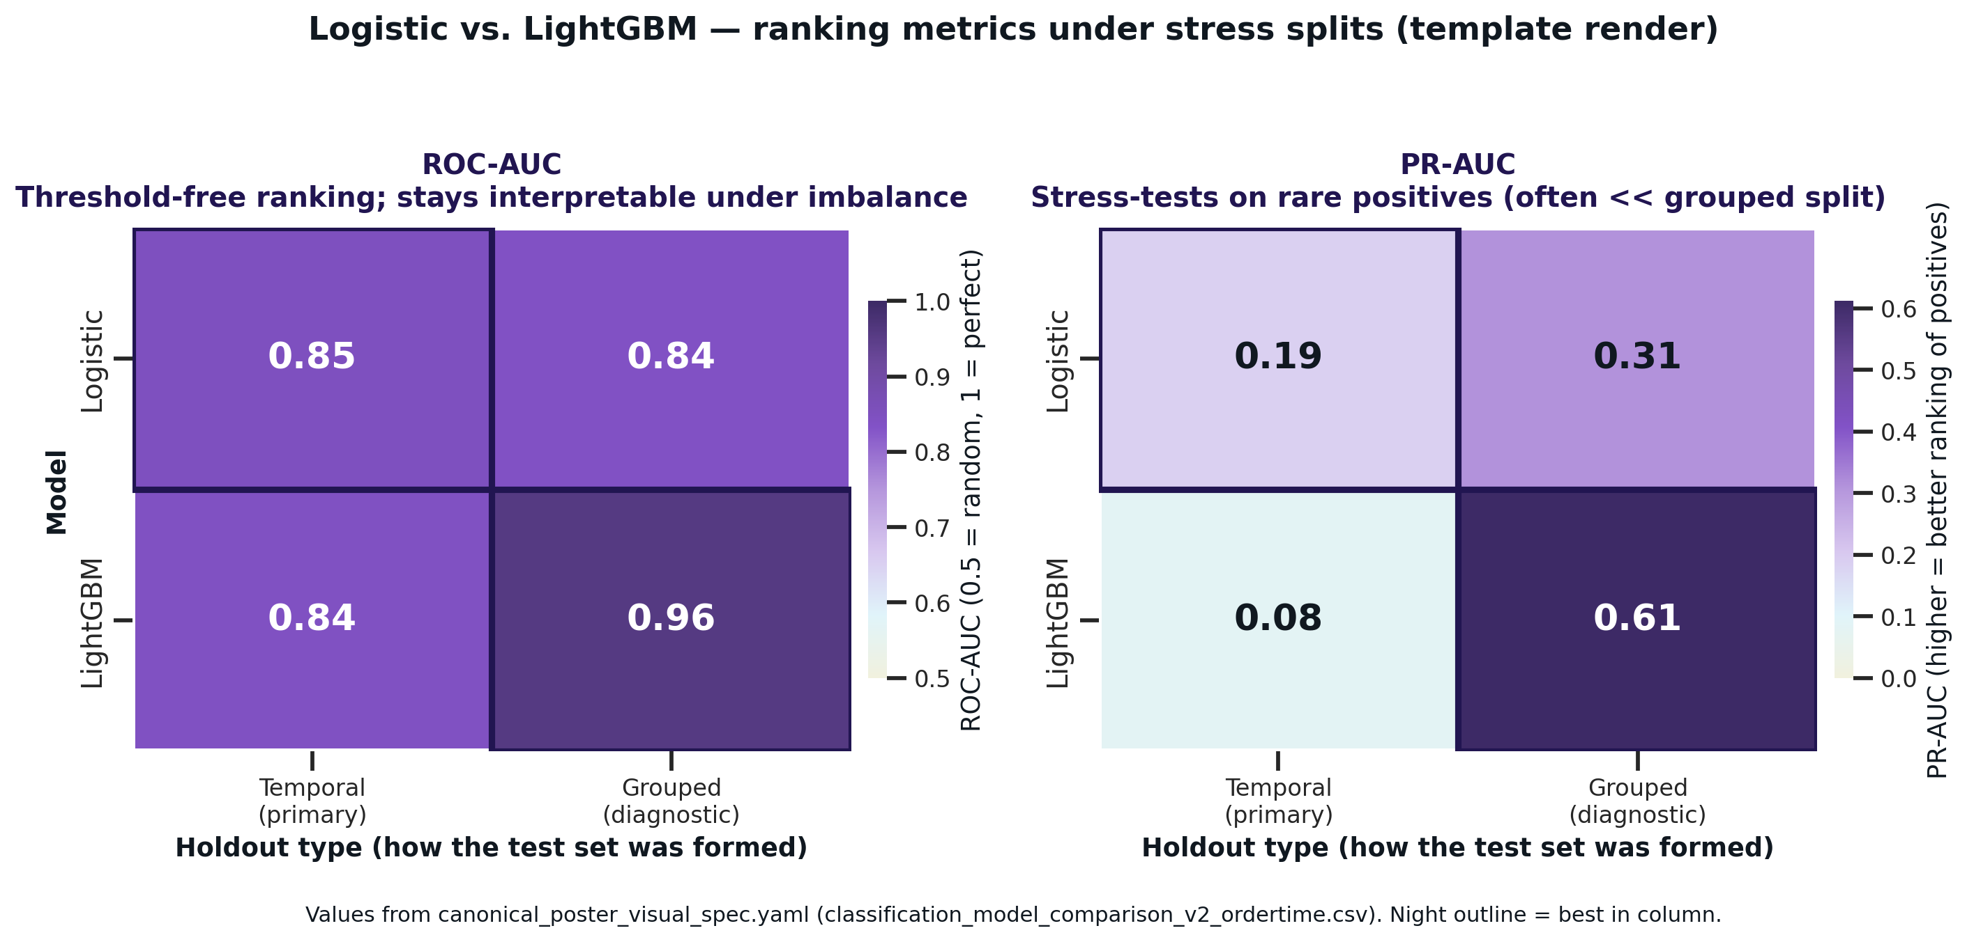
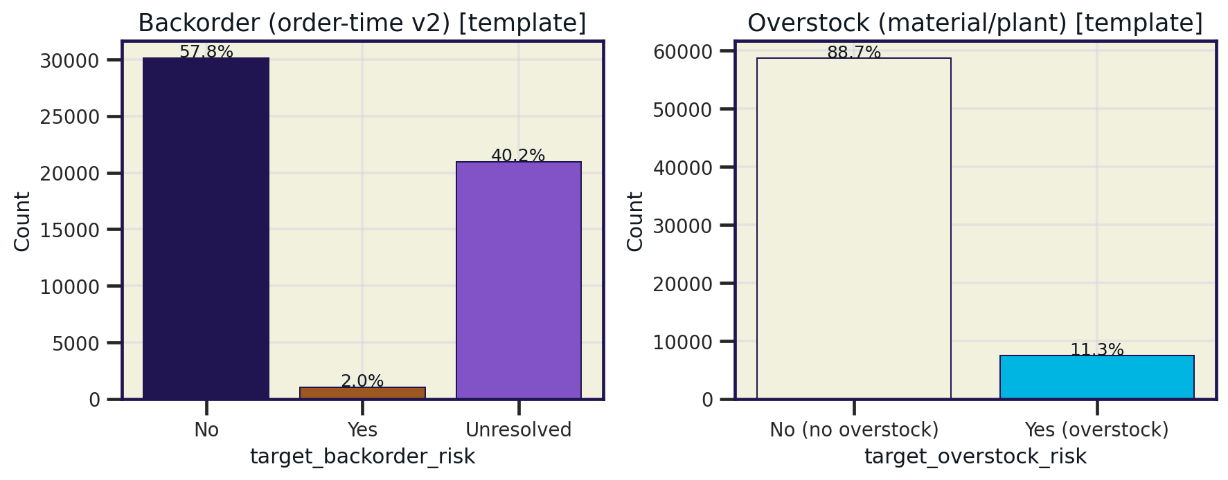
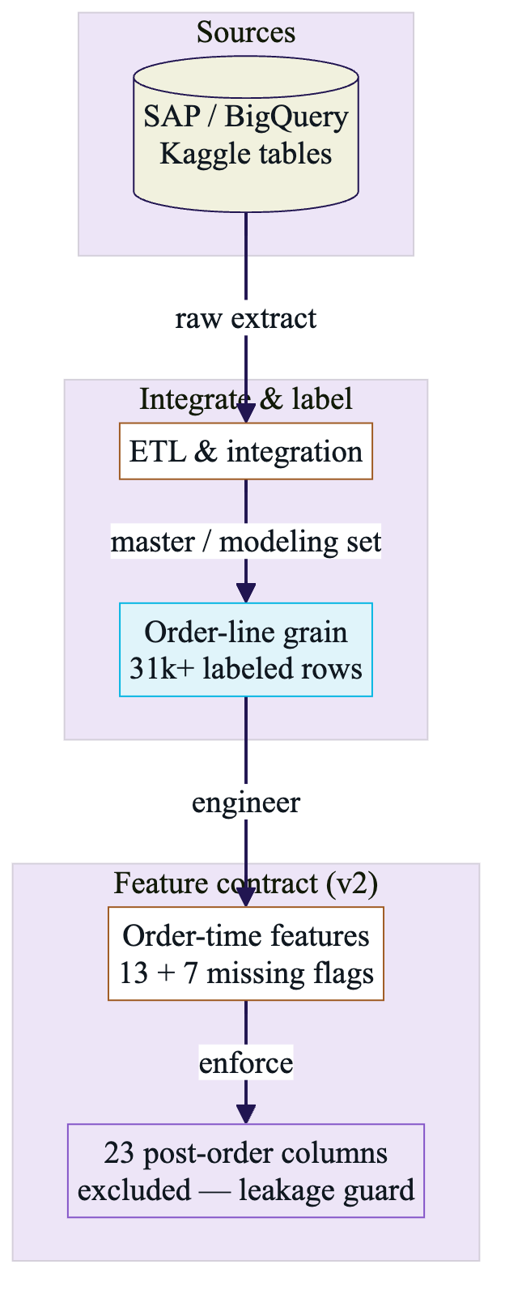
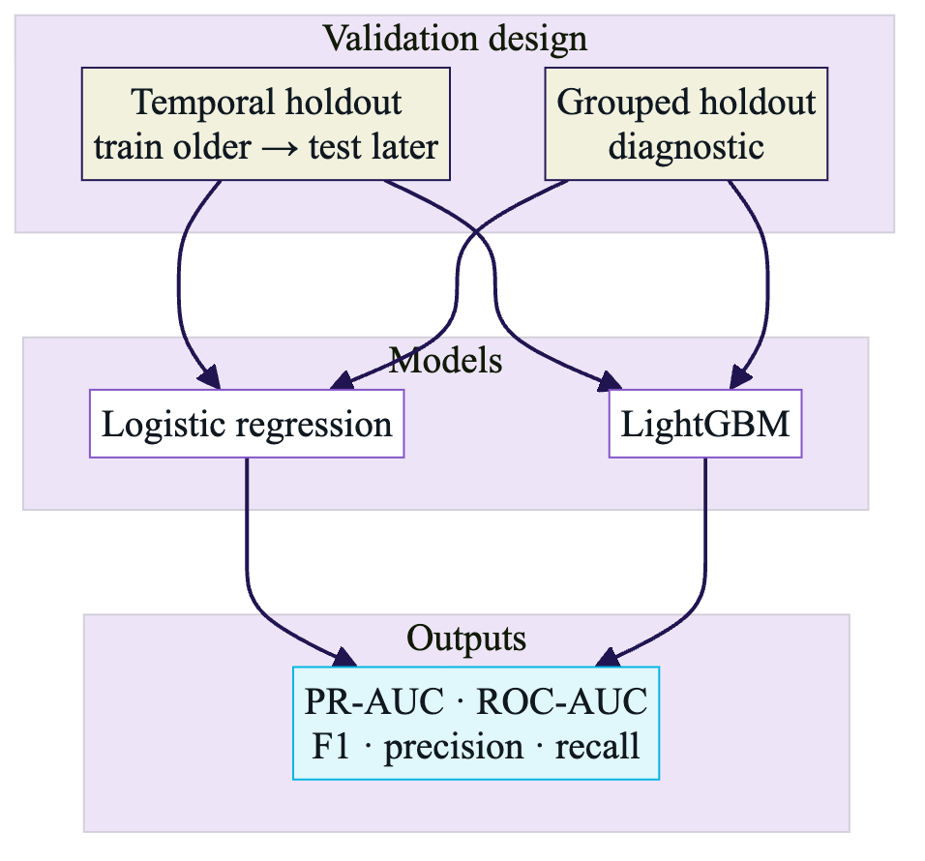
Predictive Supply Chain Analytics for Backorder Risk
Temporal holdout: logistic (LR) vs. LightGBM (LGBM)
Addy Cruz
Advisor: Dr. Liang Jingsai
DATA-470 Capstone | Data Science | Westminster University
Motivation
Validation & metrics
Results
Imbalance + leakage: complex models can look best on the wrong split—need evaluation that matches deployment, not a leaderboard.
Order-time (pre-fulfillment) features only; post-order fields dropped—leakage-safe, deployable input set.
Rare event (~3.4% pos.). Regularized LR vs. LGBM: temporal holdout, not an easy random split, is the real test.
What the figures show: time-aware splits, feature lineage, LR vs. LGBM:
If train/test periods overlap, grouped validation is easy; temporal is the deploy stress test.
Temporal: PR-AUC 0.19 (LR) vs. 0.08 (LGBM); ROC-AUC ~0.85 each—no LGBM ranking edge.
Ship LR; use LGBM as a complexity benchmark only.
Turning off post-order fields cuts grouped F1 vs. a leaky view—mostly split/leakage, not model family. CMs/heatmap: recall at one threshold; very few positives.
Limits & next steps: when to boost
Limitations:
Temporal test: only 0.89% pos. (n=58)—F1/precision at a threshold is noisy. No post-order features → no causal story. Drift/label noise: fixed thresholds are fragile.
If LGBM is worth it
Only if temporal PR-AUC clearly beats LR (not just on grouped), or business needs recall. Else LR default.
Next
Magnitude target; entity/demand/inventory signals at order time; rolling retrain / drift checks.
Data
SAP Supply Chain (BigQuery/Kaggle): sales … master—order-line.
N = 31,177 lines (from 52,118 rows; 59.8% coverage); 3.38% pos. (1,054 backorders).
13 order-time + 7 missingness; 23 post-order features withheld. Tabular → LR first, LGBM as check.
Models
Task
Line-level backorder: penalized LR (default) vs. LGBM. Nonlinear gain must show on the temporal test—not only a grouped time-overlap split.
Splits & metrics
Primary: temporal (train early → test late). Secondary: grouped by document. Threshold: 5-fold stratified OOF on train.
PR-AUC / ROC-AUC: rank quality. F1, P, R, confusion: rare-event operating point. Low temporal F1 with strong ROC is possible.
Data Sources:
SAP Supply Chain (BigQuery / Kaggle).
Reproducible ETL and modeling code accompany the project. LR = penalized logistic regression; LGBM = LightGBM.

