Slide 1
GLOBAL RECIPROCAL COLLEGES | BS INFORMATION TECHNOLOGY
A Scheduling and
Duty Management System
with AI Application in Absence Handling
CAPSTONE DEFENSE • KAIZEN SECURITY AGENCY CORP.
Nel Laurice T. Acop • Ranzie Kirth O. Cahulugan
Ashley Eunice V. Cruz • Christian Mark G. Regacho
Adviser: Mrs. Ann Camile M. Maupay
SCHED
Notes:
Title
Suggested time: 25 seconds
Introduce the researchers and the study. Our project supports the scheduling office of Kaizen Security Agency Corp. and personnel deployed to LRT stations. The presentation explains the operational problem, development approach, implemented solution, reported evaluation results, and limitations.
Sources: Manuscript title page (PDF p. 1).

Slide 2
CHAPTER I · PROJECT CONTEXT
SCHED
Why the study was needed
Kaizen Security Agency Corp. • Security deployment across 25 LRT stations
25
15 days
3 roles
LRT stations
per scheduling period
Admin • Head Guard • Security
Excel rosters required manual balancing of posts, shifts, and rest days.
Unexpected absences triggered repeated searches and phone calls.
Delayed replacements could extend the shifts of on-duty guards.
Study focus: connect roster preparation, absence handling, and duty information.
Source: manuscript, Ch. I; Ch. V, pp. 127–129
02 / 24
Notes:
Project context
Suggested time: 40 seconds
Explain the existing workflow: administrators prepare spreadsheets, distribute files, and search for available replacements when someone is absent. Each station has different staffing needs, so a general calendar is insufficient. The study focuses on both planned scheduling and the daily changes caused by absences.
Defense note: use 25 stations as the operational scope. The 573 figure elsewhere in the manuscript is a deployed personnel-record count, not the evaluation sample. Counts visible in appendix screenshots reflect different data snapshots.
Sources: Manuscript Ch. I, PDF pp. 16–23; Ch. V, PDF pp. 139–142.

Slide 3
CHAPTER I · OBJECTIVES
SCHED
What the study aimed to achieve
General objective: develop a scheduling and duty management system with AI-assisted absence handling.
01
Automate schedules
Follow station needs, rest days, and rotation rules.
02
Recommend replacements
Screen candidates and add AI-assisted ranking.
03
Streamline absence handling
Support quicker assignments and reduce avoidable shift extensions.
04
Evaluate the system
Assess accessibility, timeliness, and usability.
Source: manuscript, Ch. I, pp. 5–6
03 / 24
Notes:
Objectives
Suggested time: 45 seconds
Walk through the four objectives in order. Objective 1 concerns roster constraints. Objective 2 concerns selection among eligible candidates. Objective 3 concerns the operational replacement process, while Objective 4 concerns user access and acceptance.
Defense note: do not claim a measured reduction in overtime. The manuscript provides processing benchmarks and workflow improvements, but no comparable before-and-after field timing for replacement arrival or shift extensions.
Sources: Manuscript Ch. I, PDF pp. 17–18; Ch. V, PDF pp. 139–147.

Slide 4
CHAPTER I · SCOPE AND DELIMITATIONS
SCHED
What the system covers
Deployment: Windows and web for administrators; Android for guards and head guards.
Included
Outside the study scope
15-day schedules, rotation, and station setup
Payroll and overtime-pay computation
Attendance reports, requests, and replacements
Biometric, GPS, or automatic time recording
In-app alerts, archives, and PDF reports
SMS, email, and iOS support
The AI recommends; the administrator confirms the final replacement.
Source: manuscript, Ch. I, pp. 6–11
04 / 24
Notes:
Scope and delimitations
Suggested time: 45 seconds
The project serves the agency’s LRT security operations. Attendance is reported by head guards rather than captured through biometrics or location tracking. All notification features described here are in-app. Guards can view published schedules, submit requests, and volunteer to cover a rest-day duty.
Key terms: a post is a named duty position; a reliever covers eligible duty gaps or rest days; an absence replacement is an administrator-confirmed assignment. The 15-day period is the manuscript’s operational meaning of bi-weekly. Internet connectivity is required for the deployed service.
Sources: Manuscript Ch. I, PDF pp. 18–28; local README.md.

Slide 5
CHAPTER I · SIGNIFICANCE
SCHED
Who benefits from the study
Expected value for agency operations and future development.
Agency & admins
Security personnel
Researchers
Centralized records and roster control
Duty details available on mobile
Practical system-development experience
Less manual work when staffing changes
Clear requests, updates, and cover assignments
Reference for AI-assisted workforce tools
The intended benefit is clearer coordination and more timely staffing decisions.
Source: manuscript, Ch. I, pp. 12–13
05 / 24
Notes:
Significance
Suggested time: 35 seconds
Relate each benefit to a real user. Administrators gain one place to prepare and update schedules. Security personnel can check duty information without requesting a spreadsheet. The agency gains better visibility of uncovered posts. The researchers gain experience integrating a cross-platform client, scheduling service, database, and optional AI review.
Frame reduced fatigue and extended-duty exposure as intended operational benefits. Long-term effects require follow-up measurement.
Sources: Manuscript Ch. I, PDF pp. 24–25.

Slide 6
CHAPTER II · RELATED LITERATURE
SCHED
What the literature supports
Selected themes from the paper’s local and foreign literature review.
Local literature
Foreign literature
Workload-based staffing supports balanced assignments.
Security scheduling affects coverage and employee workload.
AI adoption needs user readiness and responsible data handling.
AI can support complex workforce-planning decisions.
Aytona et al. (2022) • Andaya (2025)
Hughes (2024) • Kupunarapu (2022)
Design implication: combine scheduling rules, usable interfaces, and human oversight.
Source: manuscript, Ch. II, pp. 17–23; citations as presented in the manuscript
06 / 24
Notes:
Related literature
Suggested time: 40 seconds
Summarize themes rather than reciting every author. As reviewed in the manuscript, local literature emphasizes workload allocation and organizational readiness, while foreign literature links scheduling quality with coverage and employee workload. These ideas motivate configurable staffing requirements, clear duty information, and administrator control.
Citation note: these are summaries of the literature review supplied in the paper. The presentation does not independently verify the original publications or add external literature.
Sources: Manuscript Ch. II, PDF pp. 29–35; references, PDF pp. 148–155.

Slide 7
CHAPTER III · RESEARCH AND DEVELOPMENT METHOD
SCHED
Rapid Application Development
Working prototypes, stakeholder feedback, and repeated testing guided development.
01
02
03
04
Requirements
User design
Construction
Test & deploy
Identify users, rules,
and station needs.
Prototype interfaces
and map workflows.
Build and refine
working features.
Validate functions
and deploy clients.
Feedback and refinement across the development cycle
Why RAD: operational rules and interfaces could be refined through repeated feedback.
Source: manuscript, Ch. III, pp. 35–38; development timeline, pp. 89–92
08 / 24
Notes:
Research and development method
Suggested time: 45 seconds
Explain the four phases using one example: absence reporting was prototyped, checked against head-guard shift scope, tested, and refined. The research evaluation uses a descriptive-quantitative approach, while RAD is the software-development method.
Timeline backup: the manuscript describes planning and gathering requirements early in the year, design and development through midyear, and refinement and documentation later. Avoid claiming all future timeline entries were completed on the presentation-preparation date.
Team backup: Cruz led coordination, documentation, and testing; Cahulugan handled full-stack development; Regacho supported quality assurance and literature work; Acop supported documentation and literature work.
Sources: Manuscript Ch. III, PDF pp. 47–50, 101–104, 107.

Slide 8
CHAPTER III · CONCEPTUAL FRAMEWORK
SCHED
Input → Process → Output
The system turns operational records into schedules and actionable duty information.
INPUT
PROCESS
OUTPUT
Personnel and availability
Validate and apply rules
Published duty rosters
Station posts and shifts
Generate duty schedules
Approved replacements
Requests and absences
Rank eligible replacements
Reports and notifications
Administrative review remains part of publishing schedules and assigning replacements.
Source: manuscript, Ch. III, pp. 38–39; IPO redrawn for presentation
09 / 24
Notes:
Conceptual framework
Suggested time: 45 seconds
Explain the IPO diagram from left to right. Inputs include both stable requirements, such as station posts, and changing records, such as leave and absences. Rules enforce eligibility and constraints. Outputs provide the schedule and the information needed to act on it.
Defense note: the algorithm generates the roster. Gemini is used in reviewing replacement candidates, and the administrator makes the final assignment. Keep those responsibilities distinct.
Sources: Manuscript Ch. III, PDF pp. 50–51; scheduler.py, replacements.py, ai_service.py.

Slide 9
CHAPTER III · SOFTWARE AND HARDWARE REQUIREMENTS
SCHED
How the system is built
A shared backend connects desktop, web, and mobile clients.
Flutter clients
Python + FastAPI
Supabase
Admin: Windows / web
Scheduling rules
PostgreSQL records
Guards: Android
Hosted on Render
Centralized data access
Gemini: optional AI review
Operating needs: a Windows PC or browser, Android devices, and internet access.
Source: manuscript, Ch. III, pp. 39–46; project implementation
10 / 24
Notes:
Architecture and requirements
Suggested time: 45 seconds
Flutter provides the role-specific user interfaces. FastAPI handles the rules and communicates with Supabase PostgreSQL. The optional Gemini service receives a screened candidate context through the backend. All clients work from shared records.
Hardware backup: the paper lists Android 7.0 with 2 GB RAM as a minimum and Android 10+ with 4 GB RAM as recommended. Avoid presenting these listed requirements as new device-compatibility test results.
Defense note: if Gemini is unavailable, the backend still produces the rule-based candidate ranking. Internet access is still needed for the deployed backend; offline schedules are a recommendation.
Sources: Manuscript Ch. III, PDF pp. 51–58; README.md; backend_python/requirements.txt; scheduling_system/pubspec.yaml.

Slide 10
CHAPTER III · SYSTEM ANALYSIS AND DESIGN
SCHED
Three actors, one duty record
Context, data-flow, use-case, and entity diagrams define the same connected workflow.
Administrator
Head Guard
Security personnel
Configure, generate, publish
View the station roster
View personal duty schedules
Approve requests and covers
Submit attendance per shift
File requests and cover offers
Core data path
Personnel + Stations → Schedules → Duty assignments → Attendance / Replacements
18 tables organize reference data, rotation, schedules, requests, and audit records.
Source: manuscript, Ch. III, pp. 46–69; simplified design summary
11 / 24
Notes:
System analysis and design
Suggested time: 45 seconds
The diagrams in the manuscript describe the boundary of the system, the responsibilities of each actor, the flow of records, and how the records relate. A station-period schedule expands into individual duty assignments. Absence handling updates those assignments and records the applied replacement.
Database defense: the manuscript states that the schedule-to-duty-assignment relationship is enforced by the database; many other relationships are logical joins resolved by the application. Do not claim every relationship is protected by a foreign key. Credentials are stored separately from employee profile records.
Sources: Manuscript Ch. III, PDF pp. 58–81; backend_python/schema/001_initial.sql, 002_auth_accounts.sql, 003_ai_suggestions.sql.

Slide 11
CHAPTER III · EVALUATION PROCEDURE
SCHED
How the study evaluated the system
Descriptive-quantitative evaluation using an ISO/IEC 25010-based instrument.
5
211
1–5
IT expert respondents
end-user respondents
Likert rating scale
Six criteria: functionality, efficiency, compatibility, reliability, usability, maintainability.
Ratings summarized by criterion and by respondent group.
4.21–5.00 interpreted as “Highly Acceptable.”
Source: manuscript, Ch. III, pp. 93–98; Ch. IV, pp. 114–126
12 / 24
Notes:
Evaluation procedure
Suggested time: 55 seconds
Five IT experts and 211 end users evaluated the system. End users include administrators, head guards, and security personnel. The paper describes a Google Forms rating instrument and a five-point Likert scale. Six selected ISO/IEC 25010 criteria were used; the manuscript’s phrase “eight” is inconsistent with its six-item list and results.
Calculation defense: individual item scores summarize response frequencies; criterion ratings average their items; overall ratings average six criteria. Four end-user criteria weight the role-specific ratings equally. The paper reports a respondent-count-weighted sensitivity result of 4.67, still Highly Acceptable. Do not invent a sampling formula or per-role sample split absent from the provided text.
Sources: Manuscript Ch. III, PDF pp. 105–110; Ch. IV, PDF pp. 126–138.

Slide 12
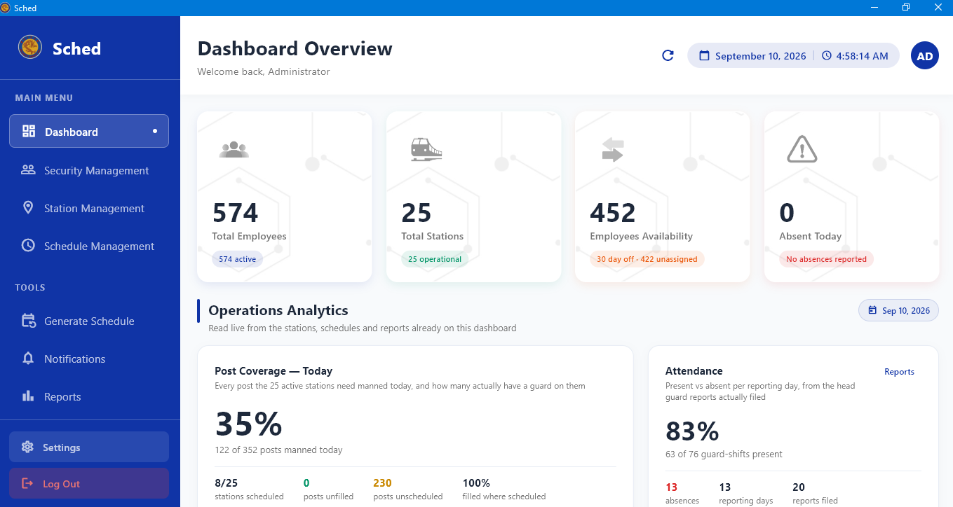
CHAPTER IV · IMPLEMENTED SYSTEM
SCHED
Sched: the administrator workspace
The implemented application connects roster preparation with day-to-day duty management.
Monitor personnel and station coverage.
Manage schedules, requests, and reports.
Review staffing gaps before publication.
Source: manuscript, Appendix D, p. 155; screenshot reproduced from the paper
14 / 24
Notes:
Implemented system overview
Suggested time: 35 seconds
Use the dashboard screenshot to orient the panel. Point to the operational summary and the sidebar modules, then move quickly to scheduling and absence handling. This is a real screenshot embedded in the supplied paper.
Defense note: dashboard counts are a captured snapshot, not study-wide evaluation metrics. This image shows 574 employees; the manuscript separately reports 573 records during deployment testing. Do not treat these as the same measurement. If demonstrating the live application, explain that current data can differ from the documentation screenshot.
Sources: Manuscript Appendix D, PDF p. 167; local Flutter administrator screens.

Slide 13
CHAPTER IV · OBJECTIVE 1 RESULTS
SCHED
Automated schedules follow station requirements
The generator applies staffing rules, rest days, and station rotation.
1.7 ms
0.04 s
7,700
reported median: one station period
reported generation: all 25 stations
duty assignments in that benchmark
Coverage follows configured shift and post requirements.
Tests checked double bookings, rest days, and rotation behavior.
Staffing shortfalls appear as notes for administrator review.
Benchmark scope: scheduling computation; full user response also includes data and network time.
Source: manuscript, Ch. IV, p. 104; Ch. V, pp. 127–128
15 / 24
Notes:
Automated scheduling results
Suggested time: 55 seconds
These are reported manuscript benchmarks, not new measurements. The paper reports a median of 1.7 milliseconds to compute one 15-day station schedule and 0.04 seconds for 25 stations producing 7,700 assignments. Explain that these numbers describe the generation computation; they do not measure the entire UI, database write, publishing, network, or AI request.
Operational defense: the system produces the best roster permitted by available staffing and reports gaps. It cannot create guards when the agency is understaffed. Do not promise complete coverage in every possible staffing situation.
Sources: Manuscript Ch. IV, PDF p. 116; Ch. V, PDF pp. 139–140; scheduler.py, schedule_notes.py.

Slide 14
CHAPTER IV · OBJECTIVE 2 RESULTS
SCHED
How AI assists absence handling
Rules establish eligibility; Gemini adds a recommendation and explanation.
1
2
3
4
SCREEN
RANK
AI REVIEW
CONFIRM
Check availability,
conflicts, shift and post
Score familiarity,
workload and offers
Compare candidates;
explain the choice
Admin approves;
update roster and alerts
AI output is checked against the eligible shortlist.
If AI fails, the rule-based ranking remains available.
Source: manuscript, Ch. III, pp. 61–62; Ch. IV, p. 106; Ch. V, p. 128
16 / 24
Notes:
AI-assisted absence handling
Suggested time: 70 seconds
The candidate list exists before Gemini is consulted. The backend first removes conflicts and ineligible roles, then scores the remaining candidates. Gemini can consider recent cover burden, consecutive duties, and fairness when comparing those candidates. Its output must refer to an identifier from the supplied shortlist. The administrator confirms the final assignment.
Defense note: this is a rule-based scheduling and ranking system with generative-AI decision support. It does not train a new model, predict future absences, or let a model autonomously schedule personnel. Cached reviews are reused only while their candidate context remains valid. The paper reports fallback testing for missing configuration, disabled AI, quota failures, timeouts, and malformed responses.
Sources: Manuscript PDF pp. 73–74, 118, 140; replacements.py, ai_service.py, ai_review.py.

Slide 15
CHAPTER IV · OBJECTIVE 3 RESULTS
SCHED
A shorter replacement workflow
The system reduces manual coordination steps and provides a clear reporting time.
Previous process
Implemented process
Review Excel and search for available guards
Receive absence and open a ranked shortlist
Call candidates; repeat when they decline
Confirm a cover; update duty and notify guard
Example: 05:00–17:00 post + assignment at 09:00 → adjusted duty 10:00–19:00
Field reduction in replacement waiting time and overtime still requires before-and-after measurement.
Source: manuscript, Ch. V, pp. 128–129, 133–135; preparation-window module
17 / 24
Notes:
Replacement workflow and delay
Suggested time: 60 seconds
Explain the change in steps rather than inventing a percentage improvement. The system surfaces a screened list and prioritizes personnel who have already offered cover. This reduces the need for an administrator to construct the list and relay each detail manually.
Preparation example: for a 05:00–17:00 post assigned at 09:00, the configured policy sets the replacement’s duty to 10:00–19:00. That allows an hour for preparation and extends the original end by two hours. If assigned early enough, original hours remain. Applying a replacement after the original post has ended is refused.
Limitation: an assignment does not establish that the guard has arrived. Travel feasibility and actual reductions in overtime require field observation.
Sources: Manuscript Ch. V, PDF pp. 140–141, 145–147; backend_python/prep_window.py and replacements.py.

Slide 16
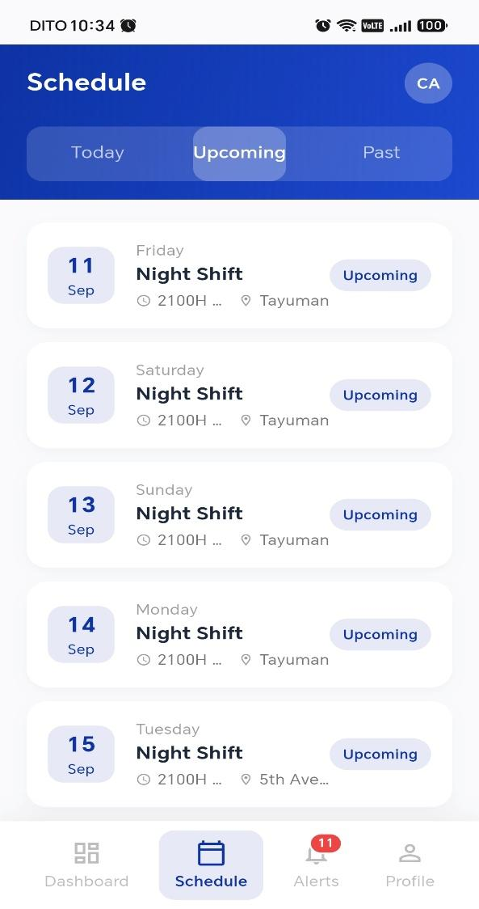
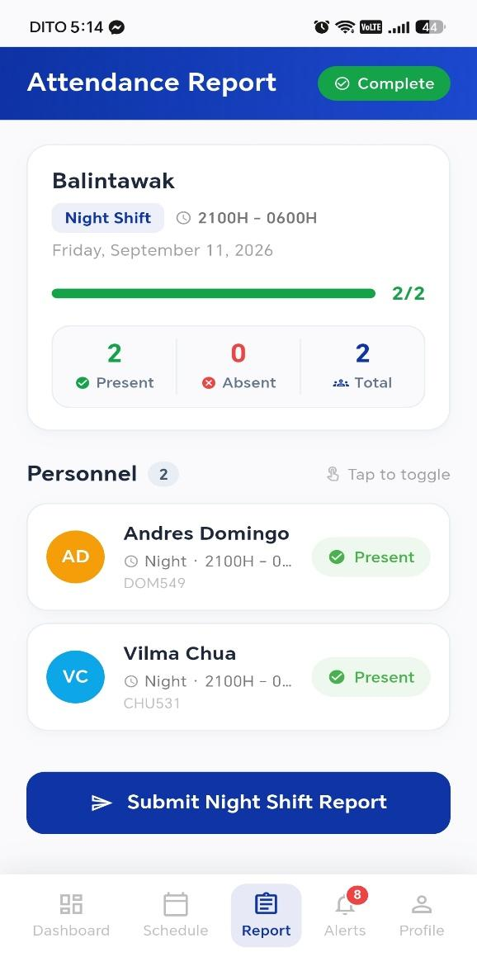
CHAPTER IV · OBJECTIVE 4 RESULTS
SCHED
Duty information reaches personnel on mobile
Guard and head-guard views use the same shared operational records.
View current and past duties.
File absence, leave, and day-off requests.
Receive decisions and cover assignments.
Head guards report attendance for their own shifts.
Personal schedule
Shift attendance report
Source: manuscript, Appendix D, pp. 182, 192; Ch. IV, pp. 108–113
18 / 24
Notes:
Mobile access and duty information
Suggested time: 45 seconds
Use the first screenshot to show that the guard has personal duty information on the phone. Use the second to show that head guards report station attendance within their assigned shift scope. The day head guard reports morning and afternoon; the night head guard reports night. Duplicate shift submissions are prevented.
The deployed app requires connectivity and uses in-app notifications. Avoid promising SMS, operating-system push delivery, or offline access. Duty status is calculated against the server’s Manila time. The reported usability and accessibility findings should be read alongside the evaluation ratings on the next slides.
Sources: Manuscript Ch. IV, PDF pp. 120–125; Appendix D, PDF pp. 194 and 204; Flutter mobile screens.

Slide 17
CHAPTER IV · EVALUATION RESULTS
SCHED
Both groups rated the system highly acceptable
Mean ratings on a five-point scale • IT experts (n = 5) • End users (n = 211)
4.79 / 5
IT experts: overall rating
4.74 / 5
End users: overall rating
Efficiency rated
lowest in both
groups.
Source: manuscript, Table 26, p. 114; Table 33, p. 124; interpretation, pp. 125–126
20 / 24
Notes:
Evaluation results
Suggested time: 70 seconds
The IT experts reported an overall rating of 4.79 and end users 4.74, both in the 4.21–5.00 Highly Acceptable range. The highest expert rating is usability, 4.93. The highest end-user rating is functional suitability, 4.92. Performance efficiency is the lowest-rated criterion for both: 4.53 and 4.59.
Interpretation: the respondents found the system acceptable, while responsiveness remains a priority for improvement. Ratings measure respondent assessment; they are not a causal experiment proving reductions in overtime or improved deployment outcomes.
Weighting defense: the manuscript’s role-balanced end-user overall is 4.74. Its respondent-count-weighted sensitivity value is 4.67, also Highly Acceptable. Keep the two respondent panels separate rather than claiming a single pooled average.
Sources: Manuscript Ch. IV, PDF pp. 126–138, especially Tables 26 and 33.

Slide 18
CHAPTER V · SUMMARY OF FINDINGS
SCHED
Findings aligned with the objectives
The evidence combines implemented functions, reported tests, and user evaluation.
Scheduling
Station-based 15-day rosters; staffing gaps are visible.
Absence handling
Screened candidates, explained AI advice, and rule-based fallback.
Workflow
Less manual searching; field time savings remain to be measured.
User access
Shared duty access; high acceptability in both respondent groups.
Source: manuscript, Ch. V, pp. 127–130; Ch. IV evaluation tables
21 / 24
Notes:
Summary of findings
Suggested time: 40 seconds
Return to the four objectives and match each to the available evidence. Scheduling has rule checks and computation benchmarks. Absence handling has candidate validation and fallback tests. Workflow efficiency is supported by a reduction in manual steps, with operational timing still an open measurement. User access and acceptance are supported by implemented mobile features and respondent ratings.
This distinction lets the group defend what was actually demonstrated without overstating long-term business outcomes.
Sources: Manuscript Ch. V, PDF pp. 139–142; Ch. IV, PDF pp. 126–138.

Slide 19
CHAPTER V · CONCLUSIONS
SCHED
What the study concludes
The delivered system connects routine scheduling with day-to-day absence response.
Automated roster generation reduces manual schedule construction.
Rules and AI advice support administrator decisions on replacement candidates.
Shared desktop, web, and mobile records improve access to duty information.
Testing and respondent ratings support use in the agency’s studied setting.
Continuous coverage still depends on available personnel, timely reporting, and actual arrival.
Source: manuscript, Ch. V, pp. 131–133
22 / 24
Notes:
Conclusions
Suggested time: 40 seconds
State the contribution in practical terms: the administrator reviews a generated roster and a prepared replacement shortlist instead of building both manually. The integration keeps duty records and personnel views connected. The respondent ratings support acceptability in the studied setting.
Boundary: the study does not establish that AI always outperforms the rule-based ranking. It also does not guarantee full coverage under understaffing or prove long-term reductions in overtime. Those are suitable topics for future field evaluation.
Sources: Manuscript Ch. V, PDF pp. 143–145; recommendations, PDF pp. 146–147.

Slide 20
CHAPTER V · RECOMMENDATIONS
SCHED
What should happen next
Priorities drawn from the paper’s recommendations.
Agency operations
System improvements
Future research
Train users on requests and shift reporting.
Fix layout issues and hosting delays.
Measure replacement time, overtime, and satisfaction.
Review staffing notes and confirm AI suggestions.
Use staging tests; add offline and wider notification support.
Compare AI advice with rule-based ranking.
Priority: measure the operational benefits during sustained real-world use.
Source: manuscript, Ch. V, pp. 134–135
23 / 24
Notes:
Recommendations
Suggested time: 45 seconds
Give the agency practical first steps: train users, keep station records accurate, and review generation notes before publishing. For development, resolve the reported narrow-screen layout issue, improve hosting responsiveness, and test writes in a separate staging database. SMS/email, iOS, and offline caching are future extensions rather than existing features.
For research, collect a manual baseline and post-adoption timing for replacement assignment, arrival, and overtime. Compare administrator choices with AI recommendations and with the rule-based list. Examine fairness and user satisfaction over sustained operation.
Sources: Manuscript Ch. V, PDF pp. 146–147.

Slide 21
SCHED | CAPSTONE DEFENSE
Thank you.
Questions and discussion
Global Reciprocal Colleges • Kaizen Security Agency Corp.
Notes:
Questions and discussion
Suggested time: 15 seconds
DEFENSE QUICK REFERENCE
1. What is the main contribution? An integrated workflow linking station-based scheduling, absence reporting, eligible-candidate ranking, administrator approval, and notification.
2. Where is the AI? Gemini reviews an already-screened shortlist and explains a replacement recommendation. Rules generate the roster and enforce eligibility.
3. Why use AI if rules already rank candidates? It can add contextual reasoning about recent cover burden and consecutive duties. Its incremental value should be evaluated against administrator choices; superiority was not established by the reported ratings.
4. What if AI fails? The rule-based shortlist remains usable. Invalid candidate identifiers are rejected.
5. What if there are too few guards? Generate the available roster and expose staffing gaps for review; no software can create missing personnel.
6. Did the system reduce overtime? It streamlines coordination and sets adjusted reporting hours. Actual overtime reduction needs a field baseline and post-adoption measurement.
7. How were results evaluated? Five IT experts and 211 end users rated six criteria. Overall scores were 4.79 and 4.74; both are Highly Acceptable.
8. What does 1.7 ms measure? Reported schedule-generation computation for one station period, not the full end-to-end application response.
9. Is the AI data anonymous? Names and contact details are excluded, but identifiers and job records can still be linkable. Use the term minimized rather than fully anonymous.
10. Can it run offline? The deployed backend requires internet. Offline schedule caching is recommended future work.
11. What remains unresolved? The paper reports a small notification-tab layout issue and recommends staging tests, responsiveness improvements, and longitudinal field evaluation.
12. Why are some project documents incomplete? The supplied final PDF includes evaluation results absent from older local drafts. This presentation takes its academic results from the PDF.
Sources: Supplied manuscript and selected local implementation modules; source locations are provided in each slide’s notes.

