Slide 1
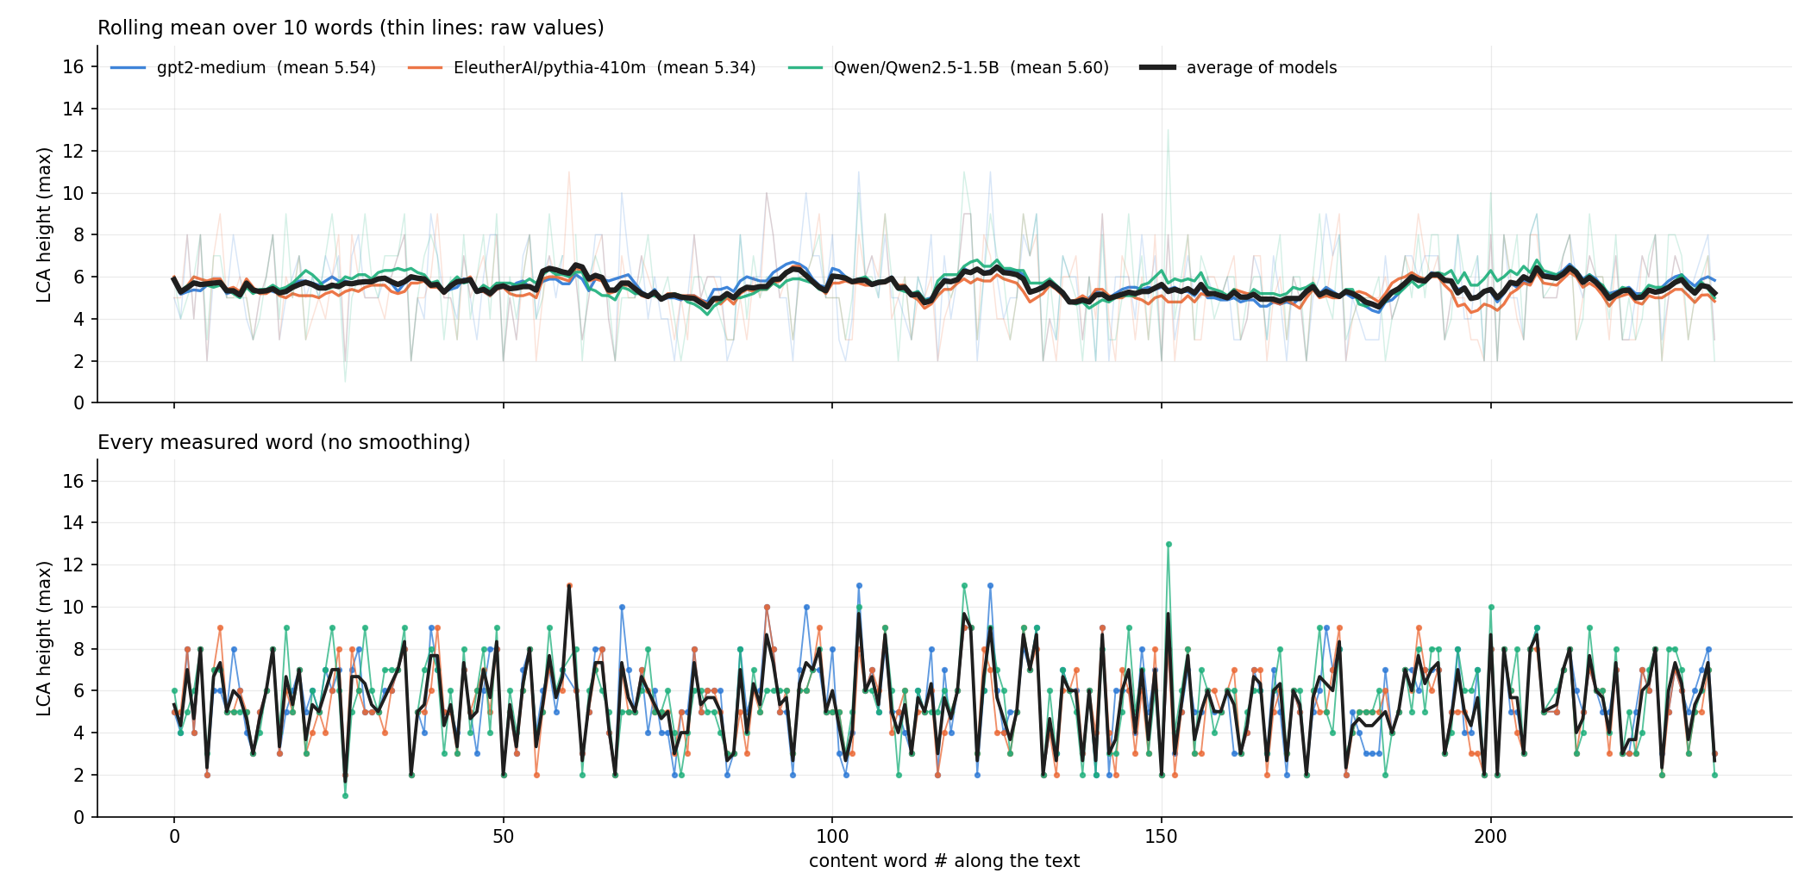
Wikipedia — Black hole
FACTUAL
Average of the 3 models: mean LCA 5.51 · variance 3.34 · mean |jump| 2.19 · 234 measured words · 31% verbs
Notes:
gpt2-medium: mean 5.54, var 3.98, mean |jump| 2.34, noun mean 6.38, n=233
EleutherAI/pythia-410m: mean 5.34, var 3.75, mean |jump| 2.28, noun mean 6.23, n=234
Qwen/Qwen2.5-1.5B: mean 5.60, var 4.22, mean |jump| 2.52, noun mean 6.45, n=233

Slide 2
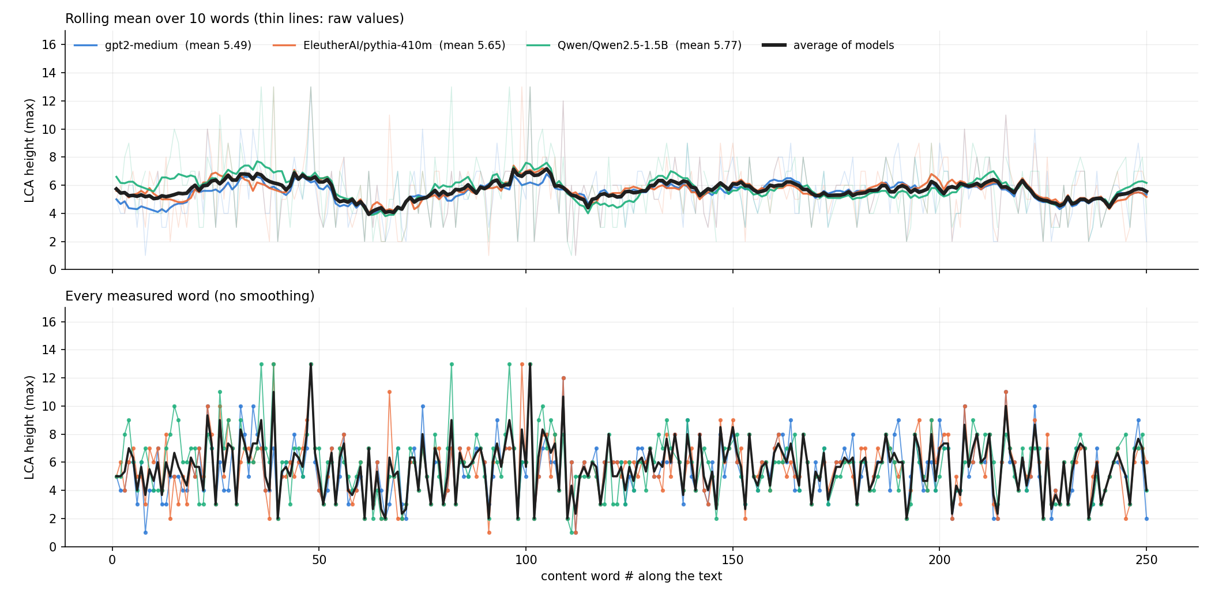
Wikipedia — Copper
FACTUAL
Average of the 3 models: mean LCA 5.66 · variance 3.66 · mean |jump| 2.19 · 248 measured words · 23% verbs
Notes:
gpt2-medium: mean 5.49, var 4.43, mean |jump| 2.41, noun mean 6.16, n=247
EleutherAI/pythia-410m: mean 5.65, var 4.76, mean |jump| 2.46, noun mean 6.33, n=247
Qwen/Qwen2.5-1.5B: mean 5.77, var 5.08, mean |jump| 2.34, noun mean 6.56, n=242

Slide 3
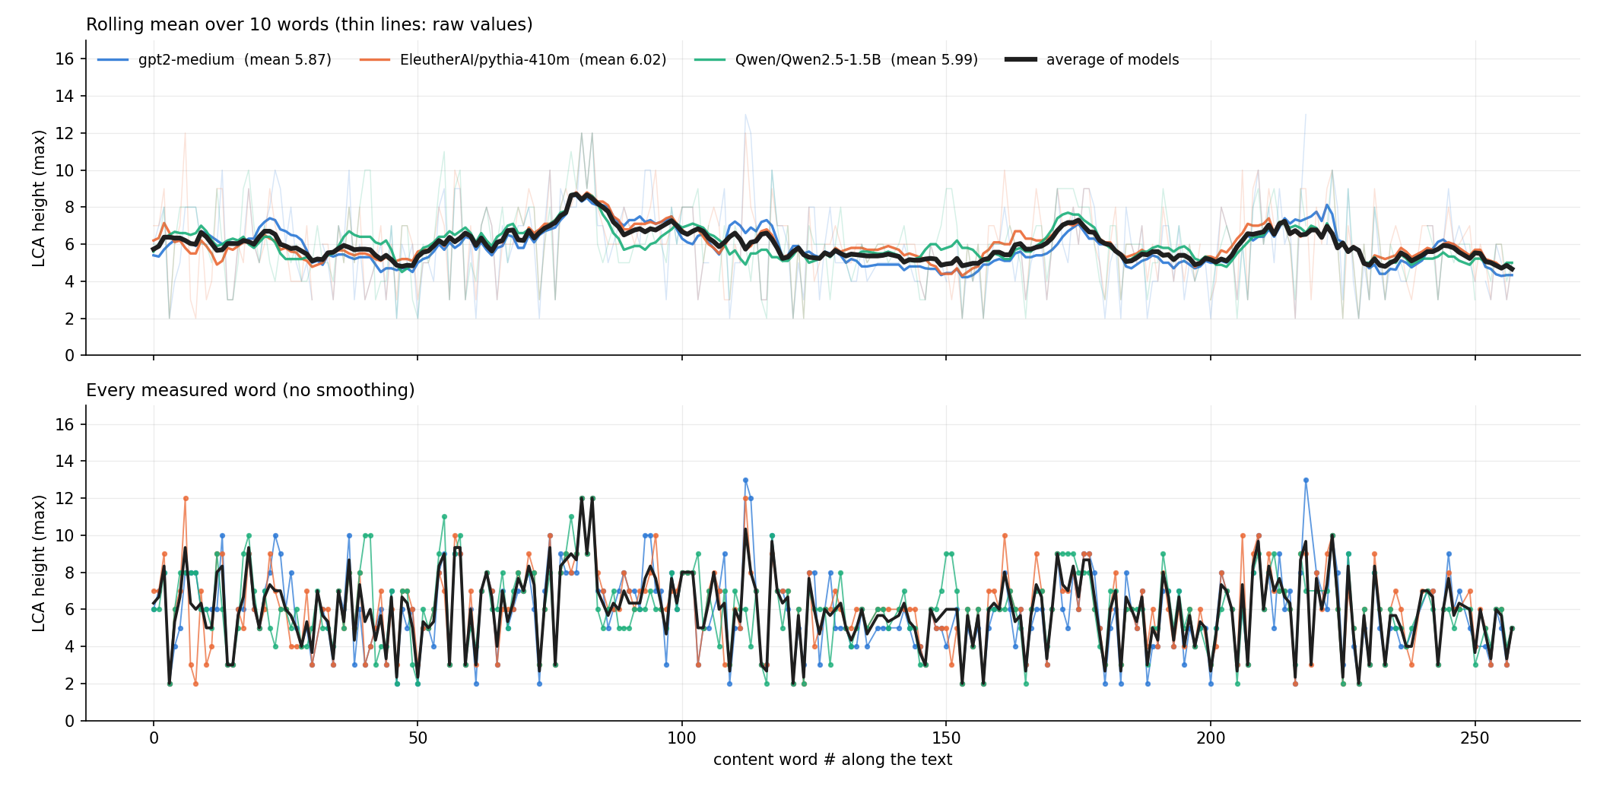
Wikipedia — Mitochondrion
FACTUAL
Average of the 3 models: mean LCA 5.96 · variance 3.69 · mean |jump| 2.00 · 254 measured words · 20% verbs
Notes:
gpt2-medium: mean 5.87, var 5.13, mean |jump| 2.31, noun mean 6.62, n=246
EleutherAI/pythia-410m: mean 6.02, var 4.56, mean |jump| 2.28, noun mean 6.74, n=252
Qwen/Qwen2.5-1.5B: mean 5.99, var 4.18, mean |jump| 2.00, noun mean 6.67, n=248

Slide 4
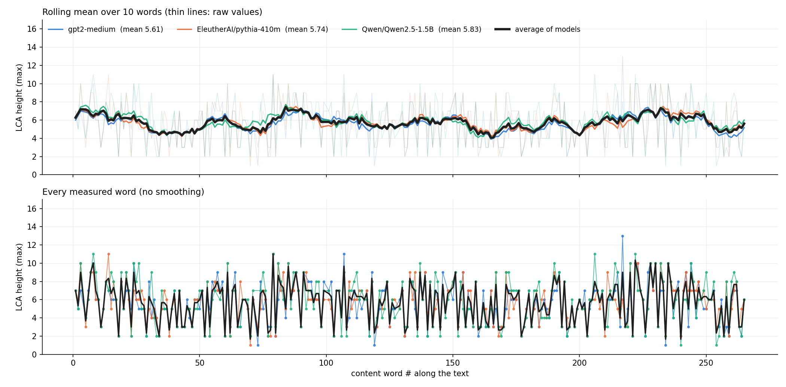
Wikipedia — Photosynthesis
FACTUAL
Average of the 3 models: mean LCA 5.72 · variance 4.70 · mean |jump| 2.57 · 261 measured words · 28% verbs
Notes:
gpt2-medium: mean 5.61, var 5.19, mean |jump| 2.69, noun mean 6.66, n=259
EleutherAI/pythia-410m: mean 5.74, var 5.05, mean |jump| 2.67, noun mean 6.82, n=261
Qwen/Qwen2.5-1.5B: mean 5.83, var 6.27, mean |jump| 2.93, noun mean 6.99, n=259

Slide 5
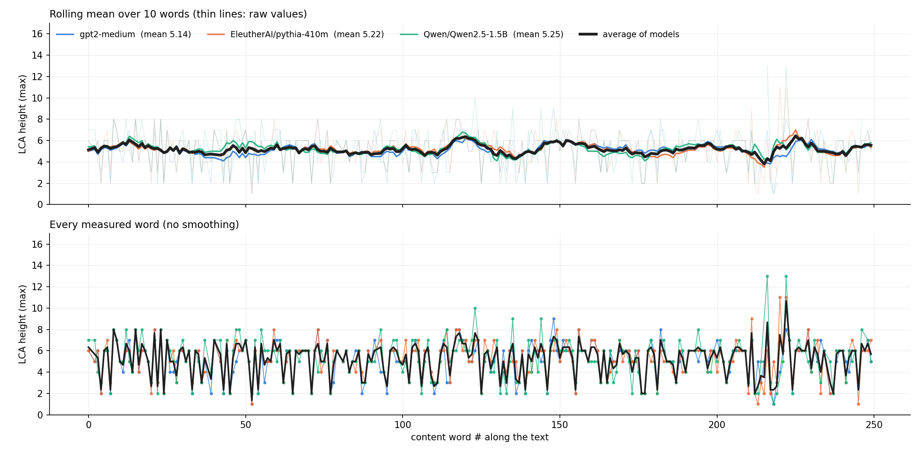
Wikipedia — Plate tectonics
FACTUAL
Average of the 3 models: mean LCA 5.20 · variance 2.59 · mean |jump| 1.83 · 243 measured words · 23% verbs
Notes:
gpt2-medium: mean 5.14, var 2.84, mean |jump| 1.88, noun mean 5.80, n=243
EleutherAI/pythia-410m: mean 5.22, var 3.01, mean |jump| 1.98, noun mean 5.88, n=243
Qwen/Qwen2.5-1.5B: mean 5.25, var 3.66, mean |jump| 2.16, noun mean 5.98, n=239

Slide 6
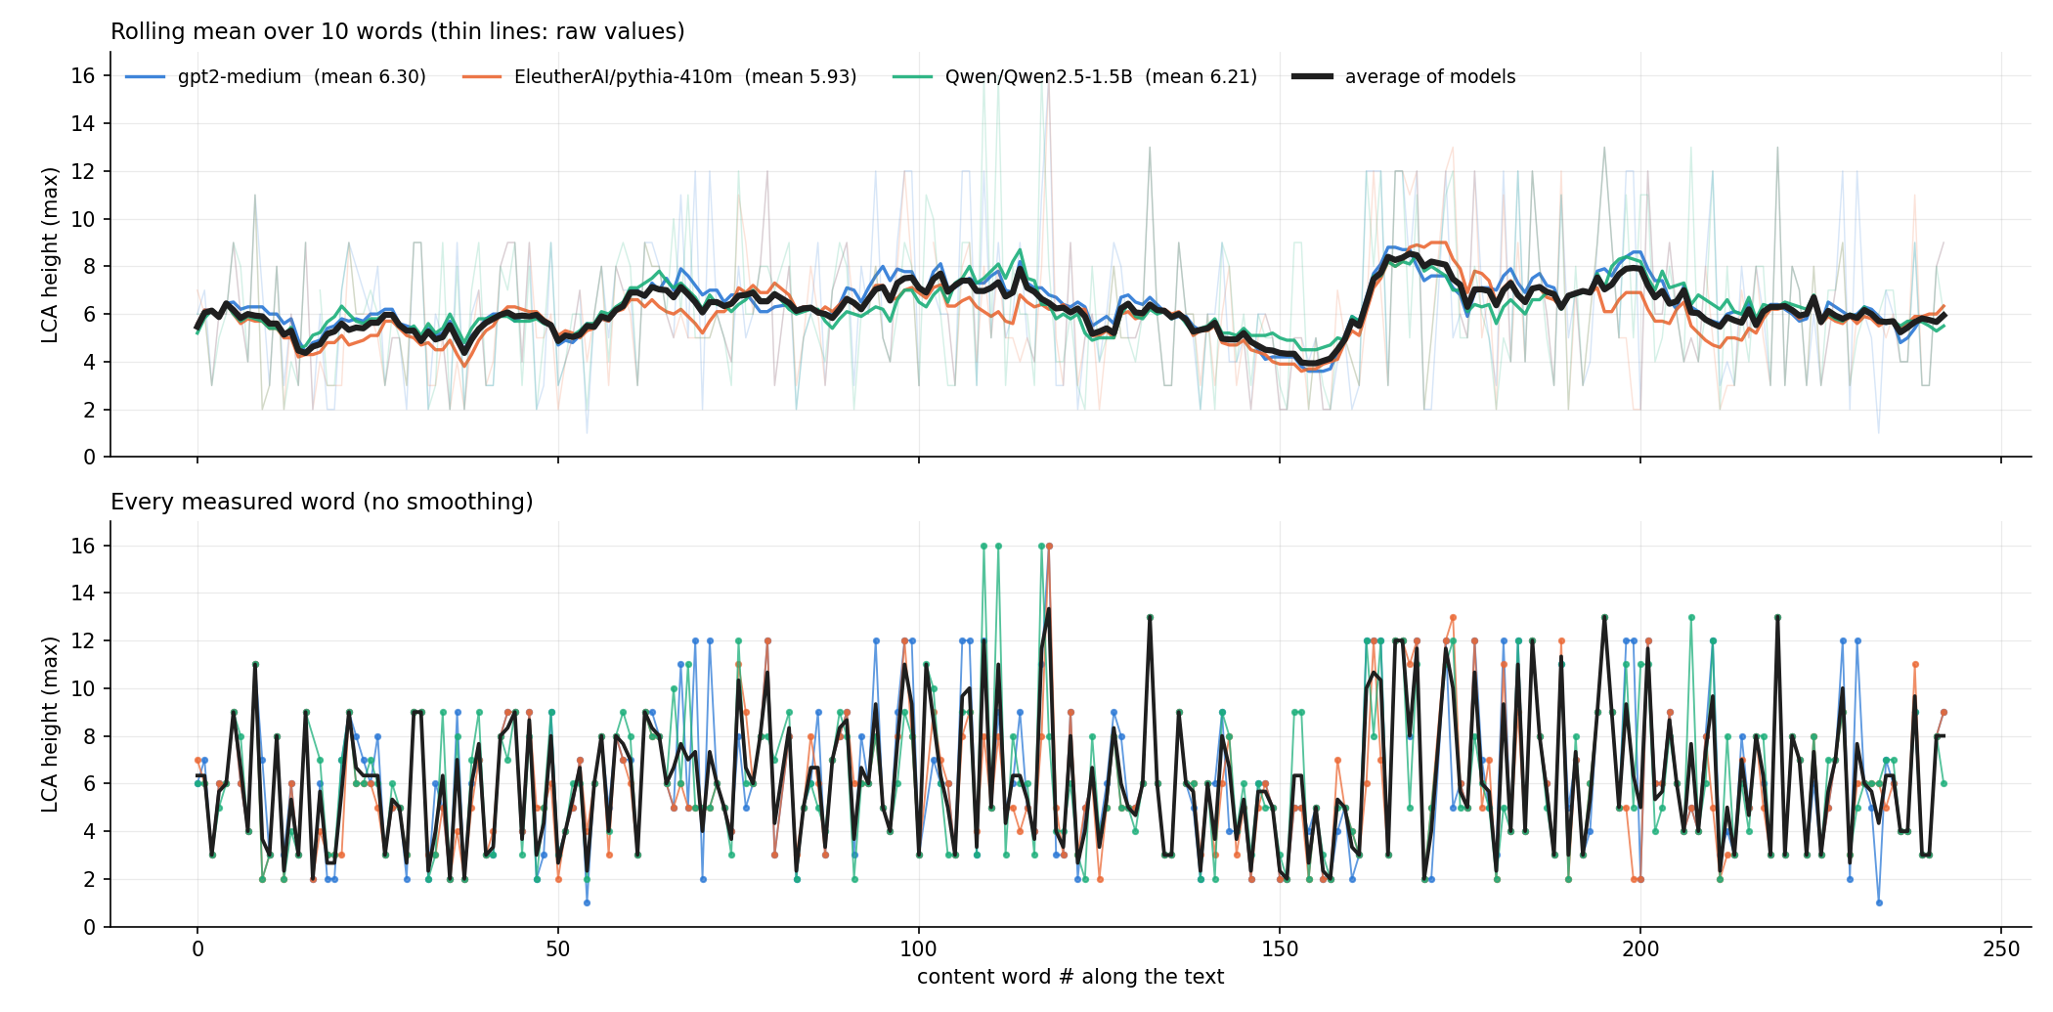
Wikipedia — Vaccine
FACTUAL
Average of the 3 models: mean LCA 6.15 · variance 7.53 · mean |jump| 3.24 · 241 measured words · 33% verbs
Notes:
gpt2-medium: mean 6.30, var 10.04, mean |jump| 3.69, noun mean 7.77, n=240
EleutherAI/pythia-410m: mean 5.93, var 7.88, mean |jump| 3.06, noun mean 7.18, n=240
Qwen/Qwen2.5-1.5B: mean 6.21, var 9.10, mean |jump| 3.57, noun mean 7.63, n=240

Slide 7
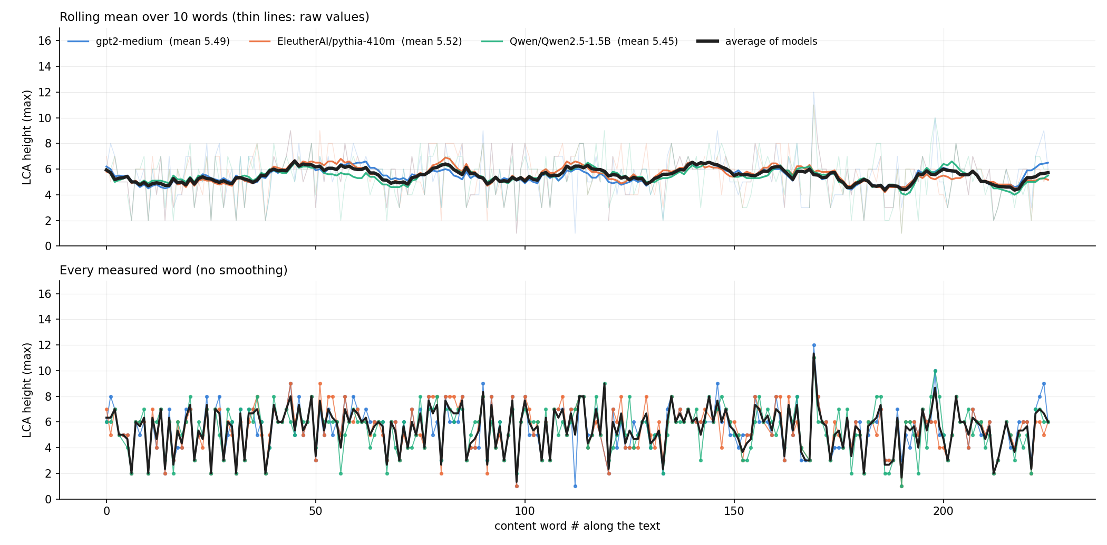
Wikipedia — Volcano
FACTUAL
Average of the 3 models: mean LCA 5.50 · variance 2.74 · mean |jump| 1.93 · 225 measured words · 25% verbs
Notes:
gpt2-medium: mean 5.49, var 3.24, mean |jump| 2.08, noun mean 6.19, n=223
EleutherAI/pythia-410m: mean 5.52, var 3.14, mean |jump| 2.00, noun mean 6.25, n=221
Qwen/Qwen2.5-1.5B: mean 5.45, var 3.17, mean |jump| 2.04, noun mean 6.21, n=223

Slide 8
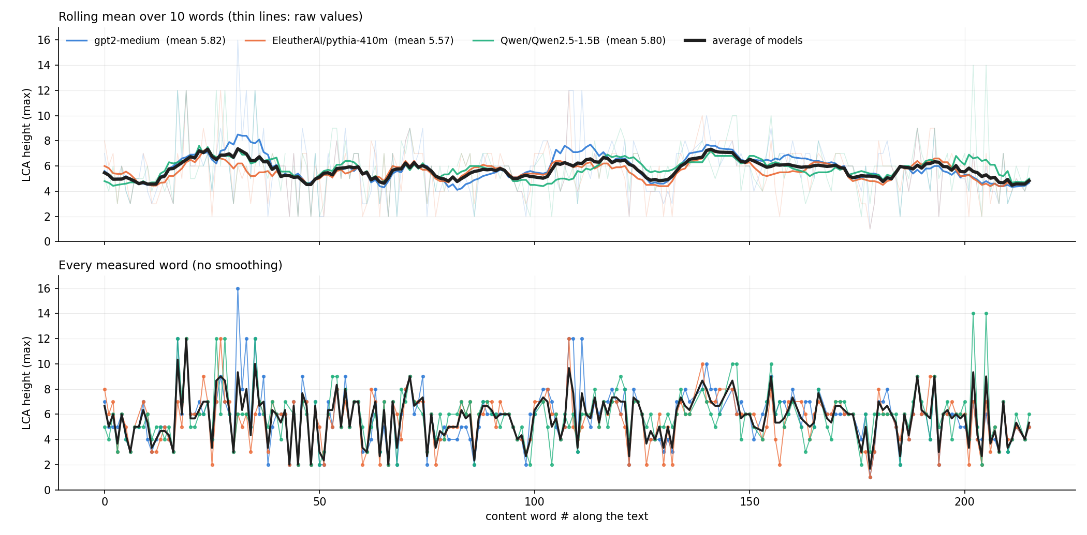
Wikipedia — Wordnet
FACTUAL
Average of the 3 models: mean LCA 5.72 · variance 3.28 · mean |jump| 1.90 · 206 measured words · 23% verbs
Notes:
gpt2-medium: mean 5.82, var 5.19, mean |jump| 2.20, noun mean 6.53, n=205
EleutherAI/pythia-410m: mean 5.57, var 3.80, mean |jump| 1.99, noun mean 6.20, n=205
Qwen/Qwen2.5-1.5B: mean 5.80, var 4.43, mean |jump| 2.25, noun mean 6.38, n=203

Slide 9
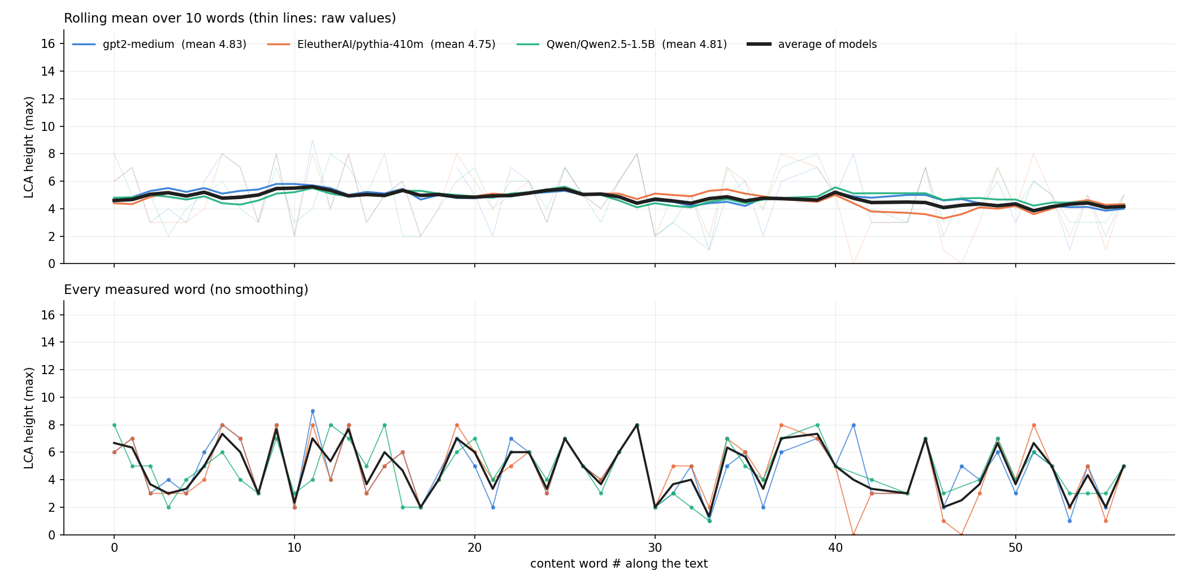
Harry Potter — Book 1 opening
CREATIVE
Average of the 3 models: mean LCA 4.77 · variance 3.36 · mean |jump| 2.33 · 55 measured words · 36% verbs
Notes:
gpt2-medium: mean 4.83, var 4.37, mean |jump| 3.00, noun mean 5.88, n=54
EleutherAI/pythia-410m: mean 4.75, var 5.05, mean |jump| 2.87, noun mean 5.63, n=55
Qwen/Qwen2.5-1.5B: mean 4.81, var 3.62, mean |jump| 2.13, noun mean 5.91, n=53

Slide 10
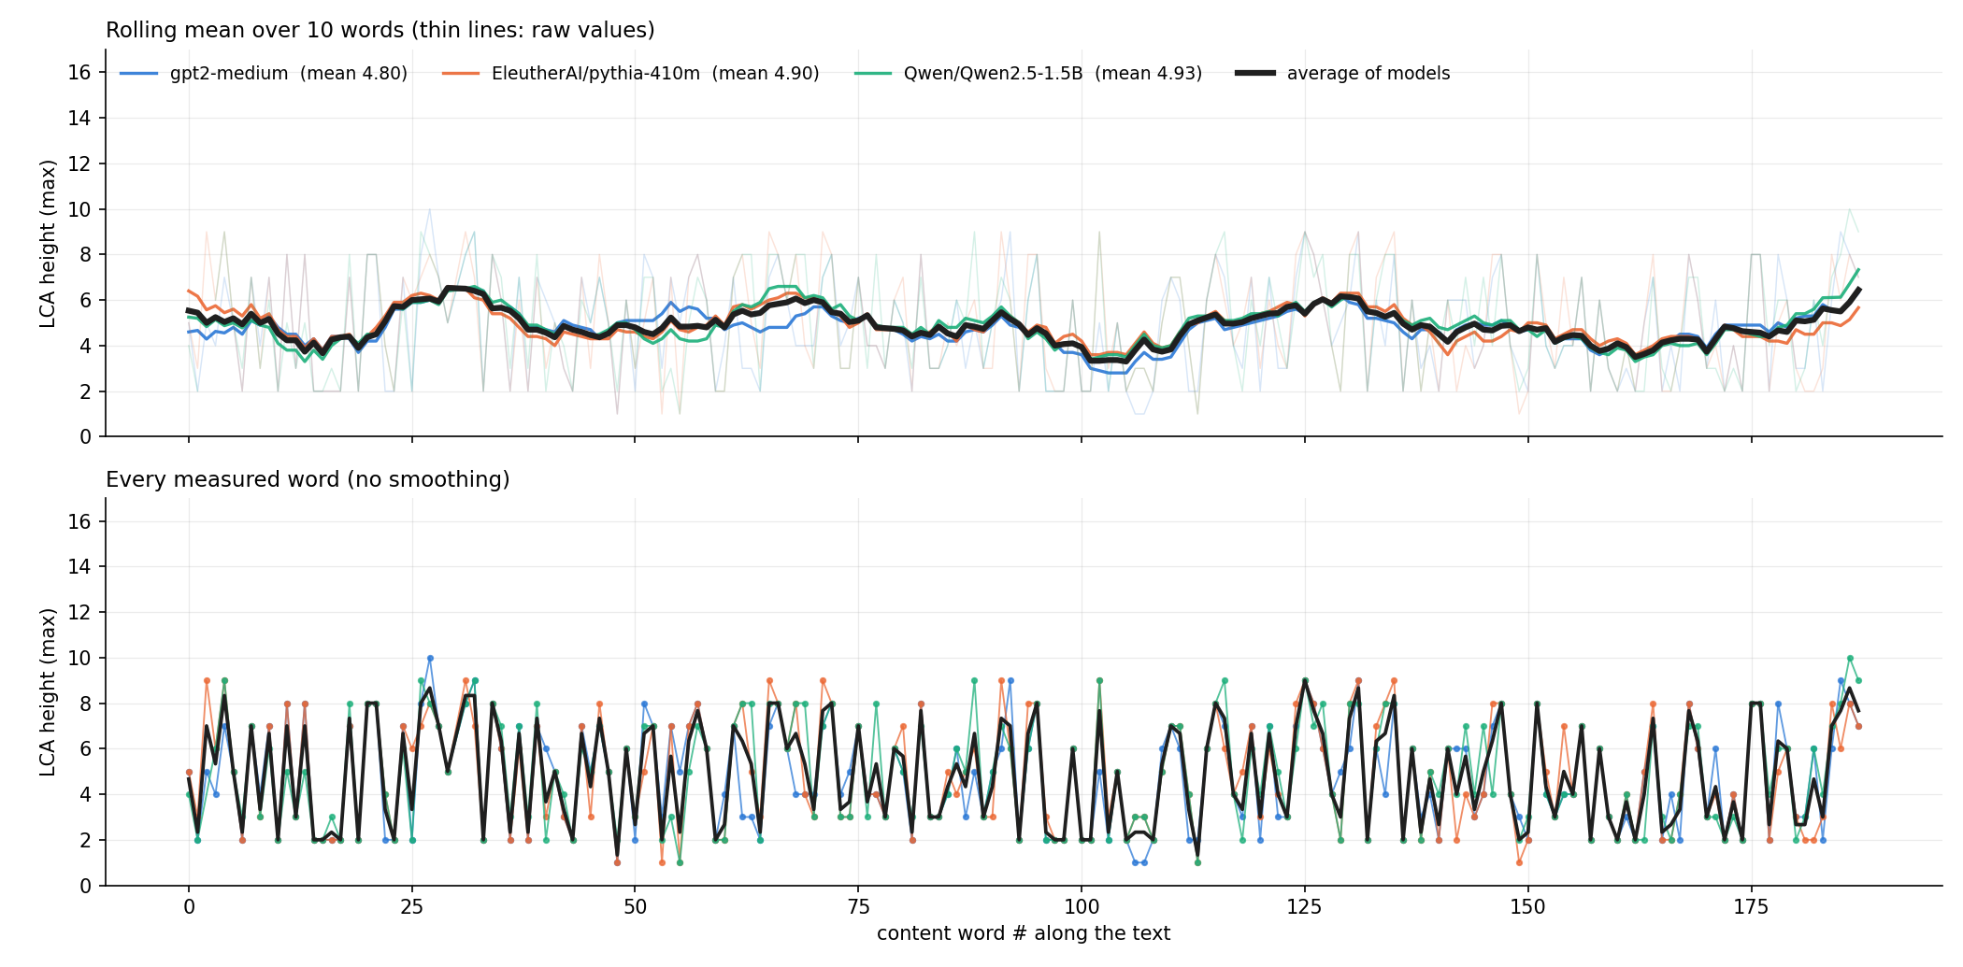
Harry Potter — Book 1 (mid-book excerpt)
CREATIVE
Average of the 3 models: mean LCA 4.88 · variance 4.91 · mean |jump| 2.67 · 187 measured words · 49% verbs
Notes:
gpt2-medium: mean 4.80, var 5.31, mean |jump| 2.75, noun mean 6.56, n=187
EleutherAI/pythia-410m: mean 4.90, var 5.85, mean |jump| 2.92, noun mean 6.85, n=187
Qwen/Qwen2.5-1.5B: mean 4.93, var 5.56, mean |jump| 2.74, noun mean 6.86, n=186

Slide 11
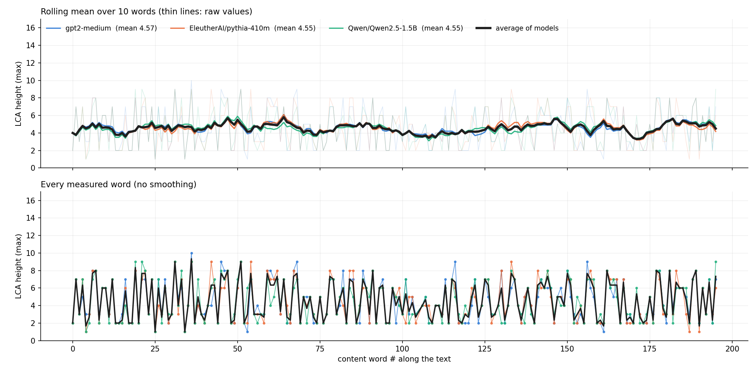
Harry Potter — Book 2 (mid-book excerpt)
CREATIVE
Average of the 3 models: mean LCA 4.56 · variance 4.74 · mean |jump| 2.64 · 195 measured words · 52% verbs
Notes:
gpt2-medium: mean 4.57, var 5.34, mean |jump| 2.77, noun mean 6.55, n=195
EleutherAI/pythia-410m: mean 4.55, var 5.33, mean |jump| 2.73, noun mean 6.48, n=195
Qwen/Qwen2.5-1.5B: mean 4.55, var 5.02, mean |jump| 2.75, noun mean 6.51, n=195

Slide 12
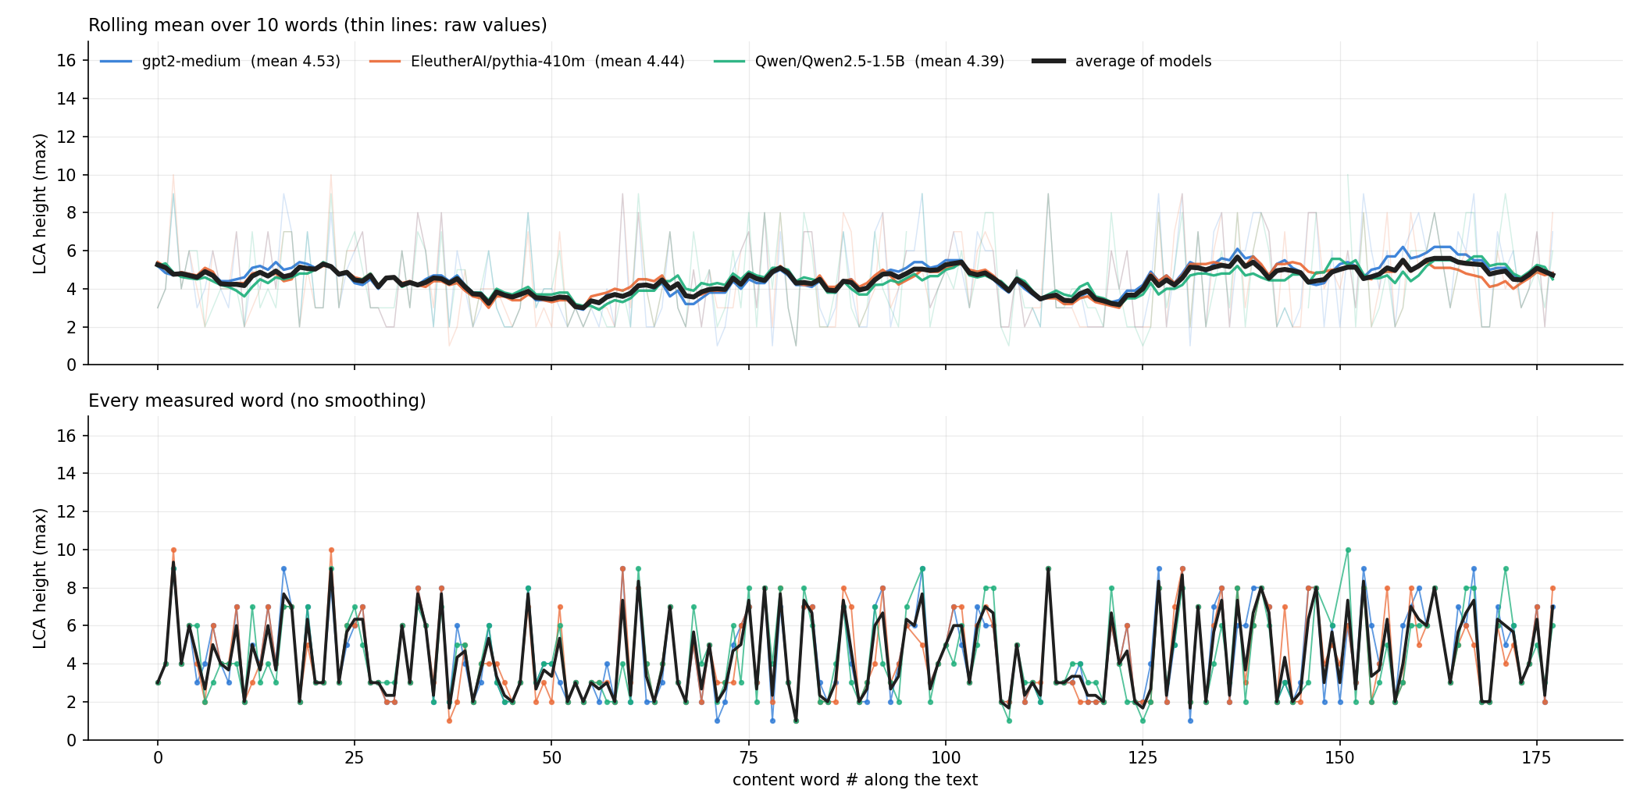
Harry Potter — Book 3 (mid-book excerpt)
CREATIVE
Average of the 3 models: mean LCA 4.45 · variance 4.47 · mean |jump| 2.61 · 177 measured words · 54% verbs
Notes:
gpt2-medium: mean 4.53, var 5.36, mean |jump| 2.82, noun mean 6.56, n=177
EleutherAI/pythia-410m: mean 4.44, var 5.09, mean |jump| 2.73, noun mean 6.44, n=176
Qwen/Qwen2.5-1.5B: mean 4.39, var 5.00, mean |jump| 2.67, noun mean 6.20, n=173

Slide 13
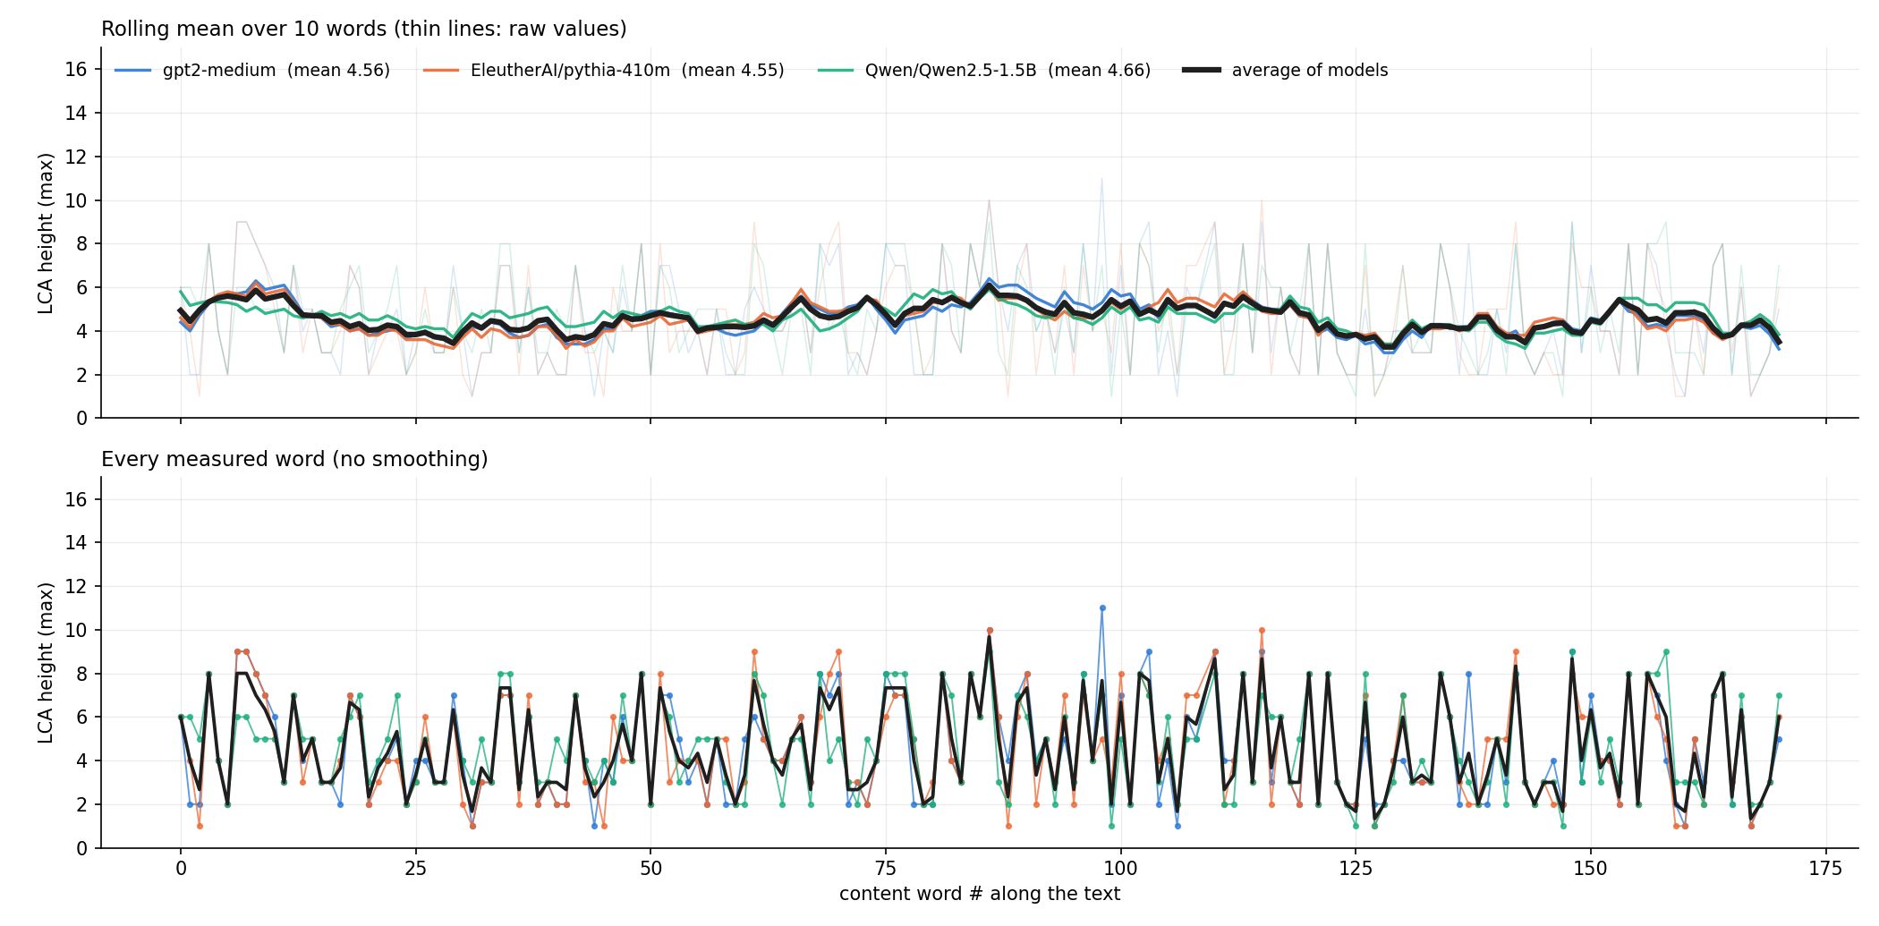
Harry Potter — Book 4 (mid-book excerpt)
CREATIVE
Average of the 3 models: mean LCA 4.59 · variance 4.60 · mean |jump| 2.60 · 170 measured words · 55% verbs
Notes:
gpt2-medium: mean 4.56, var 5.57, mean |jump| 2.76, noun mean 6.47, n=170
EleutherAI/pythia-410m: mean 4.55, var 5.54, mean |jump| 2.75, noun mean 6.45, n=170
Qwen/Qwen2.5-1.5B: mean 4.66, var 4.75, mean |jump| 2.61, noun mean 6.40, n=170

Slide 14
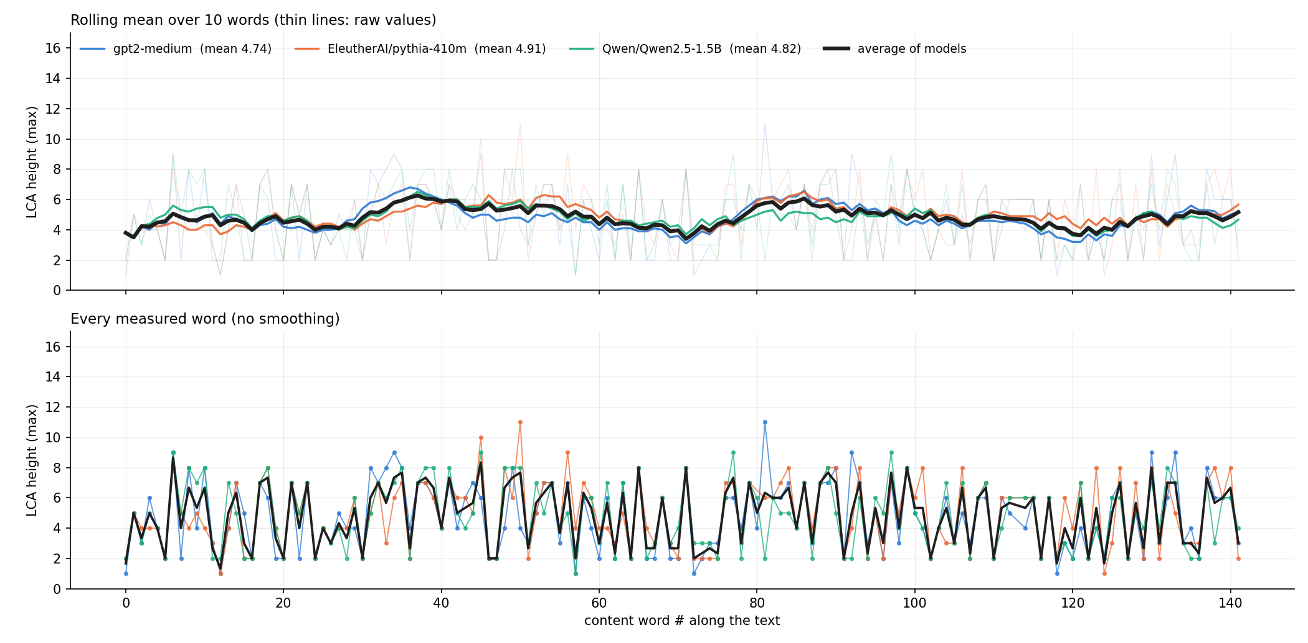
Harry Potter — Book 5 (mid-book excerpt)
CREATIVE
Average of the 3 models: mean LCA 4.83 · variance 4.15 · mean |jump| 2.64 · 141 measured words · 46% verbs
Notes:
gpt2-medium: mean 4.74, var 5.28, mean |jump| 2.93, noun mean 6.34, n=141
EleutherAI/pythia-410m: mean 4.91, var 5.17, mean |jump| 2.83, noun mean 6.47, n=140
Qwen/Qwen2.5-1.5B: mean 4.82, var 4.95, mean |jump| 2.81, noun mean 6.38, n=141

Slide 15
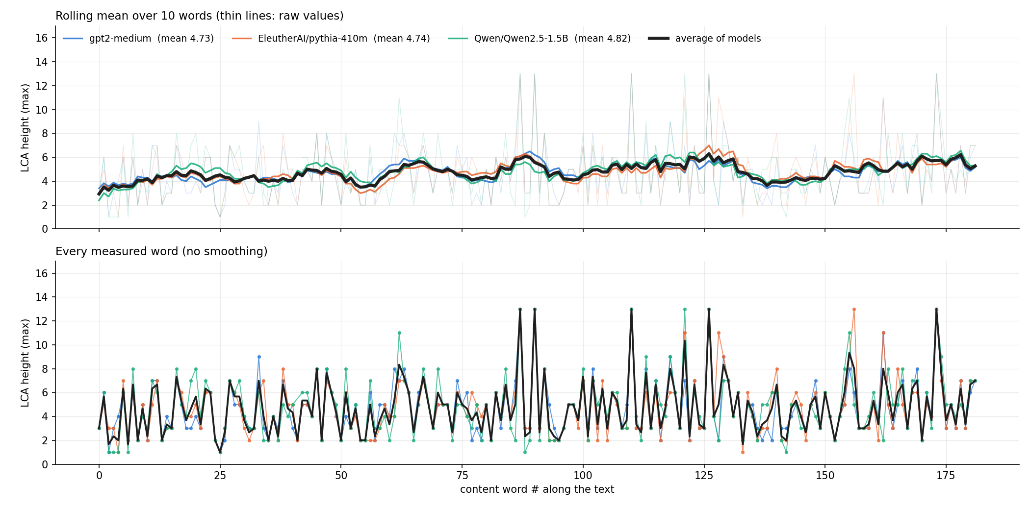
Harry Potter — Book 6 (mid-book excerpt)
CREATIVE
Average of the 3 models: mean LCA 4.76 · variance 5.45 · mean |jump| 2.77 · 181 measured words · 54% verbs
Notes:
gpt2-medium: mean 4.73, var 5.72, mean |jump| 2.84, noun mean 6.43, n=181
EleutherAI/pythia-410m: mean 4.74, var 6.40, mean |jump| 2.87, noun mean 6.46, n=181
Qwen/Qwen2.5-1.5B: mean 4.82, var 6.83, mean |jump| 2.99, noun mean 6.87, n=180

Slide 16
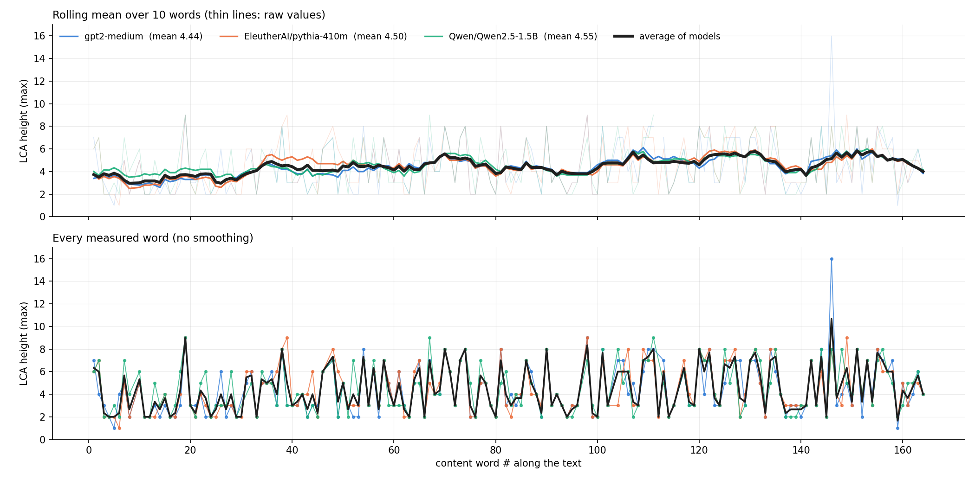
Harry Potter — Book 7 (mid-book excerpt)
CREATIVE
Average of the 3 models: mean LCA 4.48 · variance 4.06 · mean |jump| 2.31 · 159 measured words · 55% verbs
Notes:
gpt2-medium: mean 4.44, var 5.31, mean |jump| 2.58, noun mean 6.21, n=157
EleutherAI/pythia-410m: mean 4.50, var 4.66, mean |jump| 2.32, noun mean 6.15, n=159
Qwen/Qwen2.5-1.5B: mean 4.55, var 4.43, mean |jump| 2.50, noun mean 6.21, n=156

Slide 17
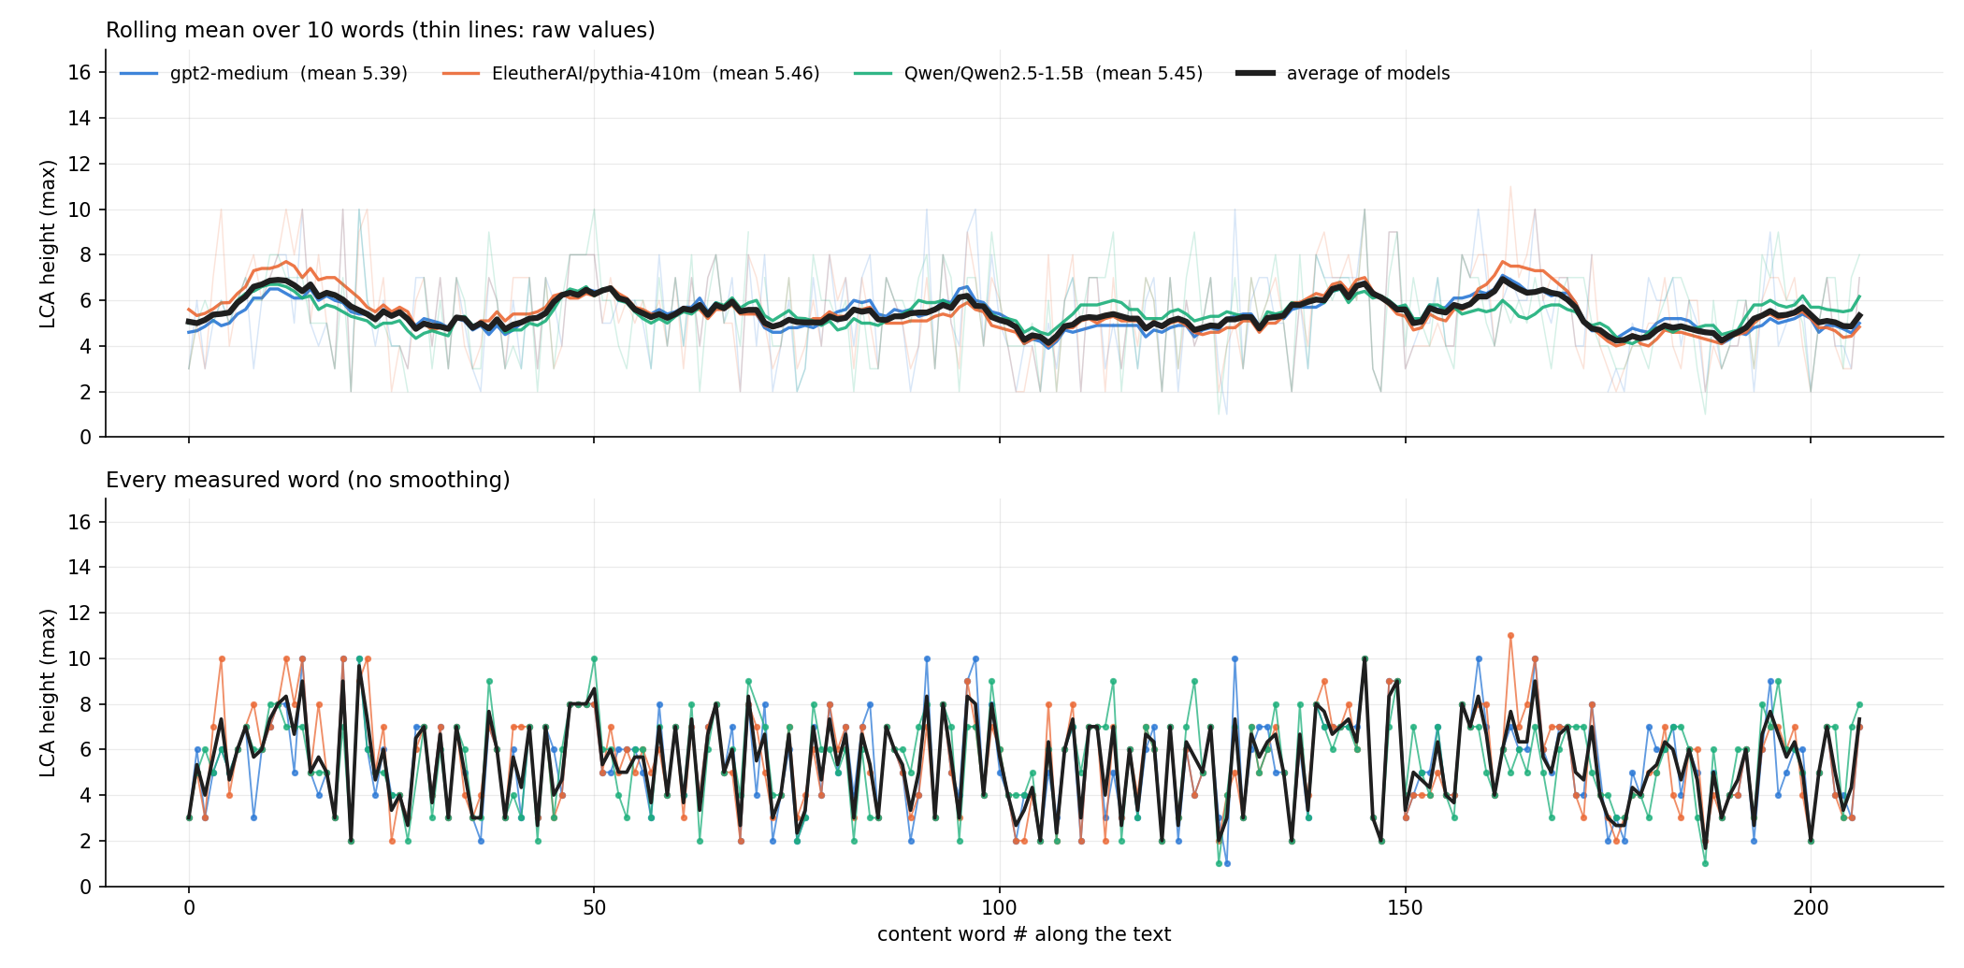
Jokes For All Occasions — excerpt 1
CREATIVE
Average of the 3 models: mean LCA 5.43 · variance 3.56 · mean |jump| 2.26 · 207 measured words · 33% verbs
Notes:
gpt2-medium: mean 5.39, var 4.47, mean |jump| 2.58, noun mean 6.34, n=206
EleutherAI/pythia-410m: mean 5.46, var 4.56, mean |jump| 2.41, noun mean 6.37, n=207
Qwen/Qwen2.5-1.5B: mean 5.45, var 3.97, mean |jump| 2.31, noun mean 6.33, n=205

Slide 18
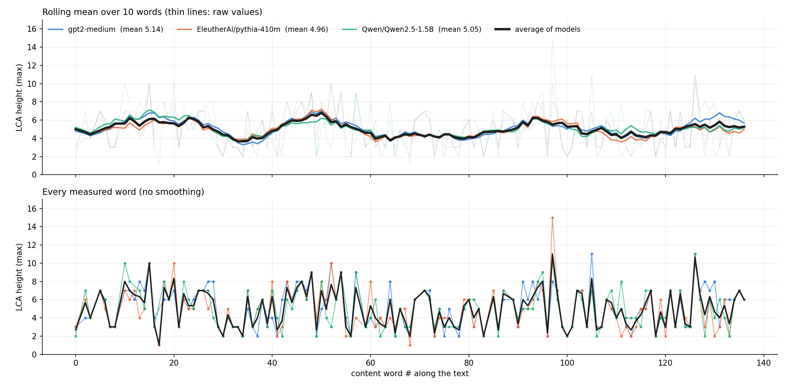
Jokes For All Occasions — excerpt 2
CREATIVE
Average of the 3 models: mean LCA 5.03 · variance 4.25 · mean |jump| 2.36 · 130 measured words · 38% verbs
Notes:
gpt2-medium: mean 5.14, var 4.95, mean |jump| 2.35, noun mean 6.33, n=129
EleutherAI/pythia-410m: mean 4.96, var 5.49, mean |jump| 2.69, noun mean 6.04, n=130
Qwen/Qwen2.5-1.5B: mean 5.05, var 4.82, mean |jump| 2.62, noun mean 6.23, n=127

