Slide 1
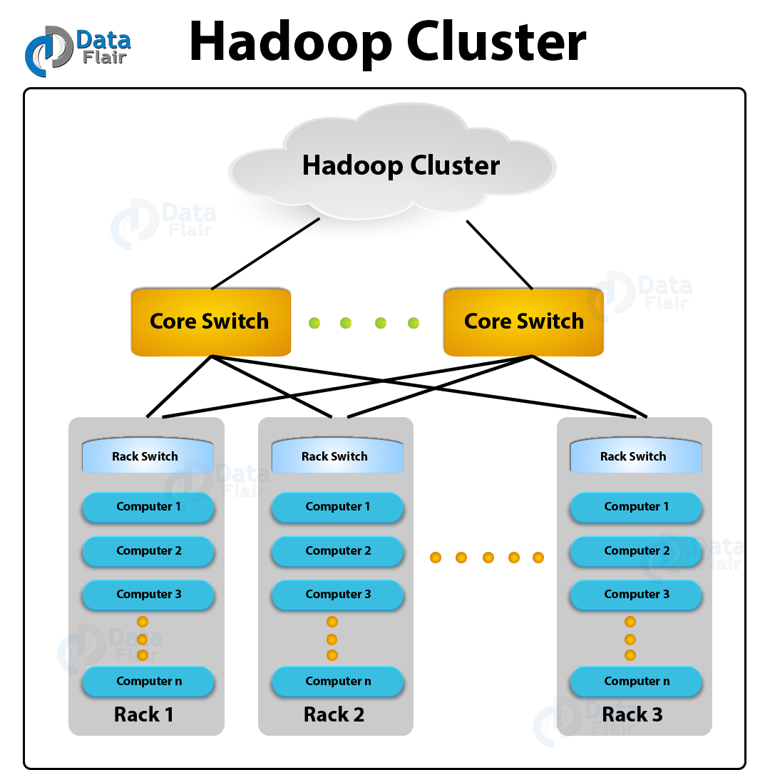

What is Apache HBase?
Column-oriented database
By Daniel Giordanno Magaña Cruz

Slide 2
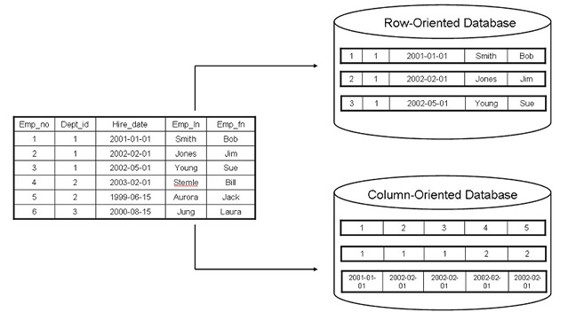
What is Apache HBase?

Slide 3


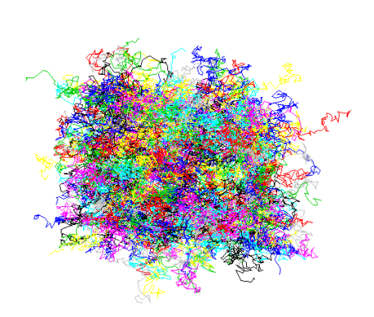
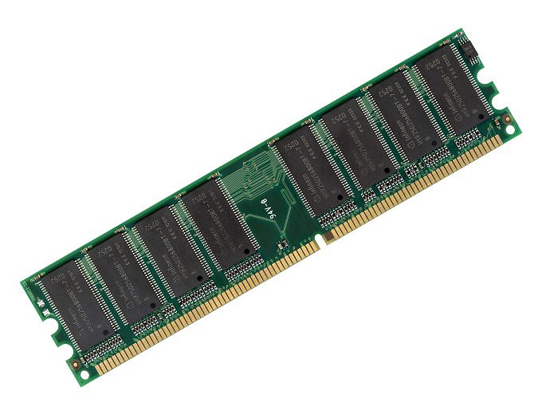
ADVANTAGES AND DISADVANTAGES

Slide 4

APPLICATIONS

Slide 5

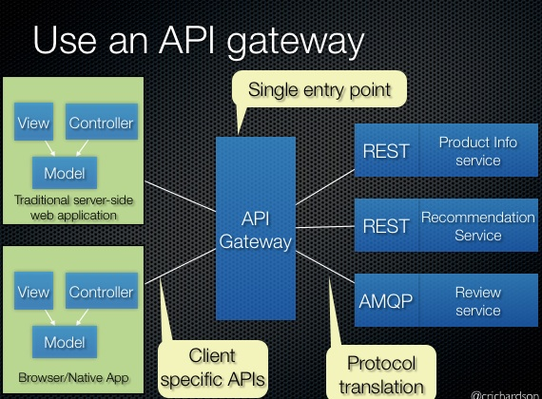
WHICH OPERATING SYSTEM IS SUPPORTED BY HBASE?
HOW CAN CLIENTS GET ACCESS TO HBASE?
WHAT ARE THE OPERATIONAL COMMANDS OF HBASE?
GET
DELATE
PUT INCREMENT SCAN

