Slide 1
TEMPORAL STRUCTURES: TIMELINES AND FLOWS

Slide 2
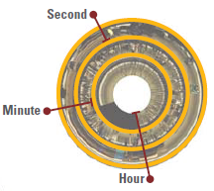
Time is an abstract concept and, thus, not inherently visual.
Time is related with movement & us

Slide 3
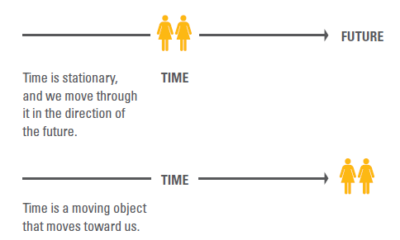

Slide 4
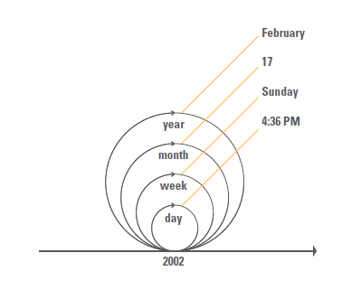
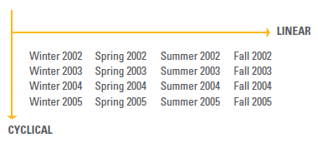

Slide 5
MEASURING TIME
Time was measured against the visible motion of the stars and the Sun
Movements that only exist in relation to our point of view
Consciousness or ‘inner durée.
Metric time
Gregorian
Hebrew
Islamic
Indian
Chinese
Julian

Slide 6
STRUCTURING MODELS
Linear:
History is an irreversible sequence of unrepeatable events
Tell a story of linked events moving in a direction
Cyclical:
Not related events
Motions are parts of repeating cycles
Time has no direction

Slide 7
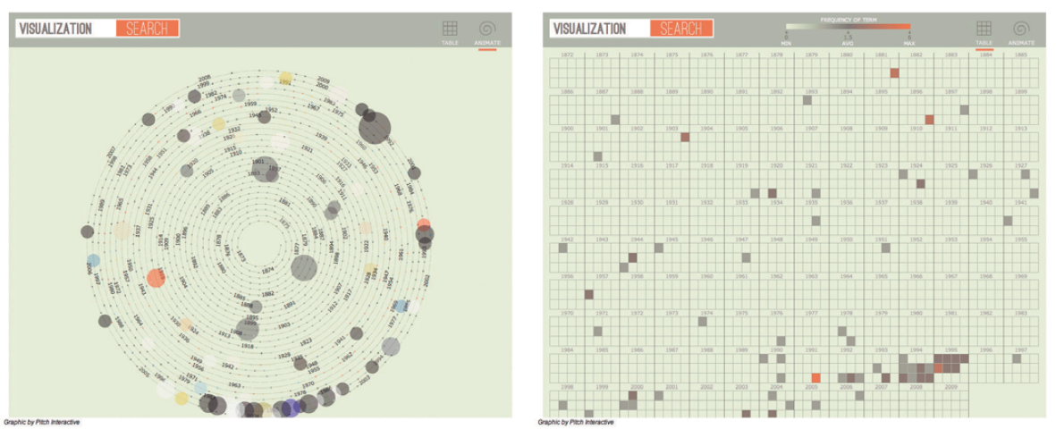
STRUCTURING MODELS
Predominance of the linear model
Cyclical model used in visualizations mostly portraying periodic patterns in the data

Slide 8
REPRESENTATIONS OF HISTORICAL TIME
Timelines were not invented until the eighteenth century
Lists and tables
Lists: each line stands for an event independent of the temporal interval between them
Timelines: space communicates temporal distance
Timelines might reveal meaningful patterns

Slide 9
VERTICAL VERSUS HORIZONTAL AXES
Vertical axis
defined by gravity and by all the things on earth correlated with gravity.
Horizontal axis
All the things on earth parallel to it
The vertical orientation has precedence over the horizontal
The horizontal preference for depicting time

Slide 10
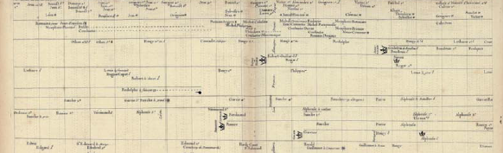
THE BEGINNING OF UNIFORM TIMELINES
In 1753, Jacques Barbeu-Dubourg (1709–1779), created a 5.4-foot chart (1.6 m) depicting history from the Creation to his time.
The chart is considered the first to have depicted a uniform timescale by dividing space arithmetically.

Slide 11
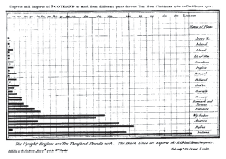
EARLY TEMPORAL STRUCTURES IN OTHER DISCIPLINES
William Playfair. 1786. Created a graphical representation for Exports and Imports of Scotland in which time was not one of the dimensions, and resulted in the first known bar chart

Slide 12
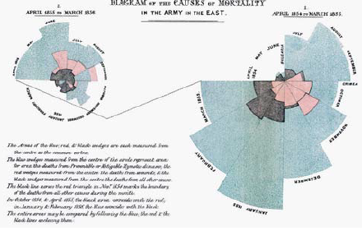
EARLY TEMPORAL STRUCTURES IN OTHER DISCIPLINES
Florence Nightingale.
1858
Diagram of the Causes of Mortality in the Army in the East
It is a polar graph, not a pie chart
The radius of each wedge depicts the number of deaths for each month.
Color stands for the types of death causes: preventable diseases (blue) war wounds(red) and fatalities(black)

Slide 13
GRAPHICAL CONVENTIONS
Timescale
is uniform and represented arithmetically following Newton’s notion of absolute time.
Time indicators
Dates are inscribed at the top and at the bottom, and connected by lines to facilitate perception of the temporal divisions
Thematic sections
Horizontal thematic sections are separated by lines.

Slide 14
GRAPHICAL CONVENTIONS
Line indicators
are used to depict duration
Line differentiators
Levels of uncertainty in the data are graphically depicted by the quality of lines (solid or broken lines), and with the addition of dots.
Color code

Slide 15
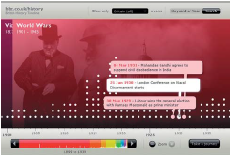
TIMELINES IN THE DIGITAL ENVIRONMENT
Digital timelines enable navigation through time by means of sliding back and forth along the linear structure
Interactivity, such as the ability to filter data according to specified thresholds, to delve into content, and to zoom in and out of time, as mentioned earlier.

Slide 16
Magical Number Seven
Our limited capacity for receiving, processing, and remembering information
Areas
Our span of absolute judgment can distinguish about seven categories.
Our span of attention encompasses six objects at a glance.
Our span of working memory is about seven items in length.

Slide 17
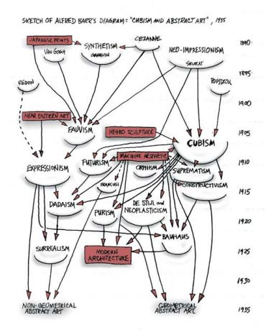
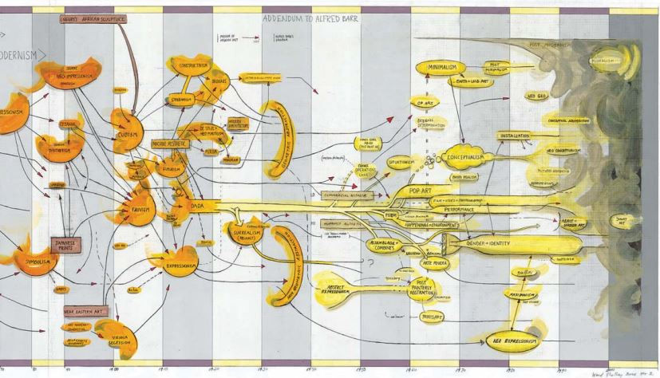
Case of study: Representing events over time

Slide 18
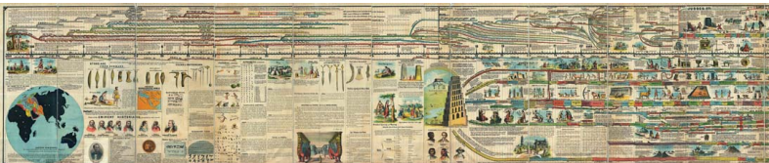
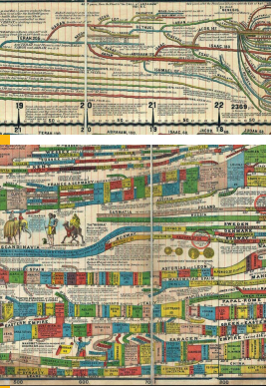
Case of study: Representing events over time

Slide 19
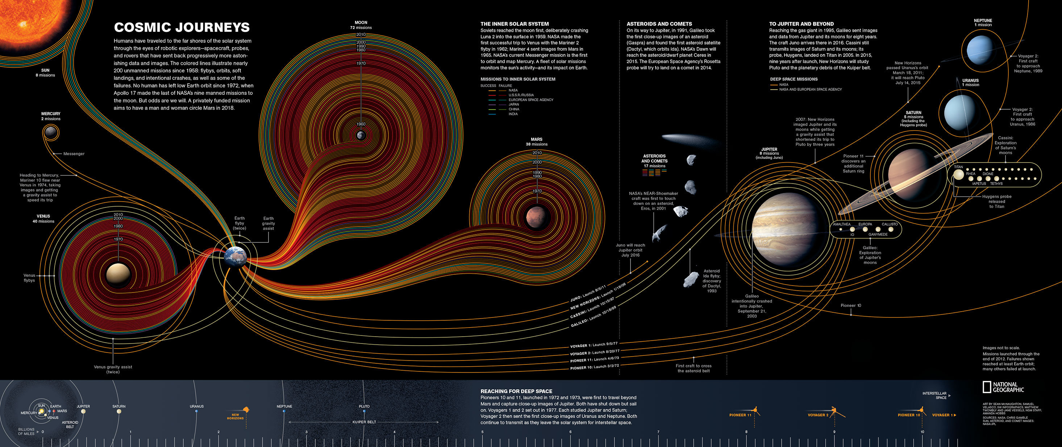
Case of study: Representing events over time

Slide 20
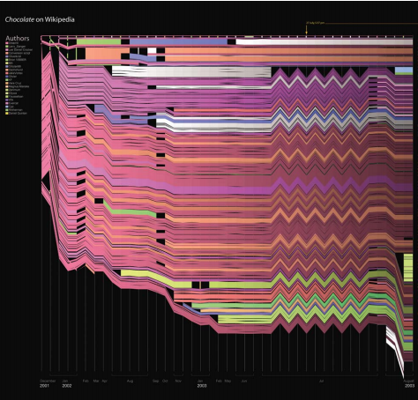
Case of study: Representing amount over time

