Slide 1
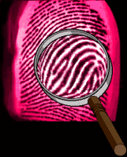
Fingerprint Recognition
Fingerprint recognition is one of the oldest and most
researched fields of biometrics.
Some biological principles (Moenssens 1971) related
to fingerprint recognition are as follows:
Individual epidermal ridges and furrows have different characteristics for different fingerprints.
This forms the foundation of fingerprint recognition
The configuration types are individually variable; but they vary within limits that allow for a systematic classification.
Herein lies the basis for fingerprint classification.
The configuration and minute details of furrows are permanent and unchanging.

Slide 2
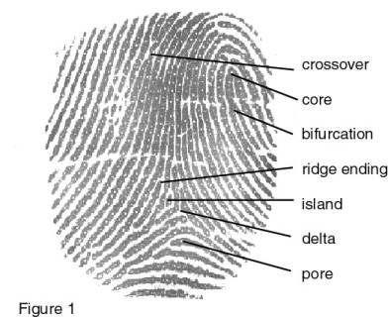
Fingerprint Formation
Fingerprints are fully formed at about seven months of fetus development and finger ridge configurations do not change throughout the life of an individual except due to accidents such as bruises and cuts on the fingertips (Babler, 1991).
Unrelated persons of the same race have very little generic similarity in their fingerprints.
Parent and child have some generic similarity as they share half the genes.
Siblings have more similarity.
The maximum generic similarity is observed in monozygotic (identical) twins.

Slide 3
Applications
Banking Security - ATM security,card transaction
Physical Access Control (e.g. Airport)
Information System Security
National ID Systems
Passport control (INSPASS)
Prisoner, prison visitors, inmate control
Voting
Identification of Criminals
Identification of missing children
Secure E-Commerce (Still under research)

Slide 4
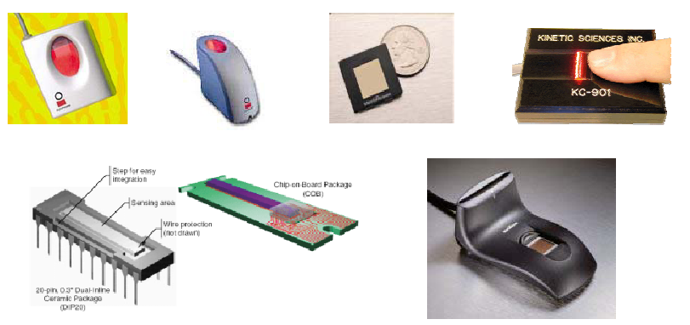
Fingerprint Sensors

Slide 5
Fingerprint Sensors
Optical
Silicon Based Capacitive Sensors
Ultrasound
Thermal

Slide 6
Optical Sensors
Oldest and most widely used technology.
Majority of companies use optical technology.
The finger is placed on a coated hard plastic plate.
In most devices, a charged coupled device (CCD) converts the image of the fingerprint, with dark ridges and light valleys, into a digital signal.
The brightness is either adjusted automatically or manually, leading to a usable image.

Slide 7
Optical Sensors-contd..
Advantages
They are the most proven over time.
They can withstand, to some degree, temperature fluctuations.
They are fairly inexpensive.
They can provide resolutions up to 500 dpi.
Disadvantages
Size, the sensing plate must be of sufficient size to achieve a quality image
Residual prints from previous users can cause image degradation, as severe latent prints can cause two sets of prints to be superimposed.
The coating and CCD arrays can wear with age, reducing accuracy.
A large number of vendors of fingerprint sensing equipment are gradually shifting towards silicon-based technology.

Slide 8
Silicon Based Sensors
Silicon technology has gained considerable acceptance since its introduction in the late 90's.
Most silicon, or chip, technology is based on DC Capacitance, but some also use AC Capacitance.
The silicon sensor acts as one plate of a capacitor, and the finger is the other.
The capacitance between the sensing plate and the finger is converted into an 8-bit grayscale digital image.

Slide 9
Silicon Based Sensors-contd..
Fingerprint cards contain numerous capacitive plates which measure the capacitance between the plates and the fingertip.
When the finger is placed on the sensor extremely weak electrical charges are created, building a pattern between the finger's ridges or valleys and the sensor's plates.
Using these charges the sensor measures the capacitance pattern across the surface.
The measured values are digitized by the sensor then sent to the neighboring microprocessor.
This can be done directly by applying an electrical charge to the plate or by using electronic pulses passed to the fingertip.

Slide 10
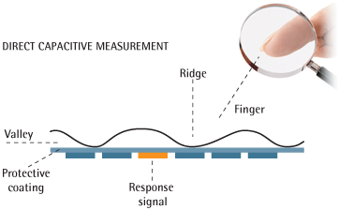
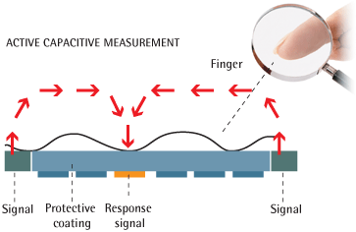
Direct v/s Active Capacitive Measurement

Slide 11
Silicon Based Sensors-contd..
Advantages
The Silicon chip comprises of about 200*200 lines on a wafer the size of 1cm*1.5cm, thus providing a pretty good resolution for the image.
Hence, Silicon generally produces better image quality, with less surface area, than optical.
Also, the reduced size of the chip means lower costs especially with the dropping costs in Silicon chip manufacturing.
Miniaturization of Silicon chips also makes it possible for the chips to be integrated into numerous devices.
Disadvantages
In spite of claims by manufacturers that Silicon is much more durable than optical, Silicon's durability, especially in sub-optimal conditions, has yet to be proven.
Also, with the reduction in sensor size, it is even more important to ensure that enrolment and verification are done carefully.

Slide 12
Ultrasound Sensors
Ultrasound technology is perhaps the most accurate of the fingerprint technologies.
It uses transmitted ultrasound waves and measures the distance based on the impedance of the finger, the plate, and air.
Preliminary usage of products indicates that this is a technology with significant promise.

Slide 13
Ultrasound Sensors-contd..
Advantages
Ultrasound is capable of penetrating dirt and residue on the sensing plate and the finger.
This overcomes the drawbacks of optical devices which can't make that distinction.
It combines a strength of optical technology-large platen size and ease of use, with a strength of silicon technology-the ability to overcome sub-optimal reading conditions.
It is also virtually impossible to deceive an ultrasound system.
Disadvantages
The quality of the image depends to a great extent on the contact between the finger and the sensor plate which could also be quite hot.

Slide 14
Thermal Sensors
Uses Pyro Electric material.
Pyro-electric material is able to convert a difference in temperature into a specific voltage.
This effect is quite large, and is used in infrared cameras.
A thermal fingerprint sensor based on this material measures the temperature differential between the sensor pixels that are in contact with the ridges and those under the valleys, that are not in contact.

Slide 15
Thermal Sensors-contd..
Advantages
A strong immunity to electrostatic discharge
Thermal imaging functions as well in extreme temperature conditions as at room temperature.
It is almost impossible to deceive with artificial fingertips.
Disadvantages
A disadvantage of the thermal technique is that the image disappears quickly.
When a finger is placed on the sensor, initially there is a big difference in temperature, and therefore a signal, but after a short period (less than a tenth of a second), the image vanishes because the finger and the pixel array have reached thermal equilibrium.
However, this can be avoided by using a scanning method where the finger is scanned across the sensor which is the same width as the image to be obtained , but only a few pixels high.

Slide 16
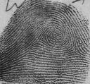
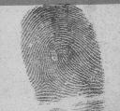
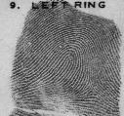
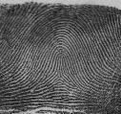
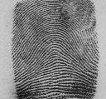
Fingerprint Classification
Whorl
Right Loop
Left Loop
Tented Arch
Arch
Classification of Fingerprints
Large volumes of fingerprints are being collected in everyday applications-for e.g.. The FBI database has 70 million of them.
To reduce the search time and computational complexity classification is necessary.
This allows matching of fingerprints to only a subset of those in the database.
An input fingerprint is first matched at a coarse level to one of the pre-specified types and then, at a finer level, it is compared to the subset of the database containing that type of fingerprints only.
Numerous algorithms have been developed in this direction.

Slide 17








Line Types Classification
Bifurcation: It is the intersection of two or more line-types which converge or diverge.
Arch: They are found in most patterns, fingerprints made up primarily of them are called “Arch Prints”.
Loop: A recursive line-type that enters and leaves from the same side of the fingerprint.
Island: A line-type that stands alone.( i.e. does not touch another line-type)
Ellipse: A circular or oval shaped line-type which is generally found in the center of the fingerprint, it is generally found in the Whorl print pattern.
Tented Arch: It quickly rises and falls at a steep angle. They are associated with “Tented Arch Prints”.
Spiral: They spiral out from the center and are generally associated with “Whorl Prints”.
Rod: It generally forms a straight line. It has little or no recurve feature. They are gennerally found in the center.
Sweat Gland: The moisture and oils they produce actually allow the fingerprint to be electronically imaged.

Slide 18
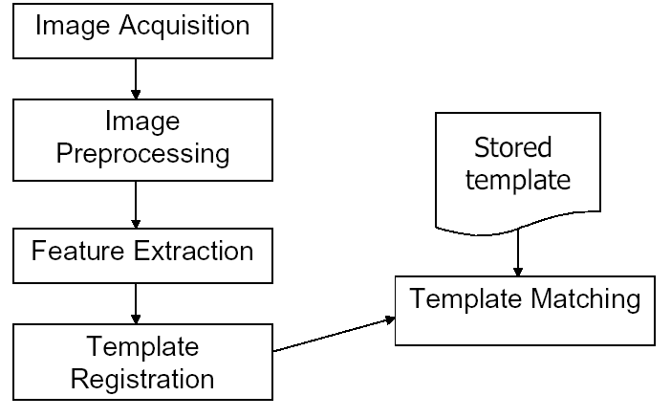
Automatic Verification System

Slide 19
Feature Extraction
The human fingerprint is comprised of various types of ridge patterns.
Traditionally classified according to the decades-old Henry system: left loop, right loop, arch, whorl, and tented arch.
Loops make up nearly 2/3 of all fingerprints, whorls are nearly 1/3, and perhaps 5-10% are arches.
These classifications are relevant in many large-scale forensic applications, but are rarely used in biometric authentication.
Notes:
Why are the classes not frequently used in biometric authentication?
What is used for biometric classification?

Slide 20
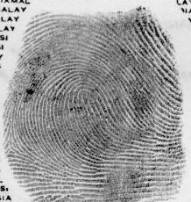
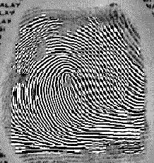
Feature Enhancement
Original
Enhanced
The first step is to obtain a clear image of the fingerprint.
Enhancement is carried out so as to improve the clarity of ridge and furrow structures of input fingerprint images based on the estimated local ridge orientation and frequency.
For grayscale images, areas lighter than a particular threshold are discarded, and those darker are made black.
The ridges are then thinned from 5-8 pixels in width down to one pixel, for precise location of endings and bifurcations.

Slide 21
Feature Extraction-contd..
Minutiae localization is the next step.
Even a very precise image has distortions and false minutiae that need to be filtered out. (e.g. search and eliminate one of two adjacent minutiae)
Anomalies caused by scars, sweat, or dirt appear as false minutiae, and algorithms locate any points or patterns that don't make sense, such as a spur on an island (probably false) or a ridge crossing perpendicular to 2-3 others (probably a scar or dirt).
A large percentage of would-be minutiae are discarded in this process.
The point at which a ridge ends, and the point where a bifurcation begins, are the most rudimentary minutiae. Once the point has been situated, its location is commonly indicated by the distance from the core, with the core serving as the 0,0 on an X,Y-axis. In addition to the placement of the minutia, the angle of the minutia is normally used. When a ridge ends, its direction at the point of termination establishes the angle. This angle is taken from a horizontal line extending rightward from the core, and can be up to 359.
In addition to using the location and angle of minutiae, some classify minutia by type and quality. The advantage of this is that searches can be quicker, as a particularly notable minutia may be distinctive enough to lead to a match. [6]

Slide 22
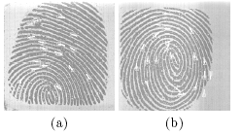
Template Selection
The matching accuracy of a biometrics-based authentication system relies on the stability (permanence) of the biometric data associated with an individual over time.
The biometric data acquired from an individual is susceptible to changes introduced due to improper interaction with the sensor (e.g., partial fingerprints), modifications in sensor characteristics (e.g., optical vs. solid-state fingerprint sensor), variations in environmental factors (e.g.,dry weather resulting in faint fingerprints) and temporary alterations in the biometric trait itself (e.g., cuts/scars on fingerprints).
Thus, it is possible for the stored template data to be significantly different from those obtained during authentication, resulting in an inferior performance (higher false rejects) of the biometric system. [9]
Variation in fingerprint exhibiting partial overlap.

Slide 23
Template Selection-contd..(Solutions to variations)
Multiple templates, that best represent the variability associated with a user's biometric data, should be stored in the database. (E.g. One could store multiple impressions pertaining to different portions of a user's fingerprint in order to deal with the problem of partially overlapping fingerprints.)
There is a tradeoff between the number of templates, and the storage and computational overheads introduced by multiple templates.
For an efficient functioning of a biometric system, this selection of templates should be done automatically.
There are two methods that are discussed in the literature. Please refer to references [9] for further details.

Slide 24
Finger Matching Approaches
Correlation-based matching
  Superimpose images – compare pixels
Minutiae-based matching
  Classical Technique – Most popular
  Compare extracted minutiae

Slide 25
Correlation Results

Slide 26
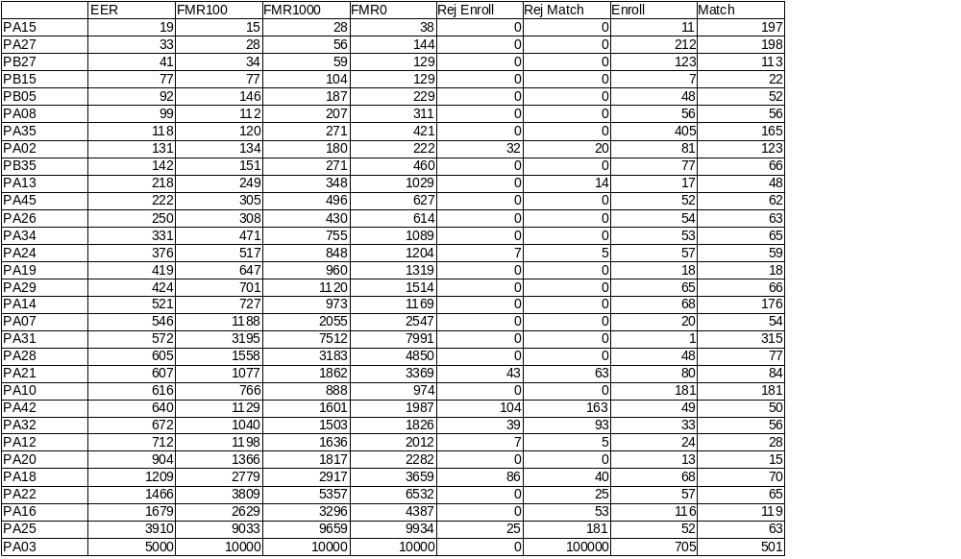
Co-relation

Slide 27
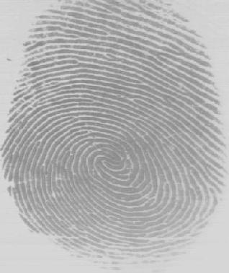
Matching Algorithm
Automatic Minutiae Detection: Minutiae are essentially terminations and bifurcations of the ridge lines that constitute a fingerprint pattern.
Automatic minutiae detection is an extremely critical process, especially in low-quality fingerprints where noise and contrast deficiency can originate pixel configurations similar to minutiae or hide real minutiae.
Algorithm:
The basic idea here is to compare the minutiae on the two images.
The figure alongside is the input given to the system, as can be seen from the figure the various details of this image can be easily detected. Hence, we are in a position to apply the AMD algorithm.

Slide 28
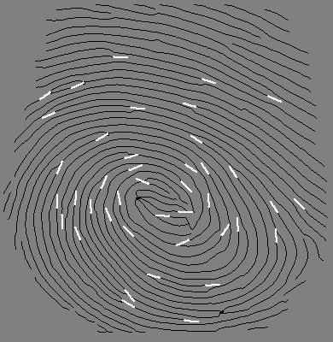
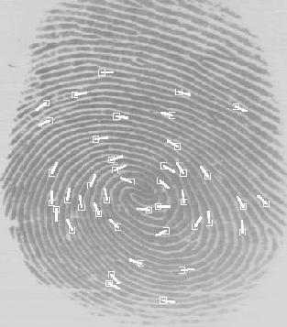
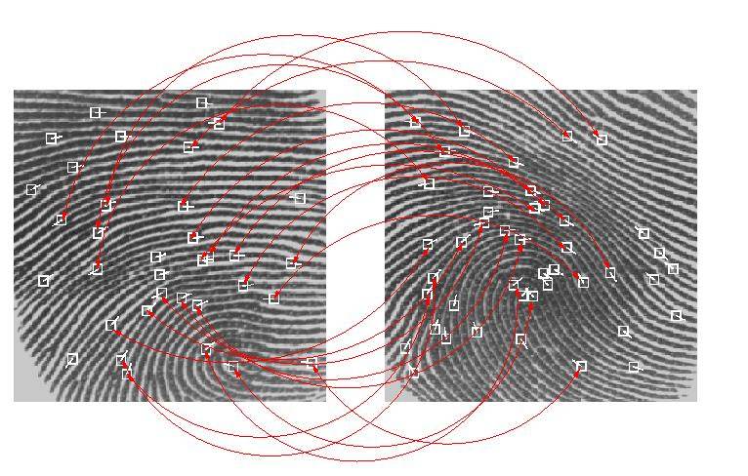
Matching Algorithm-contd..
Algorithm (contd.)
The next step in the algorithm is to mark all the minutiae points on the duplicate image of the input fingerprint with the lines much clear after feature extraction.
Then this image is superimposed onto the input image with marked minutiae points as shown in the figure.
Finally a comparison is made with the images in the database and a probabilistic result is given.

Slide 29
Form factors
Form factor is a term used to describe the manner in which a biometric sensor is embedded into an acquisition device.
  Desktop Peripherals (Mouse)
  Embedded Desktop Solutions (biometrically enabled keyboards)
  Embedded Physical Access Solutions (keypads and door locks)
  Embedded Wireless Handheld Solutions

Slide 30
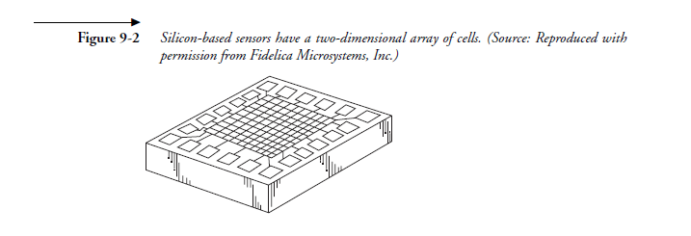
More on Sensors

Slide 31
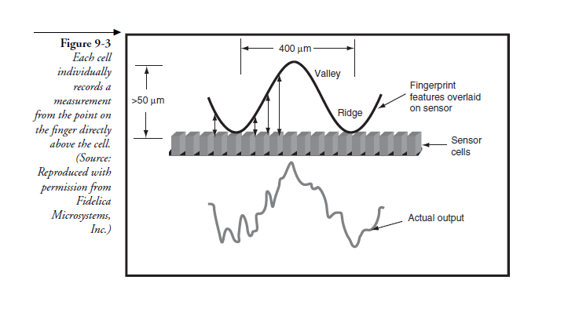

Slide 32
