Slide 1
Biometrics
Unit I

Slide 2
Lets Define !
“A biometric is a physiological, chemical or behavioral characteristic of a human being that can distinguish one person from another and that theoretically can be used for identification or verification of identity.”

Slide 3
More Definitions
“a general term for technologies that permit matches between a ‘live’ digital image of a part of the body and a previously recorded image of the same part usually indexed to personal or financial information” (Alterman - 2003)
“measuring relevant attributes of living individuals or populations to identify active properties or unique characteristics”
(Mordini - 2004)

Slide 4
Security Challenges
Authentication with negative recognition
Non-Repudiation
Integrity
Secrecy

Slide 5
Types of Attacks
Client attack – Guessing passwords, Stealing tokens
Host attack – Accessing plain text file with password
Eavesdropping – Password surfing
Repudiation
Trojan Horse
DoS

Slide 6
Biometrics as Authentication
Authentication depends on
  What you have
  What you know
  What you ARE !
  Not easy to steal or share

Slide 7
History
Possibly the first known example of biometrics in practice was a form of finger printing being used in China in the 14th century, as reported by explorer Joao de Barros. He wrote that the Chinese merchants were stamping children's palm prints and footprints on paper with ink to distinguish the young children from one another. This is one of the earliest known cases of biometrics in use and is still being used today

Slide 8
History
Elsewhere in the world up until the late 1800s, identification largely relied upon "photographic memory." In the 1890s, an anthropologist and police desk clerk in Paris named Alphonse Bertillon sought to fix the problem of identifying convicted criminals and turned biometrics into a distinct field of study. He developed a method of multiple body measurements which got named after him (Bertillonage). His system was used by police authorities throughout the world, until it quickly faded when it was discovered that some people shared the same measurements and based on the measurements alone, two people could get treated as one. After the failure of Bertillonage, the police started using finger printing, which was developed by Richard Edward Henry of Scotland Yard, essentially reverting to the same methods used by the Chinese for years

Slide 9
History
Lot of research happening from 1960s – systems, IBM
1970s – face recognition system at Osaka World fair
1974 –signature recognition at Stanford
1974 – hand recognition system at University of Georgia
1990 – Iris system at Cambridge
1991 – mercedes Benz, Finger Print recognition system failed
2001 Super Bowl in Tampa, Florida -- each facial image of the 100,000 fans passing through the stadium was recorded via video security cameras and checked electronically against mug shots from the Tampa police. No felons were identified and the video surveillance led many civil liberties advocates to denounce biometric identifying technologies.
Post 9/11 -- after the attacks, authorities installed biometric technologies in airports to ID suspected terrorists, but some airports, like Palm Beach International, never reached full installation status due to the costs of the surveillance system.

Slide 10
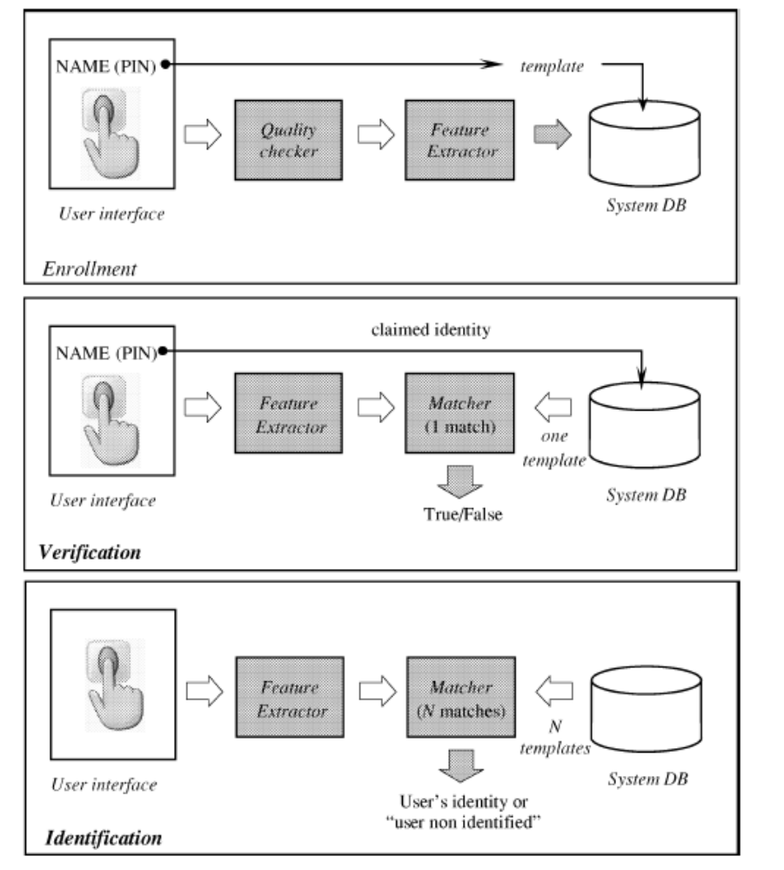
Recognition system

Slide 11
Operational Modes Contd.
In Verification mode, the system validates the person’s identity by comparing the captured biometric data with the template stored in the database. This template is stored in the Enrollment phase.
In Identification mode the system identifies the person by searching the templates of all users in the database for a match. One to many Comparison.

Slide 12
Modules needed to build a Biometric System
Sensor module
Feature Extraction module
Matcher Module
System Database Module

Slide 13
Sensor Module- It captures the Biometric data of an Individual. An example can be a Fingerprint Sensor.
Feature Extraction Module- Here the obtained biometric data of an Individual is processed to extract features. Example can be the Local ridge feature extraction from a Fingerprint.
Matcher Module- Here the features extracted during the above phase are matched against the templates stored in the database.
System Database Module- Used to Store Biometric templates of the users enrolled. The enrollment module is responsible for Enrolling Individuals to the database.

Slide 14
Types of Physiological Biometrics
Fingerprints
Hand/Finger geometry
Palm Print
Facial Recognition
Vein Patterns
Iris Recognition
Retina Scans
DNA
Dental
Facial Thermogram
Odor
Ear

Slide 15
Behavioral
Voice
Signature
Typing pattern
Gait

Slide 16
Current application categories
Commercial
Government
Forensics

Slide 17
Performance: 7 Pillars of (biometric) Wisdom
Universality
Uniqueness
Permanence
Collectability/Measurability
Performance
Acceptability
Circumvention
EC report: Biometrics at the Frontiers: Assessing the Impact on Society (2005)

Slide 18
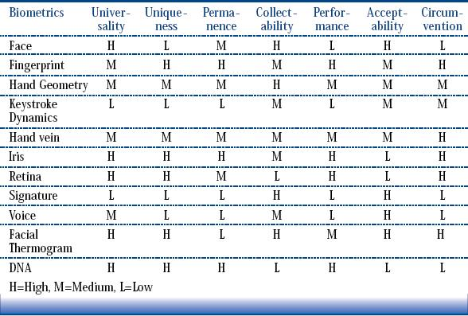

Slide 19
The metrics of Biometrics
FTE – Failure To Enroll
FTA – Failure To Accept
FAR – False Acceptance Rates
FRR – False Reject Rates

Slide 20
Unimodal biometrics disadvantages
Noise in sensed data
Intra-class variations due to sensor issues or user issues like change of pose
FAR/FMR is 0.2% in Fingerprint, 1% in Face and 10% in Speech
FRR/FNMR is is 0.2% in Fingerprint, 10%-20% in Face and 2%-5% in Speech

Slide 21
Unimodal disadvantages
Distinctiveness – inter-class similarities
Non-universality - FTE
Spoof attacks

Slide 22
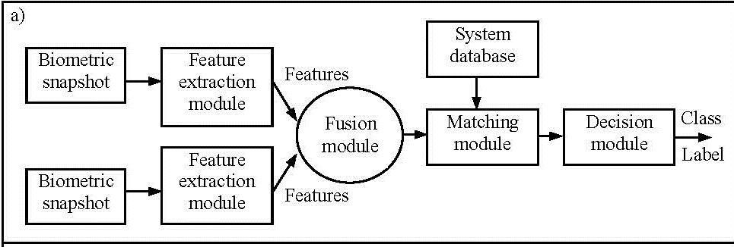
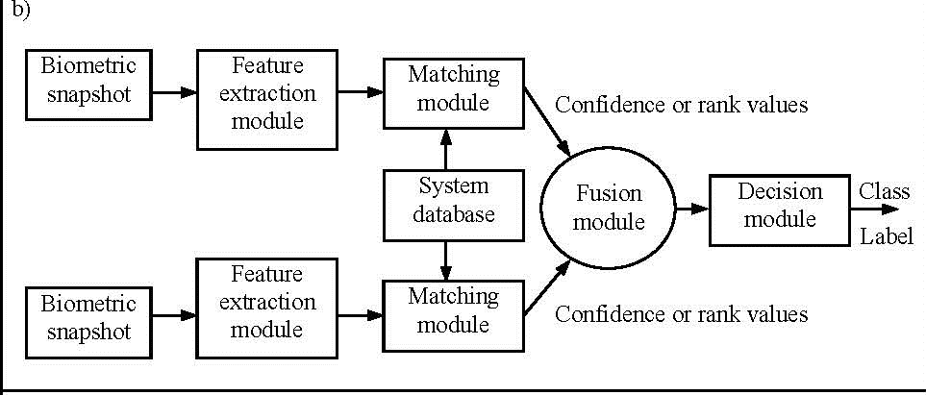
Multimodal Biometrics

Slide 23
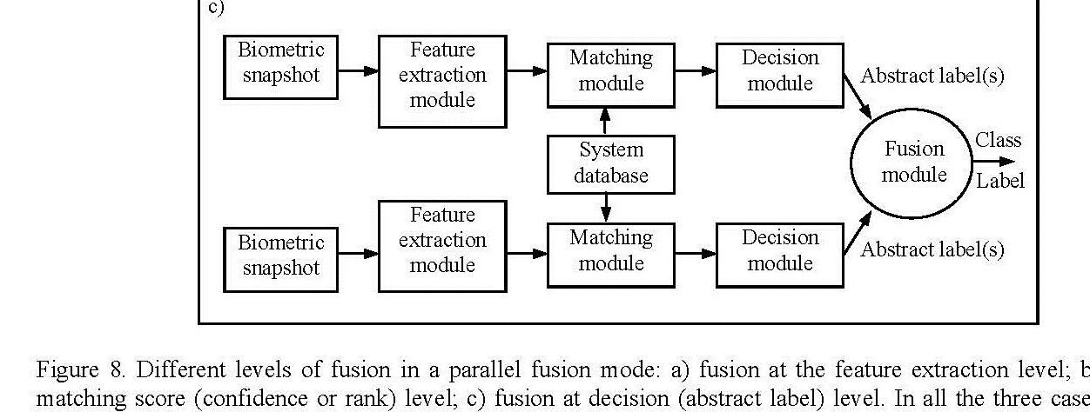

Slide 24
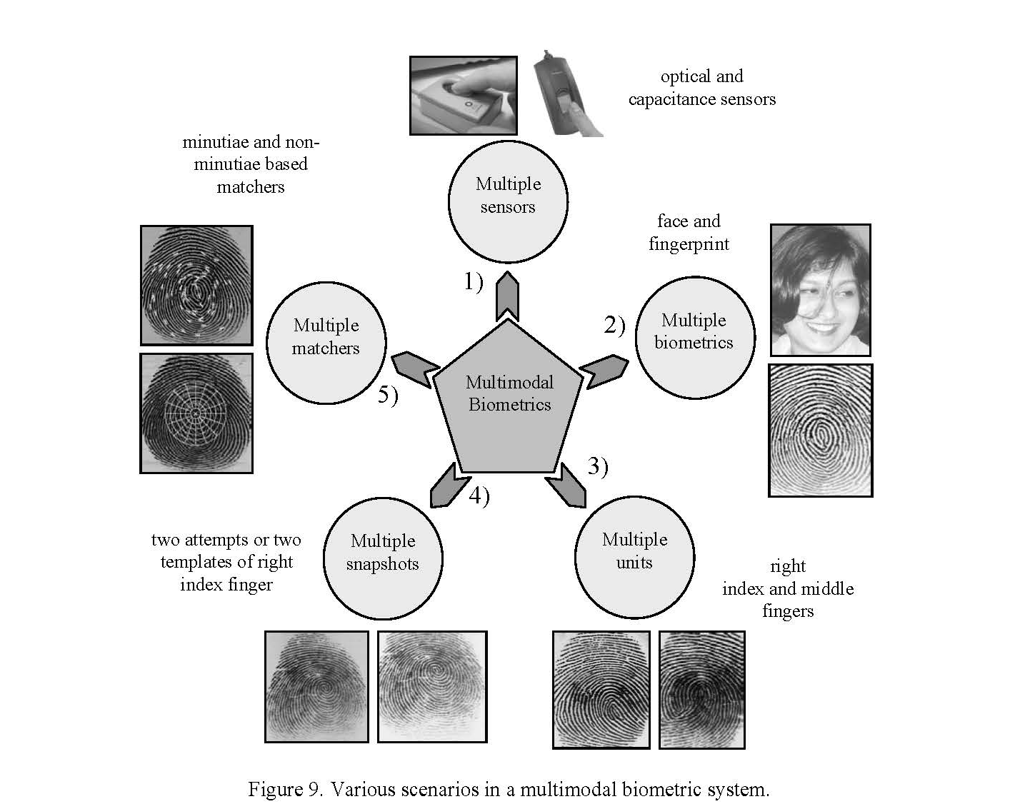


Slide 25
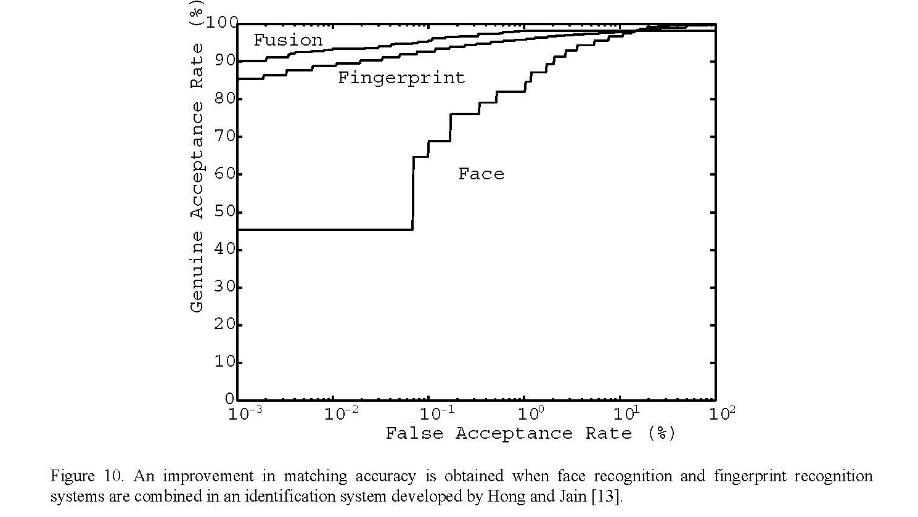

Slide 26
The metrics of Biometrics
Similarity Score
  Authentic score
  Impostor score
Threshold
Genuine Accept Rate (GAR) = 1 – FRR
EER & F-ratio
D^{t} & Identification Rate

Slide 27
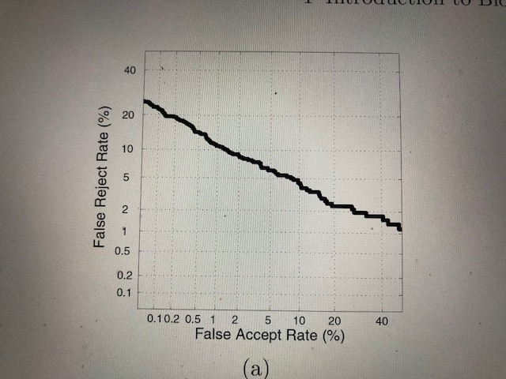

Slide 28
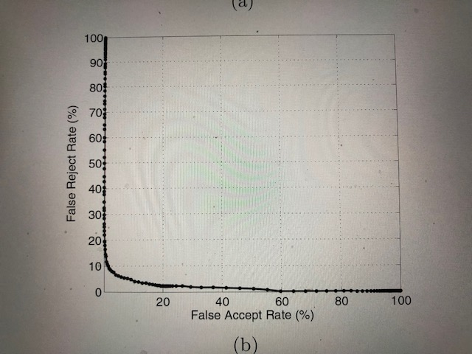

Slide 29
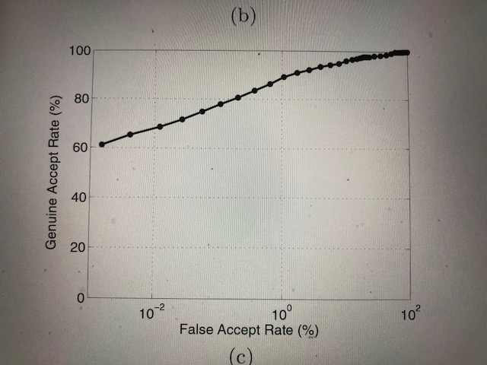

Slide 30
Doddington zoo
Sheep
Goats
Lambs
Wolves

