Slide 1

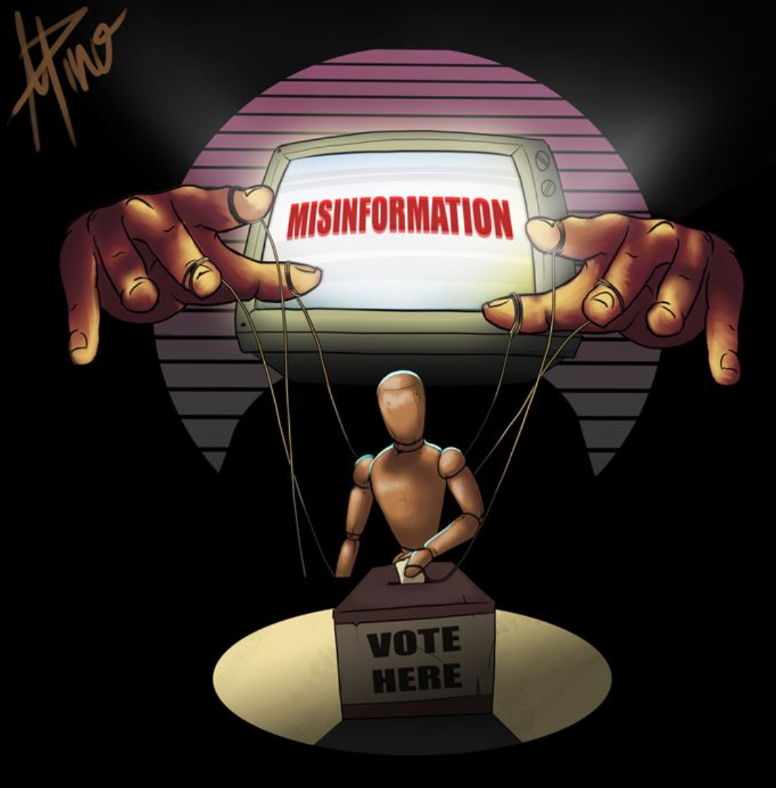

Linguistic and Topical Patterns in Political Misinformation A Text Analysis of the LIAR Dataset
Cruz Lawrence-Mayes
SOCI 5155 –Fall 2025
Notes:
Hello everyone, my name is Cruz Lawrence-Mayes, and this presentation summarizes my final text analysis project for SOCI 5155. My project focuses on political misinformation and explores how deceptive versus accurate political statements differ in terms of language, themes, and semantic structure. The analyses are based on the LIAR dataset, which contains thousands of fact-checked political claims. Throughout this presentation, I’ll walk through my research questions, preprocessing steps, the four analytical techniques I used, and the main findings from each

Slide 2
Empirical Questions
Do political statements exhibit consistent topical structure?
Are some topics more strongly associated with misinformation?
Can linguistic features predict whether a statement is misinformation?
What does the semantic structure of political language look like?
Notes:
These are the four empirical questions that guided my project.
First, I wanted to know whether political statements naturally cluster into coherent themes or topics.
Second, I was interested in whether certain topics tend to appear more often in misinformation categories like ‘pants-fire’ or ‘false.’
Third, I explored whether linguistic features alone can accurately predict misinformation, which I tested using a Naive Bayes classifier.
And finally, I wanted to understand the broader semantic landscape of political language, which I examined through word embeddings.
Each of the methods I use later in the presentation connects directly back to one or more of these questions.

Slide 3
Dataset: LIAR
~12,000 fact-checked political statements
Sourced from PolitiFact
Labeled across 6 truthfulness categories
- Pants-fire, false, barely-true, half-true, mostly-true, true
Includes speaker, subject, context
Ideal for studying misinformation patterns
Notes:
For this project I used the LIAR dataset, which is a well-known collection of political statements that have been fact-checked by PolitiFact. It contains a little over twelve thousand short statements, each assigned one of six truthfulness labels ranging from ‘true’ to ‘pants-fire.’
In addition to the statement itself, the dataset includes metadata like the speaker, the subject category, the speaker’s job, and some contextual notes. This makes it a really strong dataset for studying misinformation because the truth labels give us a reliable reference point, and the size of the dataset is large enough to support techniques like topic modeling, classification, and word embeddings.
Throughout the analysis, I focused primarily on how these truth categories relate to linguistic and topical patterns in the data.

Slide 4
Preprocessing workflow
Removed empty/missing statements
Standardized truth labels
Tokenized and lowercased text
Removed punctuation, numbers, and stopwords
Built document-feature matrix (DFM)
Trimmed rare terms to reduce noise
Prepared data for LDA, STM, classification, and embeddings
Notes:
Before running any of the analysis techniques, I followed a standard preprocessing workflow similar to what we’ve used throughout the course. First, I removed any empty or missing statements and converted the truth labels into a clean, ordered factor.
Next, I tokenized the text, lowercased everything, and removed punctuation, numbers, and English stopwords. After that, I built a document-feature matrix to represent each statement as a collection of word counts. I also trimmed out rare terms that appeared only a handful of times since those usually add noise and don’t contribute much to topic models or classifiers.
These cleaned representations were then used as the input for all four techniques later in the project: LDA, STM, the Naive Bayes classifier, and the word embeddings. Keeping the preprocessing consistent across all methods helps ensure that the results are comparable and meaningful.

Slide 5
Technique #1: Latent Dirichlet Allocation (LDA) ~Description~
Unsupervised topic modeling method
Discovers themes based on word co-occurrence
Each statement = mixture of topics
Helps identify broad issue categories
Addresses: Do political statements show consistent topical structure?
Notes:
My first technique was Latent Dirichlet Allocation, or LDA. This is an unsupervised topic modeling method that identifies clusters of words that tend to appear together, which we treat as underlying topics.
LDA assumes that every statement in the dataset is made up of a mixture of topics, and that each topic is defined by a distinctive set of words. This makes it useful for answering my first empirical question: do political statements naturally organize into consistent themes?
LDA doesn’t use the truth labels at all — it simply reveals the kinds of issues that dominate the dataset overall. Once those themes are identified, they can be compared later with misinformation patterns using STM.

Slide 6
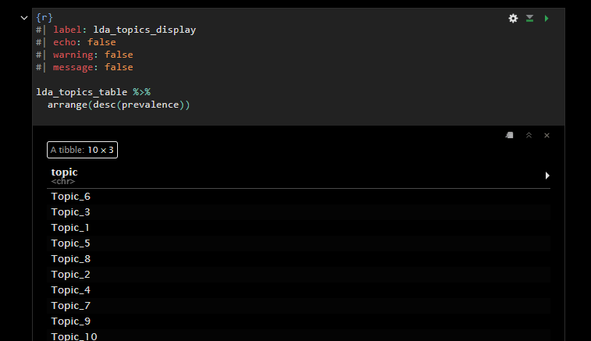
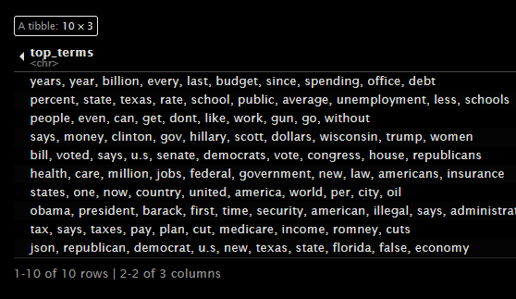
Technique #1: ~Findings~
10 coherent political topics identified
Themes include: elections, taxation, immigration, healthcare, federal spending
Topic prevalence relatively balanced
Confirms strong thematic structure in political statements
Notes:
Here are the results from the LDA model. I ran a 10-topic solution, and all ten topics came out relatively clean and easy to interpret. The table shows the top words for each topic, which makes the underlying themes pretty clear.
Some topics revolve around elections and voting, others around taxes and government spending, and others around healthcare or immigration. One thing that stood out is that the topics are fairly balanced — no single issue dominates the dataset.
This tells us that political statements in the LIAR dataset are organized into recognizable issue areas. And this directly answers my first empirical question: yes, political statements show strong and consistent topical structure.
LDA sets the stage for the next step, where we examine which of these topics relate more closely to misinformation using STM.

Slide 7
Technique #2: structural topic modeling (STM) ~Description~
Extensions of LDA that includes document metadata
Incorporates truthfulness labels as a covariate
Estimates how topic prevalence changes across truth categories
Helps identify topics more strongly linked to misinformation
Addresses: Are certain topics associated with false or “pants-fire” claims?
Notes:
My second technique was Structural Topic Modeling, or STM. STM works a lot like LDA because it still identifies topics based on word patterns, but it adds one major improvement: it can incorporate metadata directly into the model.
In this case, I included each statement’s truthfulness label as a covariate. That means the model not only estimates the topics themselves but also how common each topic is within different truth categories — like ‘pants-fire,’ ‘false,’ ‘half-true,’ and so on.
STM is the best choice for my second empirical question: are certain topics more closely associated with misinformation? Unlike LDA, which treats all documents the same, STM allows us to compare topic prevalence across truth labels and see where misinformation tends to cluster.
This makes STM especially powerful for studying political deception because it directly connects themes with accuracy levels.

Slide 8
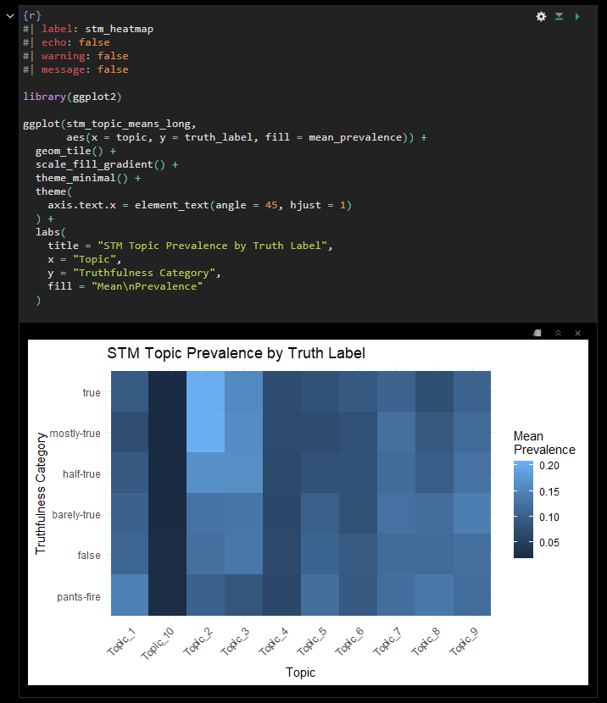
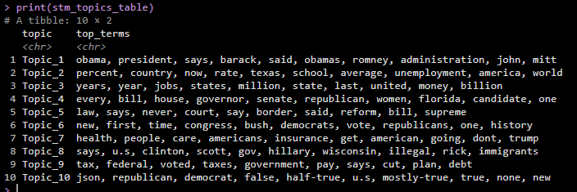
Technique #2: ~Findings~
Topic prevalence varies across truth categories
Some topics appear more often in misinformation (pants-fire/false)
Others appear more often in accurate statements
Shows misinformation clusters around specific issue areas
Notes:
Here are the results from the Structural Topic Model. The heatmap shows how each of the ten topics varies across the six truth categories. Darker colors represent higher topic prevalence within that truth label.
What stands out immediately is that some topics are much more common in the ‘pants-fire’ and ‘false’ categories than they are in the more accurate categories. For example, a couple of topics show noticeably higher prevalence in the lowest truthfulness levels, which suggests that misinformation tends to concentrate in certain issue areas.
On the other hand, some topics appear more frequently in ‘mostly true’ or ‘true’ statements, which indicates that truthful political statements focus on somewhat different themes.
Overall, STM provides strong evidence that misinformation is not evenly distributed. Instead, different truth levels emphasize different topics, supporting the idea that deceptive statements rely on specific themes or rhetorical frames. This directly answers my second empirical question about whether misinformation is tied to particular topics.

Slide 9
Technique #3: Naïve-Bayes Classification ~Description~
Supervised learning method
Predicts misinformation vs. non-misinformation
Uses bag-of-words features from the DFM
Tests whether linguistic patterns distinguish truth levels
Addresses: Can language alone predict misinformation?
Notes:
My third technique was a supervised classification model, specifically a Naïve-Bayes classifier. Unlike topic models, which are unsupervised, this method directly tries to predict whether a political statement is misinformation or not based on linguistic features.
I converted the six truth labels into a binary outcome: ‘misinfo’ for pants-fire and false statements, and ‘not_misinfo’ for everything else. The classifier learned patterns from the training split of the dataset and then predicted labels on the test split.
This technique addresses my third empirical question: can linguistic features alone help identify misinformation? Even though political statements often use similar vocabulary regardless of accuracy, the classifier still attempts to detect subtle patterns that distinguish deceptive from truthful content.
The next slide shows how well the classifier performed.

Slide 10
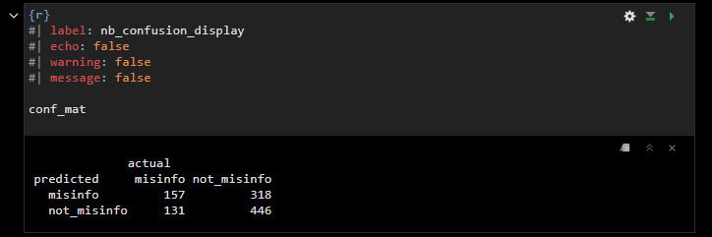

Technique #3: ~Findings~
Task: misinfo vs. not_misinfo
Model: Naive Bayes
Task: misinfo vs. not_misinfo
Accuracy: 57.3%
Above-chance performance
Shows linguistic cues contain some predictive signal
Notes:
Here are the results from the classification model. Using a Naive Bayes classifier, I tried to predict whether a statement was misinformation based solely on its word patterns.
The confusion matrix shows how well the model performed on the test data. The overall accuracy was about 57 percent, which is above chance and indicates that linguistic features do contain some signal that helps distinguish misinformation from other statements.
At the same time, the accuracy is far from perfect. This makes sense because truthful and deceptive political statements often use very similar vocabulary. Misinformation isn’t always defined by the presence of certain words; sometimes the difference lies in context or factual content rather than linguistic style.
Still, the model’s performance tells us that there are subtle patterns in word usage that help separate false from accurate claims. So this technique gives partial support to my third empirical question: language alone can provide some predictive value, but it has clear limitations.

Slide 11
Technique #4: Word embeddings ~Description~
Represents words as vectors in a semantic space
Learned from word co-occurrence patterns
Similar words → nearby in vector space
Uses GloVe-style model + PCA for visualization
Addresses: What does the semantic structure of political language look like?
Notes:
My fourth technique was word embeddings, using a GloVe-style model. Instead of counting how often words appear, embeddings represent each word as a vector in a high-dimensional semantic space, based on how often it co-occurs with other words.
The basic idea is that words used in similar contexts will have similar vectors and will be located near each other in this space. After training the GloVe model on the LIAR statements, I reduced the embeddings down to two dimensions using PCA so that I could visualize the structure.
This technique speaks to my fourth empirical question: what does the semantic structure of political language look like? It doesn’t directly classify statements as true or false, but it shows how terms cluster into meaningful groups, such as economic language, healthcare language, or election-related language. That gives a more intuitive view of how political discourse is organized.

Slide 12
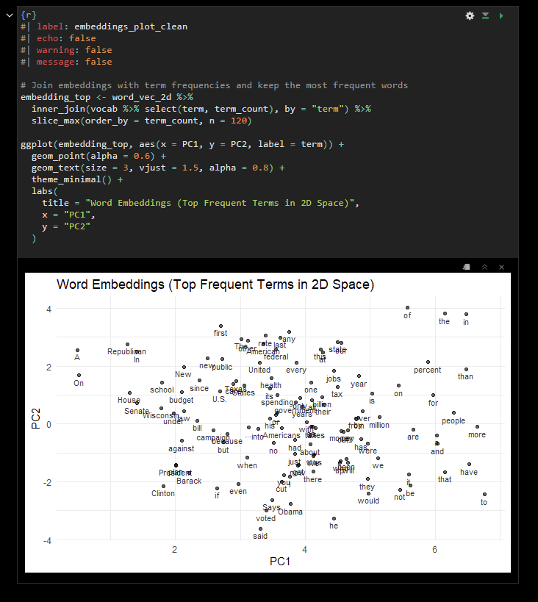
Technique #4: ~Findings~
Task: misinfo vs. not_misinfo
Words cluster into meaningful semantic groups
Clear groupings around major political issues
Shows structure of political language beyond simple word counts
Complements topic models by revealing term-level relationships
Notes:
Finally, these are the results from the word embeddings. This plot shows a two-dimensional projection of the GloVe vectors for the most frequent terms in the dataset. Words that appear in similar contexts are located near each other in this space.
You can see that terms related to the same types of issues tend to cluster together. For example, economic terms group in one region, healthcare terms cluster in another, and election- or campaign-related language appears in its own neighborhood. This gives us a more intuitive picture of how political language is structured beyond simple word counts.
Embeddings don’t directly tell us whether a statement is true or false, but they help contextualize the other results. The topics we saw in LDA and STM are built out of these underlying semantic relationships, and the clusters here show how tightly connected many of those issue areas are in political discourse.

Slide 13

Final summary / Takeaways
Political statements show clear topical structure
Misinformation concentrates in specific topics
Linguistic cues offer modest predictive power
Semantic clusters reveal deeper structure of political language
Project highlights the value of combining multiple techniques
Notes:
To wrap up, here are the main takeaways from my project. First, political statements do show strong and consistent topical structure, which we saw clearly in the LDA model.
Second, misinformation is not randomly distributed across topics. The STM results showed that certain themes appear much more often in ‘pants-fire’ and ‘false’ claims, while other topics tend to be associated with accurate statements.
Third, language alone provides some predictive power for identifying misinformation, although the Naive Bayes classifier demonstrated that this distinction is subtle and far from perfect.
Finally, the word embeddings revealed the broader semantic organization of political language, showing which terms cluster around major issues.
Overall, this project showed how using multiple text analysis techniques together provides a much more complete picture than relying on just one. It also helped me gain hands-on experience with preprocessing, topic modeling, classification, and semantic modeling — skills that I can apply to similar research questions in the future.

Slide 14

References
Stoltz, D. S., & Taylor, M. A. (2024). Mapping Texts: Computational Text Analysis for the Social Sciences. Cultural Cartography Press. https://culturalcartography.gitlab.io/
Wang, L., et al. (2017). LIAR Dataset: A Benchmark Dataset for Fake News Detection. Retrieved from PolitiFact and hosted at https://www.cs.ucsb.edu/~lijun/data/LIAR-dataset.zip
Notes:
These are the two sources I used in this project. All of my methods and analytical choices came directly from our course textbook, Mapping Texts. The dataset for the project is the LIAR dataset, which compiles thousands of fact-checked political statements originally drawn from PolitiFact. Outside of these two sources, everything in the project reflects my own work and interpretations.

