Slide 1
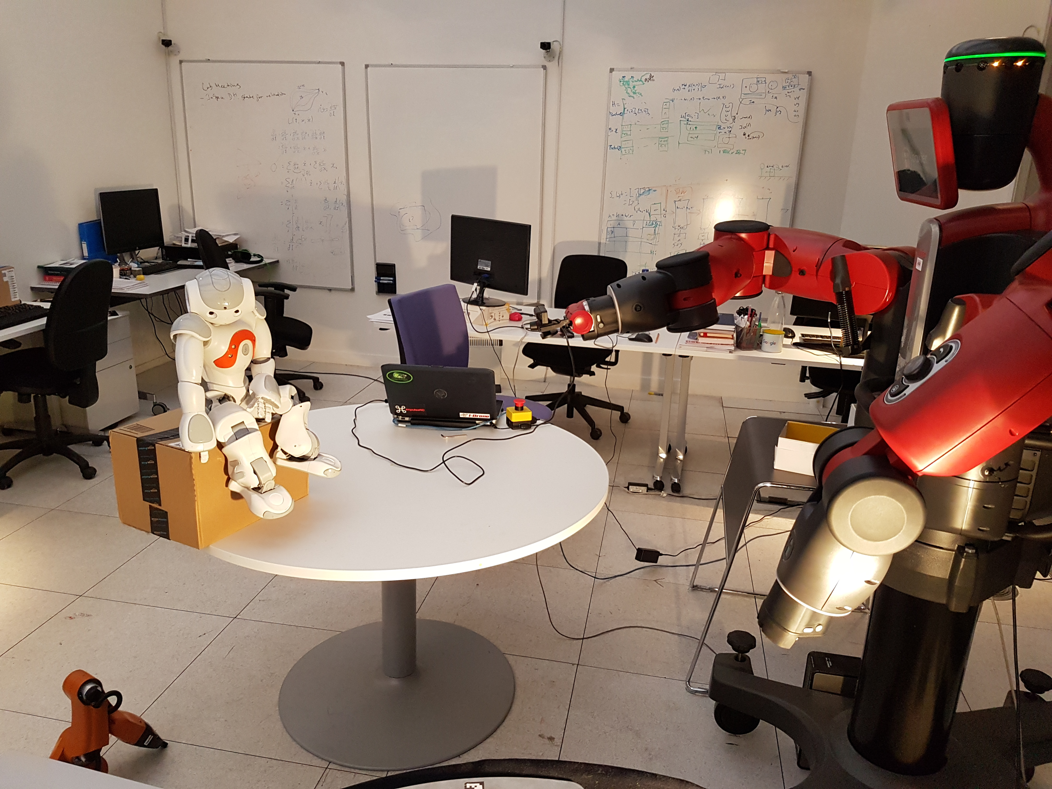
Adaptive Light Field Sampling

Slide 2
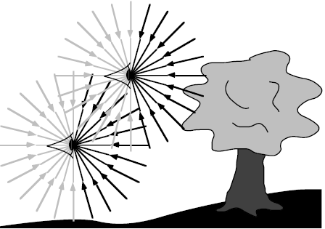
Basis of the Light Field
Purpose
An immersive rendering method for rendering
Can reconstruct depth from scenes
Interactive image processing post capture
Of great interest in VR circles, gaining in
robotics
Plenoptic Function
Describes all of the light from every
possible view
Visualization of the plenoptic function
Light Field Parameterizations
A 4D function that describes the direction
of a ray

Slide 3
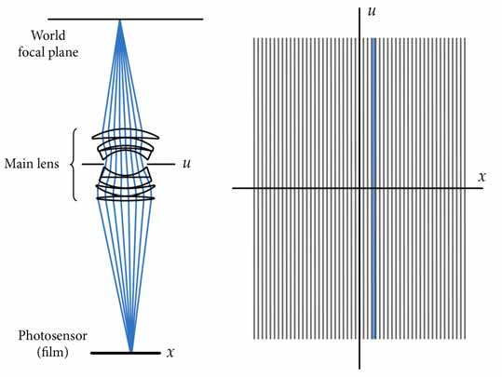
Traditional Camera Ray Space
Traditional cameras capture little
angular information
Capture much spatial information
Modern technology means large image
sensors
Ray space diagram of traditional camera

Slide 4
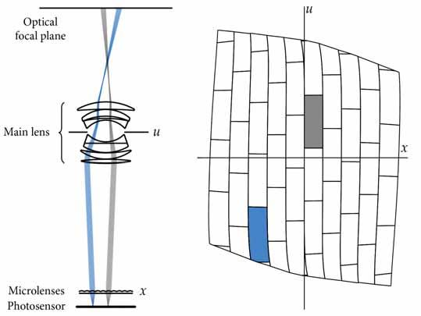
Light Field Sampling Ray Space
Light field captures much angular information
The trade off is lower spatial resolution
Large image sensors means a camera can
be fitted with a microlens array
Ray space diagram of light field capture system

Slide 5
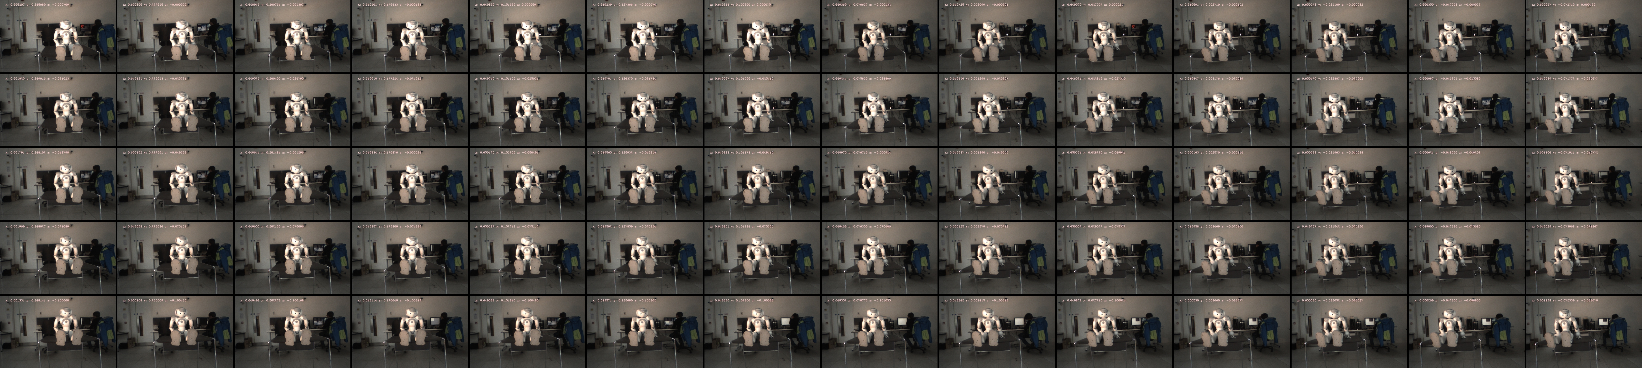
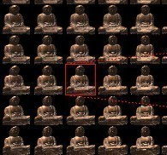
Example Light Slabs
Slab captured by Baxter robot
Captured Light Field
The 4D representation of the plenoptic function
Very dense data spatially and angularly
Generally referred to as a slice or slab of the
plenoptic function
Examples shown with 2PP
Slab captured by Levoy et al

Slide 6
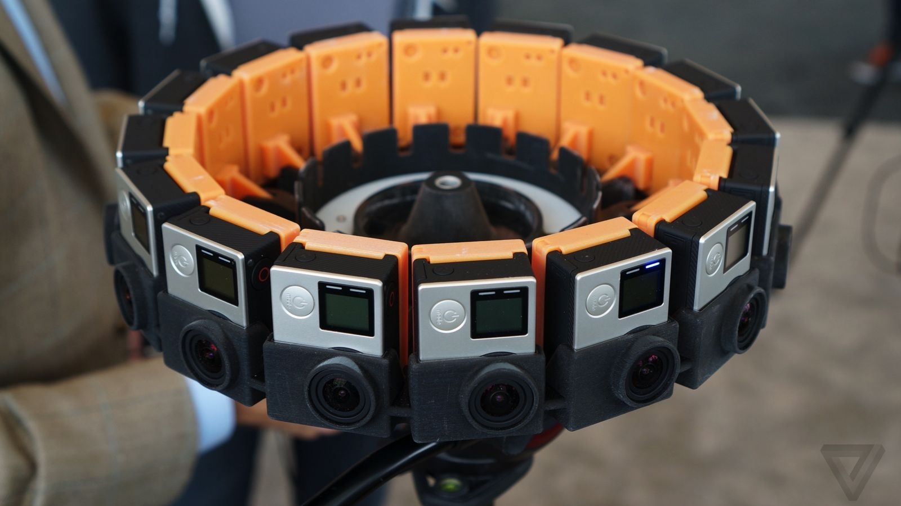
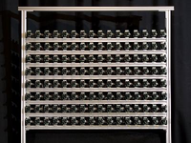
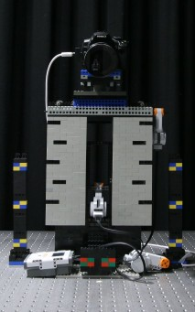
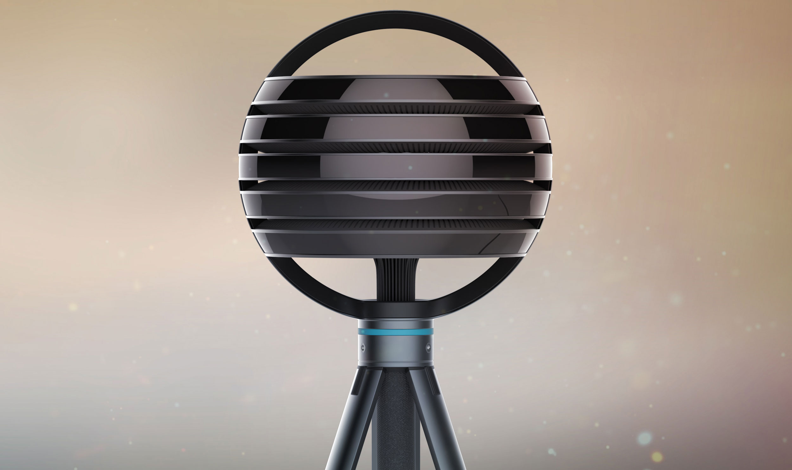
Typical Collection Methods
Stanford array
Google Jump
Lytro Immerge
Stanford Gantry

Slide 7
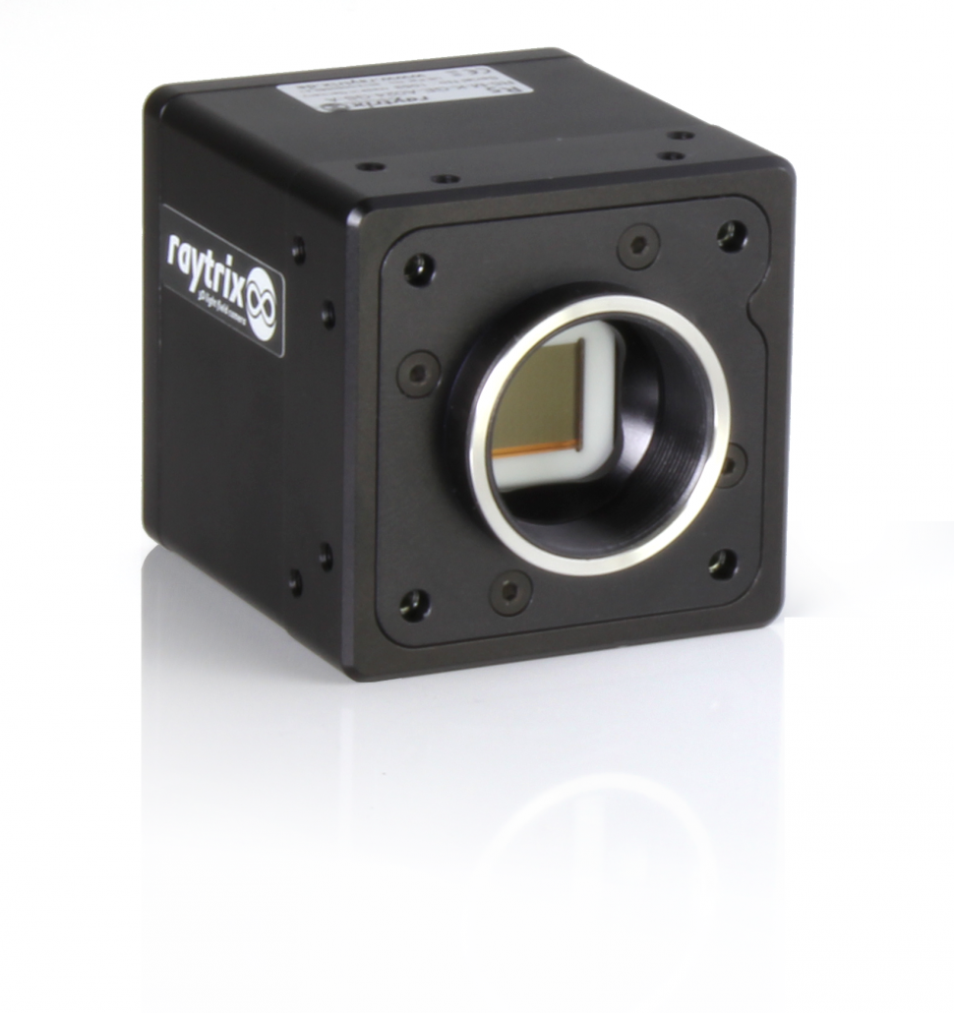
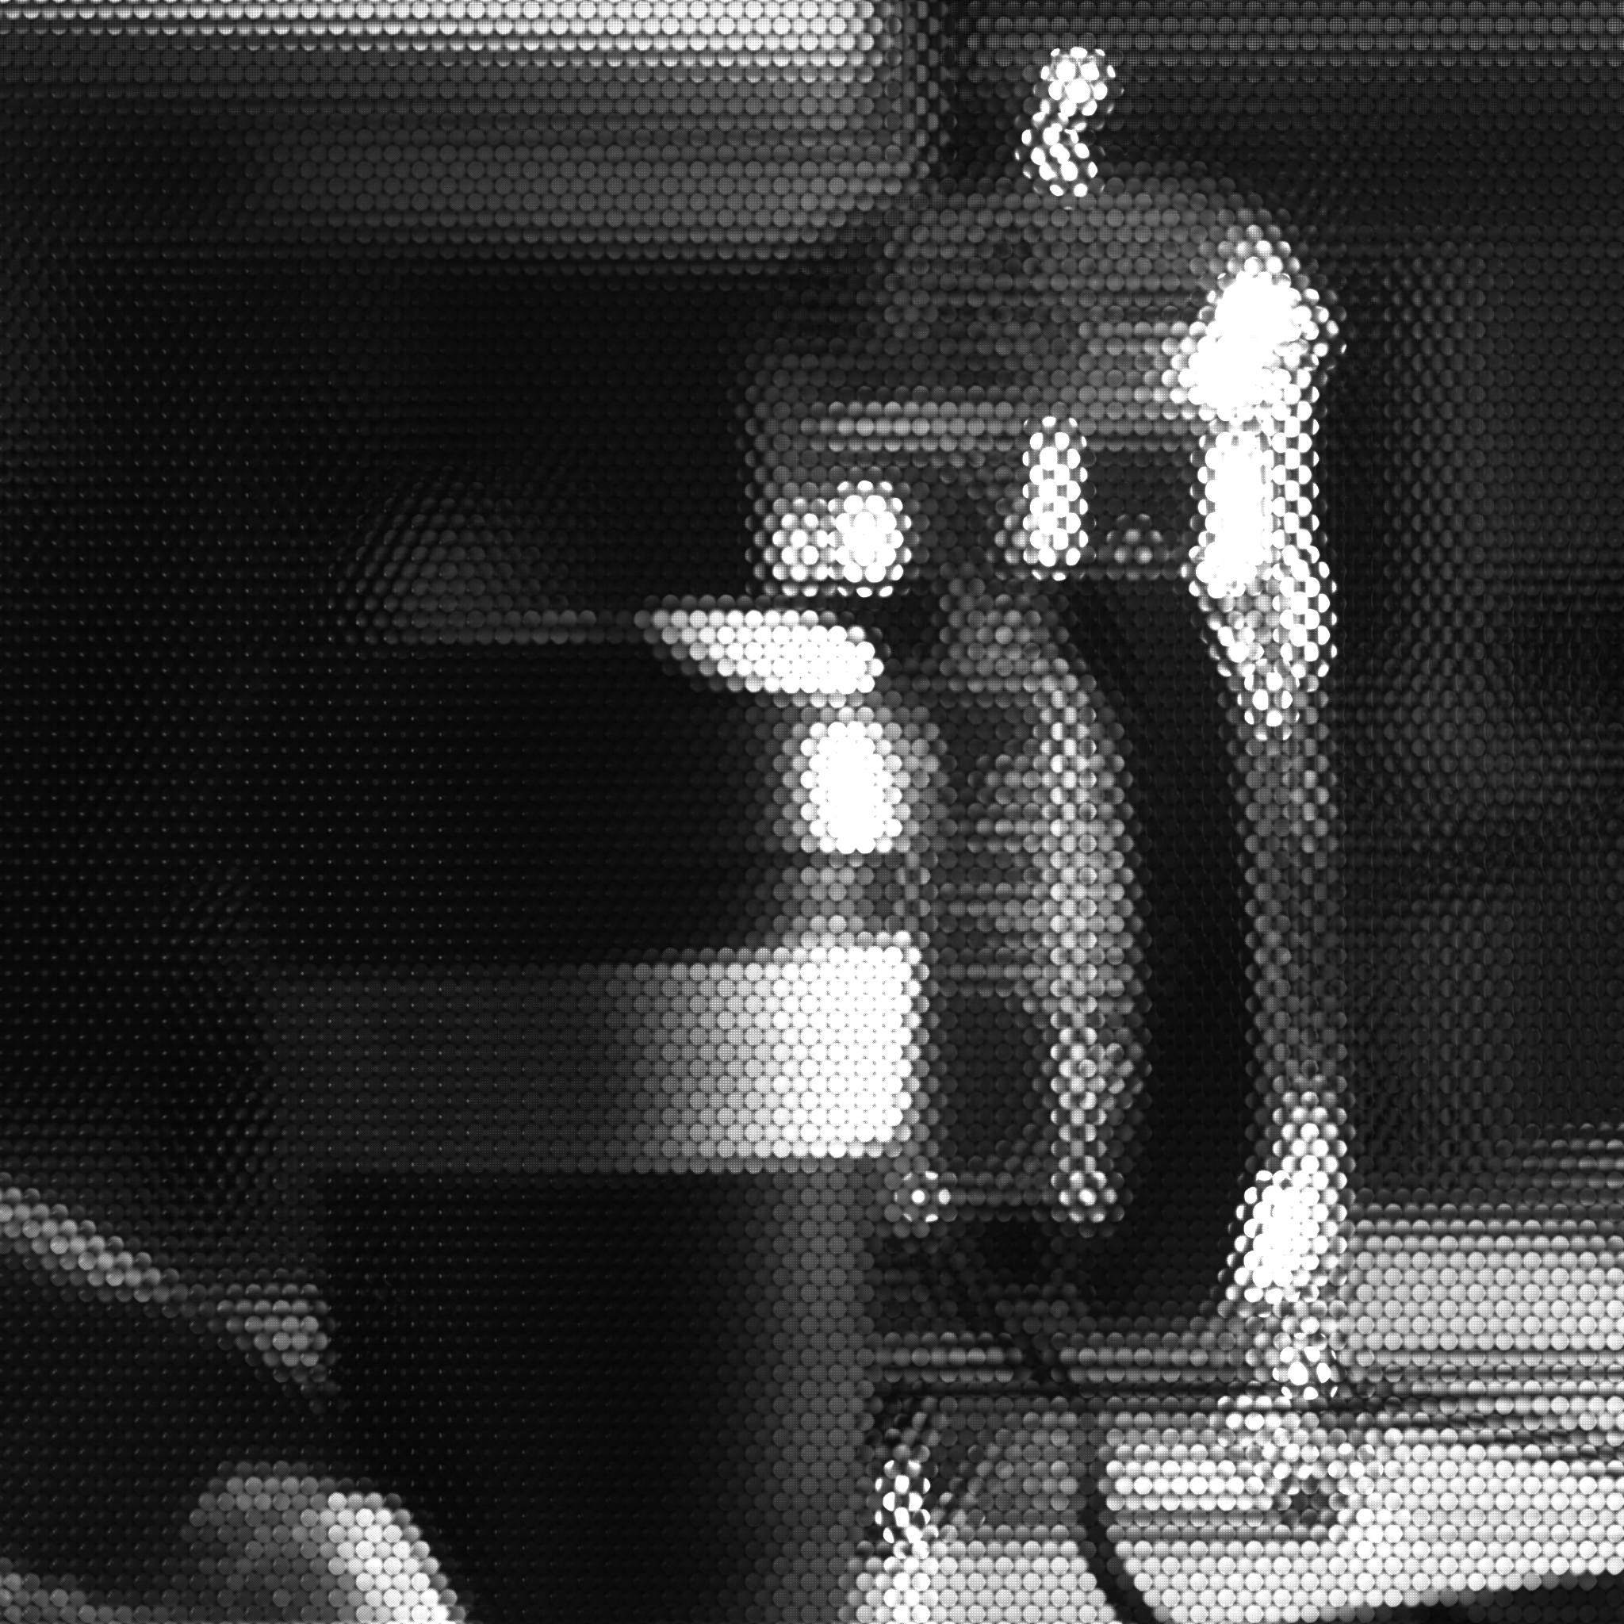
Handheld Camera
Raytrix r5 and raw image
Large image sensors preceded by
microlens array
Not hugely popular due currently limited
applications
Can be used for 3D capture

Slide 8
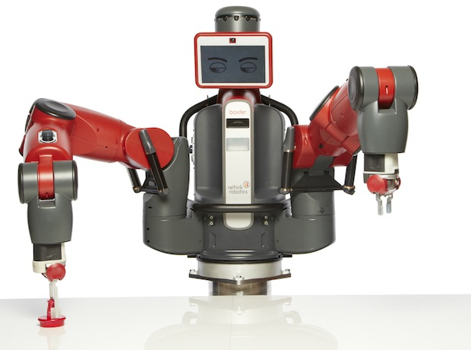
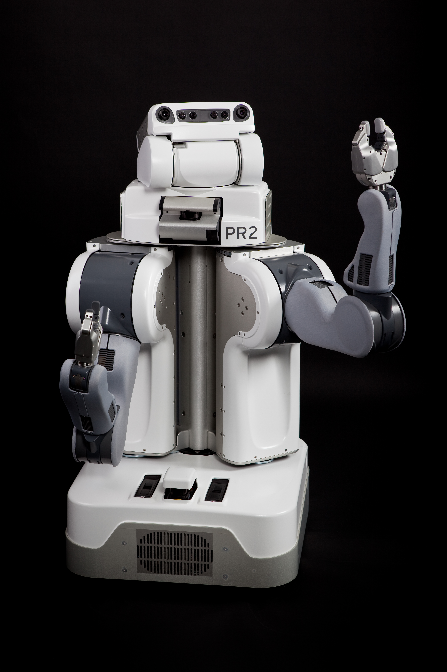
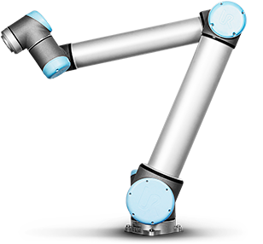
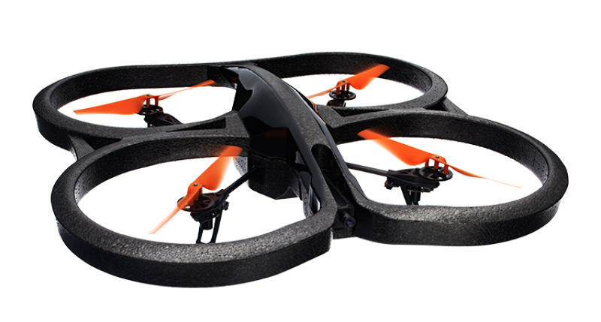
Robot Platforms Used
New method for capturing light field
Can capture for difficult locations
Potential to adapt to subject and/or
environment
PR2
UR10
Baxter
AR Drone

Slide 9
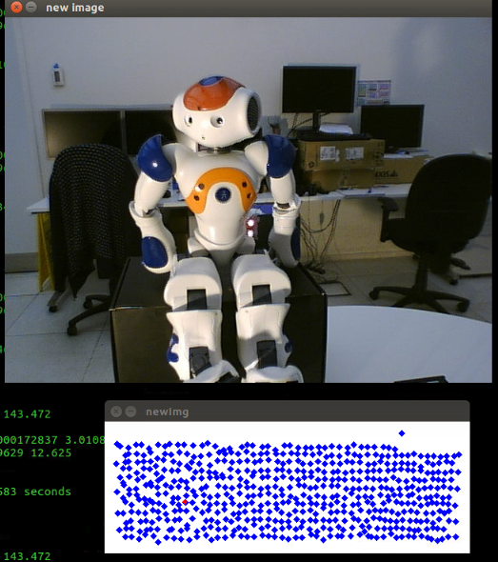
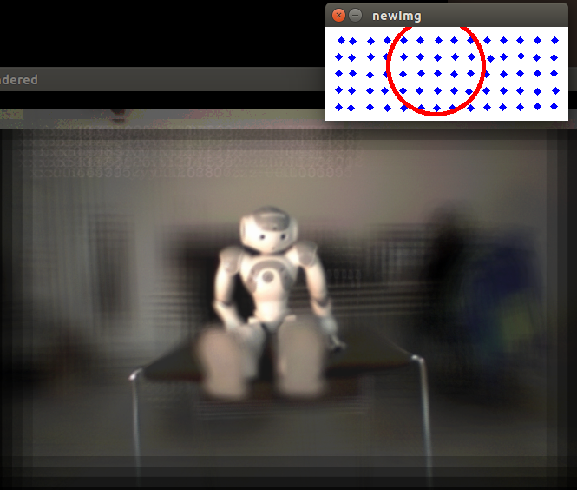
Systems Built
Two light fields collected with Baxter
Two parameterizations
One is unstructured

Slide 10
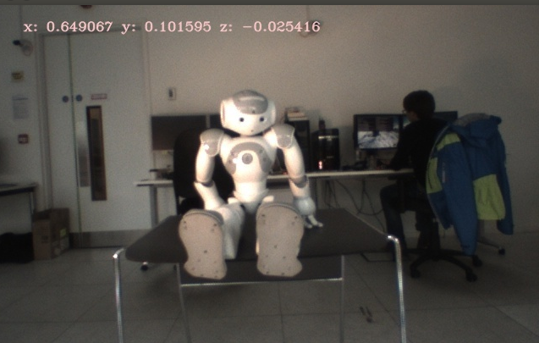
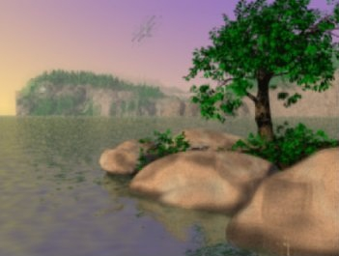
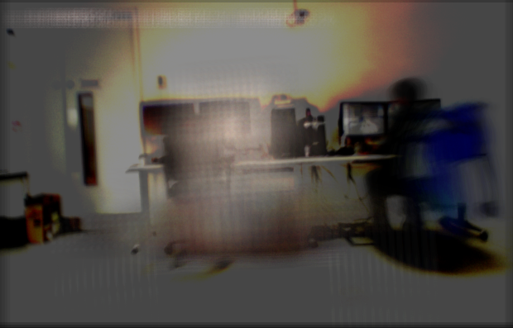
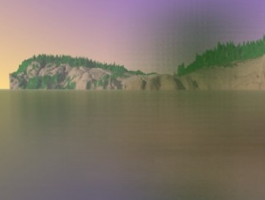
Successful Demonstration of Light Field Properties
Lab collected images with large aperture
Isaksen et al, large aperture

Slide 11
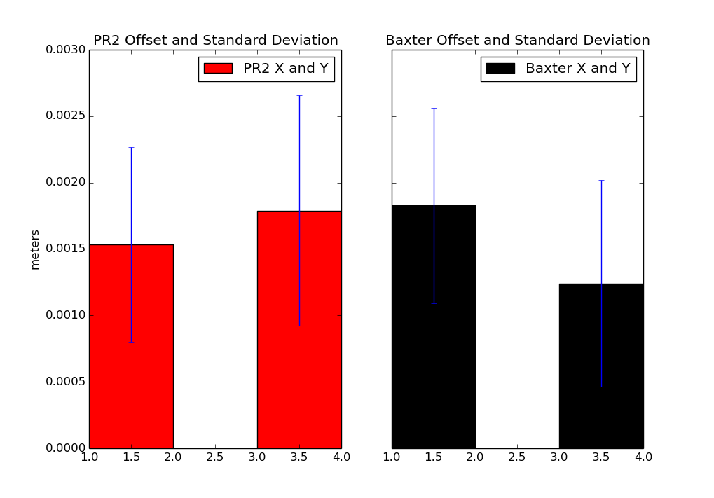
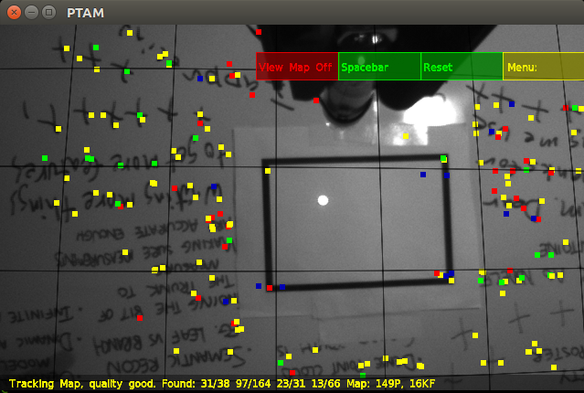
Robot Error Analysis
Light fields require precise knowledge of location
Information not easily available
SLAM methods also tested

Slide 12
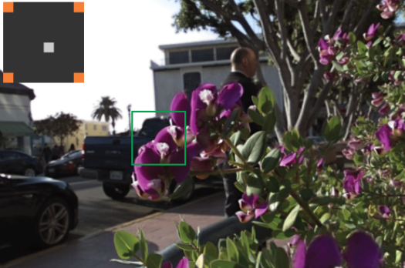
Next Steps:
Minimizing Images Required
Explored by many researchers (Kalantari et al,
Shi et al, Camahort et al, etc)
Methods vary from geometric, to
Fourier reconstruction, to convolution
NNs
All methods are tried with structured
light fields
First Step: Adapting Kalantari et al to
work with unstructured light fields
Kalantari et al demonstrating learning
image relationships

Slide 13
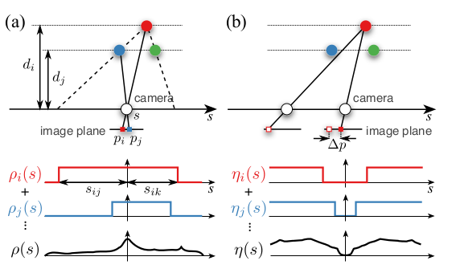
Adapting to Conditions
Determine min and max sample
spacing according to conditions
Take into account minimum images
required
Online adaptation
Kim et al demonstrating constraints for online
sampling algorithm

Slide 14
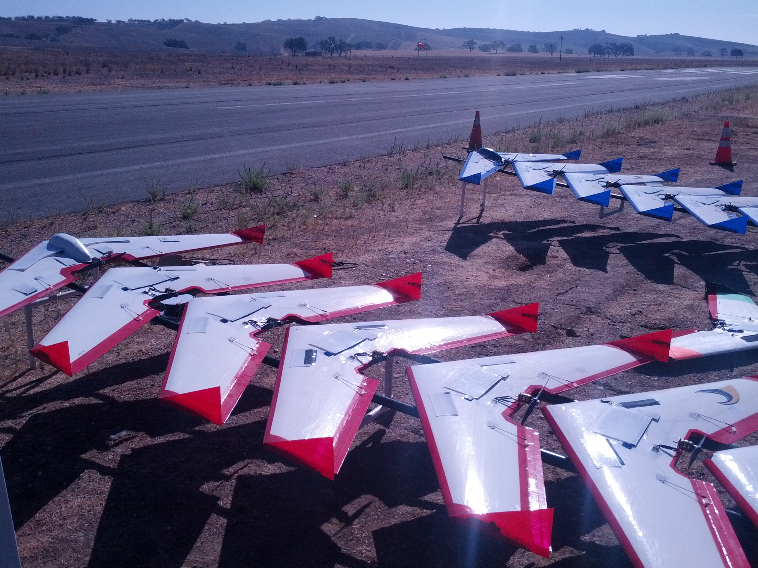
Large Scale Collection and
Light Field Video
Control a large number of robots
With this, and the results from the
previous steps, cover a large area
Allow minimal agents to adapt to
conditions and capture light field
for large scene
DARPA Swarm UAV challenge

