Slide 1
A line-space analysis of light-field representations
(Or Uniformity and View Independence in Light Fields)
Emilio Camahort, Francisco Abad, Don Fussell

Slide 2
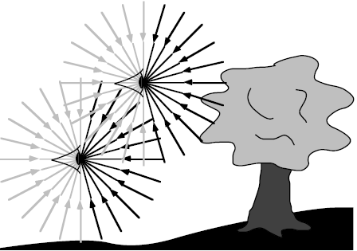
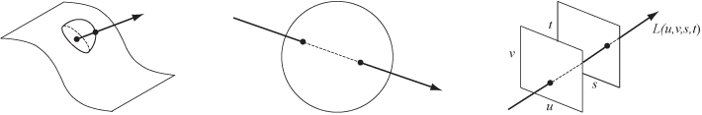
What is a light field parameterization?
What is a light field?
It is generally a 4D version of the 7D
plenoptic function
In the case of the 4D parametrization, it is a method of defining the direction of individual light rays.

Slide 3
What is it used for?
Largely, construction, or rendering, of virtual scenes using real images for a more immersive experience
Few attempts have been made at applications outside of entertainment

Slide 4
Purpose of the paper
Quantify geometric errors in light field representations (parametrizations)
Optimize a light field model by choosing the best parametrization with least geometric error bound
A comparative analysis of light field parameterizations

Slide 5
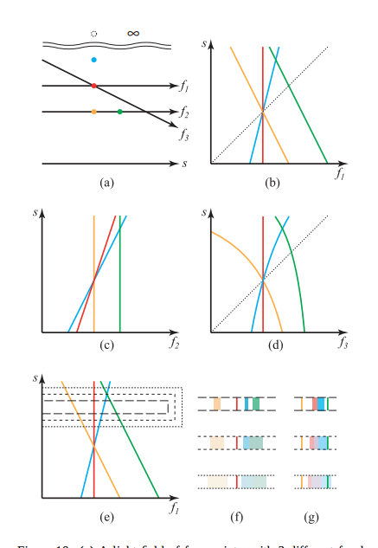
What is the line space?
Reduction of the 4D light field to 2D

Slide 6
Potential rendering artifacts
End goal for the author is to produce the best visual results, which is difficult to quantify
Encountered Artifacts:
Disparity
Seams
Hair
Pixelation

Slide 7
Geometric analysis of light rays
Two points on a sphere or the 2SP parametrization is determined to be the best
Does not suffer from the the same problems of aligning light slabs

