Slide 1
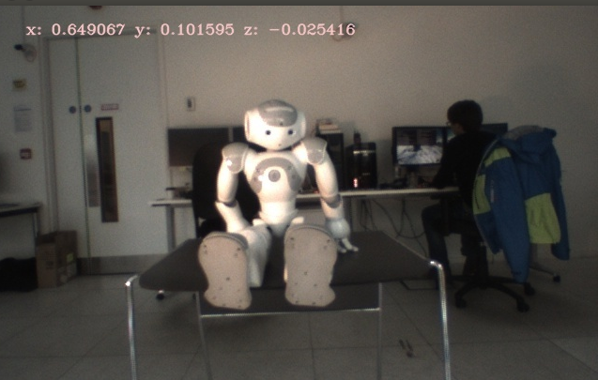
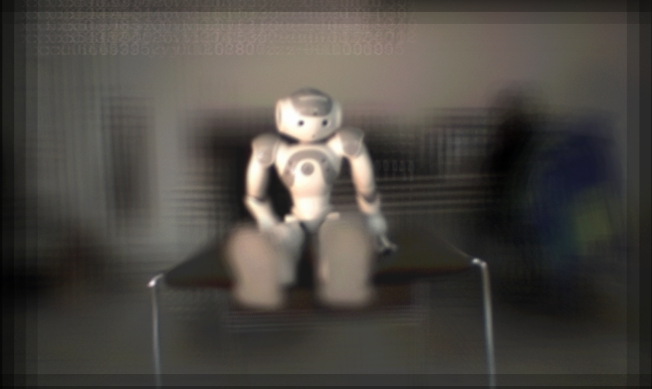
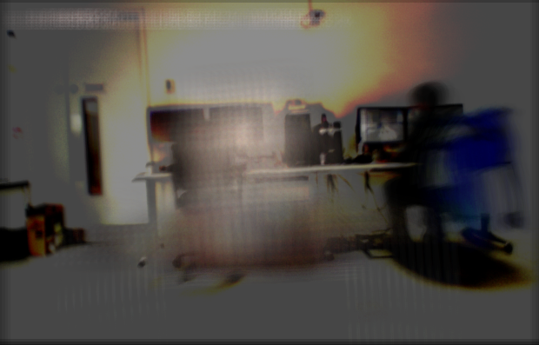
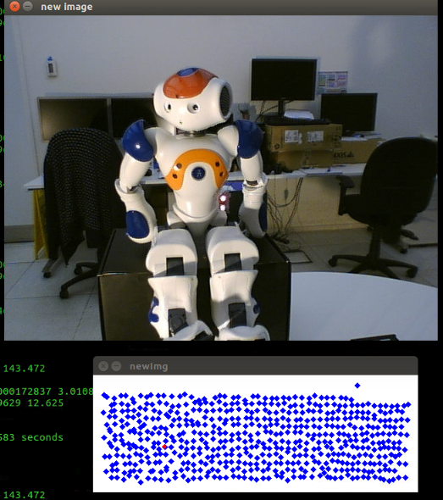
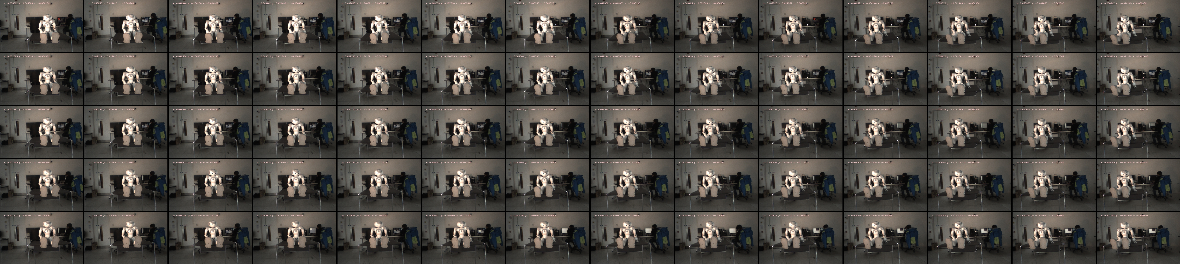
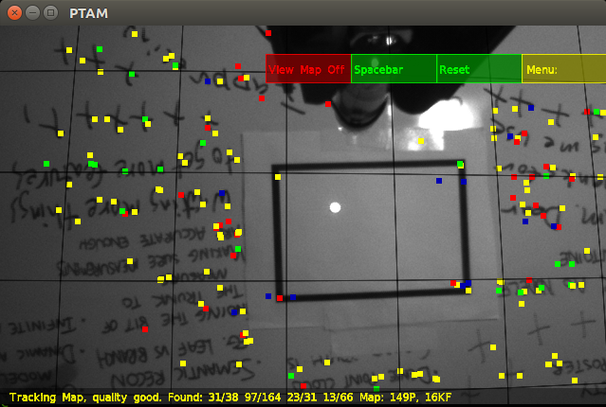
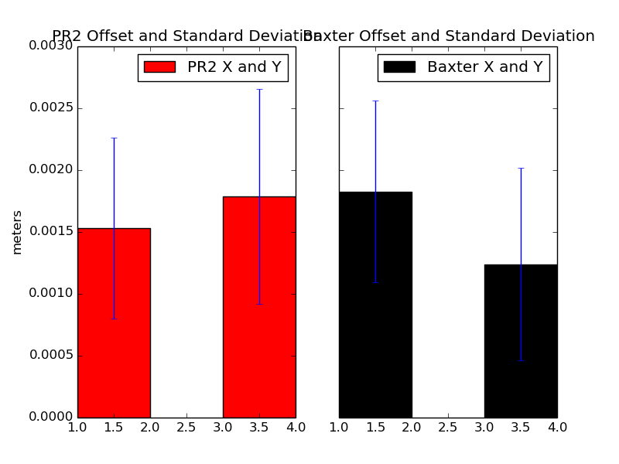

Understanding Light Field Parameterizations
Rendering
Part of the appeal of the light field is the way in which
novel images are displayed. As well, unlike a
panorama which can display views in 3D, the light
field allows for 6D movement through a scene.
Several renderers have been built to best view the
captured light fields and make use of some of the
Carson Vogt, February, 2016
Kartic Subr, Alex Belyaev
Introduction
unique aspects of the light field data shown in the mosaic in the first column. The first image on the left is the pinhole model of the light field with infinite depth of field. By creating a synthetic aperture, a mobile focal plane is possible, allowing subjects in the foreground to be shown (demonstrated by the second image on the left) or, by increasing the synthetic aperture further and moving the focal plane to the background of the scene, the occlusion may be nearly removed entirely. These images were all captured using a Baxter robot in a planar parameterization.
Light fields are a unique way of capturing, storing, and
displaying the light from a scene. Derived from the 7D
plenoptic function meant to capture all light in a
volume, the 4D function describes the radiance of a
ray along a line described by two points:
Typical methods for capturing a light field are by
camera array, or light field camera, which is simply a
large image sensor with a micro lens array behind the
aperture, allowing for the capture of spatial and angular
data.
Three parameterizations (shown above) are used to
keep a constant depth from a subject when capturing
images as individual rays are rarely used. My research
at this point seek to analyze the errors in rendering
methods associated with each parameterization. I am
able to do this due to unique access to robots that can
adapt to different parameterization shapes, specifically
cylindrical, planar, and spherical. To date, a planar
(shown below) and spherical parameterization have
been captured.
Using the Baxter again,
but with a spherical
parameterization, the
image on the right shows
a pinhole view of the
subject and the total
number of images
captured displayed as
individual blue squares.
With a constant depth, the
3D spherical coordinates
are constrained to 2D
angles omitting the radius.
Experiments
To effectively capture a light
field, the location of the camera
must be known precisely. Two
robots and several
Simultaneous Localization and
Mapping (SLAM) methods were
tested to determine the best
platform and localization
Future Work
With the infrastructure in place to capture and render a
light field from each of the common parameterizations,
analyses of the resulting images can be completed.
With the limited amount of research done on the
parameterizations themselves, interpolation methods
can be compared on variable density light fields
collected of the same subject, which has never been
done before. Once this has been completed, and with
the adaptability of the robot, other, novel
parameterizations may be possible based on the
platform being used and the subject under
observation.
method to use. The image at the left shows the
experiment layout, with the robot moving to specific
positions while holding a laser. At each position, an
image is captured, and the relative position of the
laser within the frame is captured then compared
with the robot and SLAM pose estimators. The
SLAM method errors were an order of magnitude
greater than the robots (PR2 and Baxter). The
robot results are comparable and shown below, with
acceptable precision.

