Slide 1
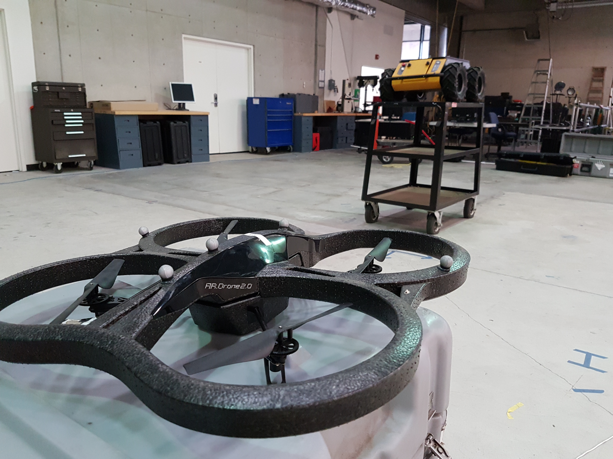
UAV-based Light Field Sampling
Carson Vogt – University of Edinburgh, Heriot-Watt University
Mentor - Kevin Jones – Naval Postgraduate School

Slide 2
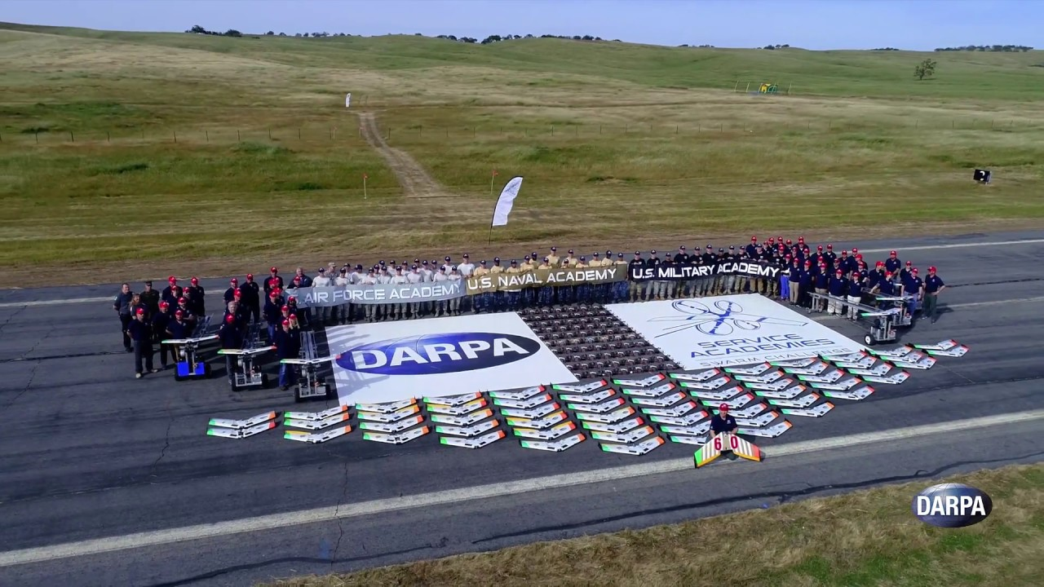
Visualizing a Swarm

Slide 3
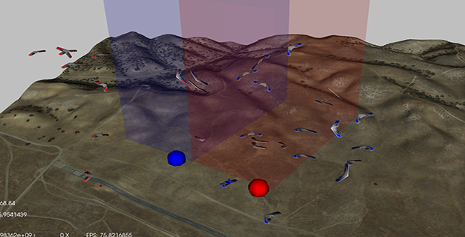
Visualizing a Swarm

Slide 4
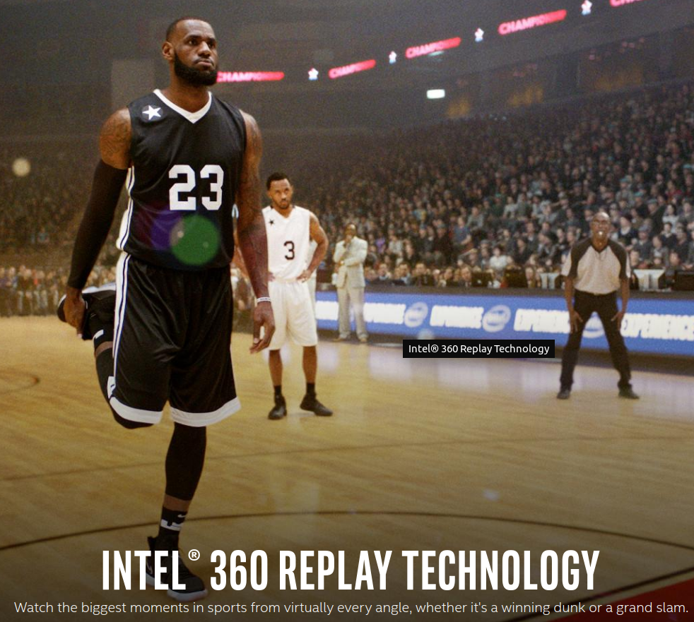
What is a Light Field?
A collection of images
taken from varying angles

Slide 6
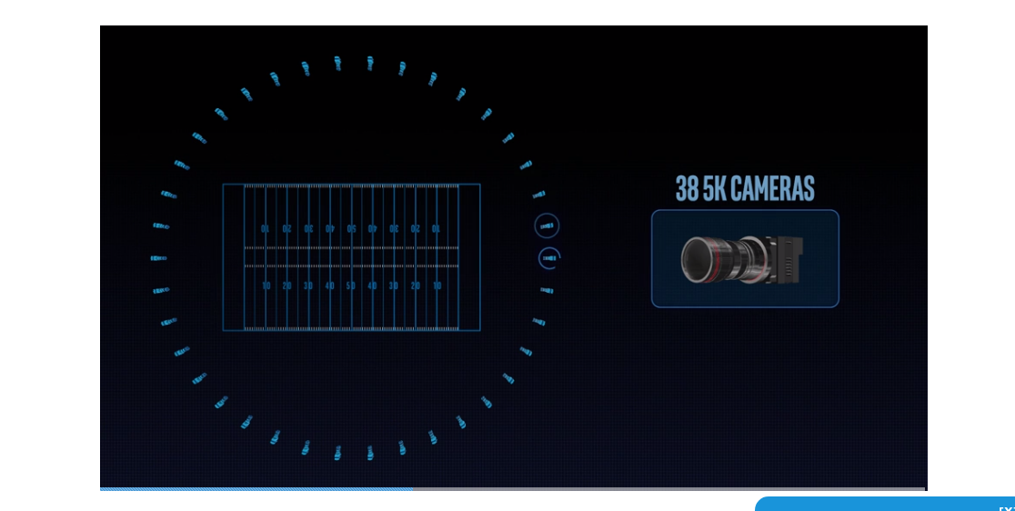

How Do They Do It?
Collect a Lot of Data
Process that Data Quickly
About 1 TB of Data Per Replay

Slide 7
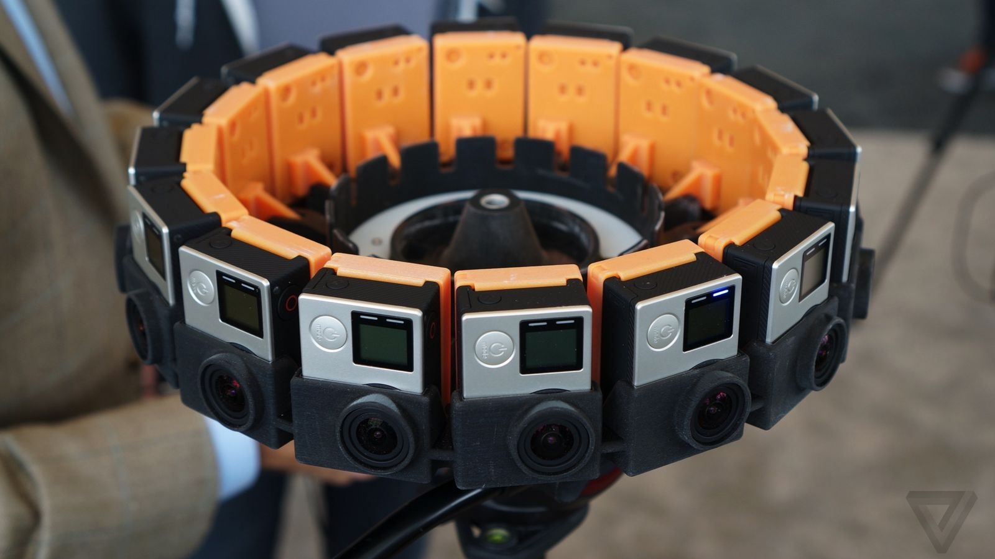
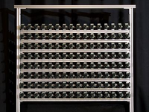
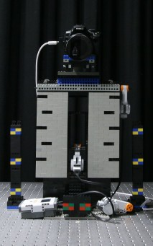

Typical Fixed Collection Methods
Stanford Array
Google Jump
Lytro Immerge
Stanford Gantry

Slide 8
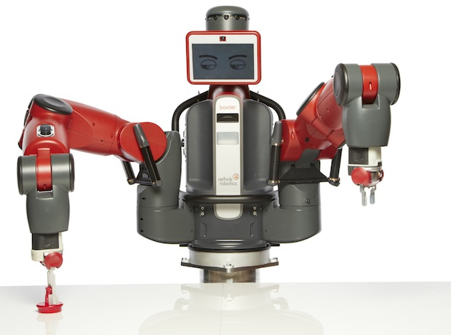
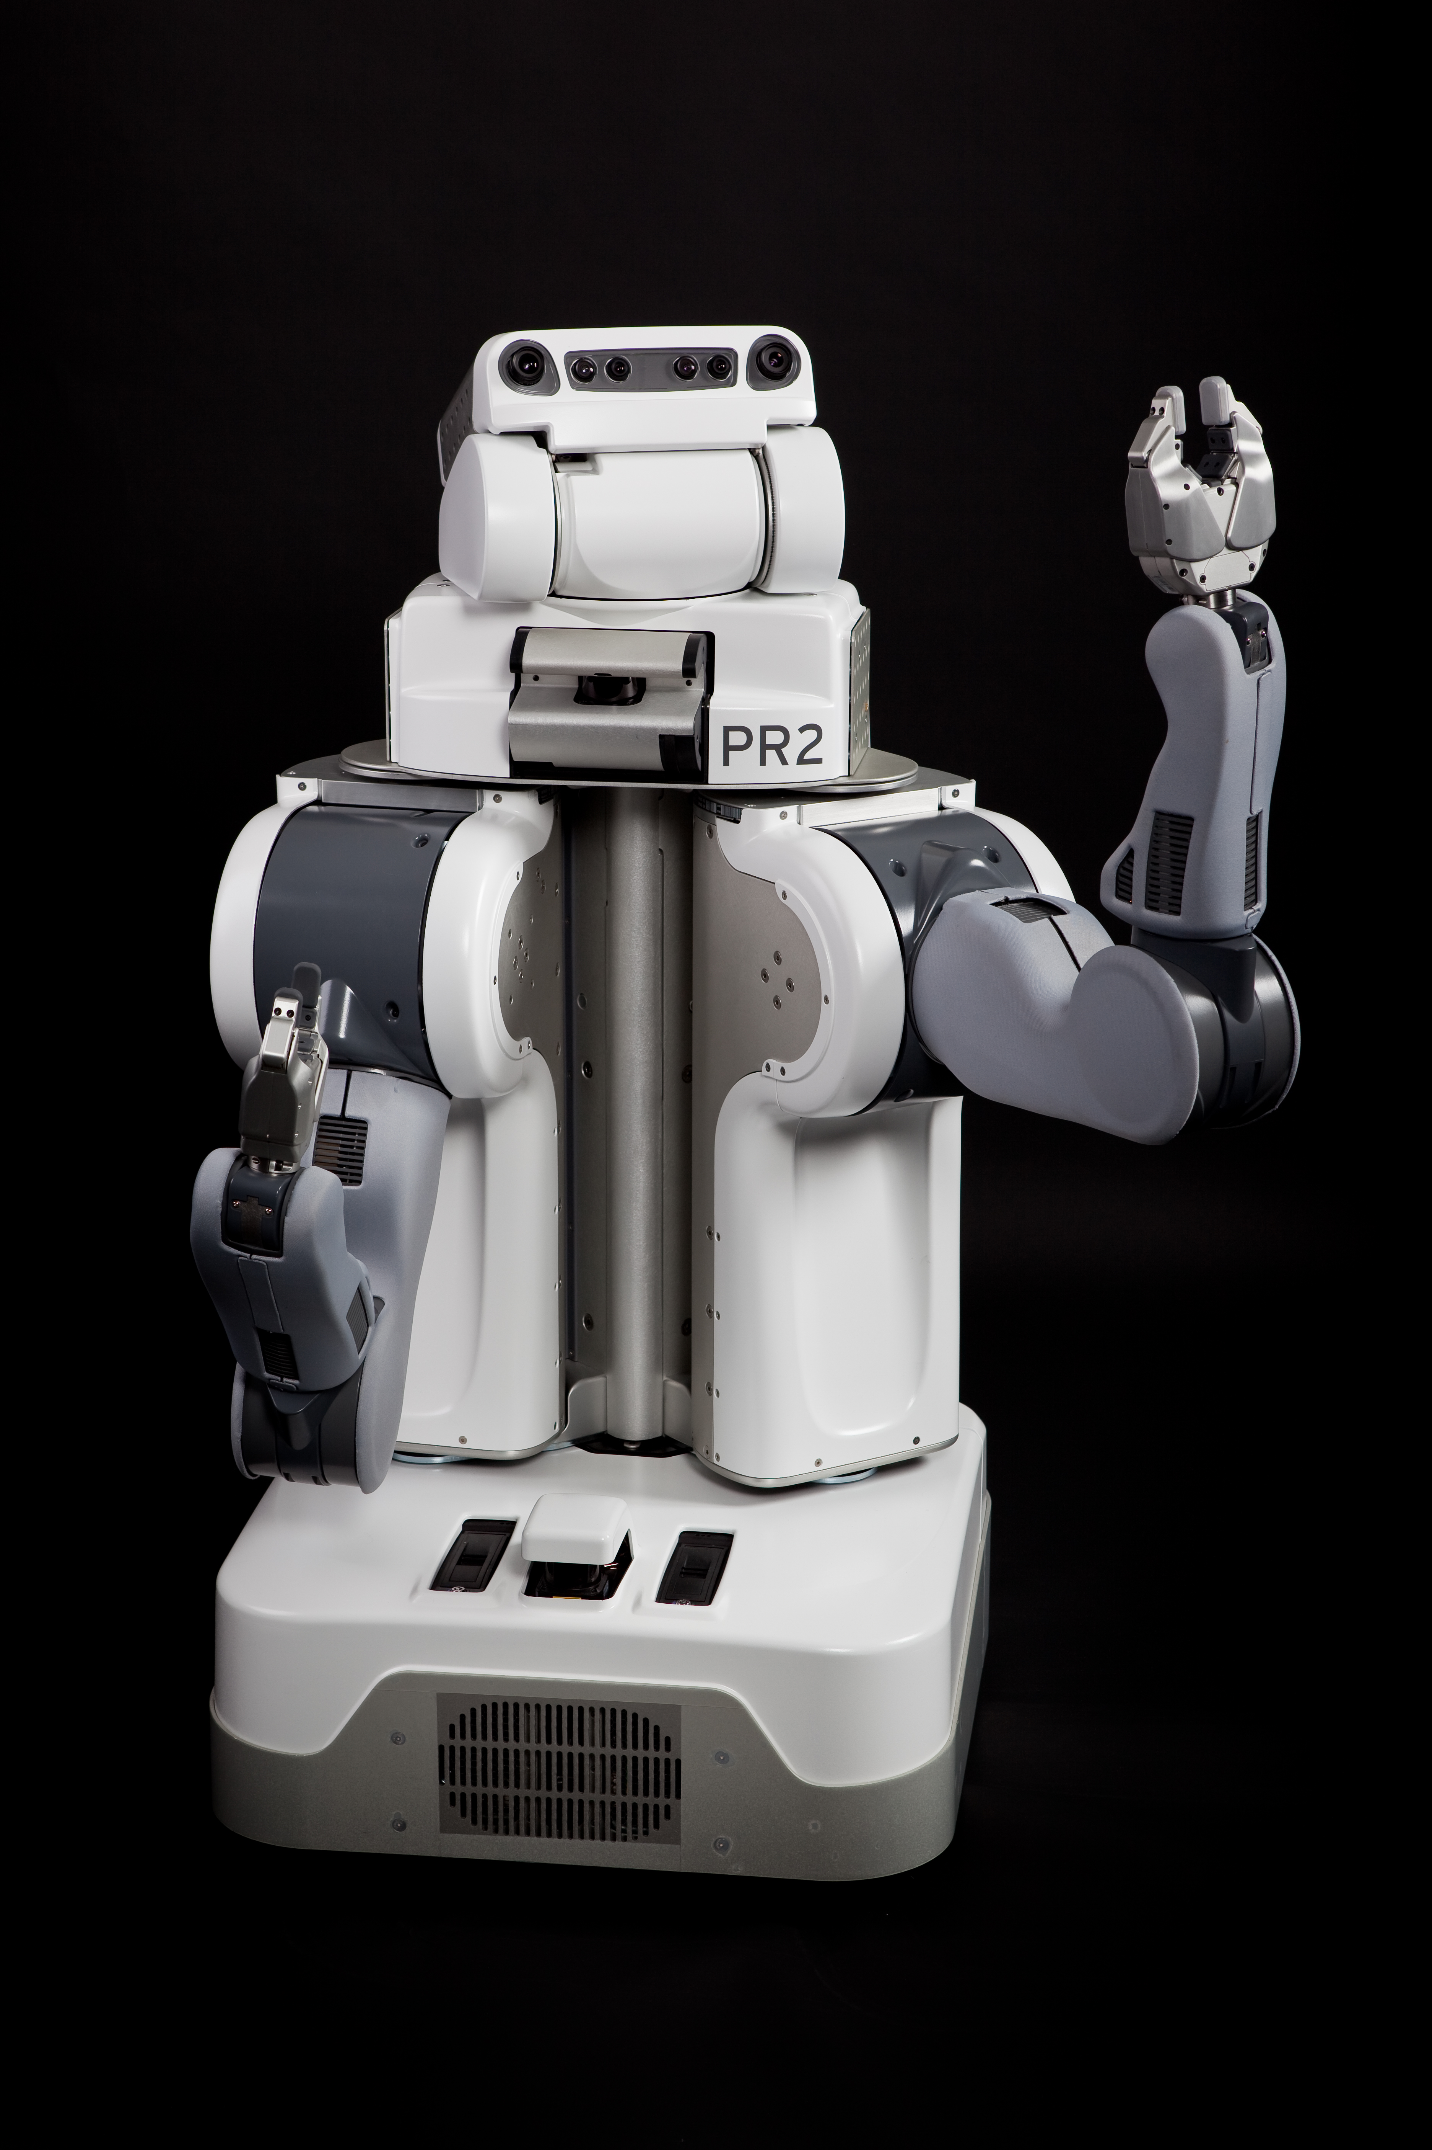
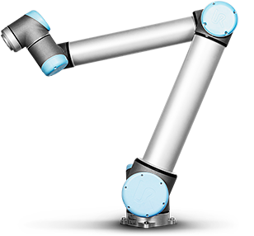
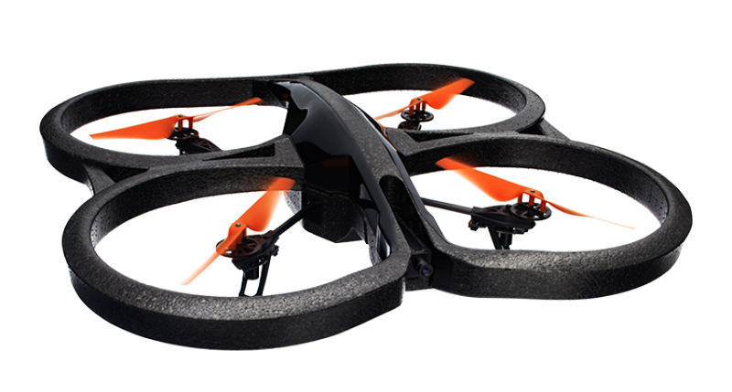
Robot Platforms Used
Creating New Methods for
Capturing Light Fields
PR2
UR10
Baxter
AR Drone

Slide 9
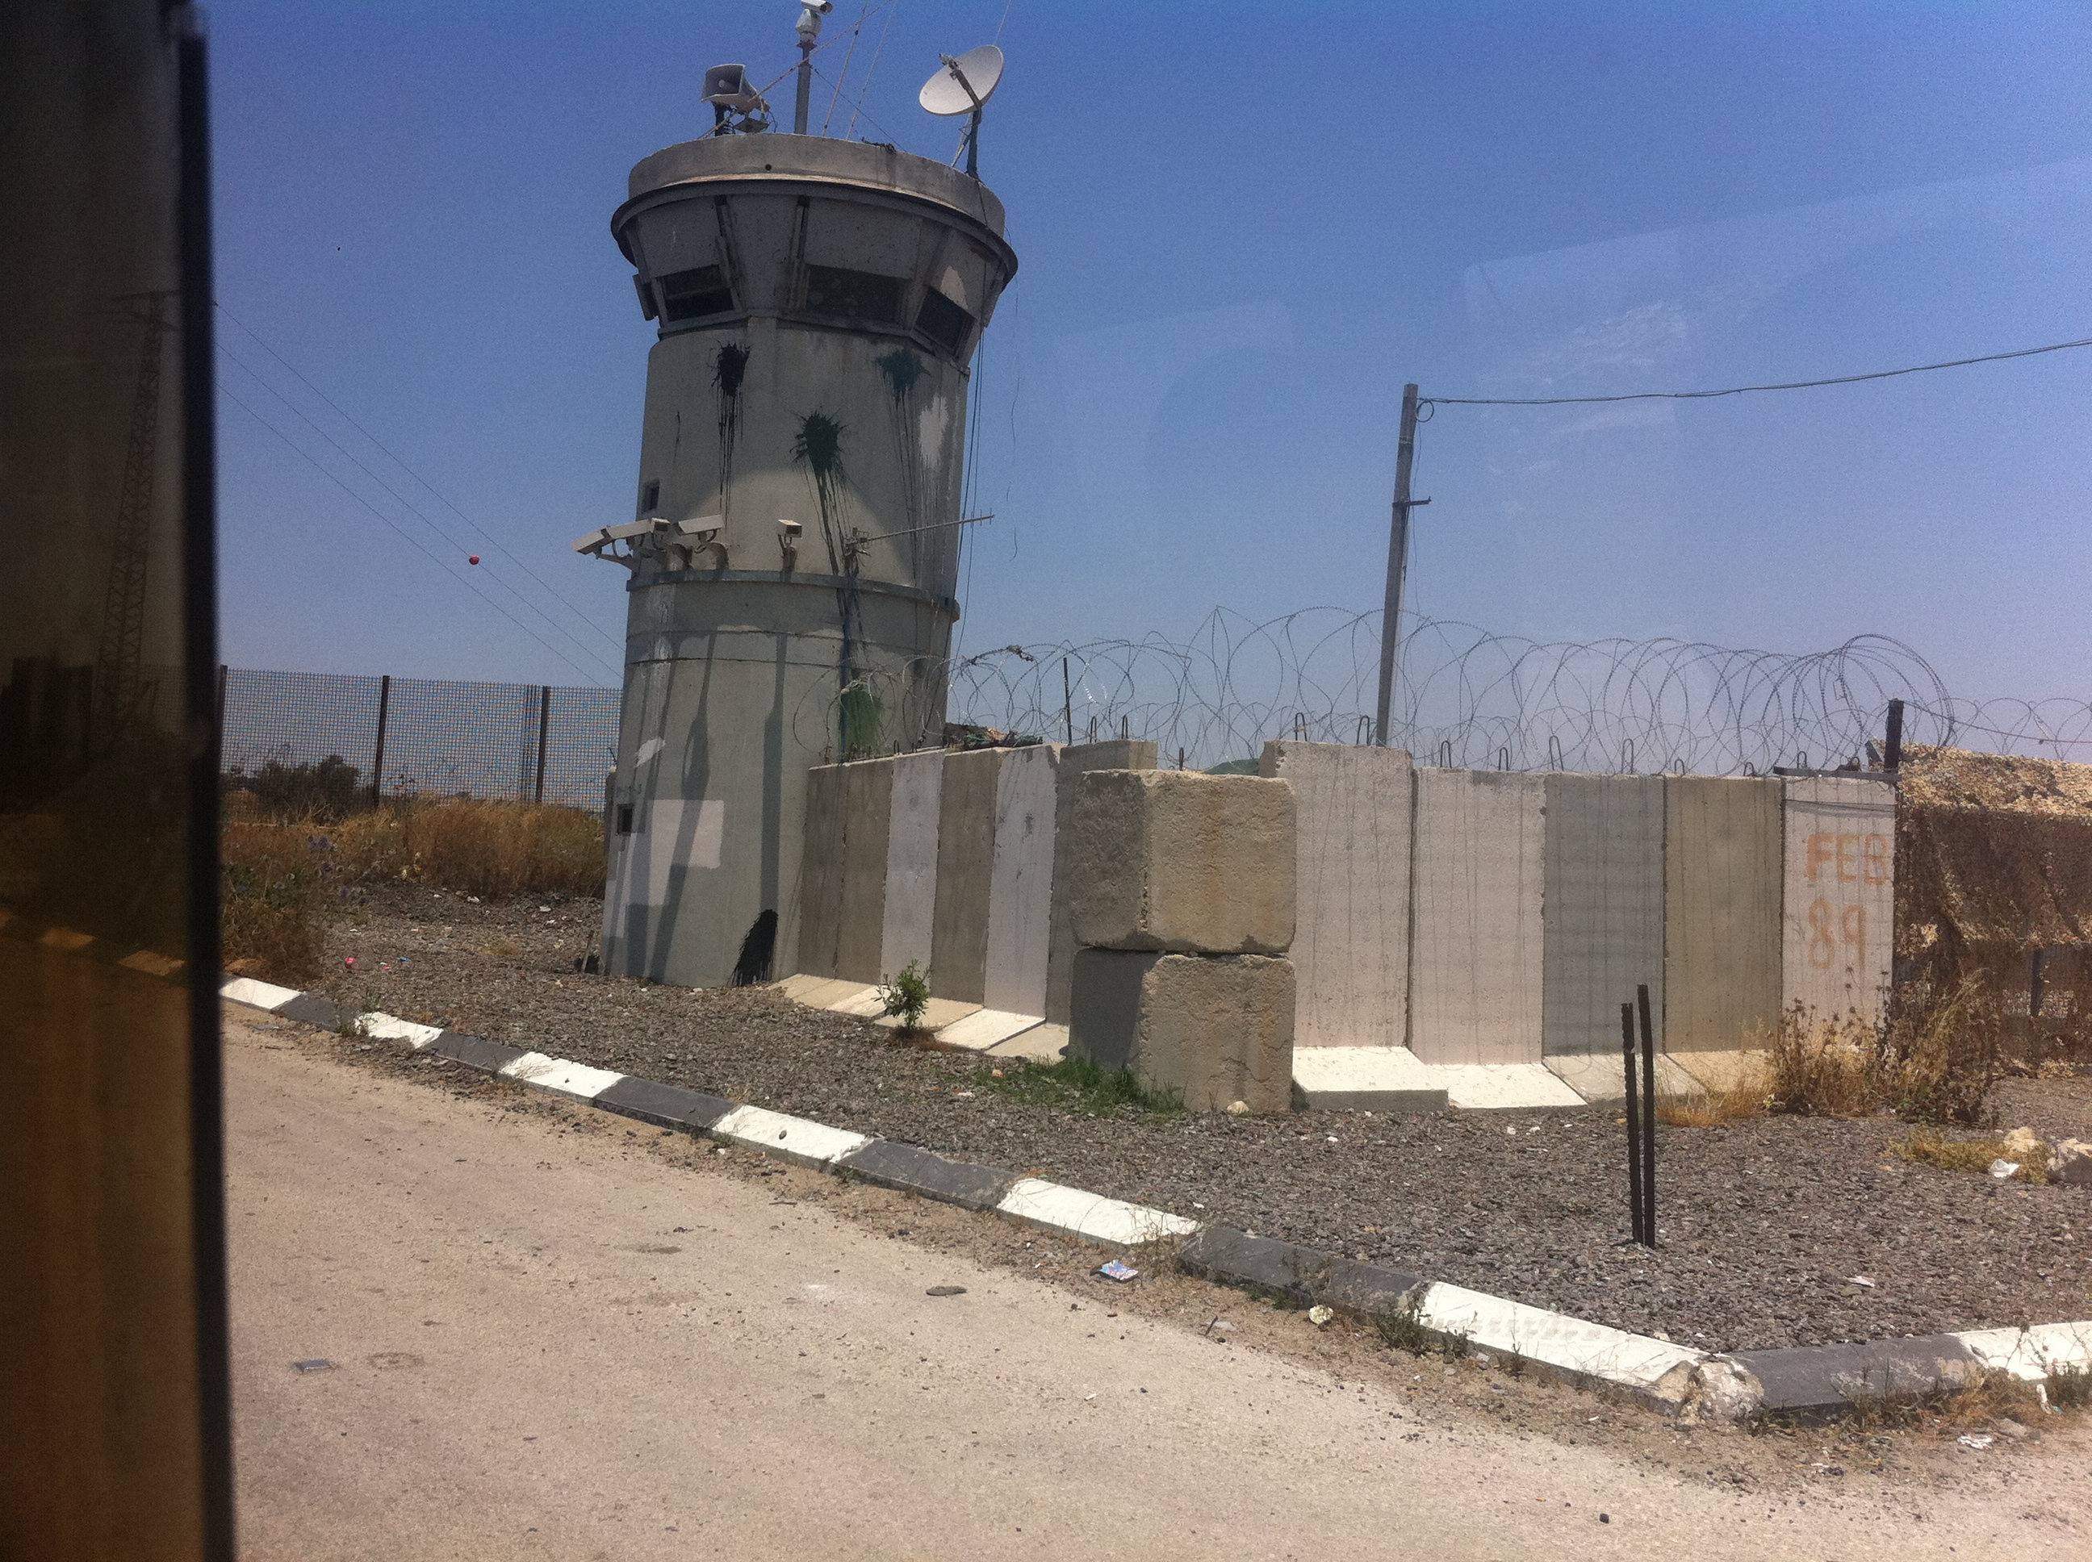
Potential Military Application
Viewing Objects of
Interest

Slide 10
Potential Military Application
Viewing Objects of
Interest

Slide 11
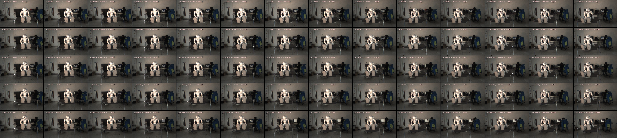
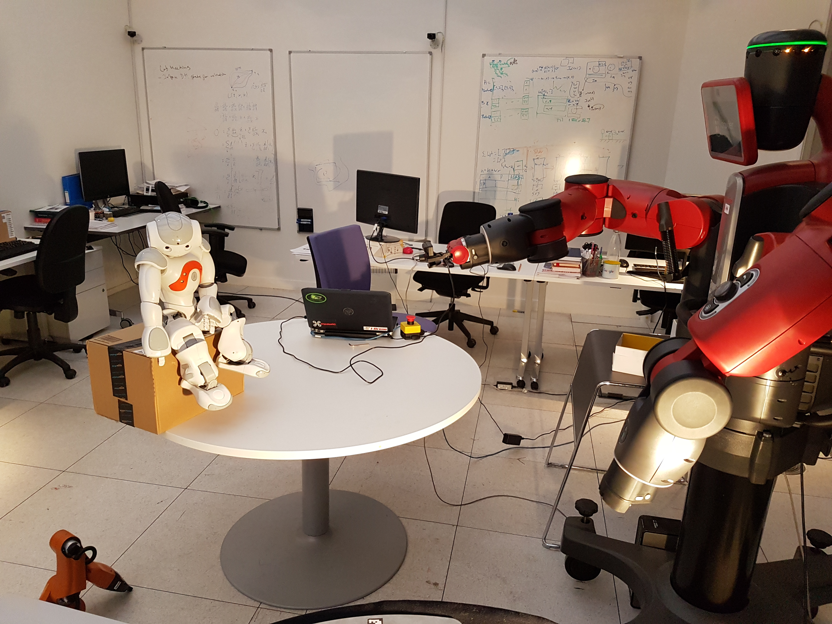
Example Light Field
Slab captured by Baxter robot
Collection in Progress

Slide 12
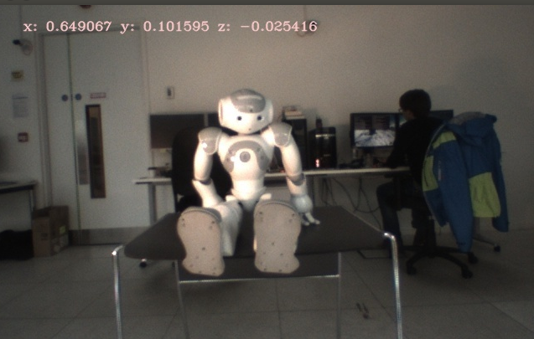
Light Field Example Renderings

Slide 13
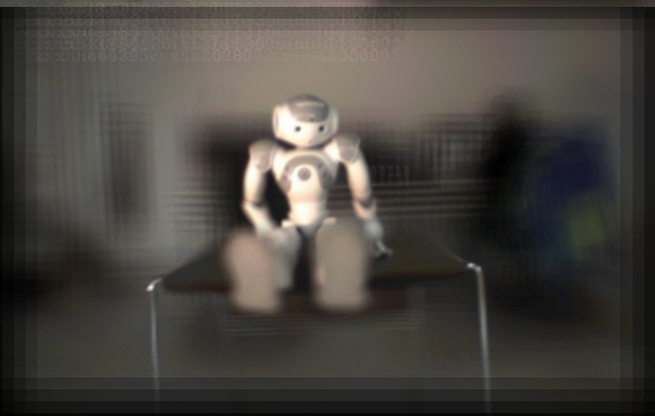

Slide 14
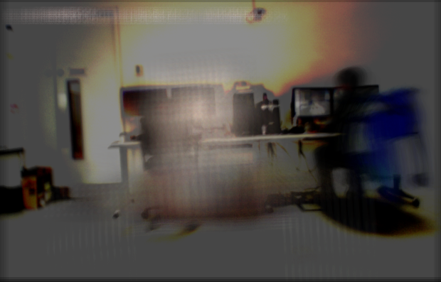

Slide 15
Next Steps
Complete Capture Process
Determine Best Sampling
Frequency for Collection
Expand to Multiple Agents

