Slide 1

CST499 University Portal
Christopher Rodriguez-Wakim

Slide 2
SRS Document Key Aspects
Functional requirements are the specific features that the system needs to be able to perform based on the user and business needs (Functional vs. Non Functional Requirements, 2020).
Functional Requirements:
  New user registration that includes account and profile creation.
  Each new user should have a unique ID associated with a password. The system should guard against two users using the same ID for registration.
  Post registration, users can login to the system at any time using the ID and the password created during the registration process.
  A user can also cancel the enrollment from any course that they are enrolled in.

Slide 3
SRS Document Key Aspects
Non-functional requirements are the specifications of the quality attributes of the system, including the performance, reliability, and security of the system (NonFunctional Requirements in Software Engineering, 2020).
Non-Functional Requirements:
  In terms of response time, it should take no longer than a second or two for the system to respond to any user’s request.
  The system needs to be able to handle a number of concurrent users similar to or equal to the number of students attending the university
  In terms of reliability and availability, the online registration system must be upkept 24 hours a day, seven days a week, except for maintenance periods which will be announced in advance.
  Security is another non-functional requirement that must be focused on, especially since the user profiles contain such sensitive information.

Slide 4
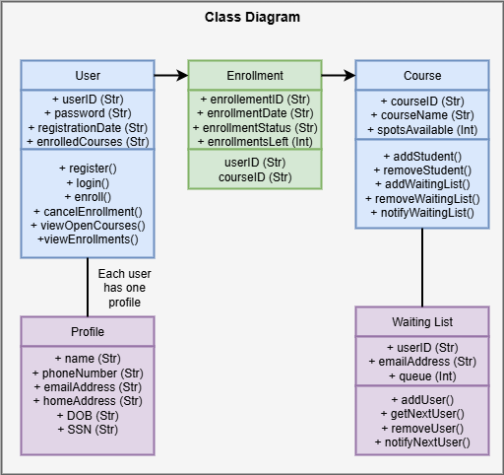
UML Design Models
Class Diagram
  This class diagram showcases how the various classes of the software are connected to one another, in addition to the functions they are able to perform and the variables they contain.

Slide 5
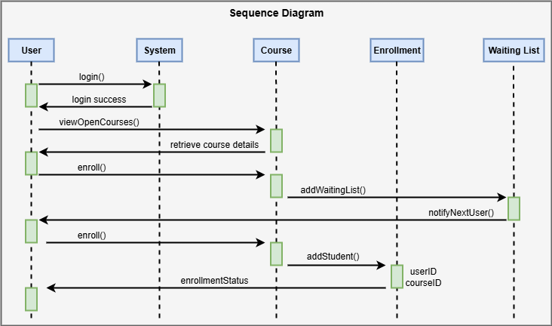
UML Design Models
Sequence Diagram
  This sequence diagram demonstrates how different actions that a user takes cause interactions to occur between objects in the system over a period of time.

Slide 6
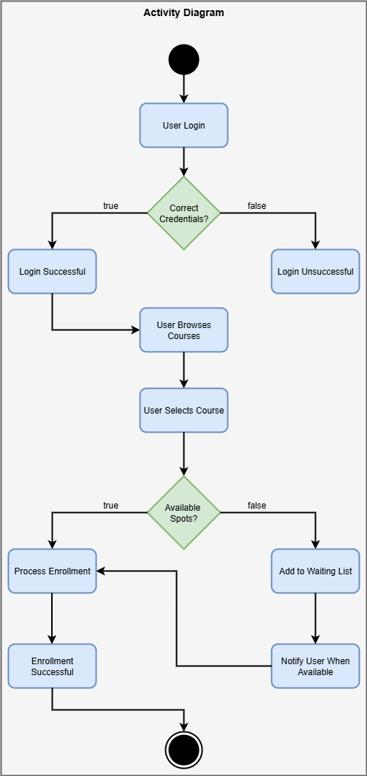
UML Design Models
Activity Diagram
  This activity diagram showcases the workflow of the software system, including the different choices that a user can make and their results.

Slide 7
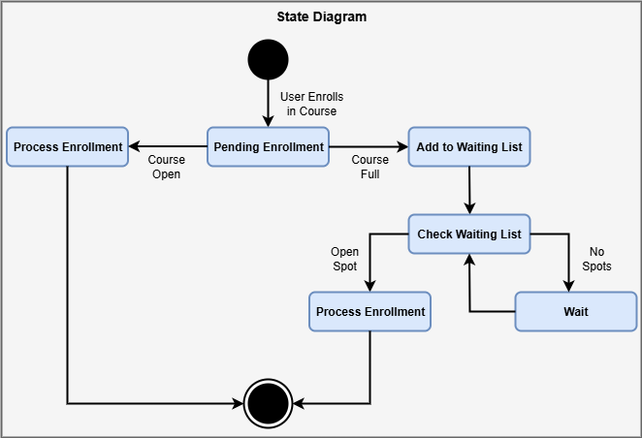
UML Design Models
State Diagram
  This state diagram models the states of the software system and the transitions that occur between those states.

Slide 8
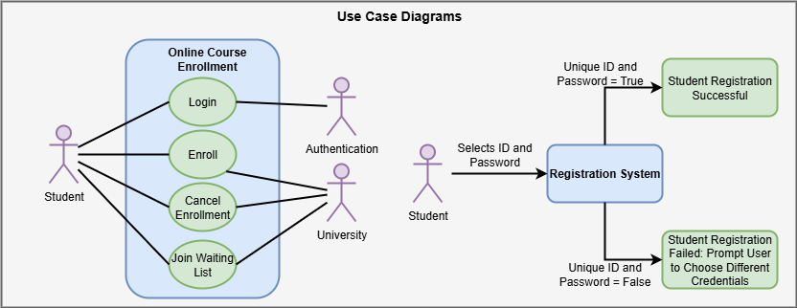
UML Design Models
Use Case Diagram
  These use case diagrams demonstrate how the user might interact with the software system, its components, and other entities associated with it.

Slide 9
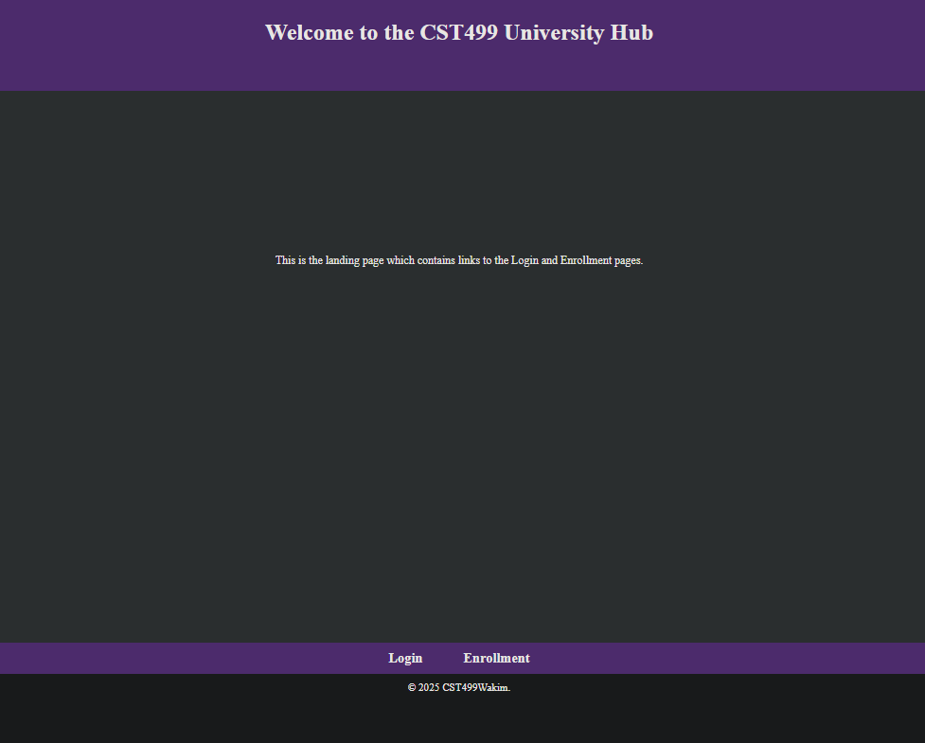
Landing, Login, and Enrollment
The landing page contains a brief introduction to the University Portal and provides links to the login and enrollment pages.

Slide 10
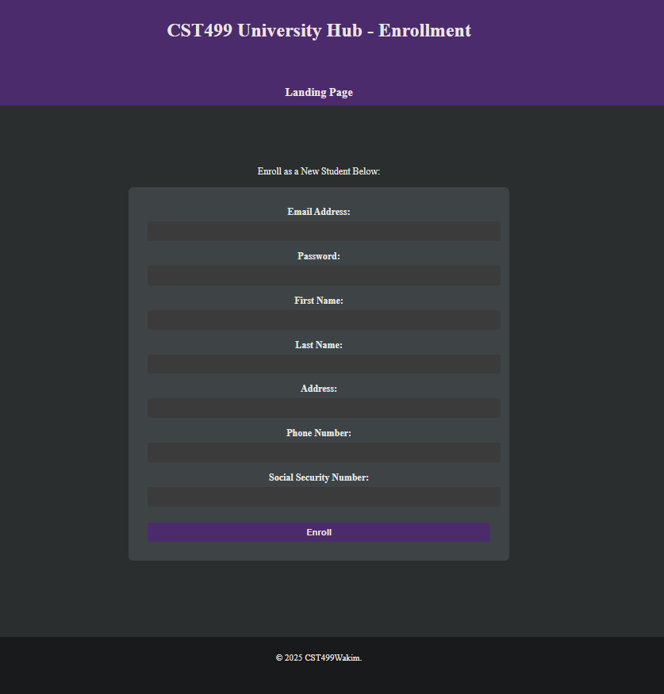
Landing, Login, and Enrollment
The enrollment page prompts users to enroll as a new student by entering their email address, password, first name, last name, address, phone number, and social security number.
If the password that the user enters is not unique, it will cause an error and prompt the user to choose a unique one.
Upon enrolling, the user’s information is saved in the student table in the database.

Slide 11
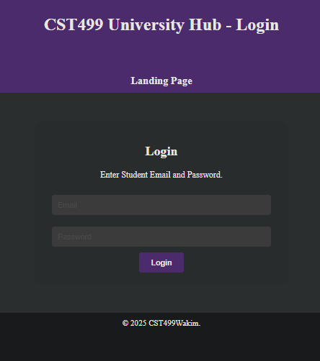
Landing, Login, and Enrollment
The login page allows users to log into the Student Portal using the credentials that they created during the enrollment process.
If the email address or password are incorrect, the user will be prompted to try again.
Upon successfully logging in, the user will be redirected to the Student Portal Homepage.

Slide 12
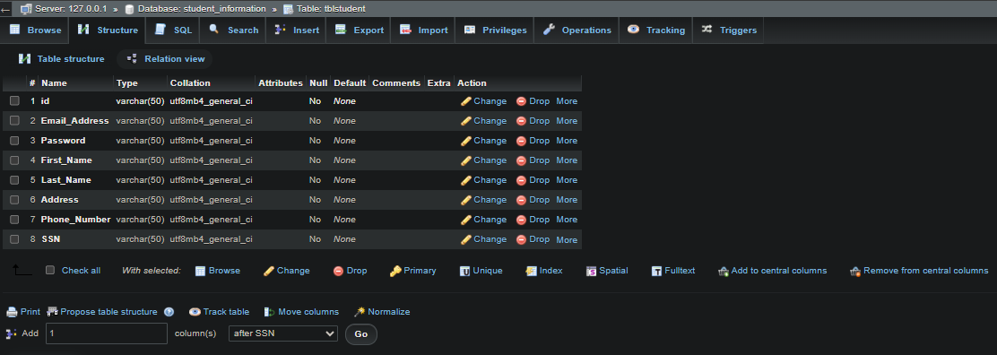
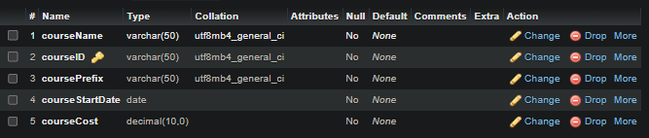
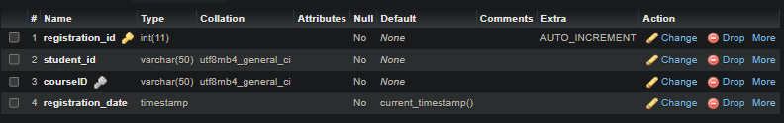
Databases
Three distinct database tables were designed for the University Portal, one to contain all the student information for login purposes, another to contain all the relevant course information, and one more to handle enrollments.

Slide 13
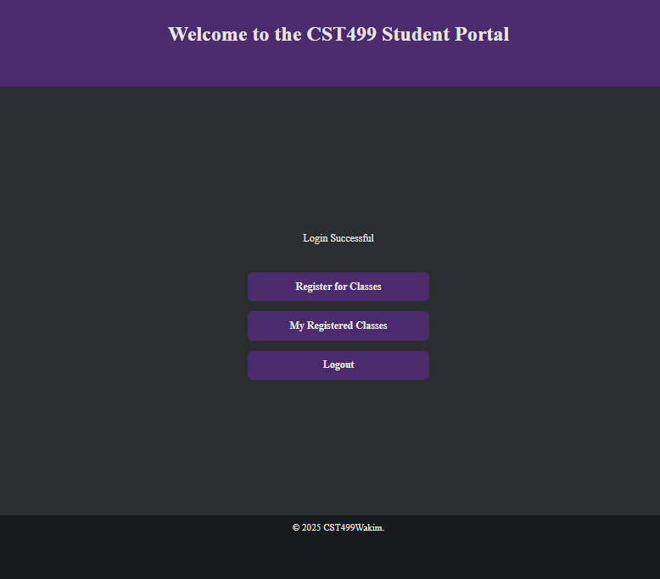
Class Registration
After logging in and being redirected to the Student Portal Homepage, the user has three choices.
They can register for classes, view their registered classes, or logout of the portal.

Slide 14
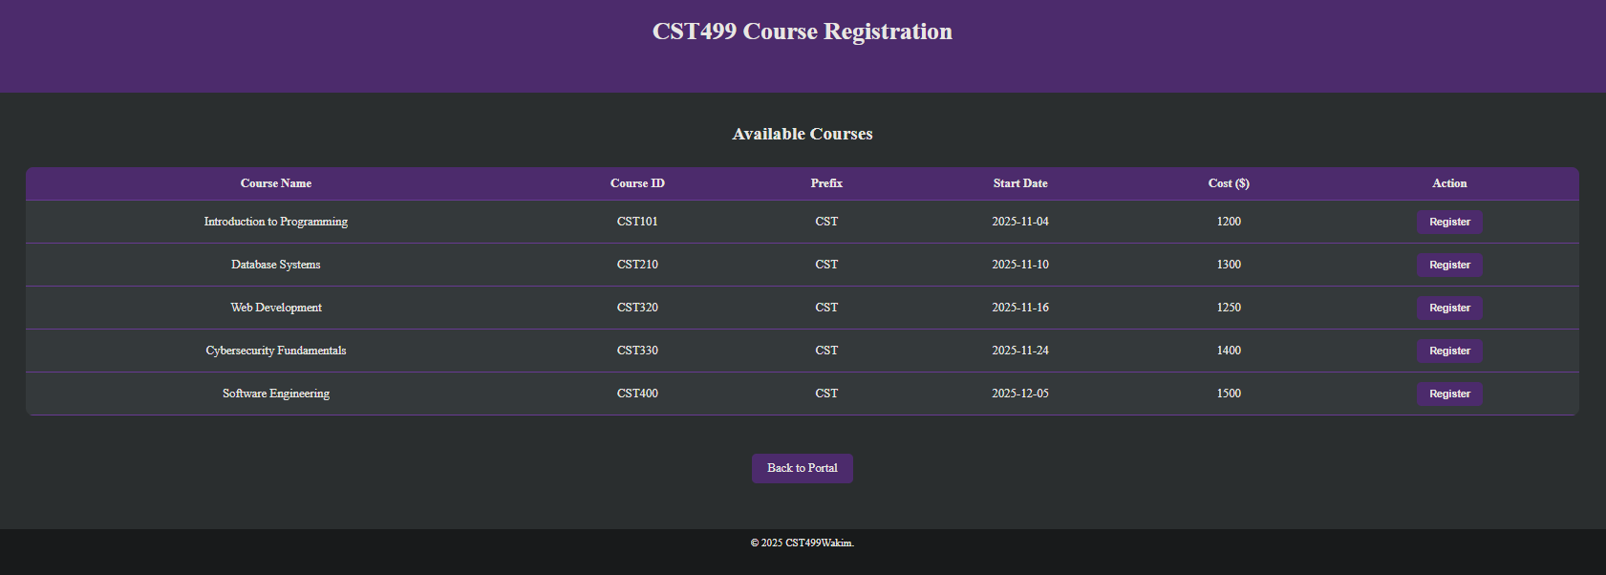
Class Registration
The course registration page contains all the course information retrieved from the database table, including the name, course ID, prefix, start date, and cost.
Next to every course is a register button which will enroll the user in the course and record it in the enrollment database table.
If the user attempts to register for a course they are already enrolled in, it will give them a warning and inform them of the situation.

Slide 15
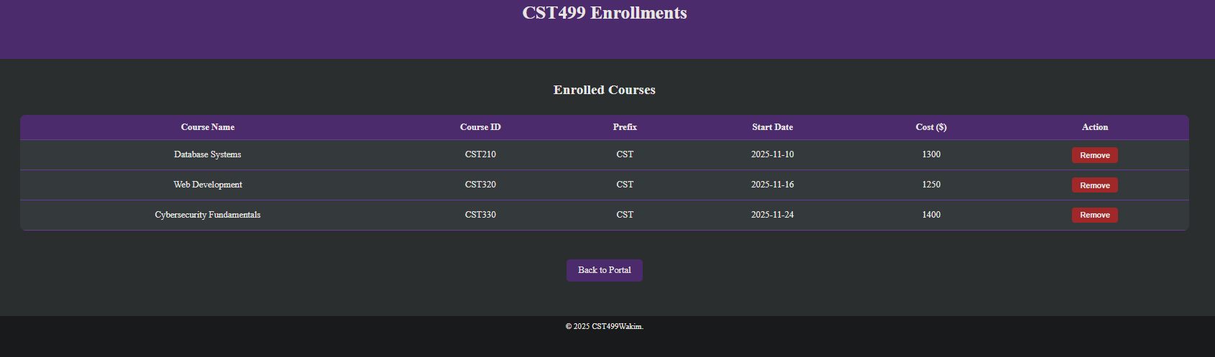
Class Registration
The enrollments page contains all of the courses that the student is currently enrolled for, in addition to information about those courses.
These enrolled courses are stored in the database table, and the user can remove any of them by pressing the remove button on the far right.
When this button is pressed, the course will be simultaneously removed from the database table, as well as the web page.

Slide 16
References
Functional vs. Non Functional Requirements. (2020, April 28). GeeksforGeeks. https://www.geeksforgeeks.org/software-engineering/functional-vs-non-functional-requirements/
NonFunctional Requirements in Software Engineering. (2020, June 3). GeeksforGeeks. https://www.geeksforgeeks.org/software-engineering/non-functional-requirements-in-software-engineering/
Tsui, F., Karam, O., & Bernal, B. (2018). Essentials of software engineering (4th ed.). Jones & Bartlett Learning.

Slide 17
Thank You University of Arizona Global Campus!
Christopher Rodriguez-Wakim

