Slide 1
Procedural Programming

Slide 2
In this approach problem viewed as sequence of things to be done like reading, calculating and printing.
The POP basically consist of writing a list of instructions for the computer to follow and organizing these instructions into groups known as functions.
Number of functions are written to accomplish these tasks. The main focus is on the functions.

Slide 3
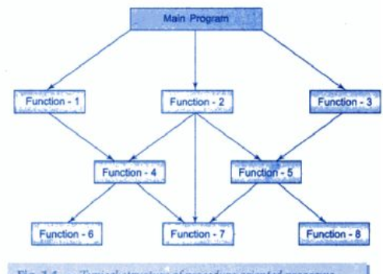
Structure of procedure oriented programs

Slide 4
We use flowchart to organize the actions.
We concentrate on the development of the functions.
But we need to concentrate on what happens to the data?
How is the data affected?

Slide 5
In the multi-function program many important data items are placed as global so that they may be accessed by the functions.
Each functions has its own local data also.

Slide 6
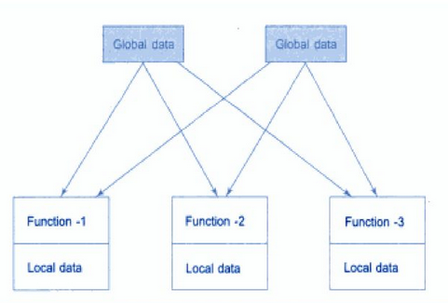
Relationship of data and functions in POP

Slide 7
Global data is more vulnerable.
In large program it is very difficult to identify what data is used by which function.
POP does not model real world problems very well. This is because functions are action oriented.

Slide 8
Characteristics of POP
Emphasis on doing things(algorithms).
Large program divided into smaller programs known as functions.
Most functions share global data.
Data move openly around system from function to function.
Employs top down approach in program design.

Slide 9
Disadvantages of POP
Unrestricted Access.
Data is exposed to whole program, so no security for data.
Difficult to relate with real world objects. Separate data and functions.
Importance is given to the operation on data rather then the data.
Increase complexity when program becomes large.
A change in global data may necessitate rewriting all the functions that access that item.
Doesn’t emphasize on what to do to solve problem.
Difficult to modify.

Slide 10
Advantages of POP
Efficiency - procedural programs can be fast and use a few memory.
Simplicity - procedural programs are often easy to understand and maintain.
Ease of Implementation - procedural languages are generally easier to learn and use than, for example, object-oriented languages.

Slide 11
