Slide 1
Tracking Maternal Health Progress Toward SDG 3.1
IBM EDUNET PROJECT
Presented By:
1. Siddharth Raj-Haridwar University-CSE

Slide 2
OUTLINE
Problem Statement
Proposed System/Solution
System Development Approach
TECHNOLOGY USED
Algorithm & Deployment
Result
Conclusion
Git-hub Link
Future Scope
References

Slide 3
Problem Statement
The Challenge: Maternal mortality remains a major global health concern, with large disparities across regions and income groups. Under Sustainable Development Goal (SDG) 3.1, countries aim to reduce the maternal mortality ratio to less than 70 per 100,000 live births by 2030. However, monitoring progress toward this target is challenging due to the involvement of multiple influencing factors such as antenatal care coverage, skilled birth attendance, adolescent birth rates, and healthcare expenditure. Manual analysis of these indicators across countries is time-consuming and limits timely, data-driven decision-making.

Slide 4
Proposed Solution
This project uses maternal health data from the AI Kosh SDG dataset and analyzes it using IBM Cloud Lite services. By using IBM watsonx.ai Studio, the project studies how factors like antenatal care, skilled birth attendance, adolescent birth rates, and healthcare spending affect maternal mortality. The goal is to understand which countries are doing well and which are at risk in achieving SDG 3.1.
  Analyzes country-wise maternal health data using IBM Cloud.
  Uses machine learning to predict maternal mortality risk.
  Helps track progress toward the SDG 3.1 target.

Slide 5
System Approach
The system collects maternal health data from the AI Kosh dataset and processes it using Python on IBM watsonx.ai Studio. Machine learning models are built and deployed on IBM Cloud Lite to analyze maternal mortality and track progress toward SDG 3.1.
Collect maternal health data from the AI Kosh SDG dataset.
Preprocess and clean the data using Python.
Analyze key indicators affecting maternal mortality.
Build machine learning models using IBM watsonx.ai Studio.
Deploy the best model on IBM Cloud Lite for prediction.

Slide 6
TECHNOLOGY USED
IBM cloud lite services
IBM watsonx.ai Studio
IBM AutoAI
Python
Jupyter Notebook
AI Kosh SDG Dataset (CSV)

Slide 7
IBM CLOUD SERVICES USED
IBM Cloud Watsonx AI Studio
IBM Cloud Watsonx AI runtime
IBM Cloud Agent Lab
IBM Granite foundation model

Slide 8
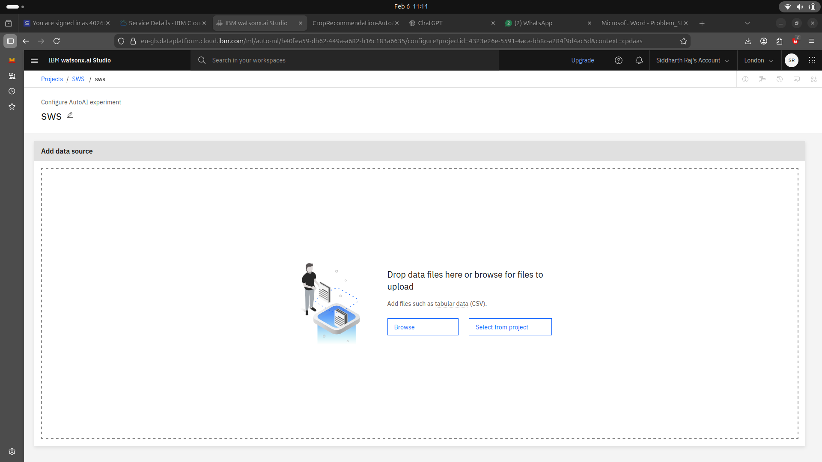
Result

Slide 9
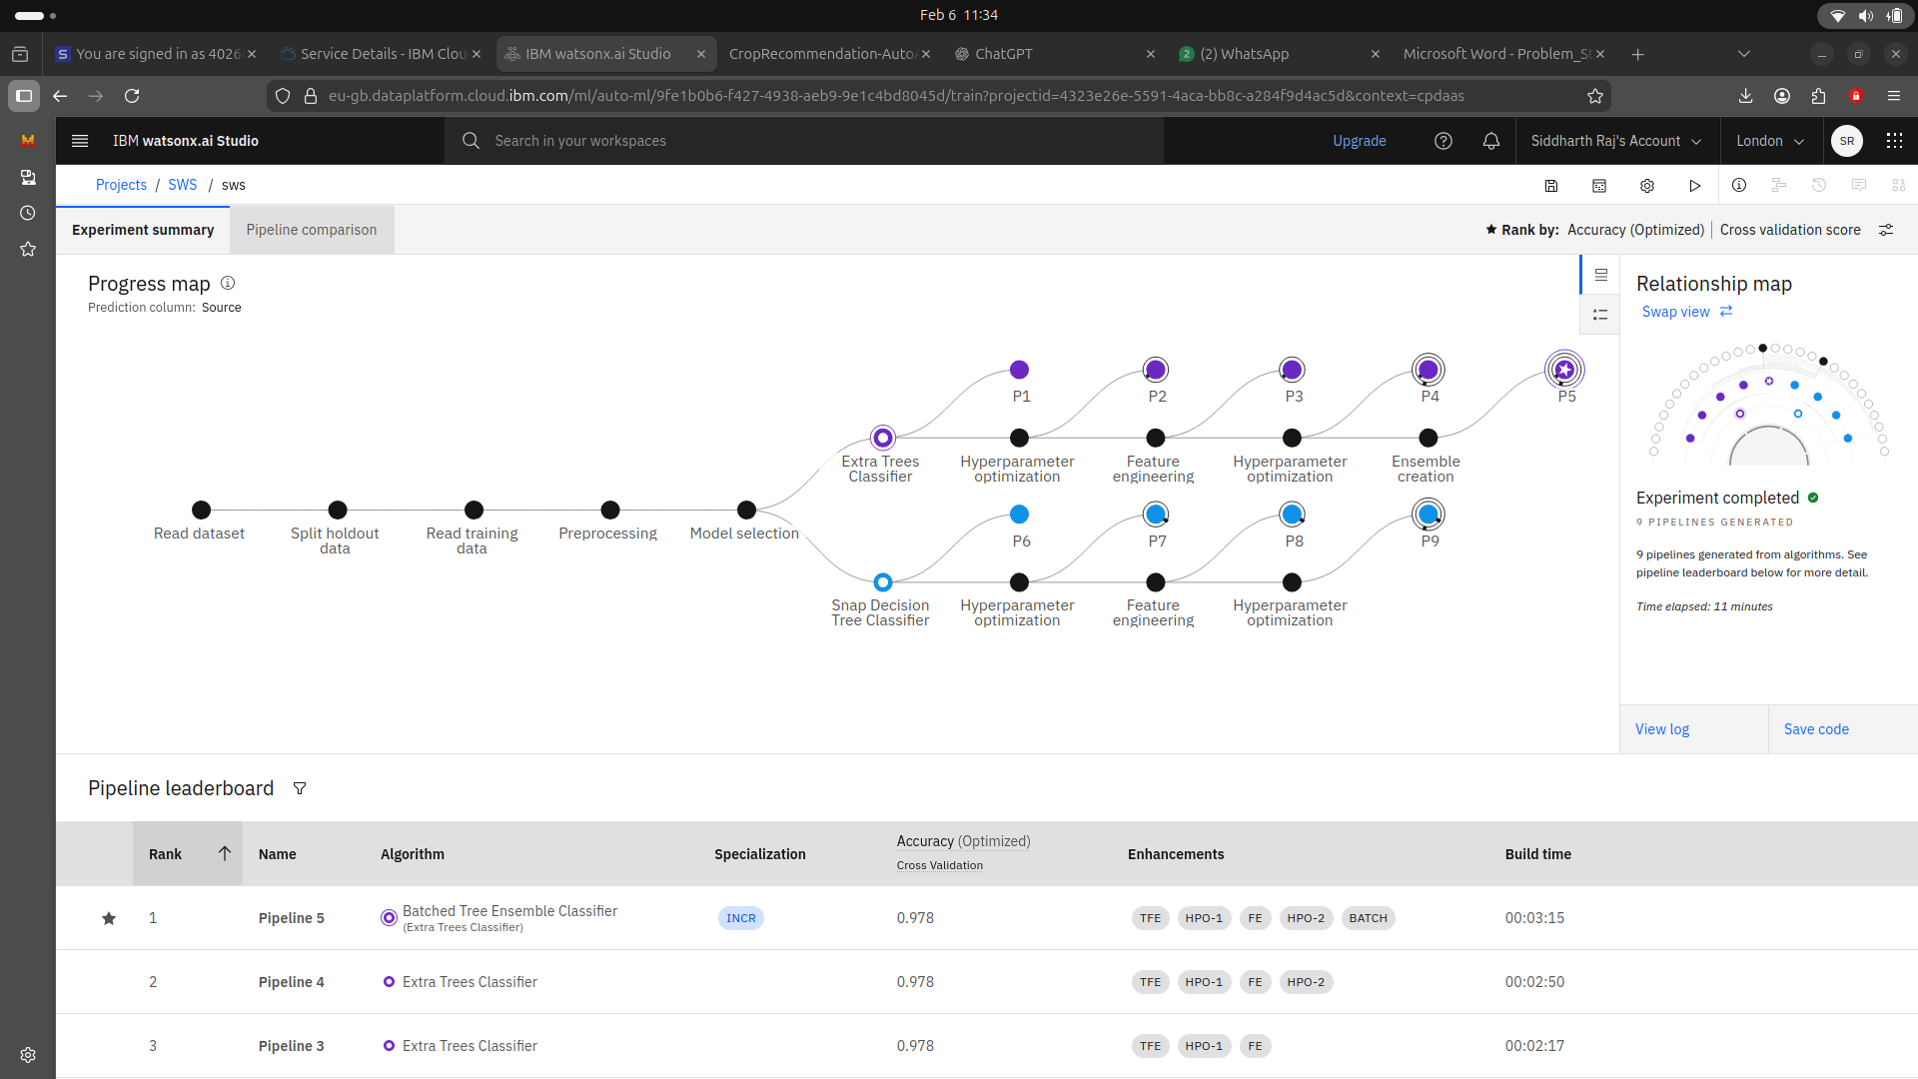
Result

Slide 10
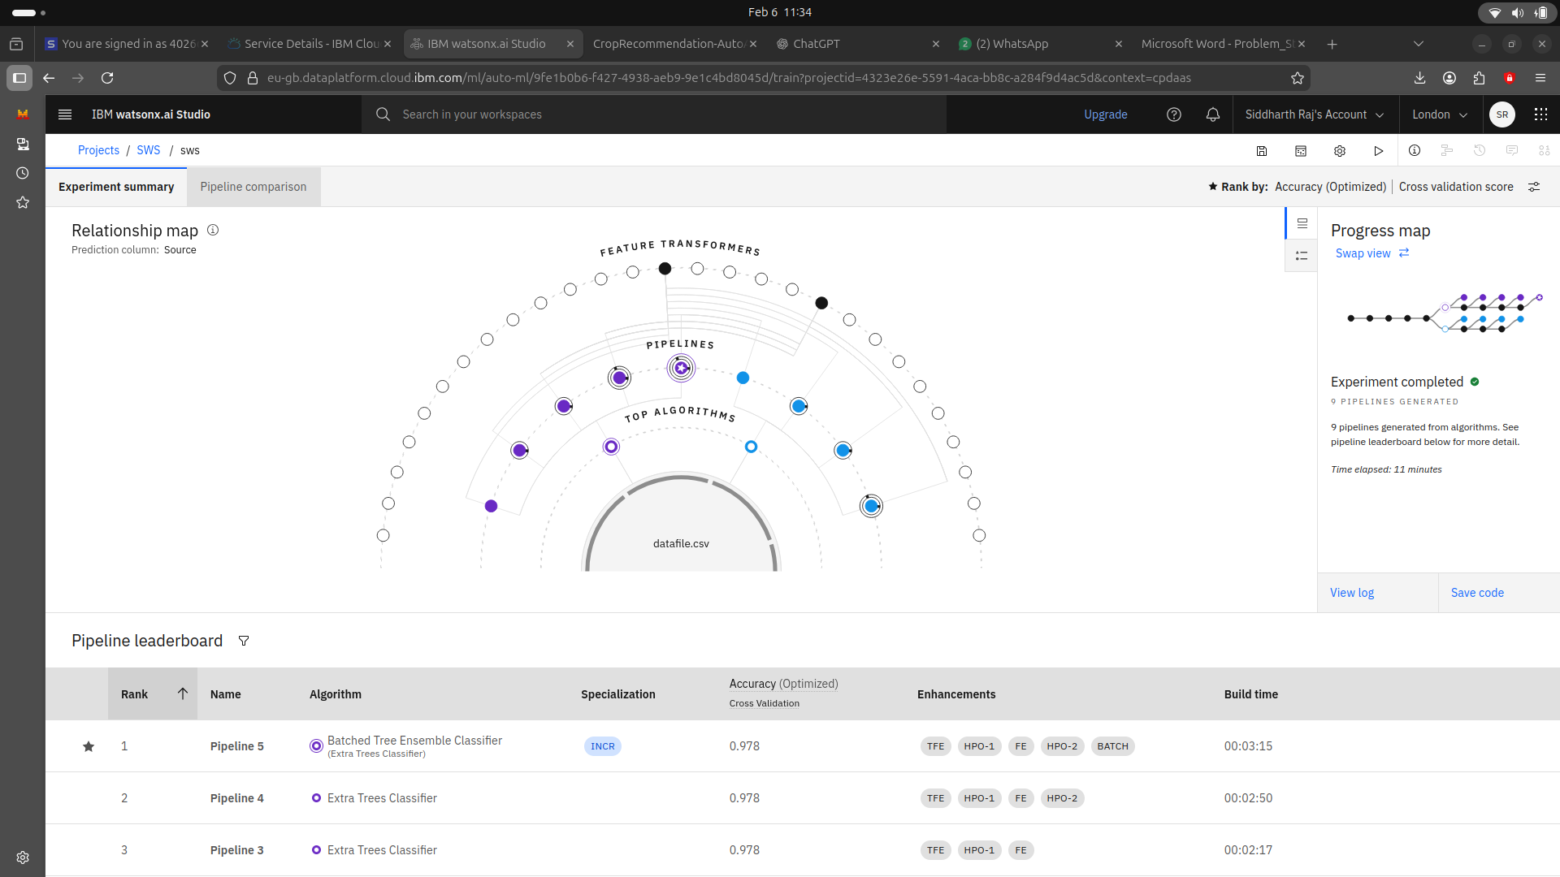
Result

Slide 11
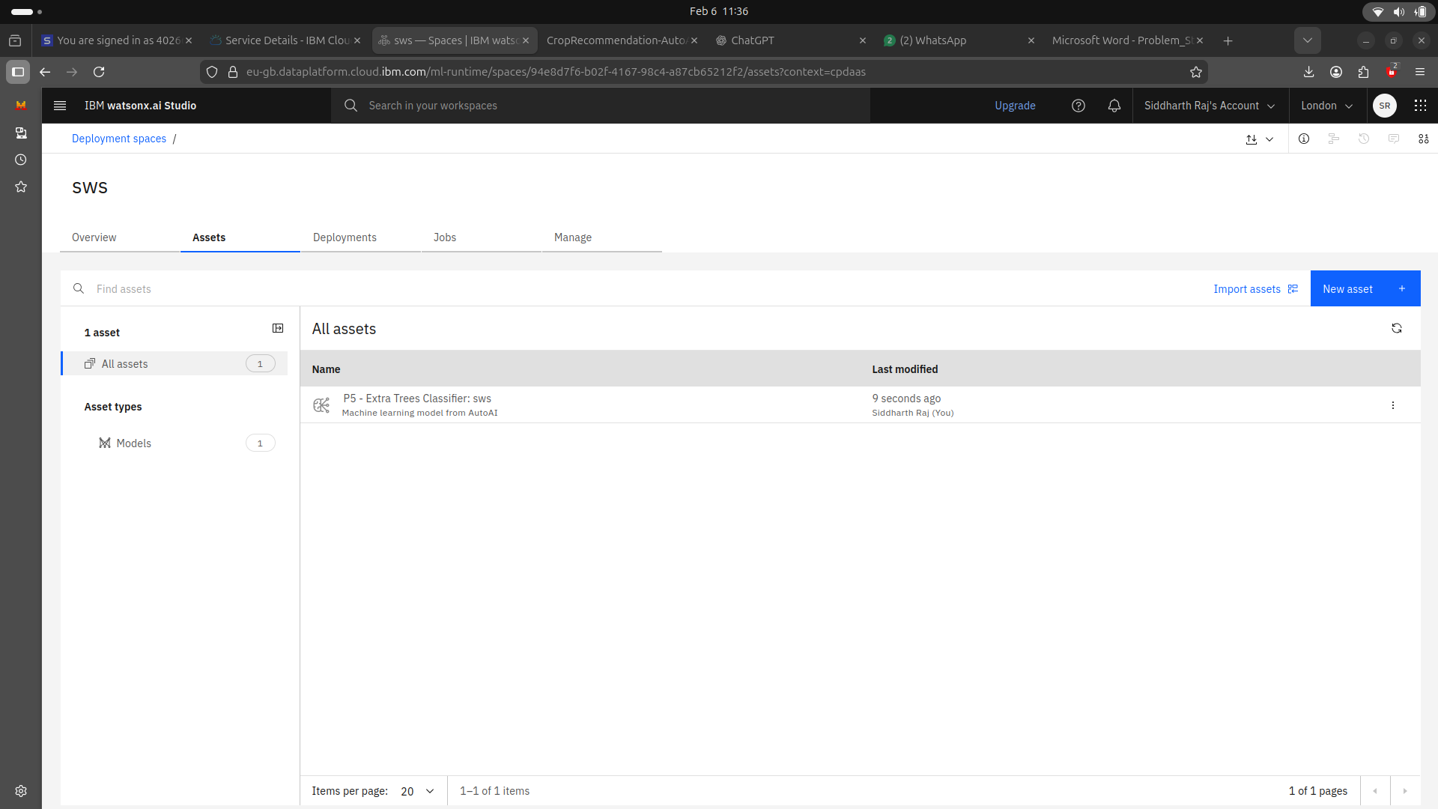
Result

Slide 12
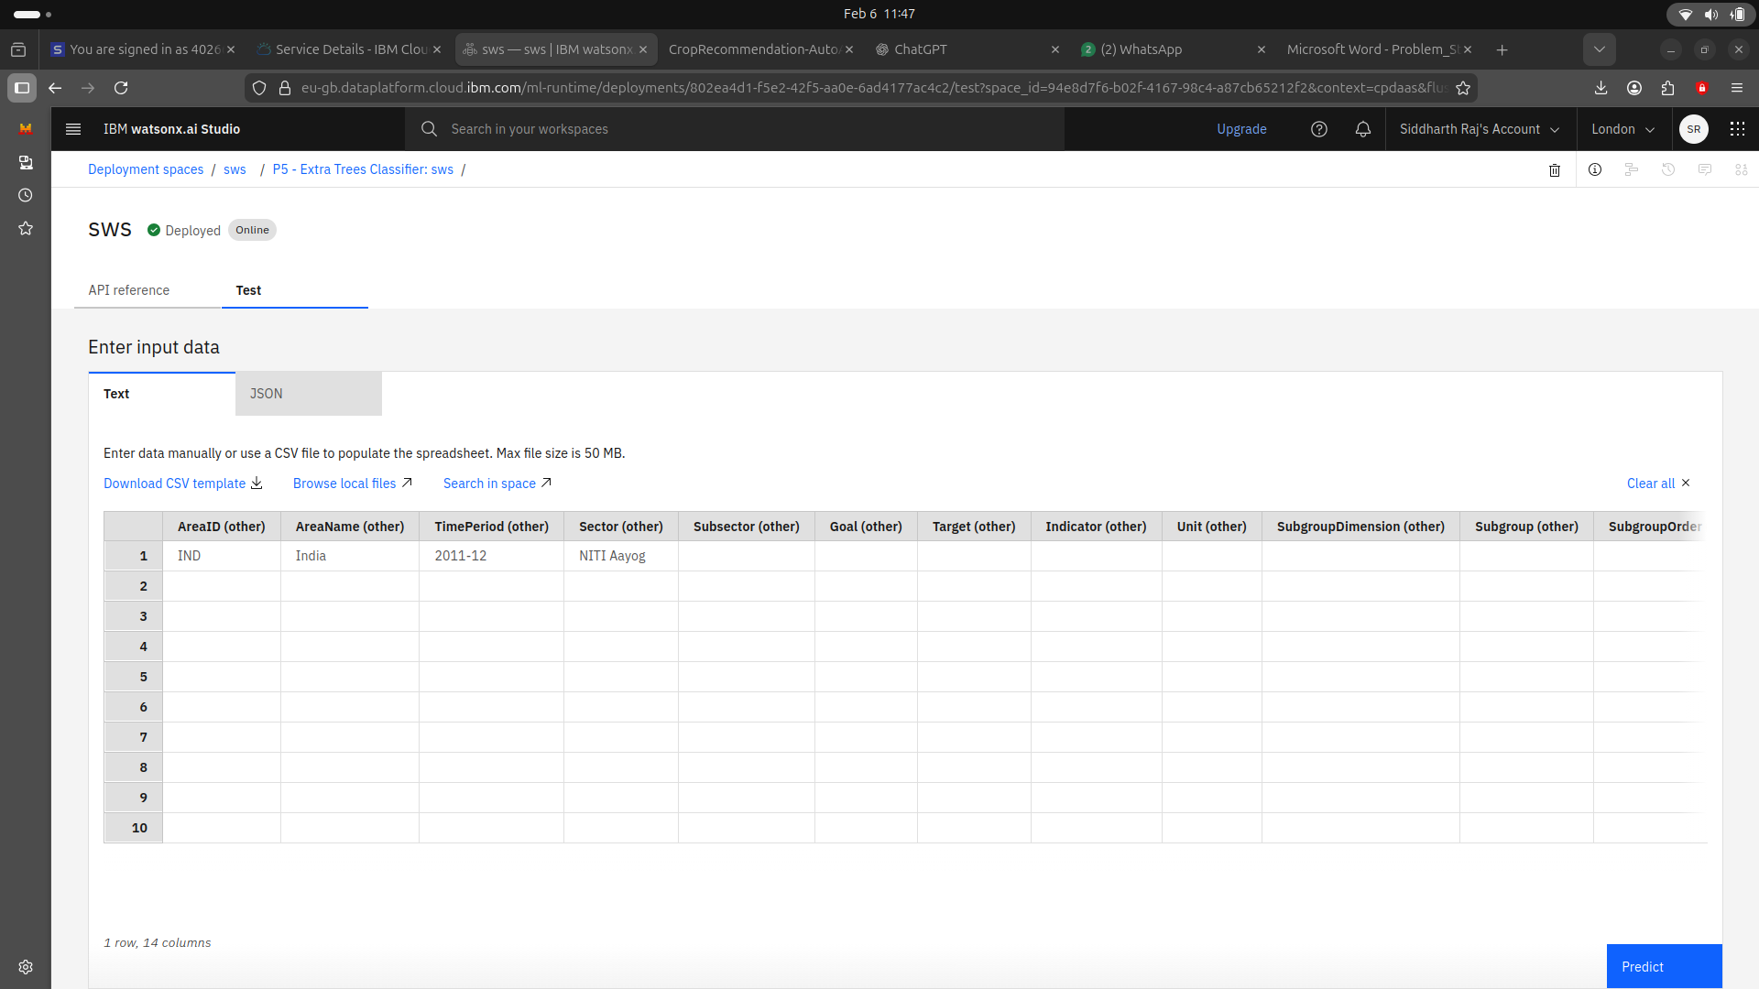
Result

Slide 13
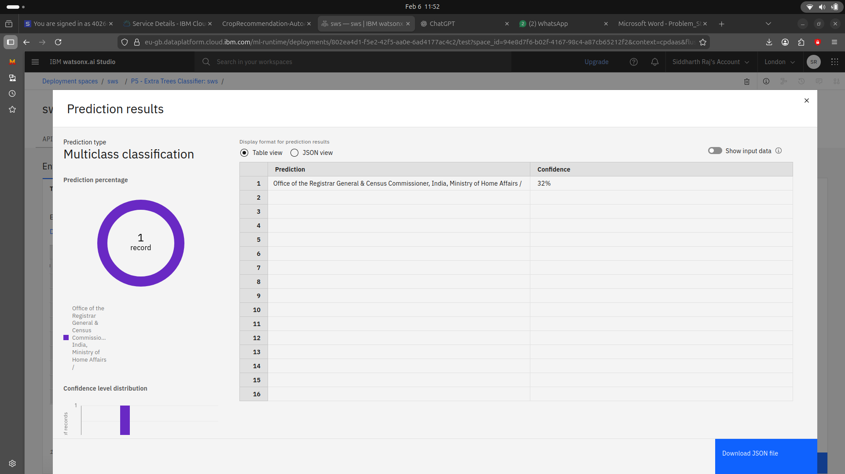
Result

Slide 14
Conclusion
This project uses cloud-based data analysis and machine learning to study maternal health and track progress toward SDG 3.1. By analyzing key maternal health indicators, the system helps understand factors influencing maternal mortality and supports better planning and decision-making in public health.
The system analyzes maternal health data to assess SDG 3.1 progress.
Machine learning automation reduces manual analysis effort.
The approach improves accuracy and efficiency in maternal health analysis.
Cloud deployment enables easy access and scalability.

Slide 15
Git-hub Link
https://github.com/cry-wizard/SDG-3.1-Maternal-Mortality-Analysis-IBM-Cloud.git

Slide 16
Future scope
Integration of real-time and more recent maternal health data
Region-wise and country-wise comparative dashboards
Advanced predictive models for improved accuracy
AI-based policy recommendation support
Integration with public health monitoring systems

Slide 17
References
AI Kosh – SDG National Indicator Framework Dataset
United Nations Sustainable Development Goals (SDG 3.1)
IBM Cloud and IBM watsonx.ai Studio Documentation
World Health Organization (WHO) Maternal Health Reports

Slide 18
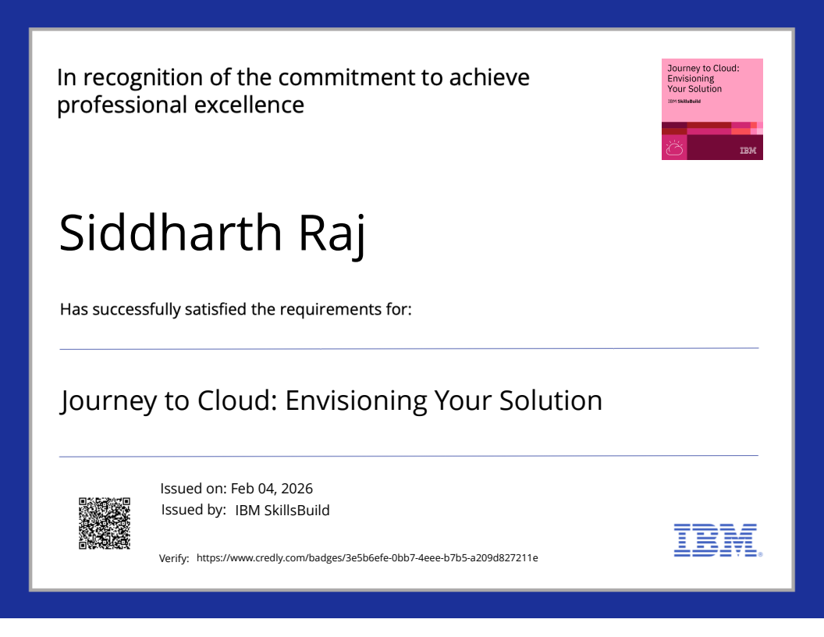
IBM CERTIFICATIONS

Slide 19
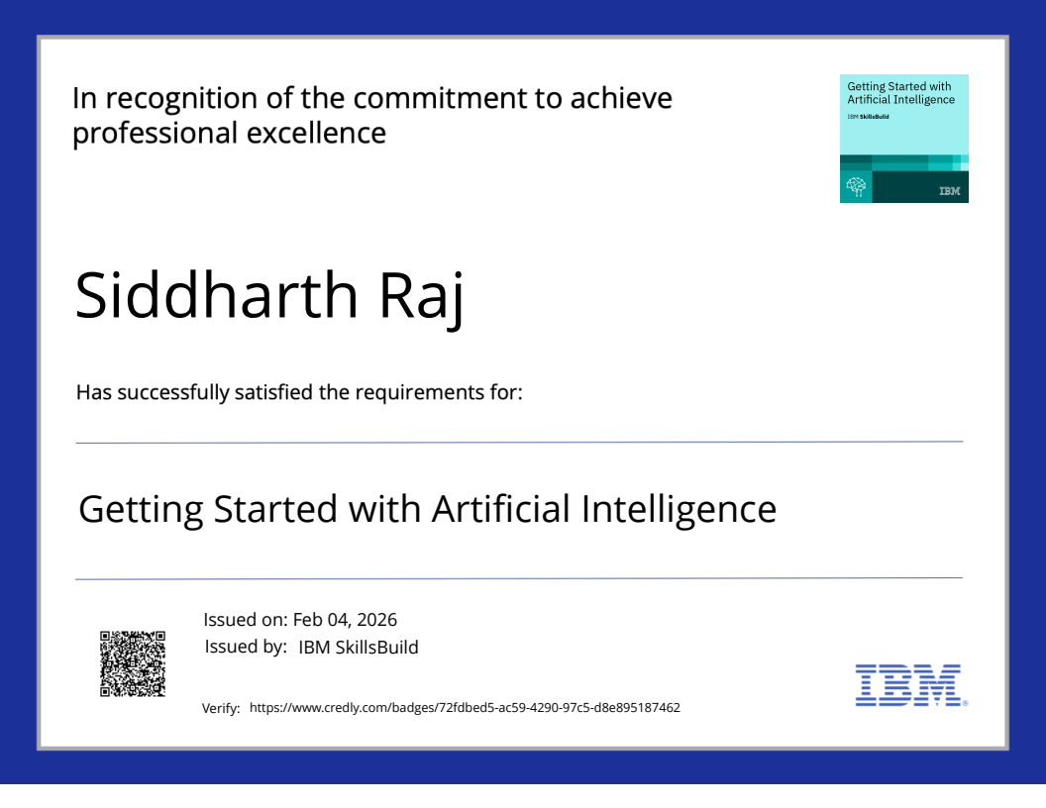
IBM CERTIFICATIONS

Slide 20
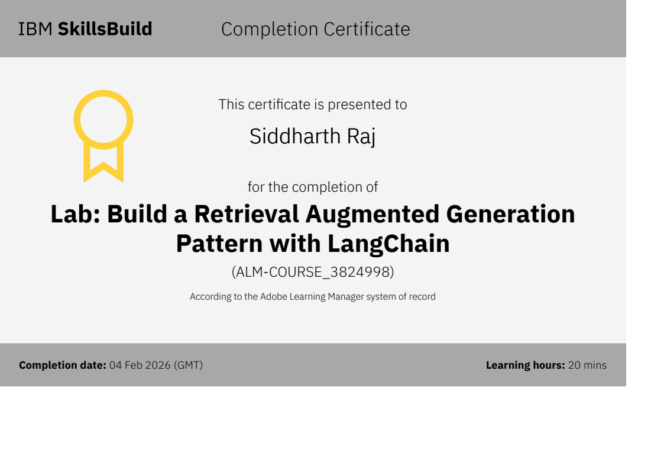
IBM CERTIFICATIONS

Slide 21
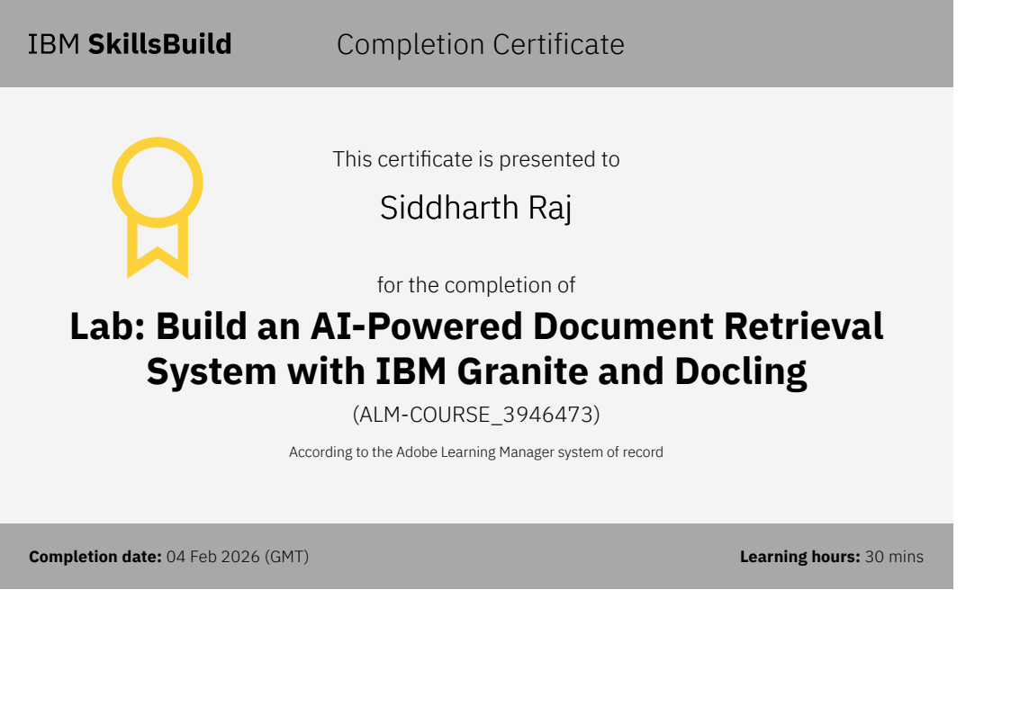
IBM CERTIFICATIONS

Slide 22
THANK YOU

