Slide 1


Tranexamic Acid (TXA) in Trauma: Does a Different Phenotype Require a Different Treatment?
https://github.com/cryanking/cryanking.github.io/tree/main/lectures/tark
Christopher Ryan King, MD, PhD
Associate Professor
Washington University in St Louis School of Medicine

Slide 2
Travmada Traneksamik Asit (TXA): Farklı Bir Fenotip Farklı Bir Tedavi Gerektirir mi?
https://github.com/cryanking/cryanking.github.io/tree/main/lectures/tark
Christopher Ryan King, MD, PhD
Doçent
Washington University in St Louis School of Medicine

Slide 3
Learning objectives and Disclosures
Why is TXA used in DCR?
What evidence supports the efficacy of TXA in DCR?
Does neurotrauma benefit from TXA?
Does time-since-injury modify the efficacy of TXA?
Does shock severity modify the efficacy of TXA?
Does fibrinolytic phenotype on viscoelastic testing modify the efficacy of TXA?
Does antiplatelet status modify the efficacy of TXA?
I have no financial conflicts of interest.
I will discuss both clinical tests approved in the EU but not the United States, and tests that are used only in research.
02 EN
Notes:
I was asked today to discuss the evidence behind TXA in trauma, and if we should use it differently in subgroups of patients.
I have no financial conflicts of interest. I will discuss clinical tests used in Europe and assays used only in research.

Slide 4
Öğrenim hedefleri ve çıkar çatışması bildirimi
Hasar kontrol resüsitasyonunda (DCR) TXA neden kullanılır?
DCR'de TXA'nın etkinliğini hangi kanıtlar destekler?
Nörotravmada TXA yarar sağlar mı?
Yaralanmadan sonra geçen süre TXA'nın etkinliğini değiştirir mi?
Şokun şiddeti TXA'nın etkinliğini değiştirir mi?
Viskoelastik testteki fibrinolitik fenotip TXA'nın etkinliğini değiştirir mi?
Antiplatelet ilaç kullanımı TXA'nın etkinliğini değiştirir mi?
Finansal çıkar çatışmam yoktur.
Avrupa Birliği'nde onaylı olup Amerika Birleşik Devletleri'nde onaylı olmayan klinik testleri ve yalnızca araştırmalarda kullanılan testleri tartışacağım.
02 TR

Slide 5
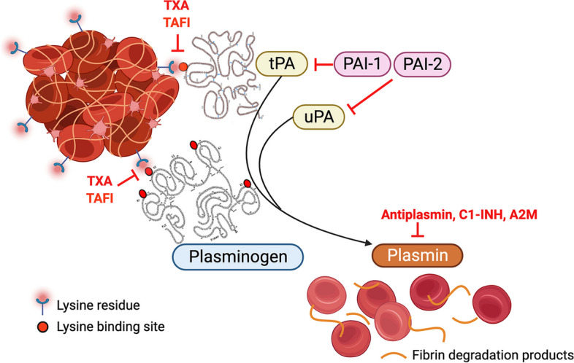
TXA targets surface-localized plasmin biology
Lysine binding localizes plasminogen to fibrin and cells
Endogenous tPA transforms bound plasminogen to plasmin
Plasmin degrades fibrin, exposing more binding sites and disrupting clot
PAI-1 suppresses tPA activity, antiplasmin binds plasmin to down-regulate
TXA competes for lysine binding
Inhibiting clot lysis does not eliminate all plasmin generation
Source: 10.1186/s12959-023-00540-0
03 EN
Notes:
A core aspect of coagulopathy in trauma and DCR is degradation of clot due to pathological up-regulation of endogenous fibrinolysis. Higher than normal levels of tPA overwhelm degradation by PAI-1, and higher than normal levels of plasmin overwhelm binding by antiplasmin, allowing breakdown of clot to propagate systemically. TXA competitively inhibits the tPA-dependent creation of plasmin from plasminogen, which should stabilize clot.
There are other biochemical mechanisms that TXA may have relevant effects on, such as complement binding and glycocalyx shedding, which I am omitting here because they have lower levels of evidence, but they provide a reasonable alternative mechanism in some settings.
Blocking clot breakdown does not mean blocking all plasmin generation. TXA can make plasminogen easier for urokinase to activate. This is one proposed explanation for later resumption of lysis.
References:
Lysine-dependent regulation: https://pubmed.ncbi.nlm.nih.gov/22974122/
Platelet-associated plasminogen activation: https://pubmed.ncbi.nlm.nih.gov/15894352/
Human complement study: https://pubmed.ncbi.nlm.nih.gov/40879162/
Longstaff & Locke 2019: https://pmc.ncbi.nlm.nih.gov/articles/PMC6334274/
Human Draxler study: https://pubmed.ncbi.nlm.nih.gov/33443933/
Wu et al., uPA active-site inhibition: https://pmc.ncbi.nlm.nih.gov/articles/PMC6418500/
Source: 10.1186/s12959-023-00540-0

Slide 6
TXA, yüzeye bağlanmış plazminojen/plazmin sistemini hedefler
Lizin bağlanması, plazminojeni fibrine ve hücrelere yönlendirir
Endojen tPA, bağlı plazminojeni plazmine dönüştürür
Plazmin fibrini parçalar; yeni bağlanma bölgeleri açığa çıkar ve pıhtı bozulur
PAI-1 tPA aktivitesini baskılar; antiplazmin plazmine bağlanarak aktivitesini azaltır
TXA, lizin bağlanma bölgeleri için yarışır
Pıhtı lizisinin inhibisyonu, tüm plazmin oluşumunu ortadan kaldırmaz
Kaynak: 10.1186/s12959-023-00540-0
03 TR
Notes:
References (same source figures and evidence as English slide):
Lysine-dependent regulation: https://pubmed.ncbi.nlm.nih.gov/22974122/
Platelet-associated plasminogen activation: https://pubmed.ncbi.nlm.nih.gov/15894352/
Human complement study: https://pubmed.ncbi.nlm.nih.gov/40879162/
Longstaff & Locke 2019: https://pmc.ncbi.nlm.nih.gov/articles/PMC6334274/
Human Draxler study: https://pubmed.ncbi.nlm.nih.gov/33443933/
Wu et al., uPA active-site inhibition: https://pmc.ncbi.nlm.nih.gov/articles/PMC6418500/

Slide 7
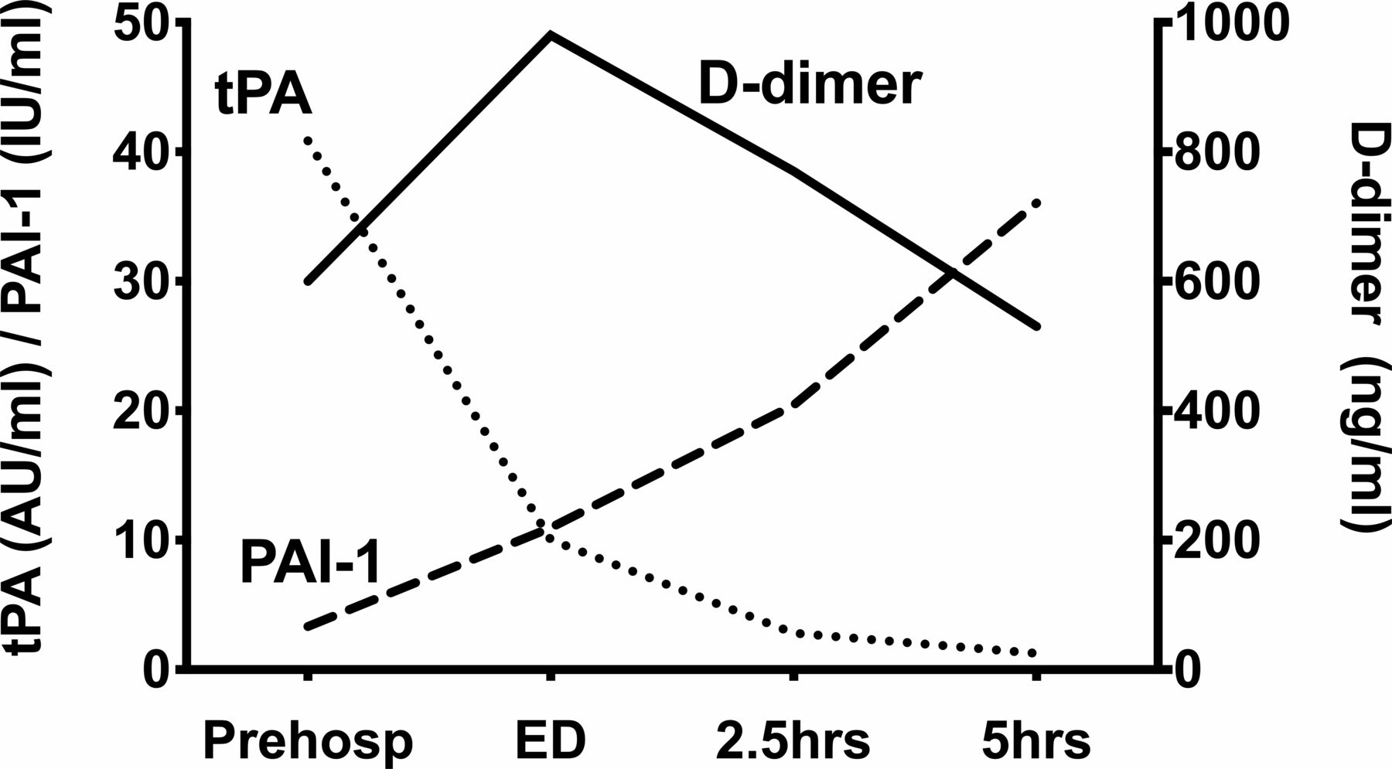
The activator-inhibitor balance changes over time
Tissue destruction causes massive initial release of tPA
PAI-1 peaks much later
Fibin degradation product (d-dimer) and plasmin degradation products (PAP) are cleared more slowly
Sampling time and treatment alter the apparent phenotype
Source: 10.1136/emermed-2019-209181
04 EN
Notes:
This diagram comes from a classic smaller study, but it is representative of what you will see in more recent ones as well. I will give a caveat that not all the laboratory methods used are interchangeable, and the levels are not interchangeable with activity.
What we see is that with severe injury, there is a massive release of tPA, with split fibrin products peaking in the hours after injury, followed by increasing PAI-1 and reduction of tPA to normal or near-normal levels.
This provides us with the major motivation for TXA use in prehospital settings and initial resuscitation: if we can get past the first 2-3 hours with high levels of tPA, perhaps we can avoid clot breakdown promoting ongoing blood loss and the issues discussed by the other presenters during DCR. However, TXA isn't without risks. There are subgroups of patients in whom it may increase the risk of venous thromboembolism or provoke seizures. Therefore, if we could have a more targeted use of it, that would be beneficial. We may also suspect that because this diagram is an average and not a uniform pathway for patients, that we may see some patients in whom more TXA is helpful.
References:
Human early tPA/PAI-1 time course: https://emj.bmj.com/content/37/3/135
Serial tPA antigen, PAI-1 activity/antigen, and antiplasmin: https://pubmed.ncbi.nlm.nih.gov/7514044/
DAMPs and serial fibrinolysis markers: https://pubmed.ncbi.nlm.nih.gov/37674235/
Overwhelming tPA release in traumatic hyperfibrinolysis: https://pubmed.ncbi.nlm.nih.gov/26491796/
Source: 10.1136/emermed-2019-209181

Slide 8
Aktivatör–inhibitör dengesi, fenotip adı değişmeden önce değişir
Doku hasarı başlangıçta büyük miktarda tPA salınmasına yol açar
PAI-1 çok daha sonra zirveye ulaşır
Fibrin yıkım ürünü (D-dimer) ve plazmin yıkım ürünleri (PAP) daha yavaş temizlenir.
Örnekleme zamanı ve tedavi, gözlenen fenotipi değiştirir
Kaynak: 10.1136/emermed-2019-209181
04 TR
Notes:
References (same source figures and evidence as English slide):
Human early tPA/PAI-1 time course: https://emj.bmj.com/content/37/3/135
Serial tPA antigen, PAI-1 activity/antigen, and antiplasmin: https://pubmed.ncbi.nlm.nih.gov/7514044/
DAMPs and serial fibrinolysis markers: https://pubmed.ncbi.nlm.nih.gov/37674235/
Overwhelming tPA release in traumatic hyperfibrinolysis: https://pubmed.ncbi.nlm.nih.gov/26491796/

Slide 9
Major trauma trials establish overall modest efficacy
TXA versus placebo in patients with shock or risk of severe bleeding
Remarkably large studies
Reasonable early-timepoint differences, small later-timepoint ones
Trial | Population | Start | TXA regimen | Mortality
CRASH-2 2010 | n=20,211 Bleeding / at risk Hospital | ≤8 h | 1 g / 10 min + 1 g / 8 h 2 g total | 4 weeks 14.5% vs 16.0% RR 0.91 (0.85–0.97)
STAAMP 2020 | n=903 analyzed Hypotension or tachycardia Prehospital | ≤2 h | Prehospital 1 g / 10 min Then no more (1 g total), 1 g / 8 h (2 g total), or 1 g bolus + 1 g / 8 h (3 g total) | 30 days 8.1% vs 9.9% Overall nonsignificant
PATCH 2023 | n=1,310 recruited Advanced systems Prehospital | ≤3 h | Prehospital 1 g / 10 min Then 1 g / 8 h 2 g total | 28 days 17.3% vs 21.8% Secondary outcome
Mazzei 2024 Secondary analysis | n=1,744 STAAMP + ROC-TBI Hemorrhage risk / TBI | ≤2 h Parent trials | STAAMP: 1 / 2 / 3 g total ROC: 1 g + 1 g infusion or 2 g bolus Placebo controls | 28 days: 10.5% vs 12.1% Unadjusted p=.31 Adjusted HR 0.72 (0.54–0.96), p=.03
CRASH-2: enrollment ≤8 h; timing analysis supports initiation ≤3 h. STAAMP combines regimens. Mazzei reuses parent-trial participants.
05 EN
Notes:
This theory worked out reasonably well in practice. These three trials established modest differences in mortality, although early timepoints overall showed more signal than late ones, which we might expect given the short-term impact of the treatment. Notably these trials focused on prehospital or emergency department administration, although some patients received TXA later.
A pooled individual-participant analysis of STAAMP and a prehospital TBI trial also suggests a survival benefit. The unadjusted comparison was uncertain. After adjustment, the hazard ratio was 0.72.
References:
Original trial: https://pubmed.ncbi.nlm.nih.gov/20554319/
STAAMP: https://pmc.ncbi.nlm.nih.gov/articles/PMC7536625/
PATCH: https://www.nejm.org/doi/full/10.1056/NEJMoa2215457
STAAMP design and dosing regimens: https://pmc.ncbi.nlm.nih.gov/articles/PMC4623322/
PATCH protocol: https://doi.org/10.1136/bmjopen-2020-046522
Mazzei 2024 pooled individual-participant analysis: https://pmc.ncbi.nlm.nih.gov/articles/PMC11422517/

Slide 10
Trial | Main enrollment criteria | How bleeding risk was operationalized
CRASH-2 | Trauma patients appearing ≥16 years, within 8 h of injury, with significant hemorrhage or considered at risk; clinician uncertain whether to give an antifibrinolytic. | Significant hemorrhage: SBP <90 mm Hg and/or HR >110/min. Alternatively, clinician judgment of risk was sufficient, even without those thresholds. No required transfusion, bleeding-volume threshold, or coagulation assay. Protocol
STAAMP | Ages 18–90, injured patients undergoing prehospital transport or interhospital transfer to a participating trauma center within approximately 2 h of injury. | At least one prearrival episode of SBP ≤90 mm Hg or HR ≥110/min, as described in the final publication. Thus, tachycardia alone could qualify; persistent shock or confirmed major bleeding was unnecessary.
PATCH-Trauma | Adults ≥18, any injury mechanism, COAST score ≥3, with prehospital study drug feasible within 3 h, and transport to a participating trauma center. | A structured prediction of acute traumatic coagulopathy, using injury pattern and physiology—not laboratory confirmation. Suspected pregnancy and nursing-home residence were exclusions. Protocol
CRASH-3 | Adults ≥16 with TBI, GCS ≤12 OR any intracranial bleeding on CT, and no major extracranial bleeding. Initially within 8 h, amended to 3 h in 2016; clinician uncertainty required. | Selected for clinically important TBI/intracranial bleeding, rather than systemic hemorrhagic shock. The protocol described significant extracranial bleeding as bleeding requiring immediate transfusion. CT-confirmed bleeding allowed enrollment with GCS 13–15. Trial report, protocol
ROC-TXA TBI / Rowell trial | Age ≥15, suspected blunt or penetrating TBI, GCS 3–12, ≥1 reactive pupil, SBP ≥90 mm Hg, and treatment initiation within 2 h. | Prehospital neurological criteria; CT confirmation was not required before randomization. The SBP criterion selected patients without hypotension at enrollment, rather than patients with hemorrhagic shock. Trial
Trial | Enrollment and definition of risk
TAMPITI | Adults ≥18, treatment within 2 h, with traumatic injury requiring ≥1 unit RBC or an emergency operation for possible bleeding control. This used treatment requirements rather than vital signs alone. Trial
POISE-3 | Age ≥45, inpatient noncardiac surgery, with specified cardiovascular/bleeding-risk criteria. Qualification included established vascular disease, NT-proBNP ≥200, major vascular surgery, or a combination of risk factors. Procedures judged low risk were excluded; active bleeding was not required. Eligibility details
TRACTION | Adults ≥18 undergoing major inpatient noncardiac surgery with an estimated ≥5% RBC-transfusion risk. The protocol included open procedures or laparoscopic procedures expected to last ≥3 h. Risk was defined prospectively by the procedure. Protocol
ATACAS | Adults undergoing on- or off-pump coronary surgery, with or without additional procedures, at increased risk of complications because of age or comorbidity. This was perioperative prophylaxis, without an active-hemorrhage requirement. Trial
HeLiX | Adults ≥18 scheduled for open or minimally invasive liver resection for a cancer-related indication, including suspected cancer or precancer. Selection was procedure based, without a required bleeding-risk score. Trial
WOMAN | Women ≥16 with clinically diagnosed postpartum hemorrhage: estimated loss >500 mL after vaginal birth, >1,000 mL after cesarean, or any loss compromising hemodynamic stability; clinician uncertainty required. Trial
HALT-IT | Adults with significant acute upper/lower GI bleeding and clinician uncertainty. “Significant” meant risk of bleeding to death, indicated by hypotension, tachycardia, shock, or anticipated transfusion/urgent endoscopy/surgery. No mandatory numerical blood-loss threshold. Trial methods
Notes:
PATCH’s COAST score: entrapment 1 point; SBP 90–99 = 1, <90 = 2; temperature 32–<35°C = 1, <32°C = 2; major chest injury likely to require intervention 1; suspected intra-abdominal/pelvic injury 1. ≥3 points qualified; use only the highest category within each physiological item. Trial registry
For the resuscitation studies discussed alongside TXA: PROPPR required early blood-component transfusion plus ABC score ≥2 or physician prediction of massive transfusion; iTACTIC required clinical bleeding triggering the local major-hemorrhage protocol and initiation of RBC transfusion. Neither randomized TXA itself. PROPPR, iTACTIC

Slide 11
Büyük travma çalışmaları genel olarak mütevazı bir etkinlik gösterir
Şok veya ciddi kanama riski olan hastalarda TXA ile plasebo karşılaştırması
Çok büyük çalışmalar
Erken zaman noktalarında daha belirgin, geç dönemde daha küçük farklar
Çalışma | Hasta grubu | Başlangıç | TXA rejimi | Mortalite
CRASH-2 2010 | n=20,211 Kanama / kanama riski Hastanede | ≤8 sa | 1 g / 10 dk + 1 g / 8 sa Toplam 2 g | 4 hafta %14.5 ve %16.0 RR 0.91 (0.85–0.97)
STAAMP 2020 | n=903 analiz edildi Hipotansiyon veya taşikardi Hastane öncesi | ≤2 sa | Hastane öncesi: 1 g / 10 dk Sonra ek doz yok (toplam 1 g), 1 g / 8 sa (toplam 2 g) veya 1 g bolus + 1 g / 8 sa (toplam 3 g) | 30 gün %8.1 ve %9.9 Genel fark anlamlı değil
PATCH 2023 | n=1,310 hasta Gelişmiş sistemler Hastane öncesi | ≤3 sa | Hastane öncesi: 1 g / 10 dk Sonra 1 g / 8 sa Toplam 2 g | 28 gün %17.3 ve %21.8 İkincil sonlanım
Mazzei 2024 İkincil analiz | n=1,744 STAAMP + ROC-TXA Kanama riski / TBI | ≤2 sa Ana çalışmalar | STAAMP: toplam 1 / 2 / 3 g ROC: 1 g + 1 g infüzyon veya 2 g bolus Plasebo kontrolleri | 28 gün: %10.5 ve %12.1 Düzeltilmemiş p=.31 Düzeltilmiş HR 0.72 (0.54–0.96), p=.03
CRASH-2: kabul ≤8 sa; zamanlama analizi ≤3 sa içinde başlamayı destekler. STAAMP dozları birleştirir. Mazzei aynı ana çalışma katılımcılarını kullanır.
05 TR
Notes:
References (same source figures and evidence as English slide):
Original trial: https://pubmed.ncbi.nlm.nih.gov/20554319/
STAAMP: https://pmc.ncbi.nlm.nih.gov/articles/PMC7536625/
PATCH: https://www.nejm.org/doi/full/10.1056/NEJMoa2215457
STAAMP design and dosing regimens: https://pmc.ncbi.nlm.nih.gov/articles/PMC4623322/
PATCH protocol: https://doi.org/10.1136/bmjopen-2020-046522
Mazzei 2024 pooled individual-participant analysis: https://pmc.ncbi.nlm.nih.gov/articles/PMC11422517/

Slide 12
Large surgical trials
Broad surgical use can reduce bleeding or transfusion
Liver resection did not show the same benefit
Trial | Setting | Main finding | Safety qualification
POISE-3, 2022 | Noncardiac surgery; 9,535 randomized | Bleeding composite 9.1% vs 11.7% | Cardiovascular noninferiority was not established
TRACTION, 2026 | Hospital policy; 8,273 evaluable | Transfusion 7.4% vs 9.8% | Met 90-day VTE noninferiority criterion
ATACAS, 2017 | Coronary surgery; 4,631 with outcomes | Less bleeding requiring reoperation | More seizures
HeLiX, 2024 | Oncologic liver resection; 1,245 in primary analysis | No transfusion reduction | More postoperative complications
06 EN
Notes:
Trials outside of trauma might also give us reason to think that TXA used routinely could improve outcomes. Although there was heterogeneity, in trials of elective surgery with risk of major blood loss, TXA reduced overall bleeding. Because these populations can be more selected, they also give us more insight into some complications of TXA use, such as VTE and seizures. Notably, POISE-3 did not meet its cardiovascular noninferiority criterion, although the observed risk of harm was essentially neutral.
References:
POISE-3: https://www.nejm.org/doi/abs/10.1056/NEJMoa2201171
TRACTION: https://www.nejm.org/doi/full/10.1056/NEJMoa2515820
ATACAS: https://pubmed.ncbi.nlm.nih.gov/27774838/
HeLiX: https://jamanetwork.com/journals/jama/fullarticle/2822555

Slide 13
Büyük cerrahi çalışmalar
Cerrahide TXA kullanımı kanamayı veya transfüzyonu azaltabilir
Karaciğer rezeksiyonunda aynı yarar gösterilemedi
Çalışma | Ortam | Temel bulgu | Güvenlilik açısından sınırlama
POISE-3, 2022 | Kalp dışı cerrahi; 9,535 hasta randomize edildi | Birleşik kanama sonlanımı %9.1 ve %11.7 | Kardiyovasküler güvenlilikte daha kötü olmama gösterilemedi
TRACTION, 2026 | Hastane düzeyinde uygulama; 8,273 değerlendirilebilir hasta | Transfüzyon %7.4 ve %9.8 | 90 günlük VTE açısından daha kötü olmama ölçütünü karşıladı
ATACAS, 2017 | Koroner cerrahi; sonuç verisi olan 4,631 hasta | Yeniden ameliyat gerektiren kanama daha az | Nöbet daha fazla
HeLiX, 2024 | Onkolojik karaciğer rezeksiyonu; birincil analizde 1,245 hasta | Transfüzyonda azalma yok | Ameliyat sonrası komplikasyonlar daha fazla
06 TR
Notes:
References (same source figures and evidence as English slide):
POISE-3: https://www.nejm.org/doi/abs/10.1056/NEJMoa2201171
TRACTION: https://www.nejm.org/doi/full/10.1056/NEJMoa2515820
ATACAS: https://pubmed.ncbi.nlm.nih.gov/27774838/
HeLiX: https://jamanetwork.com/journals/jama/fullarticle/2822555

Slide 14
Is TBI / neurotrauma different?
Intracranial bleeding has different consequences
Injury severity matters
Trial | Population | Start | TXA regimen | Outcomes
CRASH-3 2019 | TBI GCS ≤12 or CT bleed No major extracranial bleed n=12,737 randomized | ≤3 h primary Originally ≤8 h | IV 1 g / 10 min + 1 g / 8 h 2 g total | Primary: head-injury death ≤28 days 18.5% vs 19.8% RR 0.94 (0.86–1.02)
Rowell 2020 (ROC-TBI) | Suspected moderate/severe TBI GCS ≤12; SBP ≥90 mm Hg Prehospital n=966 analyzed | ≤2 h | Bolus + infusion: prehospital IV 1 g + 1 g / 8 h Bolus only: prehospital IV 2 g then placebo infusion Both 2 g total | Primary: favorable 6-month function GOS-E >4: 65% vs 62%; P=.16 Secondary: 28-day mortality 14% vs 17%; P=.26
Bossers 2021 | Prehospital severe TBI registry, n=1827 | prehospital | Usually 1g bolus | 30 day mortality OR 1.17 (0.84-1.65), p=.35, isolated TBI OR 2.05 (1.22-3.45) p=.007
CRASH-3 GCS 9–15: head-injury death RR 0.78 (0.64–0.95).
07 EN
Notes:
Intracranial bleeding can be important without hemorrhagic shock. Patients with neurotrauma present a distinct set of concerns, which motivated several trials, of which I’m showing two large ones. In CRASH-3, head-injury death among patients treated within three hours was 18.5% with TXA and 19.8% with placebo. The confidence interval included no effect. A prespecified analysis found a clearer signal in mild-to-moderate TBI.
A separate North American prehospital trial did not demonstrate a significant improvement in its primary six-month functional comparison. A fairly credible observational study in severe TBI found a signal for harm in patients with isolated TBI
References:
CRASH-3: https://pubmed.ncbi.nlm.nih.gov/31623894/
Out-of-hospital TXA in moderate or severe TBI: https://pubmed.ncbi.nlm.nih.gov/32897344/
Registry: https://doi.org/10.1001/jamaneurol.2020.4596

Slide 15
TBI / nörotravma farklı mı?
Kafa içi kanamanın sonuçları farklıdır
Yaralanmanın şiddeti önemlidir
İşlevsel yarar belirsizliğini korumaktadır
Çalışma | Hasta grubu | Başlangıç | TXA rejimi | Sonlanımlar
CRASH-3 2019 | TBI GKS ≤12 veya BT’de kanama Büyük ekstrakraniyal kanama yok n=12,737 randomize | Birincil: ≤3 sa Başlangıçta ≤8 sa | IV 1 g / 10 dk + 1 g / 8 sa Toplam 2 g | Birincil: ≤28 günde kafa travmasına bağlı ölüm %18.5 ve %19.8 RR 0.94 (0.86–1.02)
Rowell 2020 (ROC-TBI) | Orta/ağır TBI şüphesi GKS ≤12; SKB ≥90 mm Hg Hastane öncesi n=966 analiz edildi | ≤2 sa | Bolus + infüzyon: hastane öncesi IV 1 g + 1 g / 8 sa Yalnızca bolus: hastane öncesi IV 2 g sonra plasebo infüzyonu Her ikisi de toplam 2 g | Birincil: 6. ayda olumlu işlevsel sonuç GOS-E >4: %65 ve %62; P=.16 İkincil: 28 günlük mortalite %14 ve %17; P=.26
TXA ve plasebo karşılaştırması. CRASH-3 birincil sonuç: tedavi ≤3 sa. Rowell aktif kolları birleştirir. CRASH-3 GKS 9–15: kafa travmasına bağlı ölüm RR 0.78 (0.64–0.95).
07 TR
Notes:
References (same source figures and evidence as English slide):
CRASH-3: https://pubmed.ncbi.nlm.nih.gov/31623894/
Out-of-hospital TXA in moderate or severe TBI: https://pubmed.ncbi.nlm.nih.gov/32897344/

Slide 16
Time modifies treatment effects across several trials
Earlier treatment signals extend beyond CRASH-2
Endpoint and injury severity matter
A 90-minute signal is not a proven cutoff
08 EN
Notes:
Recall the early tPA response and evolving inhibitor balance. They provide a plausible biological explanation for timing effects, and make time since injury perhaps the most obvious phenotype to consider. CRASH-2 observed benefit when administered less than 3 hours from injury, although there may have been quality issues with the definition of time from injury. STAAMP and PATCH also support earlier treatment, and found marked improvements at earlier timepoints of 60 and 90 minutes. CRASH-3 had a somewhat more complicated finding, with early treatment being more beneficial primarily in the mild-moderate injury group.
References:
CRASH-2 timing analysis: https://pubmed.ncbi.nlm.nih.gov/21439633/
STAAMP original trial: https://pmc.ncbi.nlm.nih.gov/articles/PMC7536625/
Tranexamic Acid Timing and Mortality Impact After Trauma: https://doi.org/10.1016/j.annemergmed.2025.06.609
CRASH-3 original trial: https://pubmed.ncbi.nlm.nih.gov/31623894/
CRASH-3 full trial report timing analysis: https://www.ncbi.nlm.nih.gov/books/NBK570199/

Slide 17
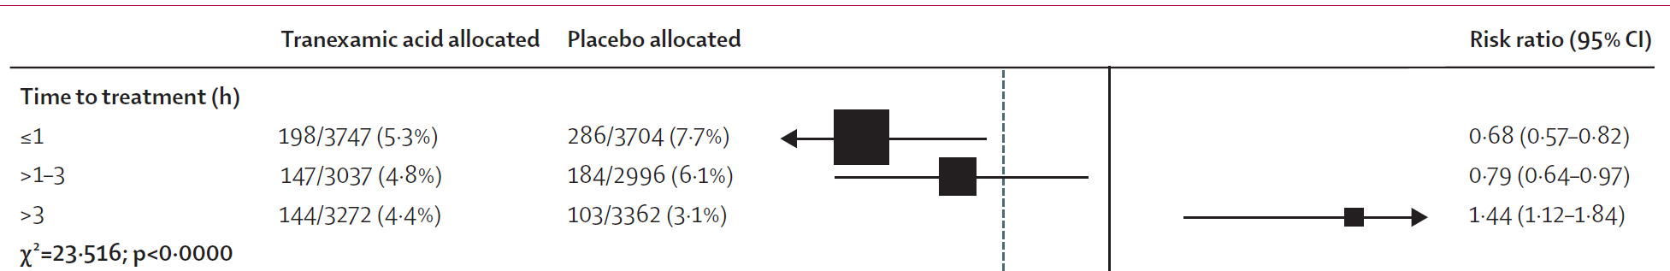
Time modifies treatment effects across several trials
Trial / analysis | Timing finding | Outcome | Evidence qualification
CRASH-2 timing analysis, 2011 | At <=1 h: RR 0.68 (0.57-0.82); >1-3 h: RR 0.79 (0.64-0.97); >3 h: RR 1.44 (1.12-1.84) | Death due to bleeding | Exploratory analysis of randomized treatment; strong treatment-by-time evidence
STAAMP, 2020 | Within 1 h: mortality 4.6% with TXA vs 7.6% with placebo | 30-day all-cause death | Post hoc subgroup; overall trial neutral
PATCH timing analysis, 2026 | <=90 min: adjusted RR 0.64 (0.50-0.82); >90 min: adjusted RR 1.04 (0.74-1.47) | 28-day all-cause death | Exploratory modeling and data-informed subgroup boundary; not a confirmed treatment deadline
CRASH-3, 2019 | Earlier treatment more effective in mild/moderate TBI (adjusted analysis P=.005); no clear timing effect in severe TBI (P=.73) | Head-injury death | Severity-dependent timing analysis; not a uniform effect across all TBI
08 EN
Notes:
Recall the early tPA response and evolving inhibitor balance on slide two. They provide a plausible biological explanation for timing effects, and make time since injury perhaps the most obvious phenotype to consider. CRASH-2 observed benefit when administered less than 3 hours from injury, although there may have been quality issues with the definition of time from injury. STAAMP and PATCH also support earlier treatment, and found marked improvements at earlier timepoints of 60 and 90 minutes. CRASH-3 had a somewhat more complicated finding, with early treatment being more beneficial primarily in the mild-moderate injury group.
References:
CRASH-2 timing analysis: https://pubmed.ncbi.nlm.nih.gov/21439633/
STAAMP original trial: https://pmc.ncbi.nlm.nih.gov/articles/PMC7536625/
Tranexamic Acid Timing and Mortality Impact After Trauma: https://doi.org/10.1016/j.annemergmed.2025.06.609
CRASH-3 original trial: https://pubmed.ncbi.nlm.nih.gov/31623894/
CRASH-3 full trial report timing analysis: https://www.ncbi.nlm.nih.gov/books/NBK570199/

Slide 18
Birçok çalışmada zaman, tedavi etkisini değiştirir
Çalışma / analiz | Zamanlama bulgusu | Sonlanım | Kanıtın niteliği
CRASH-2 zamanlama analizi, 2011 | ≤1 sa: RR 0.68 (0.57-0.82); >1-3 sa: RR 0.79 (0.64-0.97); >3 sa: RR 1.44 (1.12-1.84) | Kanamaya bağlı ölüm | Randomize tedavinin keşifsel analizi; tedavi–zaman etkileşimine ilişkin güçlü kanıt
STAAMP, 2020 | 1 sa içinde: TXA ile mortalite %4.6, plasebo ile %7.6 | 30 günlük tüm nedenlere bağlı Ölüm | Sonradan yapılan alt grup analizi; çalışmanın genel sonucu nötr
PATCH zamanlama analizi, 2026 | ≤90 dk: düzeltilmiş RR 0.64 (0.50-0.82); >90 dk: düzeltilmiş RR 1.04 (0.74-1.47) | 28 günlük tüm nedenlere bağlı Ölüm | Keşifsel modelleme ve veriye dayalı alt grup sınırı; doğrulanmış bir tedavi son süresi değil
CRASH-3, 2019 | Hafif/orta TBI'da erken tedavi daha etkili (düzeltilmiş analiz P=.005); ağır TBI'da belirgin zaman etkisi yok (P=.73) | Kafa travmasına bağlı ölüm | Yaralanma şiddetine bağlı zamanlama analizi; tüm TBI hastalarında aynı etki gösterilmedi
08 TR
Notes:
References (same source figures and evidence as English slide):
CRASH-2 timing analysis: https://pubmed.ncbi.nlm.nih.gov/21439633/
STAAMP original trial: https://pmc.ncbi.nlm.nih.gov/articles/PMC7536625/
Tranexamic Acid Timing and Mortality Impact After Trauma: https://doi.org/10.1016/j.annemergmed.2025.06.609
CRASH-3 original trial: https://pubmed.ncbi.nlm.nih.gov/31623894/
CRASH-3 full trial report timing analysis: https://www.ncbi.nlm.nih.gov/books/NBK570199/

Slide 19
Shock severity and injury mechanism
Profound shock: a strong exploratory signal
Benefit is not proven to be limited to severe shock
No established blunt-versus-penetrating treatment difference
Clinical feature | Supporting data | Interpretation
Profound shock | STAAMP, SBP <=70 mm Hg: 30-day mortality 18.5% with TXA vs 35.5% with placebo; difference -17 percentage points (95% CI -25.8 to -8.1) | Large post hoc subgroup signal; hypothesis-generating
Baseline mortality risk | CRASH-2, 13,273 treated within 3 h; risk strata <6%, 6-20%, 21-50%, >50%; interaction P=.96 for all-cause death and P=.98 for bleeding death | No detected heterogeneity; does not support restricting benefit to the highest-risk group
Blunt versus penetrating injury | CRASH-2 reanalysis: no significant injury-type heterogeneity for early benefit or late harm | Mechanism alone is not an established TXA treatment selector
Failure to detect an interaction does not prove identical effects. Baseline risk of death is not a pure measure of hemorrhagic shock.
09 EN
Notes:
Another obvious phenotype to consider is the severity of injury. STAAMP found a large mortality difference in patients with profound shock. This was a post hoc subgroup, so it needs confirmation. Larger CRASH-2 analyses did not show a clear difference in relative benefit across baseline-risk groups.
A higher bleeding risk can produce a larger absolute benefit even if the relative treatment effect is similar.
CRASH-2 also did not establish a different response in blunt and penetrating injury. These data support assessing bleeding risk, but not limiting TXA to one shock threshold or injury mechanism.
References:
STAAMP original trial: https://pubmed.ncbi.nlm.nih.gov/33016996/
Prespecified CRASH-2 baseline-risk analysis: https://pubmed.ncbi.nlm.nih.gov/22968527/
CRASH-2 exploration of early benefit and late harm: https://pubmed.ncbi.nlm.nih.gov/28143564/

Slide 20
Şokun şiddeti ve yaralanma mekanizması
Ağır şok: güçlü bir keşifsel bulgu
Yararın yalnızca ağır şokla sınırlı olduğu kanıtlanmadı
Künt ve penetran yaralanma arasında kanıtlanmış bir tedavi etkisi farkı yok
Klinik özellik | Destekleyen veriler | Yorum
Ağır şok | STAAMP, SKB ≤70 mm Hg: 30 günlük mortalite TXA ile %18.5, plasebo ile %35.5; fark -17 yüzde puanı (%95 GA -25.8 ile -8.1) | Sonradan yapılan alt grupta büyük fark; hipotez oluşturucu
Başlangıç mortalite riski | CRASH-2, 3 sa içinde tedavi edilen 13,273 hasta; risk grupları <%6, %6-20, %21-50, >%50; etkileşim: tüm nedenlere bağlı ölüm için P=.96, kanamaya bağlı ölüm için P=.98 | Heterojenlik saptanmadı; yararı yalnızca en yüksek riskli grupla sınırlamayı desteklemez
Künt ve penetran yaralanma | CRASH-2 yeniden analizi: erken yarar veya geç zarar açısından yaralanma tipine bağlı anlamlı heterojenlik yok | Yaralanma mekanizması tek başına TXA seçimi için kanıtlanmış bir ölçüt değildir
Etkileşim saptanmaması, etkilerin aynı olduğunu kanıtlamaz. Başlangıç ölüm riski, yalnızca hemorajik şoku ölçmez.
09 TR
Notes:
References (same source figures and evidence as English slide):
STAAMP original trial: https://pubmed.ncbi.nlm.nih.gov/33016996/
Prespecified CRASH-2 baseline-risk analysis: https://pubmed.ncbi.nlm.nih.gov/22968527/
CRASH-2 exploration of early benefit and late harm: https://pubmed.ncbi.nlm.nih.gov/28143564/

Slide 21
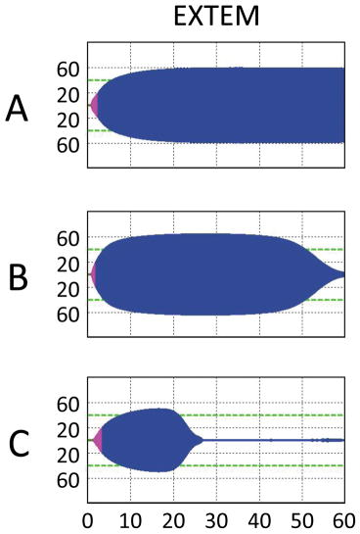
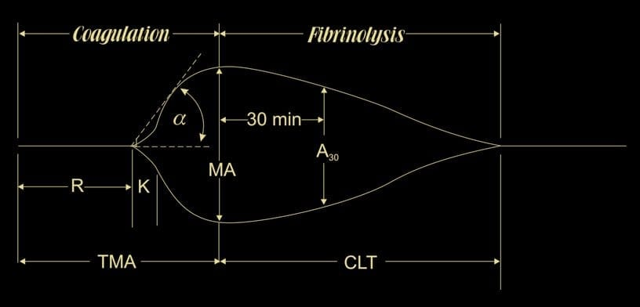
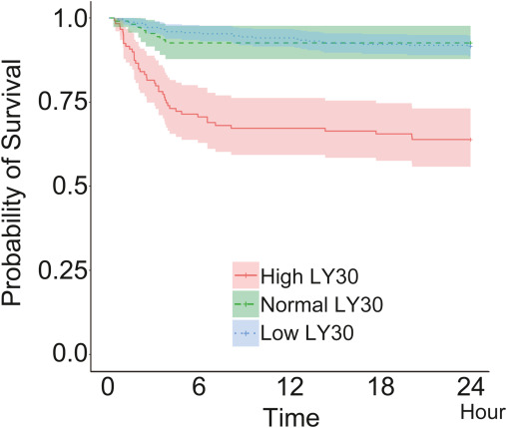
Does fibrinolysis determine who benefits?
Viscoelastic tests detect functional degradation of clot firmness
Mechanical amplitude loss and enzymatic activity can diverge
Low LY30 can coexist with dysfunction
10 EN
Notes:
Probably why this talk exists is the question of using evidence of fibrinolysis to either limit TXA or give it outside of the population with the highest evidence of benefit, such as outside of the 3-hour window in which it is protocolized. Viscoelastic hemostatic assays are the main test which people would propose for identifying patients who benefit from TXA, and they work by adding clot forming reagents like kaolin, tissue factor, or both to blood samples and measure a variable related to clot firmness over time. The TEG and ROTEM are the most popular, with the LY30, the percentage decrease in clot amplitude 30 minutes after maximum amplitude in a TEG, being the most popular in the studies that we are going to discuss. Some standard assays, such as the APTEM include an antifibrinolytic as a comparison test to suggest that lysis is plasmin-dependent.
Early work split patients into 3 categories: physiologic or normal fibrinolysis, hyperfibrinolysis, and hypo fibrinolysis or fibrinolysis shutdown, although other will redefine that term later.
Patients presenting with a high degree of fibrinolysis have been observed in many studies to have a higher risk of death, with this data coming from the PROPPR study of trauma patients likely to require massive transfusion. Several registries have also found a lower than normal amount of clot breakdown, hypofibrinolysis to predict poor outcomes.
One hope was that by using TXA selectively in patients with hyperfibrinolysis, we might get most of the benefit without exposing patients without a fibrinolysis problem to side effects.
It is important to remember that in-vitro mechanical lysis and in-vivo activity aren't the same. In the PROPPR analysis, low LY30 was associated with lower fibrinogen, reduced antiplasmin, and platelet dysfunction. So low LY30 should not automatically be translated into high inhibitor reserve or a strongly hypercoagulable clot.
References:
TEG lysis shutdown represents coagulopathy in bleeding trauma patients: PROPPR analysis: https://pubmed.ncbi.nlm.nih.gov/29664836/
EXTEM/APTEM comparison: https://pmc.ncbi.nlm.nih.gov/articles/PMC3781292/
Further PROPPR biochemical comparison: https://www.rpthjournal.org/article/S2475-0379%2824%2900263-2/fulltext

Slide 22
Fibrinoliz, kimin yarar göreceğini belirler mi?
Viskoelastik testler, pıhtı sertliğindeki işlevsel kaybı saptar
Mekanik amplitüd kaybı ile enzimatik aktivite farklılık gösterebilir
Düşük LY30, işlev bozukluğuyla birlikte bulunabilir
10 TR
Notes:
References (same source figures and evidence as English slide):
TEG lysis shutdown represents coagulopathy in bleeding trauma patients: PROPPR analysis: https://pubmed.ncbi.nlm.nih.gov/29664836/
EXTEM/APTEM comparison: https://pmc.ncbi.nlm.nih.gov/articles/PMC3781292/
Further PROPPR biochemical comparison: https://www.rpthjournal.org/article/S2475-0379%2824%2900263-2/fulltext

Slide 23
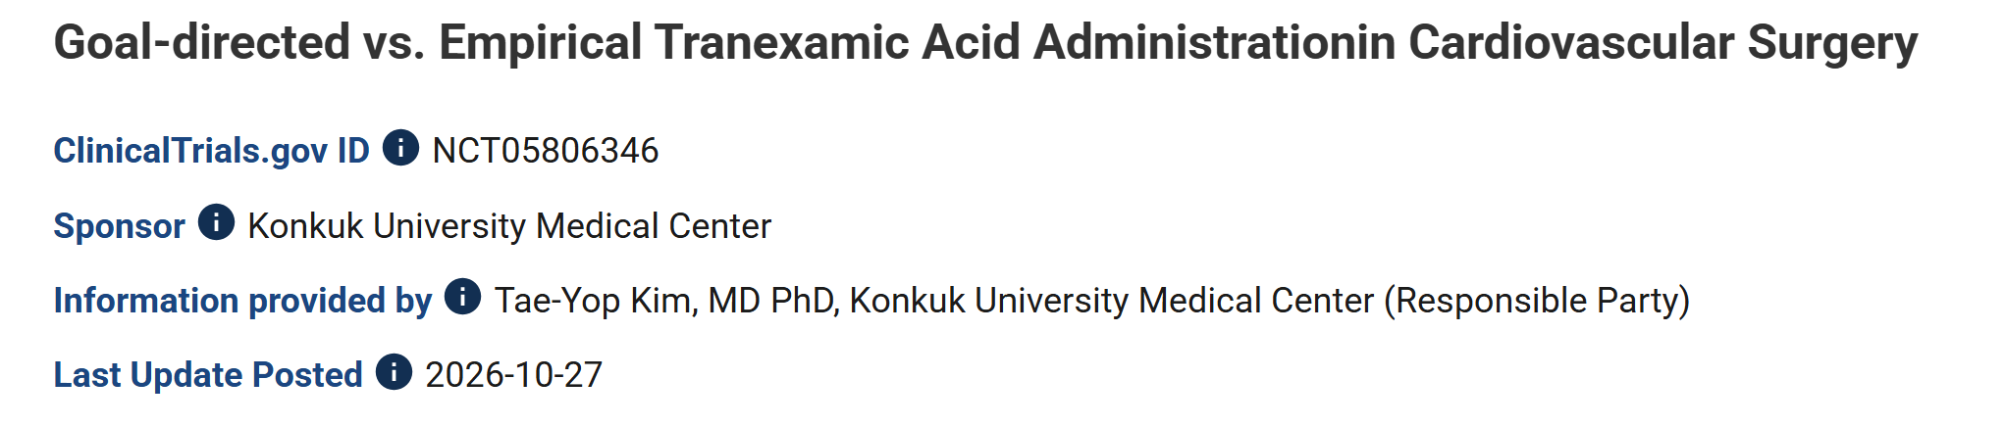
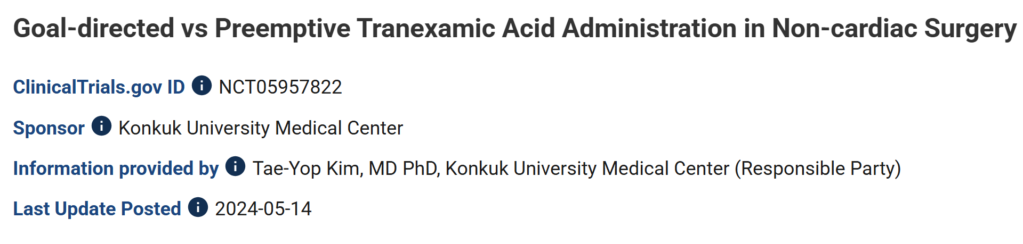
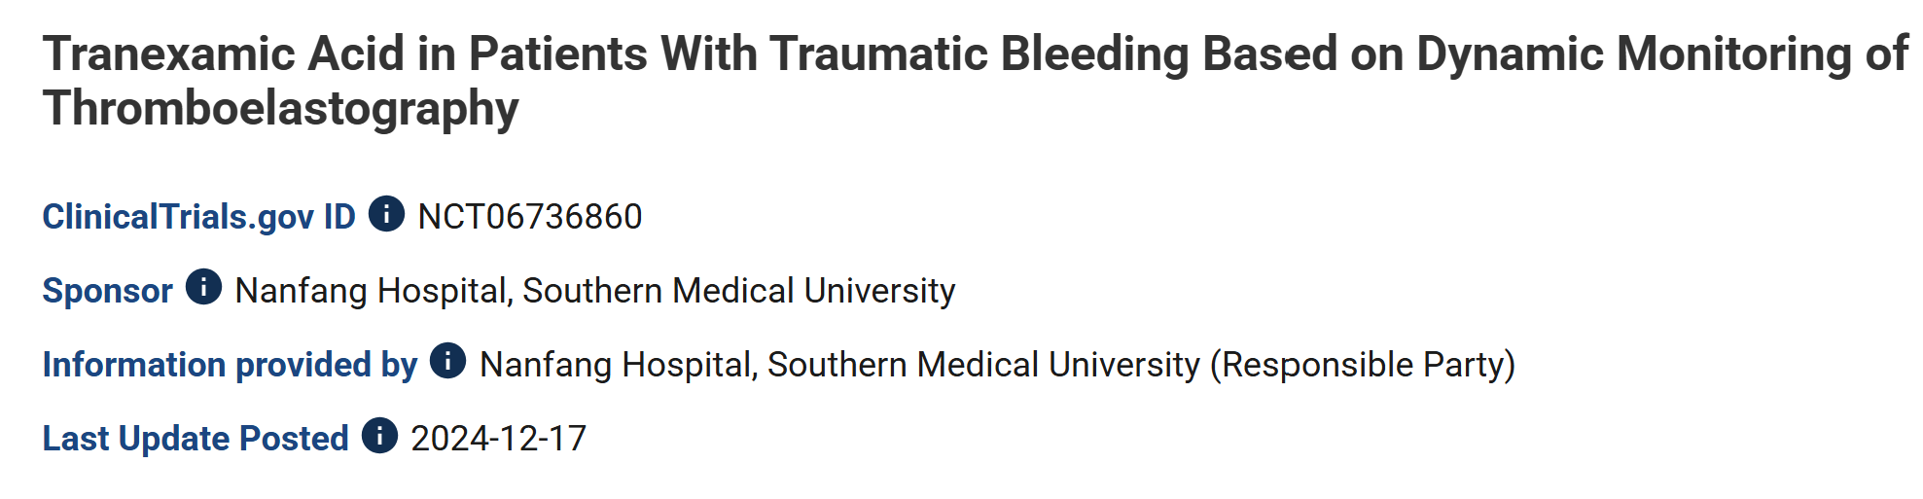
Hyperfibrinolysis targeting
iTACTIC randomized to VET broadly, but almost all received TXA
Gonzalez et al., Ann Surg 2016 randomized to VET, used less and relatively infrequent TXA
Propensity-matched data from PROPPR suggest higher benefit at 6 hours only in high LY30
European guidelines explicitly encourage not waiting for VET
15 EN
Notes:
Interestingly, there is surprisingly little data to support using VET to target hyperfibrinolysis, perhaps partially because it is something of a “parachute trial”. Most trials of VET have VET-guided treatment as a bundle, where the main changes to practice often revolve around treating low fibrinogen. Differences in TXA use in the trials of VET use are usually small. There are is a pending trial of goal-directed TXA in cardiac surgery show here that completed recruitment 2 weeks ago, but has not published results yet. There is a stale trial registration in noncardiac surgery by the same group, and an ongoing study from China specifically testing VET to identify the need for redosing of TXA
References:
iTACTIC: https://pmc.ncbi.nlm.nih.gov/articles/PMC7550843/
PROPPR hyperfibrinolysis analysis: https://pmc.ncbi.nlm.nih.gov/articles/PMC6077098/
European trauma guideline: https://pmc.ncbi.nlm.nih.gov/articles/PMC9977110/

Slide 24
Hiperfibrinolizi hedefleyen tedavi
iTACTIC, genel olarak VET kullanımına randomize etti; ancak hemen herkes TXA aldı
Gonzalez ve ark., Ann Surg 2016: VET kullanımına randomizasyon; TXA daha az ve görece
seyrek kullanıldı
PROPPR'ın eğilim skoru eşleştirilmiş verileri, yüksek LY30'da yalnızca 6. saatte daha fazla
yarara işaret ediyor
Avrupa kılavuzları açıkça VET sonucunu beklememeyi öneriyor
15 TR
Notes:
References (same source figures and evidence as English slide):
iTACTIC: https://pmc.ncbi.nlm.nih.gov/articles/PMC7550843/
PROPPR hyperfibrinolysis analysis: https://pmc.ncbi.nlm.nih.gov/articles/PMC6077098/
European trauma guideline: https://pmc.ncbi.nlm.nih.gov/articles/PMC9977110/

Slide 25
LY30, LY15 and FAST: time to an actionable result
LY30 starts after MA, not at sample collection
LY15 saves observation time, not preparation or clot formation
FAST uses a different analytical approach — investigational
Measurement | Reference clock | Practical implication
LY30 | 30 min after MA | Total delay includes setup, time to MA, interpretation and communication
LY15, where available or calculated | 15 min after MA | Earlier observation; not a 15-minute sample-to-answer test or an interchangeable LY30 threshold
Plasmin or tPA-challenge indices | Endpoint-specific, e.g. time to MA or LOT/LT | Some information precedes completed LY30; different inference and cutoffs
FAST | Five-minute plasma analytical readout | Different biological question; preparation adds time and trauma validation remains early-stage
QStat CSL | 15 min after max clot stiffness | QStat MCS is faster, (~9 min vs 29 min for TEG-6s CK MA in one study), so lysis analysis is also faster
12 EN
Notes:
Before I move on, I do want to note an inherent limitation in using fibrinolysis observed on viscoelastic tests to guide therapy: they take a fair amount of time. As we discussed earlier, the strongest evidence for benefit of TXA occurs early. LY30 is thirty minutes after maximum amplitude. Collection, transport, setup and clot formation come first. A complete result may therefore take fifty to sixty minutes, depending on the workflow. ROTEM analysis takes a similar amount of time. Waiting an hour may put the patient outside of a window in which TXA would have been helpful anyway, or clot disruption in the surgical field may have pushed the team to administer TXA empirically. This waiting time can be shortened, such as using the rapidTEG with both kaolin and tissue factor, which reaches MA about 15 minutes faster.
In cases of massive fibrinolysis, the result will occur earlier.
Some studies have shortened the lysis observation period to 15 minutes with good results. Notably, the QStat clot stability to lysis measure is 15 minutes after a relatively shot 10 minutes to maximum amplitude.
Some tPA challenged-test indices, which we will discuss in a minute, are available sooner. There has also been work with activated clotting times in plasmin-challenged samples.
There is an alternative approach under research known as FAST, which is a fluorogenic plasmin substrate to approximate plasmin activity. After sample preparation, the assay itself takes five minutes. It remains investigational for trauma treatment selection.
References:
FAST original study: https://pubmed.ncbi.nlm.nih.gov/41441916/
FAST assay explanation: https://pmc.ncbi.nlm.nih.gov/articles/PMC13052022/
tPA-TEG study reporting approximately 50 minutes to low-dose challenged LY30: https://pmc.ncbi.nlm.nih.gov/articles/PMC5527680/
earlier velocity-curve indices: https://doi.org/10.1016/j.jamcollsurg.2014.07.943
research LY15 definition in optical coagulation profiling: https://pmc.ncbi.nlm.nih.gov/articles/PMC13213682/
Earlier tPA-TEG information: https://pubmed.ncbi.nlm.nih.gov/28522144/
ClotPro TPA-test endpoint definitions: https://pmc.ncbi.nlm.nih.gov/articles/PMC8077595/
PACT: https://pubmed.ncbi.nlm.nih.gov/40517530/
Fibrinolysis resistance capacity assay: https://pubmed.ncbi.nlm.nih.gov/39837554/
Qstat time comparison: 10.1136/tsaco-2024-001672

Slide 26
LY30, LY15 ve FAST: karar verilebilir sonuca ulaşma süresi
LY30, örnek alımından değil MA'dan sonra başlar
LY15 gözlem süresini kısaltır; hazırlık ve pıhtı oluşumunu değil
FAST farklı bir analitik yaklaşım kullanır — araştırma aşamasındadır
Ölçüm | Sürenin başlangıcı | Uygulamadaki anlamı
LY30 | MA'dan 30 dk sonra | Toplam gecikme; hazırlık, MA'ya ulaşma, yorumlama ve iletişimi içerir
LY15, mevcutsa veya hesaplanıyorsa | MA'dan 15 dk sonra | Daha erken gözlem; örnekten sonuca 15 dk anlamına gelmez ve LY30 eşiğiyle aynı değildir
Plazmin veya tPA ile uyarılmış test indeksleri | Sonlanıma bağlı; örn. MA'ya ulaşma süresi veya LOT/LT | Bazı bilgiler LY30 tamamlanmadan elde edilir; çıkarım ve eşikler farklıdır
FAST | Plazmada beş dakikalık analitik okuma | Farklı biyolojik soru; hazırlık süre ekler ve travmada doğrulama erken aşamadadır
12 TR
Notes:
References (same source figures and evidence as English slide):
FAST original study: https://pubmed.ncbi.nlm.nih.gov/41441916/
FAST assay explanation: https://pmc.ncbi.nlm.nih.gov/articles/PMC13052022/
tPA-TEG study reporting approximately 50 minutes to low-dose challenged LY30: https://pmc.ncbi.nlm.nih.gov/articles/PMC5527680/
earlier velocity-curve indices: https://doi.org/10.1016/j.jamcollsurg.2014.07.943
research LY15 definition in optical coagulation profiling: https://pmc.ncbi.nlm.nih.gov/articles/PMC13213682/
Earlier tPA-TEG information: https://pubmed.ncbi.nlm.nih.gov/28522144/
ClotPro TPA-test endpoint definitions: https://pmc.ncbi.nlm.nih.gov/articles/PMC8077595/
PACT: https://pubmed.ncbi.nlm.nih.gov/40517530/
Fibrinolysis resistance capacity assay: https://pubmed.ncbi.nlm.nih.gov/39837554/

Slide 27
Signals of harm
Study | Group / exposure | Finding | What limits interpretation?
Moore 2017 — observational registry | Physiological LY30; 8 TXA recipients among 114 patients in this phenotype | Mortality 63% with TXA vs 11% without; association persisted after NISS adjustment | Very small treated group; treatment selection; universal pre-TXA draw not established
Richards 2021 — Observational | Native shutdown; 11 TXA recipients | MOF 27.3% vs 3.8%; no significant mortality difference | Pre-TXA TEG, but nonrandomized treatment and sparse events
Kenny 2026 — secondary analysis of STAAMP + ROC Randomizations | Physiological LY30 measured on admission, after prehospital treatment | Adjusted TXA HR 2.15 (0.84–5.51) for 30-day mortality | Harm direction, CI includes benefit and harm; post-treatment phenotype
Barletta 2026 — observational TBI cohort | Pretreatment TEG; TXA before TEG excluded | 12% with TXA vs 24% without 28-day mortality; adjusted OR 0.36 (0.16–0.77) | Uncontrolled treatment. Mostly mild TBI
11 EN
Notes:
More concerning than the idea that TXA might only benefit some patients, was the possibility that it might injure some, such as through promoting VTE or increased fibrin deposition in the kidneys or pulmonary vasculature. As we mentioned earlier, there was a signal of harm in CRASH-2 with late administration, which is when anti-fibrinolytics like PAI-1 would be rising. As we mentioned earlier, plasmin has multiple effects, and there are plausible other effects of TXA. Some observational studies suggested higher mortality after TXA in patients with physiological lysis or hypofibrinolysis, but this combination was relatively rare in their data. Kenny's subsequent analysis of two prominent TXA trials has a non-significant but large association in the same direction. Interestingly, it found a survival benefit in patients with hypofibrinolysis.
A key limitation of the data from STAAMP and ROC-TBI is that the TEG measurements were done after TXA, so there is a major question of if the lysis-defined groups are comparable between untreated and treated. There has recently been reassuring data in TBI with lower mortality in the hypofibrinolysis group treated with TXA, with the notable strength of measuring hypofibrinolysis before treating
References:
Moore 2017: https://pmc.ncbi.nlm.nih.gov/articles/PMC5677580/
Kenny 2026: https://journals.lww.com/10.1097/TA.0000000000005092
Richards 2021: https://journals.lww.com/10.1097/SHK.0000000000001608
Meizoso 2018: https://doi.org/10.1097/TA.0000000000001792
Primary study: https://doi.org/10.1097/TA.0000000000005066

Slide 28
Zarara işaret eden bulgular
Çalışma | Grup / maruziyet | Bulgu | Yorumun sınırları
Moore 2017 — gözlemsel kayıt çalışması | Fizyolojik LY30; bu fenotipteki 114 hastanın 8'i TXA aldı | Mortalitenin TXA alanlarda %63, almayanlarda %11 olması; NISS düzeltmesinden sonra da ilişki sürdü | Tedavi alan grup çok küçük; tedavi seçimi etkili; tüm örneklerin TXA öncesi alındığı gösterilmedi
Richards 2021 — gözlemsel | Standart testte fibrinolitik kapanma; 11 hasta TXA aldı | Çoklu organ yetmezliği (MOF) %27.3 ve %3.8; anlamlı mortalite farkı yok | TEG, TXA öncesi; ancak tedavi randomize değil ve olay sayısı az
Kenny 2026 — STAAMP + ROC randomizasyonlarının ikincil analizi | Hastane öncesi tedaviden sonra, başvuruda ölçülen fizyolojik LY30 | 30 günlük mortalite için düzeltilmiş TXA HR 2.15 (0.84–5.51) | Tahmin zarar yönünde; GA hem yararı hem zararı kapsıyor; tedavi sonrası fenotip
Barletta 2026 — gözlemsel TBI kohortu | Tedavi öncesi TEG; TEG öncesi TXA alanlar dışlandı | 28 günlük mortalite %12 ve %24; düzeltilmiş OR 0.36 (0.16–0.77) | Tedavi kontrollü değil. Çoğunlukla hafif TBI
11 TR
Notes:
References (same source figures and evidence as English slide):
Moore 2017: https://pmc.ncbi.nlm.nih.gov/articles/PMC5677580/
Kenny 2026: https://journals.lww.com/10.1097/TA.0000000000005092
Richards 2021: https://journals.lww.com/10.1097/SHK.0000000000001608
Meizoso 2018: https://doi.org/10.1097/TA.0000000000001792
Primary study: https://doi.org/10.1097/TA.0000000000005066

Slide 29
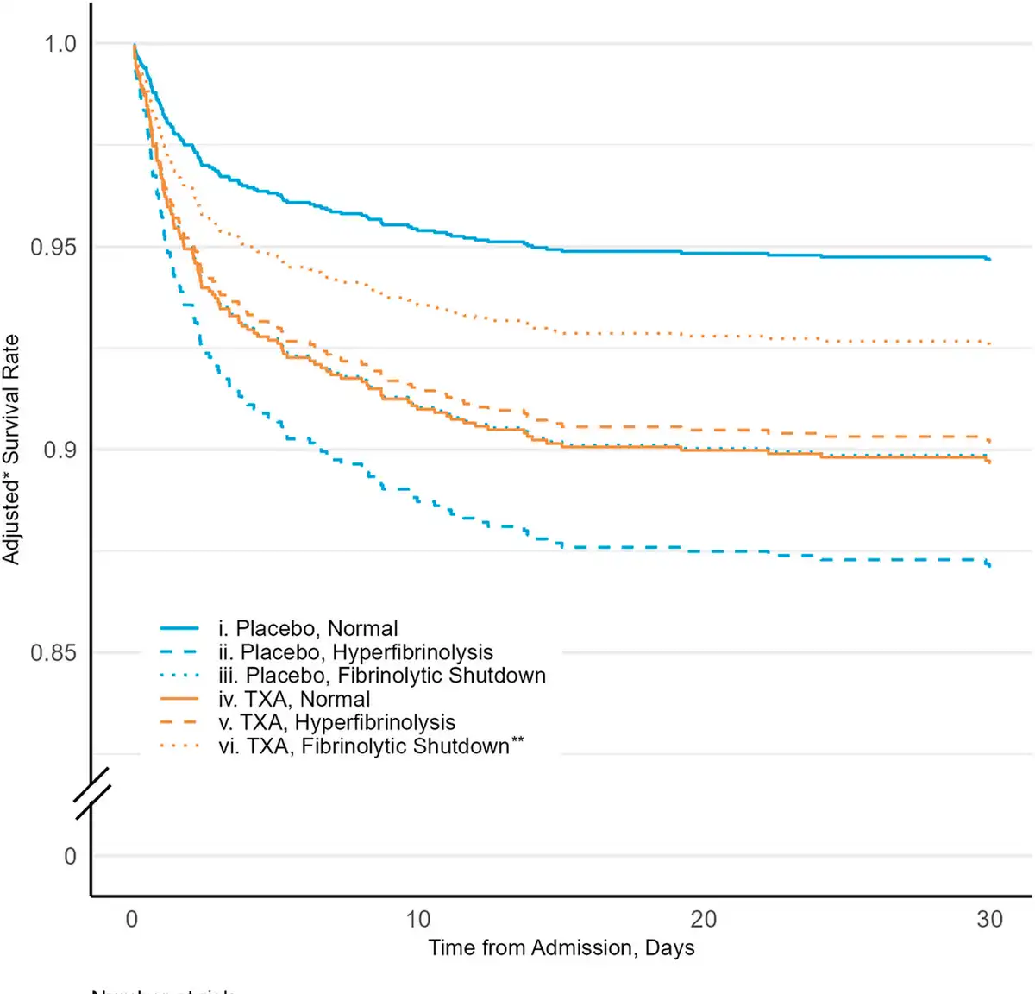
Kenny 2026 — secondary analysis of STAAMP + ROC RCT
Physiological LY30 measured on admission, after prehospital Treatment
Adjusted TXA HR 2.15 (0.84–5.51) for 30-day mortality
Harm direction, CI includes benefit and harm; post-treatment phenotype

Slide 30
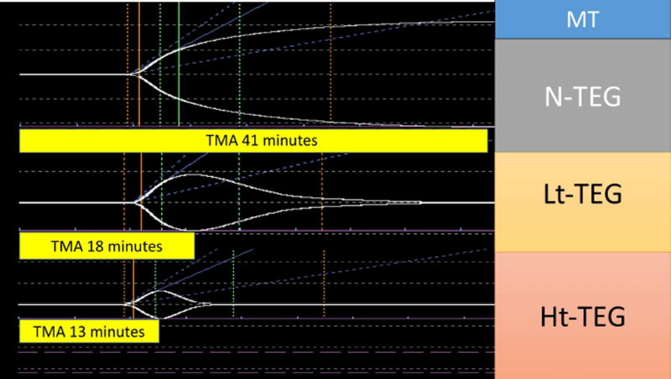
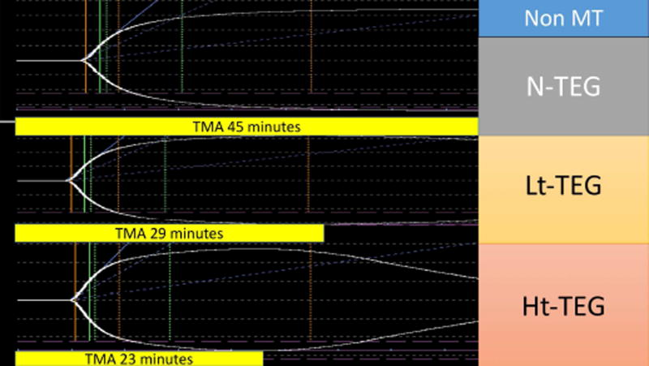
tPA challenge adds biological and prognostic information
Combined TEG and tPA-TEG improve risk discrimination
Biomarker concordance supports biological plausibility
Neither establishes a TXA treatment-response rule
Evidence | Finding | Limitation
2024 trauma cohort; n=981 | Mortality AUC: combined phenotypes 0.80; rTEG 0.63; tPA-TEG 0.75 | Observational, data-derived categorization; prognostic discrimination, not treatment-effect prediction
2025 molecular study; n=56 | tPA-TEG LY30 correlated with active PAI-1 (r=-0.77), alpha2-antiplasmin (-0.62), and PAP (+0.74) | Small convenience sample selected to represent phenotypes; not an unselected diagnostic validation cohort
Treatment strategy | No definitive outcome trial identified for withholding initial TXA by this assay | Diagnostic and prognostic evidence cannot establish clinical utility
Manual tPA-spiked TEG/TEM research protocols are not equivalent to commercial assays. ClotPro TPA-test and Apiro MultiClot is manufacturer-listed CE IVD for Europe; that status does not validate a trauma TXA-withholding algorithm. No FDA clearance for the manual research challenge was identified.
13 EN
Notes:
Interestingly, not every trauma trial even finds that TXA affects LY30-defined lysis, although it does affect other biomarkers of lysis, suggesting that LY30 is poorly sensitive for the underlying physiology.
One approach to identifying patients whose fibrinolytic systems are close to tipping into massive lysis is what's called challenged testing. Essentially, a variable amount of tPA or plasmin is added to a sample before the VET and compared to the native sample. If the VET transitions to rapid lysis with a low dose of tPA, this indicates that anti-plasmin or other counter regulatory systems are nearly exhausted, and is somewhat predictive of upcoming significant bleeding. This has the side effect of producing maximum clot amplitude earlier, resulting in a faster test result. In an observational study of 981 trauma patients, paired testing improved mortality discrimination, suggesting that it may have additional sensitivity over naïve TEG, which is known to be moderate. Challenged LY30 values have also been correlated to active PAI-1, antiplasmin, and PAP levels, even with normal LY30.
Manual tPA-TEG protocols remain research assays. A commercial ClotPro TPA-test and Apiro MultiClot VET has European marketing approval, but not for stratifying bleeding risk, it is marketed for assessing antifibrinolytic activity, and potentially the need to redose. These two tests have not been used.
References:
Paired phenotyping: https://pubmed.ncbi.nlm.nih.gov/38299576/
Molecular correlates: https://pmc.ncbi.nlm.nih.gov/articles/PMC13475717/
Manufacturer ClotPro assay list and CE IVD designation: https://hospital.haemonetics.com/en-gb/hemostasis-management/clotpro
Manufacturer intended assay role: https://hospital.haemonetics.com/-/media/files/hospital/clotpro_brochure_col-copy-001899-ie%28aa%29_final-lo-res.pdf
Published research protocol restricting tPA-TEG to research: https://cdn.clinicaltrials.gov/large-docs/67/NCT02901067/Prot_SAP_001.pdf
Earlier tPA-TEG prediction: https://pubmed.ncbi.nlm.nih.gov/28522144/
ClotPro LOT/LT definitions: https://pmc.ncbi.nlm.nih.gov/articles/PMC8077595/
ClotPro feasibility study: https://pmc.ncbi.nlm.nih.gov/articles/PMC9912243/
ClotPro assessment after TXA: https://pmc.ncbi.nlm.nih.gov/articles/PMC8077595/

Slide 31
tPA ile uyarılmış test biyolojik ve prognostik bilgi sağlar
TEG ve tPA-TEG birlikte kullanıldığında risk ayrımı iyileşir
Biyobelirteçlerle uyum, biyolojik olasılığı destekler
Hiçbiri TXA yanıtına dayalı bir tedavi kuralı oluşturmaz
Kanıt | Bulgu | Sınırlama
2024 travma kohortu; n=981 | Mortalite AUC: birleşik fenotipler 0.80; rTEG 0.63; tPA-TEG 0.75 | Gözlemsel, veriye dayalı sınıflama; prognostik ayrım, tedavi etkisi tahmini değil
2025 moleküler çalışma; n=56 | tPA-TEG LY30; aktif PAI-1 (r=-0.77), alfa2-antiplazmin (-0.62) ve PAP (+0.74) ile korele | Fenotipleri temsil edecek şekilde seçilmiş küçük örneklem; seçilmemiş bir tanısal doğrulama kohortu değil
Tedavi stratejisi | Bu teste göre ilk TXA dozunu vermemeyi değerlendiren kesin bir sonuç çalışması bulunmadı | Tanısal ve prognostik kanıt, klinik yararlılığı göstermez
Elle tPA eklenen TEG/TEM araştırma protokolleri, ticari testlerle eşdeğer değildir. ClotPro TPA-test, üretici tarafından Avrupa için CE IVD olarak listelenmiştir; bu durum travmada TXA vermeme algoritmasını doğrulamaz. Elle yapılan araştırma testi için FDA izni saptanmadı.
13 TR
Notes:
References (same source figures and evidence as English slide):
Paired phenotyping: https://pubmed.ncbi.nlm.nih.gov/38299576/
Molecular correlates: https://pmc.ncbi.nlm.nih.gov/articles/PMC13475717/
Manufacturer ClotPro assay list and CE IVD designation: https://hospital.haemonetics.com/en-gb/hemostasis-management/clotpro
Manufacturer intended assay role: https://hospital.haemonetics.com/-/media/files/hospital/clotpro_brochure_col-copy-001899-ie%28aa%29_final-lo-res.pdf
Published research protocol restricting tPA-TEG to research: https://cdn.clinicaltrials.gov/large-docs/67/NCT02901067/Prot_SAP_001.pdf
Earlier tPA-TEG prediction: https://pubmed.ncbi.nlm.nih.gov/28522144/
ClotPro LOT/LT definitions: https://pmc.ncbi.nlm.nih.gov/articles/PMC8077595/
ClotPro feasibility study: https://pmc.ncbi.nlm.nih.gov/articles/PMC9912243/
ClotPro assessment after TXA: https://pmc.ncbi.nlm.nih.gov/articles/PMC8077595/

Slide 32
tPA challenge separates biology hidden within native LY30
Native low lysis can coexist with tPA sensitivity
Native low lysis can also reflect resistance
Better risk classification is not yet treatment selection
Consolidated state | Description | Patients | Cohort share | Estimated mortality
Hyperfibrinolysis | Native high lysis with tPA sensitivity | 91 | 9.3% | 52.7%
Early shutdown | Native normal/low lysis with tPA sensitivity | 122 | 12.4% | 26.3%
Hypofibrinolysis | Native shutdown with normal response or resistance to tPA | 217 | 22.1% | 11.3%
Nonpathological | Remaining combinations | 551 | 56.2% | 4.1%
Moore 2024, n=981: mortality AUC 0.63 native rTEG; 0.75 tPA-TEG; 0.80 combined. Observational; data-derived categories.
14 EN
Notes:
The tPA-challenged VET seems to add a substantial amount of information on mortality likelihood, with trauma patient with high sensitivity to tPA having a noticeably larger likelihood of mortality.
References:
Moore 2024: https://doi.org/10.1097/XCS.0000000000001027
Maginot classification, Figure 1: https://pmc.ncbi.nlm.nih.gov/articles/PMC13475717/#F1
Earlier two-assay phenotyping: https://pubmed.ncbi.nlm.nih.gov/30562328/

Slide 33
tPA challenge separates biology hidden within native LY30
Native low lysis can coexist with tPA sensitivity
Native low lysis can also reflect resistance
Better risk classification is not yet treatment selection
Birleştirilmiş durum | Eşleştirilmiş testlerin katkısı | Patients | Cohort share | Estimated mortality
Hiperfibrinoliz | Standart testte yüksek lizis ve tPA duyarlılığı | 91 | 9.3% | 52.7%
Erken fibrinolitik kapanma | Standart testte normal/düşük lizis ve tPA duyarlılığı | 122 | 12.4% | 26.3%
Hipofibrinoliz | Standart testte kapanma ve tPA'ya normal yanıt veya direnç | 217 | 22.1% | 11.3%
Patolojik olmayan | Bu çalışmanın sınıflamasında geriye kalan kombinasyonlar | 551 | 56.2% | 4.1%
Moore 2024, n=981: mortality AUC 0.63 native rTEG; 0.75 tPA-TEG; 0.80 combined. Observational; data-derived categories.
14 EN
Notes:
The tPA-challenged VET seems to add a substantial amount of information on mortality likelihood, with trauma patient with high sensitivity to tPA having a noticeably larger likelihood of mortality.
References:
Moore 2024: https://doi.org/10.1097/XCS.0000000000001027
Maginot classification, Figure 1: https://pmc.ncbi.nlm.nih.gov/articles/PMC13475717/#F1
Earlier two-assay phenotyping: https://pubmed.ncbi.nlm.nih.gov/30562328/

Slide 34
tPA challenge separates biology hidden within native LY30
Native rTEG lysis | tPA-sensitive | Normal tPA response | tPA-resistant
High | 52.7% | 1.5% | 11.2%
Normal | 24.8% | 4.6% | 11.7%
Low | 28.3% | 10.6% | 15.6%
Moore 2024, n=981: mortality AUC 0.63 native rTEG; 0.75 tPA-TEG; 0.80 combined. Observational; data-derived categories.
14 EN
Notes:
This is the same mortality data arranged in a grid, so that you can see that tPA sensitive is doing a great dil of the work, but that there is a consistent smaller increase between normal and low degrees of lysis
The missing step is clinical. We do not yet have evidence that a pretreatment challenged phenotype identifies a different outcome benefit from TXA in studies where it was randomized. It does create some confusion in the literature on exactly what constitutes “fibrinolysis shutdown.”
References:
Moore 2024: https://doi.org/10.1097/XCS.0000000000001027
Maginot classification, Figure 1: https://pmc.ncbi.nlm.nih.gov/articles/PMC13475717/#F1
Earlier two-assay phenotyping: https://pubmed.ncbi.nlm.nih.gov/30562328/

Slide 35
VTE safety: reassuring trials, inconsistent signals
Overall randomized trauma evidence is broadly reassuring
Observational and repeated-dose signals are inconsistent
Safety within shutdown is not directly established
Evidence | Finding | Interpretation
CRASH-2 / STAAMP / PATCH | No statistically established overall excess in their reported vascular or thrombotic outcomes | Reassuring overall; not proof of no risk or a shutdown-specific safety trial
CLOTT prospective observational cohort; n=7,331 | VTE 12.5% with TXA vs 4.6% without; adjusted HR 1.00 (95% CI 0.69-1.46) | Large crude difference disappeared after adjustment; recipients differed in injury severity
TraumaRegister DGU retrospective cohort; n=37,342 | Repeated administration associated with thromboembolic events; two administrations adjusted OR 1.79 | Association, not proof of causation; endpoint broader than VTE alone
TAMPITI mechanistic RCT | Thromboembolic events 12.0%, 26.5%, 32.0% with placebo, 2 g, 4 g; reported P=.05 | Small trial and exploratory safety signal; cannot establish a universal dose-response relationship
16 EN
Notes:
After discussing shutdown, we should ask whether suppressing lysis causes clinically important thrombosis. The large randomized trauma trials are broadly reassuring overall. They do not directly establish safety within each laboratory phenotype.
Other evidence is inconsistent. In CLOTT, a large crude VTE difference disappeared after adjustment. A German registry associated repeated administration with more thromboembolic events. TAMPITI also raised a small-trial safety signal. HALT-IT, a trial of high dose TXA for GI bleeding also had a definite signal for VTE related harm. These findings support caution with additional exposure, but they do not prove that conventional early TXA causes VTE in shutdown.
References:
CRASH-2: https://pubmed.ncbi.nlm.nih.gov/20554319/
STAAMP: https://jamanetwork.com/journals/jamasurgery/fullarticle/2771225
PATCH: https://www.nejm.org/doi/full/10.1056/NEJMoa2215457
CLOTT analysis: https://pubmed.ncbi.nlm.nih.gov/37669883/
TraumaRegister DGU repeated-dose analysis: https://link.springer.com/article/10.1186/s13049-025-01512-1
TAMPITI: https://www.frontiersin.org/journals/immunology/articles/10.3389/fimmu.2020.02085/full

Slide 36
VTE güvenliliği: çalışmalar genel olarak güven verici, diğer bulgular tutarsız
Travmadaki randomize kanıtlar genel olarak güven vericidir
Gözlemsel ve tekrarlanan doz bulguları tutarsızdır
Fibrinolitik kapanmada güvenlilik doğrudan gösterilmemiştir
Kanıt | Bulgu | Yorum
CRASH-2 / STAAMP / PATCH | Bildirilen vasküler veya trombotik sonlanımlarda genel artış istatistiksel olarak gösterilmedi | Genel olarak güven verici; risk olmadığının kanıtı veya kapanmaya özgü güvenlilik çalışması değil
CLOTT ileriye dönük gözlemsel kohort; n=7,331 | VTE: TXA ile %12.5, TXA olmadan %4.6; düzeltilmiş HR 1.00 (%95 GA 0.69-1.46) | Düzeltilmemiş büyük fark, düzeltme sonrası kayboldu; alıcıların yaralanma şiddeti farklıydı
TraumaRegister DGU geriye dönük kohort; n=37,342 | Tekrarlanan uygulama tromboembolik olaylarla ilişkili; iki uygulama için düzeltilmiş OR 1.79 | Nedensellik kanıtı değil, ilişki; sonlanım yalnızca VTE'den daha geniş
TAMPITI mekanistik randomize çalışma | Plasebo, 2 g, 4 g ile tromboembolik olaylar: %12.0, %26.5, %32.0; bildirilen P=.05 | Küçük çalışma ve keşifsel güvenlilik bulgusu; evrensel bir doz–yanıt ilişkisi göstermez
16 TR
Notes:
References (same source figures and evidence as English slide):
CRASH-2: https://pubmed.ncbi.nlm.nih.gov/20554319/
STAAMP: https://jamanetwork.com/journals/jamasurgery/fullarticle/2771225
PATCH: https://www.nejm.org/doi/full/10.1056/NEJMoa2215457
CLOTT analysis: https://pubmed.ncbi.nlm.nih.gov/37669883/
TraumaRegister DGU repeated-dose analysis: https://link.springer.com/article/10.1186/s13049-025-01512-1
TAMPITI: https://www.frontiersin.org/journals/immunology/articles/10.3389/fimmu.2020.02085/full

Slide 37
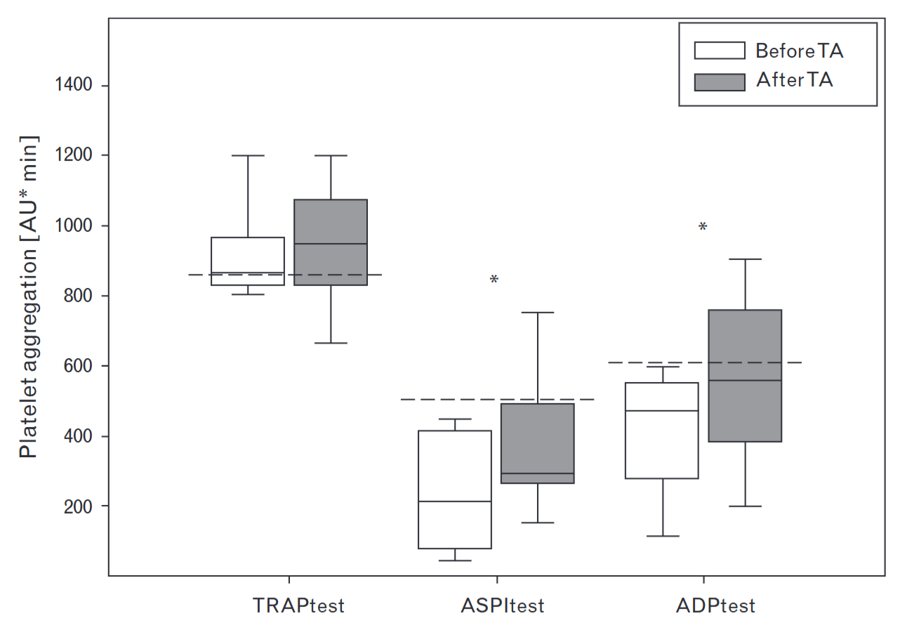
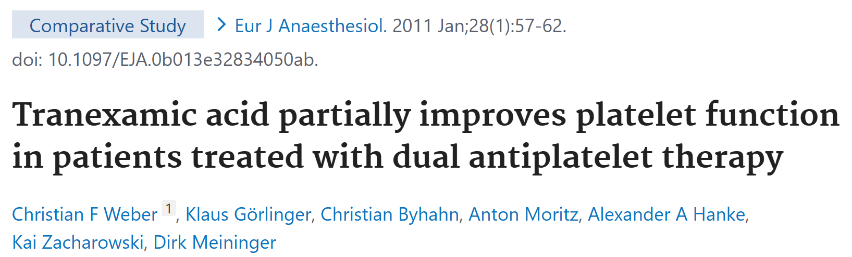
Antiplatelet treatment may matter beyond LY30
Platelet and fibrin function interact
Cardiac RCT data support hemostatic benefit
Trauma-specific selection is not established
TICH-2 without significant interaction (TXA reduced hematoma expansion with or without antiplatelets)
17 EN
Notes:
Platelet inhibition is another special case. Because VET reagents largely bypass the critical role of platelets in clot initiation, they are insensitive to the effects of aspirin and P2Y12 inhibitors. However, TXA is hypothesized to preserve the platelet-fibrin interface because Plasmin directly degrades GPIb and GPIIb/IIIa. In a randomized CABG trial, TXA reduced bleeding and transfusion. Subgroup analyses suggested an enhanced effect in patients with impaired platelet function. This is very much a partial effect, with higher bleeding still observed in patients taking antiplatelet agents.
Although I am not aware of specific evidence stratifying by antiplatelet status in trauma, the cardiac evidence makes this worth considering.
References:
Protective effects of TXA on clopidogrel before CABG: https://jamanetwork.com/journals/jamasurgery/fullarticle/1653578
Platelet-associated plasminogen activation: https://pubmed.ncbi.nlm.nih.gov/15894352/
Partial restoration of function: https://pubmed.ncbi.nlm.nih.gov/20962655/

Slide 38
Antiplatelet tedavi, LY30'un ötesinde önem taşıyabilir
Trombosit ve fibrin işlevi etkileşir
Kalp cerrahisindeki randomize veriler hemostatik yararı destekler
Travmaya özgü tedavi seçimi gösterilmemiştir
TICH-2'de anlamlı etkileşim yok: antiplatelet kullanımı olsun veya olmasın TXA hematom genişlemesini azalttı
17 TR
Notes:
References (same source figures and evidence as English slide):
Protective effects of TXA on clopidogrel before CABG: https://jamanetwork.com/journals/jamasurgery/fullarticle/1653578
Platelet-associated plasminogen activation: https://pubmed.ncbi.nlm.nih.gov/15894352/

Slide 39
Does a different phenotype require different treatment?
Treat early in high risk of bleeding; waiting for TEG data rarely worthwhile
Hyperfibrinolysis -> good motivation, caution on high doses
Hypofibrinolysis -> clinical treatment effect remains uncertain
“Shutdown” -> waiting for data with tPA-TEG and unconfounded exposure
18 EN
Notes:
We have come a surprisingly long way in improving the care of bleeding trauma patients, and early TXA has been a part of that. The classic VET interpretation algorithms that we learn have a place, but specific data that using them to target TXA treatment benefits patients is not mature enough.
References:
CRASH-2 timing: https://pubmed.ncbi.nlm.nih.gov/21439633/
paired-assay phenotyping: https://pubmed.ncbi.nlm.nih.gov/38299576/
European guideline: https://pmc.ncbi.nlm.nih.gov/articles/PMC9977110/

Slide 40
Farklı bir fenotip farklı bir tedavi gerektirir mi?
Kanama riski yüksek durumlarda erken tedavi uygulayın; TEG verilerini beklemenin genellikle bir faydası olmaz.
Hiperfibrinoliz → güçlü gerekçe, zayıf veri
Hipofibrinoliz → klinik tedavi etkisi belirsizliğini koruyor
“Fibrinolitik kapanma” → tPA-TEG ve karıştırıcı etkenlerden arındırılmış tedavi verilerini bekliyoruz
https://github.com/cryanking/cryanking.github.io/tree/main/lectures/tark
18 TR
Notes:
References (same source figures and evidence as English slide):
CRASH-2 timing: https://pubmed.ncbi.nlm.nih.gov/21439633/
paired-assay phenotyping: https://pubmed.ncbi.nlm.nih.gov/38299576/
European guideline: https://pmc.ncbi.nlm.nih.gov/articles/PMC9977110/

