Slide 1


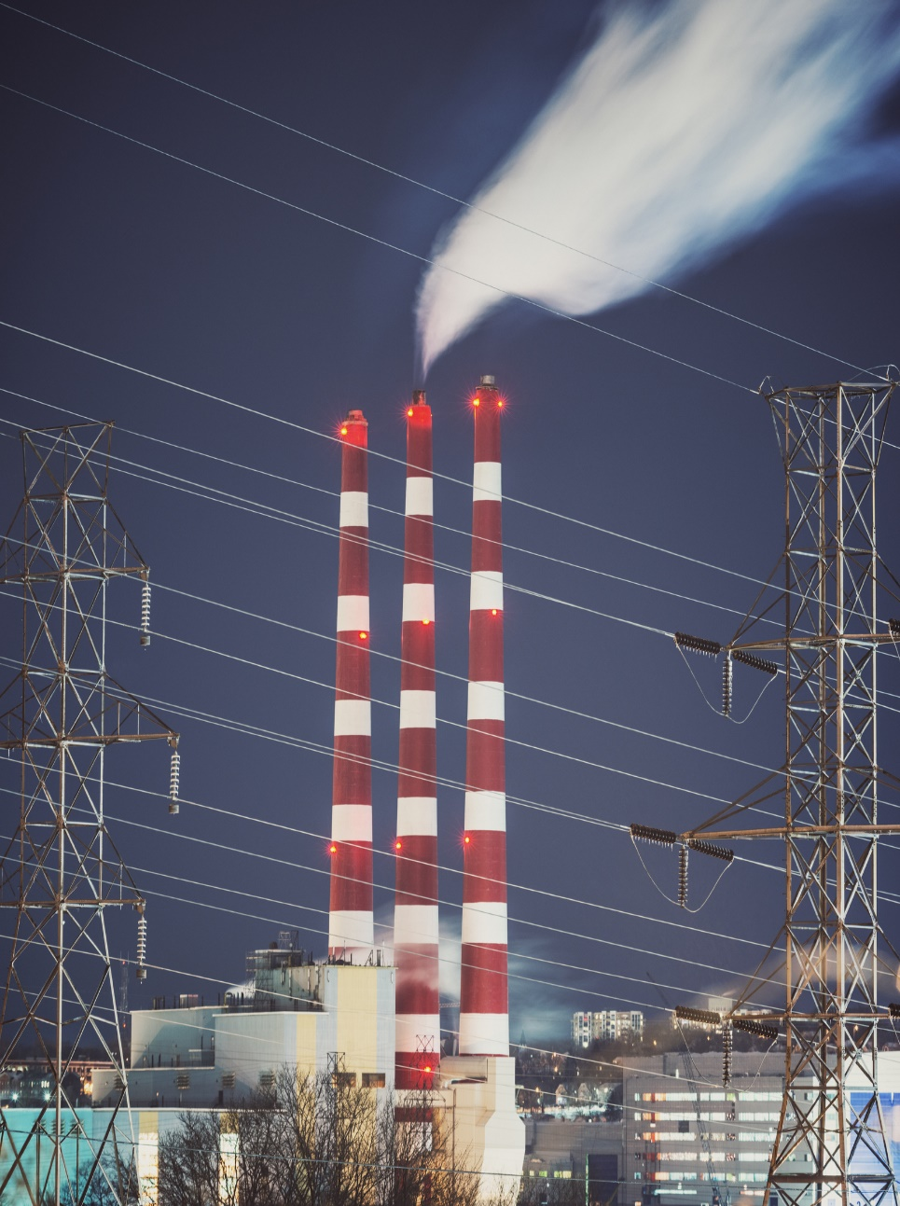
Environmental Impact Prediction Problem Using NPRI Dataset
Which industry is predicted to have the highest growth of releases in 5 years and which will have the largest decline?
NorQuest College
CMPT 2400 & CMPT 3510
April 2025
Instructors:
Nasimeh Asgarian, Mohammad Ajallooeian
Lab Instructor: Nazmus Sakeef
Alma Soria | Angela Lekivetz | Crystal Blackburn | Michaela Goud

Slide 2
Presentation Agenda
Introduction - Project Overview, Data Preparation and Task Setup
Data Transformation and Feature Engineering
Regression Modeling Approach - Model Selection and Setup
Industry Trends and Key Results
Insights and Findings
Challenges and Solutions
Conclusion
Questions & Answers

Slide 3
Introduction: Project Overview
What We Did:
Analyzed pollutant emission trends in Canadian industries using the NPRI dataset that tracks over 80 substances released to air, land, and water.
Why?
Understanding these trends helps identify high-risk industries, guide regulations, and support sustainable decisions.
Our Goal:
Forecast future emissions and explore how pollutant patterns relate to environmental factors using machine learning and time series models.

Slide 4
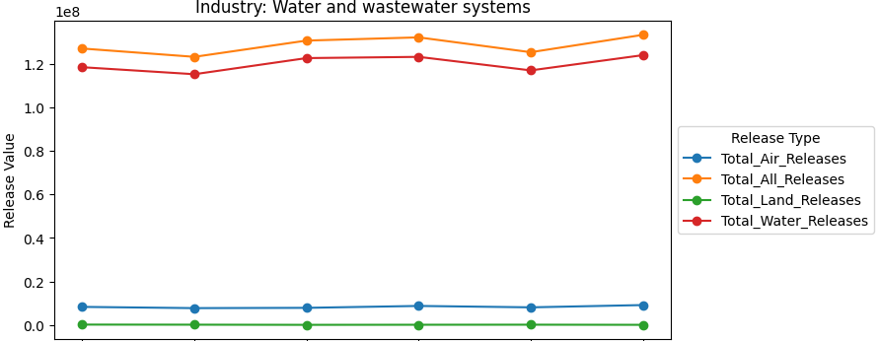
Data Transformation and Feature Engineering
Data Loading: Imported NPRI 2000–2022 data.
Cleaning: Standardized columns, fixed formatting, updated data types.
Issue Handling: Cleaned text, handled missing values, improved location data.
EDA: Generated stats, visualized patterns, retained meaningful outliers.
2023 Data Merging: Merged and aligned 2023 data with historical data.
Feature Engineering: Grouped industries, applied normalization, one-hot encoded, selected top predictors.
Data Quality: Filtered incomplete data, prioritized stable substances.
Targets: Created targets for Total_Air, Total_Land, and Total_Water Releases.
Example:
Analysis of Water and Wastewater systems by air, land, water and all.

Slide 5
Regression Modeling Approach
Model Approach
Tracked pollution trends over time
Predicted pollution output will change
Focused on Interpretable results
Model Selection
Linear Regression
Random Forest
Gradient Boosting
Key Parameters & Tuning
TimeSeriesSplit for cross-validation
GridSearchCV for tuning parameters
Lag features and trend indicators
All models showed strong predictive performance (R² > 0.7), with land and water releases nearing 90% variance explained.
Considerations in Time Series Modeling
Autocorrelation and seasonality
Data gaps
Non-Stationarity

Slide 6
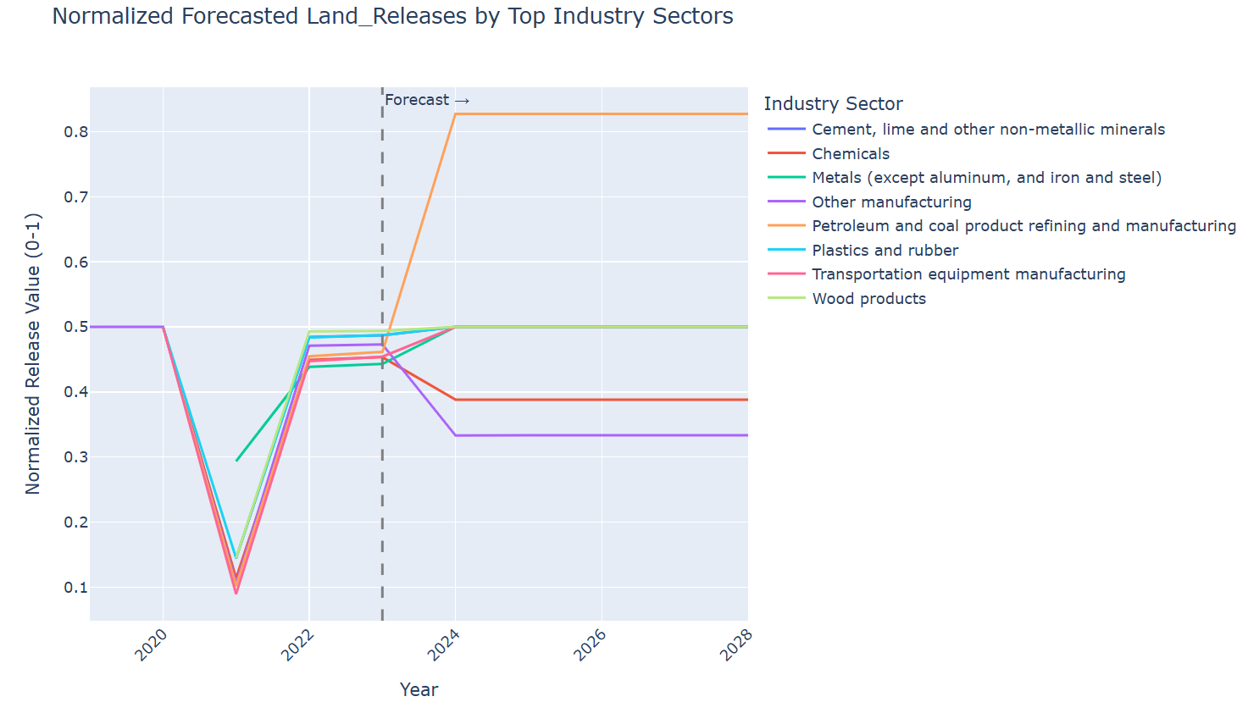
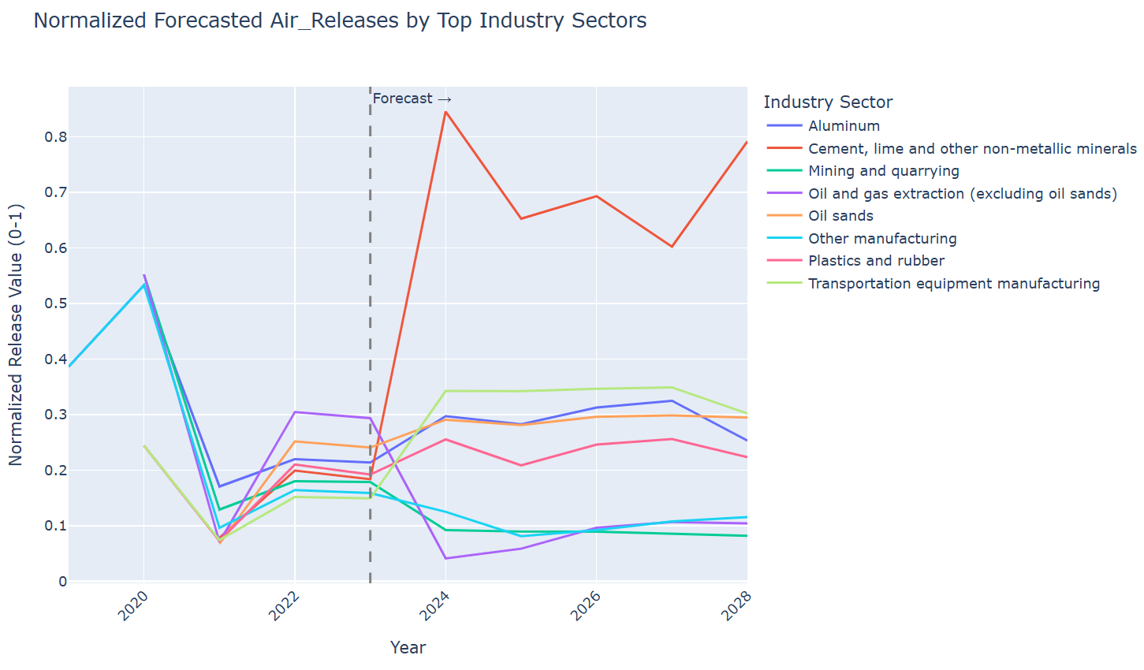
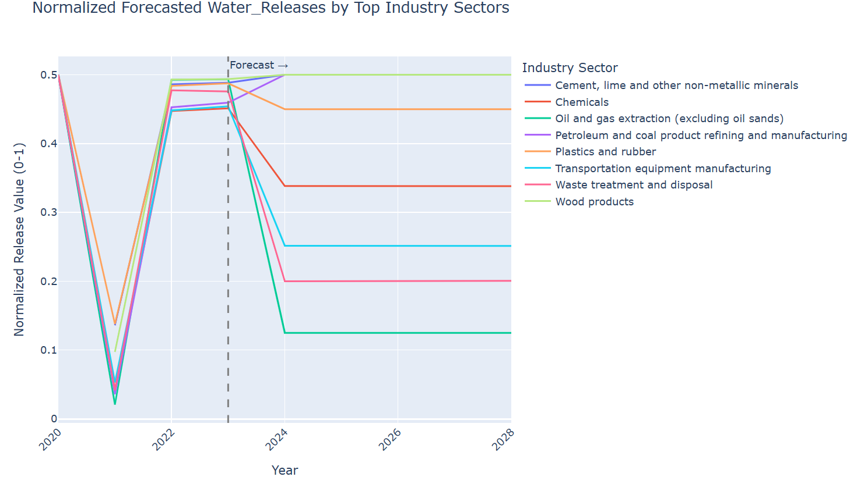
Industry Trends & Key Results
Substance specific trends: Average release ratios over time
Industry forecast: Normalized forcased releases for top polluting sectors, categorized by release target (air, land, water)

Slide 7
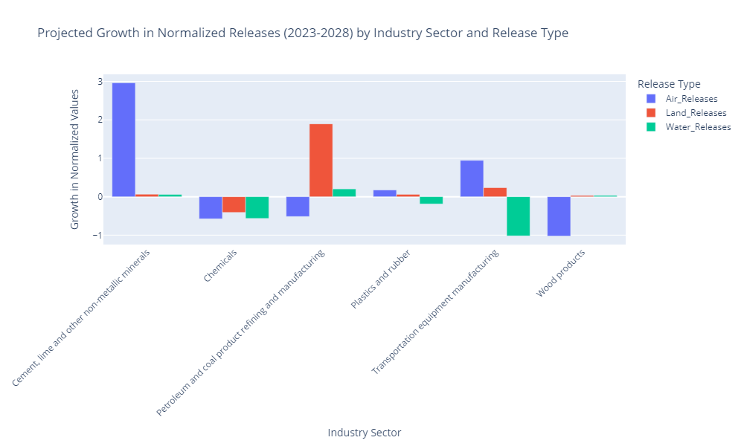
Insights and Findings
Top Polluters: Cement, Plastics, Petroleum, and Wood Products.
Growth: Cement, Lime, and Non-Metallic Minerals see the highest increase in emissions.
Decline: Iron and Steel, and Oil and Gas Pipelines are projected to reduce emissions.

Slide 8
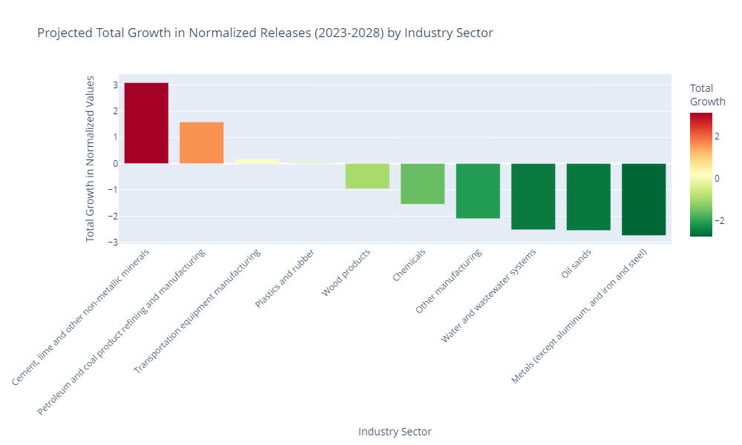
Insights and Findings
Highest Growth: Cement, lime, and non-metallic minerals
Largest Decline: The metals sector (excluding aluminum and iron/steel)

Slide 9
Challenges and Solutions
Challenge | Solution
Incomplete data across years | Filtered for substances with full yearly data (2000–2023); excluded low-coverage pollutants
Substances reported inconsistently or erratically | Ranked and selected substances using metrics like Coefficient of Variation (CV), sector coverage, and stability
Data leakage risk in forecasting | Used TimeSeriesSplit for time-aware validation and an 80/20 time-based split to simulate real forecasting
Choosing the best model for each case | Applied grid search with cross-validation per substance + target to find the best-performing model
Handling different emission behaviors (air, land, water) | Trained separate models for each medium; avoided one-size-fits-all modeling
Initial modeling assumptions changed mid-project | Pivoted to time series modeling with 7-year lag features.

Slide 10
Conclusion : Key Takeaways
Time-series regression models can effectively forecast pollutant trends across industries using historical NPRI data.
Random Forest Regressor outperformed other models, especially in handling non-linear emissions.
Distinct patterns emerged:
Highest Growth: Cement, lime, and non-metallic minerals
Could be influenced by construction booms and industrial demand
Largest Decline: The metals sector (excluding aluminum and iron/steel)
Could be due to automation and efficiency improvements and a shift towards a more circular economy

Slide 11
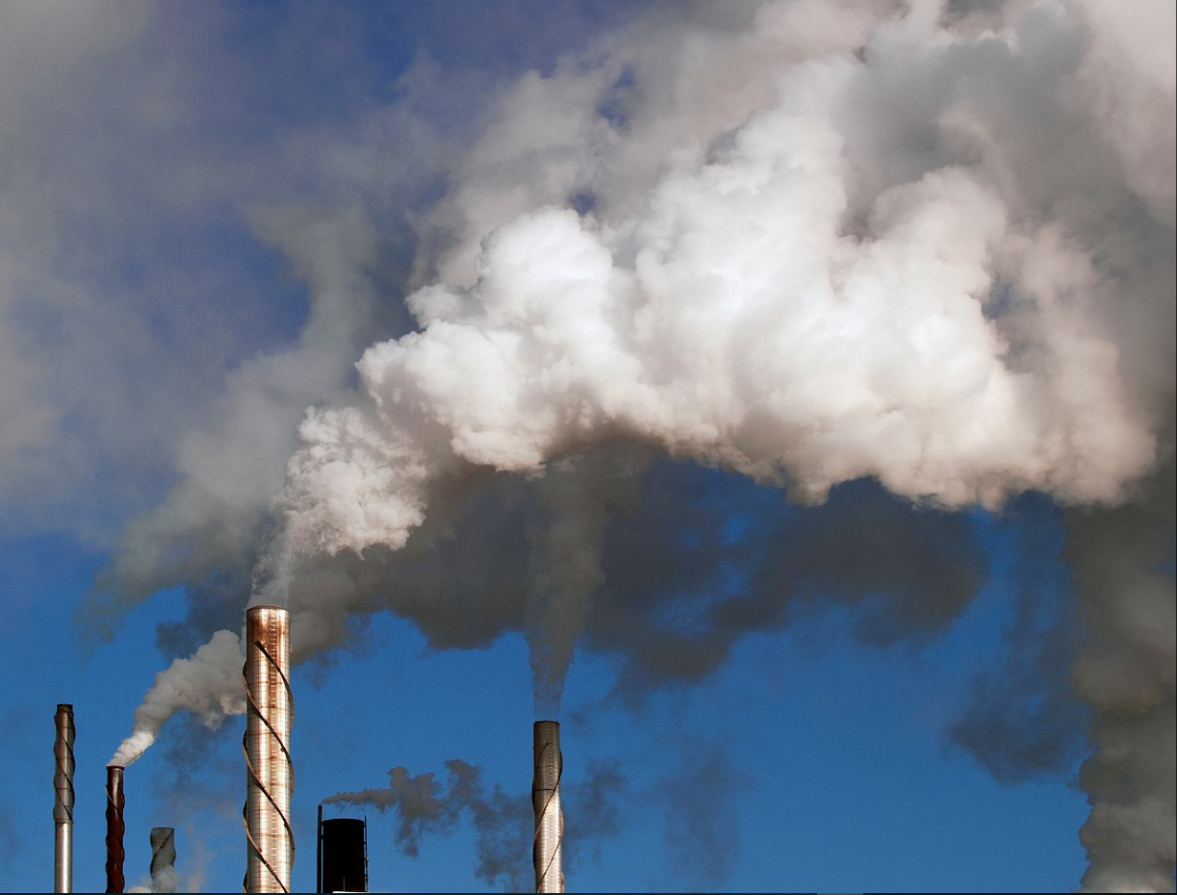
Q & A
References
Environment and Climate Change Canada (ECCC) National Pollutant Release Inventory (NPRI) – https://pollution-waste.canada.ca/npri/ (Accessed 2025)
Scikit-learn Documentation Pedregosa et al., (2011). Scikit-learn: Machine Learning in Python, JMLR. https://scikit-learn.org/stable/
Pandas Documentation The pandas development team (2023). pandas-dev/pandas: Pandas. https://pandas.pydata.org/
Matplotlib and Seaborn Libraries Hunter, J.D. (2007). Matplotlib: A 2D graphics environment. https://matplotlib.org/
Waskom, M. (2021). Seaborn: statistical data visualization. https://seaborn.pydata.org/

