Slide 1
Minimum viable NPU driver for Arm TrustZone

Slide 2

our advantages:
Drag the whole driver into secure world we can achieve minimum communication (parameters and instruction sending) with normal world compared to other secure NPU implementations(sNPU,TNPU).
Through record and replay it has a small code base compared to the whole ML framework, NPU compiler , NPU runtime and NPU driver.(just like GPUReplay)
It can achieve similar performance compared to the original one.(just like GPUReplay)(significant performance decrease is unacceptable due to the requirment of the ML tasks), but maybe the parallism and synchronization problem must be solved since NPU will distribute different layers’ operations of one single task to many cores at a single time.
It has more simple structures and more easily portable to different TEE and NPU implementations.
Doesn’t required (many) modifications to the kernel, driver , framework, runtime etc.(other implementation has changed and add many components)

Slide 3
security requirement:
confidentiality:protect parameter, code and data leakage.
through encryption
through TEE memory access isolation
Integrity
for instruction and code from normal world through HASH & MAC
for interactive templates/recordings through HASH & MAC
for boot code through chain of trust
use a counter to protect replay attack
availibility
not required I think, since TEE itself doesn’t provide this.

Slide 4
performance requirement
similar performance to the origin one
we can’t add much to the critical path of NPU execution
TEE itself has little cost
replay has little cost
maybe encryption, decryption, and authendication has, but as the NPU task execution is in parallel and it can execute many tasks in parallel, so it won’t affect much part of the critical path, may be only the beginning part will be affected.
we need to resolve synchronization and commnication in NPU task execution.
I don’t know if it has already implemented in NPU itself or in the driver. if in driver , then it must be handled in the replay template execution.
high resouse utilization
question:
how to protect user prompt with NPU execution inside TEE.
end to end execution
transformer weight parameters leakage
allow parallism of tasks and operations

Slide 5
function requirment
achieve the original function
since NPU operation is simple and more constrained compared to CPU and GPU, I think it’s not hard to achieve this.

Slide 6
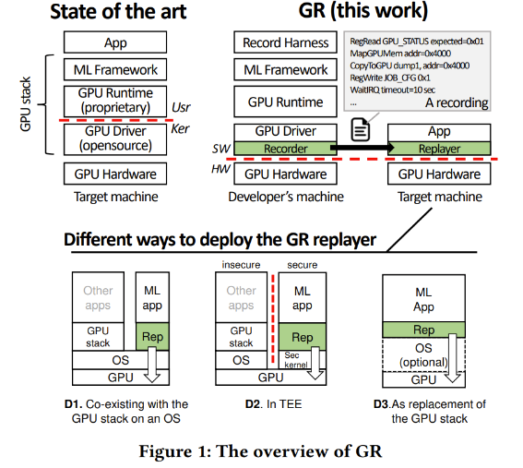
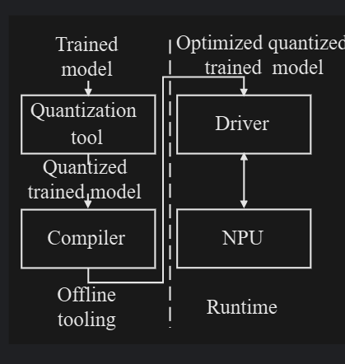
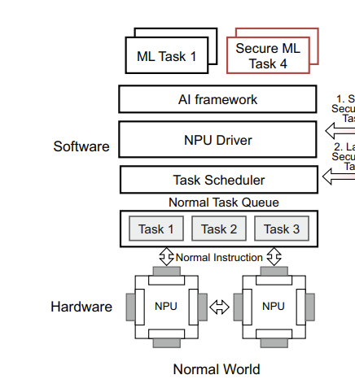
question
what should be draged into TEE? the driver or the whole stack(framework, runtime, driver) just like GR.

Slide 7
question:
It’s inevitable for TEE to communicate with normal world,how to ensure the integrity of code and parameters, using hash before sending to TEE? what if the system is corrupt and the code can be modified before hash generation?
the trained model is compiled offline and can we take specific parameters dirctly through TEE. maybe put the app in TEE directly
the synchronous problem(GR and Driverlet),will it significantly decrease the performance of TEE?
memory dump in GPU is ok, but NPU requires much more memory, will the dump takes too much time?
sNPU can combine secure and insecure operations together in NPU execution, using fine grained isolation based on secure and unsecure bits, but our NPU may be hard to achieve this due to the unavoidable synchronization and communication between two worlds’ drivers. So I wonder if we can just implement a full secure world driver that just execute secure world tasks?
like other secure NPU implementation, can we just exclude the side channel attack and any attack that requirs physical attachment to the system.
like GPUReplay, should we test in different NPU implementations?

Slide 8
what to do next
read documentations?
NPU
OP-TEE
learn record & replay?
read GPUReplay code

