Slide 1
Sentiment of the Union
Analyzing Tone in presidential state of the union addresses
Honors College Thesis Defense
Chase Rydeen

Slide 2
Motivation
Language Data and Natural Language Processing
Publicly available and consistent text data in Presidential State of the Union Addresses
Predict Presidential party, potentially hone a Political Party Predictor

Slide 3
Major Areas of Research
Natural Language Processing
Sentiment Analysis
Machine Learning
Visualizations

Slide 4
Technologies Used
Python
NLTK
D3.js

Slide 5
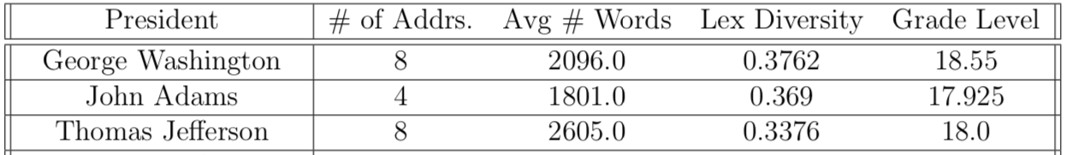
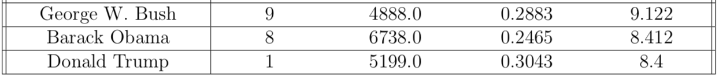
Data Set
Source
Preprocessing
Statistical Summary

Slide 6
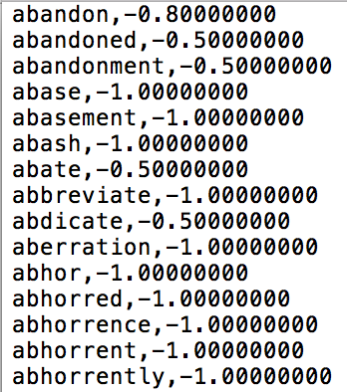
Sentiment Analysis
Lexicons
Range -1 to 1
Stemming
Modifiers

Slide 7
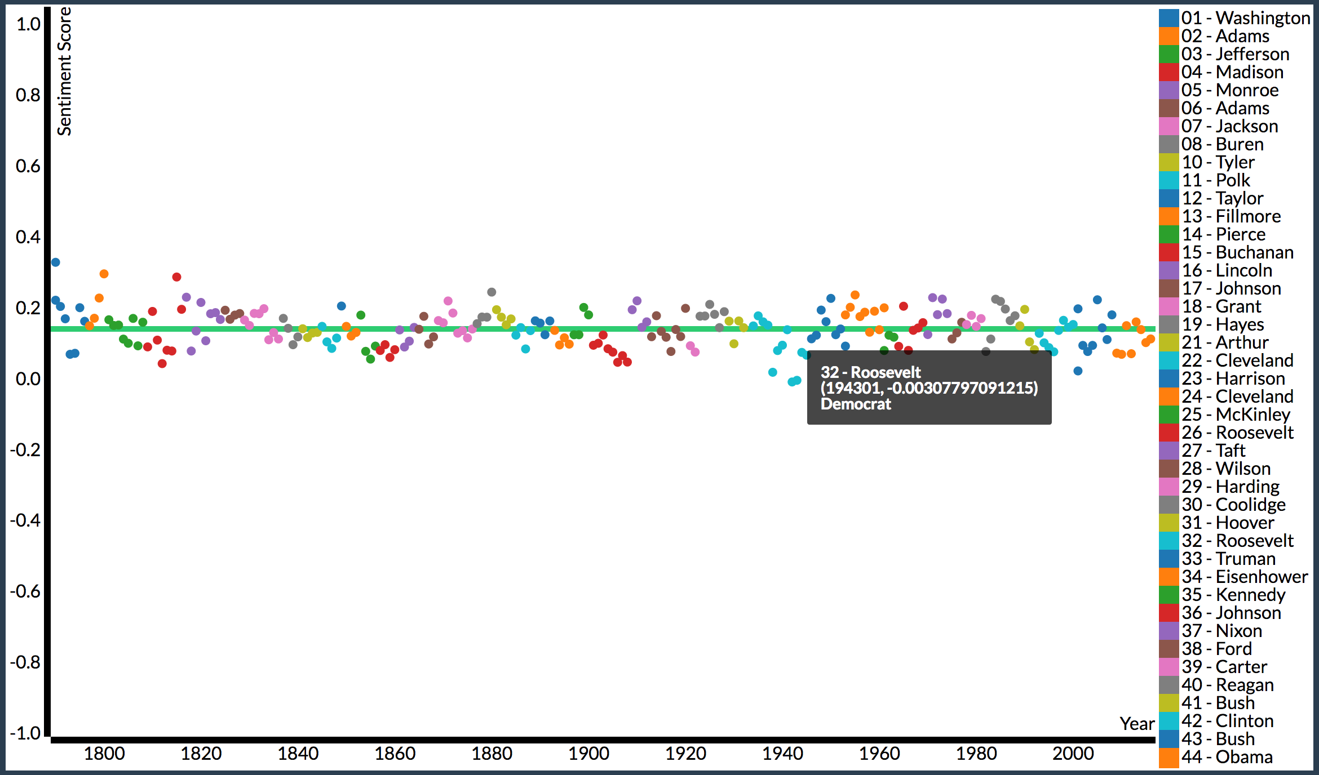
Visualizations
Line Plot (average sentiment - 0.142)

Slide 8
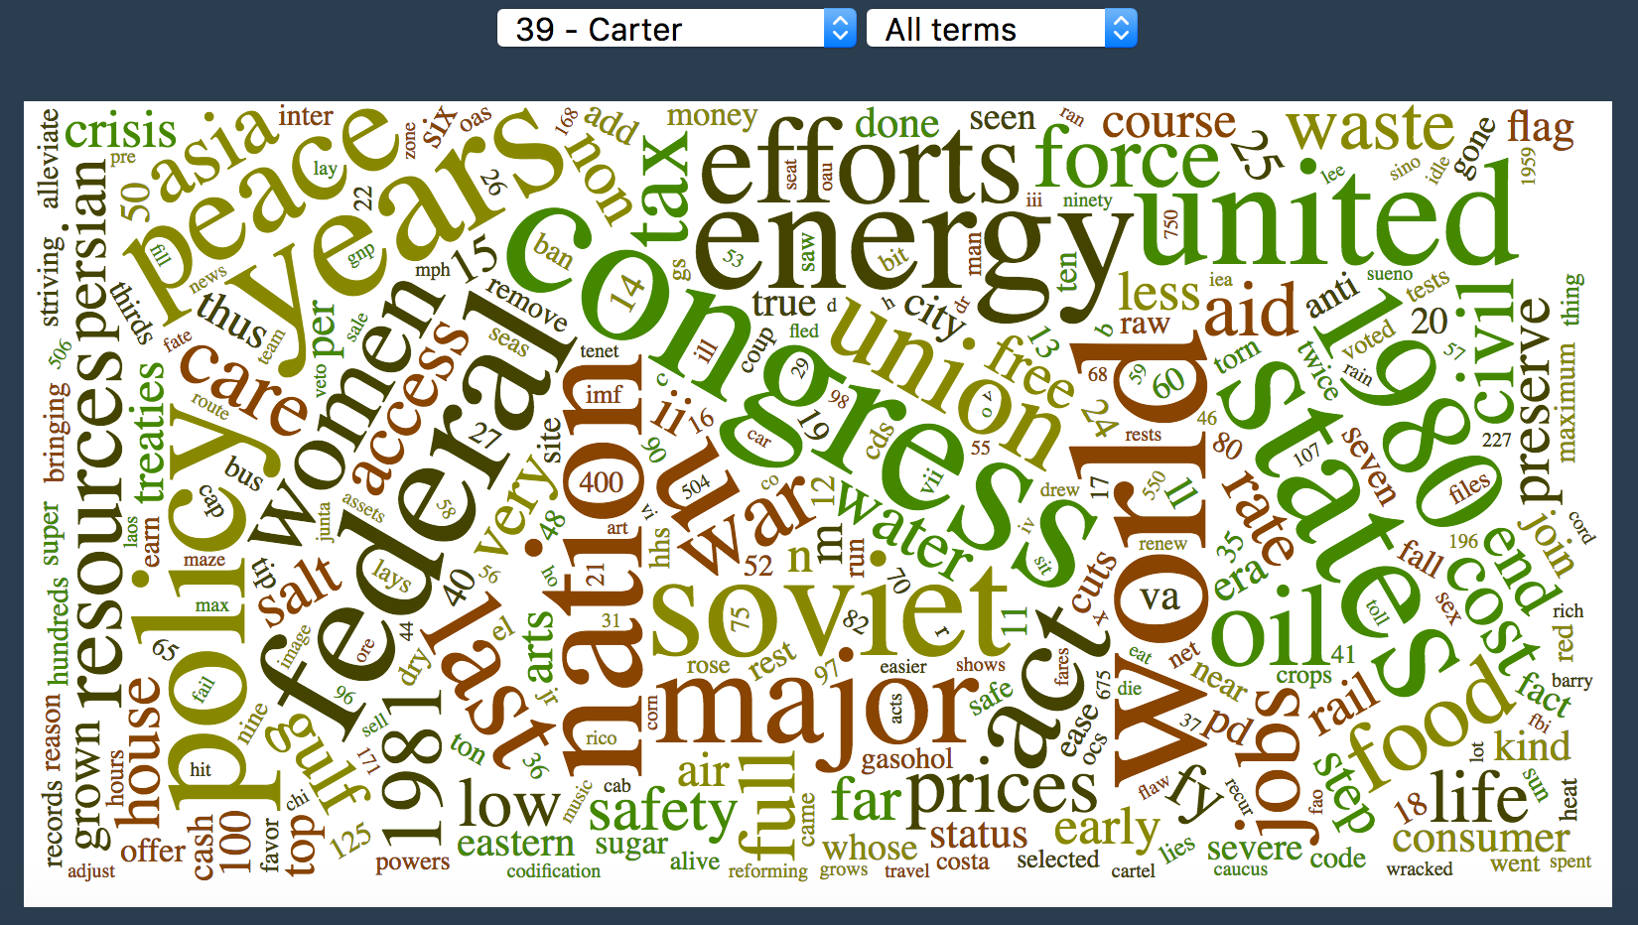
Visualizations
Word Cloud

Slide 9
Demonstration
https://turing.cs.olemiss.edu/~dcrydeen/thesis/index.html

Slide 10
Major Findings
Downward Trend in Tone
Negative Tone during Crises

Slide 11
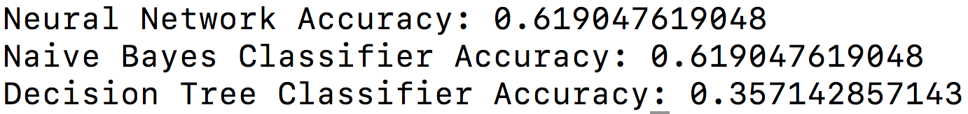
Party Prediction
Using Standard Lexicon
Machine Learning
Neural Network
Naïve Bayes
Leave-one-out Cross-validation
Results

Slide 12
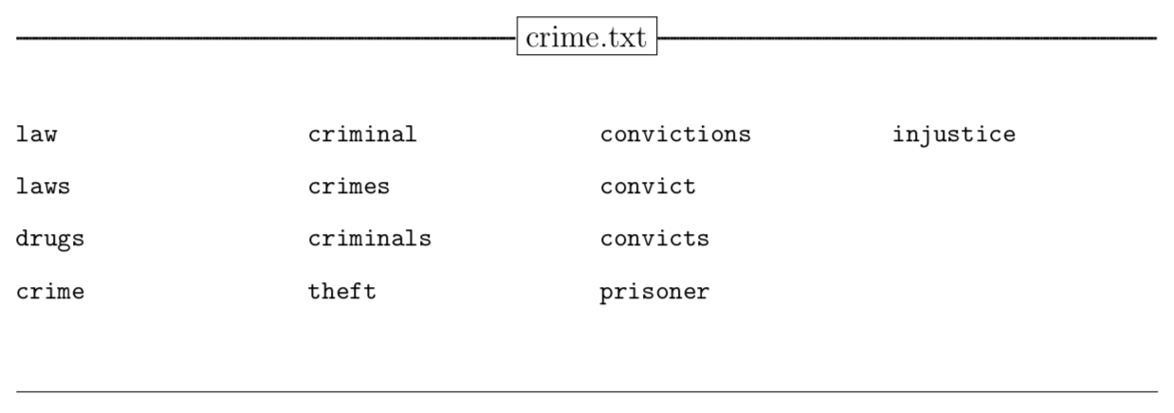
Sentiment Analysis 2.0
Topic Classification and Vector Creation
Crime, Economy, Education, Energy, Environment, Family, Foreign Affairs, Government, Jobs, Religion, Terrorism, War

Slide 13
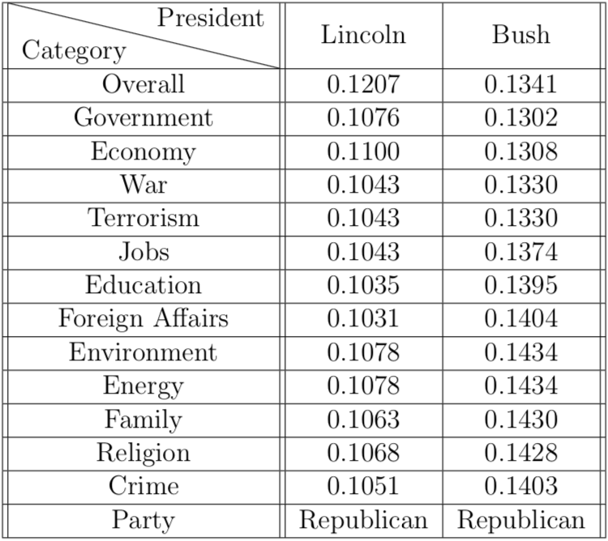
Vector Creation

Slide 14
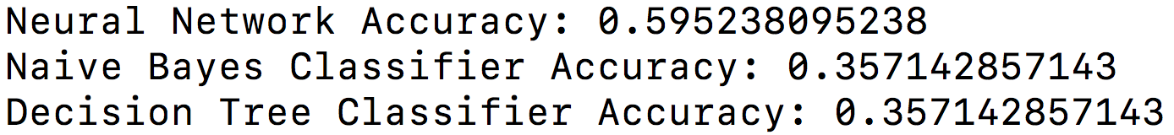
Results 2.0

Slide 15
Major Findings 2.0
Topic Classification stayed consistent across neural network, decreased on Naïve Bayes
Further improvements could be made by refinement of lexicons and sentiment analysis process

Slide 16
Complications
Text Data
Phrases
Size of Dataset
Changes in Length of SOTU

Slide 17
Future Work
Refine Overall Lexicon and Topic Category Lexicons
Utilize more Speech Data
More advanced N-grams for phrase handling
Add additional Visualizations
House and Senate Majorities, and Bills and Laws Passed versus President’s Tone

Slide 18
Thank You
Questions?

Slide 19
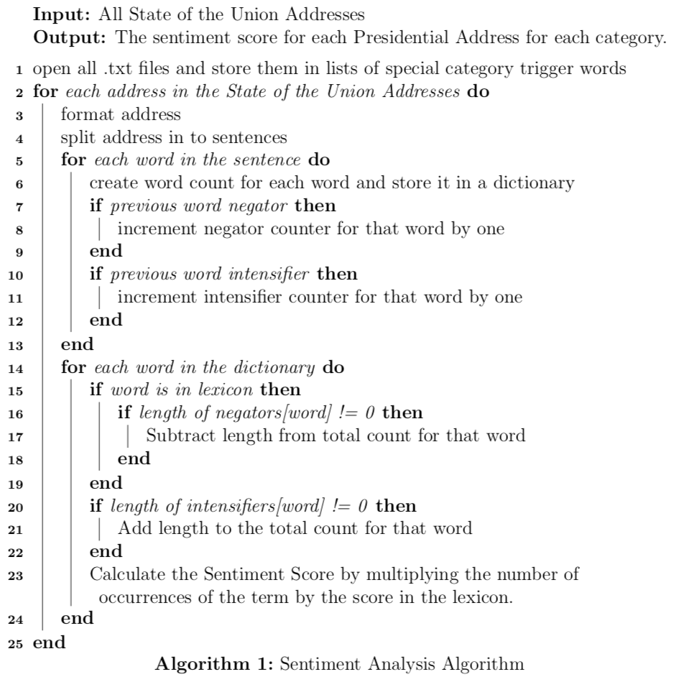
Sentiment Analysis Algorithm

Slide 20
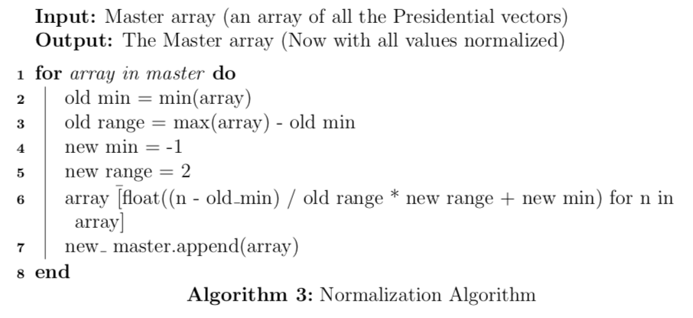
Normalization Algorithm

Slide 21
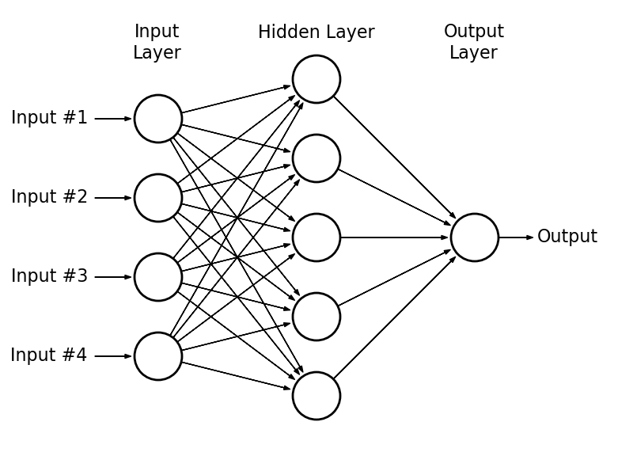
Neural Network

