Slide 1
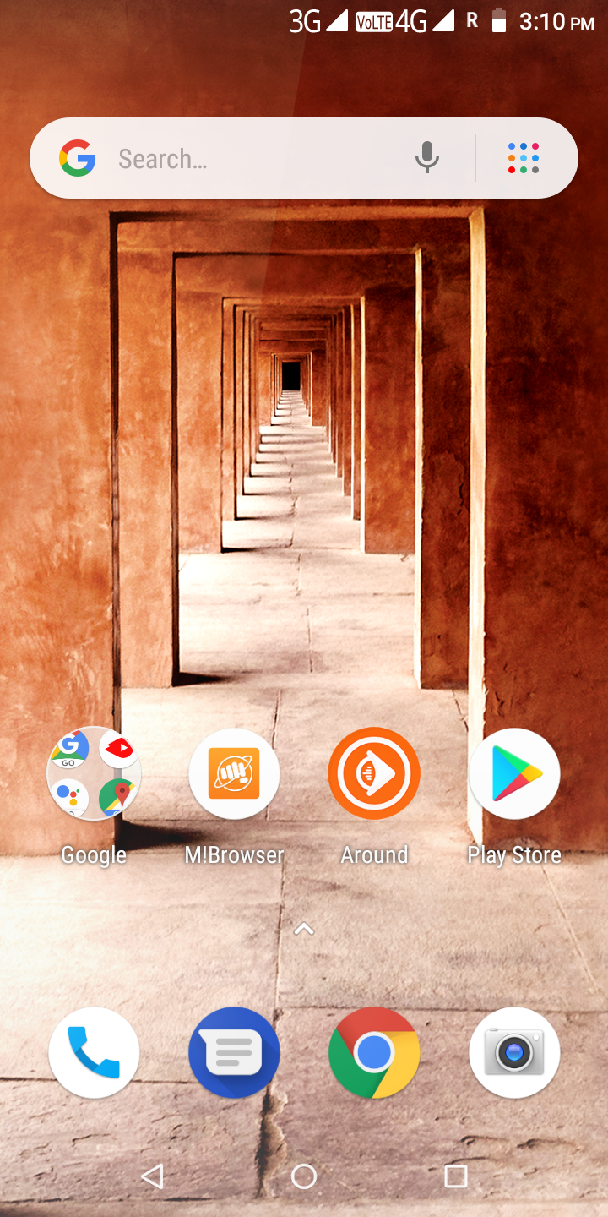
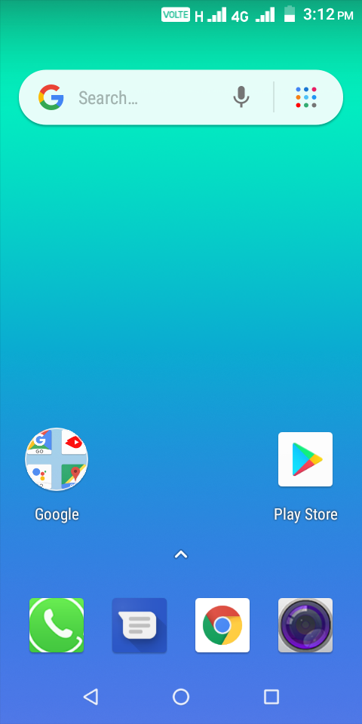
Bench Mark device
Model – Q438
Volte icon correct position when Volte SIM insert in slot2.
Volte icon incorrect position when insert in slot2
Expected Outcome
Actual Outcome

