Slide 1





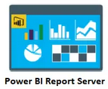


Data Sources
Data Preparation
Semantic Layer
Authoring
Presentation
Building a Data Warehouse for Adventure Works business
DBs
DQS
MDS
SSIS
SSAS
Files
SSIS
SSIS
DWH
Tabular
Cloud apps
Staging
Multidimensional
.xlsx, .csvs

