Slide 1
DATABASE PROJECT REPORT ON
Anime DATABASE MANAGEMENT
Bornil Chowdhury
Roll: 2007057

Slide 2
Project Overview
Goal: Develop a robust and user-friendly system for managing information related to anime, users, and their interactions.
Features:
Anime Data: Store and manage details about anime series and movies, including titles, studios, genres, release dates, episode information (if applicable), and average ratings.
User Management: Create and manage user accounts, allowing users to create watchlists, track their progress, and potentially rate anime they've watched.
Search and Filtering: Provide efficient search functionalities for users to find anime based on various criteria like title, genre, studio, or release year.
Data Analysis and Reporting: Generate reports and insights on user watchlist trends, popular genres, and top-rated anime.
Security: Implement mechanisms to ensure secure user authentication, data encryption for sensitive information (like passwords), and potential access control levels for different user roles.

Slide 3
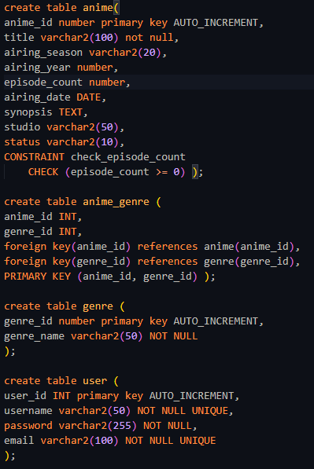
Database Structure
This is the overall table structure of the database.

Slide 4
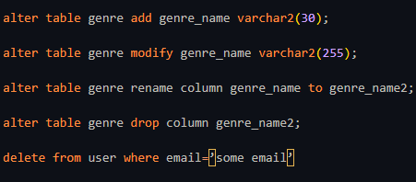
DDL Part

Slide 5
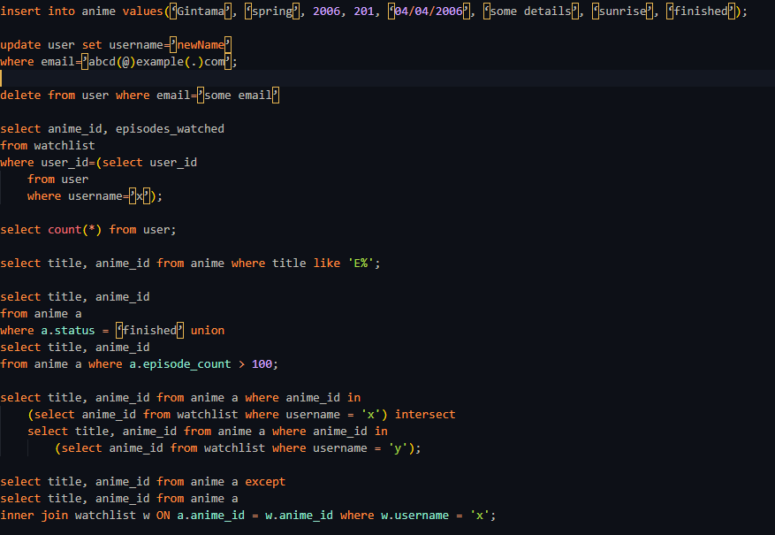
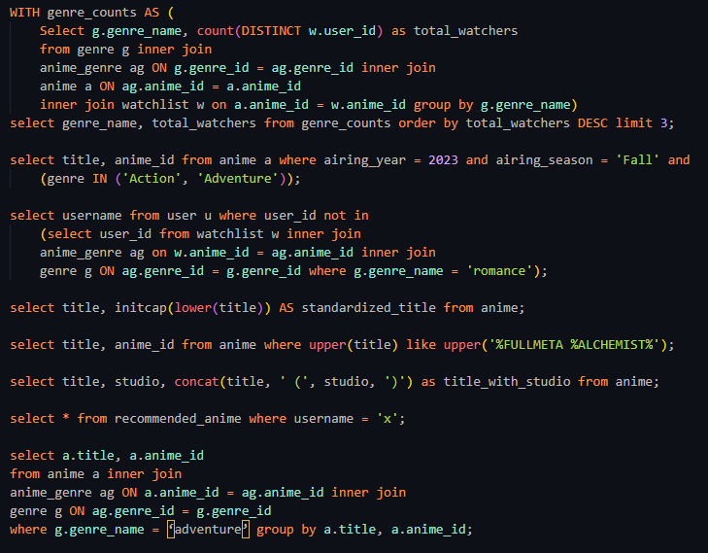
DML Part

Slide 6
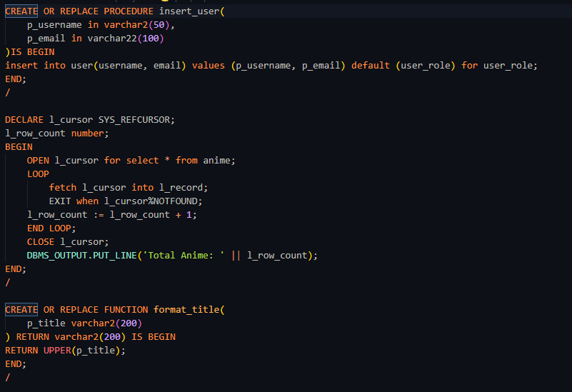
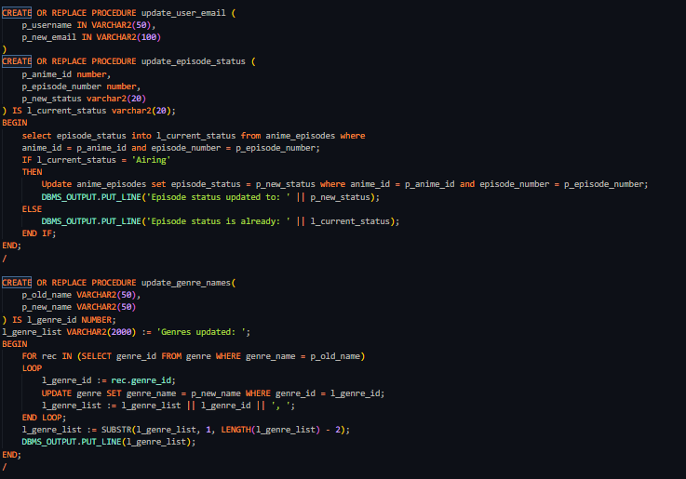
PL/SQL Part

Slide 7
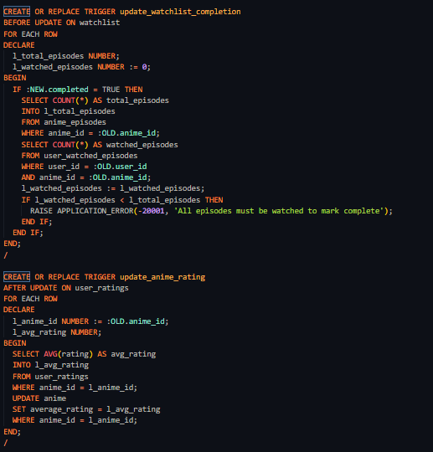
PL/SQL Part(Contd.)

Slide 8
THANK YOU

