Slide 1
LAB 5: COMPILATION STEPS OF A C PROGRAM & MAKE FILE
Dr. Kazi Md. Rokibul Alam & JAKARIA

Slide 2
COMPILATION STEPS OF A C PROGRAM
To compile and run the C program helloworld.c, all C statements must be translated individually into a sequence of instructions that a machine can understand.
These instructions are then packaged in a form called executable object program. There are other programs which perform this task to get the program running.
On a UNIX/Linux system, the translation from source code to object code (executable) is performed by a compiler driver. Here we will compile C program by gcc.
#include <stdio.h>
int main()
{
printf("hello, world!\n");
return 0;
/* helloworld.c */
}

Slide 3
COMPILATION STEPS OF A C PROGRAM
The following command (provided that gcc is installed on your Linux box) compiles C program helloworld.c and creates an executable file called helloworld. Don't forget to set appropriate permissions to helloworld.c, so that you won't get execute permission errors.
[root@host ~]# gcc helloworld.c -o helloworld
While compiling helloworld.c the gcc compiler reads the source file helloworld.c and translates it into an executable helloworld. The compilation is performed in four sequential phases by the compilation system (a collection of four programs - preprocessor, compiler, assembler, and linker).

Slide 4
COMPILATION STEPS OF A C PROGRAM
Now, let's perform all four steps one by one and understand independently.
1. Preprocessing
During compilation of a C program the compilation is started off with preprocessing the directives (e.g., #include and #define).
The preprocessor (cpp -- c preprocessor) is a separate program in reality, but it is invoked automatically by the compiler. For example, the #include <stdio.h> command in line 1 of helloworld.c tells the preprocessor to read the contents of the system header file stdio.h and insert it directly into the program text. The result is another file typically with the .i suffix. In practice, the preprocessed file is not saved to disk unless the -save-temps option is used.

Slide 5
COMPILATION STEPS OF A C PROGRAM
This is the first stage of compilation process where preprocessor directives (macros and header files are most common) are expanded. To perform this step gcc executes the following command internally.
[root@host ~]# cpp helloworld.c > helloworld.i (or)
[root@host ~]# gcc -E helloworld.c –o helloworld.i
The result is a file helloworld.i that contains the source code with all macros expanded. If you execute the above command in isolation then the file helloworld.i will be saved to disk and you can see its content by vi or any other editor you have on your Linux box.

Slide 6
COMPILATION STEPS OF A C PROGRAM
2. Compilation
In this phase compilation proper takes place. The compiler (cc) translates helloworld.i into helloworld.s. File helloworld.s contains assembly code.
You can explicitly tell gcc to translate helloworld.i to helloworld.s by executing the following command.
[root@host ~]# gcc -S helloworld.i –o helloworld.s
The command line option -S tells the compiler to convert the preprocessed code to assembly language without creating an object file. After having created helloworld.s you can see the content of this file.

Slide 7
COMPILATION STEPS OF A C PROGRAM
3. Assembly
Here, the assembler (as) translates helloworld.s into machine language instructions, and generates an object file helloworld.o. You can invoke the assembler at your own by executing the following command.
[root@host ~]# as helloworld.s -o helloworld.o
The above command will generate helloworld.o as it is specified with -o option. And, the resulting file contains the machine instructions for the classic "Hello World!" program, with an undefined reference to printf.

Slide 8
COMPILATION STEPS OF A C PROGRAM
4. Linking
This is the final stage in compilation of "Hello World!" program. This phase links object files to produce final executable file. An executable file requires many external resources (system functions, C run-time libraries etc.).
Regarding our "Hello World!" program you have noticed that it calls the printf function to print the 'Hello World!' message on console. This function is contained in a separate pre compiled object file printf.o, which must somehow be merged with our helloworld.o file.
The linker (ld) performs this task for you. Eventually, the resulting file helloworld is produced, which is an executable. This is now ready to be loaded into memory and executed by the system.
[root@host ~]# gcc helloworld.o -o helloworld
[root@host ~]# gcc helloworld1.o helloworld2.o -o helloworld [for multiple object file]

Slide 9
MAKE FILE
Small C/C++ applications with a couple of modules are easy to manage. Developers can recompile them easily by calling the compiler directly, passing source files as arguments. That is a simple approach. However, when a project gets too complex with many source files it becomes necessary to have a tool that allows the developer to manage the project.
The tool we are talking about is the make command. The make command is used not only to help a developer compile applications, it can be used whenever you want to produce output files from several input files.
This tutorial focuses on C applications and how to use the make command and makefile to build them. There is a sample folder under make_samples. The most important files in the samples are the makefiles not the C source code.

Slide 10
MAKE FILE
Make Tool: Syntax Overview
make command syntax is:
make [options] [target]
You can type make --help to see all options make command supports. In this tutorial an explanation of all those options are not in the scope. The main point is makefile structure and how it works. target is a tag (or name defined) present in makefile.
make requires a makefile that tells it how your application should be built. The makefile often resides in the same directory as other source files and it can have any name you want. For instance, if your makefile is called run.mk then to execute make command type:
make –f run.mk

Slide 11
MAKE FILE
-f option tells make command the makefile name that should be processed.
There are also two special names that makes -f option not necessary:
makefile and Makefile. If you run make not passing a file name it will look first for a file called makefile. If that does not exist it will look for a file called Makefile. If you have two files in your directory one called makefile and other called Makefile and type:
make <enter>
make command will process the file called makefile. In that case, you should use -f option if you want make command processes Makefile.

Slide 12
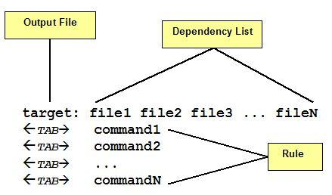
MAKE FILE
A make file consists of a set of targets, dependencies and rules. A target most of time is a file to be created/updated. target depends upon a set of source files or even others targets described in Dependency List. Rules are the necessary commands to create the target file by using Dependency List.
As you see in figure each command in the Rules part must be on lines that start with a TAB character. Space issue errors. Also, a space at end of the rule line may cause make issues an error message.
The makefile is read by make command which determines target
files to be built by comparing the dates and times (timestamp) of source files in Dependency List. If any dependency has a changed timestamp since the last build make command will execute the rule associated with the target.

Slide 13
MAKE FILE
sample is a example of simple makefile, there is multiple targets. There are 2 makefiles: mkfile.r and mkfile.w to demonstrate the right and the wrong way to write a makefile.
As you notice, the final executable (app target) is formed by 3 object files: main.o, mod_a.o and mod_b.o. Each one is a target with its source files that represent its dependency list.
app target is the main target or the target that will result the main executable file. Notice app dependency list. They are names of others targets.
Both makefiles are complete. The main difference is the order the targets are placed in the makefile.
So, we have:
mkfile.r and mkfile.w

Slide 14
MAKE FILE
app: main.o mod_a.o mod_b.o
cc -o app main.o mod_a.o mod_b.o
main.o: main.c inc_a.h inc_b.h
cc -c main.c
mod_a.o: mod_a.c inc_a.h
cc -c mod_a.c
mod_b.o: mod_b.c inc_b.h
cc -c mod_b.c
mkfile.r

Slide 15
MAKE FILE
main.o: main.c inc_a.h inc_b.h
cc -c main.c
mod_a.o: mod_a.c inc_a.h
cc -c mod_a.c
mod_b.o: mod_b.c inc_b.h
cc -c mod_b.c
app: main.o mod_a.o mod_b.o
cc -o app main.o mod_a.o mod_b.o
mkfile.w

Slide 16
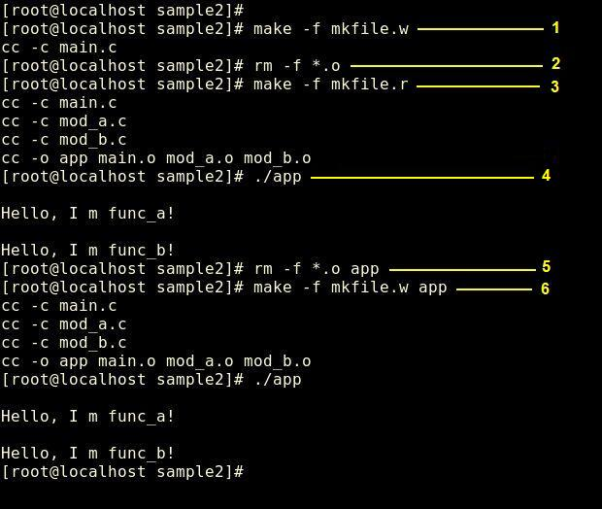
MAKE FILE
Let us try the following sequence of commands:

Slide 17
MAKE FILE
make command is invoked to process mkfile.w and you can see only the first rule is executed.
All object files resulted from previous builds were removed to force make command to perform a full build.
make command is invoked to process mkfile.r and all modules are correctly created.
app is executed.
All objects and executables were removed to force the make command to perform a full build.
make command is invoked to process mkfile.w again. But this time app target is passed as an argument and all modules are correctly created.

Slide 18
MAKE FILE
So, what is wrong with mkfile.w ? Well, technically nothing when you inform the main target (figure - item 6). However, when you do not inform a target the make command reads makefile from the beginning to find the first target to process. In the mkfile.w case, that target is main.o. main.o target only says to make to build main.o from main.c, inc_a.h and inc_b.h - there is nothing more related to do. Make will not read the next target.
Note: the first target read determines how make must interpret all other targets and which order it must follow during the building process. So, the first target should be the main target and it might relate to one or more secondary targets to perform the build.

Slide 19
MAKE FILE
Let us see app target. It is placed in different lines in both makefiles but they have identical syntax in both. So, item 3 and item 6 of figure will produce the same result:
app target says to make command it has 3 dependency to process first: main.o, mod_a.o and mob_b.o before building the final executable (app).
Then, make starts finding for a main.o target and process it.
After, it finds and processes mod_a.o.
And finally, mod_b.o is processed.
When all those 3 targets are built, app target rule is processed and app executable is created.

Slide 20
MAKE FILE
Sometimes a target does not mean a file but it might represent an action to be performed. When a target is not related to a file it is called phony target.
For instance:
getobj:
mv obj/*.o . 2>/dev/null
getobj target move all files with .o extension from obj directory to current directory -- not a big deal. However, you should be asking yourself: "What if there is no file in obj ?" That is a good question. In that case, the mv command would return an error that would be passed to the make command.

Slide 21
MAKE FILE
Note: make command default behavior is to abort the processing when an error is detected while executing commands in rules.
Of course, there will be situations that the obj directory will be empty. How will you avoid the make command from aborting when an error happens?
You can use a special character - (minus) preceding the mv command. Thus:
getobj:
-mv obj/*.o . 2>/dev/null

Slide 22
MAKE FILE
There is a special phony target called all where you can group several main targets and phony targets. All phony target is often used to lead make command while reading makefile.
For instance:
all: getobj app install putobj

Slide 23
MAKE FILE
The make command will execute the targets in sequence: getobj, app, install and putobj.
Another interesting feature, make command supports is the concept of MACRO in makefiles. We can define a MACRO by writing:
MACRONAME=value
And access the value of MACRONAME by writing either $(MACRONAME) or ${MACRONAME}.

Slide 24
MAKE FILE
For instance:
EXECPATH=./bin
INCPATH=./include
OBJPATH=./obj
CC=cc
CFLAGS=-g -Wall -I$(INCPATH)
While executing, make replaces $(MACRONAME) with the appropriated definition. Now we know what phony targets and macros are.

Slide 25
Attention Please ☺
You must practice these workflow using given files for proper understanding.
Otherwise you can not answer correctly to your VIVA questions which will be held in near future LAB.
Thank you . ☺

