Slide 1
CSE 4128 Image Processing and Computer Vision Laboratory Week 4: Region Descriptors and Feature Matching
Dr. Sk. Md. Masudul Ahsan
Professor
Dept. of CSE, KUET
Md Tajmilur Rahman
Lecturer
Dept. of CSE, KUET

Slide 2
Region Descriptors
Information that lets you recognize a region.
They focus on the content and texture of objects in an image.
They describe the distribution of pixel values within a region and capture the spatial relationships between different regions.
They extract relevant information from the image and represent it in a way that can be easily compared and matched with other images.

Slide 3
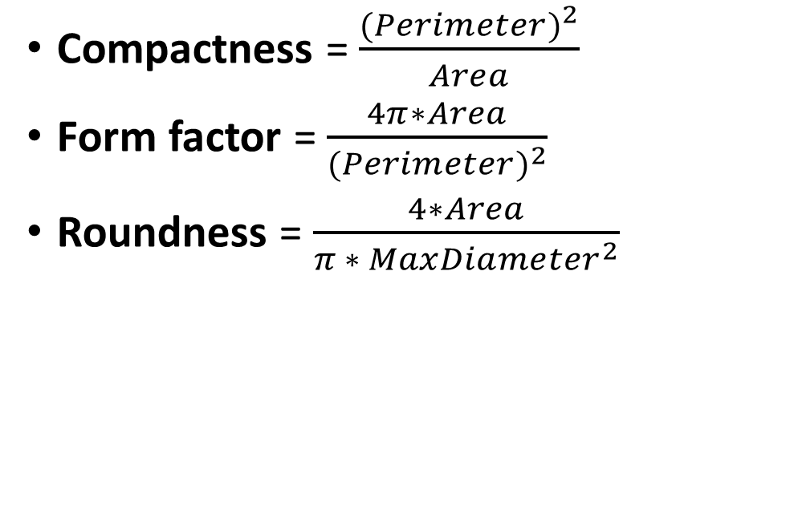
Region Descriptors
Compactness = $\frac{{(Perimeter)}^{2}}{Area}$
Form factor = $\frac{4π∗Area}{{(Perimeter)}^{2}}$
Roundness = $\frac{4∗Area}{π ∗ {MaxDiameter}^{2}}$

Slide 4



Example
Form factor
Roundness
Compactness
0.1644
2.0132
76.426
0.1184
0.6075
106.097
0.1512
1.1469
83.118

Slide 5
Classwork
Take one of each shape as train image and the other as test image.
For each binary image:
Find the Boundary of the object in the image.
Apply erosion to the binary image.
Subtract the eroded image from the binary image to get the border of the region.
Calculate Perimeter, Area, Max Diameter of the region.
Use Area, Perimeter, and Max Diameter to calculate Form factor, Roundness, and Compactness and save it in a txt file.
Matching the descriptors of the test and train images to find close Match.

Slide 6
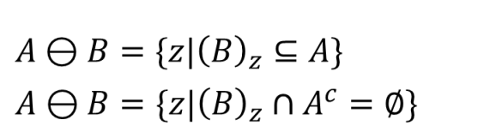

Erosion
1 | 1 | 1 | 1 | 1 | 1
1 | 1 | 0 | 0 | 1 | 1
1 | 0 | 0 | 0 | 0 | 1
1 | 1 | 0 | 0 | 1 | 1
1 | 1 | 1 | 1 | 1 | 1
0 | 0 | 0 | 0 | 0 | 0
1 | 0 | 0 | 0 | 0 | 1
1 | 0 | 0 | 0 | 0 | 1
1 | 0 | 0 | 0 | 0 | 1
0 | 0 | 0 | 0 | 0 | 0
1
1
1

Slide 7
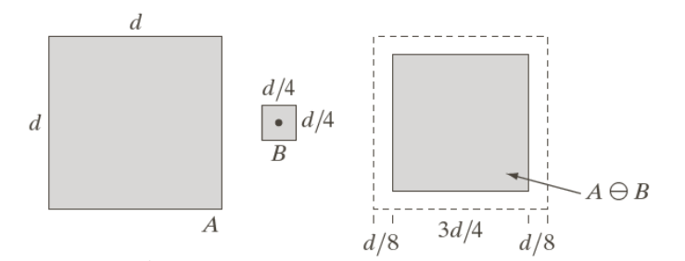
Erosion
kernel = np.ones((3,3), np.uint8)
eroded = cv2.erode(binary, kernel, iterations=1)
border = binary - eroded

Slide 8


Parameters
Area of a region is defined as the number of pixels in the region.
area = np.count_nonzero(binary_image)
Perimeter of a region is the length of its boundary.
perimeter = np.count_nonzero(border_image)

Slide 9
Parameters
MaxDiameter is considered here as the largest distance between the difference of leftmost, rightmost((x₂,y₂),(x₄,x₄))
and topmost, bottommost ((x₁,y₁),(x₃,x₃ )).
MaxDiameter =
maximum(x_{max-}x_{min ,} y_{max-} y_{min} )
(x1,y1)
x_{min}
(x2,y2)
(x4,y4)
x_{max}
(x3,y3)
y_{min}
y_{max}

Slide 10
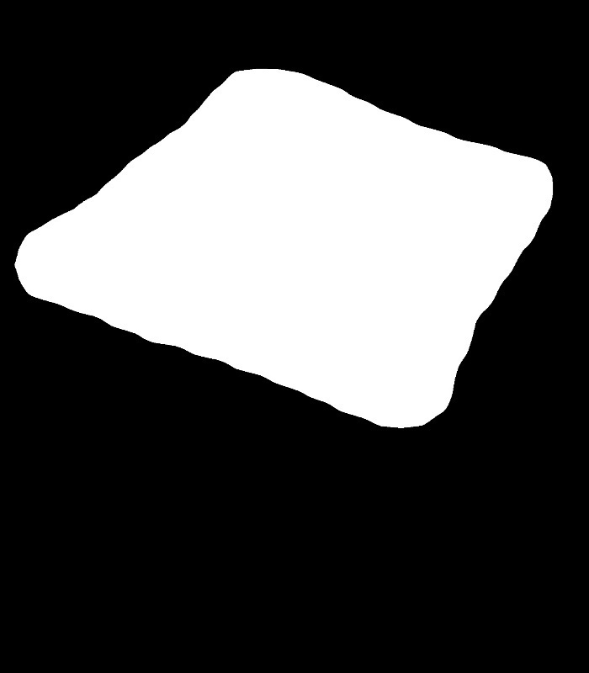
Parameters
To find MaxDiameter of an object
Find the bounding rectangle of the object
Find the x and y Extent of the rectangle
Take the largest one between the x and y extent, MaxDiameter =
maximum(x_{max-}x_{min ,} y_{max-} y_{min} )
Y_{min}
Y_{max}
X_{min}
X_{max}

Slide 11
Similarity Measure
Calculate the Euclidean Distance between each 2 images.
$$distance= \sqrt{\begin{aligned}{\left(FormFactor_{train}−FormFactor_{test}\right)}^{2} \\ +{\left({\text{Roundness}}_{train}−{\text{Roundness}}_{test}\right)}^{2} \\ +{\left({\text{Compactness}}_{train}−{\text{Compactness}}_{test}\right)}^{2} \end{aligned}}$$
Create a matrix showing the similarity among each pairs.
Find which images from test cases match the most with the image from train cases.

Slide 12
Show as table
row_headers = [f'Test {i + 1}' for i in range(4)]
col_headers = [f'GT {i + 1}' for i in range(3)]
distances_matrix = np.array(distances_matrix)
# Display the distance matrix as a table
print(tabulate(distances_matrix[0:4,0:3], headers=col_headers, showindex=row_headers, tablefmt='grid'))

Slide 13




 | GT1 | GT2 | GT3
Test 1 | 1.08 | 28.59 | 5.61
Test 2 | 29.8 | 0.2 | 23.11
Test 3 | 11.37 | 18.31 | 4.68
Test 4 | 185.22 | 155.55 | 178.52

Slide 14
Assignment
Take a gray scale input image and Calculate the
Diagonal, Vertical and horizontal GLCM matrices and visualize them.
For each of the 3 GLCM matrices find the 5 texture features
Maximum probability
Energy
Entropy
Contrast
Homogeneity
Take a small 5x5 image patch from any of your input image. Apply the above mention operations and demonstrate in your report.

Slide 15
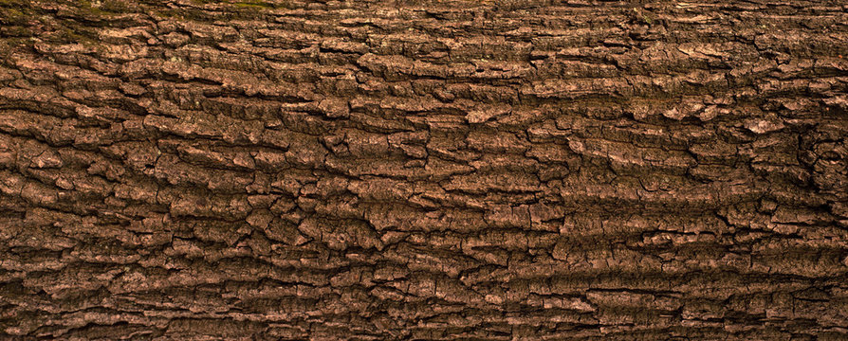
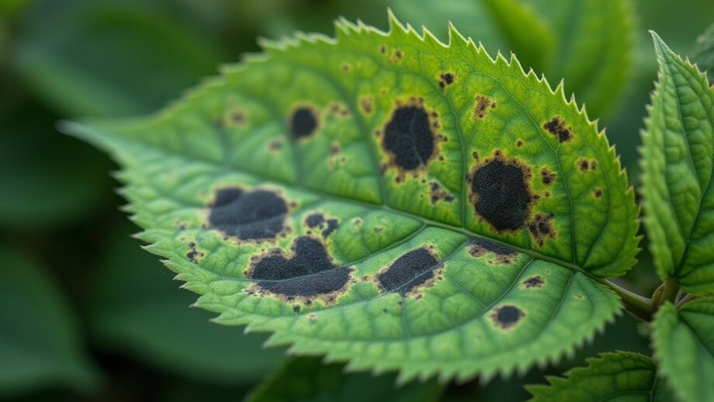
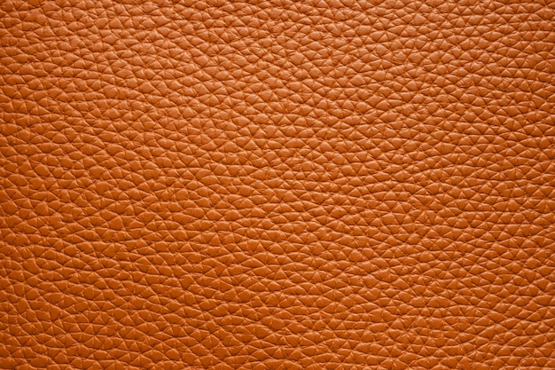
Example input images

Slide 16
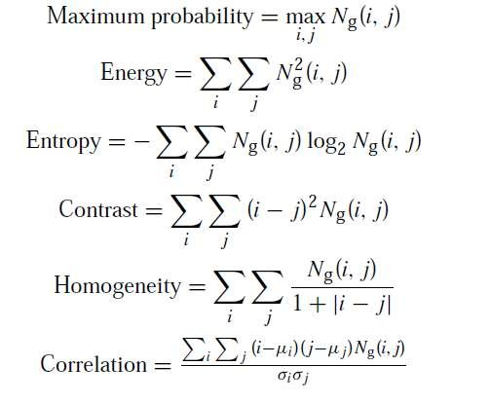
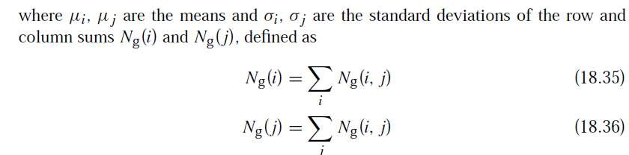
Assignment
Find the following texture based features of a gray scale image using GLCM:
Marginal distribution

Slide 17
Assignment: Texture Features
GLCM stands for Gray-Level Co-Occurrence Matrix. It’s a statistical method used in image processing to analyze texture. It shows the spatial relationship among pixels.
The gray-level co-occurrence matrix G, defined as a matrix whose element g(i, j) represents the number of times that pixel pairs with intensities zi and zj occur in image f (x, y) in the position specified by an operator d.
The vector d is known as displacement vector:

Slide 18
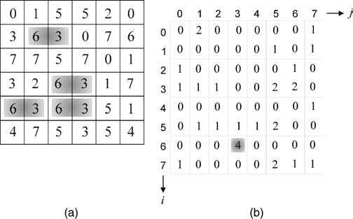
Gray level Co-occurrence Matrix
Displacement, d = [1, 0]
d can be any vector like (1,1), (0,2) etc

Slide 19
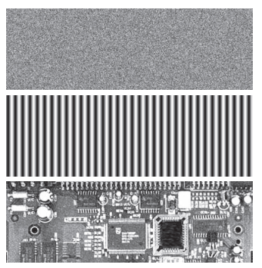
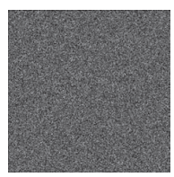
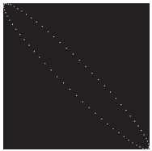
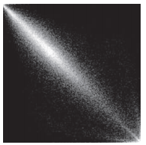
GLCM - Example
L = 256 and the position operator, d= “one pixel immediately to the right.
Image
GLCM

Slide 20

Gray level Co-occurrence Matrix
The gray-level co-occurrence matrix can be normalized as follows:
where Ng(i, j) is the normalized gray-level co-occurrence matrix.
Since all values of Ng(i, j) lie between 0 and 1, they can be thought of as the probability that a pair of points satisfying d will have values (zi, zj).
Co-occurrence matrices can be used to represent the texture properties of an image.
Instead of using the entire matrix, more compact descriptors are preferred.

Slide 21
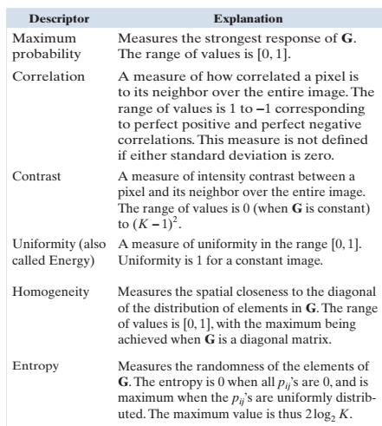
GLCM - descriptors

