Slide 1
CSE 4128 Image Processing and Computer Vision Laboratory Week 4: Region Descriptors and Feature Matching
Dr. Sk. Md. Masudul Ahsan
Professor
Dept. of CSE, KUET
Md Tajmilur Rahman
Lecturer
Dept. of CSE, KUET

Slide 2
Region Descriptors
Information that lets you recognize a region.
They focus on the content and texture of objects in an image.
They describe the distribution of pixel values within a region and capture the spatial relationships between different regions.
They extract relevant information from the image and represent it in a way that can be easily compared and matched with other images.

Slide 3
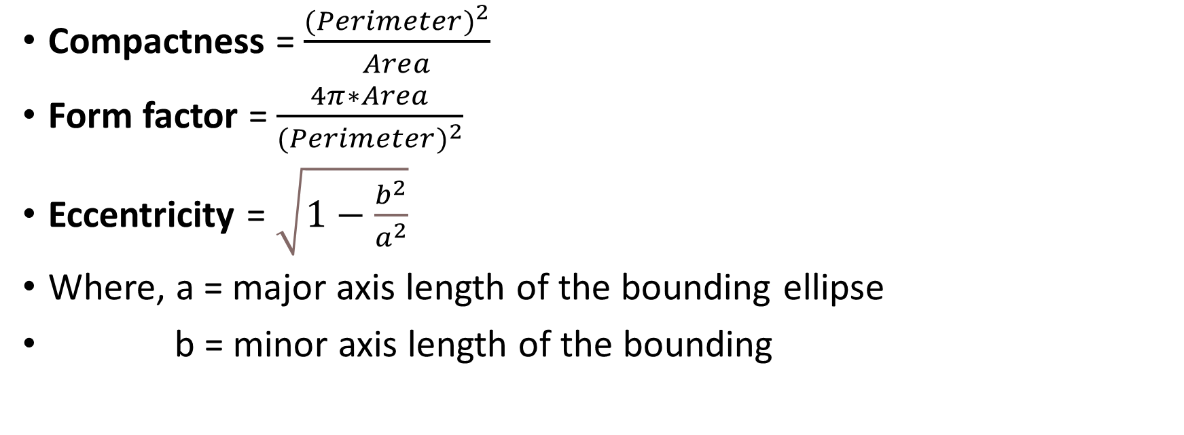
Region Descriptors
Compactness = $\frac{{(Perimeter)}^{2}}{Area}$
Form factor = $\frac{4π∗Area}{{(Perimeter)}^{2}}$
Eccentricity = $\sqrt{1−\frac{b^{2}}{a^{2}}}$
Where, a = major axis length of the bounding ellipse
b = minor axis length of the bounding

Slide 4



Example
Form factor
Compactness
Eccentricity
0.0480
261.6433
0.4073
0.1644
76.4262
0.00000
0.1512
83.1189
0.4340

Slide 5
Classwork
Take one of each shape as train image and the other as test image.
For each binary image:
Find the Boundary of the object in the image.
Apply erosion to the binary image.
Subtract the eroded image from the binary image to get the border of the region.
Calculate Perimeter, Area, major (a) and minor (b) axis length of the bounding ellipse of the region.
Use Area, Perimeter, a and b the calculate Form factor, Compactness and Eccentricity.
Matching the descriptors of the test and train images to find close Match.

Slide 6
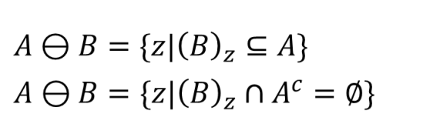

Erosion
1 | 1 | 1 | 1 | 1 | 1
1 | 1 | 0 | 0 | 1 | 1
1 | 0 | 0 | 0 | 0 | 1
1 | 1 | 0 | 0 | 1 | 1
1 | 1 | 1 | 1 | 1 | 1
0 | 0 | 0 | 0 | 0 | 0
1 | 0 | 0 | 0 | 0 | 1
1 | 0 | 0 | 0 | 0 | 1
1 | 0 | 0 | 0 | 0 | 1
0 | 0 | 0 | 0 | 0 | 0
1
1
1

Slide 7
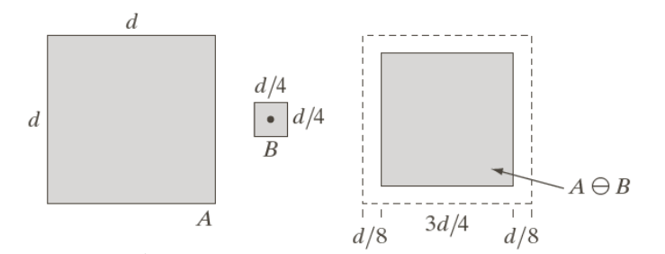
Erosion
kernel = np.ones((3,3), np.uint8)
eroded = cv2.erode(binary, kernel, iterations=1)
border = binary - eroded

Slide 8


Parameters
Area of a region is defined as the number of pixels in the region.
area = np.count_nonzero(binary_image)
Perimeter of a region is the length of its boundary.
perimeter = np.count_nonzero(border_image)

Slide 9

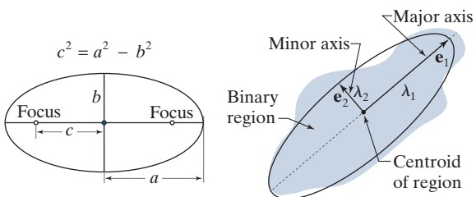
Parameters

Slide 10
How to find axes?
contours, _ = cv2.findContours(binary, cv2.RETR_EXTERNAL, cv2.CHAIN_APPROX_SIMPLE)
cnt = max(contours, key=cv2.contourArea)
if len(cnt) >= 5:
(x, y), (MA, ma), angle = cv2.fitEllipse(cnt)

Slide 11
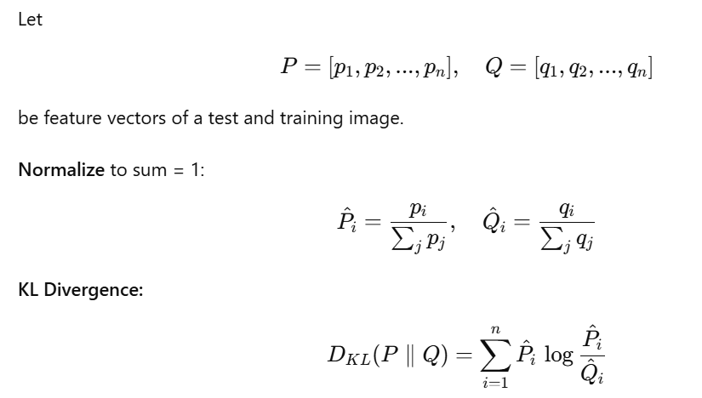
Kullback-Leibler Distance

Slide 12
Show Distance Matrix
Calculate the Kullback-Leibler Distance between each 2 images.
Create a matrix showing the similarity among each pairs.
Find which images from test cases match the most with the image from train cases.
Show the output distance matrix as a table

Slide 13
Show as table
row_headers = [f'Test {i + 1}' for i in range(4)]
col_headers = [f'GT {i + 1}' for i in range(3)]
distances_matrix = np.array(distances_matrix)
# Display the distance matrix as a table
print(tabulate(distances_matrix[0:4,0:3], headers=col_headers, showindex=row_headers, tablefmt='grid'))

Slide 14

 | GT1 | GT2 | GT3
Test 1 | 0.0000 | 0.0049 | 0.0052
Test 2 | 0.0324 | 0.0000 | 0.0030
Test 3 | 0.1095 | 0.0051 | 0.0000
Test 4 | 0.1480 | 0.0060 | 0.0004

Slide 15

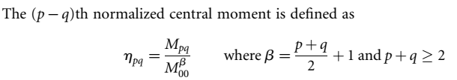



Statistical Moments
nth moment
central moments
pqth moment of a 2-D density function pðx; yÞ
(p- q)th central moment of 2-D shape I(x,y)

Slide 16
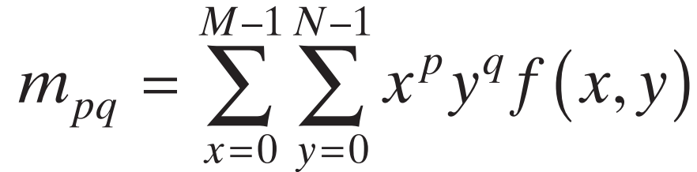
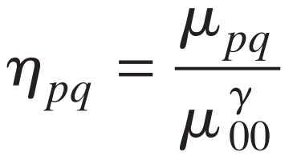
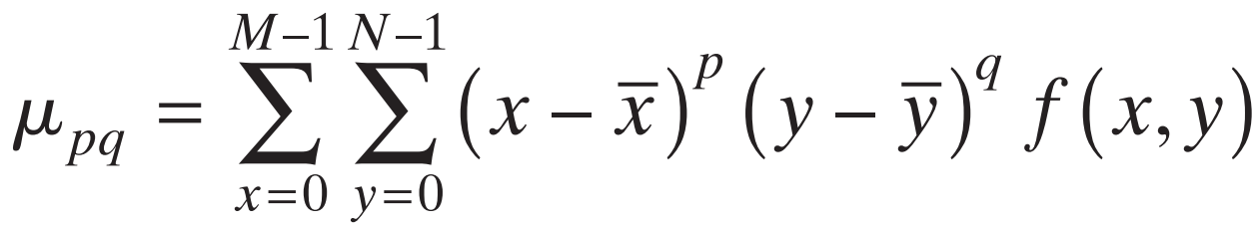
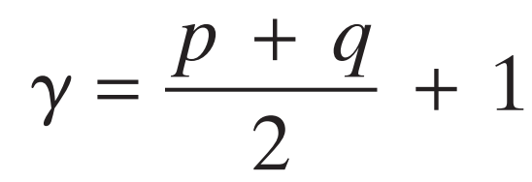
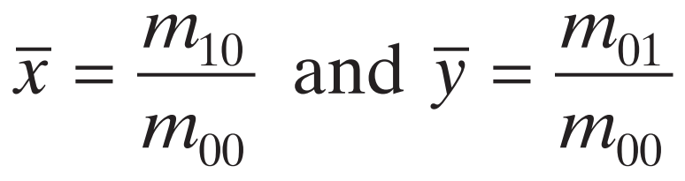
Statistical Moments
(p+q)th moment of a 2-D density function
normalized central moment of order (p+q )
(p+q)th central moment
p +q = 2 3 , ,

Slide 17
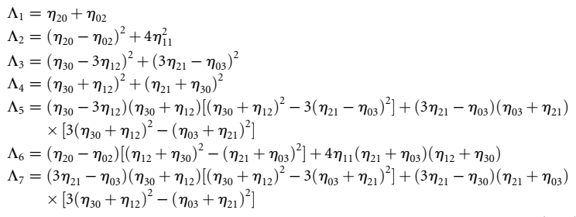
Hu Moments
φ₁
φ₂
φ₃
φ₄
φ₅
φ₆
φ₇
Derivation of these results requires concepts that are beyond the scope of this discussion. The book by Bell [1965] and the paper by Hu [1962] contain detailed discussions of these concepts. For generating moment invariants of an order higher than seven, see Flusser [2000]. Moment invariants can be generalized to n dimensions (see Mamistvalov [1998]).

Slide 18
Hu Moments
This set of moments is invariant to translation, scale change, mirroring (within a minus sign), and rotation.
We can attach physical meaning to some of the low-order moment invariants.
For example, φ1 is the sum of two second moments with respect to the principal axes of data spread, so this moment can be interpreted as a measure of data spread.
Similarly, φ3 is the difference of second moments, and may be interpreted as a measure of “slenderness.”
However, as the order of the moment invariants increases, the complexity of their formulation causes physical meaning to be lost.

Slide 19
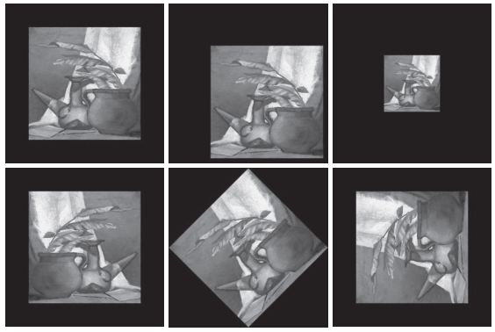
Hu Moments

Slide 20
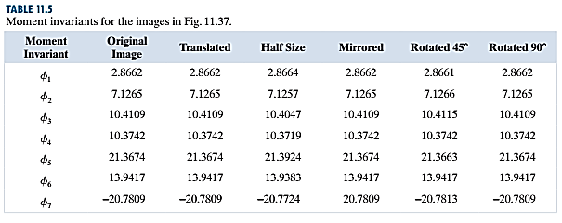
Hu Moments

Slide 21
Assignment
Take 4 gray scale images.
Appy 5 types of geometric (rotation, scaling, mirroring,..etc) and contrast-based operations on each image.
Find upto 4th Hu-moment of each variant of images as the feature vector.
Compute Chi-squared distance of 3 query images with the base image to find the best match.
Take a 5x5 patch of any input image and perform step 2, 3 and 4 on the patch. Show the feature tables and matching results in your report.

