Slide 1
CSE 4128 Image Processing and Computer Vision Laboratory Week 5: Frequency Domain Filtering
Dr. Sk. Md. Masudul Ahsan
Professor
Dept. of CSE, KUET
Md Tajmilur Rahman
Lecturer
Dept. of CSE, KUET

Slide 2
2D Discrete Fourier Transform
Represents an image in a frequency domain where the original image is represented in a spatial domain.
2D DFT converts an image into a complex array that consists of :
Power Spectrum
Phase Angle

Slide 3
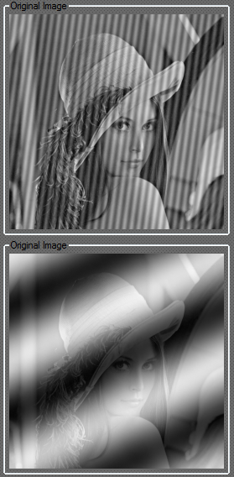
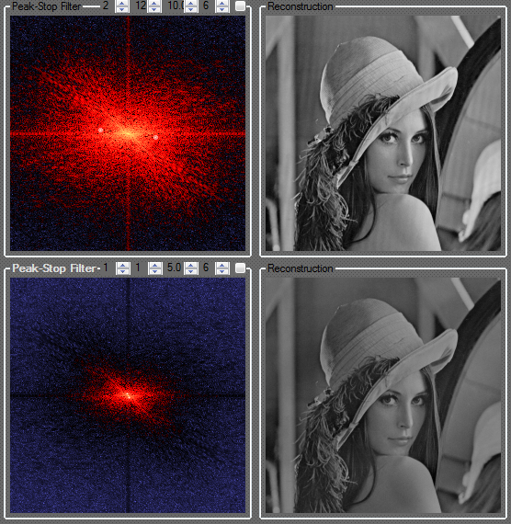
Fourier Transform

Slide 4
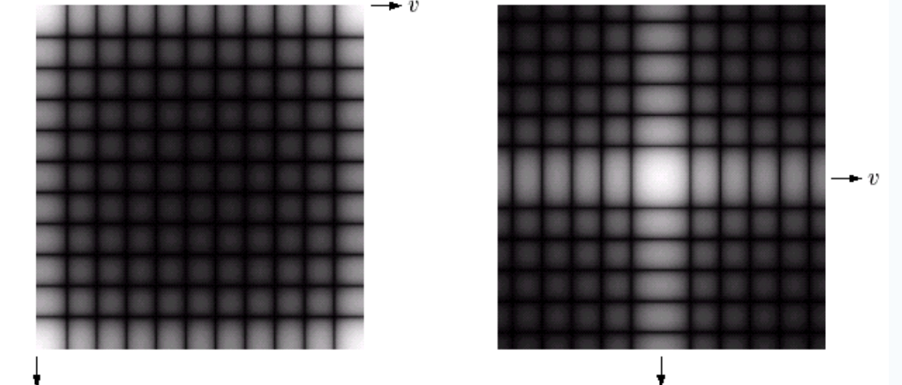
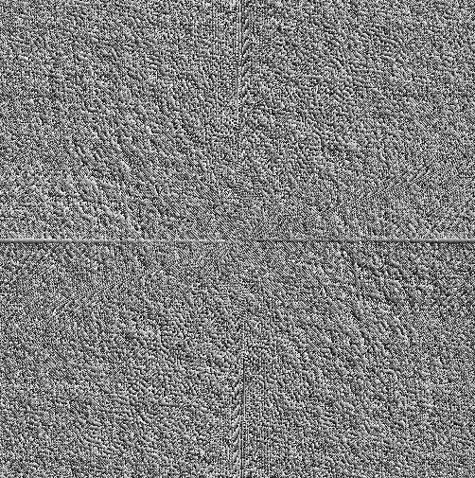
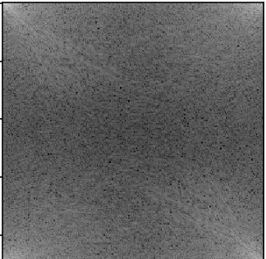
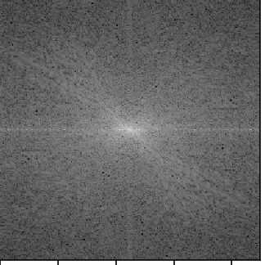
Basics of Filtering in the Frequency Domain
Phase
Spectrum moved into the centre

Slide 5
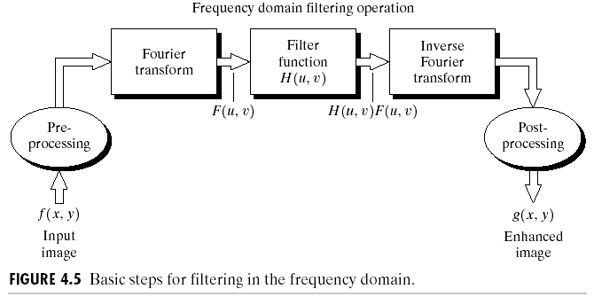
Basics of Filtering in the Frequency Domain
To filter an image in the frequency domain:
Compute F(u,v) by DFT of the image f(x,y).
Multiply F(u,v) by a filter function H(u,v).
Compute the inverse DFT of the result .

Slide 6
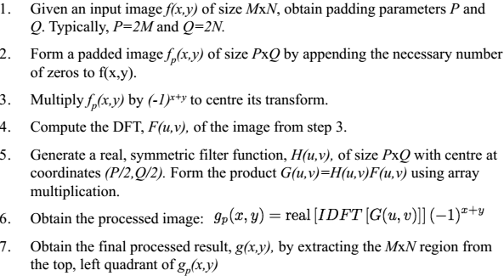
Steps for Filtering in the Frequency Domain

Slide 7
Notch Filter
A notch filter rejects (or passes) frequencies in a predefined neighborhood about the center of the frequency rectangle.
A notch is symmetric about the origin (center of the frequency rectangle)
One with center at (u₀, v₀) must have a corresponding notch at location (-u₀, -v₀)

Slide 8
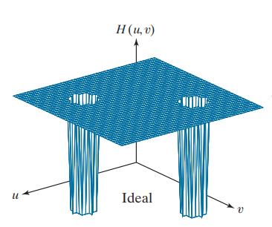
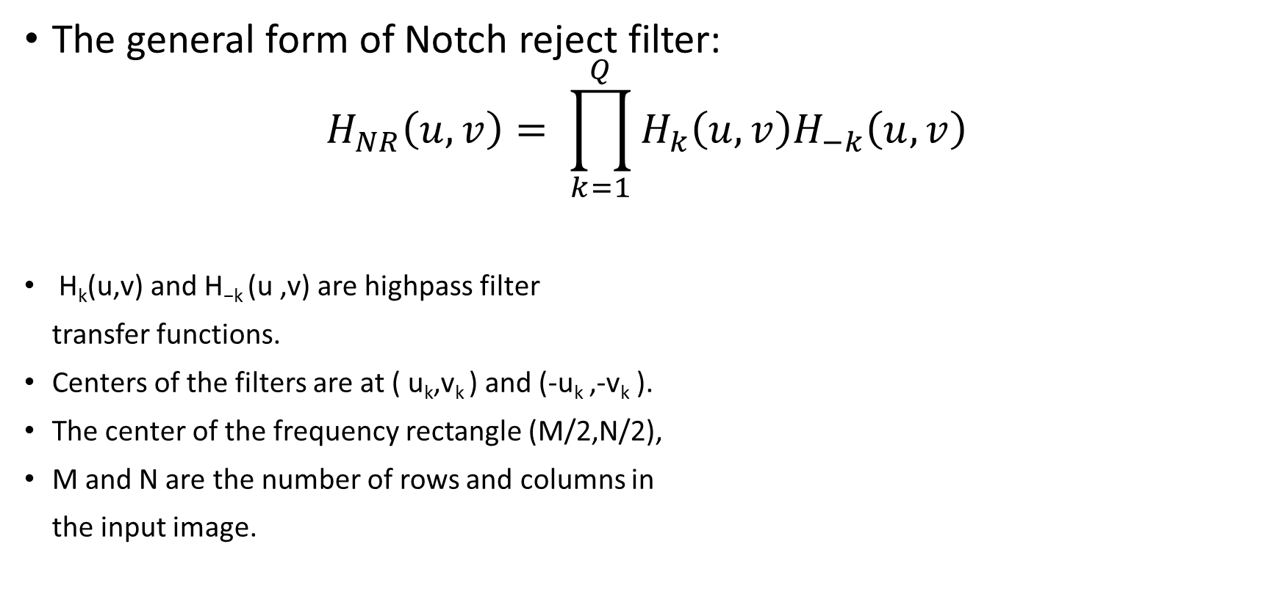
Ideal Notch Reject Filter
The general form of Notch reject filter:
$$H_{NR}\left(u,v\right)= \prod_{k=1}^{Q}{H_{k}\left(u,v\right)H_{−k}\left(u,v\right)}$$
H_{k}(u,v) and H_{−k} (u ,v) are highpass filter
transfer functions.
Centers of the filters are at ( u_{k},v_{k} ) and (-u_{k} ,-v_{k} ).
The center of the frequency rectangle (M/2,N/2),
M and N are the number of rows and columns in
the input image.

Slide 9
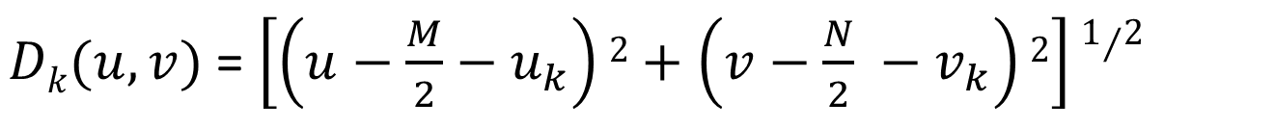
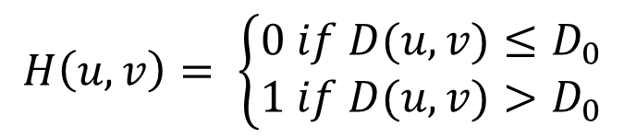
Ideal Notch Reject Filter
The general form of Ideal Highpass filter:
The distance computations for each filter transfer function are given by
$$H\left(u,v\right)= \left\{\begin{aligned}0 if D(u,v)≤D_{0} \\ 1 if D(u,v)>D_{0}\end{aligned}\right.$$
$Dk(u,v)$ = $\left[\left(u−\frac{M}{2}−u_{k}\right)2+\left(v−\frac{N}{2} −v_{k}\right)2\right]1/2$
$D−k(u,v)$ = $\left[\left(u−\frac{M}{2}+u_{k}\right)2+\left(v−\frac{N}{2}+v_{k}\right)2\right]1/2$

Slide 10
Classwork
Take an input grayscale image and apply Notch reject filters on the Fourier domain to remove periodic noise from the image.
Compute DFT F(u,v) for the input image.
Show the power spectrum of F(u,v)
Select the coordinates from the spectrum which you want to remove.
Generate the Notch reject filter around the coordinate(= center) to reject that specific frequency as H(u,v). The radius of the Notch will be user input. Show H(u,v).
Form the product G(u,v) = F(u,v)H(u,v).
Apply Inverse Fourier Transform to generate the output image in the spatial domain.

Slide 11

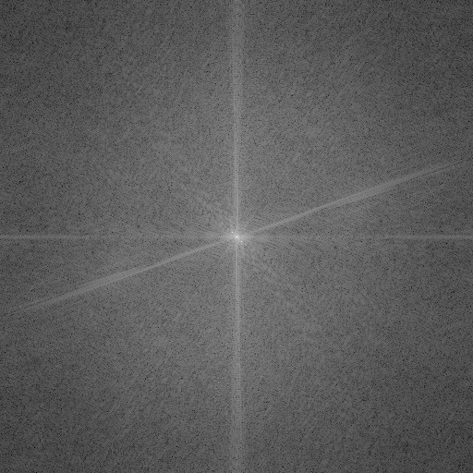
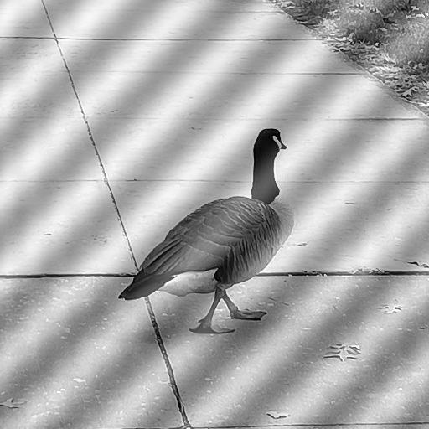
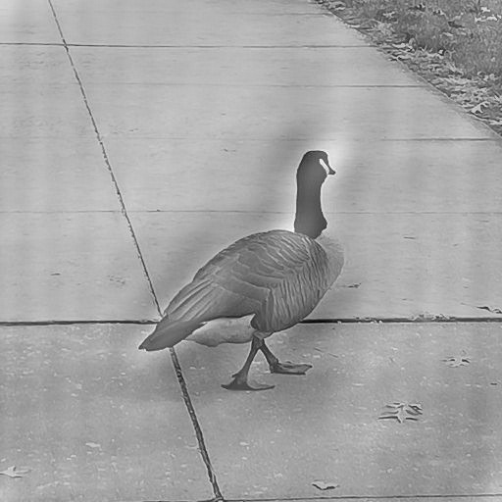
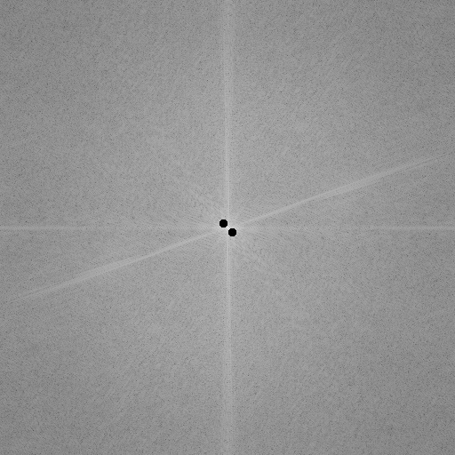
Classwork
Power spectrum
Notch filter
phase

Slide 12
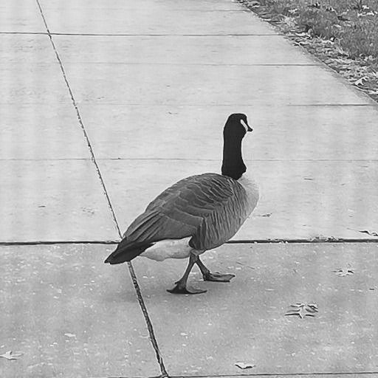
Classwork
Removing frequency at (u,v)= (261,261) , D0 = 1
Removing frequency at (u,v)= (261,261) , D0 = 5
Input image

Slide 13
References
https://www.amritaryal.com.np/posts/categories/mathematics-and-engineering/2.html
https://contra.medium.com/drawing-anything-with-fourier-series-using-blender-and-python-c0881e1b738c

